Slide 1
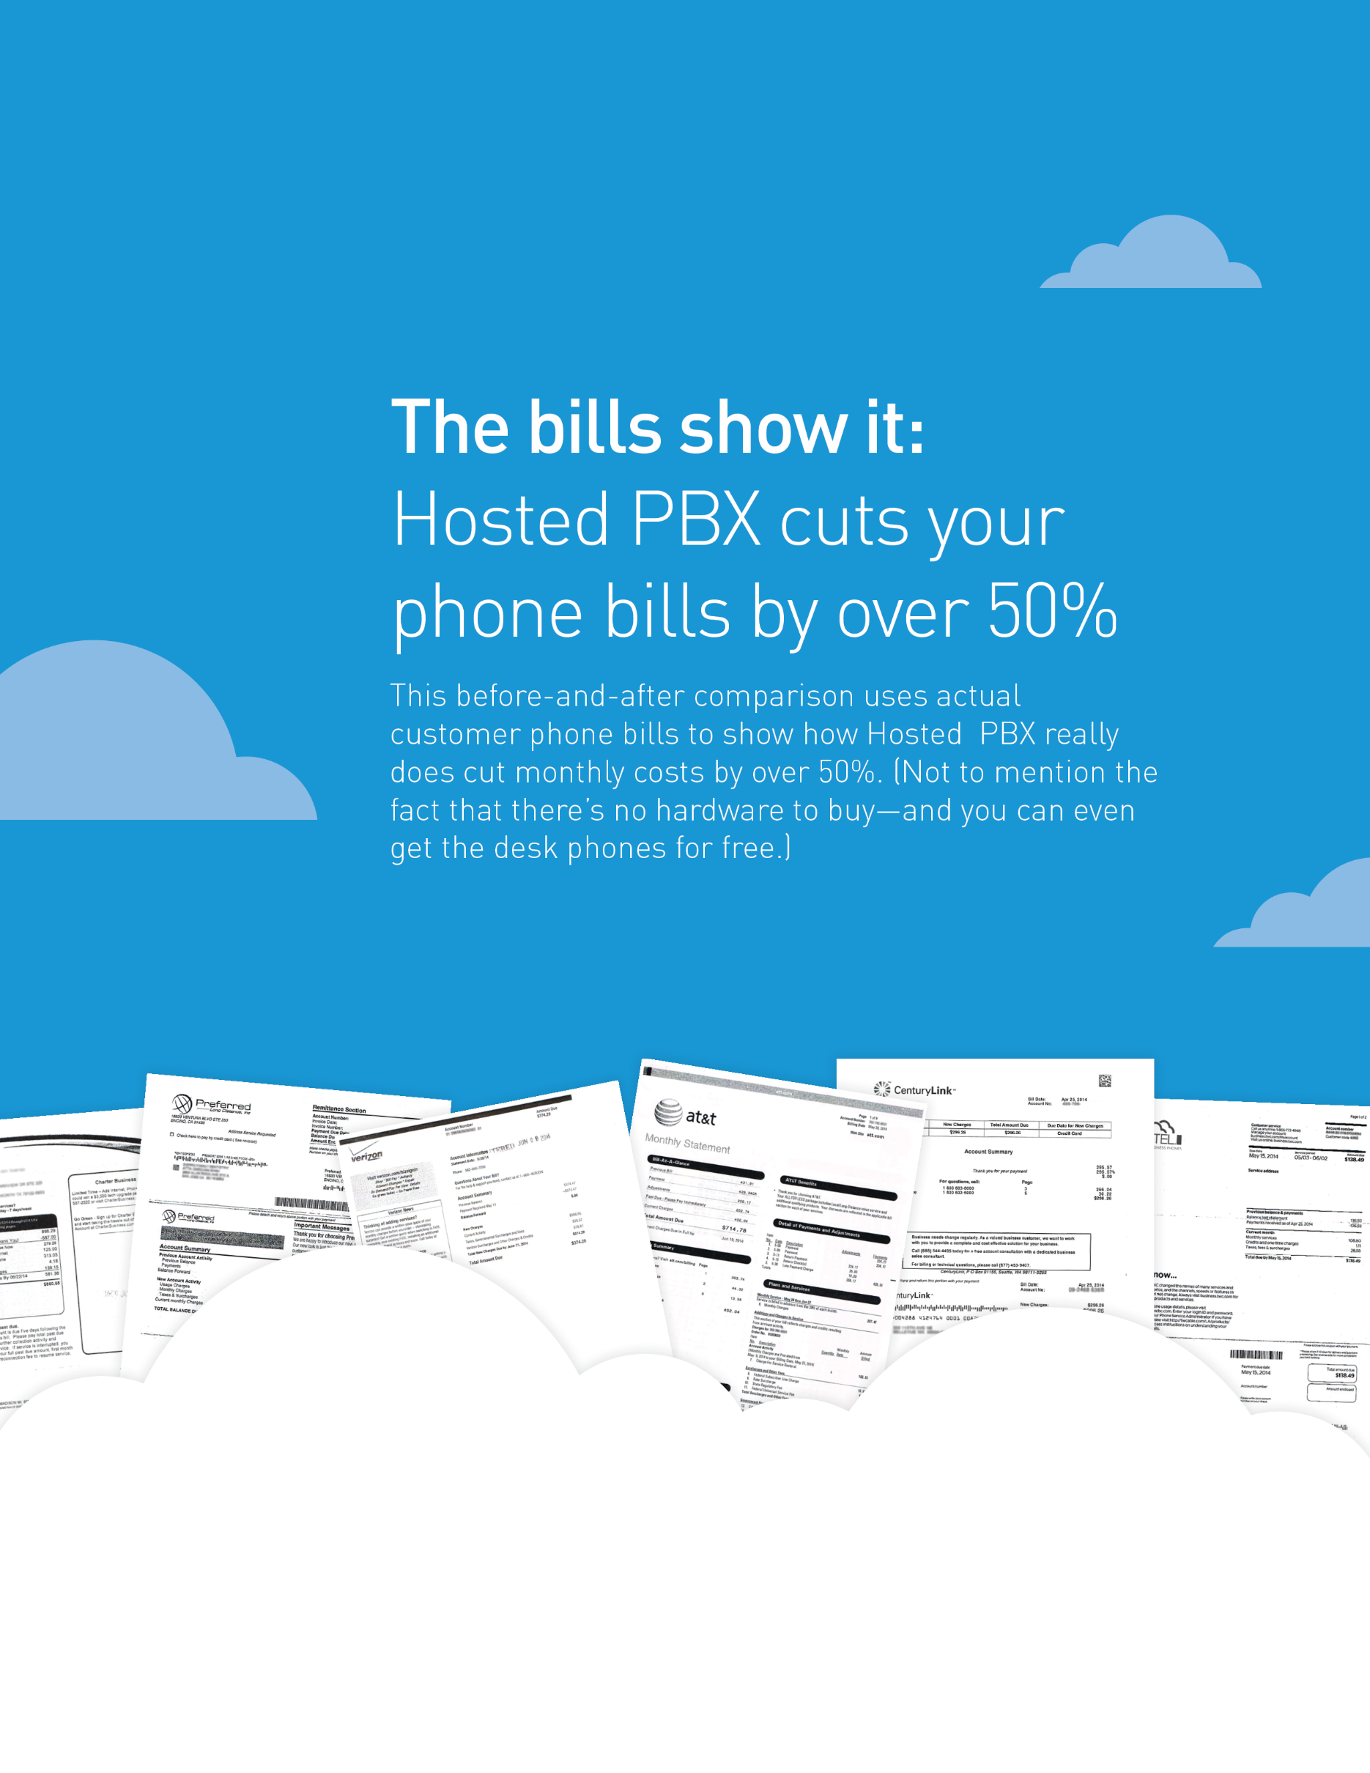

Start saving with Hosted PBX today!
CALL US
973 432 9837
EMAIL US
info@jjrcommunications.com
ON THE WEB
www.jjrcommunications.com

Slide 2
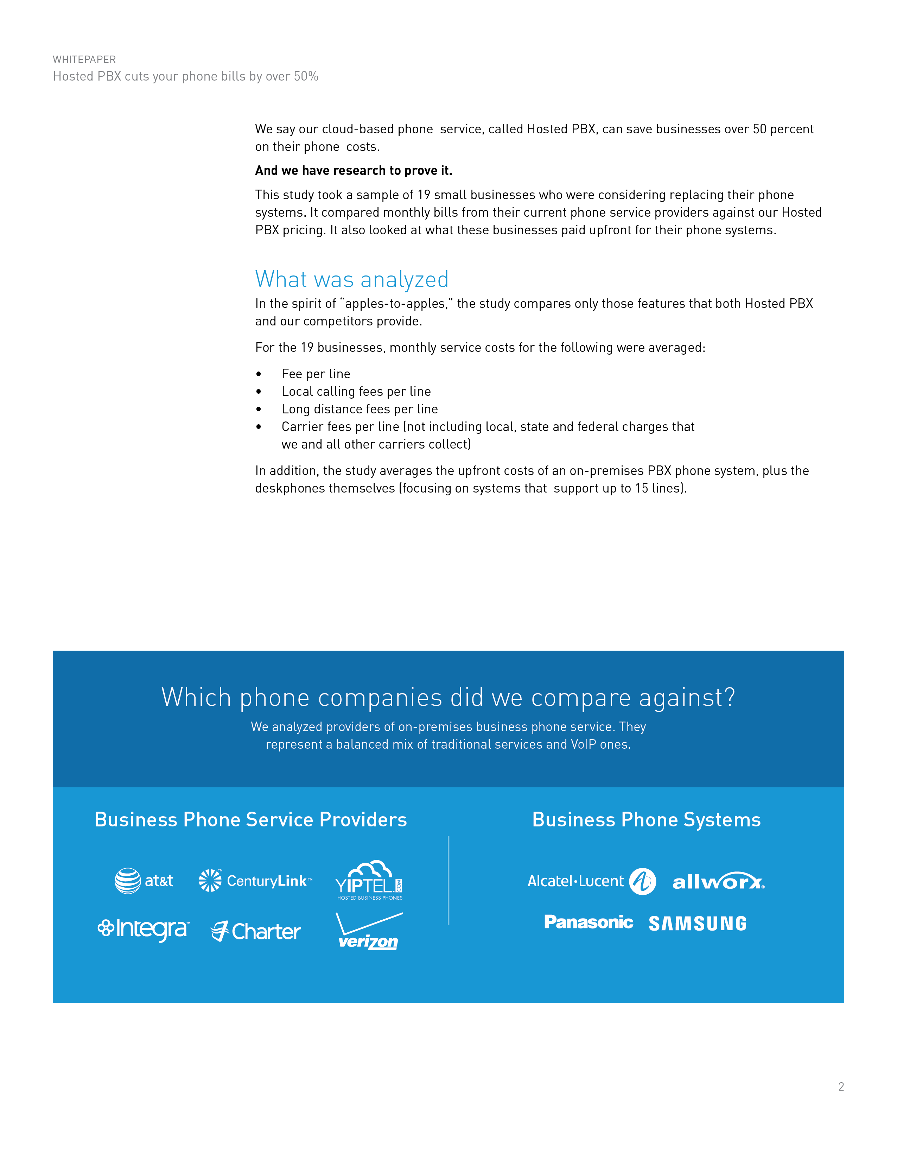

Slide 3
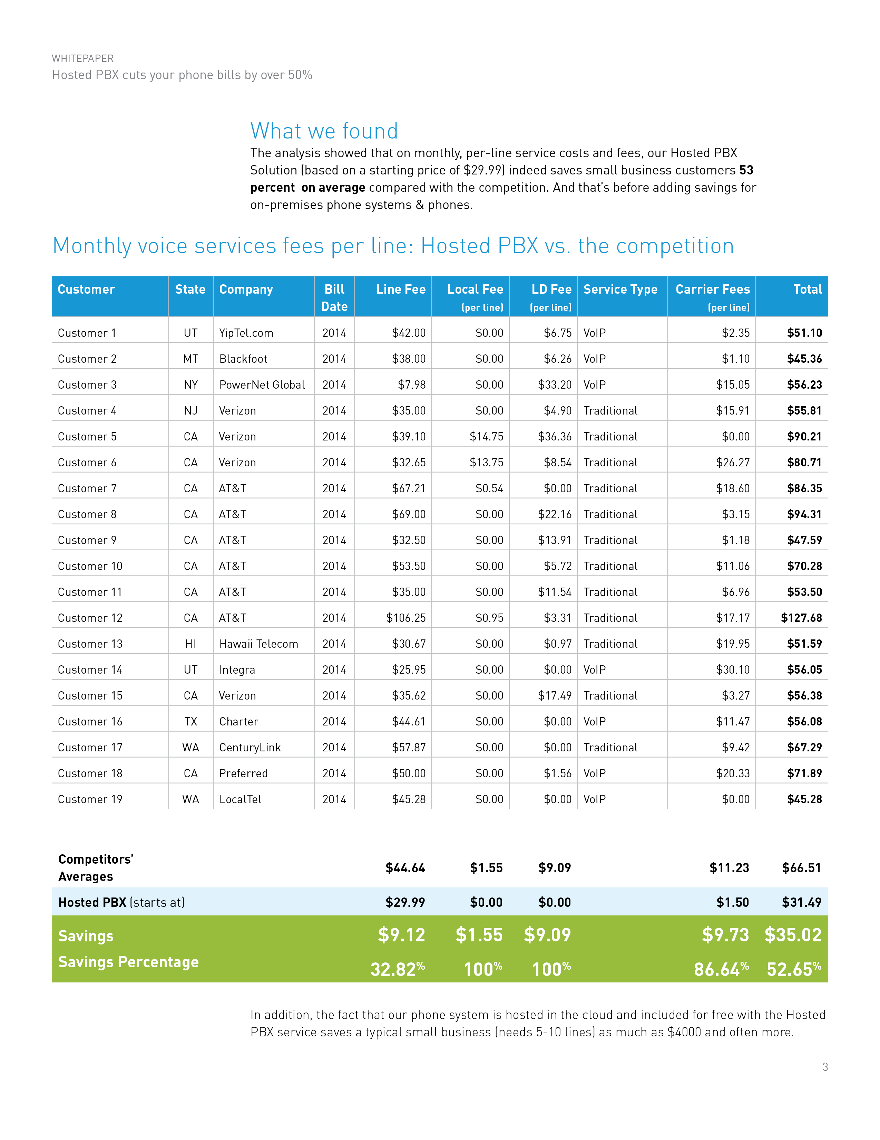

Slide 4
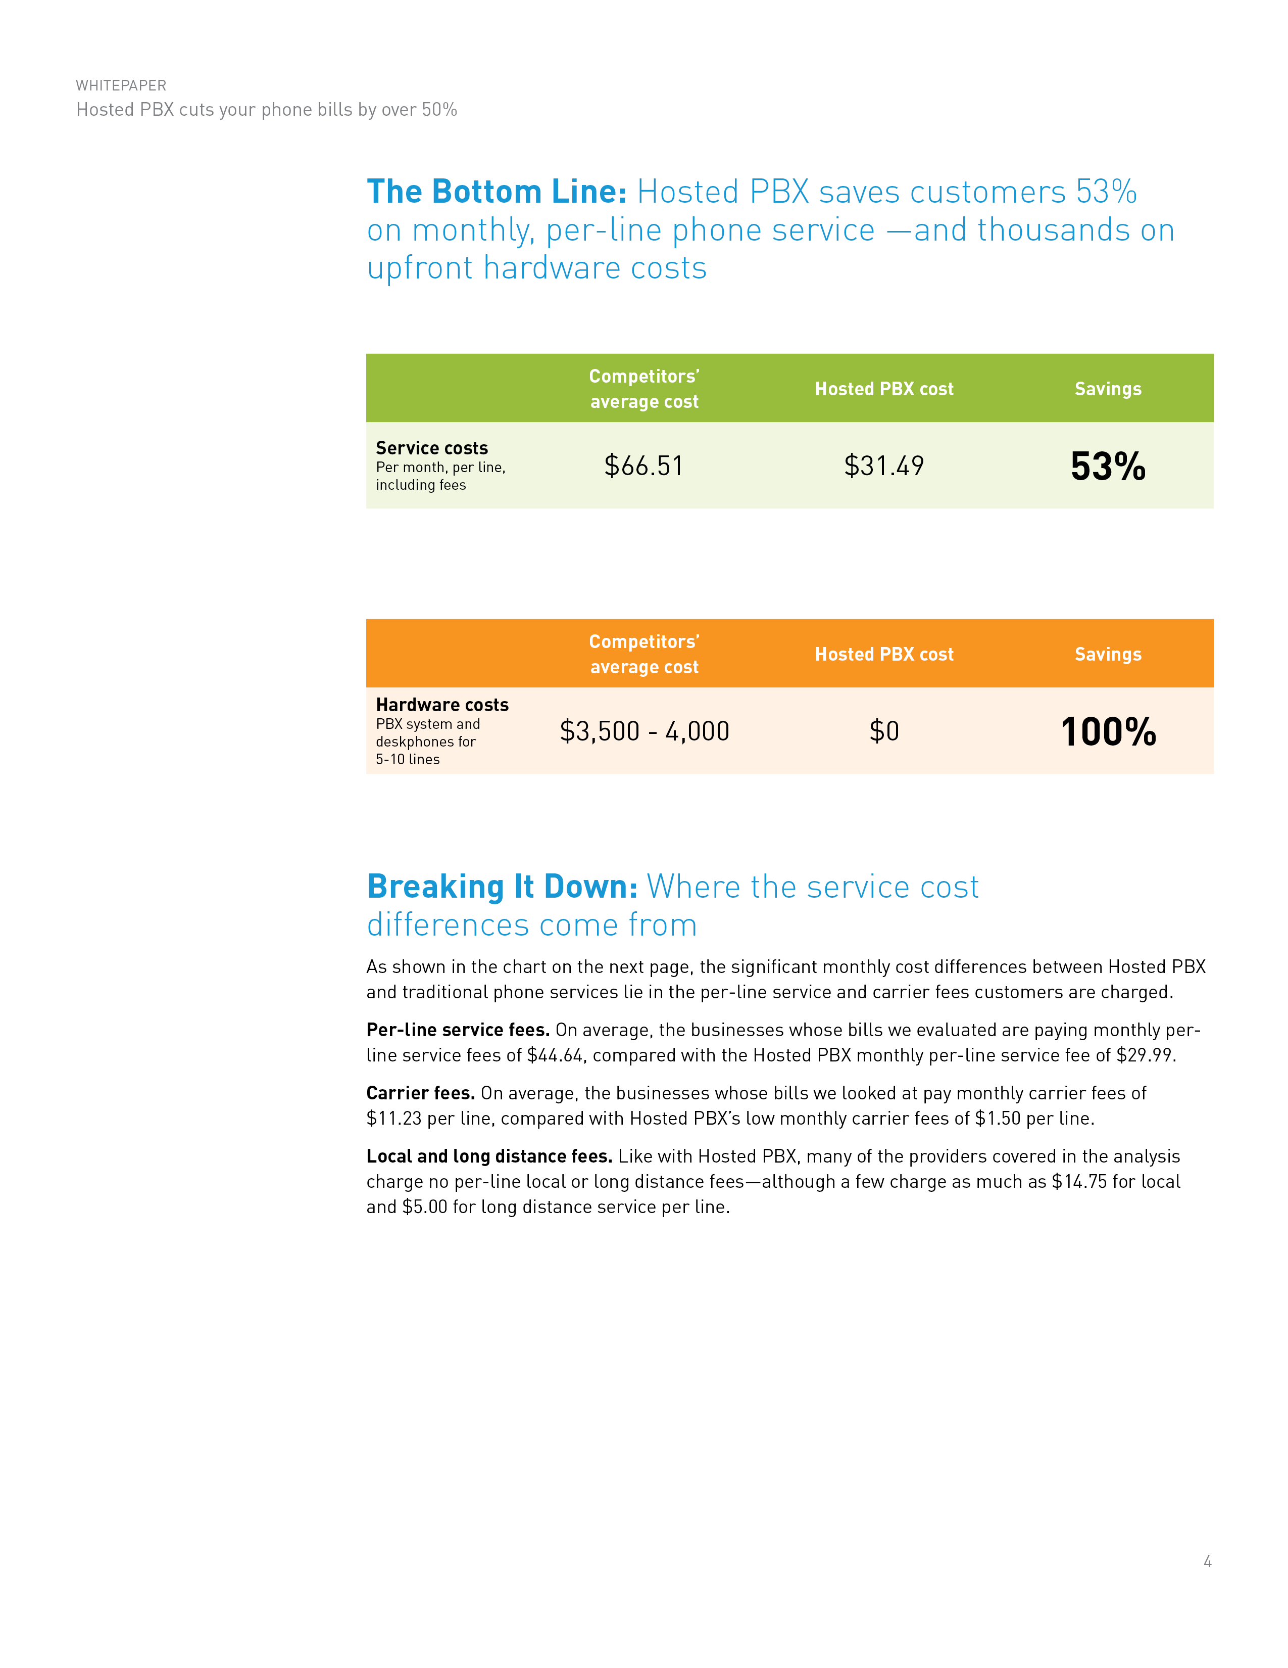

Slide 5
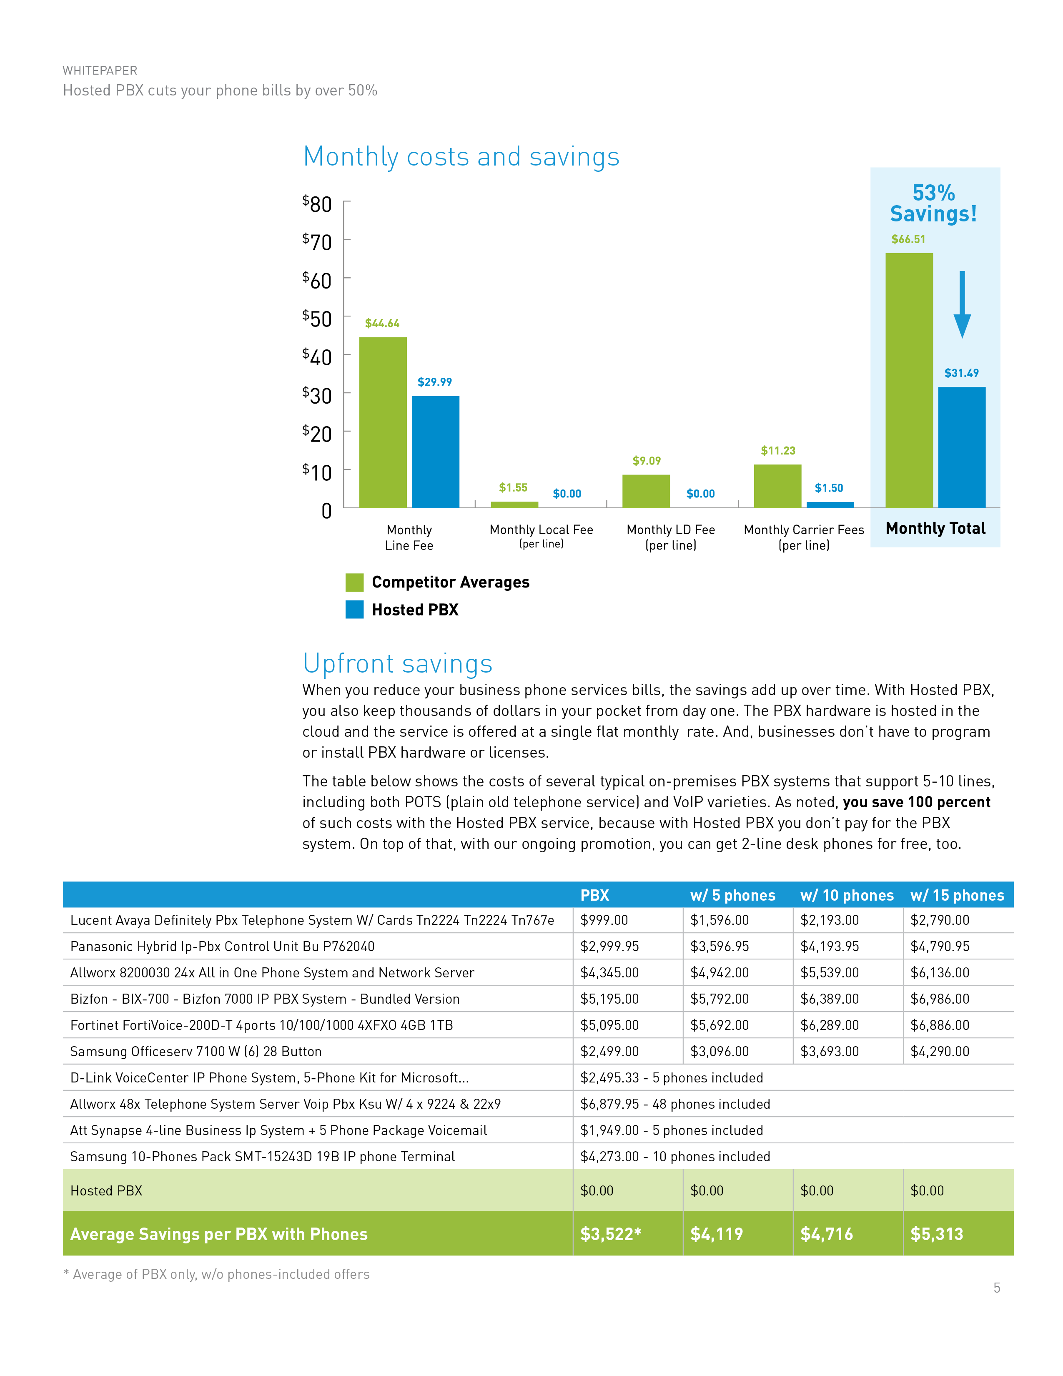

Slide 6
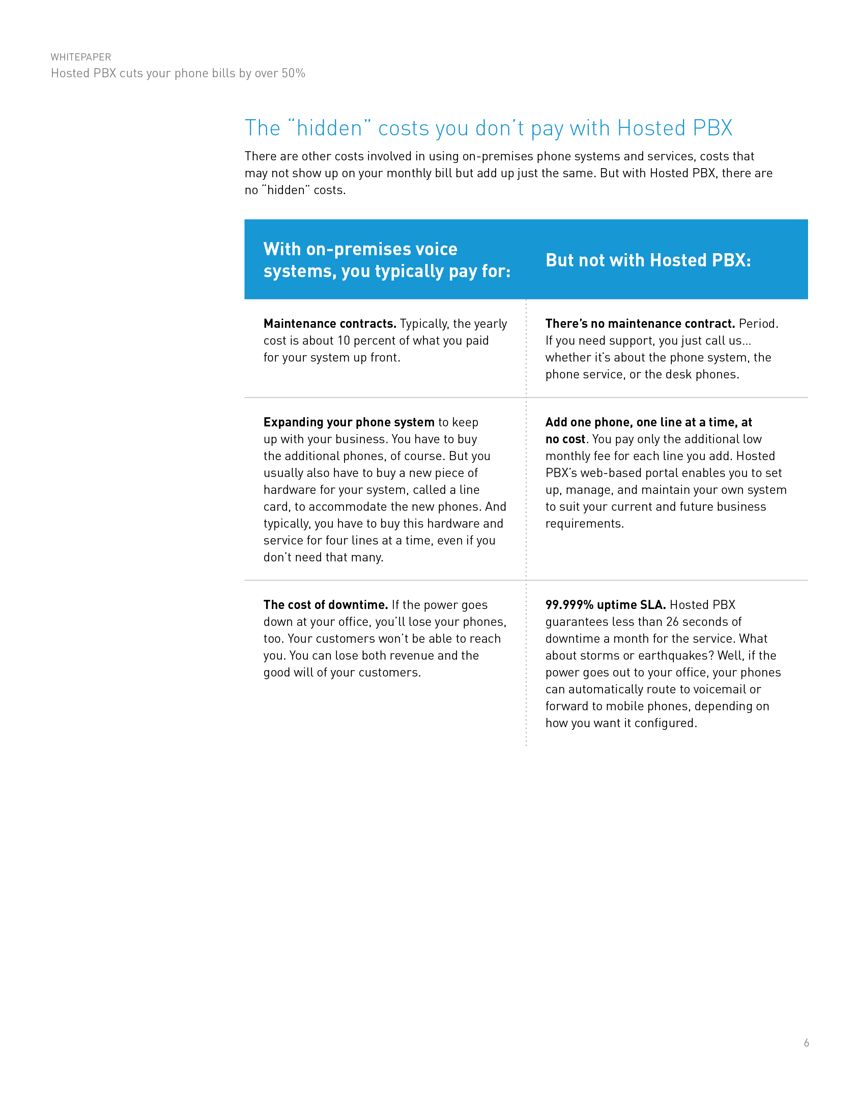


Your Logo Here
Start saving with Hosted PBX today!
CALL US
972-432 9837
EMAIL US
info@jjrcommunications.com
ON THE WEB
www.jjrcommunications.com

