Slide 1
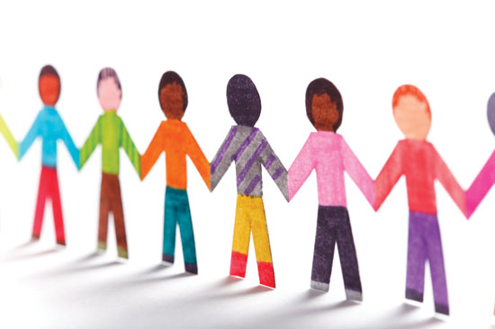
Fundraising: Know Your Donors

Slide 2
U.S. Contributions 2018
American individuals, bequests, foundations and corporations gave an estimated $427.71 billion to U.S. charities in 2018.
Total charitable giving rose 0.7% measured in current dollars over the revised total of $424.74 billion contributed in 2017.
Adjusted for inflation, total giving declined 1.7%.
www.givingusa.org

Slide 4
Giving by Generation

Slide 5
Generational Characteristics

Slide 6
Greatest Generation (1901 and 1927)
11.8% of the US population.
30% of donors aged 75+ say they have given online in the last 12 months and on average give 25% more frequently than younger generations.
88% of the Greatest gen gives to charity, donating an annual average of $1,367 across 6.2 organizations.
They represent 26% of total US giving
Greatest prefer voice calls and direct mail. These donors are late adopters of email and do not typically use text messaging or social media.
Greatest are most likely to give through direct mail campaigns and donate physical goods.

Slide 7
Baby Boomers (1946 to 1964)
23.6% of the US populations.
49% of Baby Boomer donors are enrolled in a monthly giving program.
41% give tribute gifts.
35% donate to crowdfunding campaigns.
15% gave on #GivingTuesday 2017.
21% give through Facebook fundraising tools.
71% volunteer locally, 9% internationally.
58% attend fundraising events.
24% of Boomers say they were promoted to give an online donation because of direct mail they received.
72% of Boomers give to charity, donating an annual average of $1,212 across 4.5 organizations.
Boomers answer voice calls, check email regularly, and also use text messaging and social media. Boomers are most likely to make recurring donations on a monthly, quarterly or yearly basis.

Slide 8
Gen Xers (1965 to 1980)
20.4% of US population.
49% of Gen X donors are enrolled in a monthly giving program.
31% give tribute gifts.
45% donate to crowdfunding campaigns.
14% gave on #GivingTuesday 2017.
19% give through Facebook fundraising tools.
64% volunteer locally, 8% internationally.
56% attend fundraising events.
Gen Xers are most likely to fundraise on behalf of a cause, make a pledge, and volunteer their time to an organization.
Gen X prefers text messages or voice calls. These donors regularly check email and stay up to date on social media feeds.
Email prompted 31% of online donations made by Gen X

Slide 9
Millennials (1981 to 1996)
25.9% of US population.
40% of Millennial donors are enrolled in a monthly giving program.
26% gave tribute gifts.
46% donate to crowdfunding campaigns.
15% gave on #GivingTuesday 2017.
16% give through Facebook fundraising tools.
64% volunteer locally, 9% internationally.
55% attend fundraising events.
11% of total US giving comes from Millennials
84% of Millennials give to charity, donating an annual average of $481 across 3.3 organizations.
Millennials are active on their phones; respond best to text message and social media, but rarely check personal email or respond to voice calls.
Millennials are most likely to contribute to work sponsored initiatives, donate via mobile and watch online videos before making a gift.

Slide 10
Millennials continued
44% of millennials said that would rather use their mobile phones than use cash to pay for small items.
47% of Millennials gave through an organization’s website in 2016.
88% of Millennials find their job more fulfilling when they have opportunities to make a positive impact on society and the environment.
52% of Millennials are more likely to give monthly over a large one-time donation.
77% of the respondents believe that offering employee engagement opportunities is an important recruitment strategy to attract millennials.
Among millennials, YouTube accounts for 2/3rds of the premium online video watched across devices

Slide 11
Gen Z (late-1990s to early-2000s)
59% of Gen Zs are inspired to donate to charity by a message/image they saw on social media.

Slide 12
Why People Give….and Stop Giving
Give
Stop Giving
1. Can no longer afford 54.0%
2. Feel other causes more in need 36.2%
3. Death or relocation16.0%
4. No acknowledgement past gifts 13.2%
5. Did not inform how gift used 8.1%
6. No longer needs support 5.6%
7. Poor support provided 51.%
8. Asked for inappropriate sums 4.3%
9. Inappropriate communications 3.8%
10. Did not follow donor’s wishes 2.6%
11. Staff members were not helpful 2.1%
1. Being asked by an organization with
which you have a connection
2. Being asked by someone you know well

Slide 13
Define Your Needs
Why are we raising funds?
What does the agency need to operate at capacity?
Wish list of necessary capital needs and cost.
How much will our needs cost?
How much is enough?
What is your story? Personal stories/testimonies.
When we achieve our goal, then we can…..
“If the story is not about the hearer, he will not listen.”
--John Steinbeck, East of Eden

Slide 14
Cycle of Donations

Slide 15
Who is Responsible?
Staff Responsibilities
• Draft the general plan (once adopted by the board, staff executes plan)
• Make own gift
• Help identify and enlist leadership
• Develop and help prioritize list of prospects
• Prepare agendas, support materials and make meeting agendas
• Assist in training volunteers
• Provide progress reports and assessment of campaign progress
• Manage office systems
• Motivate volunteers and thank donors and campaigners
Board Responsibilities
• Approve fund raising plans
• Ensure adequate budget is created for fund raising
• Make personal gift that sets a standard
• Provide leadership to key campaign committees
• Identify and cultivate prospective donors
• Help solicit gifts--at least open the door
• Personally thank donors and stay in touch
• Monitor fund raising program to see that funds are well used, in accordance with the donor’s wishes

Slide 16
Wrap Up / Questions and Answers

Slide 17
Sheryl Robinson McMillan
Frank McMillan
Post Office Box 6576
Corpus Christi, Texas 78466-6576
Sheryl: 361-765-4427
Frank: 361-765-4453
smcmil5049@aol.com

