Slide 1
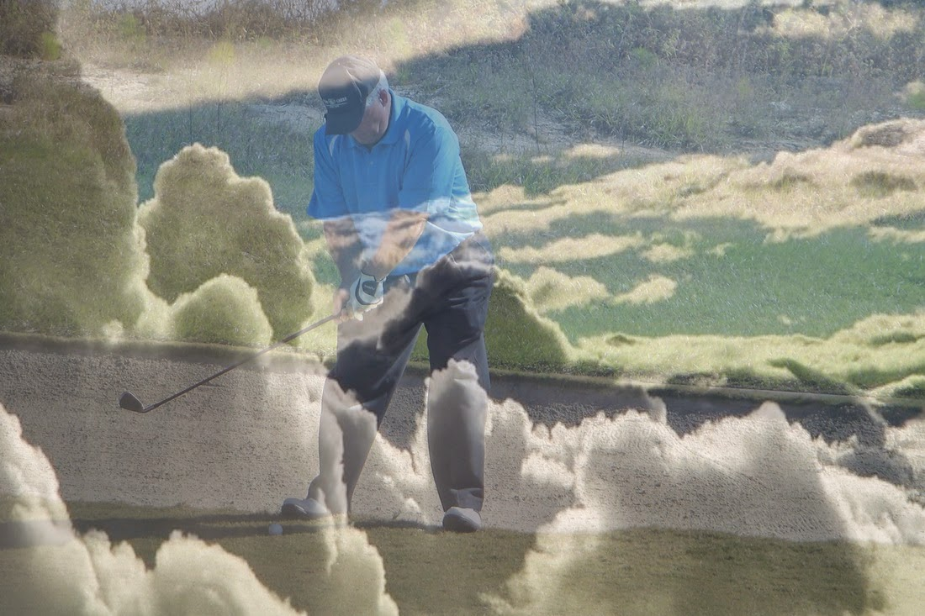
Polk Presbyterian Church
August 18, 2019
10th Sunday of Pentecost
A service of Witness to the Resurrection
Celebration of Life
Walter Dewitt Heffern
Welcoming & Announcement
Aug 18 – Blessing of backpacks
Sept 1 – Communion Sunday
Sept 7 – Officer Training
Sept 12 – Session Meeting
Suggestion Box for nominations for
Clerk of Session and new Session members

Slide 2
Sentences of Scripture (1 of 2)
Psalm 124:8
Our help is in the name of the Lord, who made heaven and earth.
John 11:25-26
I am the resurrection and the life says the Lord.﻿ Those who believe in me, even though they die, will live, and everyone who lives and believes in me will never die.
Polk Presbyterian Church
August 18, 2019
10th Sunday of Pentecost
Welcoming & Announcement
Aug 18 – Blessing of backpacks
Sept 1 – Communion Sunday
Sept 7 – Officer Training
Sept 12 – Session Meeting
Suggestion Box for nominations for
Clerk of Session and new Session members

Slide 3
Sentences of Scripture (2 of 2)
Psalm 46:1
God is our refuge and strength, a very present help in trouble. Therefore, we will not fear.
Psalm 103:13, Isaiah 66:13
As a father has compassion for his children, so the Lord has compassion for those who fear God. As a mother comforts her child, so I will comfort you, says the Lord.
Polk Presbyterian Church
August 18, 2019
10th Sunday of Pentecost
Welcoming & Announcement
Aug 18 – Blessing of backpacks
Sept 1 – Communion Sunday
Sept 7 – Officer Training
Sept 12 – Session Meeting
Suggestion Box for nominations for
Clerk of Session and new Session members

Slide 4
*Hymn His Name Is Wonderful #209 (1 of 1)
His name is Wonderful, His name is Wonderful
His name is Wonderful---Jesus, my Lord.
He is the mighty King, Master of everything.
His name is Wonderful---Jesus, my Lord.
He’s the great Shepherd, the Rock of all ages,
Almighty God is He.. Bow down before Him;
Love and adore Him, His name is Wonderful---
Jesus, my Lord.
Polk Presbyterian Church
August 18, 2019
10th Sunday of Pentecost
Welcoming & Announcement
Aug 18 – Blessing of backpacks
Sept 1 – Communion Sunday
Sept 7 – Officer Training
Sept 12 – Session Meeting
Suggestion Box for nominations for
Clerk of Session and new Session members

Slide 5
Polk Presbyterian Church
August 18, 2019
10th Sunday of Pentecost
Words of Purpose
Prayer
Welcoming & Announcement
Aug 18 – Blessing of backpacks
Sept 1 – Communion Sunday
Sept 7 – Officer Training
Sept 12 – Session Meeting
Suggestion Box for nominations for
Clerk of Session and new Session members

Slide 6
Scriptures Ecclesiastes 3:1-8 (1 of 4)
3 For everything there is a season, and a time for every matter under heaven:2 a time to be born, and a time to die; a time to plant, and a time to pluck up what is planted; 3 a time to kill, and a time to heal; a time to break down, and a time to build up; 4 a time to weep, and a time to laugh; a time to mourn, and a time to dance; 5 a time to throw away stones, and a time to gather stones together; a time to embrace, and a time to refrain from embracing;
Polk Presbyterian Church
August 18, 2019
10th Sunday of Pentecost
Welcoming & Announcement
Aug 18 – Blessing of backpacks
Sept 1 – Communion Sunday
Sept 7 – Officer Training
Sept 12 – Session Meeting
Suggestion Box for nominations for
Clerk of Session and new Session members

Slide 7
Scriptures Ecclesiastes 3:1-8 (2 of 4)
6 a time to seek, and a time to lose; a time to keep, and a time to throw away; 7 a time to tear, and a time to sew; a time to keep silence, and a time to speak; 8 a time to love, and a time to hate; a time for war, and a time for peace.
Scriptures John 14:1-6
14 “Do not let your hearts be troubled. Believe in God, believe also in me. ﻿2﻿ In my Father’s house there are many
Polk Presbyterian Church
August 18, 2019
10th Sunday of Pentecost
Welcoming & Announcement
Aug 18 – Blessing of backpacks
Sept 1 – Communion Sunday
Sept 7 – Officer Training
Sept 12 – Session Meeting
Suggestion Box for nominations for
Clerk of Session and new Session members

Slide 8
(3 of 4)
dwelling places. If it were not so, would I have told you that I go to prepare a place for you? ﻿3﻿ And if I go and prepare a place for you, I will come again and will take you to myself, so that where I am, there you may be also. ﻿4﻿ And you know the way to the place where I am going.” ﻿5﻿ Thomas said to him, “Lord, we do not know where you are going. How can we know the way?” ﻿6﻿ Jesus said to him, “I am the way, and the truth, and the life. No one comes to the Father except through me.
Polk Presbyterian Church
August 18, 2019
10th Sunday of Pentecost
Welcoming & Announcement
Aug 18 – Blessing of backpacks
Sept 1 – Communion Sunday
Sept 7 – Officer Training
Sept 12 – Session Meeting
Suggestion Box for nominations for
Clerk of Session and new Session members

Slide 9
Scriptures 2 Timothy 4:6-8 (4 of 4)
﻿6﻿ As for me, I am already being poured out as a libation, and the time of my departure has come. ﻿7﻿ I have fought the good fight, I have finished the race, I have kept the faith. ﻿8﻿ From now on there is reserved for me the crown of righteousness, which the Lord, the righteous judge, will give me on that day, and not only to me but also to all who have longed for his appearing.
Polk Presbyterian Church
August 18, 2019
10th Sunday of Pentecost
Welcoming & Announcement
Aug 18 – Blessing of backpacks
Sept 1 – Communion Sunday
Sept 7 – Officer Training
Sept 12 – Session Meeting
Suggestion Box for nominations for
Clerk of Session and new Session members

Slide 10
Meditation
The Rev. Claire Megles
Rev. Larry Myers
Polk Presbyterian Church
August 18, 2019
10th Sunday of Pentecost
Welcoming & Announcement
Aug 18 – Blessing of backpacks
Sept 1 – Communion Sunday
Sept 7 – Officer Training
Sept 12 – Session Meeting
Suggestion Box for nominations for
Clerk of Session and new Session members

Slide 11
*Hymn How Great Thou Art #16 (1 of 4)
Polk Presbyterian Church
August 18, 2019
10th Sunday of Pentecost
O Lord my God, when I in awesome wonder
Consider all the worlds Thy hands have made,
I see the stars, I hear the rolling thunder,
Thy power thru-out the universe displayed!
Then sings my soul, my Savior God, to Thee:
How great Thou art, how great Thou art!
Then sings my soul, my Savior God, to Thee:
How great Thou art, how great Thou art!
Welcoming & Announcement
Aug 18 – Blessing of backpacks
Sept 1 – Communion Sunday
Sept 7 – Officer Training
Sept 12 – Session Meeting
Suggestion Box for nominations for
Clerk of Session and new Session members

Slide 12
*Hymn How Great Thou Art #16 (2 of 4)
Polk Presbyterian Church
August 18, 2019
10th Sunday of Pentecost
When thru the woods and forest glades I wander
And hear the birds sing sweetly in the trees,
When I look down from lofty mountain grandeur
And hear the brook and feel the gentle breeze,
Then sings my soul, my Savior God, to Thee:
How great Thou art, how great Thou art!
Then sings my soul, my Savior God, to Thee:
How great Thou art, how great Thou art!
Welcoming & Announcement
Aug 18 – Blessing of backpacks
Sept 1 – Communion Sunday
Sept 7 – Officer Training
Sept 12 – Session Meeting
Suggestion Box for nominations for
Clerk of Session and new Session members

Slide 13
*Hymn How Great Thou Art #16 (3 of 4)
Polk Presbyterian Church
August 18, 2019
10th Sunday of Pentecost
And when I think that God, His Son not sparing,
Sent Him to die, I scarce can take it in—
That on the cross, my burden gladly bearing,
He bled and died to take away my sin!
Then sings my soul, my Savior God, to Thee:
How great Thou art, how great Thou art!
Then sings my soul, my Savior God, to Thee:
How great Thou art, how great Thou art!
Welcoming & Announcement
Aug 18 – Blessing of backpacks
Sept 1 – Communion Sunday
Sept 7 – Officer Training
Sept 12 – Session Meeting
Suggestion Box for nominations for
Clerk of Session and new Session members

Slide 14
*Hymn How Great Thou Art #16 (4 of 4)
Polk Presbyterian Church
August 18, 2019
10th Sunday of Pentecost
When Christ shall come with shout of acclamation
And take me home, what joy shall fill my heart!
Then I shall bow in humble adoration
And there proclaim, my God, how great Thou art!
Then sings my soul, my Savior God, to Thee:
How great Thou art, how great Thou art!
Then sings my soul, my Savior God, to Thee:
How great Thou art, how great Thou art!
Welcoming & Announcement
Aug 18 – Blessing of backpacks
Sept 1 – Communion Sunday
Sept 7 – Officer Training
Sept 12 – Session Meeting
Suggestion Box for nominations for
Clerk of Session and new Session members

Slide 15
Prayer of Thanksgiving Lord’s Prayer
Our Father who art in Heaven, hallowed be Thy name. Thy kingdom come. Thy will be done on earth as it is I heaven. Give us this day our daily bread. And forgive us our debts, as we forgive our debtors. And lead us not into temptation but deliver us from evil; for thine is the kingdom and the power, and the glory, forever. Amen.
Polk Presbyterian Church
August 18, 2019
10th Sunday of Pentecost
Welcoming & Announcement
Aug 18 – Blessing of backpacks
Sept 1 – Communion Sunday
Sept 7 – Officer Training
Sept 12 – Session Meeting
Suggestion Box for nominations for
Clerk of Session and new Session members

Slide 16
Polk Presbyterian Church
August 18, 2019
10th Sunday of Pentecost
Commendation
Committal
Welcoming & Announcement
Aug 18 – Blessing of backpacks
Sept 1 – Communion Sunday
Sept 7 – Officer Training
Sept 12 – Session Meeting
Suggestion Box for nominations for
Clerk of Session and new Session members

Slide 17
*Hymn Amazing Grace 293 (1 of 2)
Amazing grace---how sweet the sound---
That saved a wretch like me!
I once was lost but now am found,
Was blind but now I see.
‘Twas grace that taught my heart to fear,
And grace my fears relieved;
How precious did that grace appear
The hour I first believed!
Polk Presbyterian Church
August 18, 2019
10th Sunday of Pentecost
Welcoming & Announcement
Aug 18 – Blessing of backpacks
Sept 1 – Communion Sunday
Sept 7 – Officer Training
Sept 12 – Session Meeting
Suggestion Box for nominations for
Clerk of Session and new Session members

Slide 18
*Hymn Amazing Grace 293 (2 of 2)
Thru many dangers, toils and snares
I have already come;
‘Tis grace hath brought me safe thus far,
And grace will lead me home.
When we’ve been there ten thousand years,
Bright shining as the sun,
We’ve no less days to sing God’s praise
Than when we’d first begun.
Polk Presbyterian Church
August 18, 2019
10th Sunday of Pentecost
Welcoming & Announcement
Aug 18 – Blessing of backpacks
Sept 1 – Communion Sunday
Sept 7 – Officer Training
Sept 12 – Session Meeting
Suggestion Box for nominations for
Clerk of Session and new Session members

Slide 19
Polk Presbyterian Church
August 18, 2019
10th Sunday of Pentecost
Blessing
Postlude
Welcoming & Announcement
Aug 18 – Blessing of backpacks
Sept 1 – Communion Sunday
Sept 7 – Officer Training
Sept 12 – Session Meeting
Suggestion Box for nominations for
Clerk of Session and new Session members

Slide 20
Polk Presbyterian Church
August 18, 2019
10th Sunday of Pentecost
Military Honors
By
V.E.T.S. Honor Guard
Welcoming & Announcement
Aug 18 – Blessing of backpacks
Sept 1 – Communion Sunday
Sept 7 – Officer Training
Sept 12 – Session Meeting
Suggestion Box for nominations for
Clerk of Session and new Session members

Slide 21
Polk Presbyterian Church
August 18, 2019
10th Sunday of Pentecost
Welcoming & Announcement
Aug 18 – Blessing of backpacks
Sept 1 – Communion Sunday
Sept 7 – Officer Training
Sept 12 – Session Meeting
Suggestion Box for nominations for
Clerk of Session and new Session members

