Slide 1

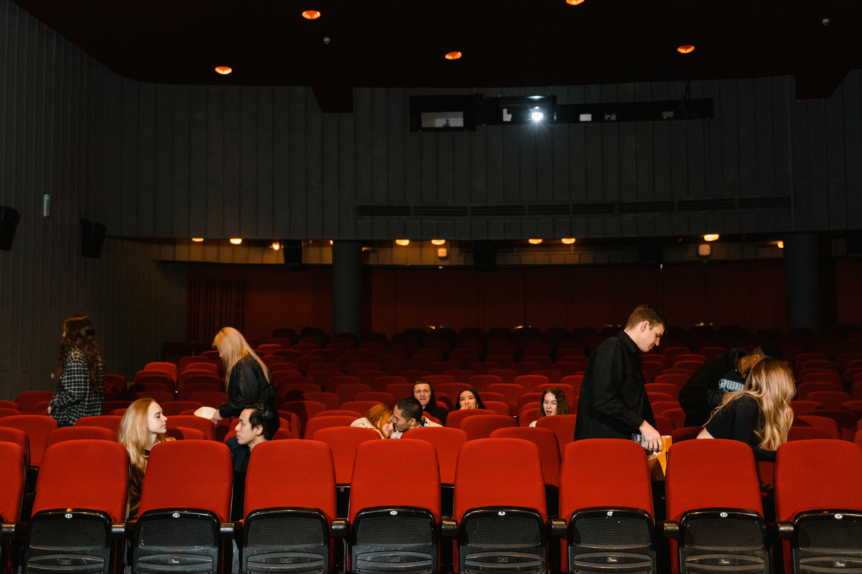
Prof. Neide Silva
Text by: Dr. Khalid Alqadi
2026- Mackenzie
LITERATURE
AND
CINEMA
Presented By: Douglas Fantini

Slide 2
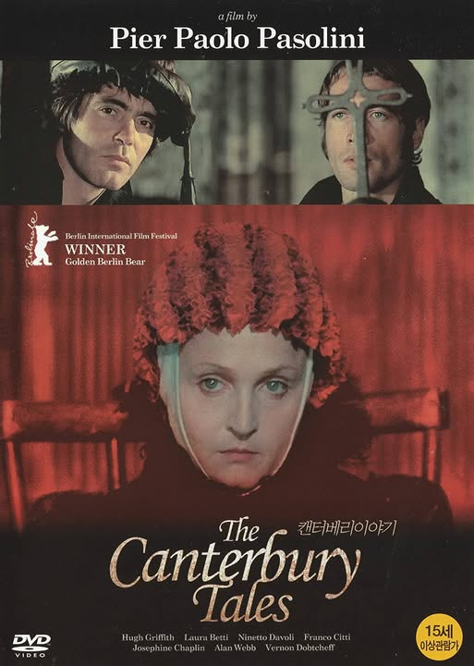
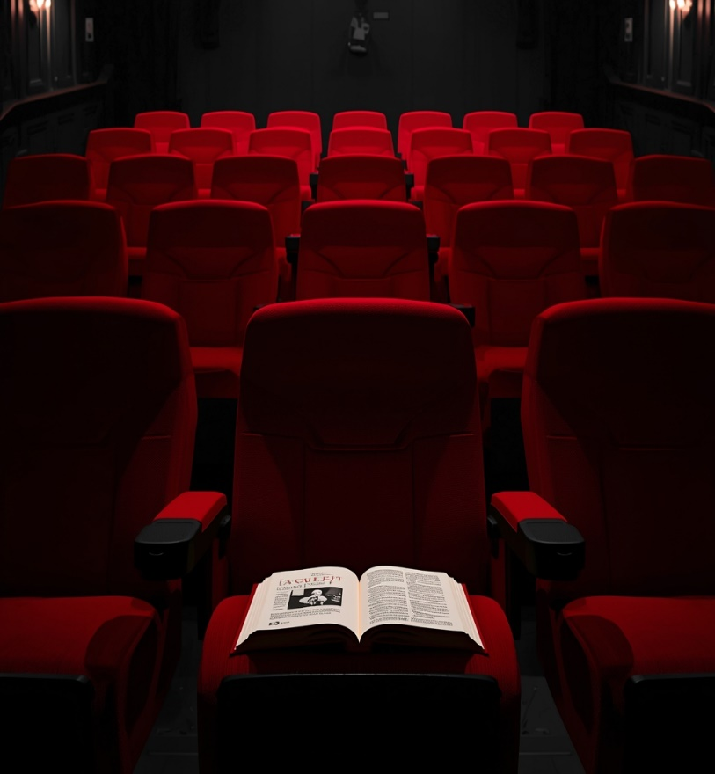
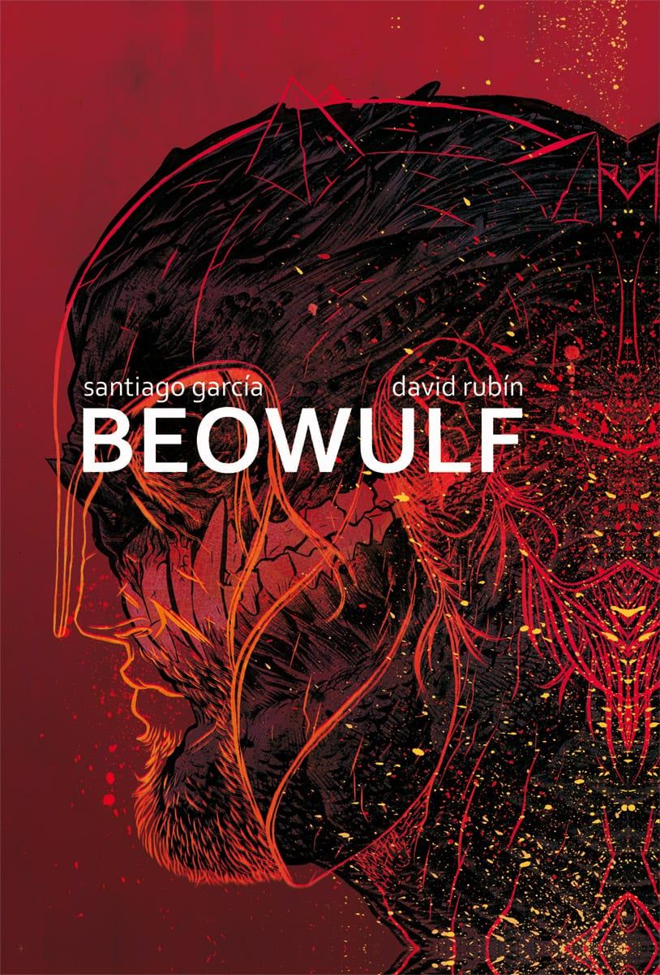
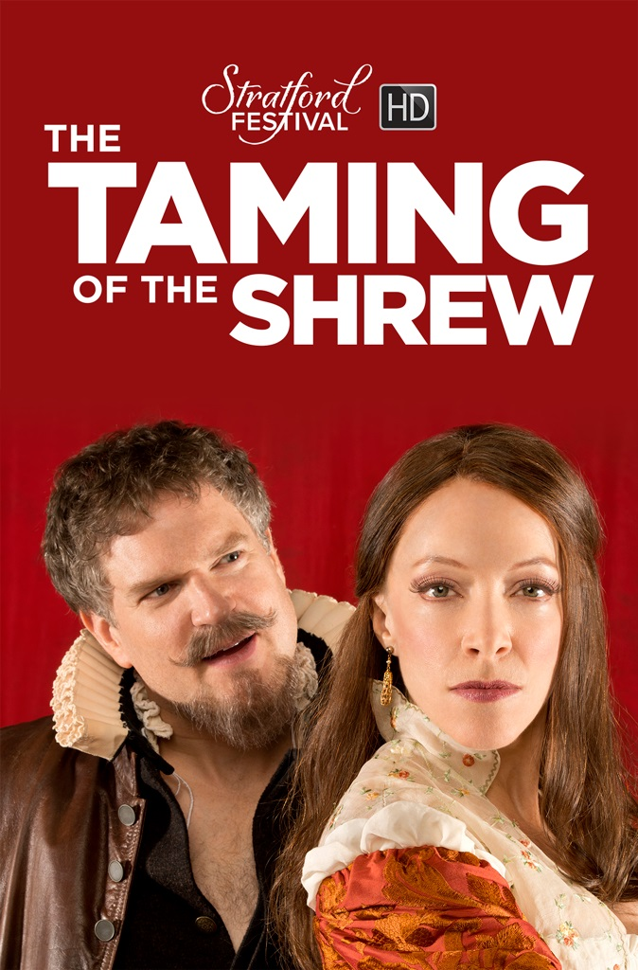
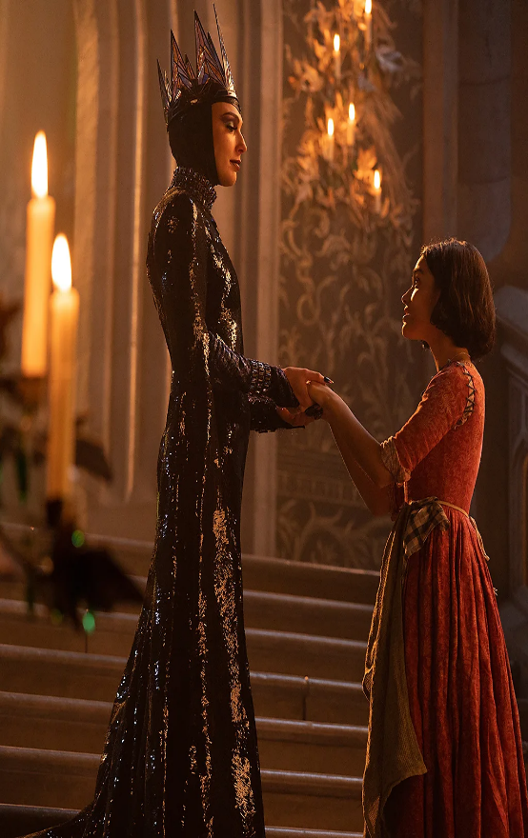
Prof. Neide Silva
Text by: Dr. Khalid Alqadi
List of Contents
LIGHTS, CAMERA, ACTION!
Introduction
1- Literature and Cinema:
On Adaptation
2- Cinema Influence
on Literature
3- Conclusion
References

Slide 3

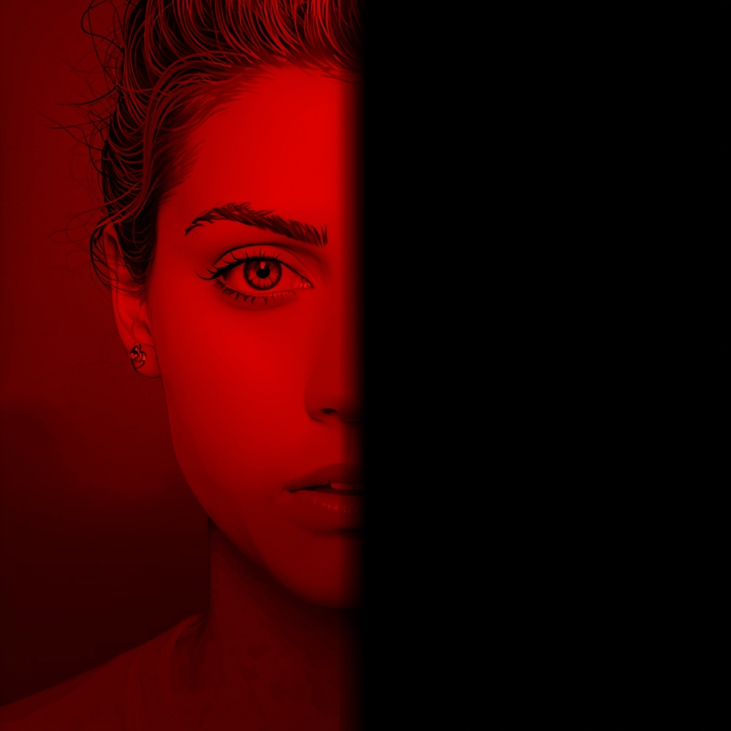
Home
Subtitles
Credits
INTRODUCTION
CRITICS AND WRITERS SHARE ONE POINT OF VIEW, CONSIDERING THE INFLUENCE OF LITERATURE ON CINEMA.
L C
But Many authors establish a forward and backward influence
He introduces the idea of the movie being faithful to a text or a novel or not.
That cinema has the ability to translate deep and abstract ideas and thoughts to the screen as brilliantly as literature does.

Slide 4
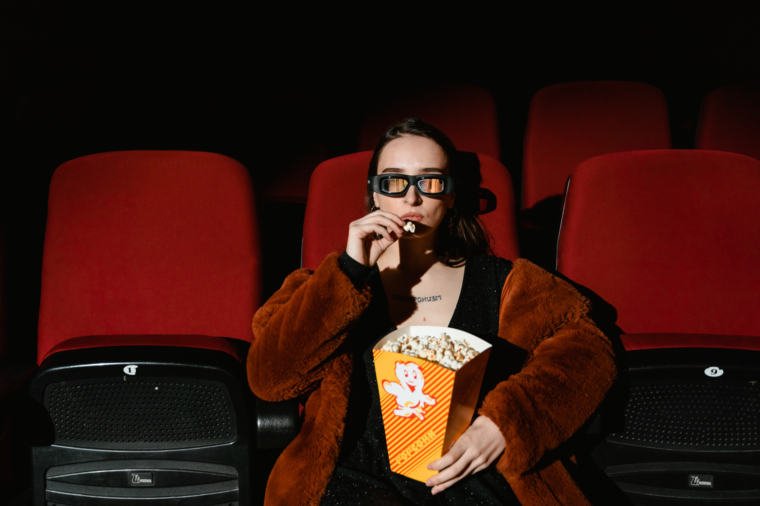
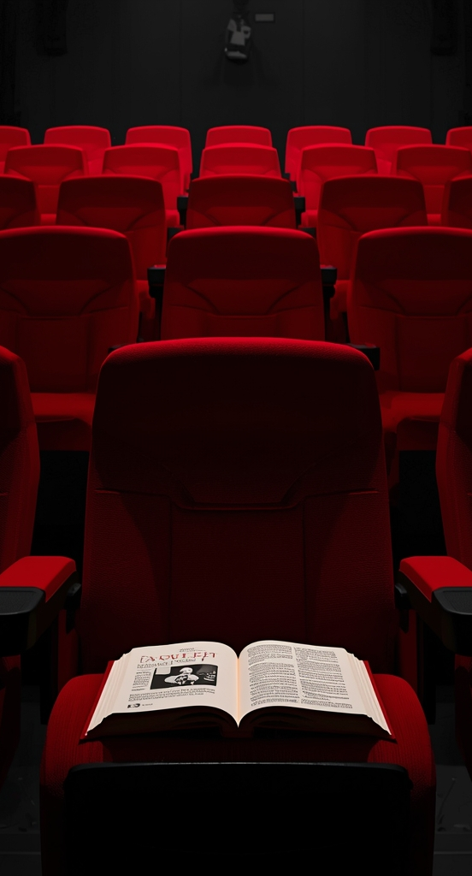
Home
Subtitles
Credits
NARRATIVE
& STORY-TELLING
Brito (2006)
"In the era of interdisciplinary, nothing is healthier than trying to see the literature’s verbality from the perspective of cinema and the movie iconicity from the perspective of literature".
Conrad (1897)
“My task which I am trying to achieve is, by the power of the written word, to make you hear, to make you feel-it is, before all, to make you see”.

Slide 5
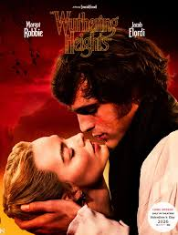

Home
Subtitles
Credits
1- LITERATURE AND CINEMA:
ON ADAPTATION
ADAPTATION IS THE TRANSLATION OF A NOVEL
so that it fits a new destination, a new target or a new audience.
critics eager to continually discuss the degree to which a film is faithful to the literary work
in literature the reader fills in the blanks himself

Slide 6
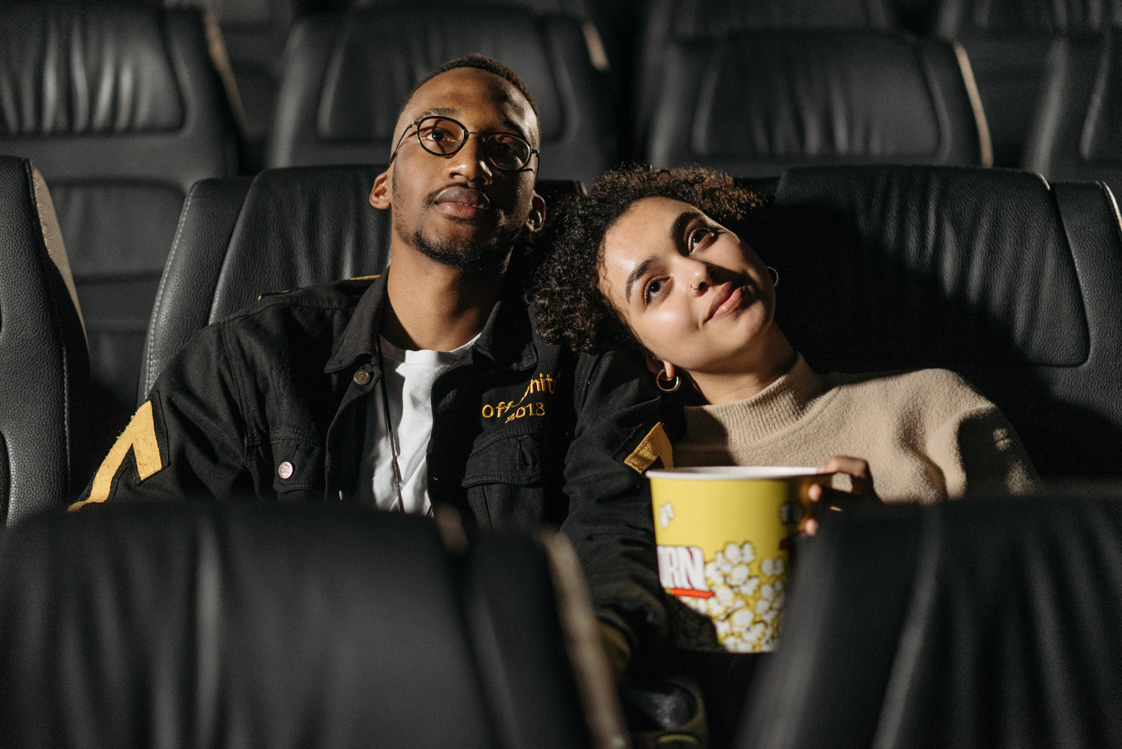

Home
Subtitles
Credits
Studies Showed
On adaptations
They do not make young people more interested in reading books
The opposite is more frequent
different intentions rather than infidelity or violation
each reader perceives his readings from his own point of view. Two readers of the same novel may
not see or capture the same things or feelings.
Fidelity criteria
Ranking from irrelevant to outstanding
So, do we receive the readings from the movie “creators”?

Slide 7
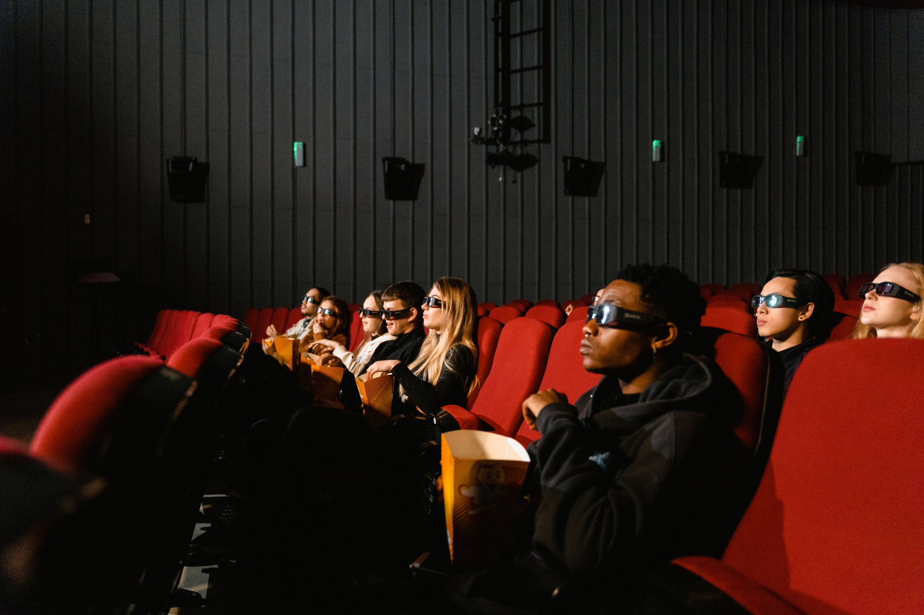
Home
Subtitles
Credits
THE THREE CLASSES
Suggested by Geoffrey Wagner
“Transposition” – no substantial interference.
“Commentary” - intentionally or involuntarily altered
“Analogy” - for the sake of making another work of art

Slide 8
Home
Subtitles
Credits
Three categories
in reverse compared to Wagner’s
Dudley
Michal Klein and Gillian Parker’s
L C
L C
Borrowing
Intersection
Fidelity – comes last
Fidelity
Reinterpretation
Raw-material and an input to an original work

Slide 9
Home
Subtitles
Credits
2- Cinema Influence on Literature
Space and time
Image and word
Knowledge and feelings
Martínez (2005)
Reality and fiction

Slide 10
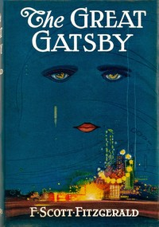
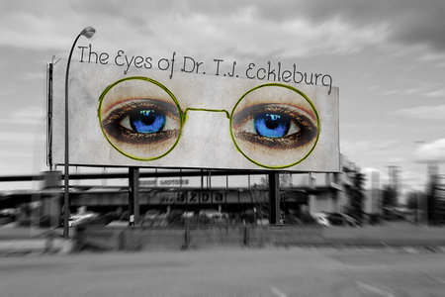
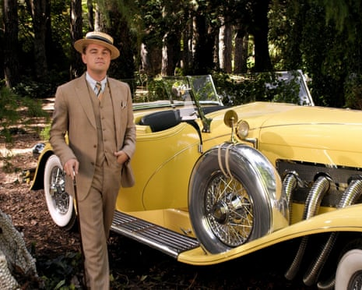
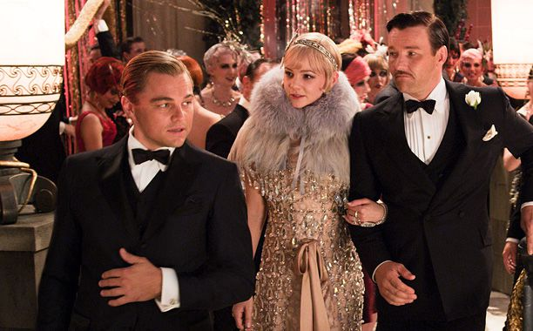
Home
Subtitles
Credits

Slide 11
Home
Subtitles
Credits
Conclusion:
The two art expressions have convergences and divergences
The creation of cinema brought new considerations and approaches of the literary text.
Films have been greatly influenced by literature
Adaptations of classics confirm that novels have inspired film-makers
Classics provide cinema with ready-made, pretested material

Slide 12

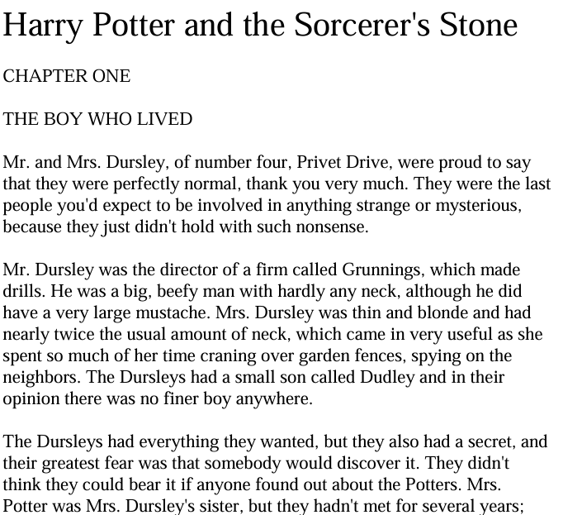
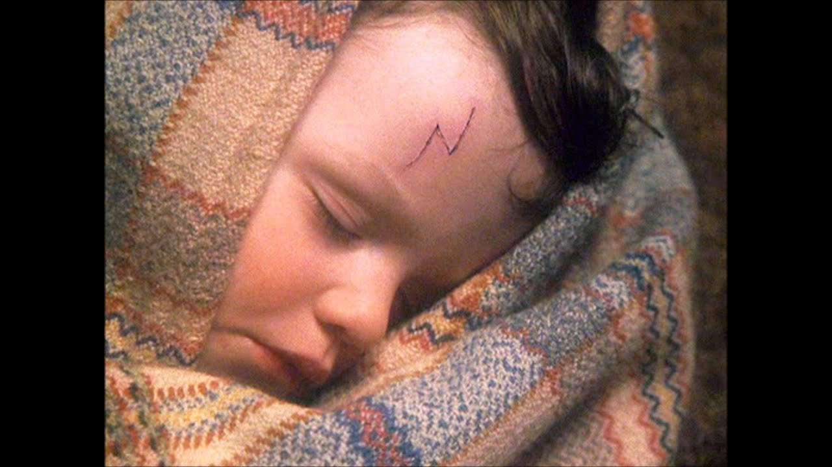
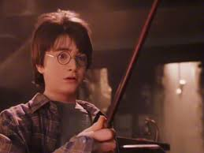
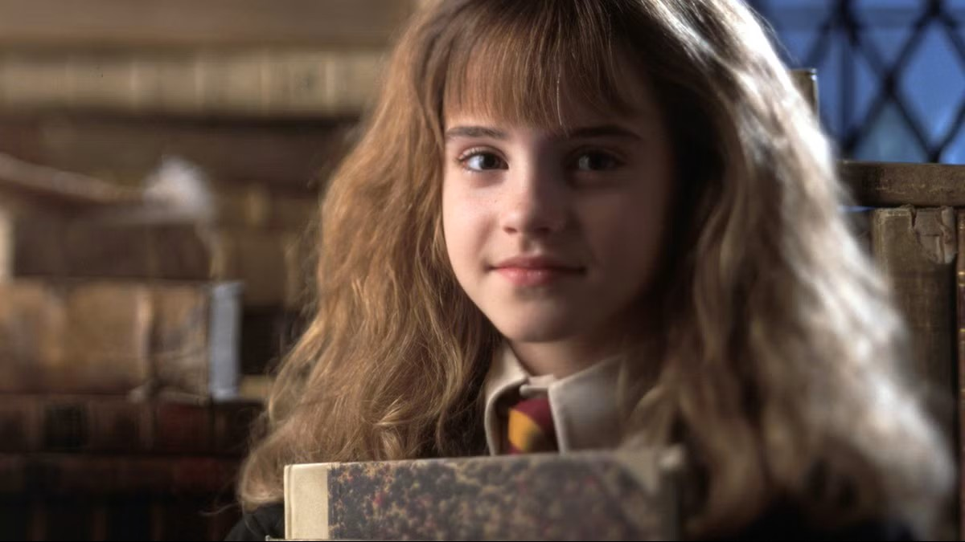

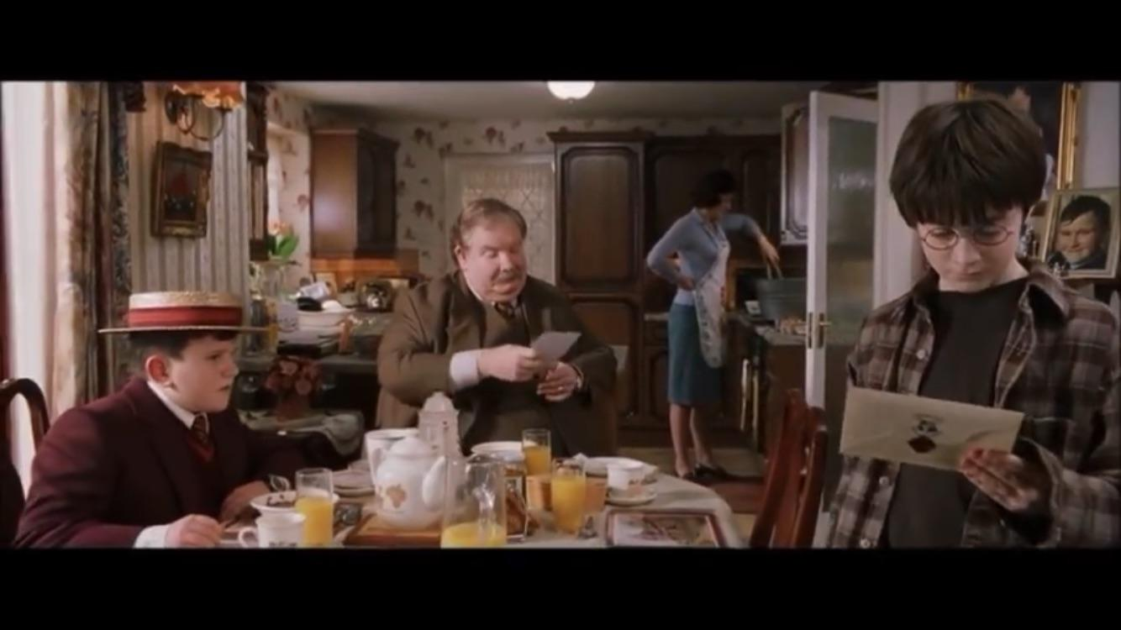
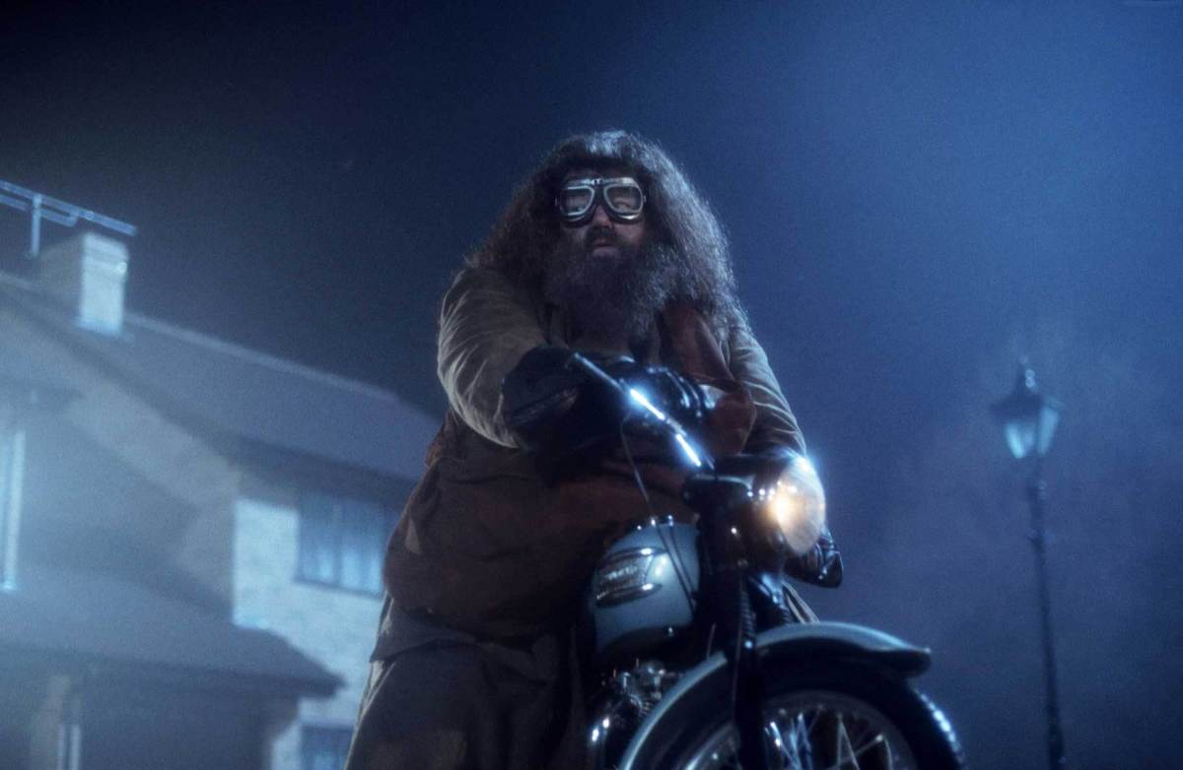
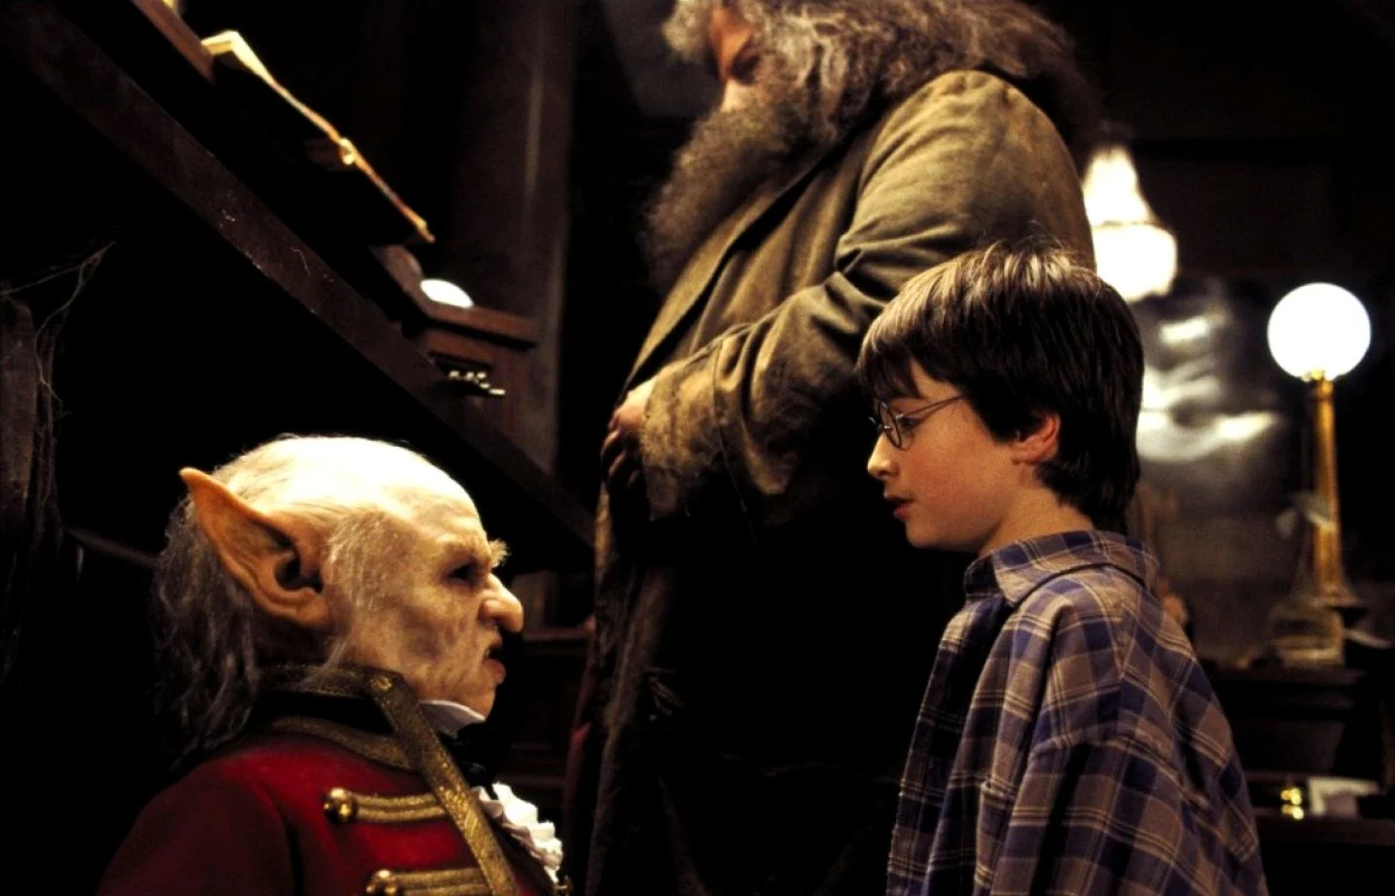
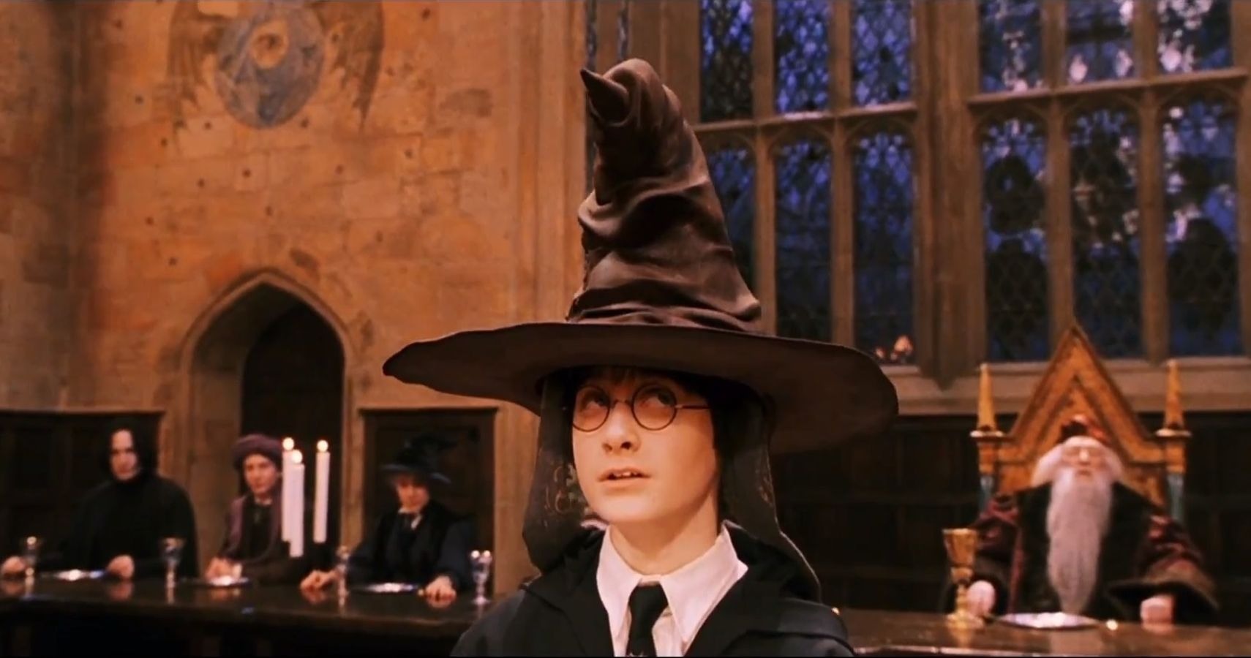
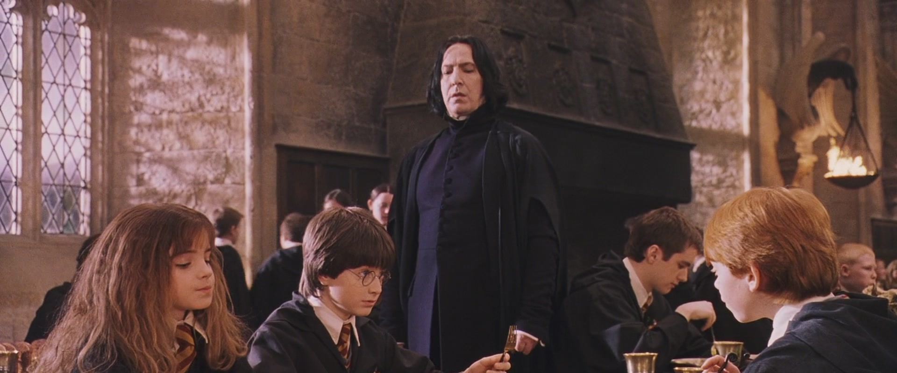
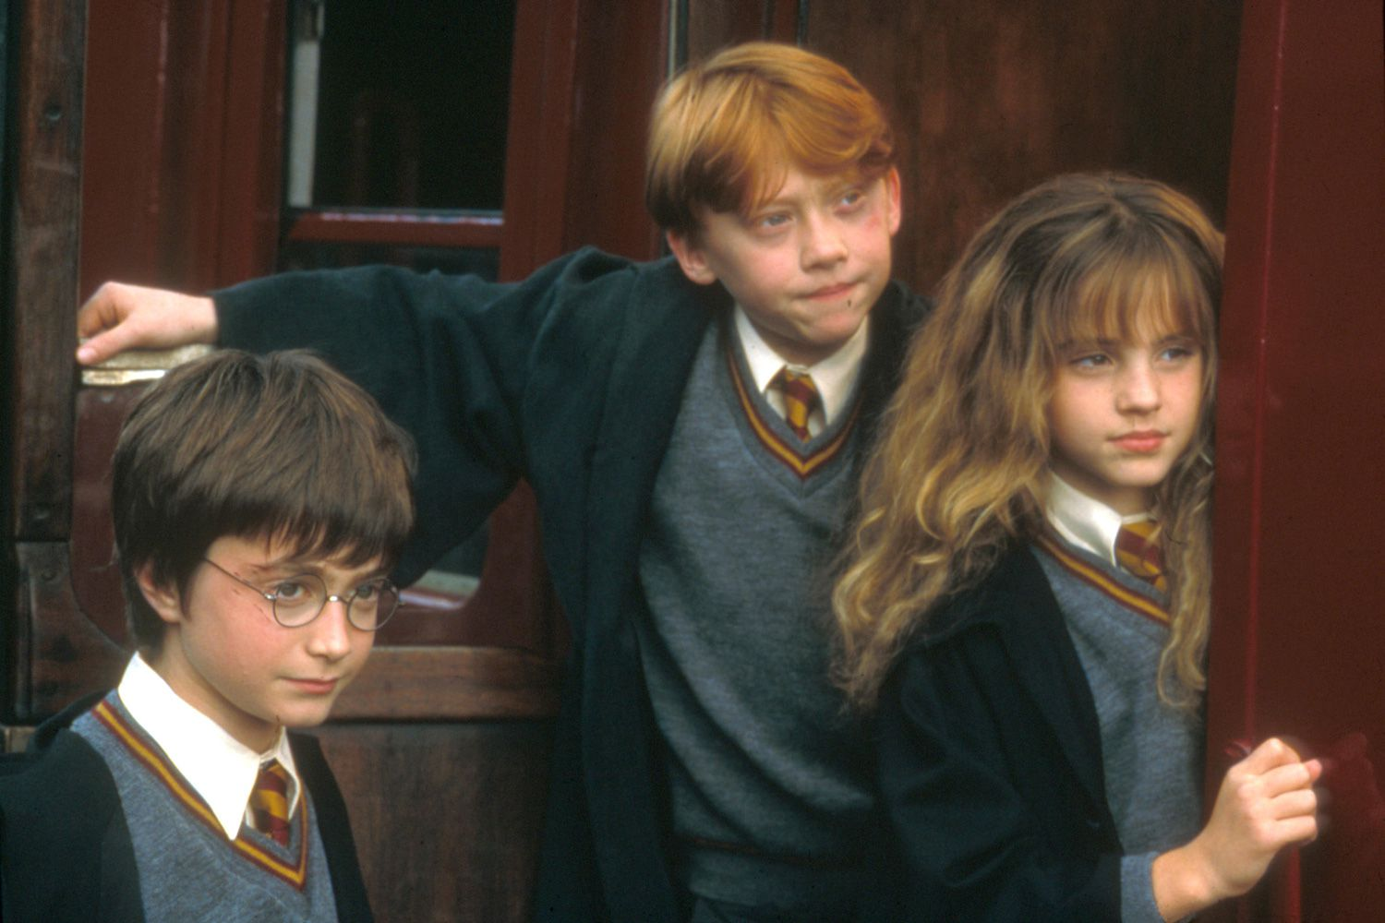
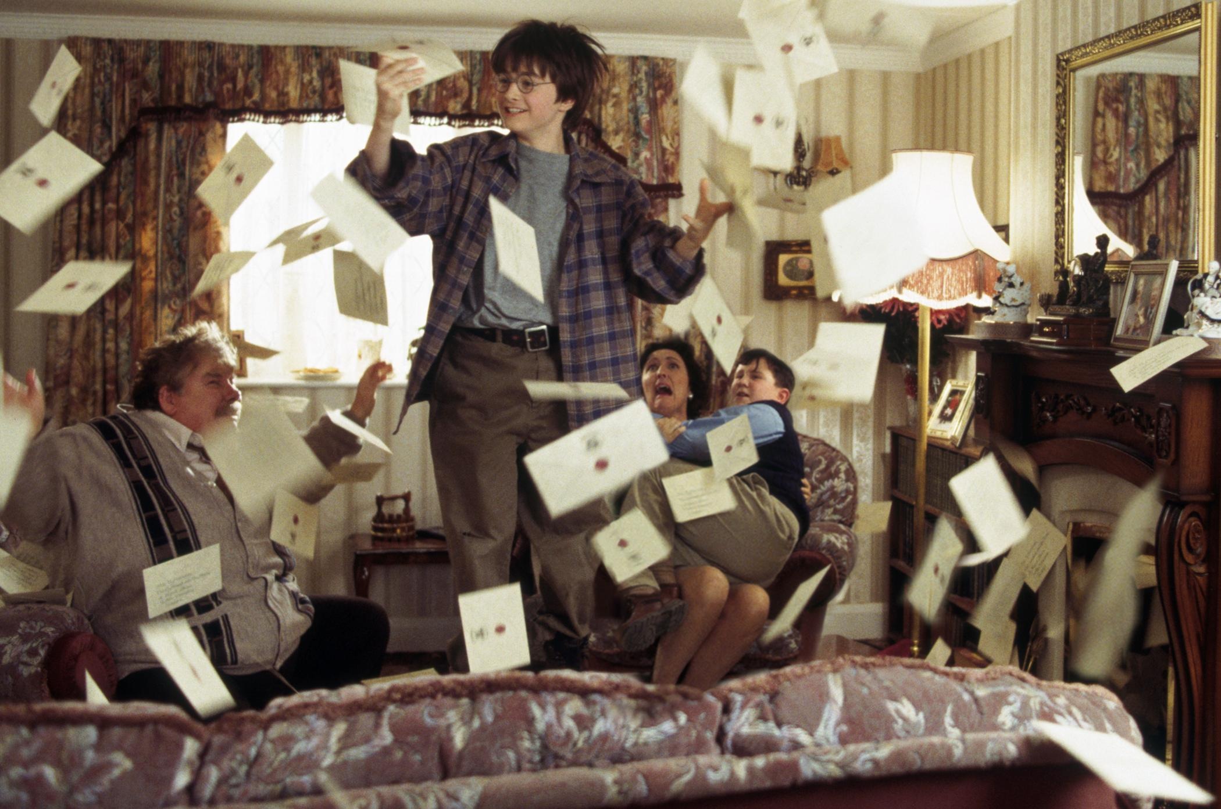
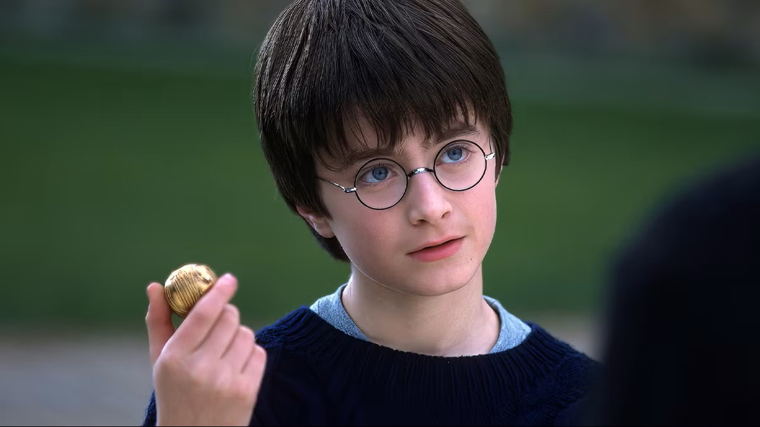
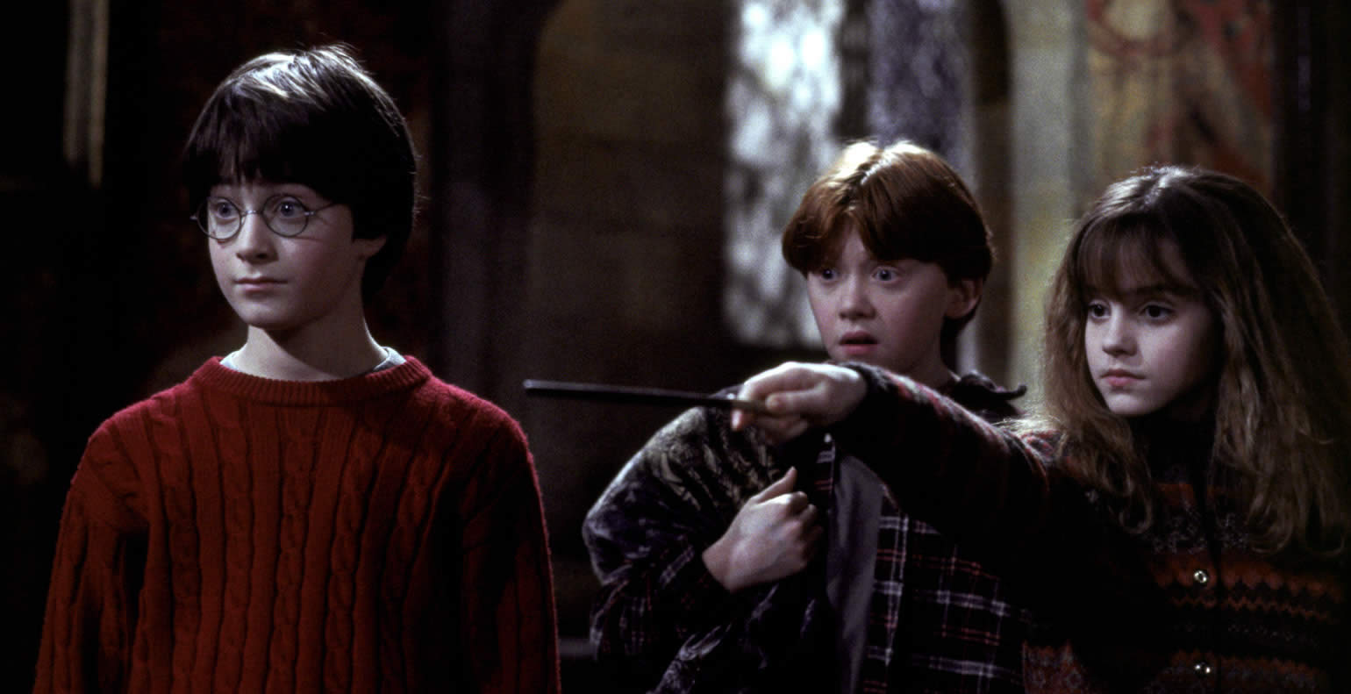
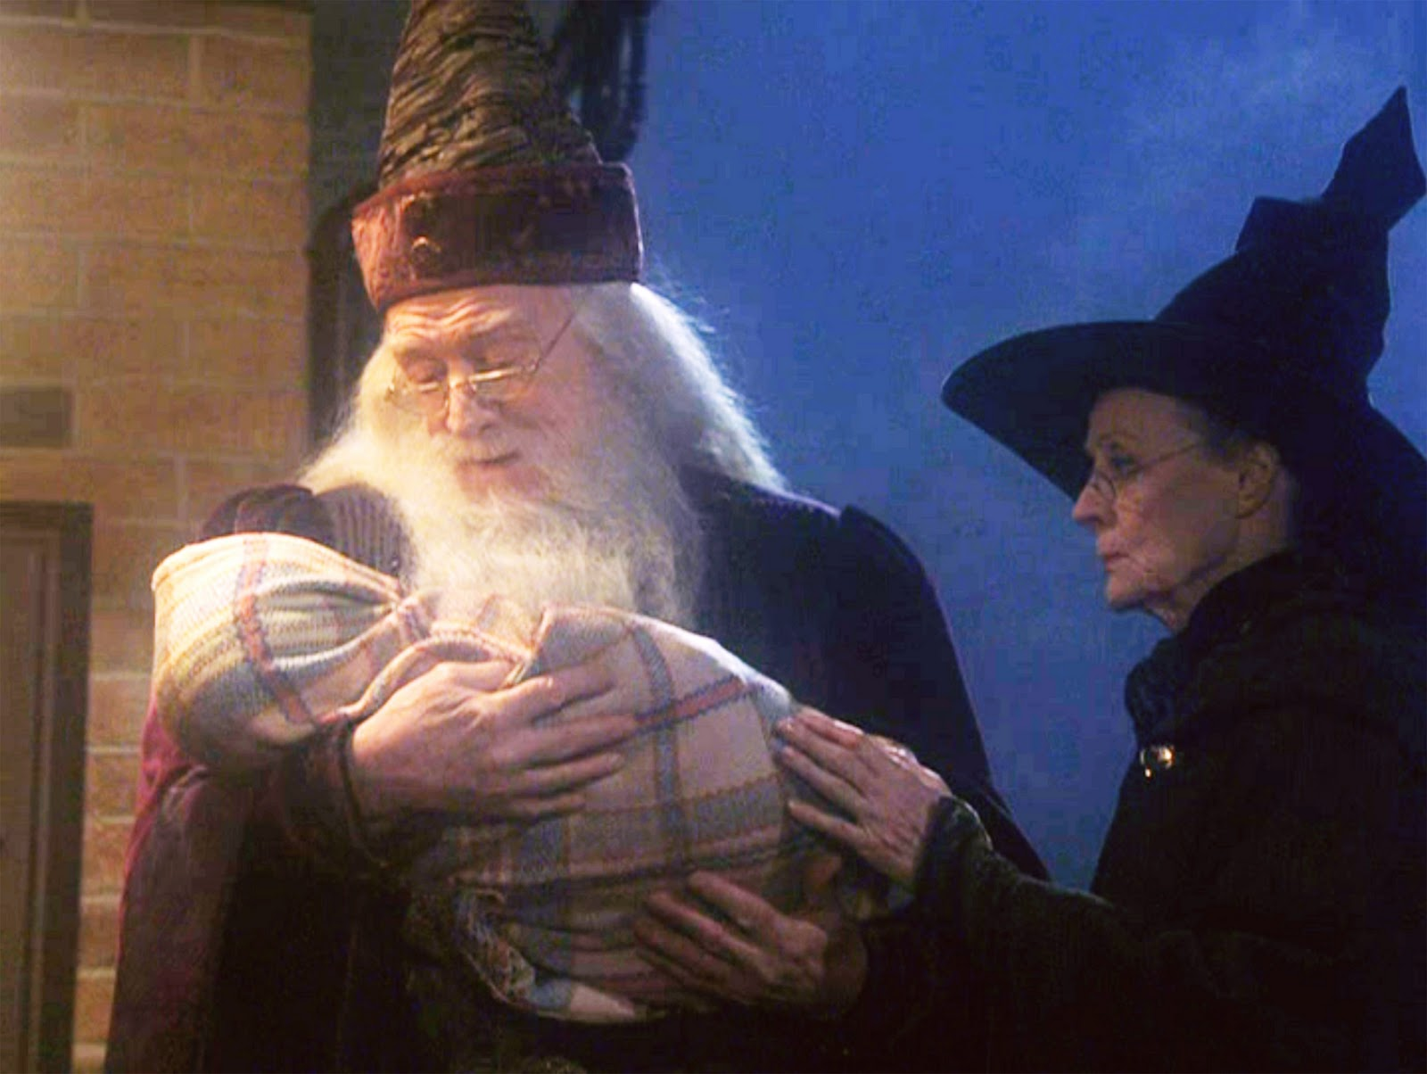
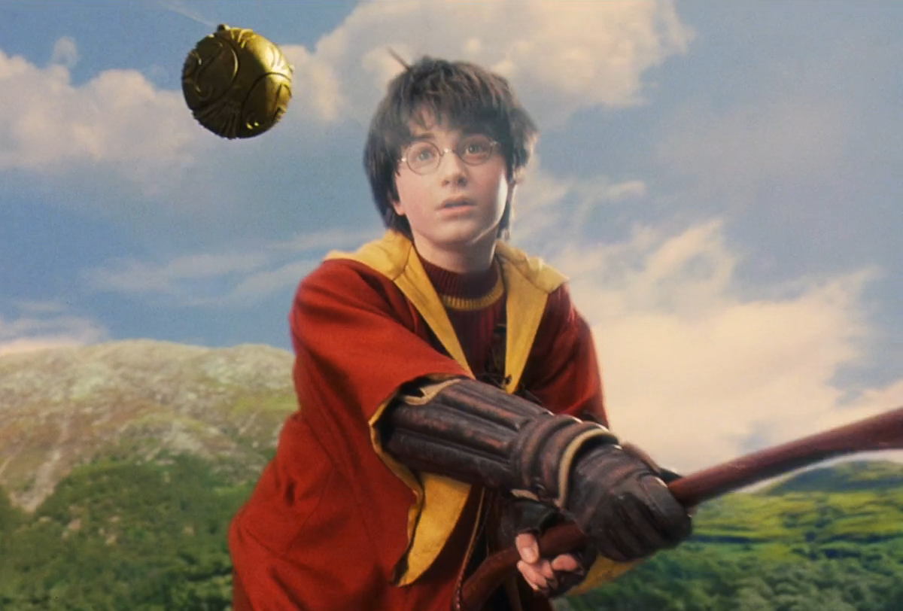

Slide 13
Home
Subtitles
Credits
References:
Brito, João. Cinema e linguagem audiovisual. São Paulo: Papirus, 2006.
Conrad, Joseph. Prefácio a: The nigger of the “Narcissus”. [S.l.]: Echo Library, 2007.
Dudley, Andrew. The well-worn muse: adaptation in film history and theory. In: Narrative strategies. Macomb: Western Illinois University Press, 1980. p. 9.
María José Fresnadillo Martínez: “Editorial: Literature and Cinema. History of a fascination”. J Med Mov 1 (2005): 57-59. Ediciones-Universidad de Salamanca

Slide 14
THANK YOU

