Slide 1
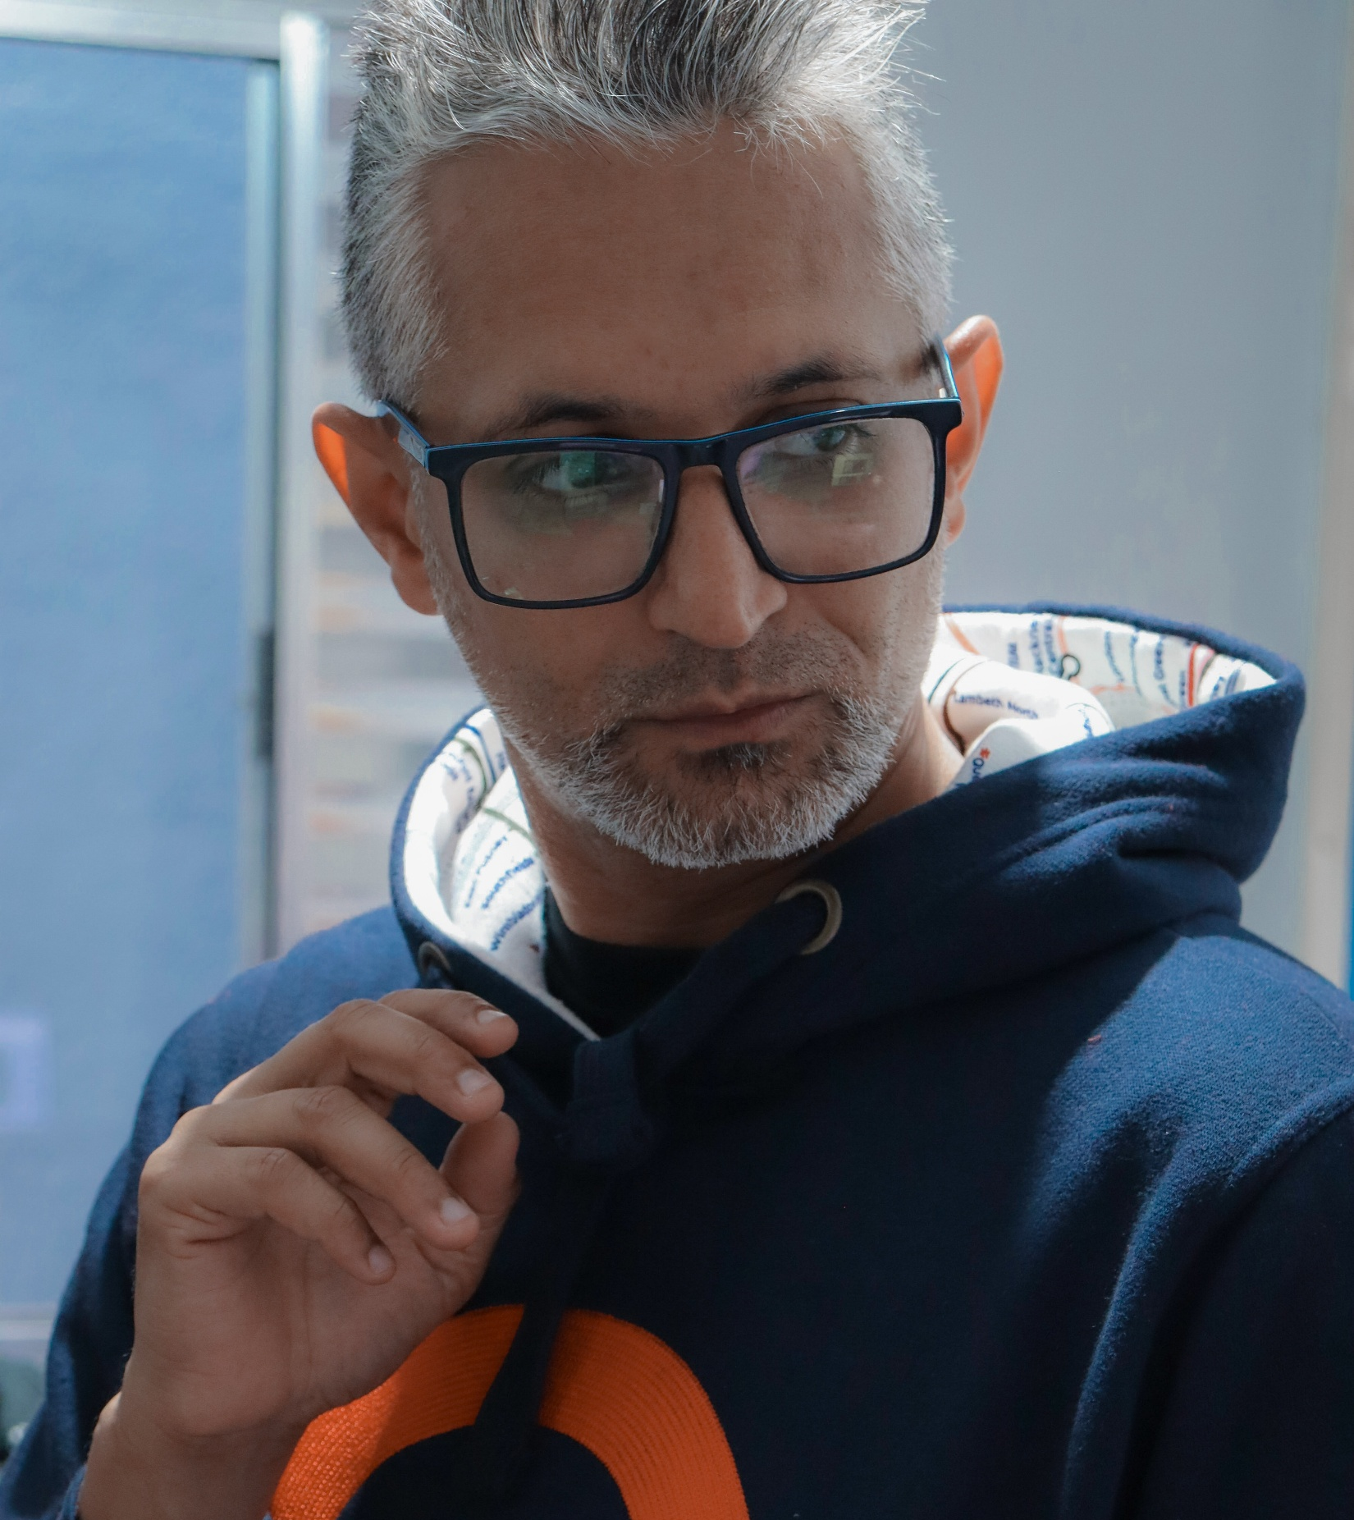
My Personal Portfolio
Language, Culture
and Society
Douglas Fantini da Silva

Slide 2
Index
My book
My video in Wales
My Podcast
Accents and dialects
Language and Society

Slide 3

This is
my book
(100 copies only)
On the left, you can see the cover of my book.
I wrote it during the first semester of 2024, and the topics are based on the lessons I’ve been teaching to my private English students.
I encourage my private students to have it to reinforce their studies in class.

Slide 4
✍️About my book
☑ Você não está no Zero in English is aimed at teaching more people, even remotely.
☑ The overall flow of the content is to help beginner students.
☑ The sections that made sense during my classes, entered the book.
☑ I love when the students read and their feedback help me to think about some adjustments in the future.
☑ I completed the final version of the manuscript, and this is a very important moment in my life
☑ I intend to continue writing.

Slide 5

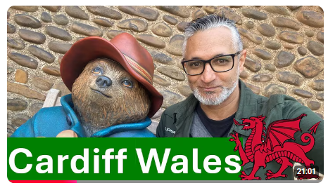
My Video in Cardiff
Wales

Slide 6

🗺️My Cardiff Travel video
🎬 I had already planned to travel to Cardiff, Wales.
📍 As my Professor Vanessa (History of English Language) gave us this task of making a video, why not doing it there?
🧠 I researched about the Welsh language, history, and the diglossia (Welsh/English)
🗺️ As I was enjoying my trip, I registered the moments related to the English and Welsh languages
🎥 I recorded around Cardiff
🗣️ I captured moments of language use and culture
📝 I noted historical and linguistic context while filming
✂️ I edited the video with structure.
📤 I exported the final travel video for sharing

Slide 7
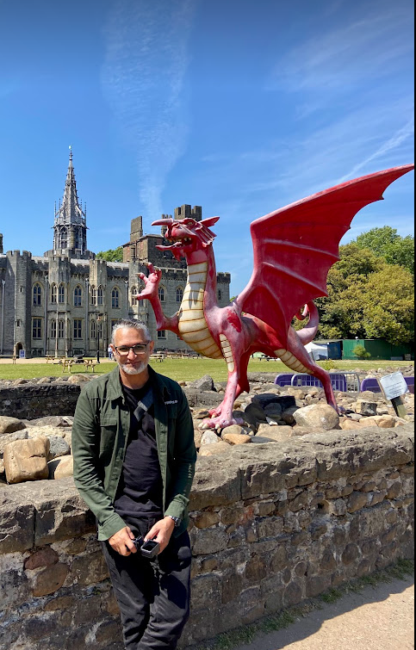
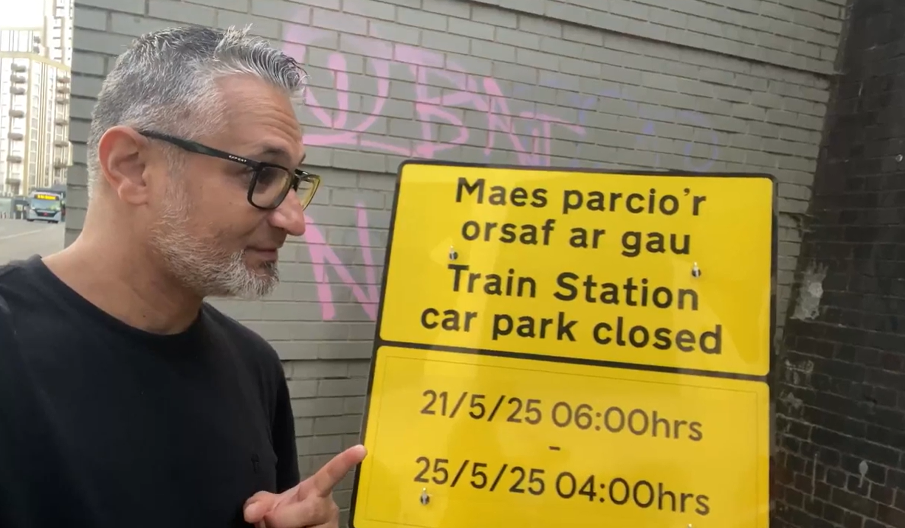
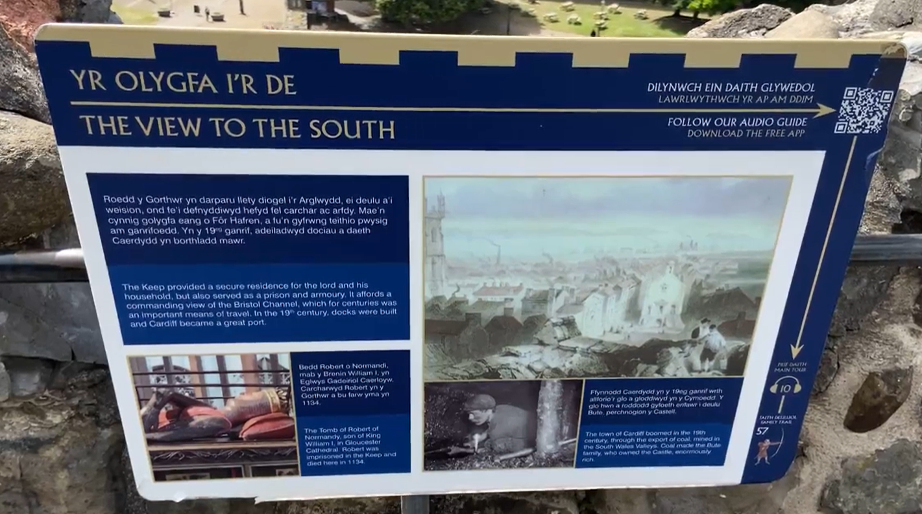
English and Welsh
As I walked through the streets of Cardiff, I took photos from the plates and street signs in both languages (English and Welsh)
I’m very happy with the result of the video and it is available on Youtube for everybody to watch

Slide 8
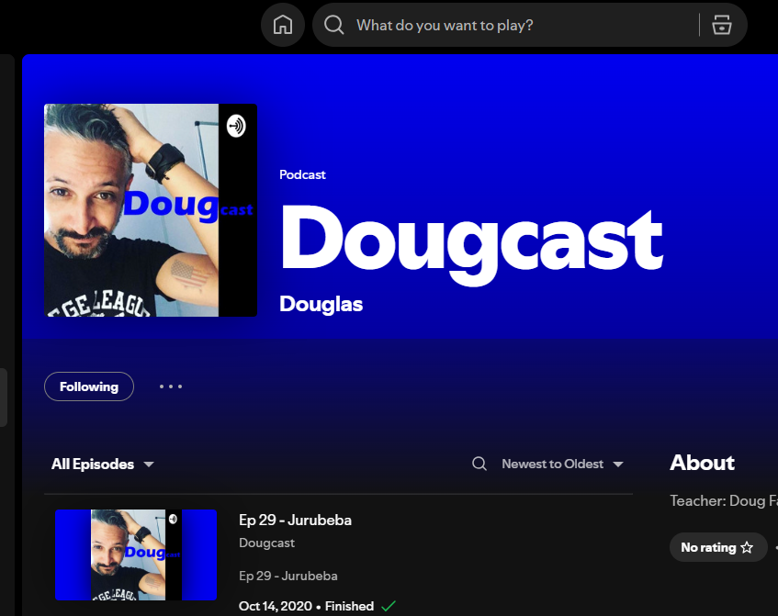
This is my podcast
I created this Podcast to reach more people with my English Language Teaching.

Slide 9

🎙️About DougCast
DougCast was created with the purpose of spreading the English language to more people. I chose the name DougCast as the podcast brand, and the episodes follow a solo format focused on language learning and curiosities. The scripts are based on topics I already teach in my lessons, which keeps the content connected and makes it both familiar and practical.
To bring the project to life, I bought a new microphone and selected recording software, and I’ve already recorded several episodes. After recording, I edit out mistakes, adjust the sound quality, and add sound effects when needed to make the listening experience more engaging. The cover art is simple, using a photo of myself.
DougCast is available on platforms like Spotify (formerly Anchor) and Apple Podcasts, and I also share it on social media and directly with my students so they can use it as listening practice. It also become an important part of my development as a teacher: it helps me improve how I explain concepts, encourages me to communicate more clearly, and gives me a space to turn classroom content into more creative formats.

Slide 10
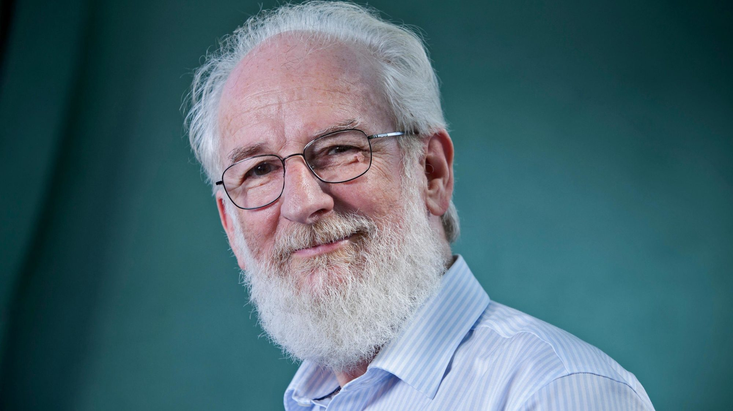
David Crystal
Accents and Dialects
I could read this amazing David Crystal’s text
The topic really interests me
The Difference between accent and dialect
Geographical variation (regional dialects)
Social variation (sociolects)
Prestige and stigma in accents
Mutual intelligibility
Accent change and language evolution
Attitudes and stereotypes about speech
Key Concepts

Slide 11


Accents vs Dialect
A dialect is a way of talking that belongs to a particular part of a country.
p.71
Accents are only to do with pronunciation.
p.73
People from Scotland speak in one of many possible Scottish accents. p73

Slide 12

On Accents and Dialects
(my Personal Experiences
My Father and My niece
They speak totally differently
I walked along a pavement in England
But I confess I called it a sidewalk
Cause I learned American Standard English
My Father is from Maceió Alagoas
He lives in são Paulo but still carries his strong North Eastern Brazilian accent
The BBC English influenced me a lot
I preffered to listen to the Variety of prestigie found in London England
But my courses were in American English.
I heard the “wee” word in Scotland
The word wee means little in Scottish edinburgh dialet – I ate a wee hamburger called Haggis there.

Slide 13


Think of their dialects and accents
.
Royal family
Bishops
Professors
Doctors
Judges
Accents can also tell others about the kind of social
background we have or the kind of job we do. p.74
When I listened to people in the London underground, I could understand a lot of their background just because the way they spoke.

Slide 14

Received Pronunciation - RP
.
In England, that neutral accent is called
Received Pronunciation
or RP for short. p.74
When I started learning English, I loved to watch BBC news to practice my listening skill.

Slide 15
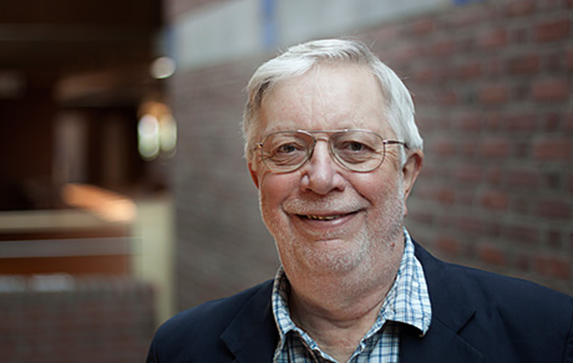
Sociolinguistics - Language and society (Peter Trudgill)
I read this introduction by Peter Trudgill where he explains the social function of the language. That language is used not only to transmit information but to establishing and maintaining relationships between people

Slide 16
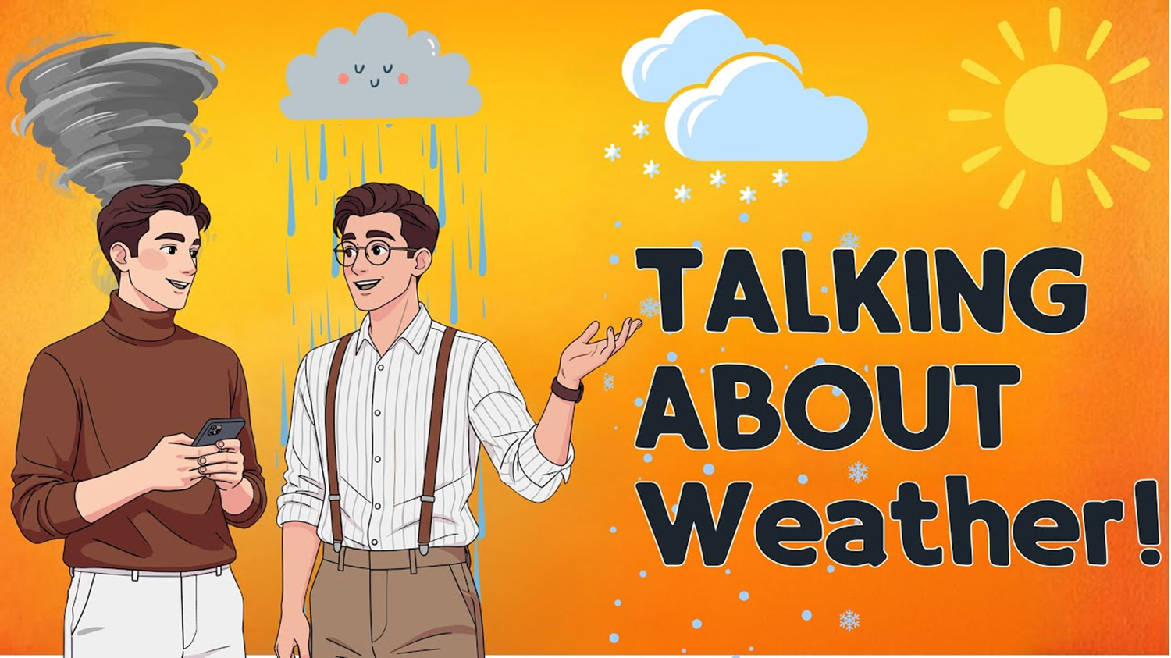
I read Sociolinguistics - Language and society (Peter Trudgill)
The example that caught my attention is this where people who never met before, start talking about the weather.
They do so not because they are interested in climatic conditions but because it’s quite embarrassing to be alone in the company of someone you are not acquainted with and not speak to them.
This is a fact in my life because many times I great or talk about the weather with people at bus stops and in bank lines.

Slide 17
References:
CRYSTAL, David. Accents and dialects. In: CRYSTAL, David. A little book of language. New Haven: Yale University Press, 2010. p. 71-77.
FANTINI, Douglas. Você Não Está no Zero: Bem-vindo à prova de que você já sabe inglês demais. São Paulo: ed. Scortecci, 2024.
TRUDGILL, Peter. Sociolinguistics: an introduction to language and society. 4. ed. London: Penguin Books, 2000.

