Slide 1

Dimensions of Bilingualism
Douglas Fantini da Silva
LE WEY

Slide 2
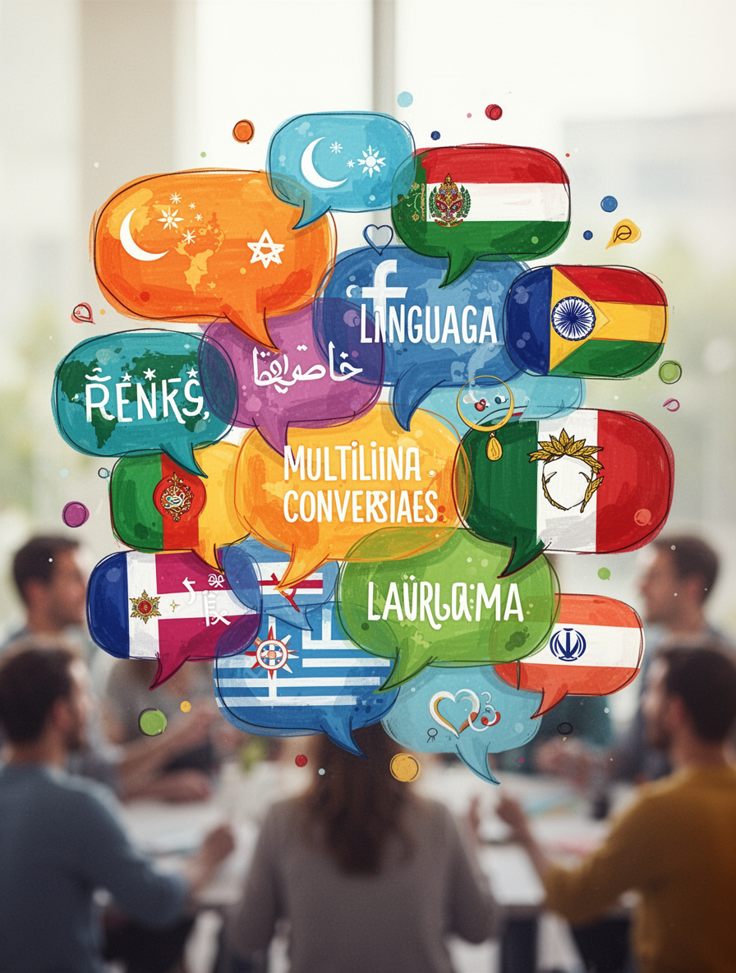
Languages in Contact
Circumstances
  People choose to meet (e.g., travel, work, trade).
  People are forced to meet (e.g., war, colonization, slavery).
  Moving to new places (migration, settlement).
  Cultural exchange (education, religion, arts).
Who are you in this list?

Slide 3

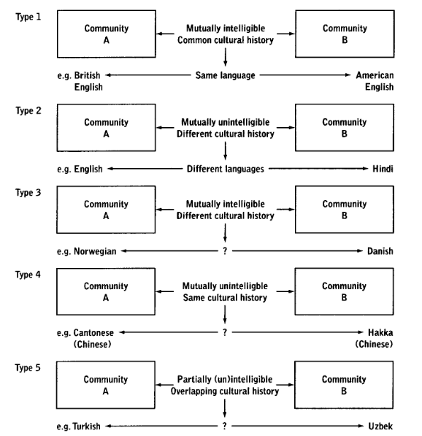
Who is a Bilingual?
page 9

Slide 4
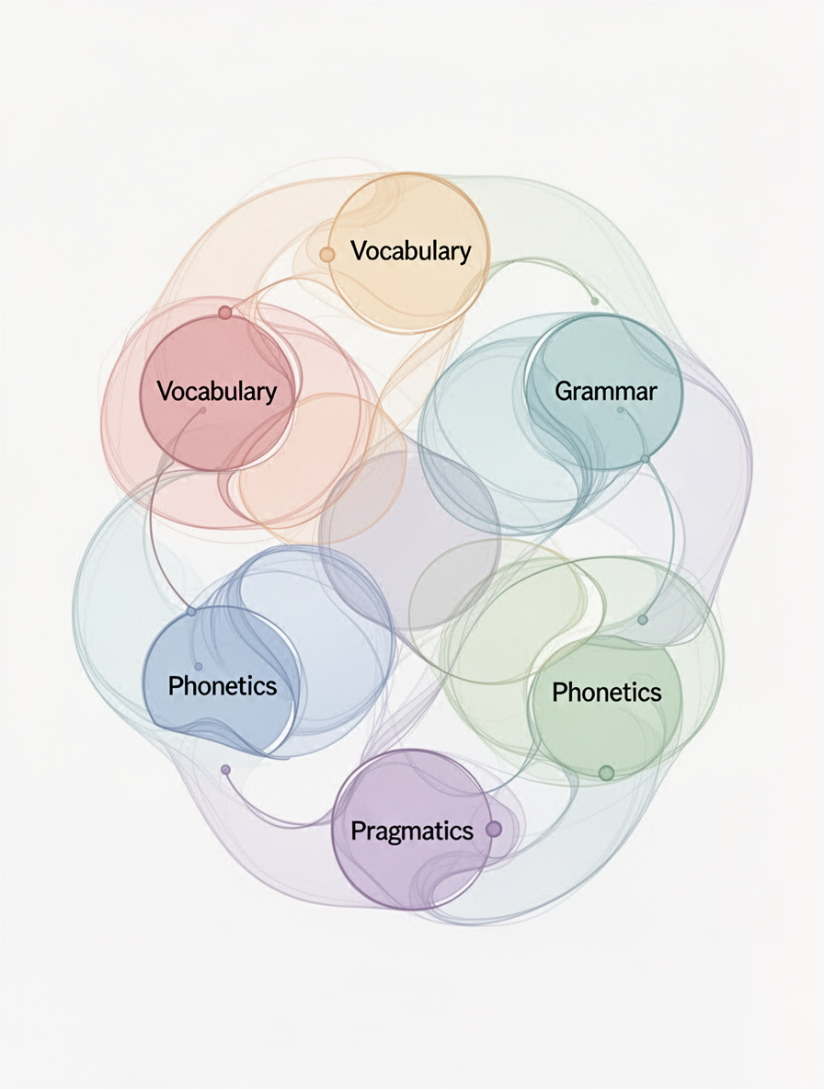
What’s in a Language?
Language vs dialect
Criteria
Size and prestige
Is Standard English a dialect?
page 7

Slide 5
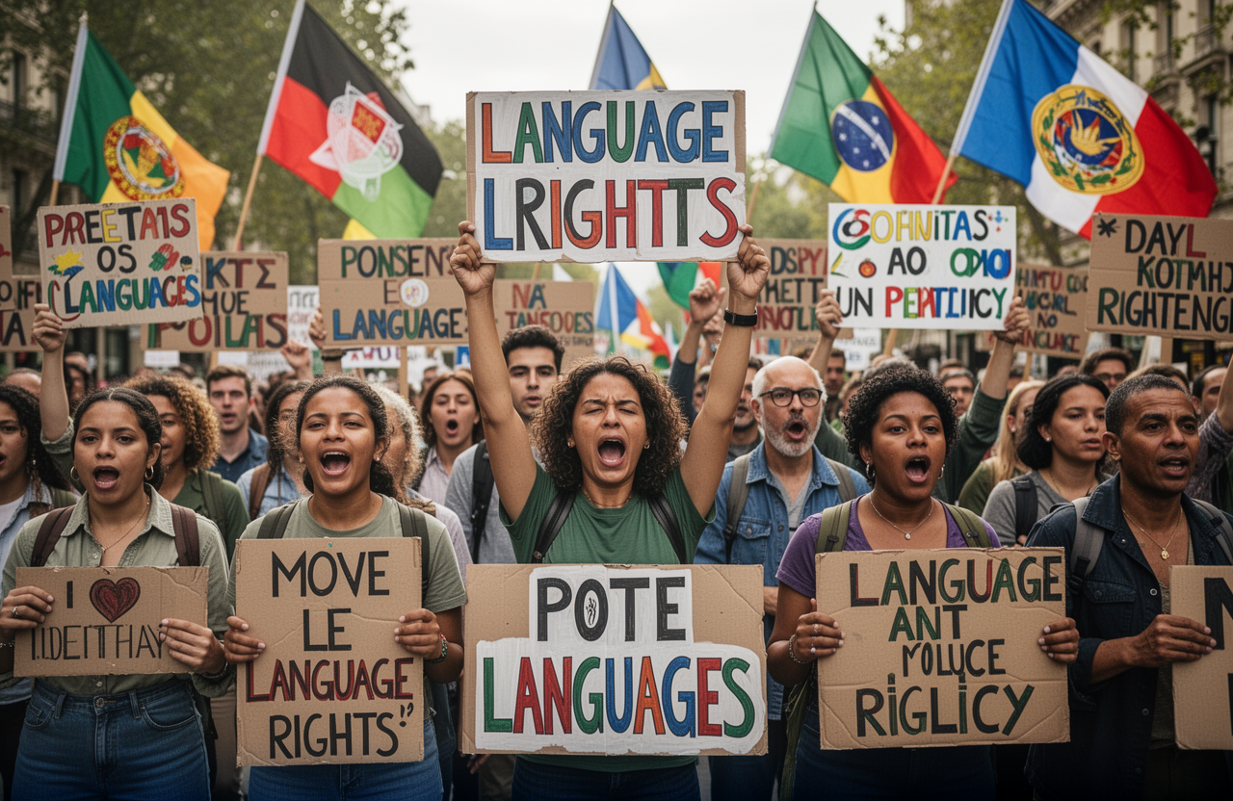
Language as a Socio-Political Issue
Multilingual countries are often thought to have certain problems which monolingual states do not
(see Fasold, 1984: Chapter 1; Edwards, 1994).
...difficulties in communication within a country can act as an impediment to commerce and industry.

Slide 6

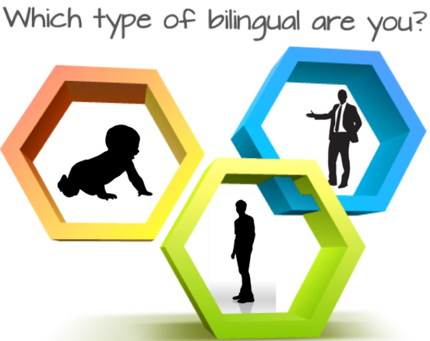
What Does It Mean to Be Bilingual?
Mental representation of a bilingual’s two languages
Evidence exists for both separate storage and shared storage of the two languages in the bilingual’s brain
people who understand a second language
Specially - someone who can function in both languages in conversational interaction.

Slide 7
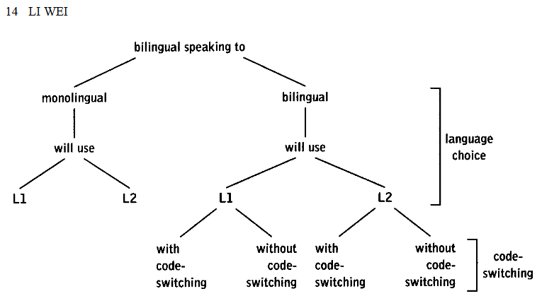
Changes in Attitudes Towards Bilingualism
Bilinguism is an asset
  for education
  social integration
  personal development
– LE WEY

Slide 8



Communicative Advantages
Wider Reach
Social Adaptation
Strategic Switching
Connect with diverse communities and individuals.
Navigate various social contexts with ease.
switch languages based on context.

Slide 9
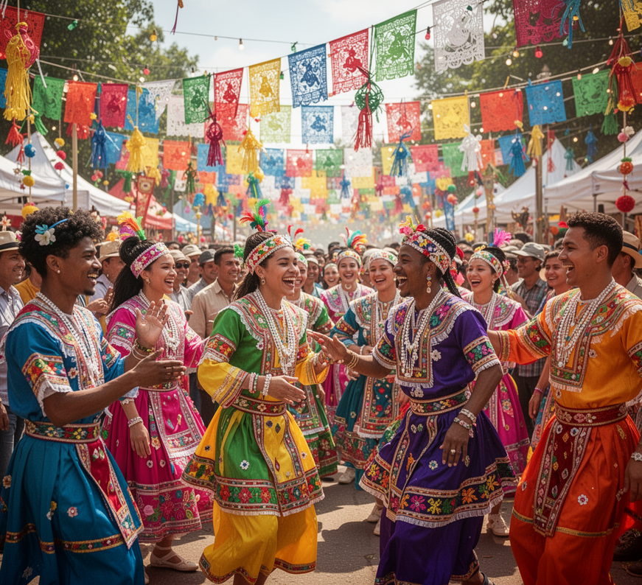


Cultural Advantages
Understanding
Appreciation
Identity
Enhanced cultural appreciation through bilingual experiences
Appreciation for diverse traditions and perspectives.
Enriched personal identity through cultural engagement.

Slide 10



Cognitive Advantages
Flexibility
Memory
Control
Bilinguals demonstrate improved mental agility in tasks.
Enhanced memory skills are common among bilinguals.
Bilinguals exhibit better executive control over tasks.

Slide 11

In conclusion
  Bilingualism means using two languages and understanding different cultures.
  Languages in contact influence how people speak and interact.
  Language reflects identity, social status, and political power.
  Bilinguals gain cognitive, communicative, and cultural advantages.
  Attitudes now see bilingualism as a valuable skill, not a drawback.

Slide 12

thank you

