Slide 1
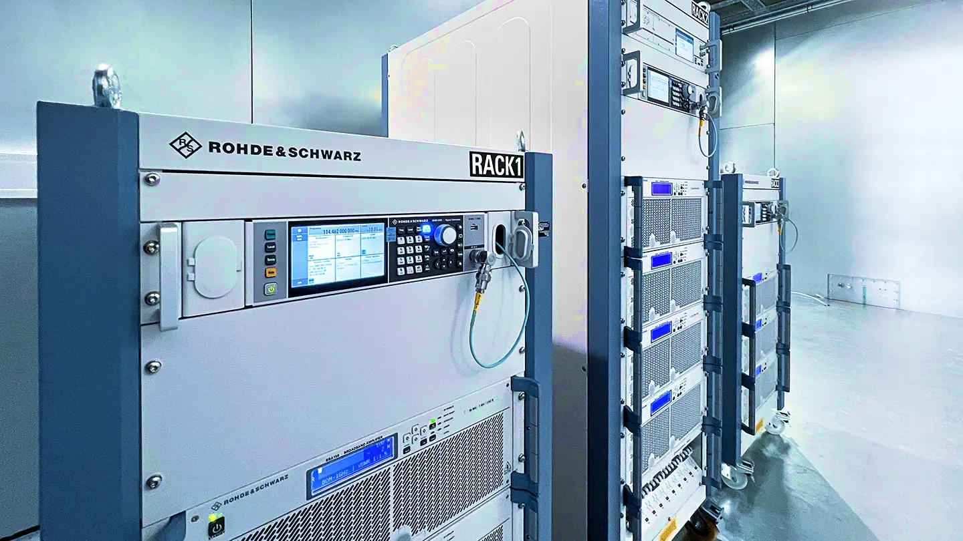
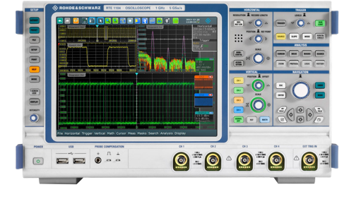

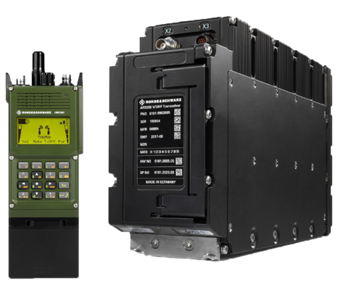
A Rhode & Schwarz win thanks to Anton Patyuchenko
Strategy; Expand SAM/win entire solution
Notes:
Change background and 1 circle image, more like test equipment

Slide 2

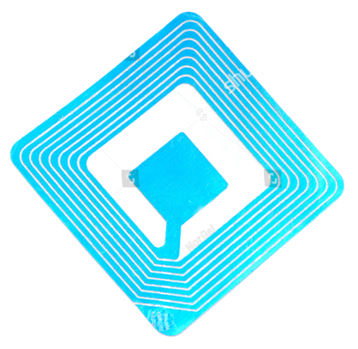

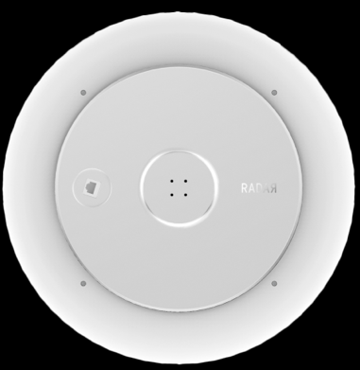
Another success story thanks to
Ralf Butz & Michael Manning
Why We Won
Silent Switchers – best in class performance
Deep product portfolio
Deep customer intimacy and technical support
Notes:
Find better image

Slide 3
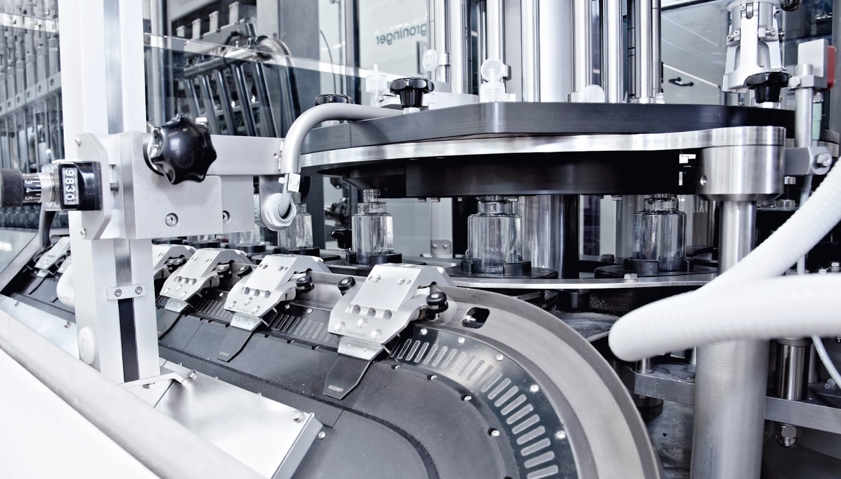
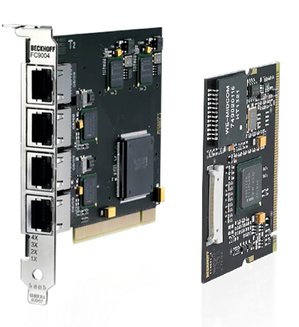

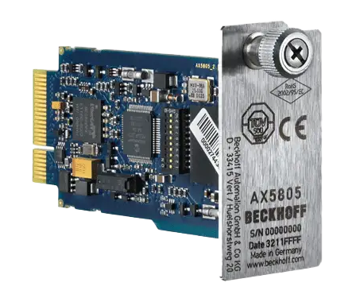
Another success story thanks to
Ender Ergin & Thomas Tzscheetzsch
Why We Won
ADP1055 to realize an isolated power supply
$10 worth of power BOM on 200W version (will be a 500W next)
Our solution is cheaper and easier to use
Notes:
Background too busy, maybe make duotone and change bottom circle image

Slide 4
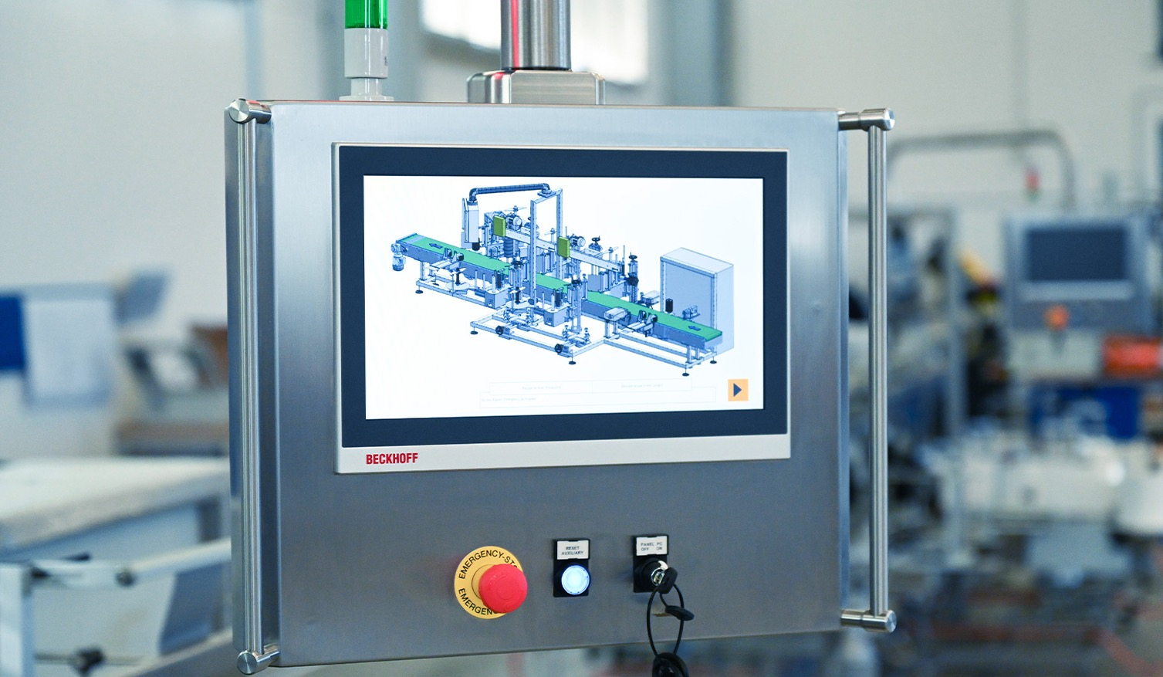
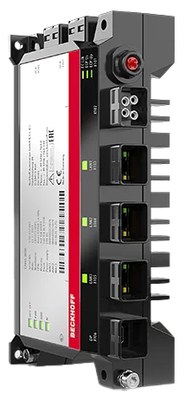
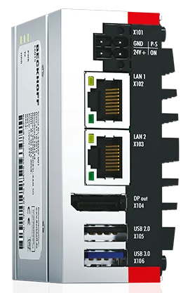
Another success story thanks to
Ender Ergin & Thomas Tzscheetzsch
Why We Won
ADP1055 to realize an isolated power supply
$10 worth of power BOM on 200W version (will be a 500W next)
Our solution is cheaper and easier to use
Notes:
Background too busy, maybe make duotone and change bottom circle image

Slide 5

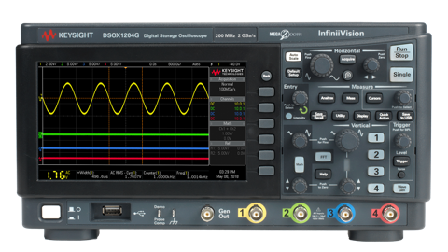
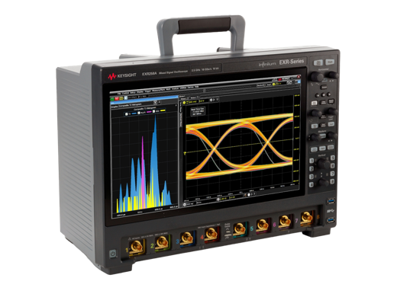
Another success story thanks to Matt Smith
Why We Won
  8 Dwins
  $12.6M ADI PAV
  $2.5M MMP PAV
  We can select a project or
  two to highlight

Slide 6
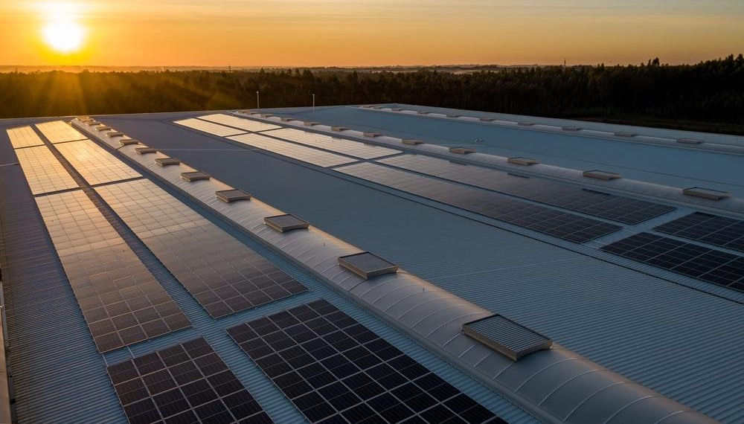

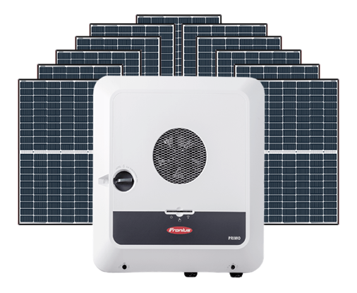
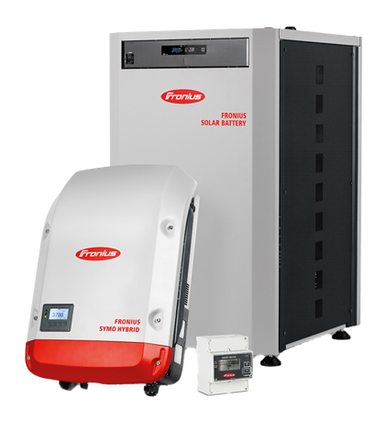
Another success story thanks to Roland Prager
Why We Won
  Wide operating voltage, up to 36V
  Internal V_{REF}
  Low power consumption
  Strong field support
  FAE to work w/customer to
  optimize performance
Notes:
Different background, solar inverter

Slide 7

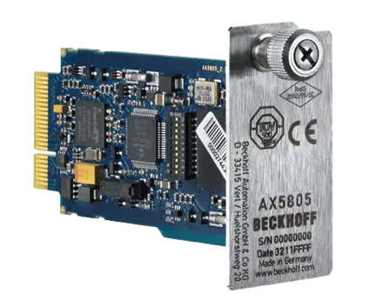
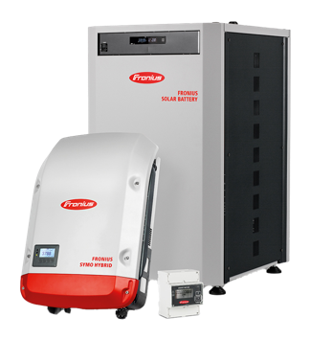
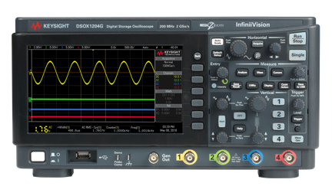
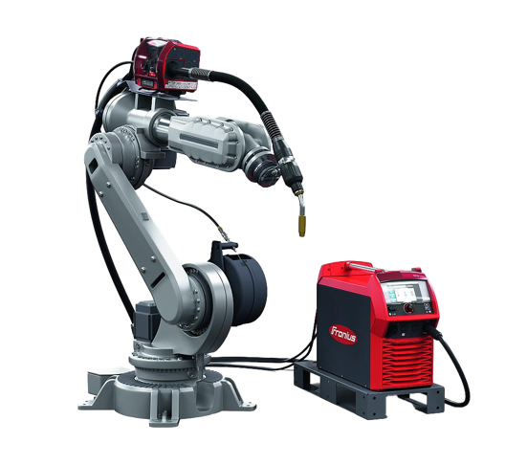
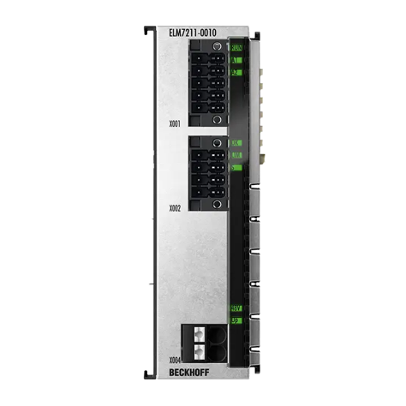

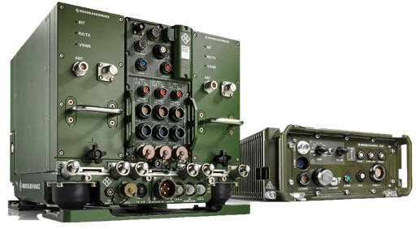
Key Success stories

