Slide 1
Power You Can Trust
Robert Westby
Principal Engineer, Power Systems Engineering

Slide 2
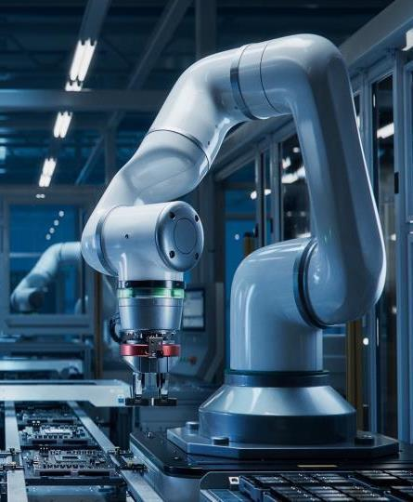
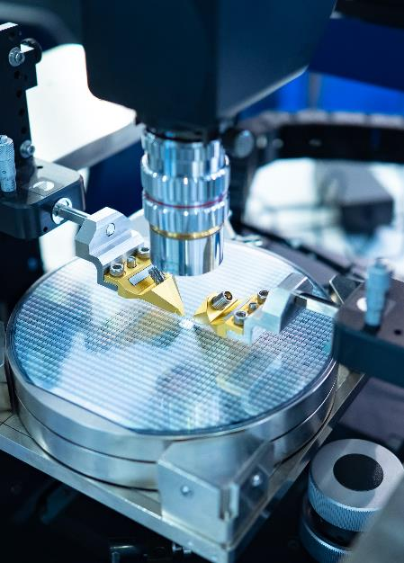
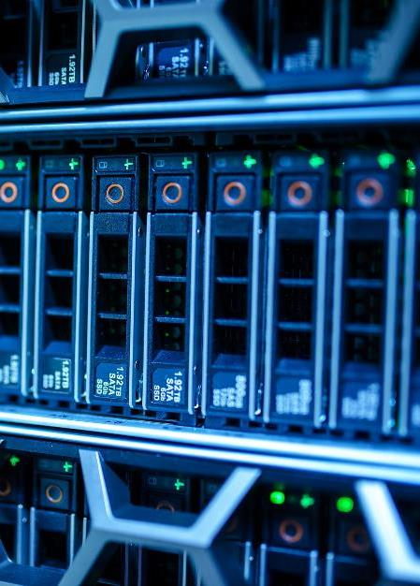
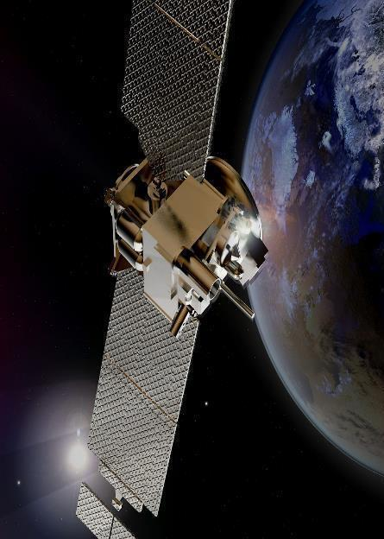

Application Areas Requiring Robust Power
Industrial
Instrumentation
Data Center
Aerospace
Digital Healthcare
Notes:
Just some of the application areas where we see tremendous potential and interest from customers

Slide 3

Robust Power System Block Diagram
System Voltage Protect & Prioritize
SuperCap Controller
Alarm for Over-Temperature
LED Alert for Switch to Backup Power
Input Voltage
LTC2977
DPSM
System Voltage Monitor
SuperCap Voltage
Regulator Voltage
Output Voltage
Inductor
Source 1
Main
Power Supply
(bench)
Super
Capacitor
12 V
LTC4421
Prioritized PowerPath Controller
MAX38890
Reversible Buck/Boost Regulator
3.7 V
LTM4656
Boost Regulator
5.6 V
7.5 V
GND
Source 2
Backup Power Supply
(laptop adapter)
19.5 V
LT8392
Buck Converter
MAX31827
Temp Sensor
12 V or 19.5 V
5.6 V
3

Slide 4
Power Glitches will NOT Stop the Robot
System Voltage Protect & Prioritize
SuperCap Controller
Alarm for Over-Temperature
LED Alert for Switch to Backup Power
LTC4421 Prioritized PowerPath Controller
Connects Valid Supply to Output Load
OV & UV & OC Detection
Limit Inrush Current
Input Voltage
LTC2977
DPSM
System Voltage Monitor
SuperCap Voltage
Regulator Voltage
Output Voltage
Inductor
Source 1
Main
Power Supply
(bench)
Super
Capacitor
12 V
LTC4421
Prioritized PowerPath Controller
MAX38890
Reversible Buck/Boost Regulator
3.7 V
LTM4656
Boost Regulator
5.6 V
7.5 V
GND
Source 2
Backup Power Supply
(laptop adapter)
19.5 V
LT8392
Buck Converter
MAX31827
Temp Sensor
12 V or 19.5 V
5.6 V
4
Notes:
Demo Interaction: 1, 2 ,3

Slide 5
No Power is No Problem for this Robot
System Voltage Protect & Prioritize
SuperCap Controller
Alarm for Over-Temperature
LED Alert for Switch to Backup Power
MAX38890 Super Capacitor Controller
Controlled Shutdowns – Current & Voltage
SuperCap Charge & Discharge Regulation
94% Efficiency
Input Voltage
LTC2977
DPSM
System Voltage Monitor
SuperCap Voltage
Regulator Voltage
Output Voltage
Inductor
Source 1
Main
Power Supply
(bench)
Super
Capacitor
12 V
LTC4421
Prioritized PowerPath Controller
MAX38890
Reversible Buck/Boost Regulator
3.7 V
LTM4656
Boost Regulator
5.6 V
7.5 V
GND
Source 2
Backup Power Supply
(laptop adapter)
19.5 V
LT8392
Buck Converter
MAX31827
Temp Sensor
12 V or 19.5 V
5.6 V
5
Notes:
Demo Interaction: 1, 2 ,3

Slide 6
Monitor Temperature and Catch Problems Early
System Voltage Protect & Prioritize
SuperCap Controller
Alarm for Over-Temperature
LED Alert for Switch to Backup Power
MAX31827 Temperature Monitor & Switch
Low Power with I2C and SMBus Support
-45°C to 145°C Temperature Range
Tiny 6-bump WLP: 1.048 x 1.268 mm
Input Voltage
LTC2977
DPSM
System Voltage Monitor
SuperCap Voltage
Regulator Voltage
Output Voltage
Inductor
Source 1
Main
Power Supply
(bench)
Super
Capacitor
12 V
LTC4421
Prioritized PowerPath Controller
MAX38890
Reversible Buck/Boost Regulator
3.7 V
LTM4656
Boost Regulator
5.6 V
7.5 V
GND
Source 2
Backup Power Supply
(laptop adapter)
19.5 V
LT8392
Buck Converter
MAX31827
Temp Sensor
12 V or 19.5 V
5.6 V
6
Notes:
Demo Interaction: 5

Slide 7
Keep Your System in the Know
System Voltage Protect & Prioritize
SuperCap Controller
Alarm for Over-Temperature
LED Alert for Switch to Backup Power
LTC2977 PMBus Power System Manager
Monitor up to 8 voltages
Automatic fault logging to internal EEPROM
LTpowerPlay for setup, config & debug
Input Voltage
LTC2977
DPSM
System Voltage Monitor
SuperCap Voltage
Regulator Voltage
Output Voltage
Inductor
Source 1
Main
Power Supply
(bench)
Super
Capacitor
12 V
LTC4421
Prioritized PowerPath Controller
MAX38890
Reversible Buck/Boost Regulator
3.7 V
LTM4656
Boost Regulator
5.6 V
7.5 V
GND
Source 2
Backup Power Supply
(laptop adapter)
19.5 V
LT8392
Buck Converter
MAX31827
Temp Sensor
12 V or 19.5 V
5.6 V
7
Notes:
Demo Interaction: 1, 2 ,3

Slide 8
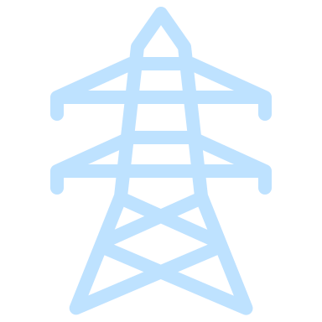

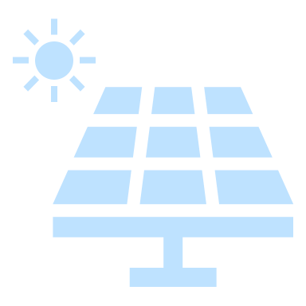




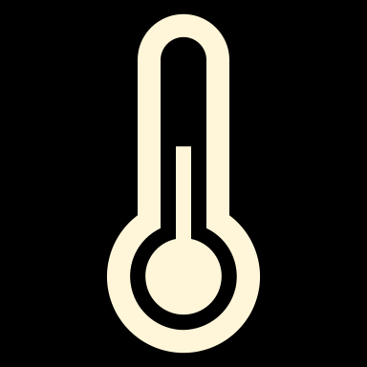




Power You Can Trust
Maintain Stable Power
Manage & Monitor the Power System
Mitigate Environment Impact
Shut Down Gracefully
8

Slide 9
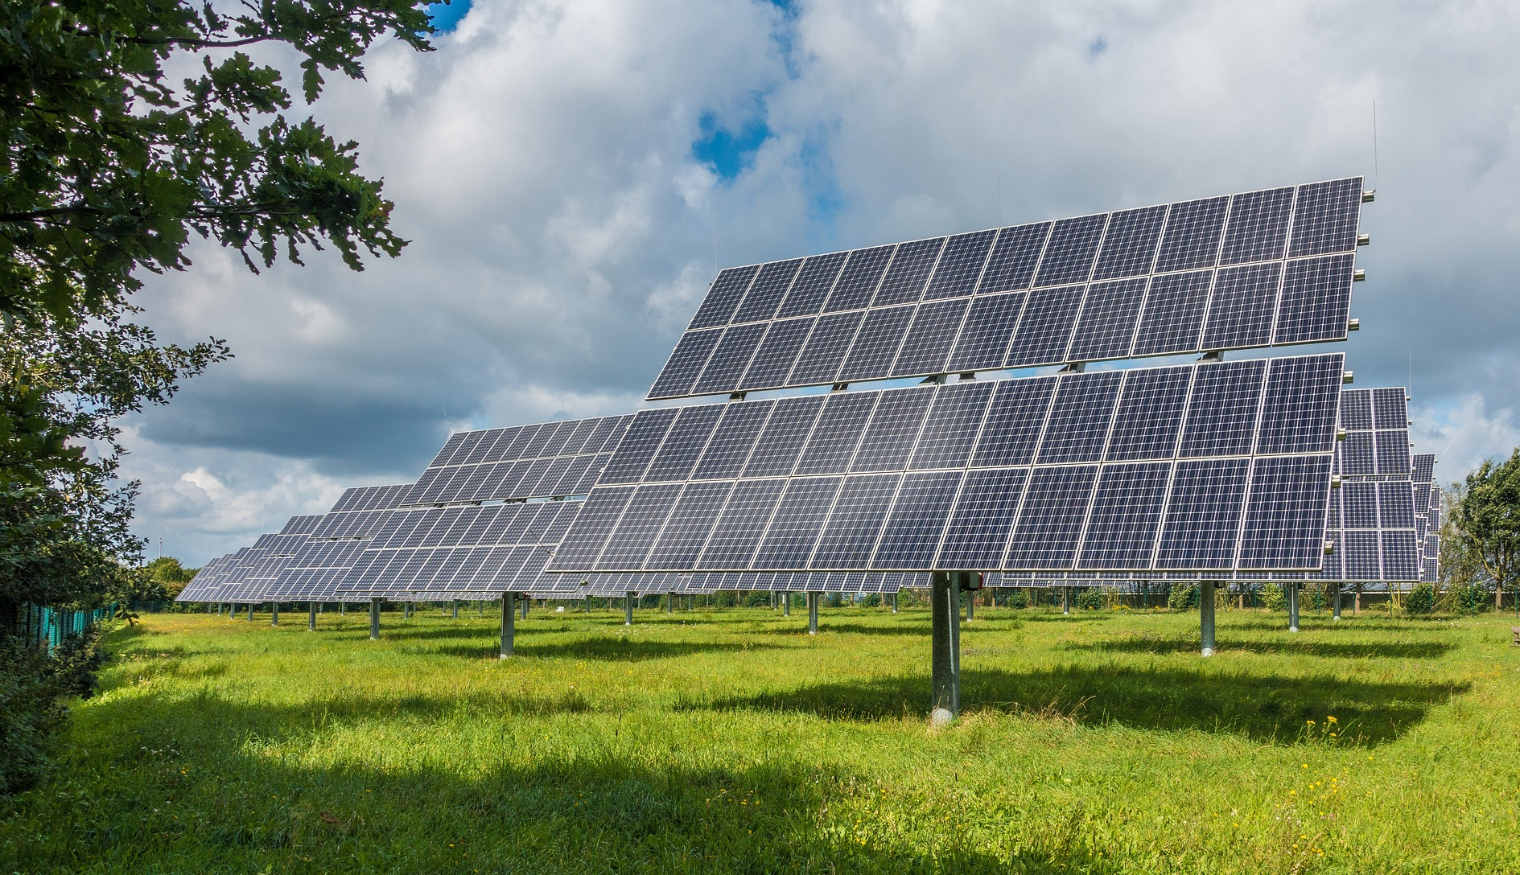
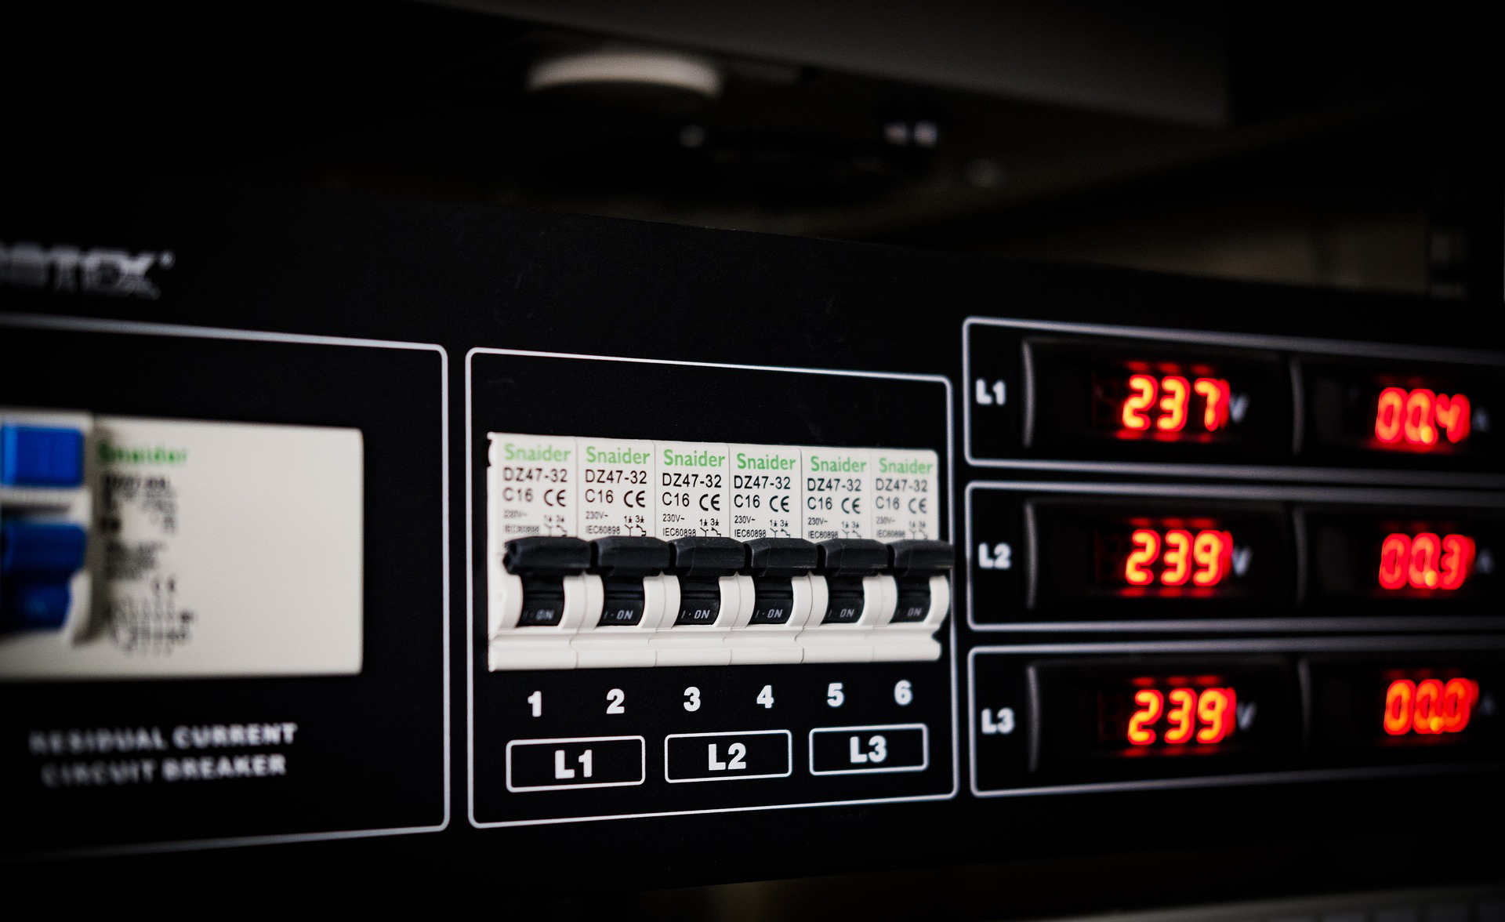


Power You Can Trust
Maintain Stable Power
Manage & Monitor the Power System
Mitigate Environment Impact
Shut Down Gracefully
9

