Slide 1
ADI Power
Al Wu
Managing Director, Multi-Market Power

Slide 2

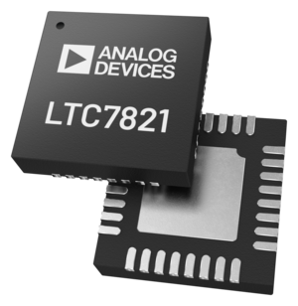
Automotive Power
Cameras
Compact, efficient power
Power management integrated circuits (PMICs)
Infotainment
Highly integrated
Display power
Audio power
Power distribution
Low Noise
Power protection circuits
Various point of load converters (POLs)
48V bus
Ultra efficient
High power density
LED Lighting
Precision current control
Matrix LED drivers
LTC7821
Power management

Slide 3
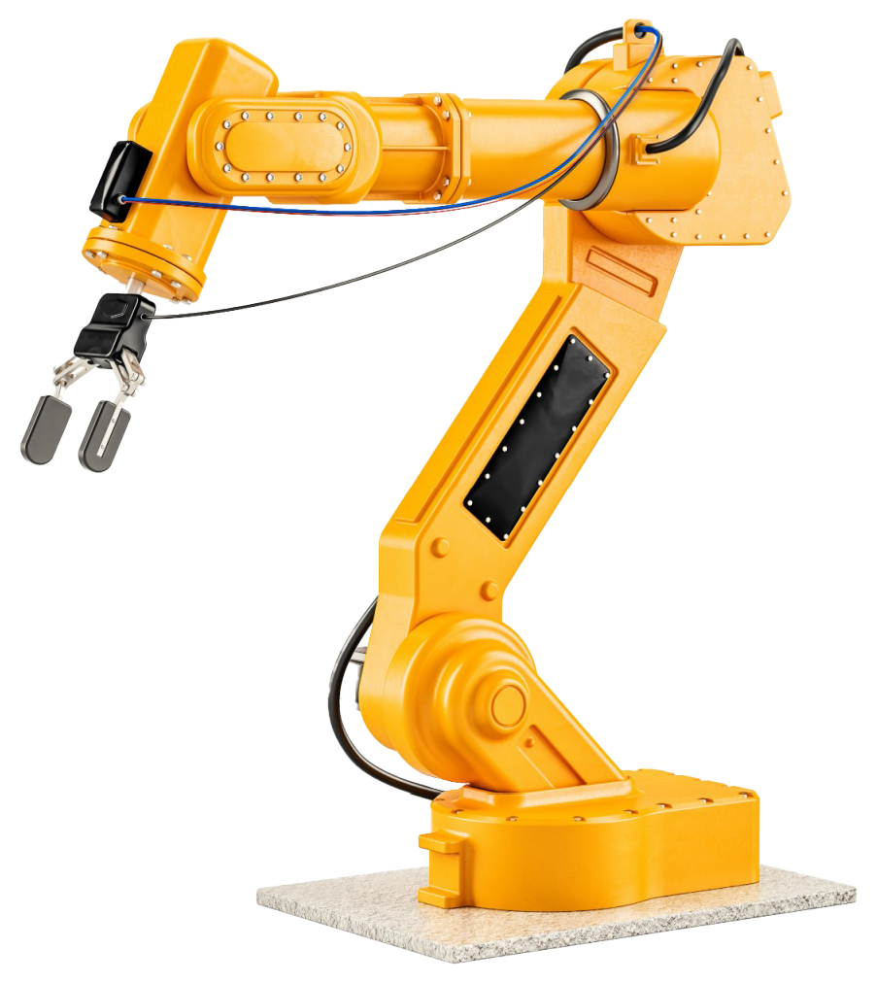
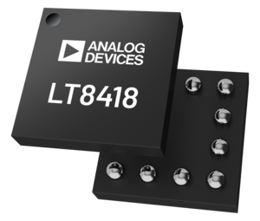
Industrial Automation
Power distribution
Fault tolerant designs
Isolated Power
Motor control
Accuracy
GaN drivers
Precision sensing
Low noise power
LT8418
GaN driver
Monitoring
Intelligence
Control
Miniaturization
High efficiency

Slide 4

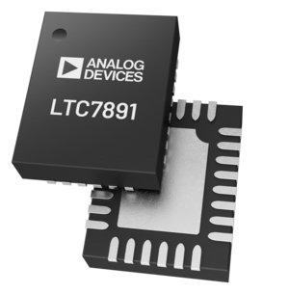
Data Center
System management
Precision measurement and control
Power protection
Hot-Swap
Distribution bus
Ultra efficient
Optical module
Ultra small power
Temperature Control
Power over Ethernet
Multi-channel
Transmit power via Ethernet
AI processor
Power density
1000s of Amps
LTC7891
Buck controller

Slide 5







ADI’s Global Footprint
USE EITHER THIS SLIDE OR THE BOXED VERSION DEPENDING ON THE CLIENT
ADI Internal Sites
Foundries
External Assembly and Test
Improves Resiliency and Flexibility
Limerick, Ireland
3× Capacity
TSMC 0.6, 0.5, 0.35 Resiliency
Chelmsford, MA, USA
Assembly & Test
OPERATIONS
EMPLOYEES
Camas, WA, USA
2× Capacity
Vanguard 0.6 Resiliency
Beaverton, OR, USA
2× Capacity
TSMC 180 nm Resiliency
Full Conversion to 8"
Chonburi, Thailand
Test
Cavite, Philippines
2 Test Sites
1 Assembly
Wilmington, MA, USA
MEMS and
Specialty Processes
Penang, Malaysia
Probe, Assembly, Final Test

