Slide 1
Computers

Slide 2
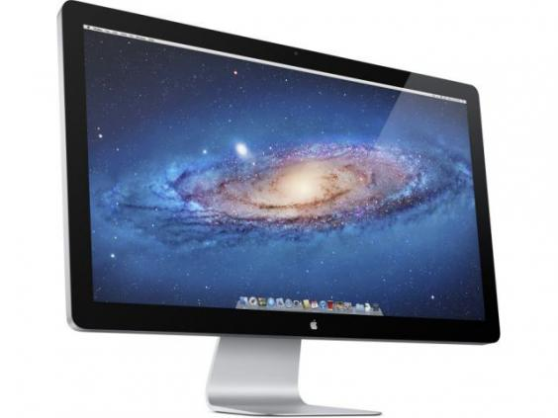
Screen (Monitor)
A monitor is a device used to display information
The monitor is a output device

Slide 3
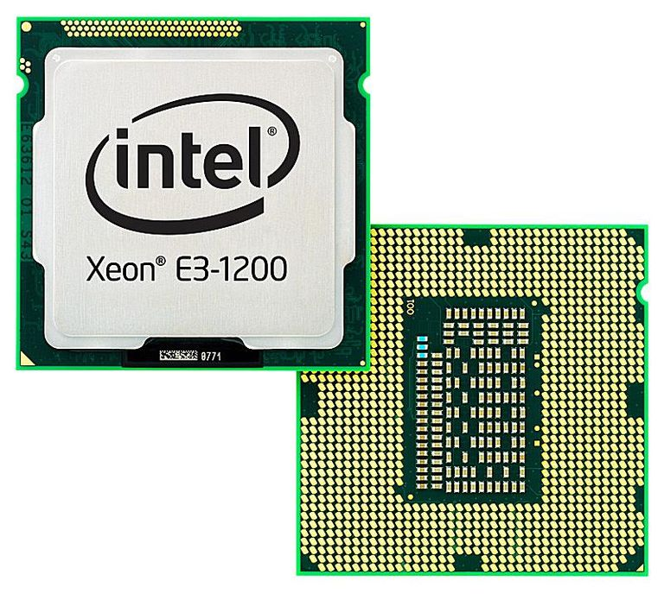
CPU
The CPU (Central Processing Unit) is the brains of the computer

Slide 4
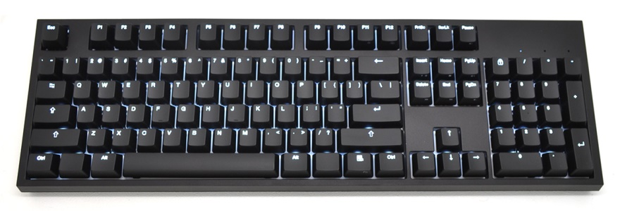
Keyboard
A keyboard is a panel of keys used to operate a computer
The keyboard is a input device

Slide 5
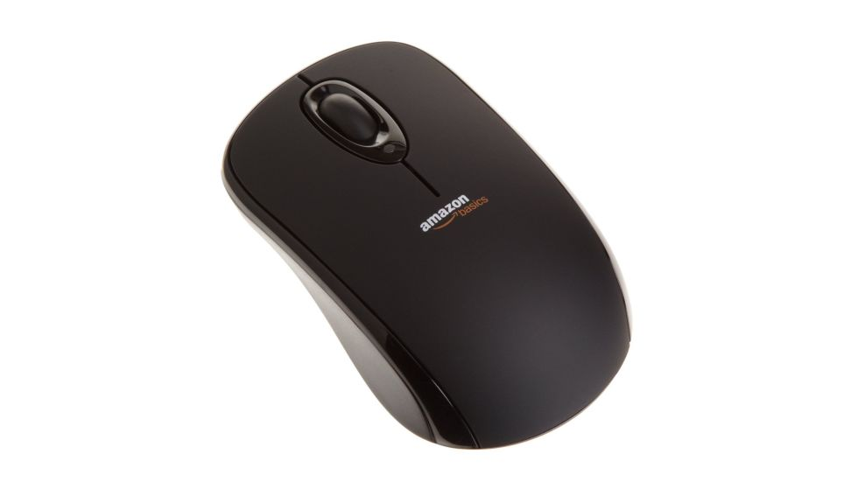
Mouse
A mouse is a pointing device used to move a cursor on a screen
The mouse is a input device

Slide 6
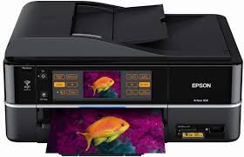
Printer
A printer is a machine used to write text or pictures onto paper
The printer is a output device

Slide 7
Thank You!
Any Questions?

