Slide 1
Starting and Shutting Down

Slide 2
Turning on Computer
Press the power button on the computer
(Optional) Turn on the monitor
Wait until the computer fully turns on
Login in

Slide 3
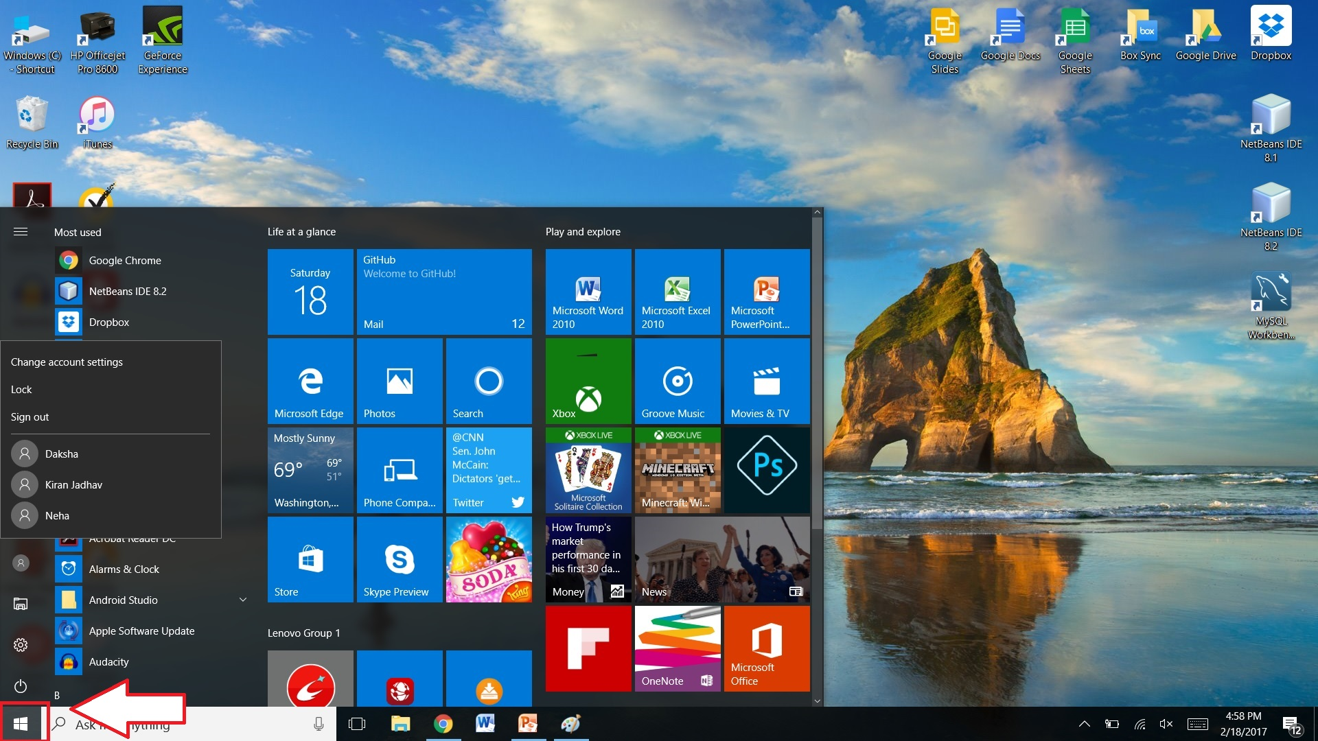

Slide 4
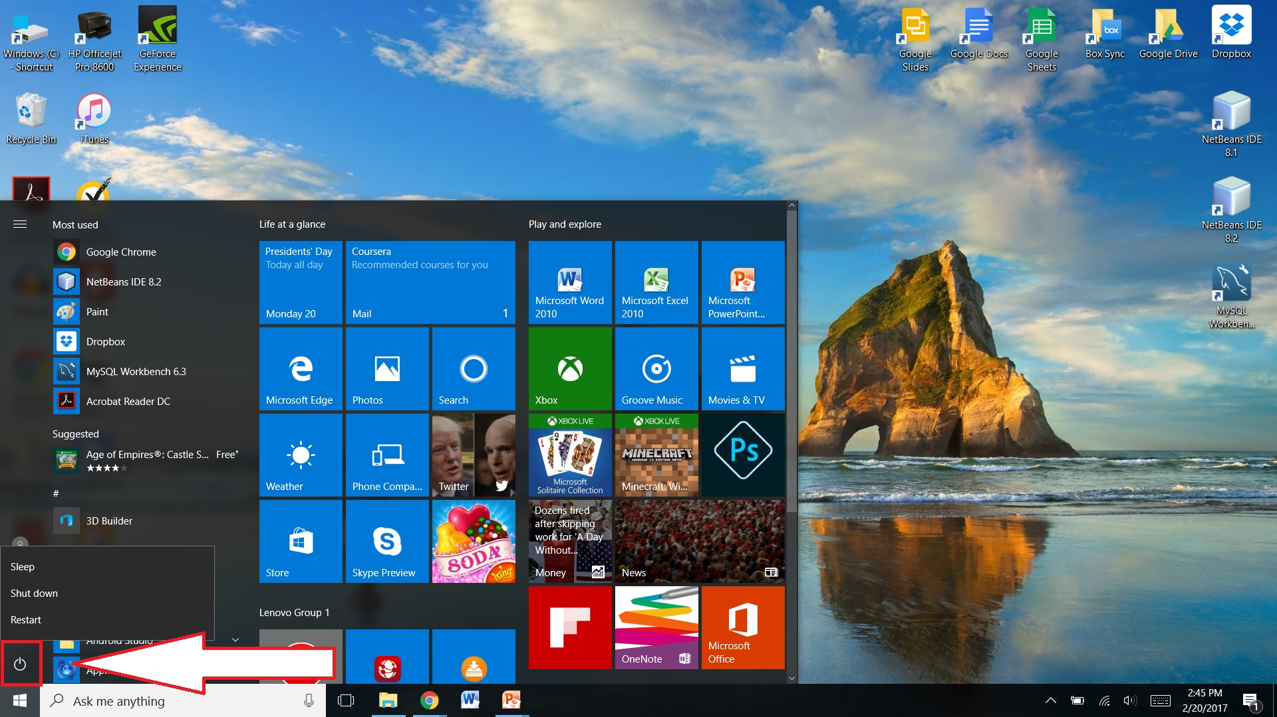

Slide 5
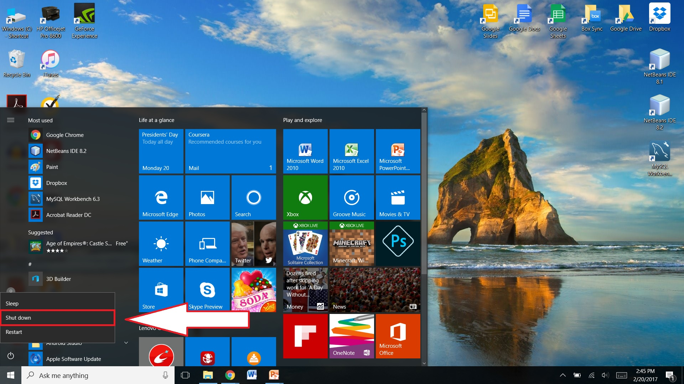

Slide 6
Turning off Computer
Press the Windows button
Press the power button
Choose the Shut Down option

Slide 7
Thank You!
Any Questions?

