Slide 1
Logging in and out

Slide 2
Login In
Select the user you wish to login into
Enter in the password for that user

Slide 3


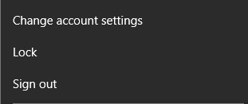
Logout
Click on the button in the bottom left of the taskbar
Click on the user icon (the fourth option from the bottom left)
Click sign out →

Slide 4
Thank You!
Any Questions?

Slide 5
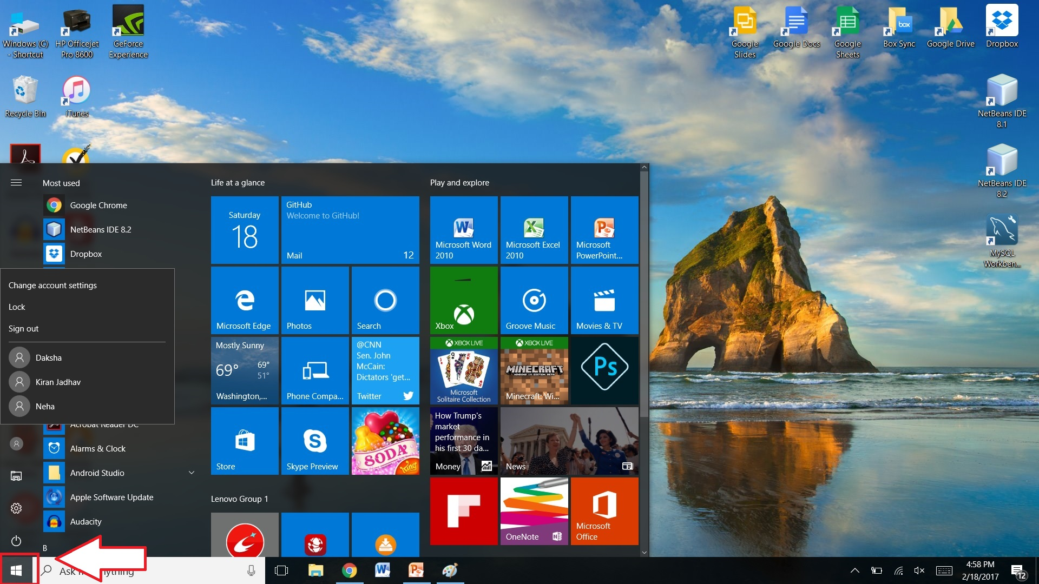

Slide 6
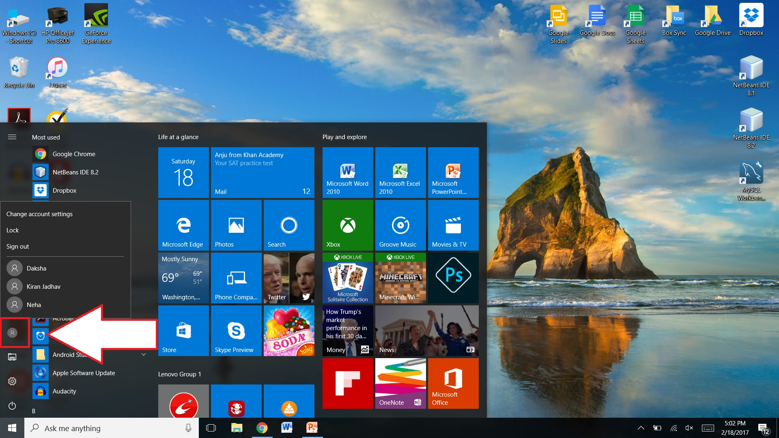

Slide 7
