Slide 1
Changing Password

Slide 2
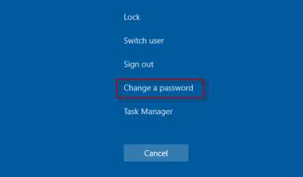
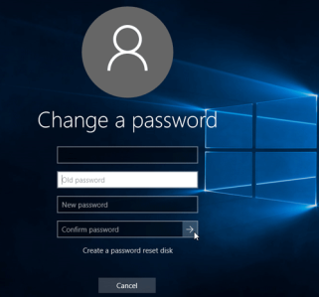
Changing a Password
Login into the computer
Press Ctrl + Alt + Delete
Select the fourth option from the top (“Change a password”)
Type your old password followed by a new password as indicated, and then type the new password again to confirm it
Press Enter

Slide 3
Thank You!
Any Questions?

Slide 4


Slide 5


