Slide 1
Access Programs

Slide 2
Programs
A computer program is a set/list of instructions used to tell the computer what to do

Slide 3
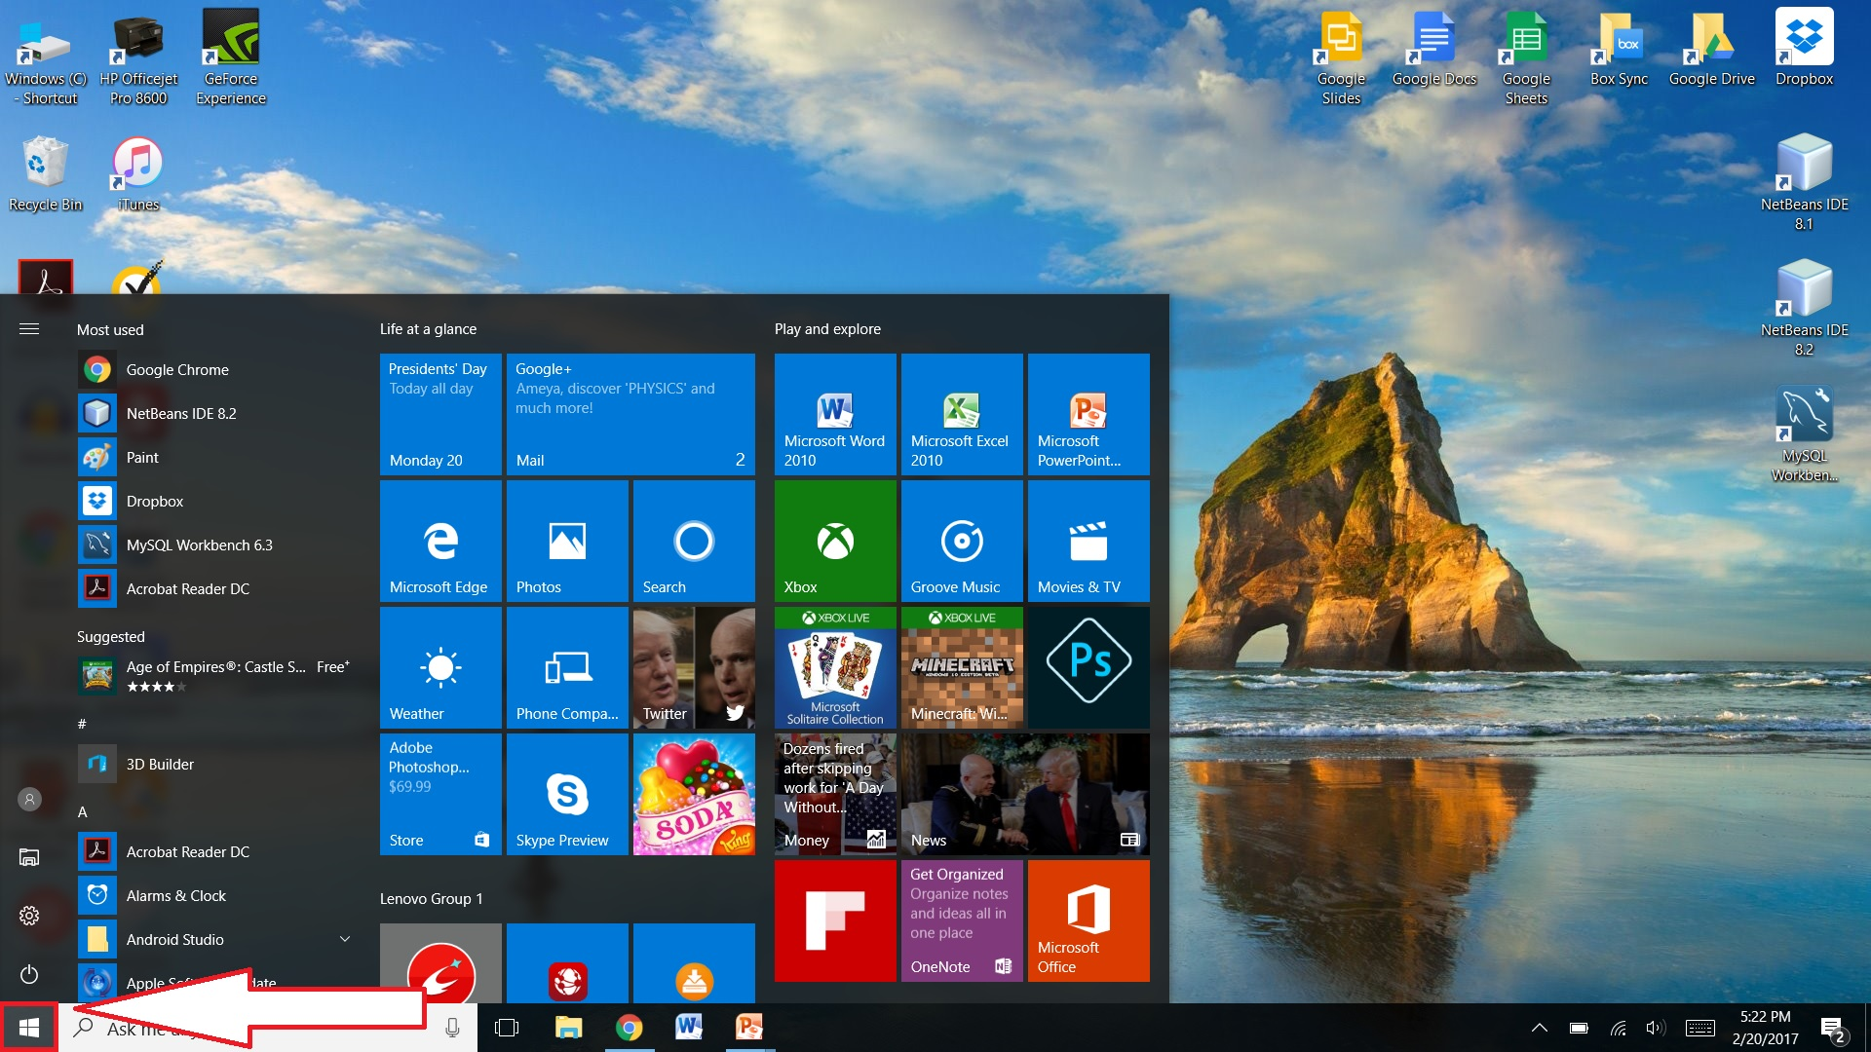

Slide 4
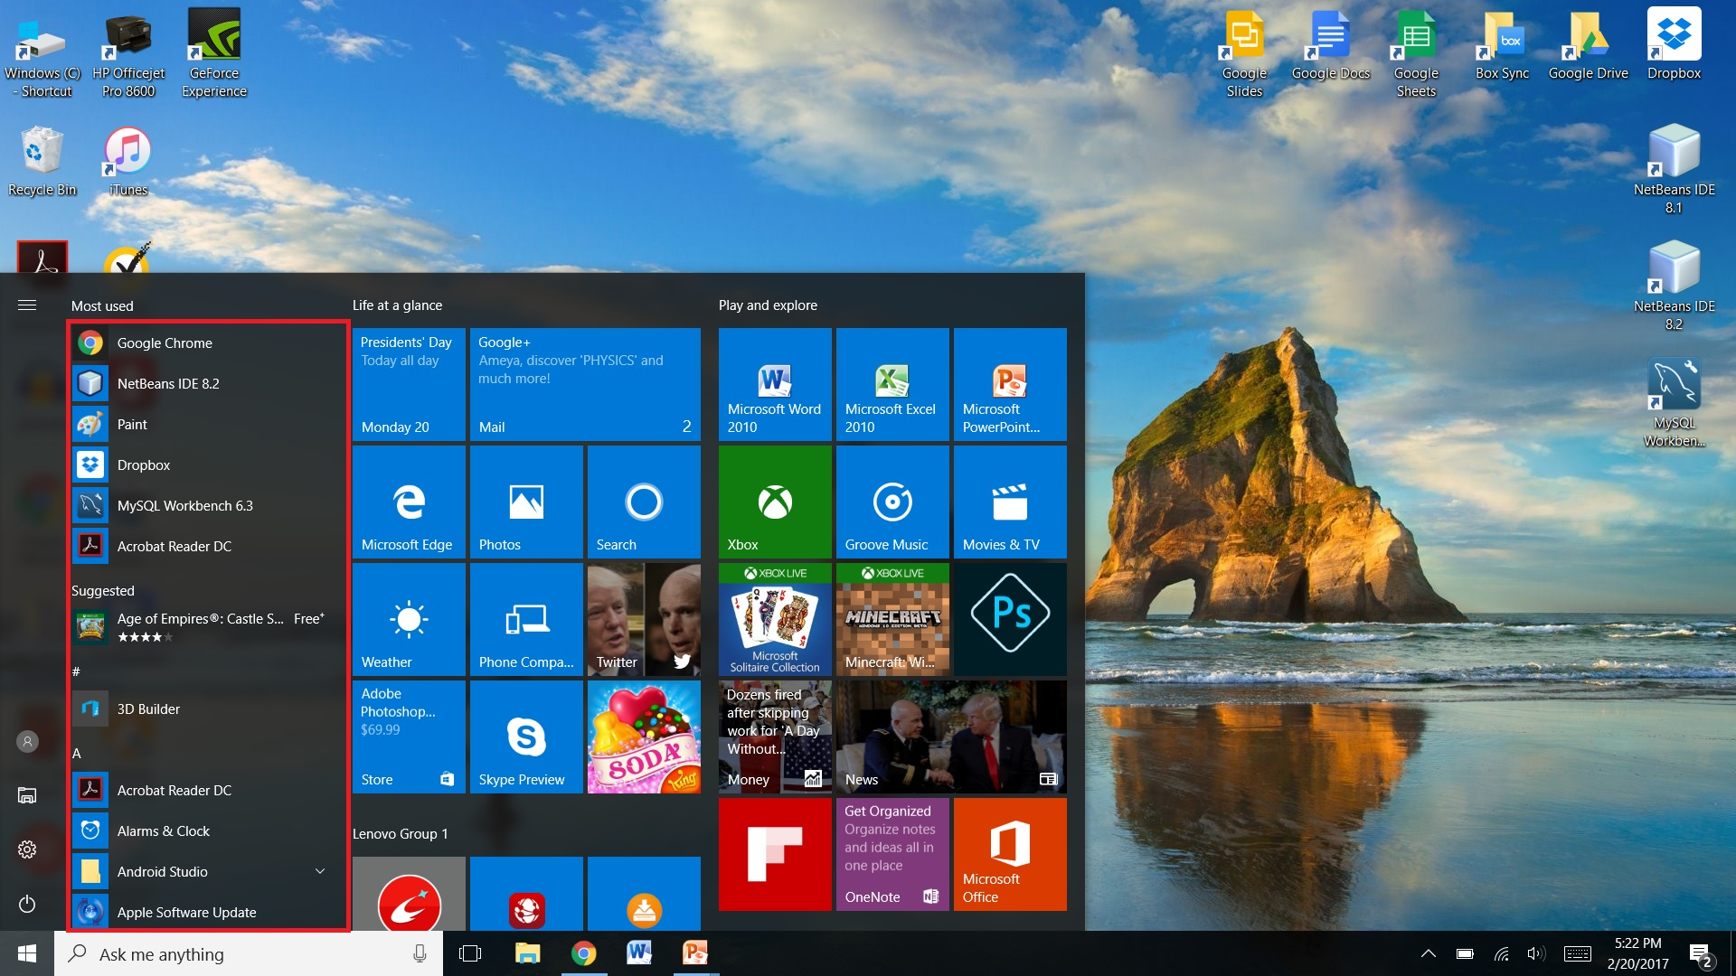

Slide 5
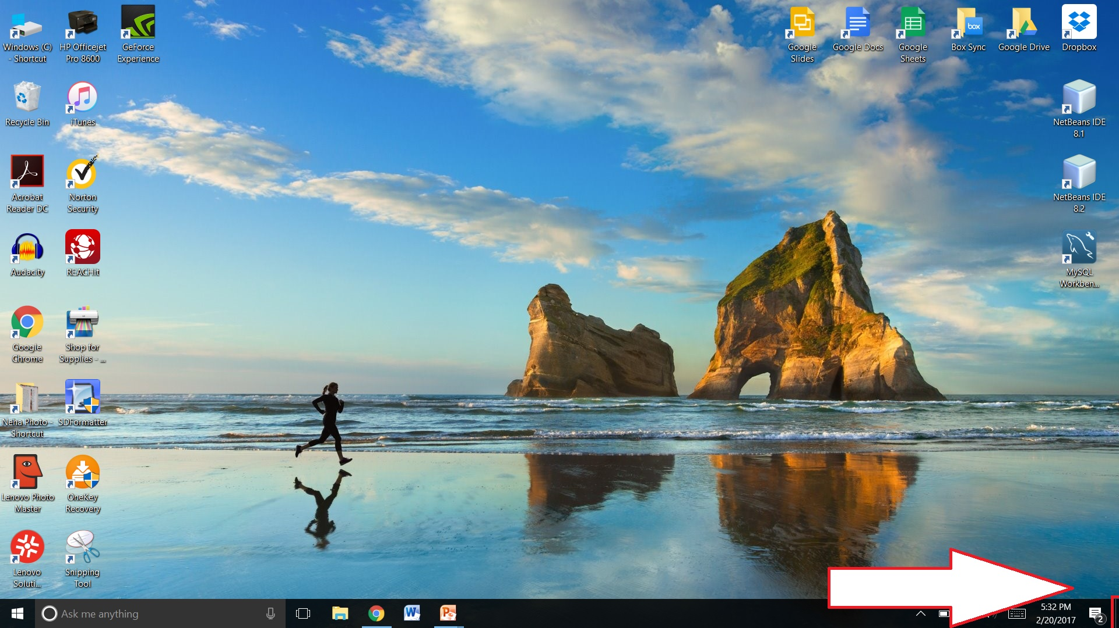

Slide 6
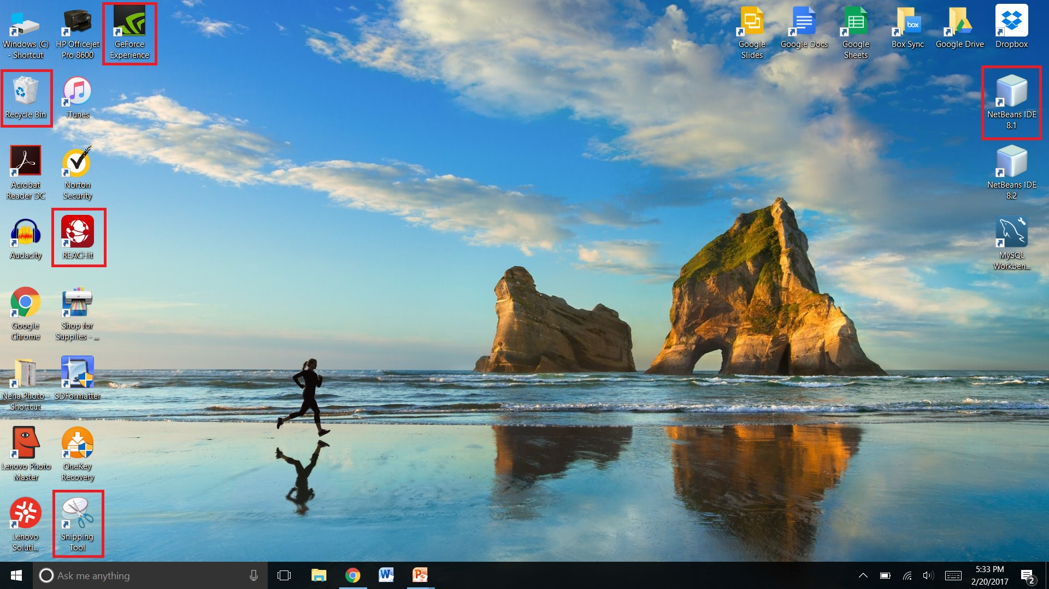

Slide 7
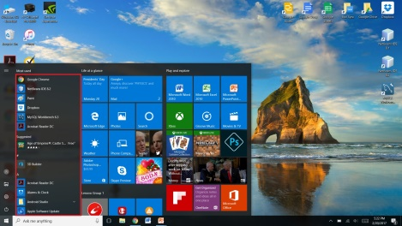
Accessing Programs
All Programs
Press the Windows start icon
All Programs will be in the popup window that appears

Slide 8
Accessing Programs
Desktop Shortcuts
Open your desktop by press the last button on your taskbar
You can now double-click any shortcut icon to open the program

Slide 9
Thank You!
Any Questions?

