Slide 1
Printing

Slide 2


Printing to Printer from Word
Option 1
Press File
Press Print
Press Print

Slide 3
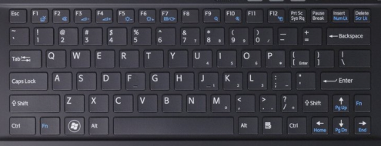
Printing to Printer from Word
Option 2
Press Ctrl + P (print command)
Press Print or Enter

Slide 4

Printing to PDF from Word
Option 1
Press File
Press Print
Select Microsoft Print to PDF from drop down menu
Press Print

Slide 5
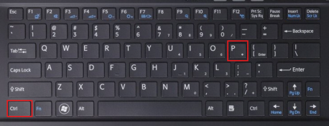
Printing to PDF from Word
Option 2
Press Ctrl + P (print command)
Select Microsoft Print to PDF from drop down menu
Press Print or Enter

Slide 6
Thank You!
Any Questions?

Slide 7
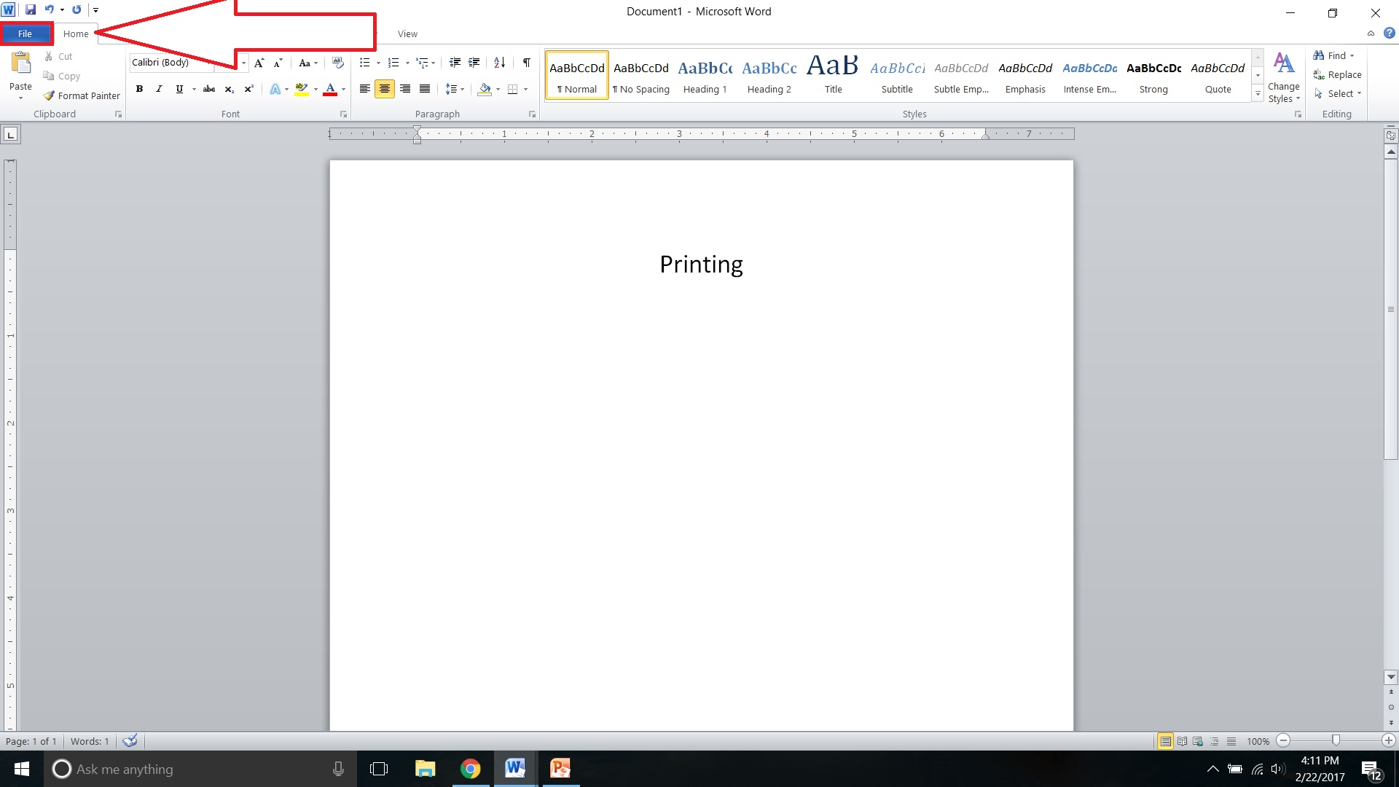

Slide 9
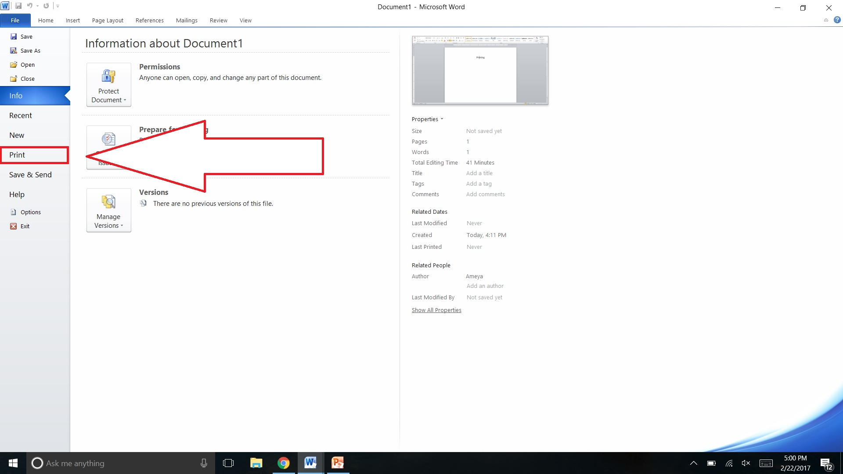

Slide 11
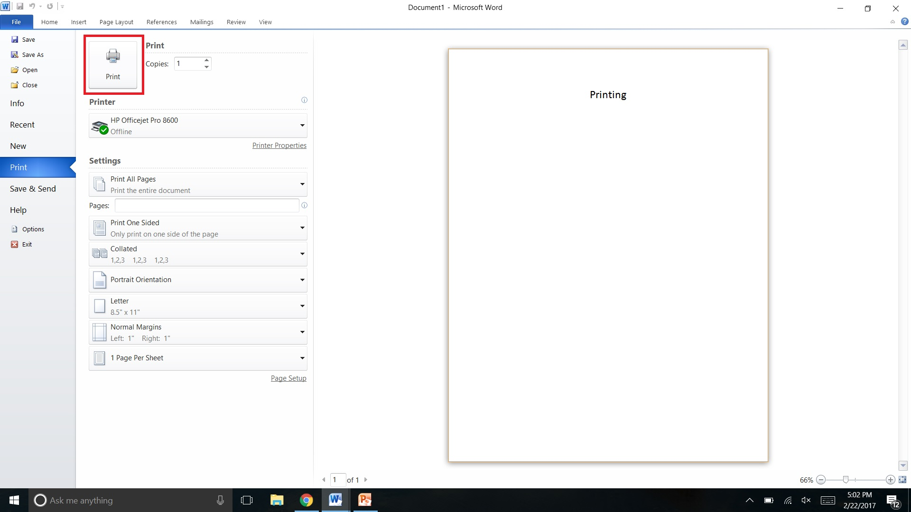

Slide 15
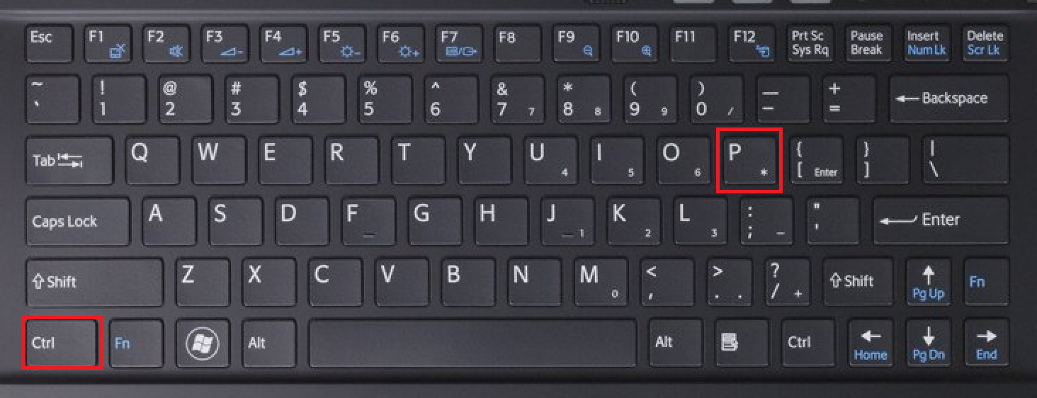

Slide 17
