Slide 1
How to open a Browser

Slide 2
Browser?
A web browser is most commonly used to access information on the web/internet.

Slide 3
Types of Browsers
There are eight popular web browsers:
Google Chrome
Firefox
Opera (Android)
Internet Explorer
Safari (IOS)
Microsoft Edge

Slide 4
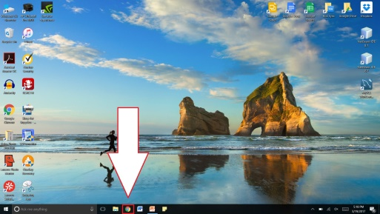
Opening a Browser
Option 1
Press the icon on the taskbar

Slide 5
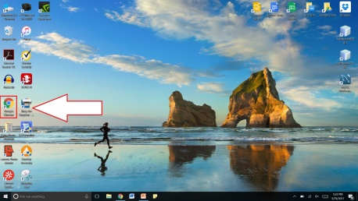
Opening a Browser
Option 2
Double-Click the desktop shortcut

Slide 6
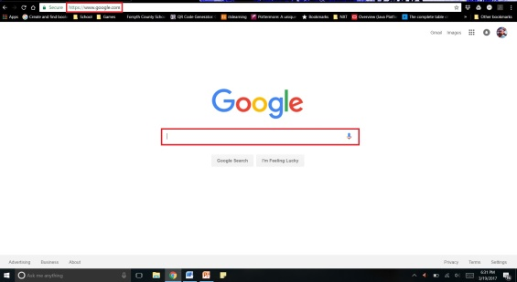
Google Search
Go to www.google.com
Search your keywords in the search bar

Slide 7
Thank You!
Any Questions?

Slide 10
