Slide 1
Ford Campaign
Maddi Haney
Notes:
emily

Slide 2
IPO- Insight, Problem and Objectives:
01
02
03
Insight
Problem
Objectives
“Individuals 35 years old and younger are most interested to buy vehicles and products from Ford” (Ford Media Center).
“You need to ensure that the car is reliable and safe, especially if you're driving with kids at the back. Family-oriented vehicles are known to be sturdy, so you won't need to worry about problematic issues while on the road” (Mazda.com).
Convince the younger generation that Ford can be safe, affordable, and family-friendly.
Notes:
emily

Slide 3
SWOT
01
Strengths
02
Weaknesses
03
Opportunities
04
Threats
Notes:
Emily

Slide 4
SWOT ANALYSIS:
Global recognition for sustainability
National Brand Representation
Loyal Customer Base
S:
Many product recalls
Dependance on U.S. and European Markets
Declining U.S. Market
W:
Notes:
emily

Slide 5
SWOT ANALYSIS:
Strong media presence
Outgoing and relevant ambassadors
O:
Increased competition
Constant technological advancements
T:
Notes:
Maddi

Slide 6
Who is our Target Audience?
Age: 25-34
Families
Income: $100,000 - $149,999
Our target audience are up and coming adults looking forward to change in the future. This is a family care that is ready for anything!
Notes:
Maddi

Slide 7

Audience Identification
Upper/Middle Class Young Family Mix
Millennial Parents and Professionals
Safety- Oriented
Fresh Starts and Familial Expansion
Notes:
Madelyn

Slide 8
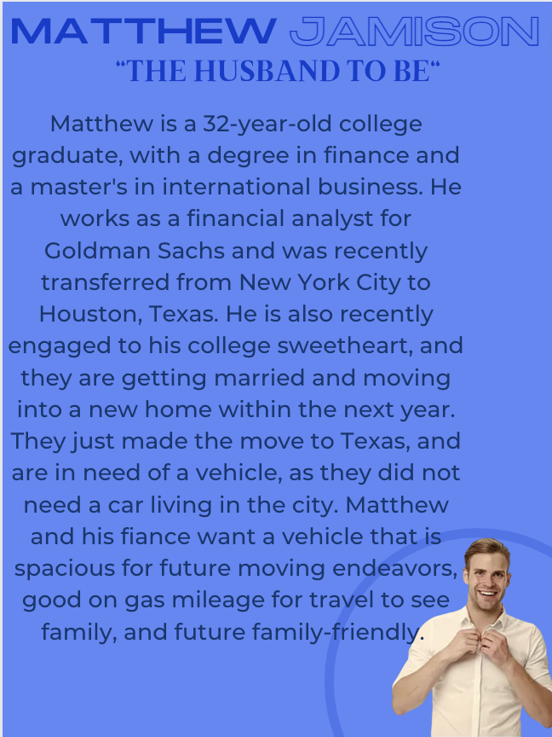
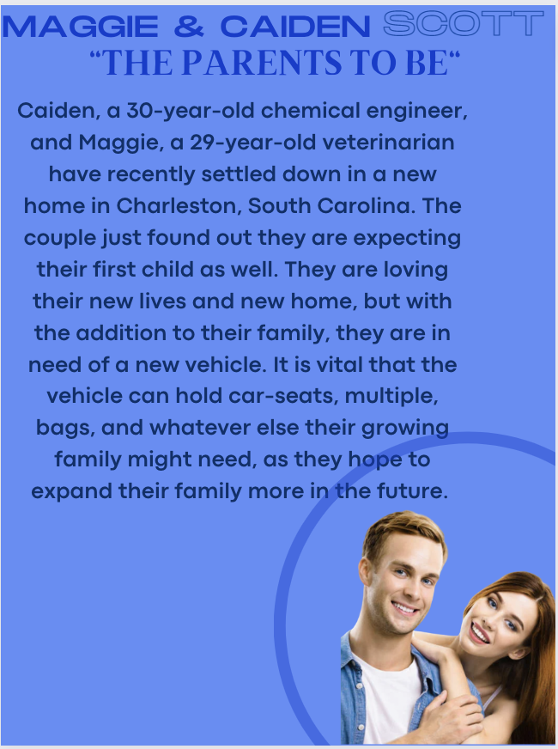
Target Persona
Notes:
Madelyn

Slide 9
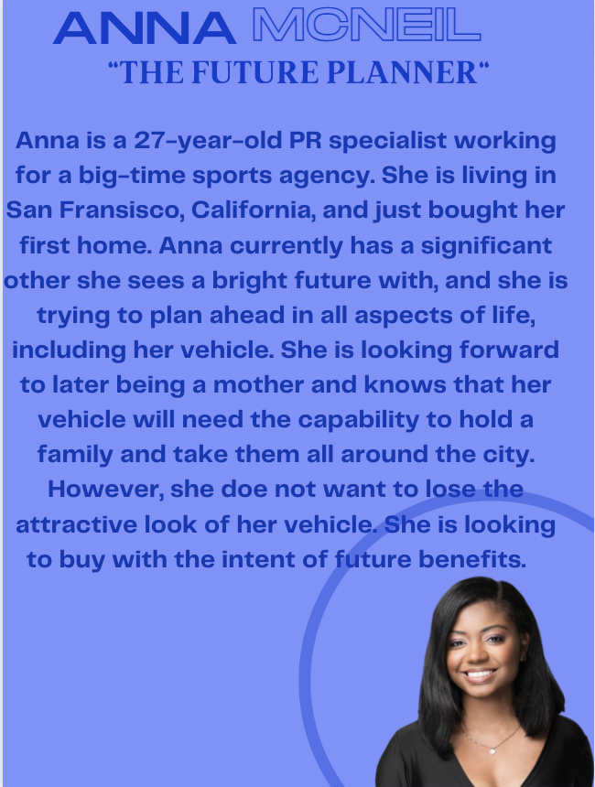
Target Persona
Notes:
Madelyn

Slide 10

Message Strategy
Ford cares about each consumer and their needs no matter what they may be and have the perfect fit for everyone.
Ford products allow our consumers to pursue their dreams and move freely throughout life.
Ford products are here to remove obstacles that limit an individual’s progress so that they can live their lives to the fullest.
Notes:
Maddi

Slide 11
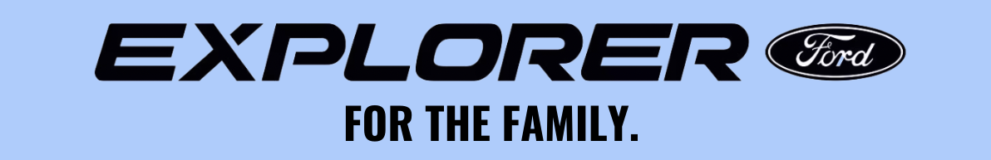
Big Idea & Tagline
Ford Explorer values safety, and the Explorer “safest car for the whole family”.
Ford is comforting, with a strong familial sense, as in having/driving the Ford Explorer is like receiving a warm hug.
Tagline “Expand your family, expand your vehicle. Do it all with Ford.”
Notes:
Madelyn

Slide 12
Promotional Strategies
01
02
03
Strategic Brand Partnerships
Familial Social Media Advertisements
Direct email newsletter
Notes:
Maddi

Slide 13
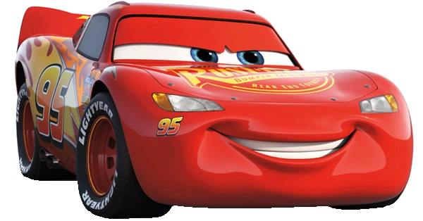
Strategic Partnership with Disney (Cars Franchise)
Creation of Ford Explorer character in the new Cars TV Series on Disney Plus.
Excites children as well as parents.
Provides examples of cars features in a fun, innovative way.
Creates relevance in media.
Notes:
Madelyn

Slide 14
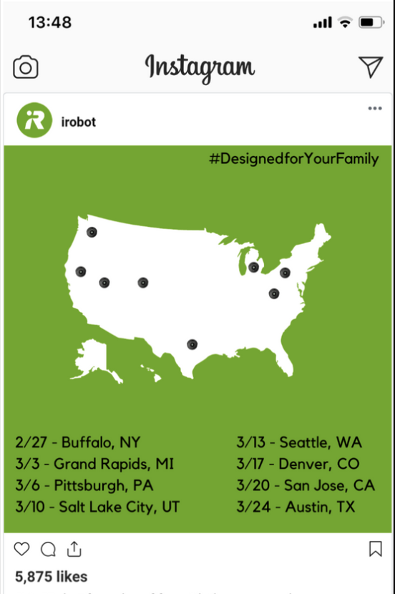
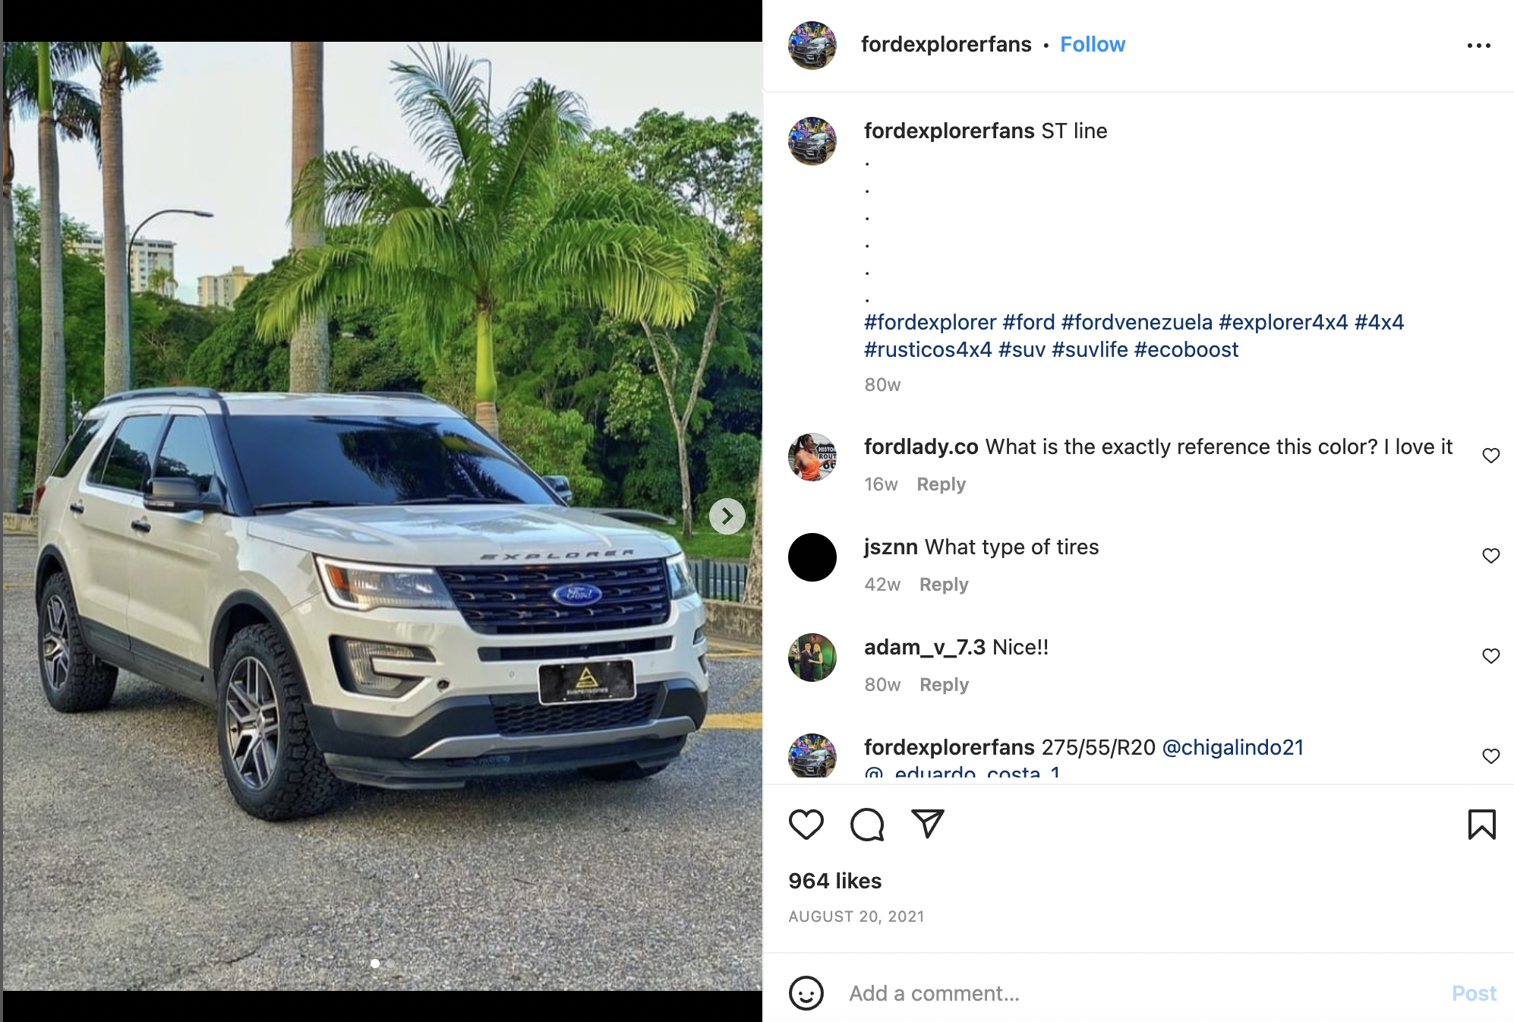
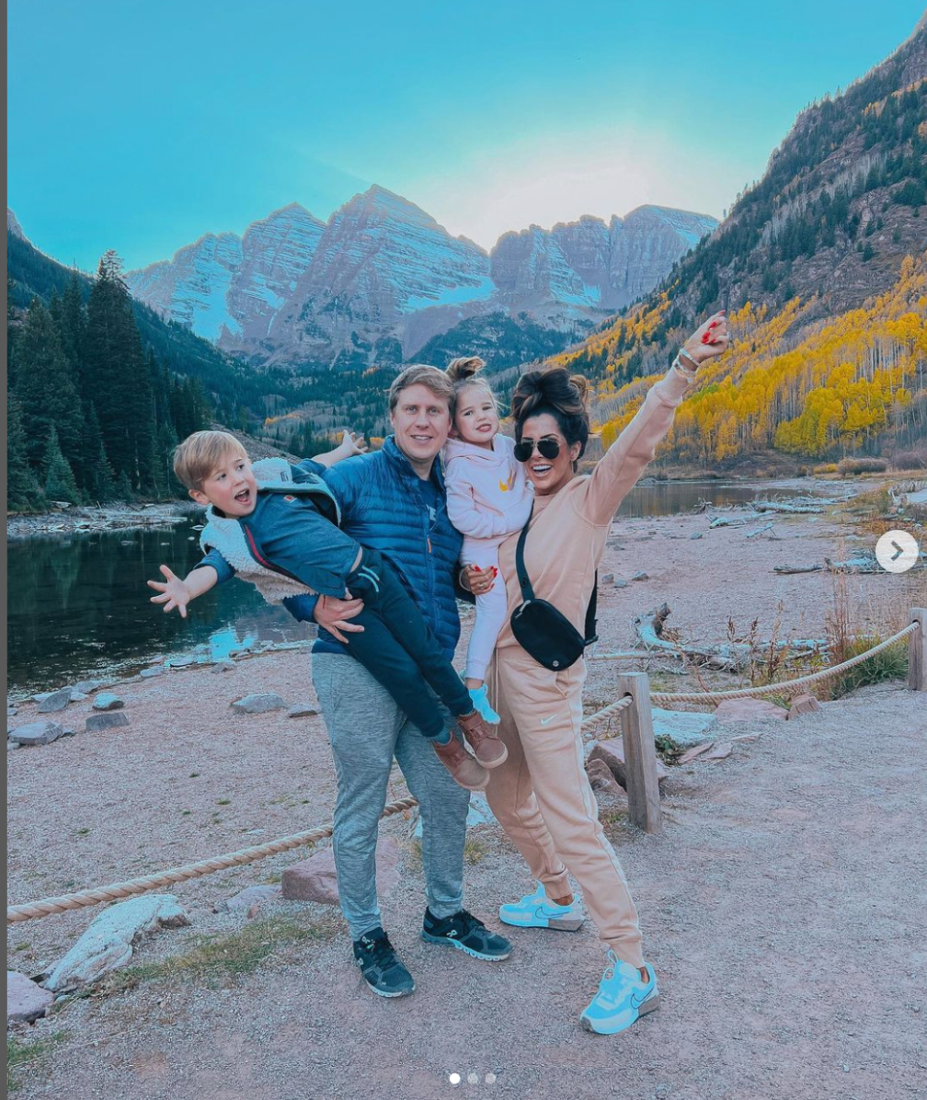
Social Media Advertisements with Family Friendly Influencers
Partnering with family based or family friendly influencers to showcase car.
Instagram (and other media) posts showing family adventures brought to them by Ford Explorer.
+
Notes:
Madelyn

Slide 15
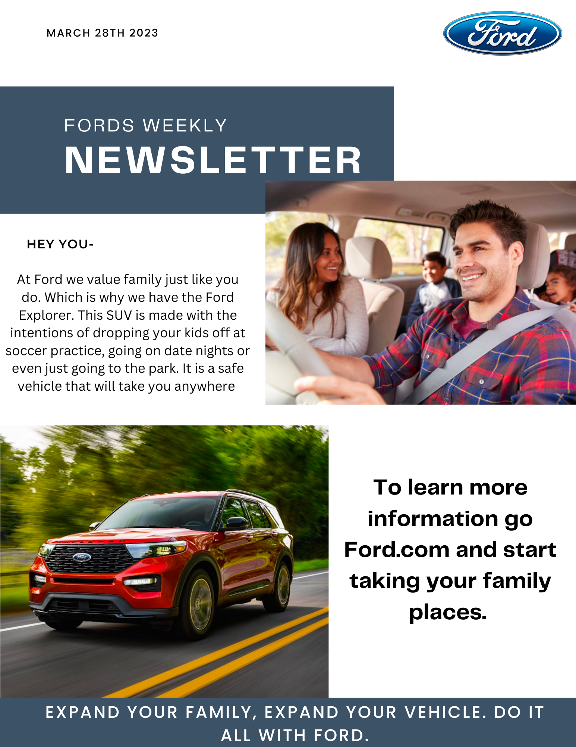
#3 promotion strategy
Being on the go means taking your phone with you, which is why we created an email newsletter to be sent direct to the targets email one or twice a week. This is a good way to get their attention with either sales coming up or just to get cars name out there.
Notes:
emily

Slide 16
Budget
Cars promotional events:
Email Newsletter:
Social media ads:
To add a new character into a show and have the character be on screen for a minute would cost $6,000 per minute
$450 per month- to promote posts on Instagram
$0 per month if using free website to create the newsletter.
Notes:
brooke

Slide 17
Timeline
 | March 2023 | April 2023 | May 2023
 |  | Start promoting Cars campaign | Beginning of the Disney cars campaign
 | Social media ads promoted everywhere | Social media ads for the car and cars campaign | Promo cars and summer sales
 | Newsletter biweekly | Newsletter biweekly | Newsletter biweekly
Notes:
brooke

Slide 18

Key Consumer Benefit
Ford is a family company that makes family-friendly cars for you and your children. Affordable care you look for in an SUV or sedan.
Notes:
Maddi

Slide 19
Creative Strategy Statement
To best showcase our product and these communications, most creative executions will be on digital platforms.
The world we live in today is primarily digital, as most of our lives have shifted to social media and other forms of online communication (Medium, 2020).
Our target audience, individuals 44 and younger that are members of Generation X and Millennials, are very much a part of this digital world and look to technology and digital media to receive information.
Looking for quick ways to receive and see all of the information about a product
Our efforts will primarily be in the form of Facebook and Instagram posts, highlighting the best of the Ford Explorer.
Notes:
brooke

Slide 20

Monitoring
Keep track of social media posts going up two or three times a week to see the activity and or involvement
Sending out a newsletter with useful information about deals and promotions we are doing
Using fun social media tactics to get audience excited about the Cars premier
  Having a cars premier ie showing the episode of the show where the explorer is being featured.
Notes:
emily

Slide 21
Evaluation
Assess the newsletters and how many people actually view them
  Are they impacting our sales?
Look at incentives we can add to our social media posts and how they would increase our sales
Evaluate how these promotions go along with the SMART objectives.
Notes:
brooke

Slide 22
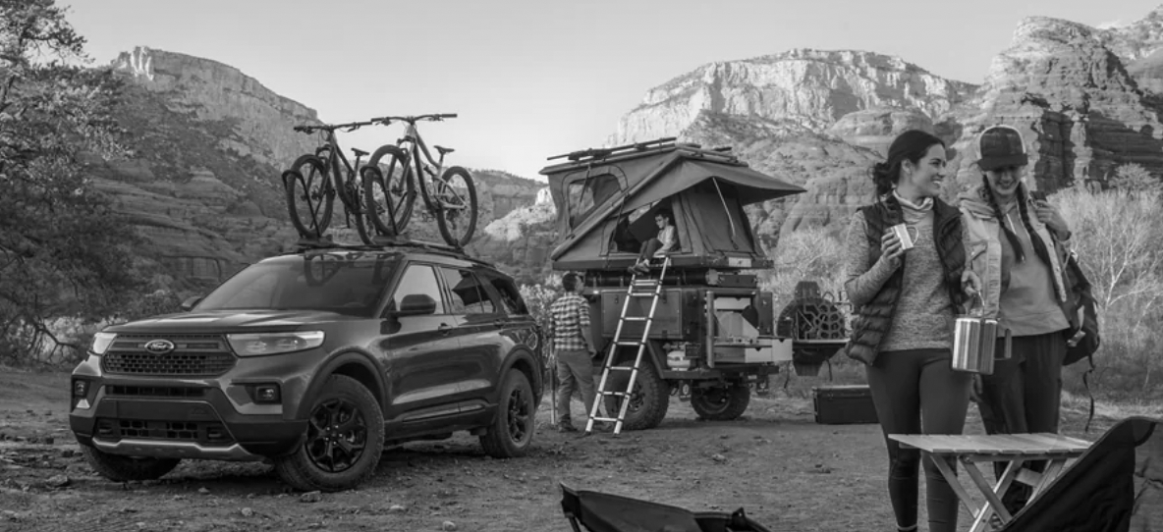
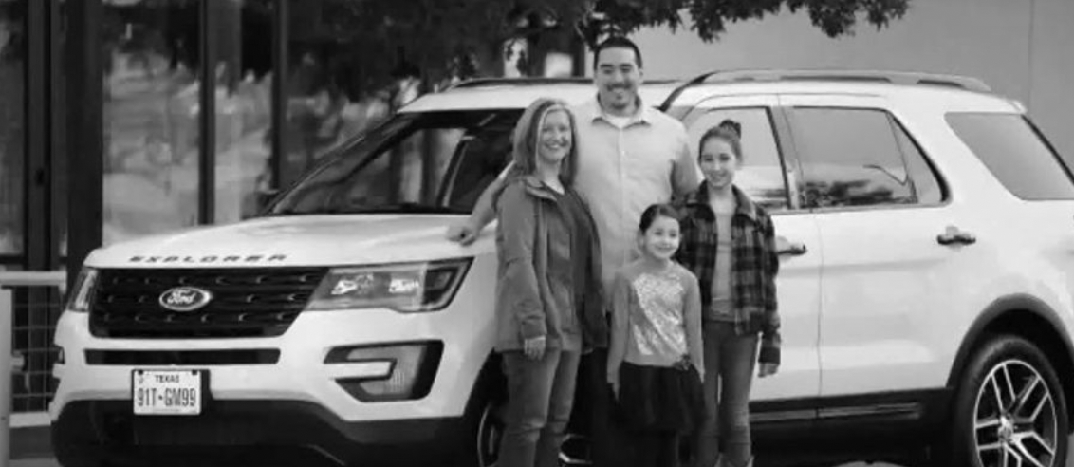
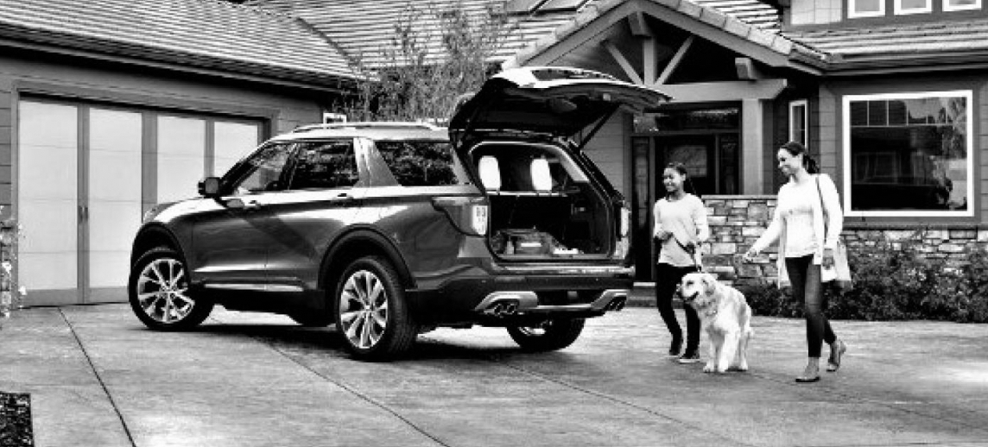
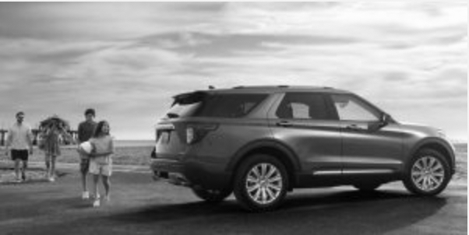
Notes:
Maddi

Slide 23
Questions?
Notes:
emily

Slide 24
Thank you!
Notes:
emily

