Slide 1
{portraits}

Slide 2
What is a Portrait?
A painting, drawing, photograph, or engraving of a person, especially one depicting only the face or head and shoulders.
Casual or Professional?
Landscape or Portrait?

Slide 3
Landscape or Portrait
Orientation is important
  Portrait Format
    Is always taller than it is wide.
  Landscape Format
    Is always wider than it is tall.

Slide 4
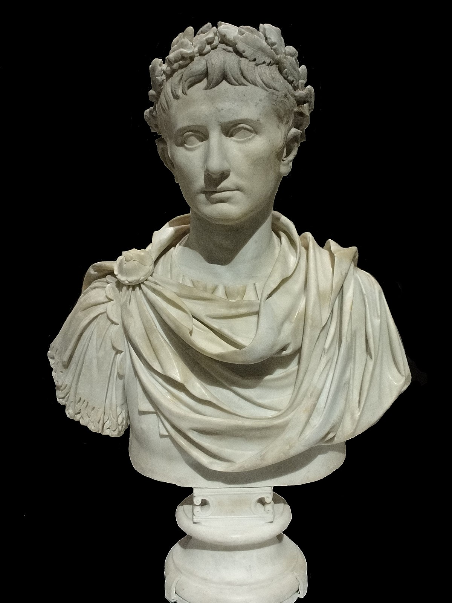
Portraits
Most portraits are three quarter or quarter shots
  Image is of the persons upper torso or shoulders and head
  Can also be called a “bust” (think of old Greek Stone head sculptures
The “Original” Portrait

Slide 5
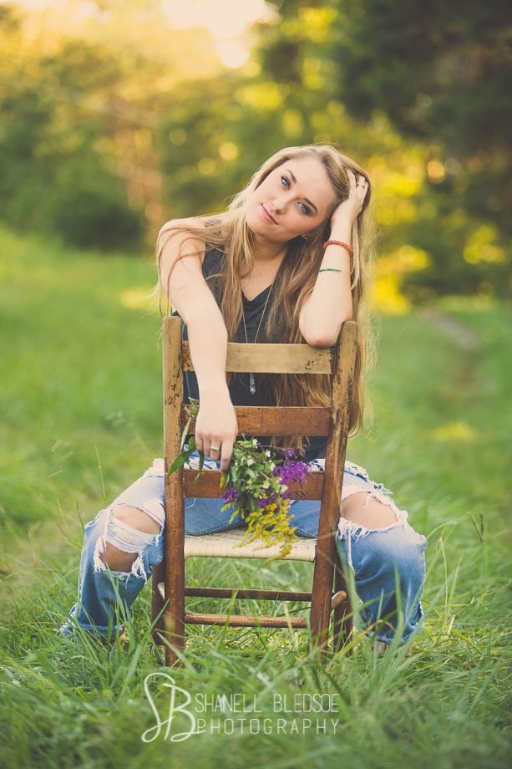

Casual Portrait
Any informal picture of a person or individual with a more relaxed feel.

Slide 6
Causal Portraits
Not ALL portrait rules apply to a casual portrait
Images can be “professional” looking, but not follow the basic rules
Using Depth of Field (DOF) is important to separate from the background
Usually naturally lighted

Slide 7
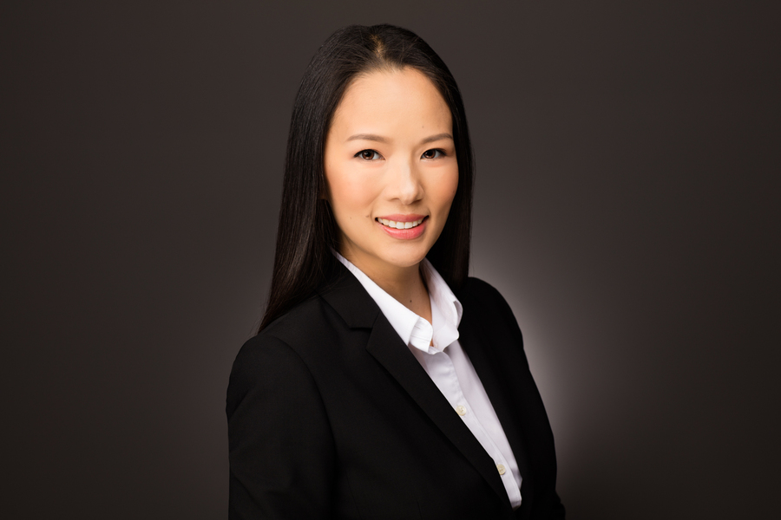
Professional Portrait
Picture taken with corrected light, simulated or otherwise background, setup required.

Slide 8
Professional Portraits
Professional portraits do not require the individual to be dressed “professionally”
Lighting correction helps the photographer control the image captured
Often uses flat lighting pattern to show the face with no shadows
Up to the professional’s discretion

Slide 9
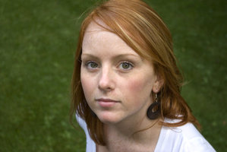
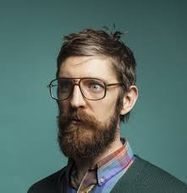
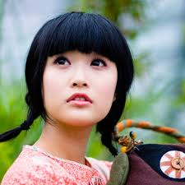
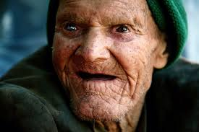
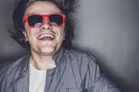
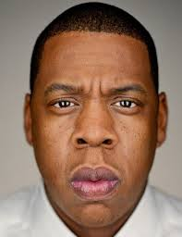
Casual or Professional

Slide 10
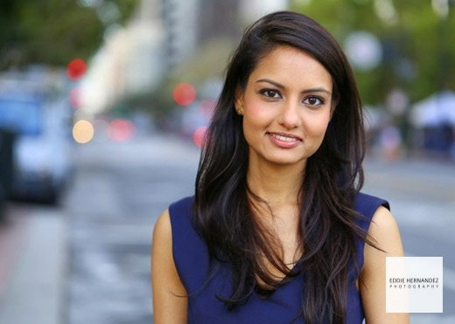
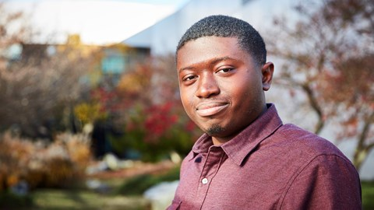
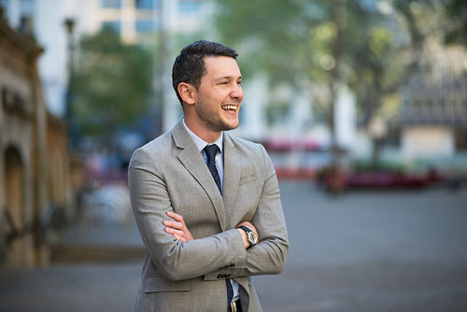
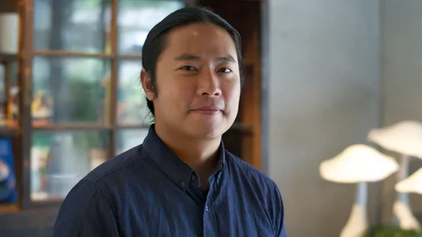
Casual

Slide 11
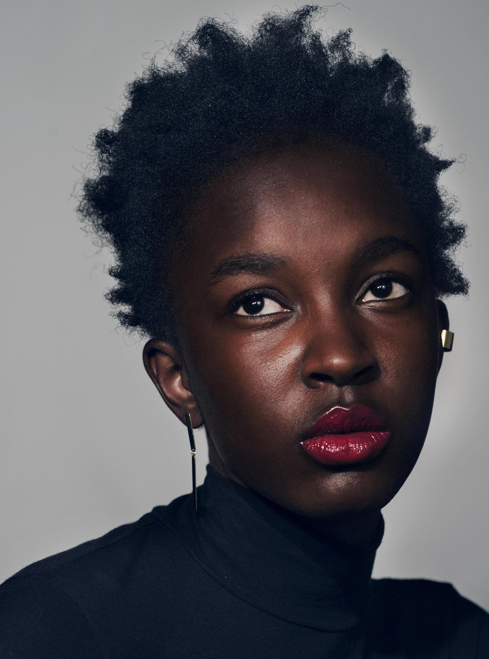
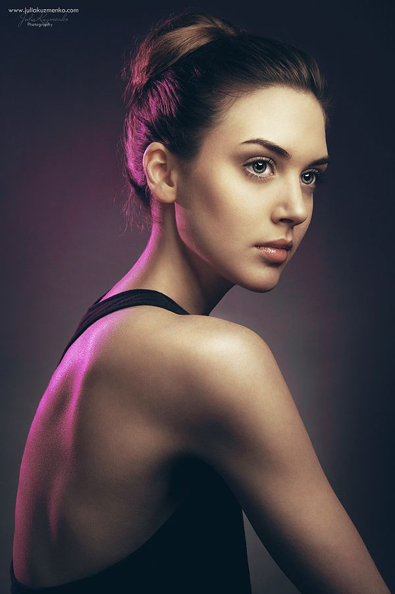
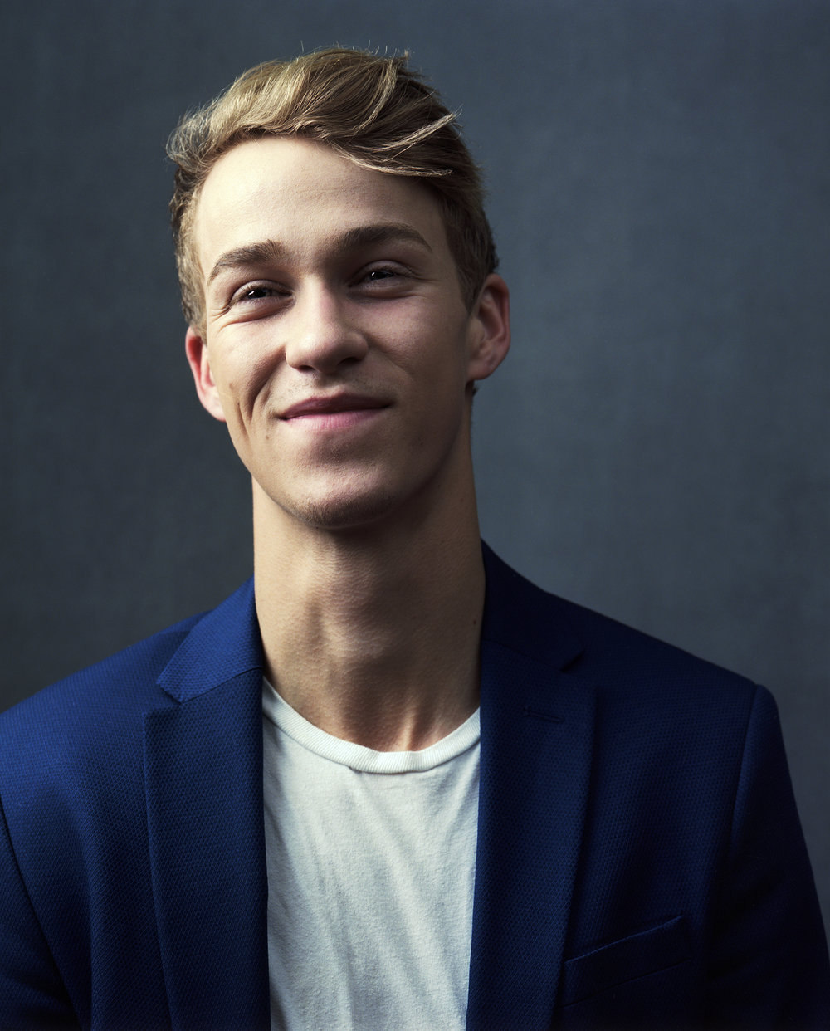

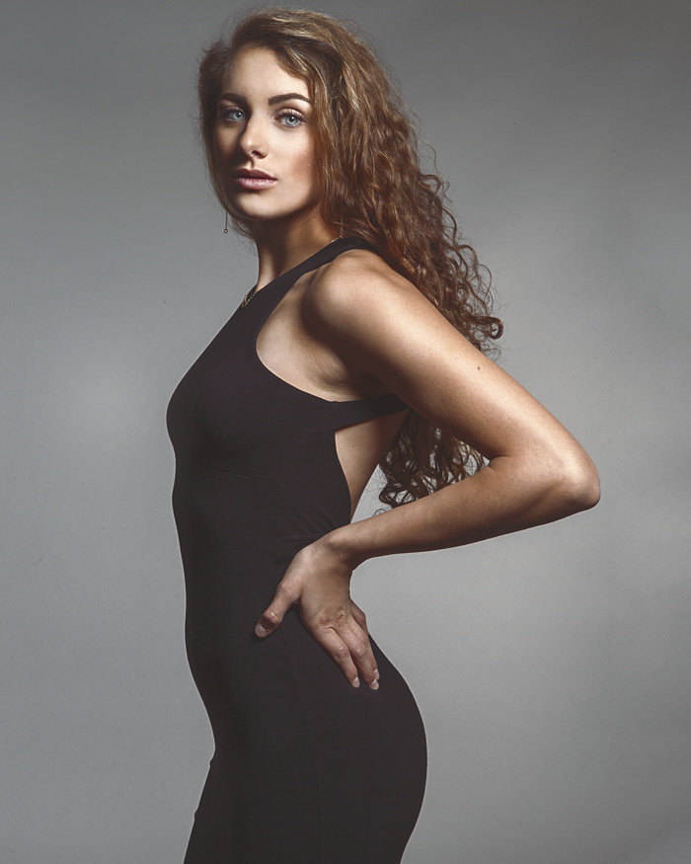
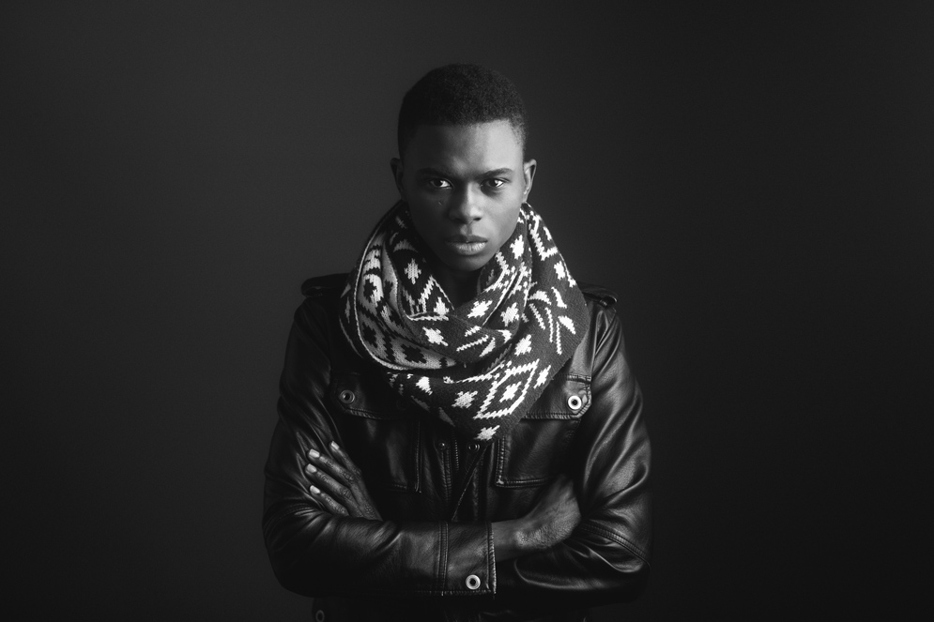
Professional

Slide 12
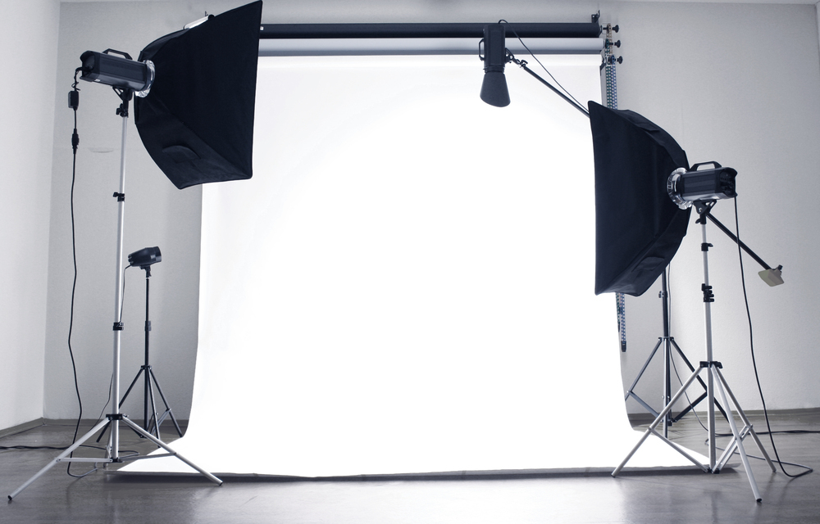
Studio Lighting
3 Point Lighting
  Key Light
  Fill Light
  Hair Light

Slide 13
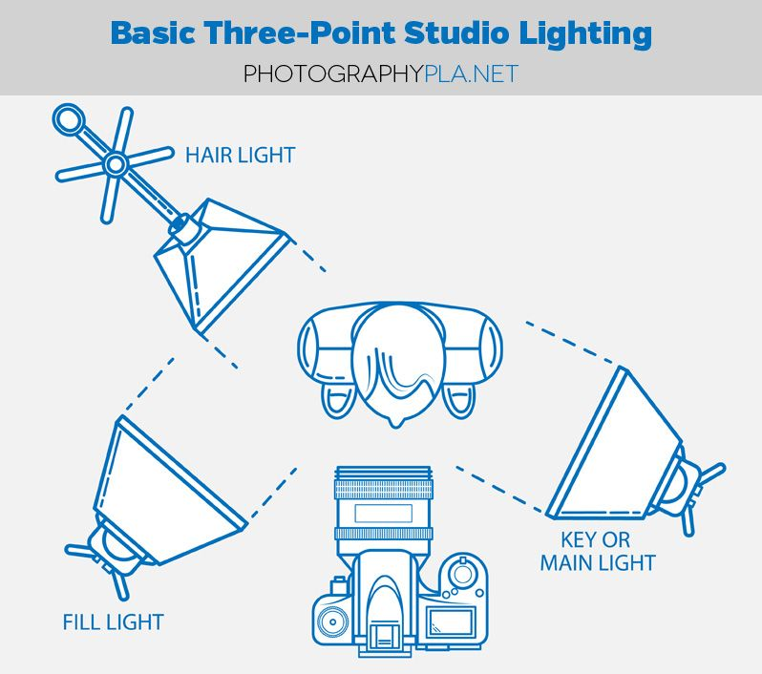
Studio Lighting

Slide 14
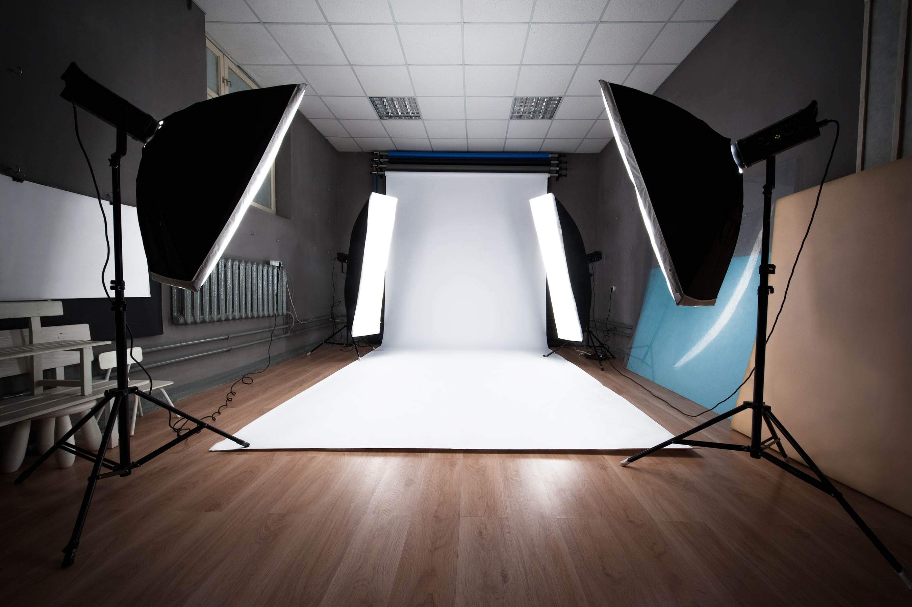
Studio Lighting
5 Point Lighting
  Key Light
  Fill Light
  Hair light
    (not Pictured)
  Kicker Light x2

Slide 15
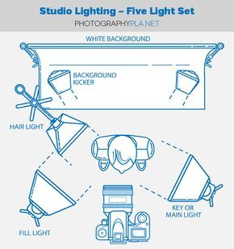
Studio Lighting

Slide 16
Be BOLD not lame
Pictures should evoke a sense of feeling and create a story.
Take LOTS of photos before you decide which one is the best. SHOOT SHOOT SHOOT
Above all be CREATIVE!

