Slide 1
Angle and Framing
Digital Photography

Slide 2
Angle Photography
Two regular angles for photography
  Landscape/ Horizontal
  Portrait/ Vertical
High/ Low
  High Angle is also called a Birds Eye view
    Makes objects/ subjects look smaller
  Low Angle is also called a Worms Eye view
    Makes objects/ subject look bigger
Unusual Angles
  Any angle not perfectly Vertical or Horizontal

Slide 3
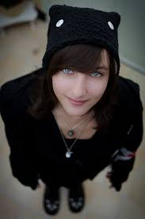
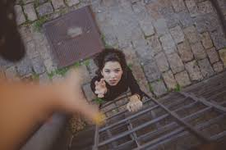
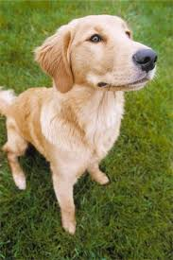
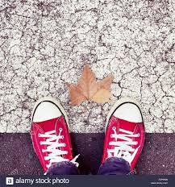
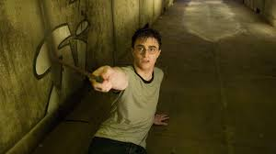
Get “High” Angle Photos

Slide 4
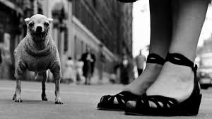
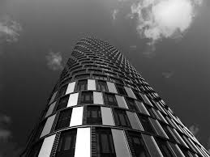
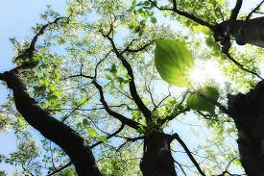
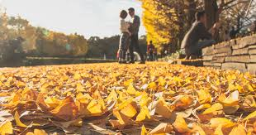
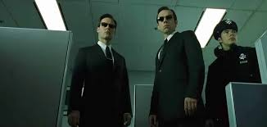
Get “Low” Angle Photos

Slide 5
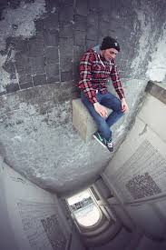
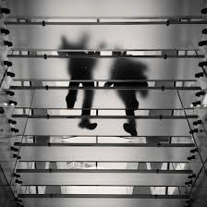
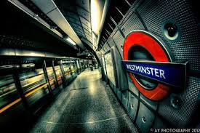
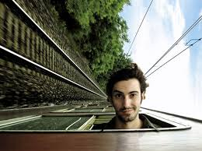
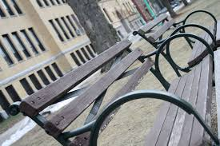
Unusual/ Abstract Angle Photos

Slide 6
Framing Photography
Using objects from the world around you to “Frame” the center of interest or focal point of your photograph
Natural Framing
  Using objects in the natural world to frame in your photograph
    Trees, Rocks, Wood, etc.
Artificial Framing
  Using objects that are man made to frame in your photograph
    Windows, Doors, Buildings, etc.

Slide 7
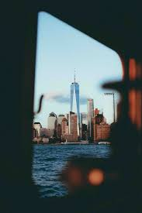
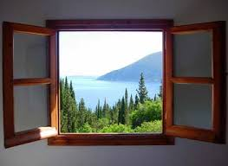
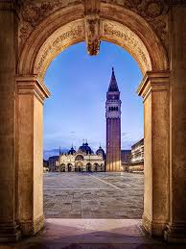
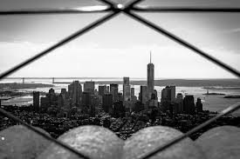
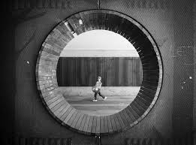
Framing (Artificial Objects)

Slide 8
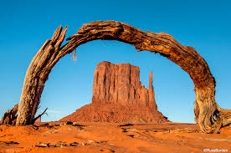
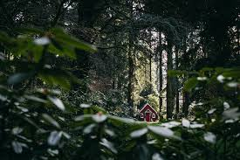
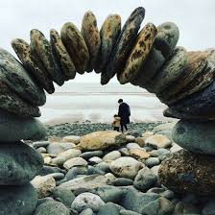
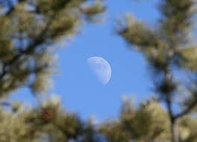
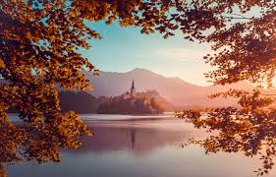
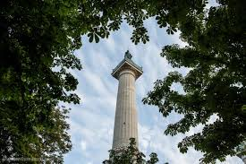
Framing (Natural Objects)

Slide 9
Composition Principles
Both types of photographs are a part of the 23 Principles of Photography we have discussed in class
The full list of Composition Principles can be found on our class website
https://nottinghamtech.com/digital
Great photos always include more than one Principle!

