Slide 1
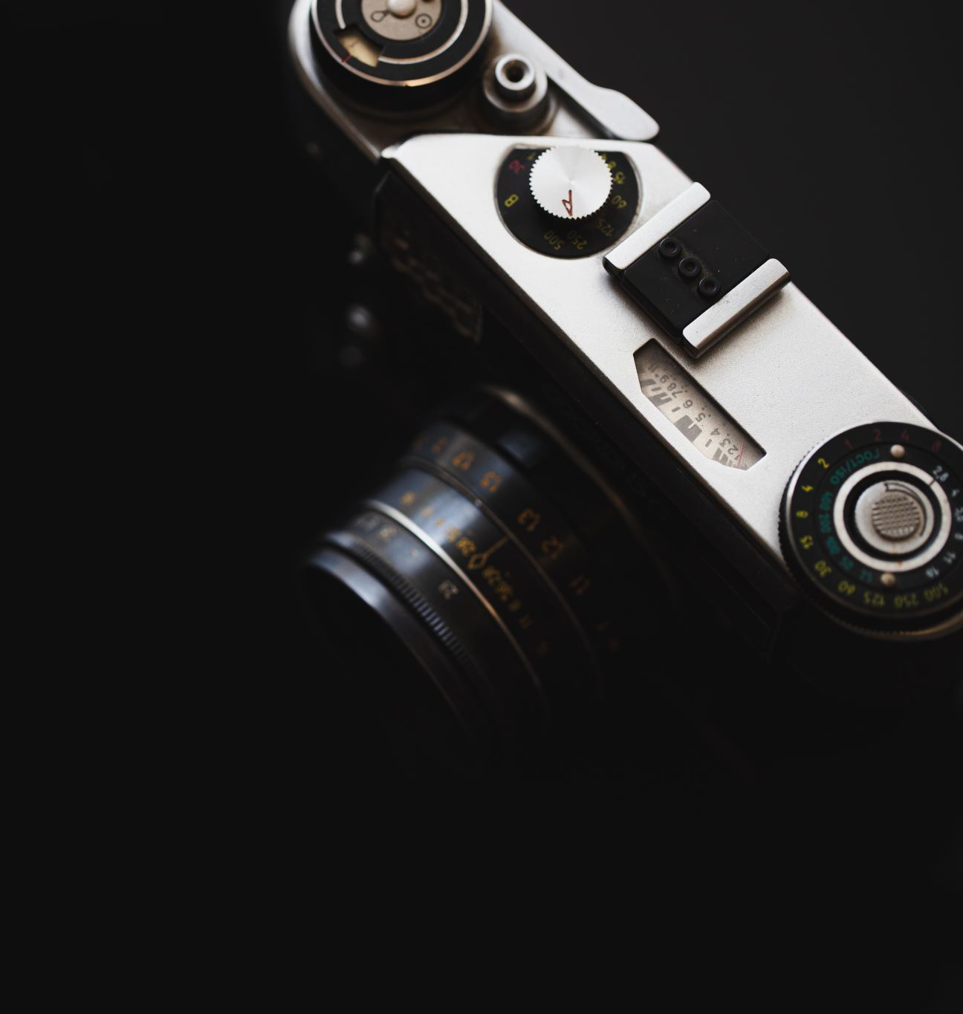
The Camera

Slide 2
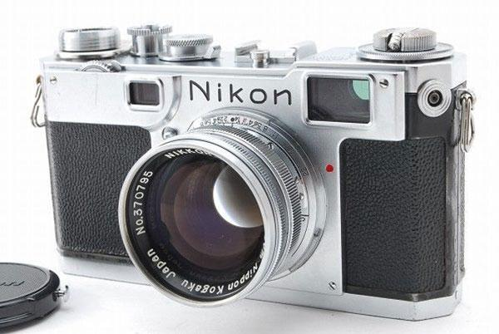
View Finder Camera

Slide 3
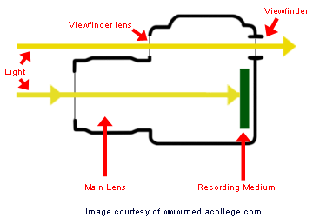
View Finder Camera
Image can be considerably different from what will be captured.

Slide 4
Single Lens Reflex
Commonly known as an SLR Camera
Camera uses a mirror and prism system
Single Lens mounts to the front of the camera
DSLR
  Digital SLR, moved from film to digital storage

Slide 5
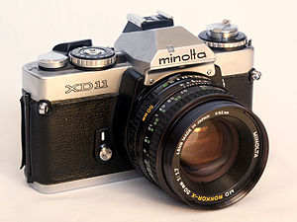
SLR Camera

Slide 6
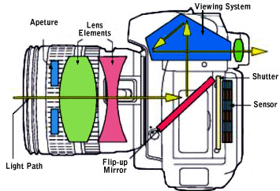
DSLR Camera Components

Slide 7
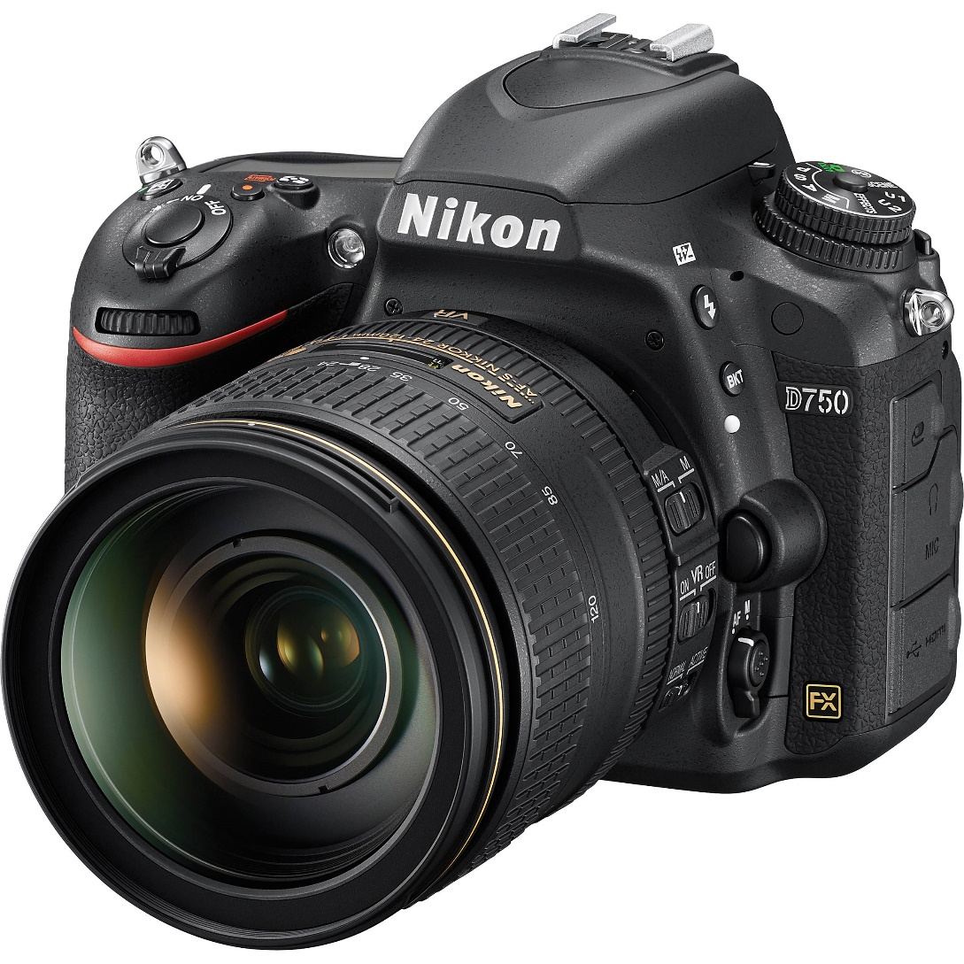
DLSR Camera

Slide 8
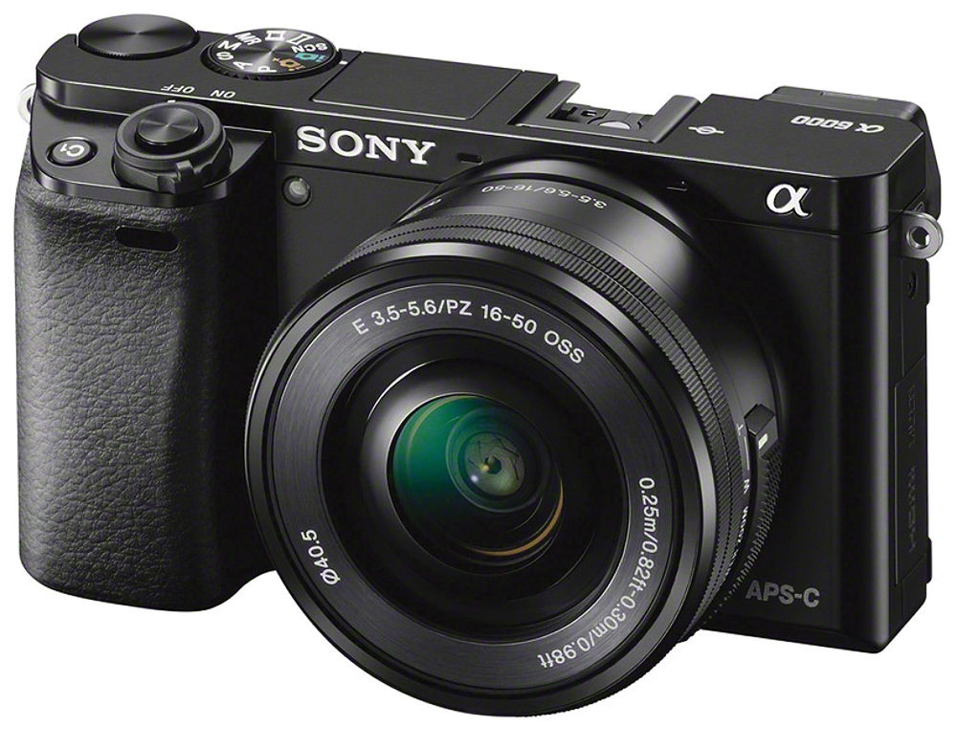
Mirrorless Camera

Slide 9
Aperture
The opening in the camera that controls the amount of light onto the sensor
Found inside the lens
Expressed in F Stops
Each aperture opening is 1/2 the previous size

Slide 10
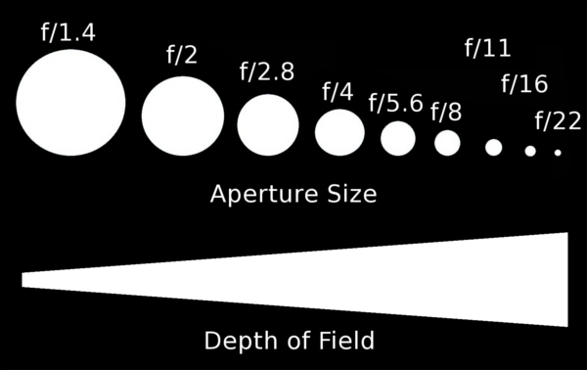
DOF vs Aperture

Slide 11
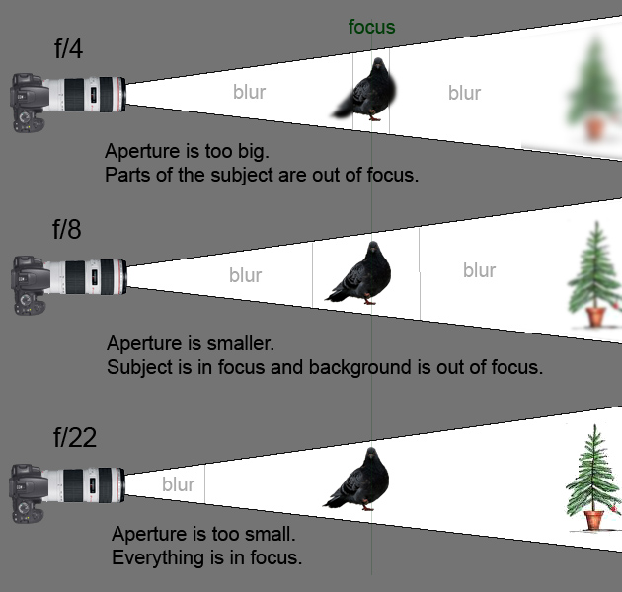
Aperture/ F Stops

Slide 12
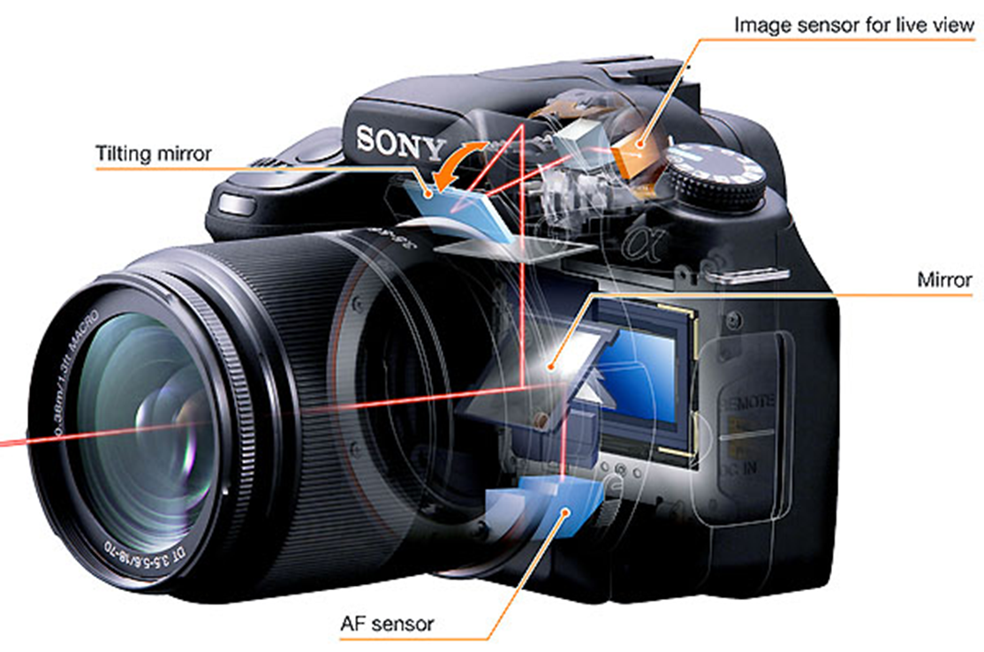
Sensor
Camera Sensor is in the back of the camera
Device that captures the light from the lens and converts it into a stored digital signal

Slide 13
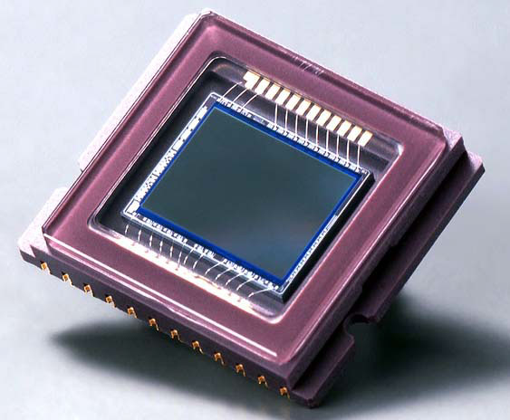
Sensor

Slide 14
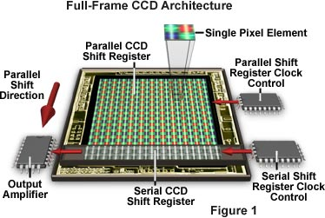
Function

Slide 15
Pentaprism
The image that comes through the lens of the camera to be flipped and corrected for the eye to see
Used to create a SLR image
Image viewed will be exact same as image captured

Slide 16
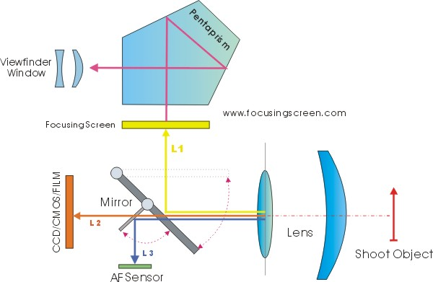
Diagram

Slide 17
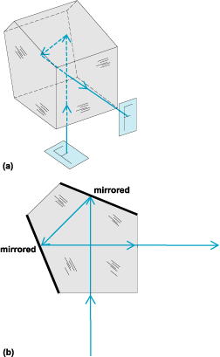
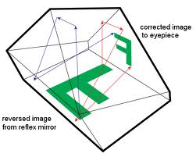
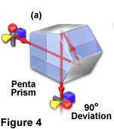
Function

Slide 18
Shutter
Is a device that allows light to pass for a determined period of time
Expressed in seconds and fractions of a second, lowest setting holds the shutter open
Bulb, 4, 2, 1 , 1/4, 1/60, 1/500, 1/3200

Slide 19
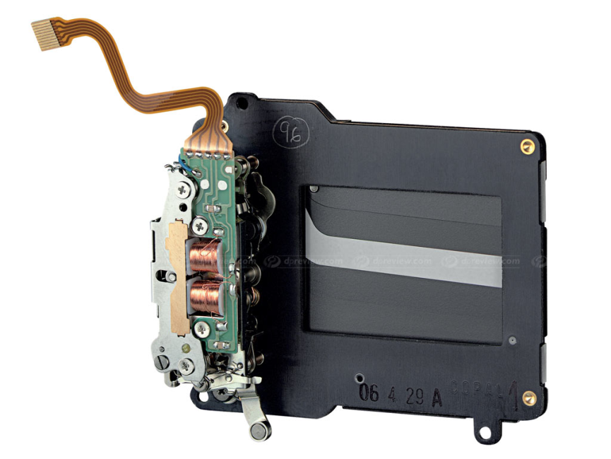
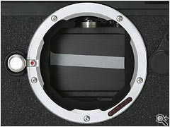
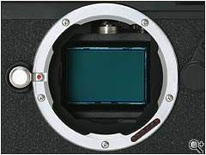
Shutter Action
Shutter Device Close in Camera Open in Camera

Slide 20
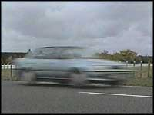
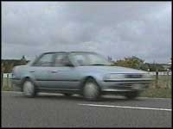
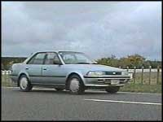
Shutter Speeds
1 Second 1/120 second 1/500 second

Slide 21
Lens
The glass elements of the camera made up of multiple different components to focus the light to the sensor
A 300mm lens has a longer distance between elements then a 25mm lens
Lenses over 100mm are called zoom a lens
Multiple different types of specialty lenses

Slide 22
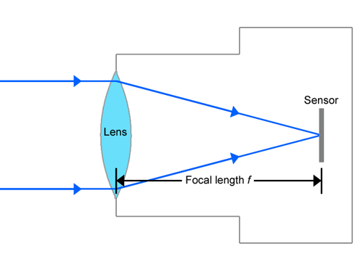
Focal Length

Slide 23
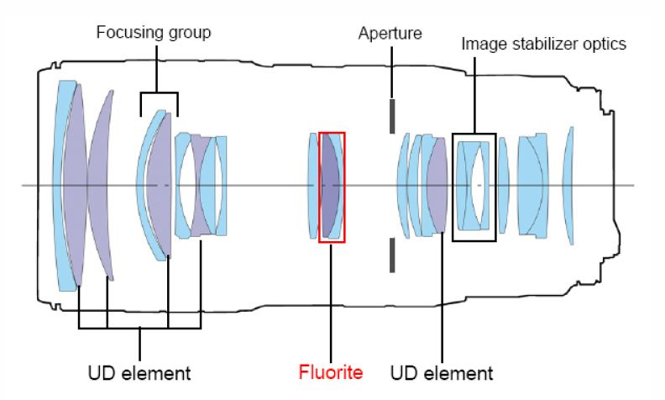
Lens Elements

Slide 24
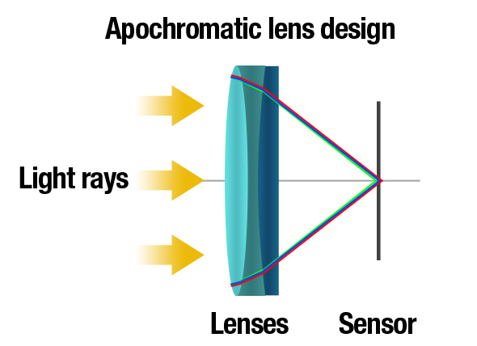
Simple Single Lens Design

Slide 25
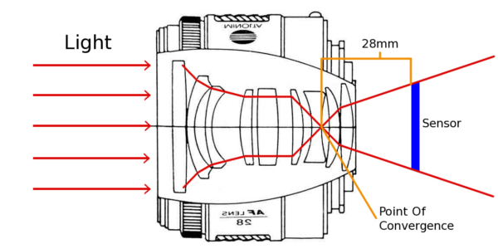
Focusing of Light

Slide 26
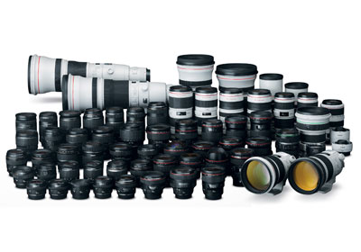
Lenses

Slide 27
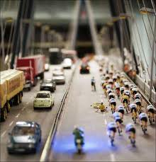
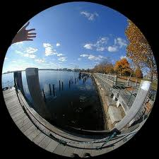
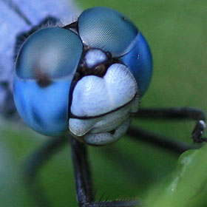
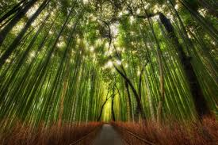
Specialty Lenses
Tilt Shift
Fisheye
Perspective
Macro/ Micro
Zoom

Slide 28
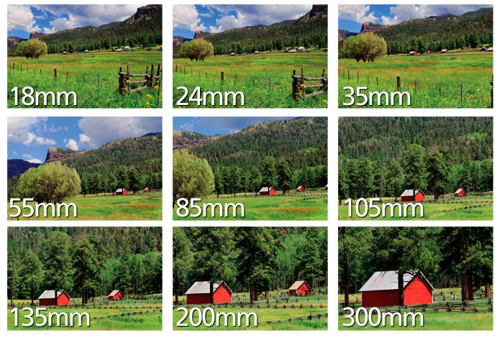
Zoom

Slide 29
Light
The image is comprised of light entering the camera lens
Light is processed by the CCD and stored as digital information to be processed or printed
Without light there would be image
Two Primary Types of Light
  Natural
  Artificial

Slide 30
Natural Light
Natural light cam come from various sources
  The Sun
  The Moon (REFLECTED light from the sun)
  Starlight (other stars in the galaxy)
  Fire (Candles, burning wood, etc.)
  Bioluminescence
    Bugs, Ocean Animals
  Lighting Storms (natural electricity)

Slide 31
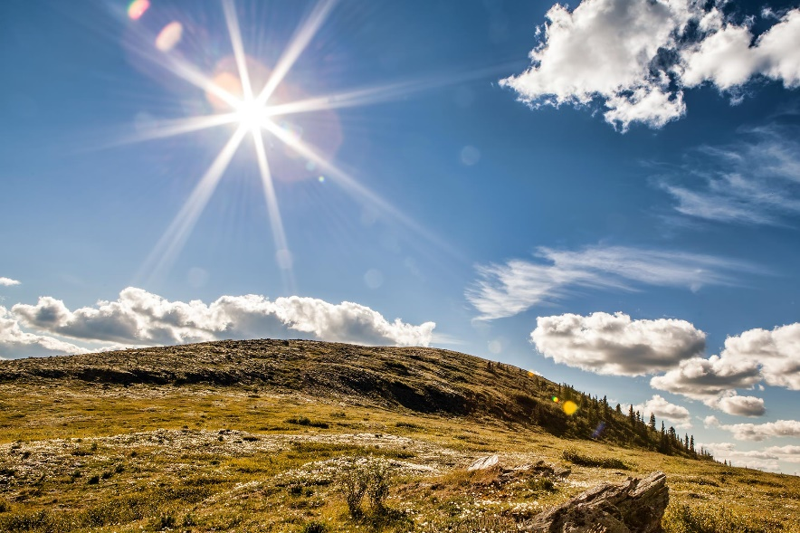
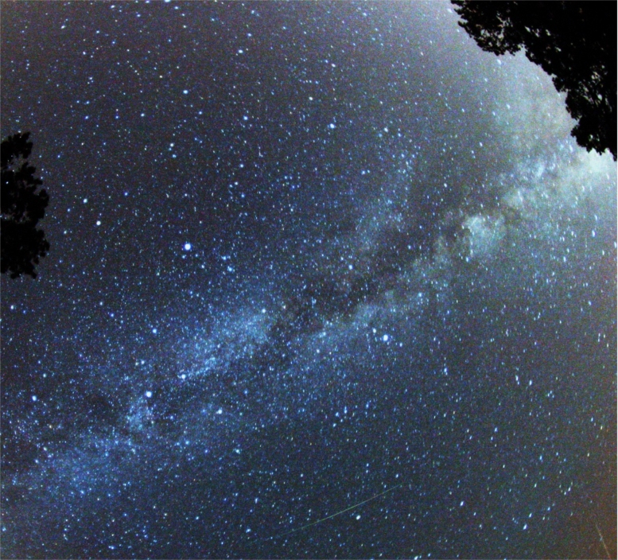
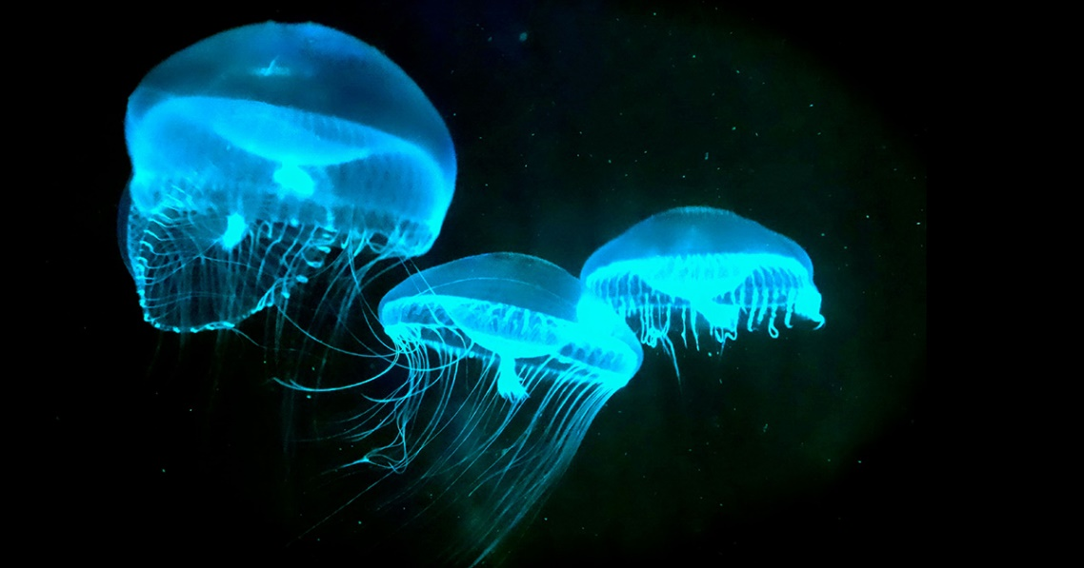
Natural Light

Slide 32
Artificial Light
Artificial Light not produced by a natural phenomenon.
Light Bulbs
  Incandescent
  Fluorescent
  CFL
  LED
Flashes/ Strobes

Slide 33
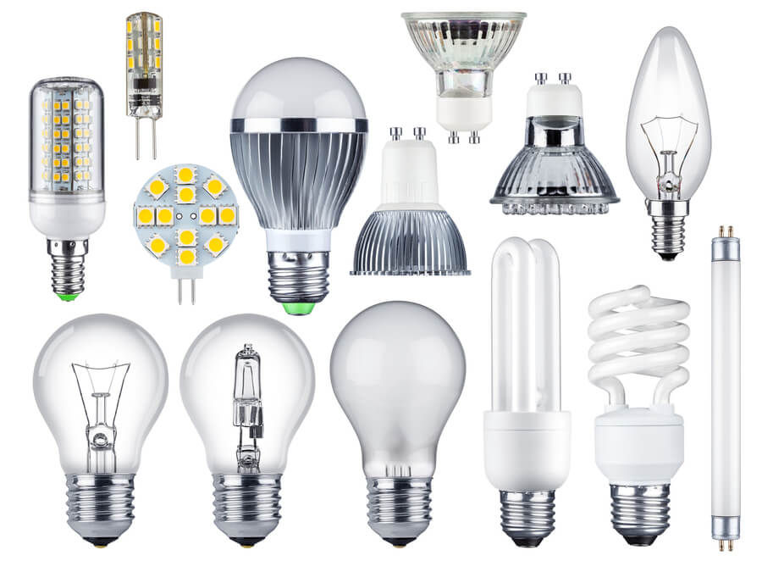
Artificial Light

Slide 34

THE END

