Slide 1

Camera
Lenses
Digital Photography

Slide 2
Camera Lenses
There are many different types of Camera lenes. Each lenes has a different purpose. There are form factors for camera lenses as well.
We will just cover the basics of camera lenses because there is enough information to fill an entire course!

Slide 3
Lens Types
Prime Lenses
  Non-zoom or fixed focal length
    Examples 35mm, 50mm, 18 mm
Zoom Lenses
  Variable length lenses
    Examples 18-55mm, 100-300mm, 400-600mm
Specialty Lenses
  Many different types and we will cover a few later in this lesson

Slide 4
Lens Focal Length
First important thing to know and understand is what the Term FOCAL LENGTH means and how it relates to lenses.
Focal Length is the effective length the camera lenses can focus. This is the distance between the Convergence Point and the Sensor/ CCD and it determines how "far" the camera can actually focus a picture.
This is also true for cellphones and any digital camera.

Slide 5
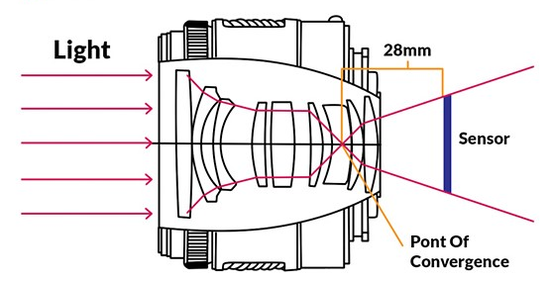
Convergence Point

Slide 6
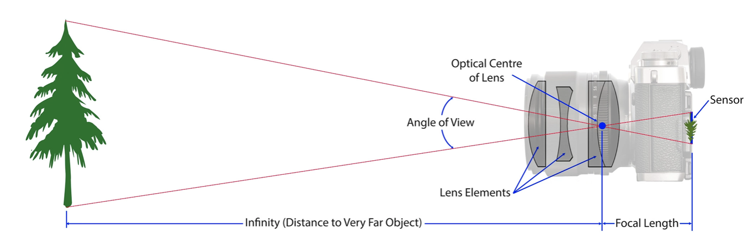
Focal Length

Slide 7
Prime Lenses
These lenses are fixed in length and cannot be adjusted. They are used generally for close up photography and are excellent for portrait work or any work where your subject does not move.
Can provide and excellent amount of light and generally have some of the largest Apertures.

Slide 8
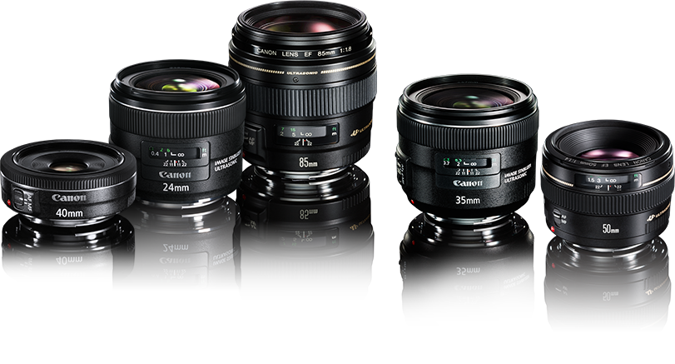
Prime Lenses

Slide 9
Zoom Lenses
Variable Length lenses come in all different sizes, but typically the longer length lenses over 100mm are considered Zoom.
The ability of the lenses to change size or "zoom in and out" is what these lenses are all about.
By extended the camera you change the Focal Length of the Lenses and therefore Zoom into something.
Also called Telephoto Lenses

Slide 10
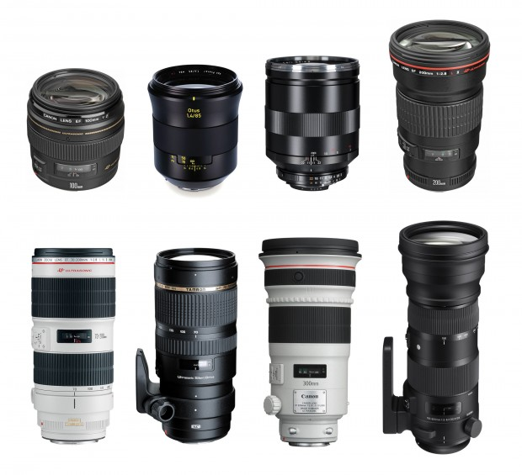
Zoom Lenses

Slide 11
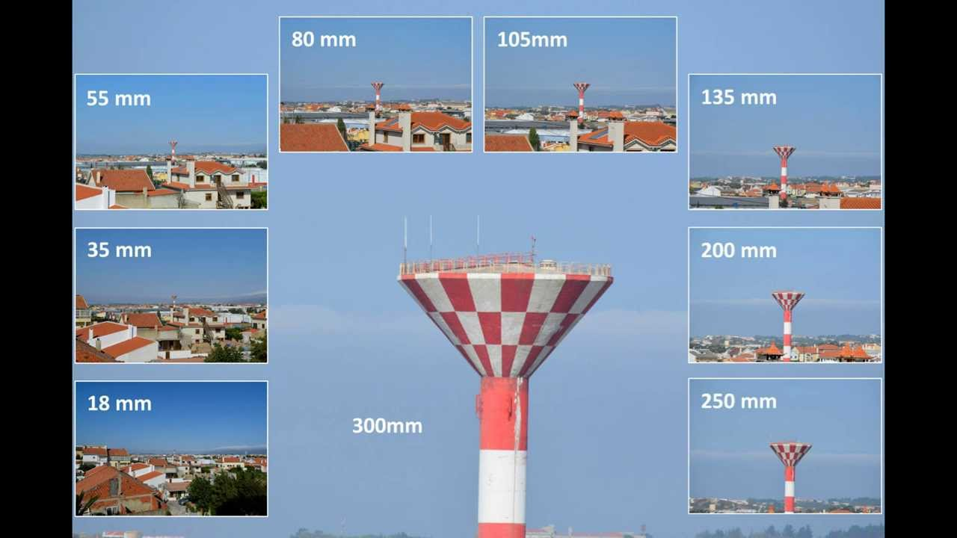
Zoom Lenses

Slide 12
Specialty Lenses
There are dozens if not hundreds of Specialty Lenses
Some commonly used ones:
  Fish Eye
  Macro
  Tilt-Shift
Each of these have special effect on photographs

Slide 13

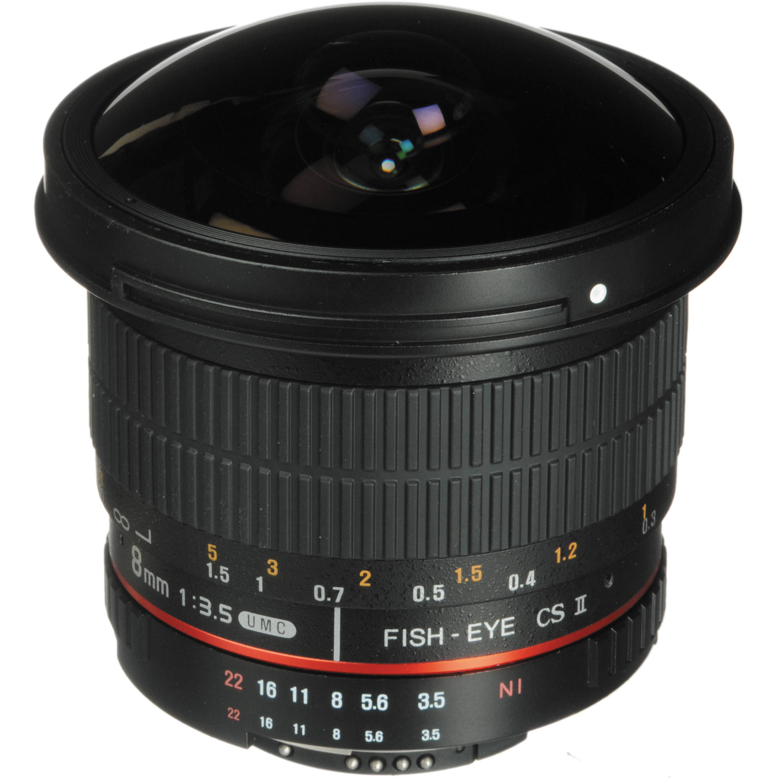
Fisheye

Slide 14

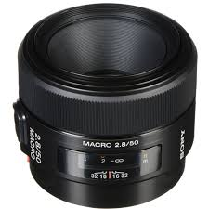
Macro

Slide 15

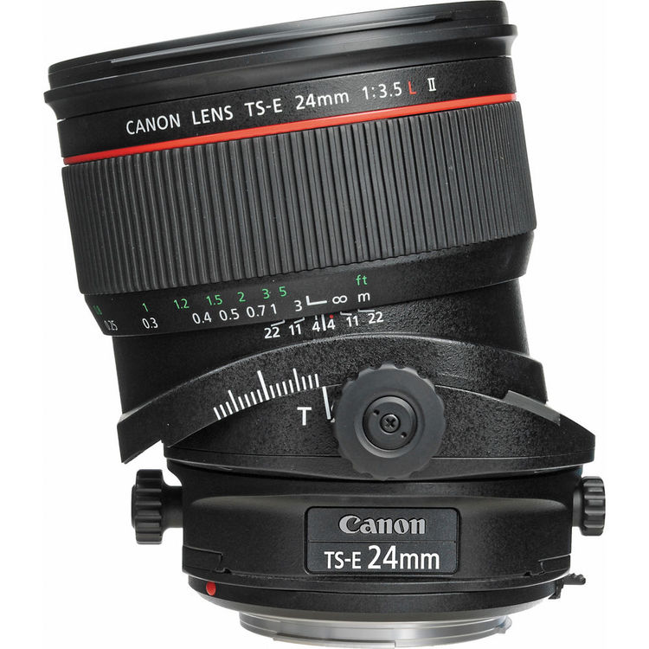
Tilt-Shift

Slide 16
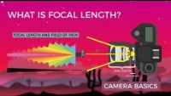
Focal Length Explained
https://www.youtube.com/watch?v=4CoEsqePADw

