Slide 1
Los Angeles Adventist Academy Alumni Association
Membership Secretary’s Report
Date: March 16, 2025
Prepared by: Kelli Angus, Membership Secretary

Slide 2
Introduction
• The LAAA Alumni Association is the VITAL LINK to foster lifelong connections between past students, current faculty, churches, and the school community.
• Mission: To engage and unite alumni and former faculty while upholding values of academic excellence and service.
• Alumni help and contribute to mentorship, scholarships, and community initiatives.
• Maintain an active membership is essential to supporting LAAA’s faith-based educational mission.

Slide 4
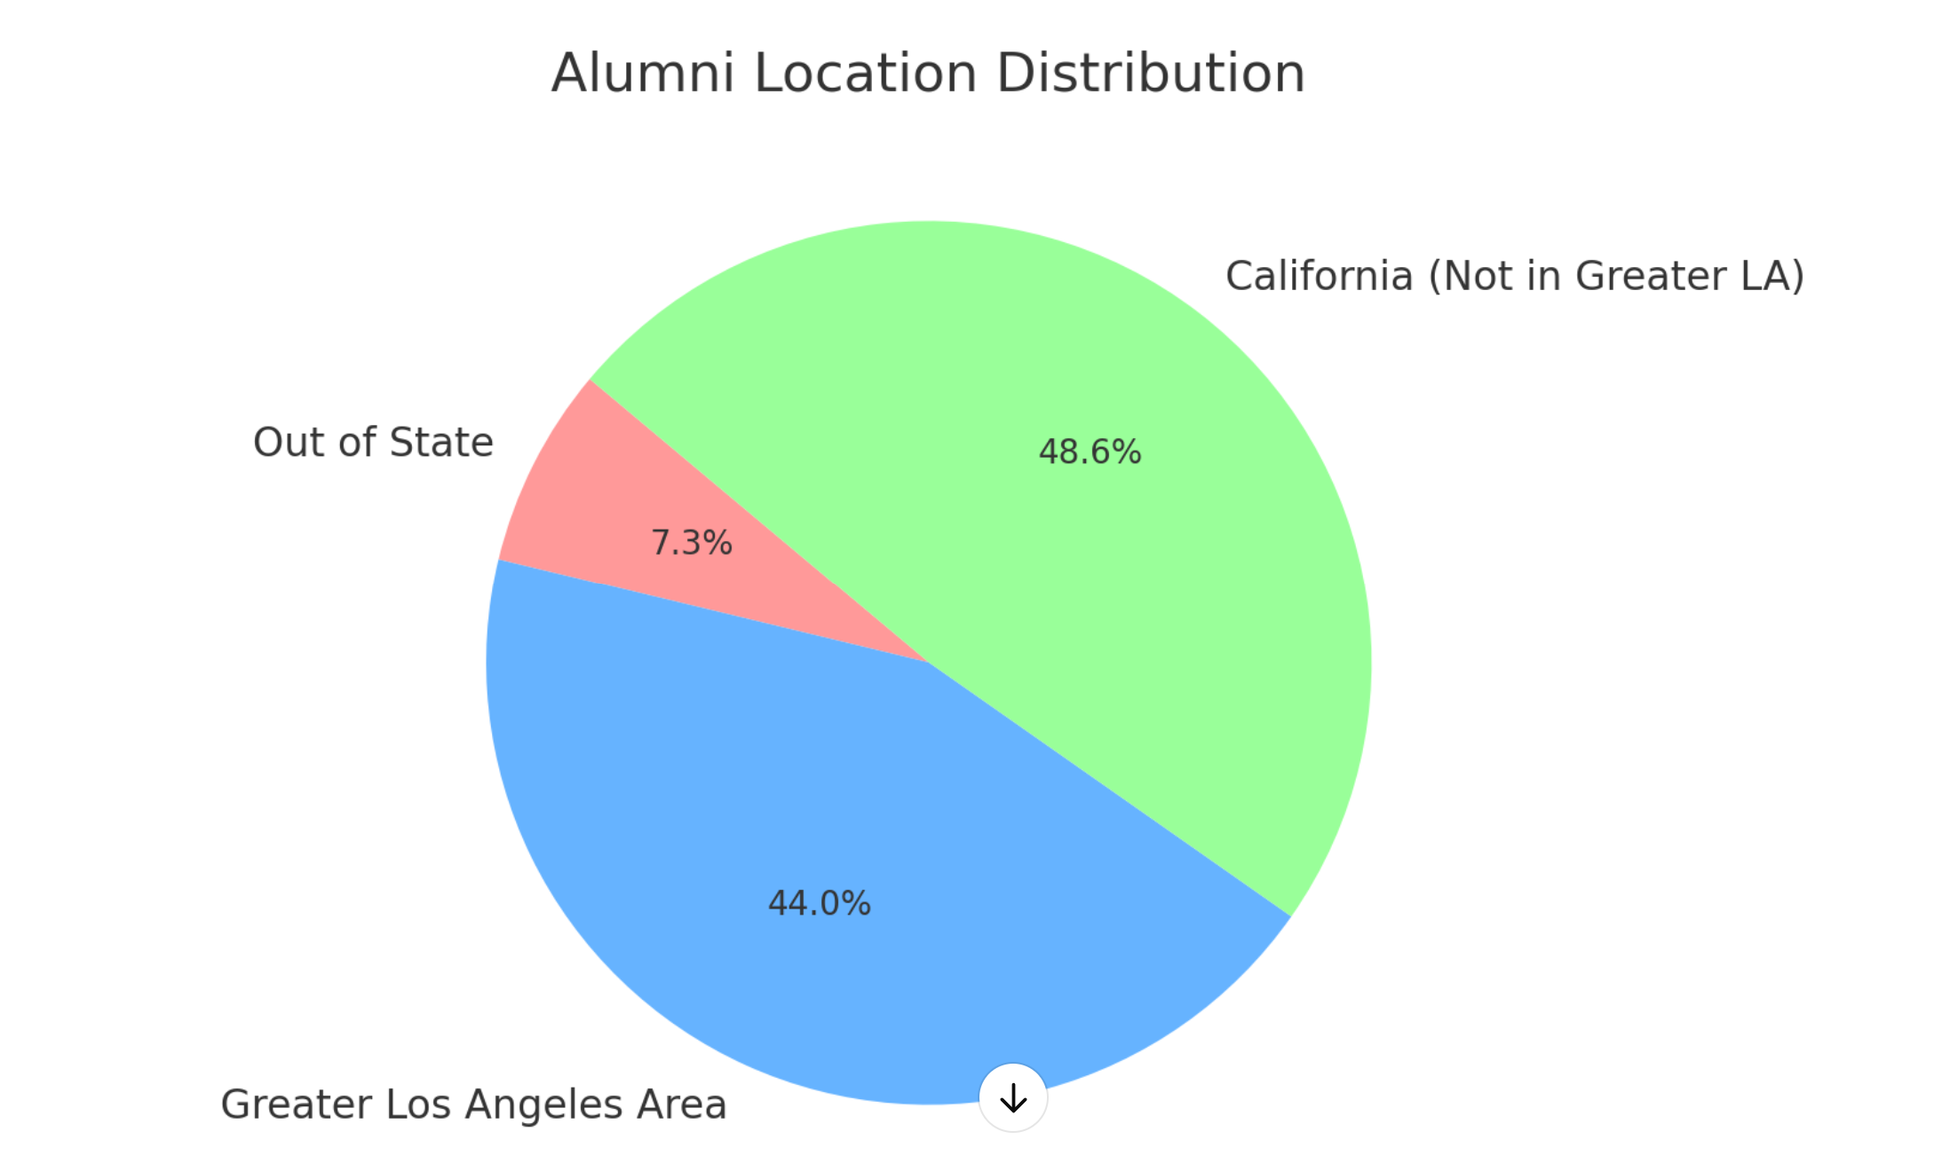
Engaged Demographic of Contacts

Slide 5
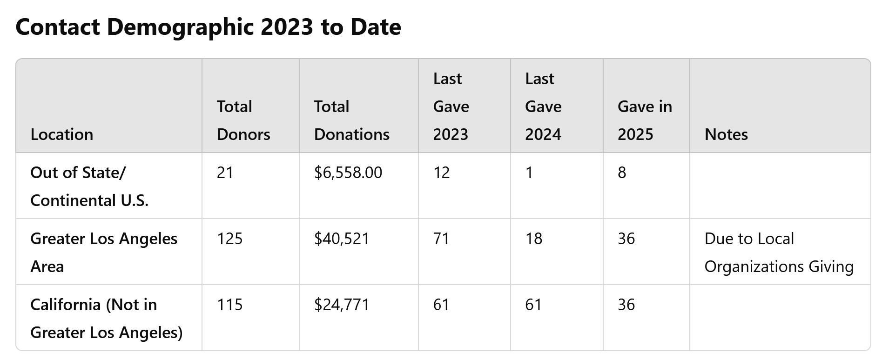
Engaged Demographic of Contacts

Slide 6
Member Engagement -Deeper Dive for 2025/2026
Event Participation:
• Track alumni attendance at events
• Record major alumni events (virtual and in-person)
Communication Channels:
• Email Campaigns: Track open rates
• Social Media: Measure engaged followers
• Alumni Website: Monitor traffic and registration stats

Slide 7
Annual Growth Trends-effective 2026
Improve Tracking Metrics
Track Year-over-Year Comparison: For annual reporting
Track Growth Rate: Percentage change from previous year or quarter
Track Key Factors for Growth:
Track Successful membership drives
Track Alumni events
Track Effective marketing strategies

Slide 8
Financial Contributions Tracking
Goals for effective 2025:
• Membership Dues:
- Track total revenue
- Track percentage of contributing members
• Additional Donations/Fundraising:
- Measure funds raised through platforms like Zeffy
• Sponsorship Contributions:
- Identify sponsors supporting the Alumni Association

Slide 9
Membership Satisfaction
Survey Strategy (Goal for 2025):
• Implement member surveys for feedback
• Identify strengths and areas for improvement

Slide 10
Challenges and Opportunities
Challenges:
• Address membership retention, engagement, and growth (Manually)
Opportunities:
• Explore new ways to increase membership with the help of technology
• Enhance engagement through better communication with help of technology

Slide 11
Conclusion and Next Steps
Key Takeaways:
• Data collection is essential but time-consuming without technology.
• Improved analytics can guide planning for fundraisers and events.
Next Steps:
1. Implement a CRM system for better communication and segmentation.
2. Introduce an SMS text system for targeted outreach.
3. Expand Zeffy data collection to include:
- Year attended
- School attended
- Volunteer participation
- Age group
- Survey responses

Slide 12
Thank You
Prepared by:
Kelli Angus, Membership Secretary
Los Angeles Adventist Academy Alumni Association

