Slide 1
Alzheimer’s Association
SC Chapter

Slide 2
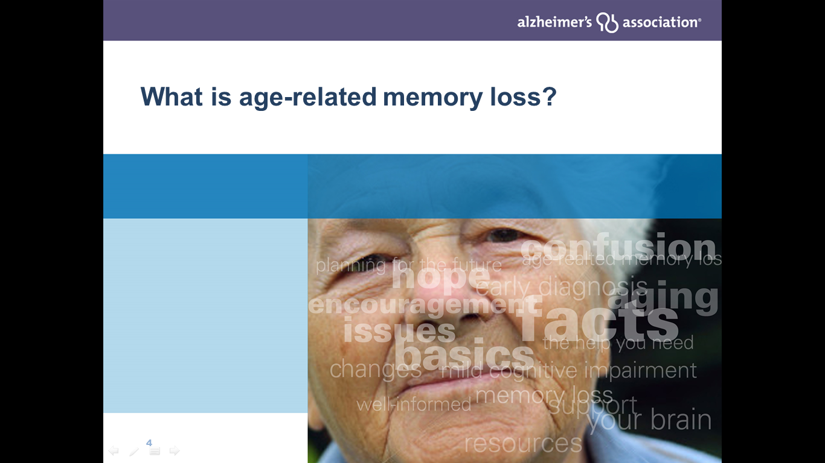


Slide 3
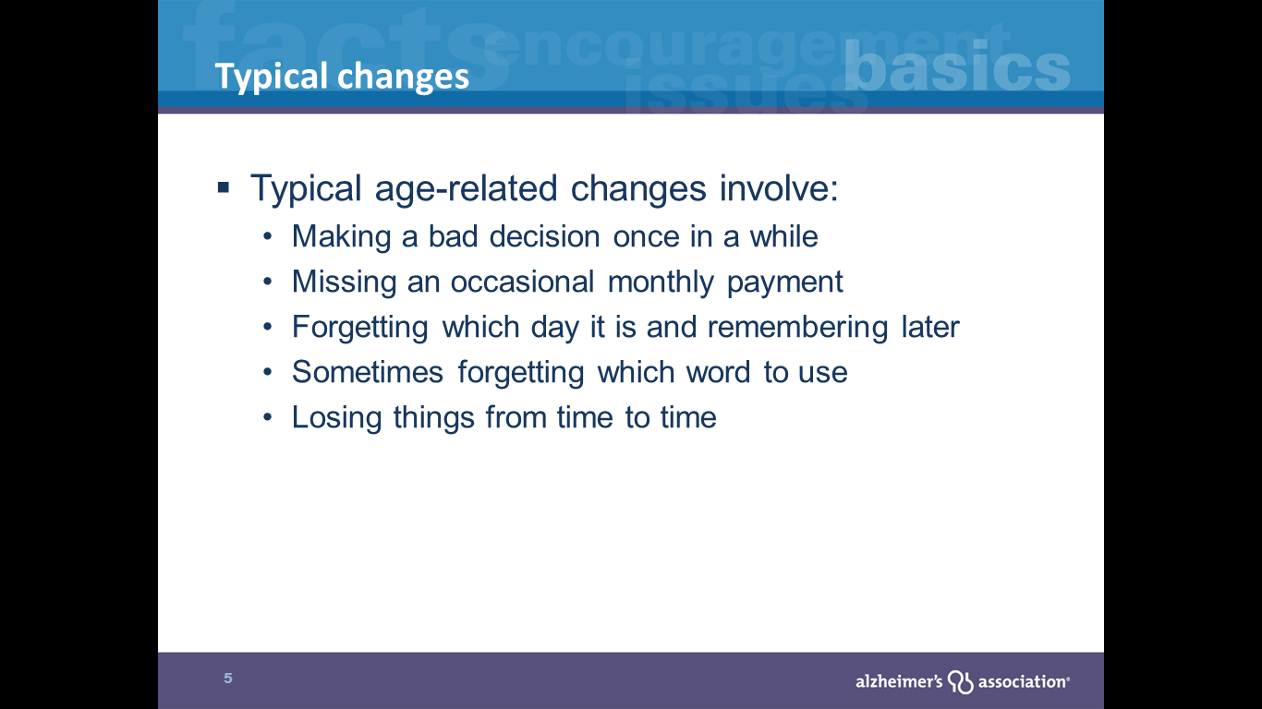

Slide 4
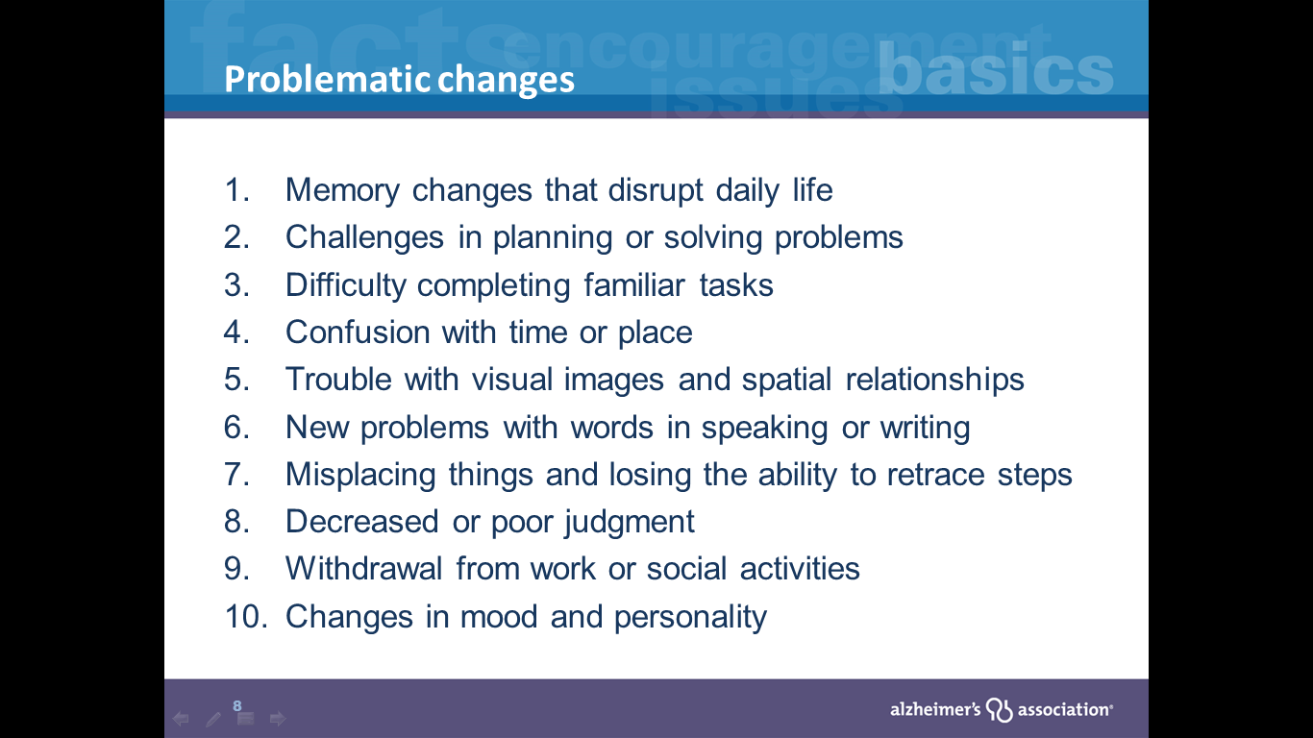

Slide 5
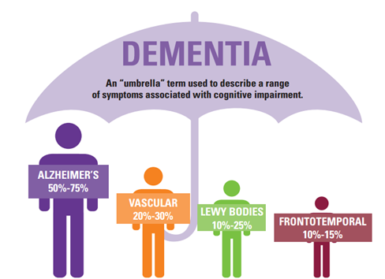
What is Dementia & Alzheimer’s?
Dementia is a collection of symptoms related to cognitive decline
Can include cognitive, behavioral and psychological symptoms
Due to biological changes in the brain
Alzheimer’s is most common cause
Notes:
If you’re like me, those numbers are staggering and it’s hard to imagine that the 5.8 million Americans are estimated to have dementia today will double in the next 30 years.
So what is dementia and what is Alzheimer’s? The simplest way to explain it is that dementia is an umbrella term we use to describe a group of symptoms related to cognitive decline.
Symptoms of dementia include difficulties with memory, language, problem-solving and other cognitive skills that affect a person’s ability to perform everyday activities.
Alzheimer’s disease is the most common form of dementia and the one we hear about the most. But other causes of dementia include:
Vascular dementia: previously called multi-infarct or post-stroke dementia or even hardening of the arteries. It can occur in people who have had mini-strokes. Some estimates say that as many of 50% of people with Alzheimer’s also show signs of infarcts or mini-strokes.
Dementia with Lewy Bodies: Some symptoms of AD, however early symptoms can also include sleep disturbances, visual impairments, visual hallucinations, gait problems and Parkinsonian movement features.
Fronto-temporal lobar degeneration (FTLD) Includes primary progressive aphasia, Pick’s disease, and several other dementias affecting the fronto-temporal lobe. Unlike Alzheimer’s, memory is typically not affected first. Instead typical early symptoms include marked changes in personality and behavior and or difficulty with producing or comprehending language.
There are other conditions like Parkinson’s disease that can cause dementia. And some situations are reversible like hormone or vitamin deficiencies. That’s why getting a diagnosis is so important.
{LAUNCH POLL QUESTION After Slide 7: Before this webinar did you know that Alzheimer's is the most common cause of dementia? Yes or No}

Slide 6
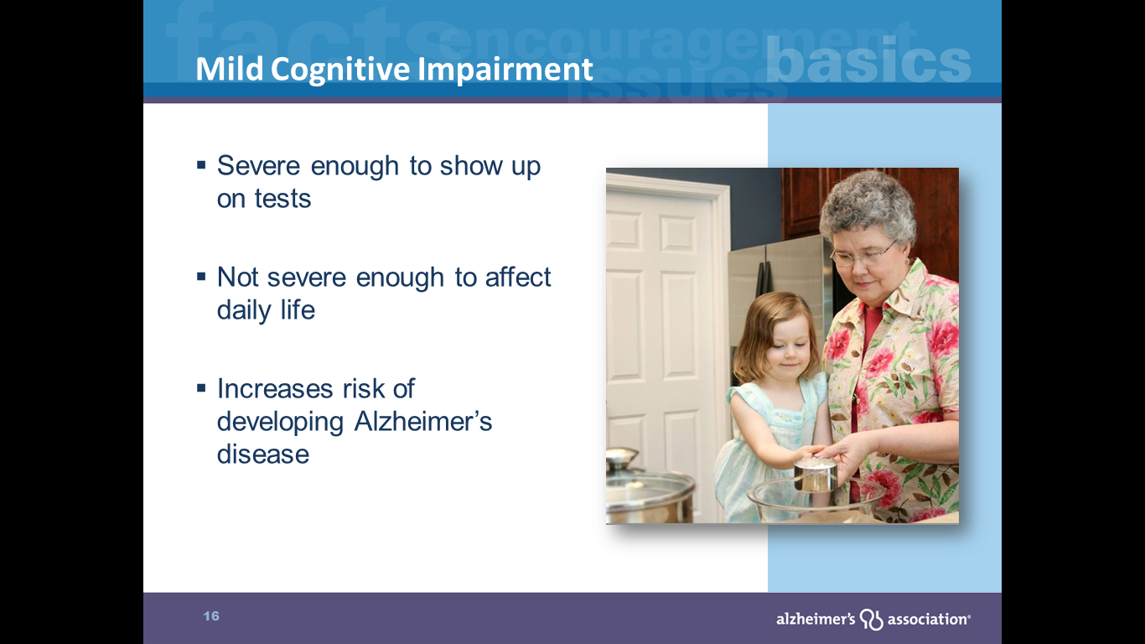
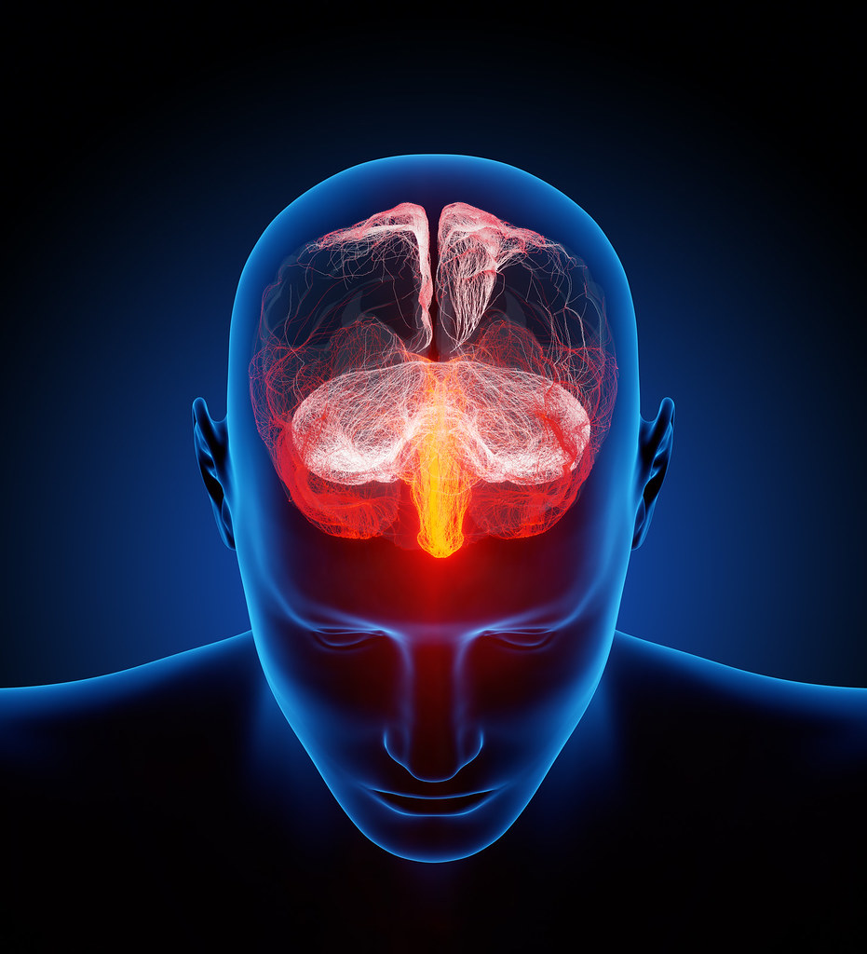

Slide 7
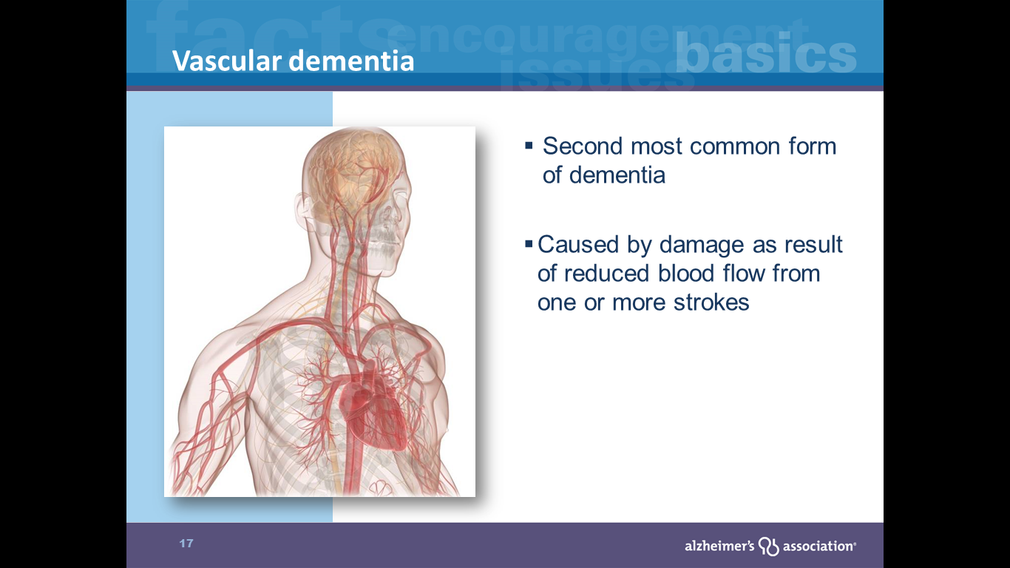

Slide 8
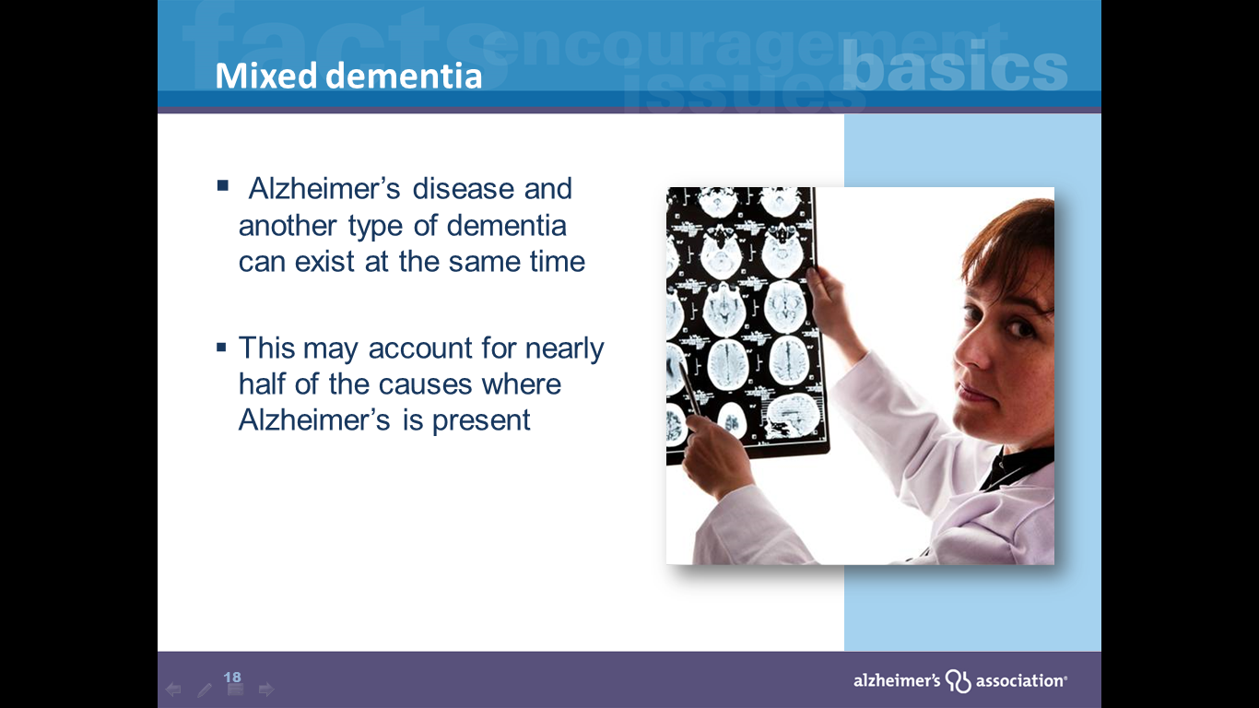
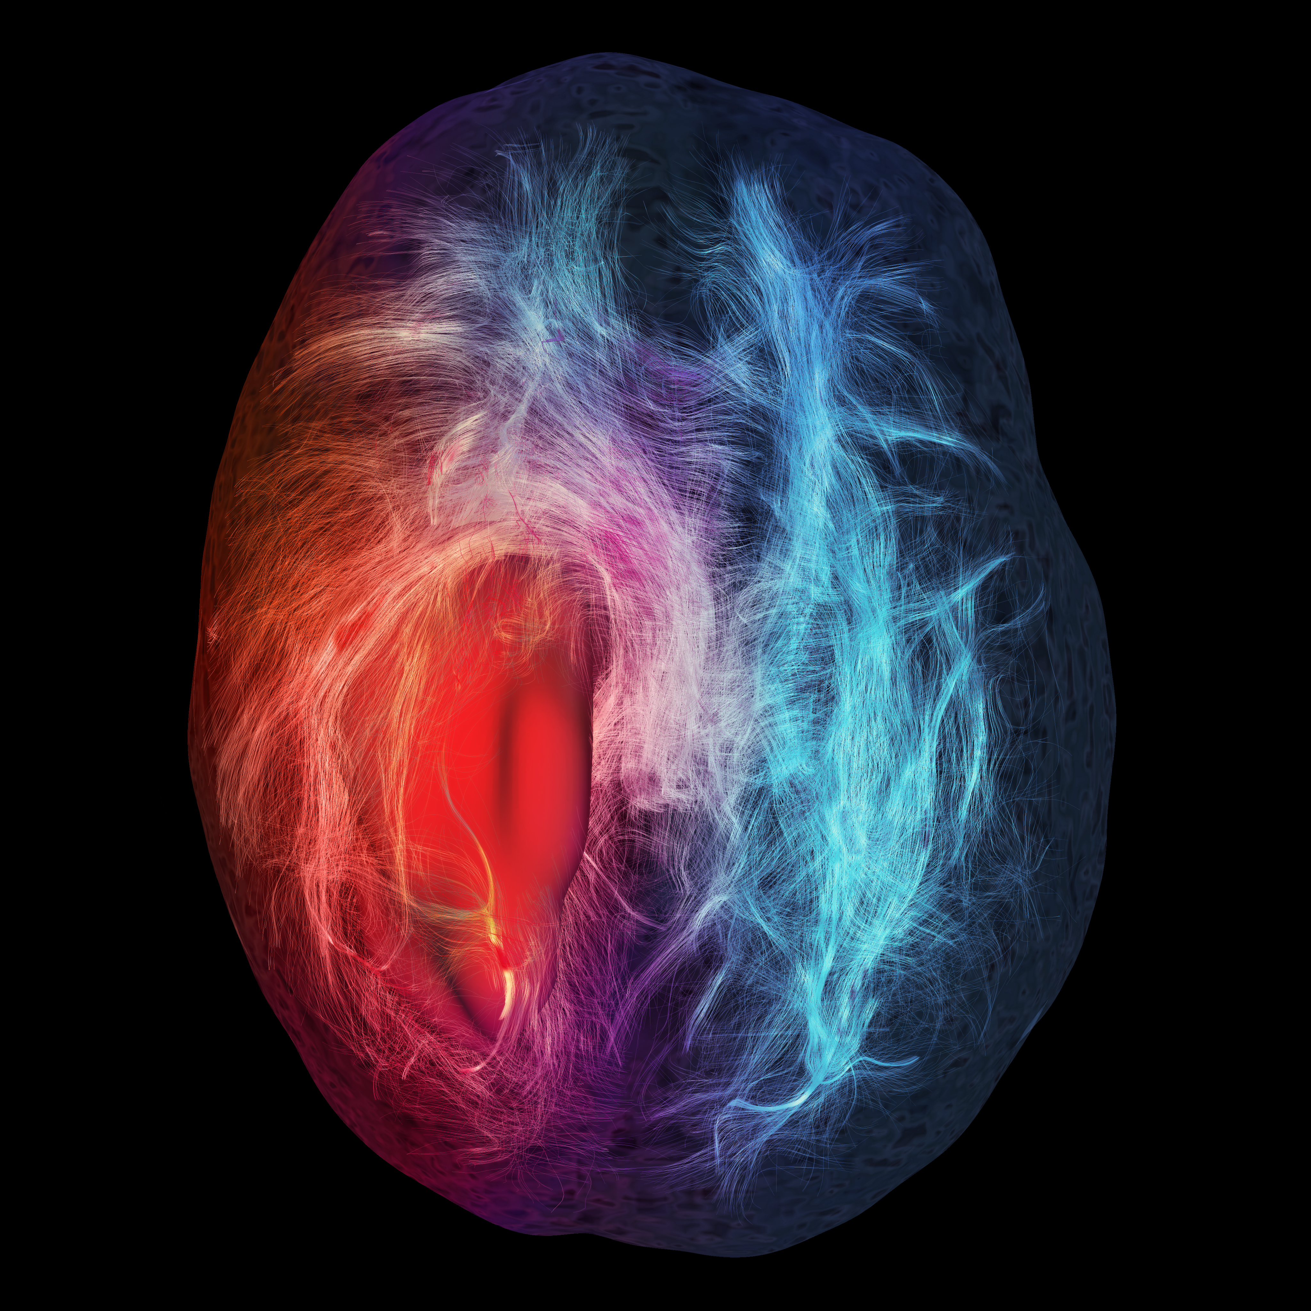

Slide 9
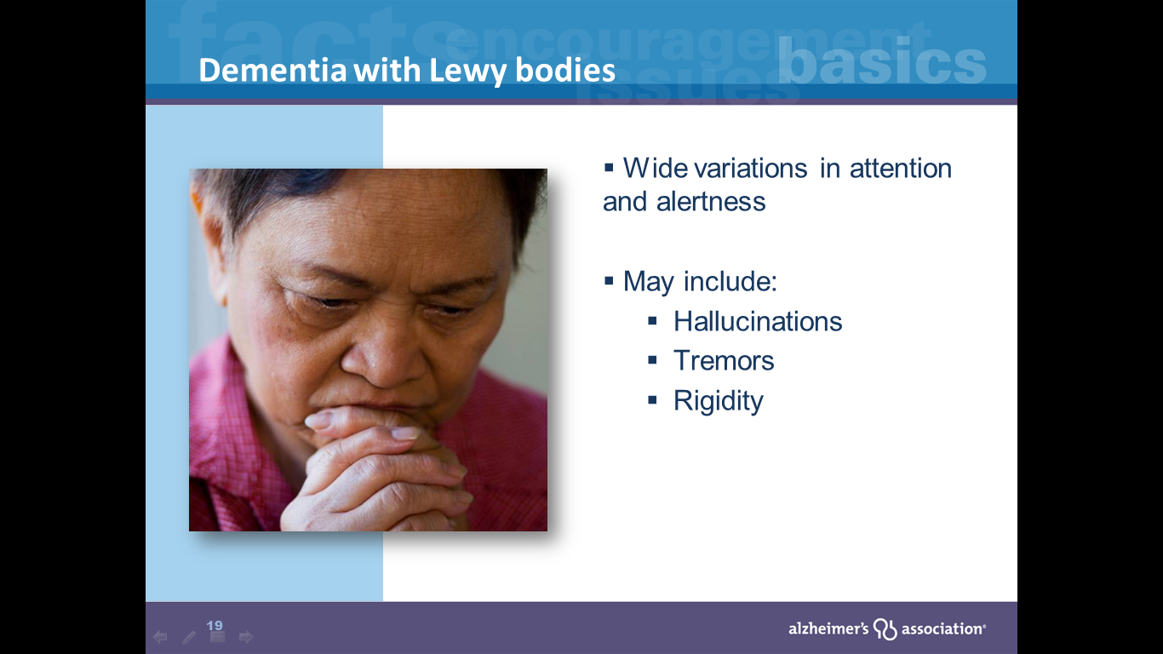
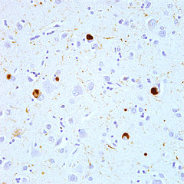

Slide 10
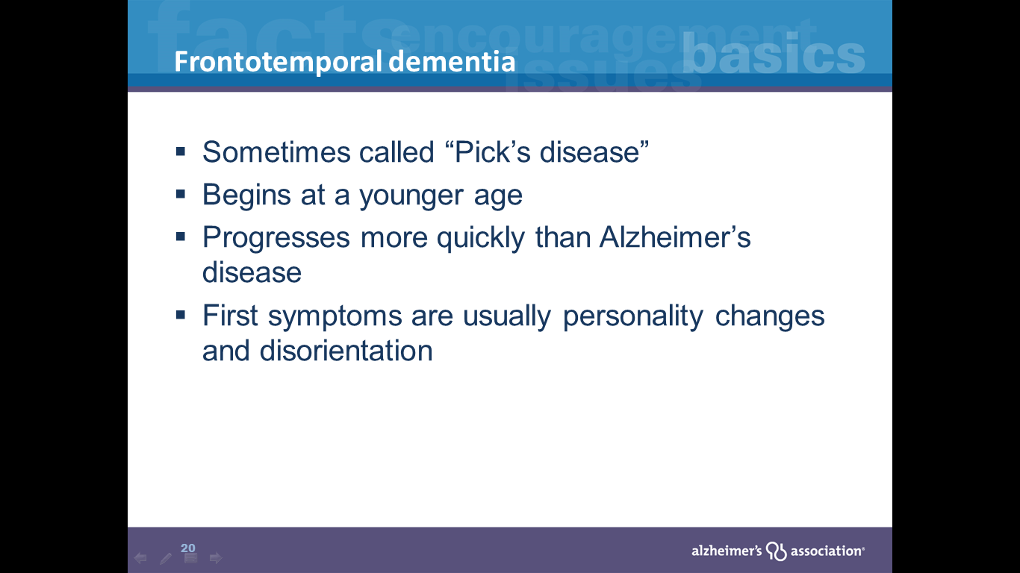

Slide 11
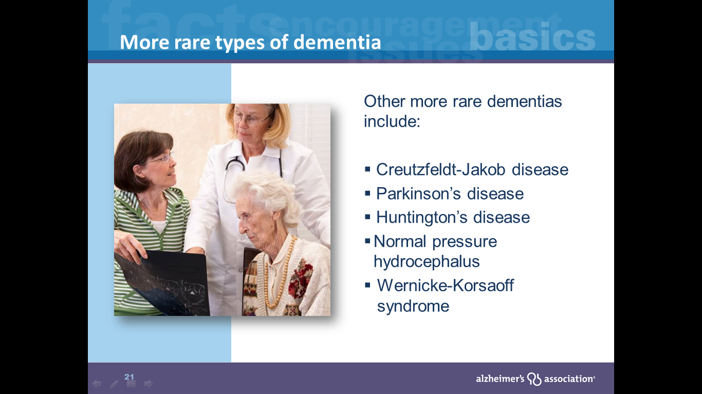
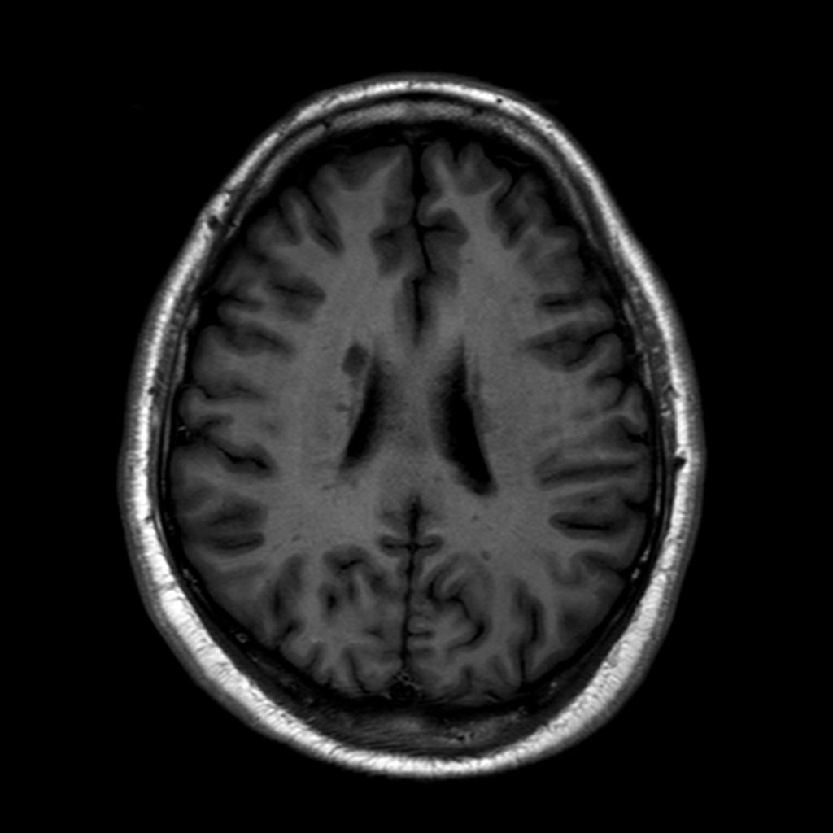

Slide 12
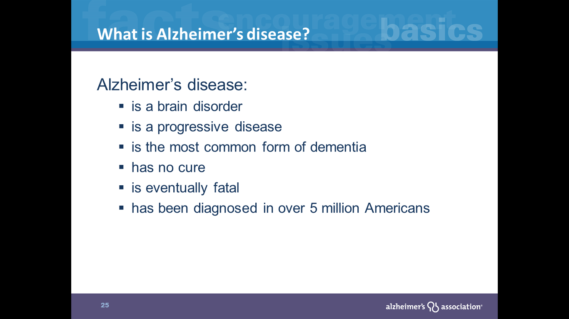


Slide 13
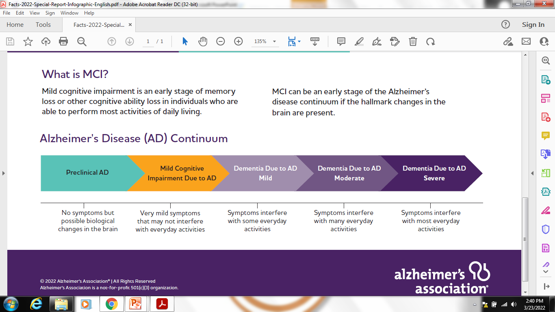

Slide 14
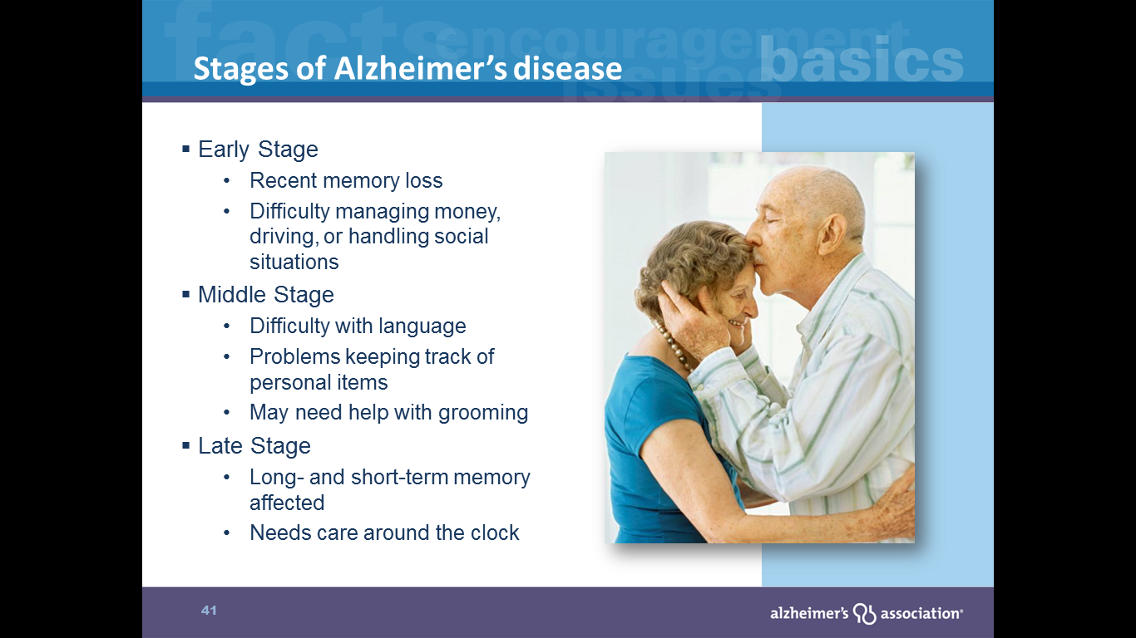
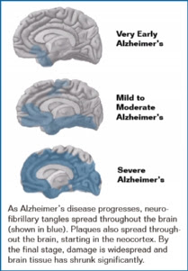

Slide 15
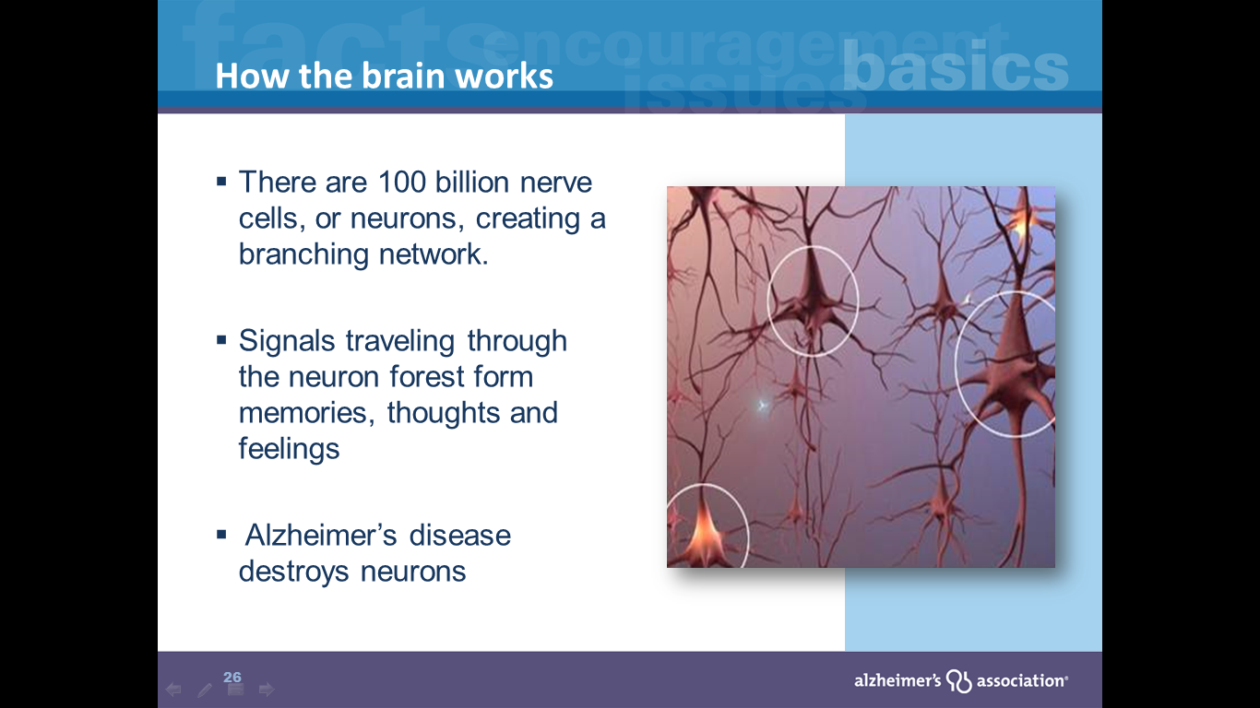

Slide 16
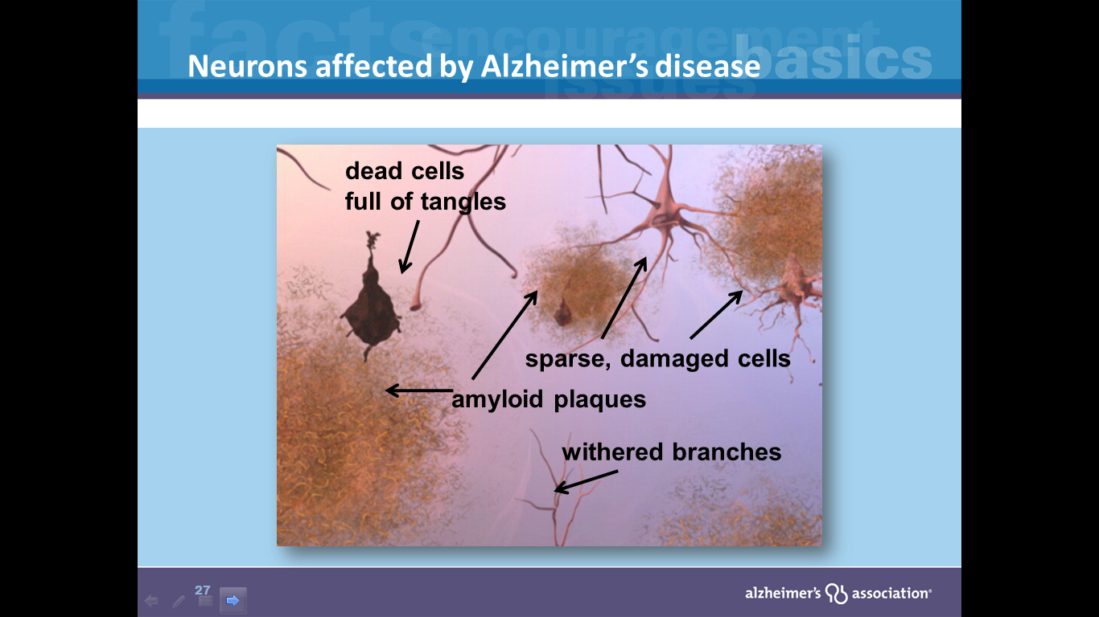

Slide 17
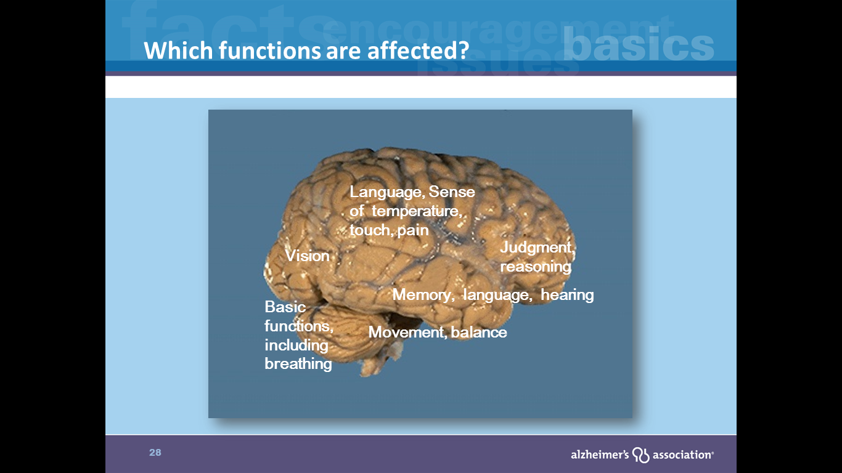

Slide 18
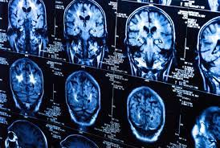
HOW IS ALZHEIMER'S DISEASE DIAGNOSED?
Medical Tests for Diagnosing Alzheimer's
Medical History
Physical exam and diagnostic test
Neurological exam
Mental Cognitive Status test
Brain Imaging

Slide 19
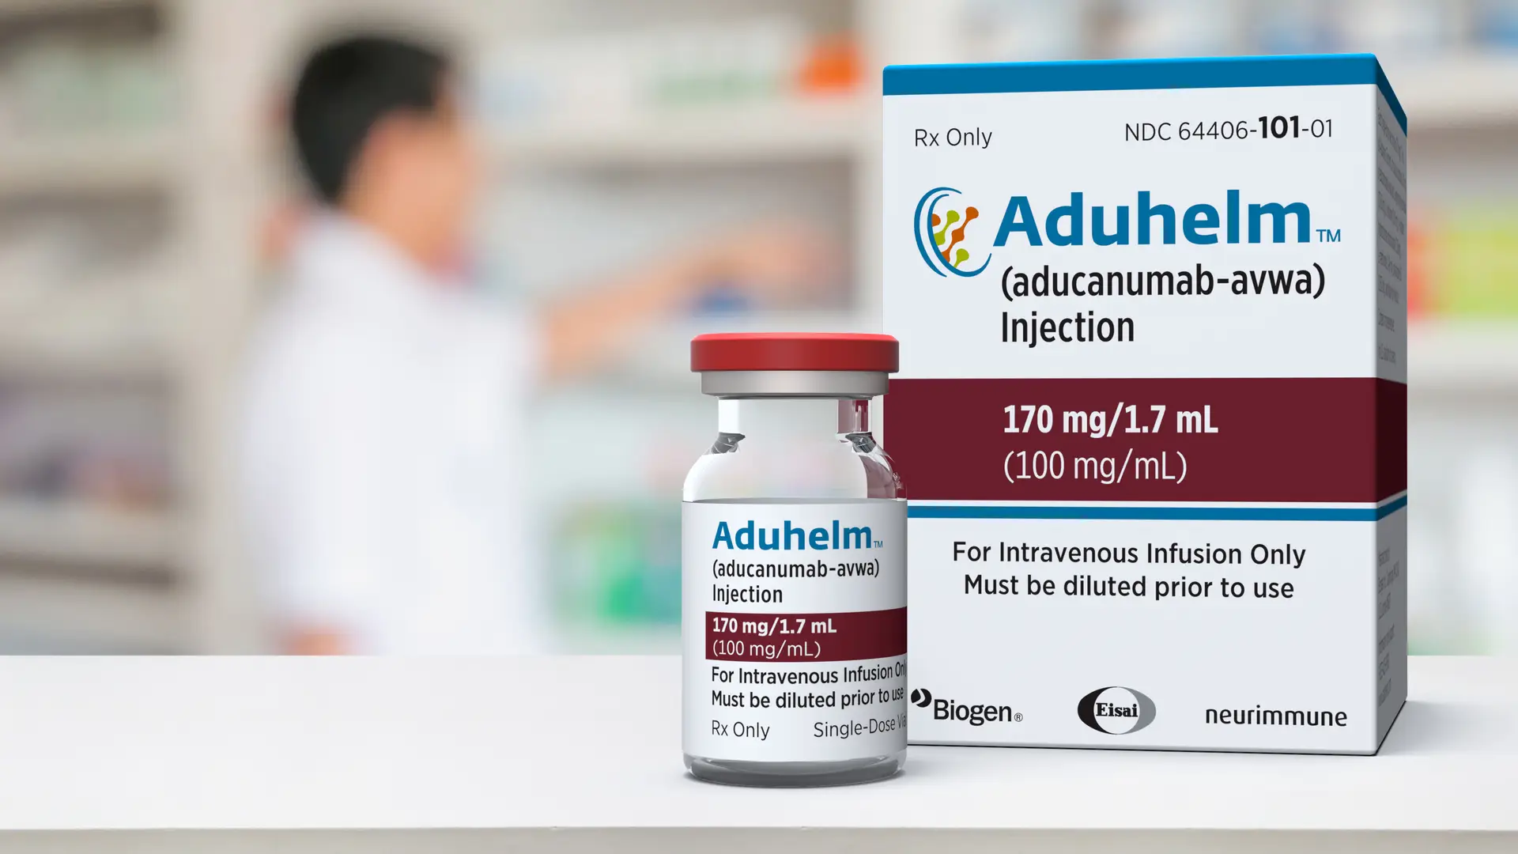
Drugs – may change disease progression
Aduhelm (aducanumab) – anti-amyloid IV infusion therapy.
  Targeting beta-amployid (microscopic protein fragment that forms in brain & accumulates into plaques).

Slide 20
Drugs – may change disease progression
Lecanemab (Leqembi) –
2nd approved treatment that addresses biology of Alzheimer’s and changes the course of the disease in meaningful way
Early Alzheimer’s w/ confirmation elevated beta-amyloid
IV infusion every 2 weeks (lasting 45-60 minutes)

Slide 21


Drugs that Treat Symptoms
Cholinesterase (KOH-luh-NES-ter-ays) inhibitors
  Aricept – Exelon – Razadyne
    Treat symptoms related to memory, thinking, language, judgment, and other thought processes.
    Medications prevent the breakdown of acetylcholine (a-SEA-til-KOHlean), chemical messenger important for memory and learning.
    These drugs support communication between nerve cells.

Slide 22
Drugs that Treat Symptoms
Cholinesterase (KOH-luh-NES-ter-ays) inhibitors
  Aricept (Donepezil) – approved treat all stages of Alzheimer’s disease
  Exelon (Rivastigmine) – approved mild-to-moderate Alzheimer’s
    (also mild-to-moderate dementia associated w/ Parkinson’s)
  Razadyne (Galantamine) – approved mild-to-moderate stages of Alzheimer's disease

Slide 23
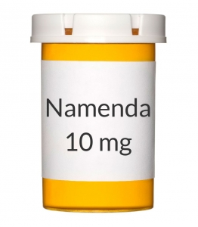
Drugs that Treat Symptoms
Glutamate regulators
  - Namenda (Memantine) -
  Prescribed to improve memory, attention, reason, language, and the ability to perform simple tasks.
  Drug works by regulating the activity of the glutamate (different chemical messenger helps brain process information.

Slide 24
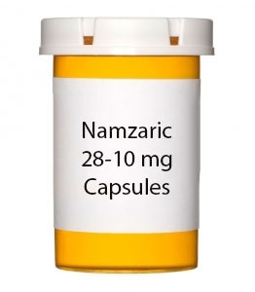
Drugs that Treat Symptoms
Cholinesterase inhibitor + glutamate regulator
  - Namzaric (Donepezil & Memantine)
  Approved for moderate-to-severe Alzheimer’s disease

Slide 25
Resources

Slide 26
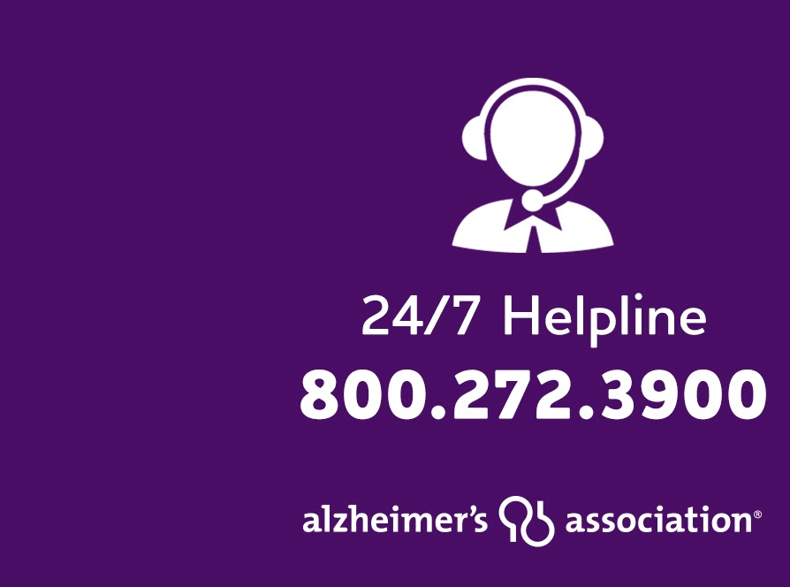

24/7 Helpline
Available around the clock, 365 days a year.
Helpline specialists and master’s-level clinicians offer confidential support and information.
Bilingual staff and translation service in 200+ languages
Live chat available.
TTY Service 866.403.3073
Notes:
The Alzheimer’s Association 24/7 Helpline (800.272.3900) is available around the clock, 365 days a year. Through this free service, specialists and master’s-level clinicians offer confidential support and information to people living with the disease, caregivers, families and the public.
Call the 24/7 Helpline day or night to:
Speak confidentially with master’s-level care consultants for decision-making
support, crisis assistance and education on issues families face every day.
Learn about the symptoms of Alzheimer’s and other dementias.
Find out about local programs and services.
Get general information about legal, financial and care decisions, as well as treatment options for managing symptoms.
Receive help in your preferred language through our bilingual staff or translation service, which accommodates more than 200 languages.
Access support through our TTY service (TTY: 866.403.3073) if assistance is required via a teletype device.

Slide 27




In-Person Virtual

Slide 28

Educational Programs
Free online e-learnings available at www.alz.org/sc
  10 Warning Signs
  Understanding Alzheimer’s and Dementia
  Dementia Conversations
  Effective Communication Strategies
  Legal and Financial Planning
  Understanding and Responding to Dementia-Related Behaviors
ALZ Navigator
Notes:
All Alzheimer’s Association programs are now available online as we await the time that it’s safe for us to get back to in person programs. We have a variety of our education programs that you can take on demand. And our ALZ Navigator is a tremendous resource helping guide Caregivers to answers by creating a personalized action plan and linking you to information, support and local resources.
You can also receive a personalized phone or virtual Care Consultation to help you design a plan by calling our 24/7 Helpline at 800-272-3900. There you can talk to a social worker about your family’s unique needs and how to support the person you’re caring for.

Slide 29

Benefits of Support Group
Peer-to-peer exchange of information, challenges and possible solutions
Helps caregiver work through feelings & share coping strategies
Emphasize importance of maintaining physical and mental health
To find a local support group, visit www.alz.org/sc
Notes:
** Pause for Polling Question at the END of this slide*****
Support groups offer excellent opportunities to learn directly from other experienced caregivers and gain support. Groups help caregivers work through their challenges and share coping strategies.
A wealth of community-based resources available in your area, including
long term care and community based services, local Association offices and their offering of programs and support services.
o Visit alz.org/CRF
For those of you who are interested in a support, but without the formal group, I’d encourage you to check out ALZ Connected.

Slide 30
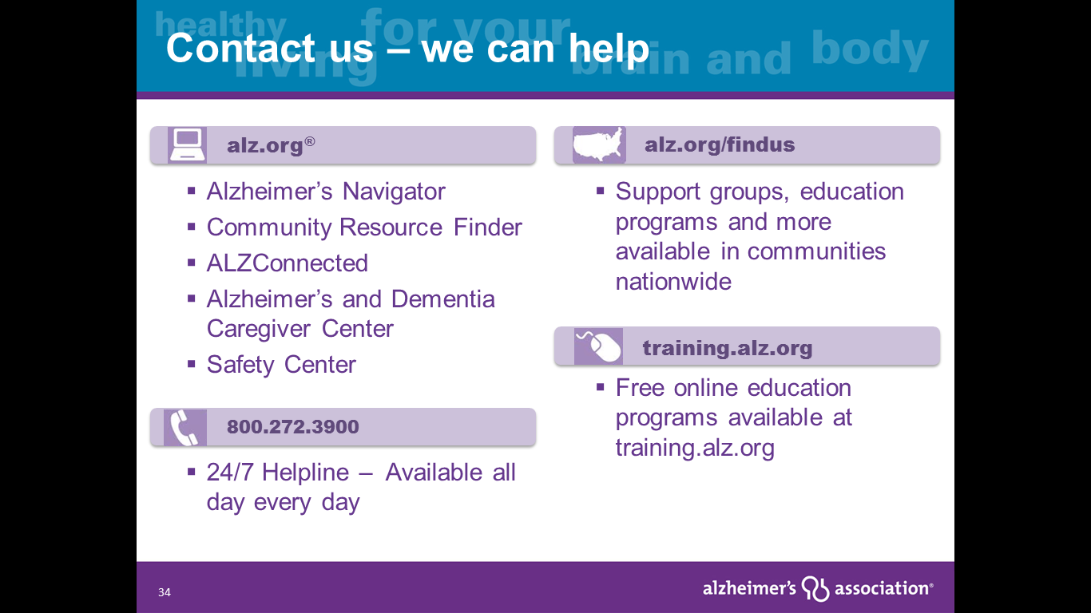

Slide 31
Early Stage Engagements - www.alz.org/sc
*Furman Lacrosse Game *Swamp Rabbit Hockey Game *Zoo
*Color & Coffee *Upstate Senior Band *Music by the Lake
*Picnic in the Park *Ice-cream social *Cupcake Creations
*Pizza & Puzzles *Donuts for Dad *Board Games *Paint Flower Pots
*Sky Top Orchard *Pizza & Pool *BINGO *Botanical Garden Tour
*Puppies & Popsicles *ELVIS *Scrapbooking *Valentine craft
*Guitarist *Color Me Happy *Lunch *Various Holiday Parties
*Nature Walks *Cookouts *Birdhouse creation *Centre Stage
*Goat Farm *Model Train Museum *Stained Glass Designs
*Pay your own way | Companies to sponsor | FREE | Indoor | Outdoor

Slide 32
Q & A

