Slide 1
Sea Island Rd. Corridor Study

Slide 2
Updates
30-Day Comment Period End 7/12/2023
All comments compiled & summarized
Key Stakeholders Meeting held 7/20/2023
Revisions made to Corridor Study Report & Measures of Effectiveness based on public comments and discussions held at Key Stakeholders Meeting
Draft Concept developed for deliverable
Final Deliverables submitted to Glynn Co.

Slide 3
MPO Process Overview
Federal & State Oversight
Oversight of policies and procedures are the responsibility of the Federal and State Government (Federal Highway Association & GDOT)
Those processes are to ensure certain standards are met & maintained
Some of the ways this is accomplished are:
  High level Regional Planning Studies (i.e. Glynn Co., or BATS MPO Area)
  Area Studies (i.e. St. Simons Island Area Study completed a few years ago)
  Project Specific or Corridor Studies (i.e. Sea Island Rd.)
Substandard findings in any given study must be addressed with further detail
  In this case, the Planning Study identified locations of substandard Level of Service (LOS) along several roadways and intersections
  St. Simons Island Area Study produced several locations below LOS standards (i.e. Frederica Rd. @ Sea Island Rd., the Gateway at Torras Causeway @ Demere Rd. & Sea Island Rd. Corridor)
LOS’s below “C” must be monitored and sufficiently improved.

Slide 4
Study Overview
The purpose of the Sea Island Corridor Study was to examine the roadway between Demere Road and Frederica Road and propose alternatives that would address current and future needs.
The Study:
Developed a detailed analysis of the corridor
Sought public input concerning the corridor
Developed a set of measures that will evaluate each proposed alternative
Presents a preferred construction alternative based on the measures
The preferred alternative of this work will help inform other planning and design activities occurring at either end of the study area and at the GDOT Dunbar Creek bridge replacement project

Slide 5
Objectives of the Corridor
From discussions with the County, the Public Comments from the Public Workshop and 30-Day Comment Period, the most important issues to address were:
Environmental Resources
Traffic Operations
Safety
Multi-modal access (pedestrians and bicycles)
Evacuation
Public Involvement
ROW

Slide 6
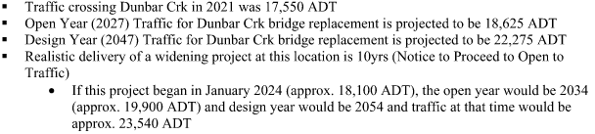
Traffic
Current vs. Projected

Slide 7
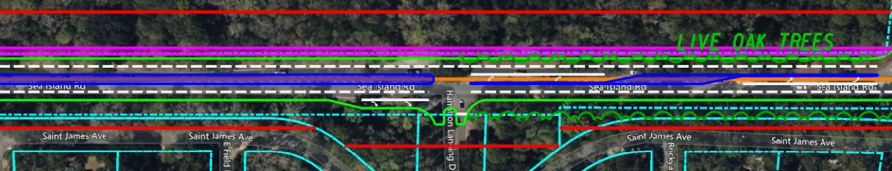
Alternatives Examined
Alternative 1-4 – Four-Lane Widening Alternatives
  Each four-lane widening alternative was slightly different to account for different approaches to widening the roadway
Alternative 5 – Three-Lane Section
  The three-lane section examined adding a center turn lane
Alternative 6 – Two-Lane Operation Improvements Only
  The two-lane section would remain as in the existing condition with the addition of turn bays at key intersections

Slide 8
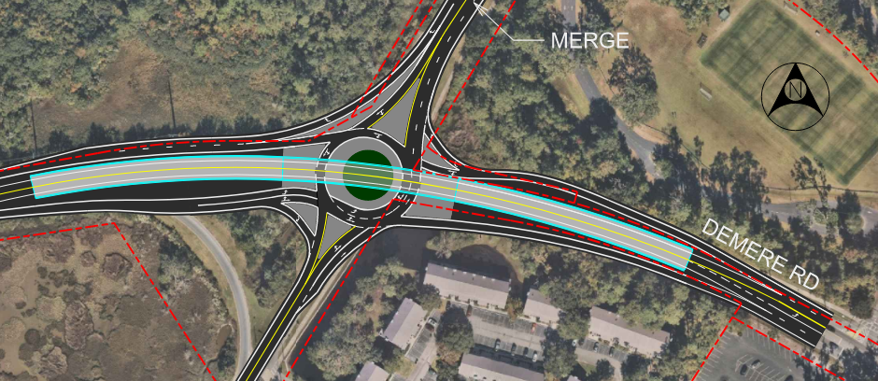
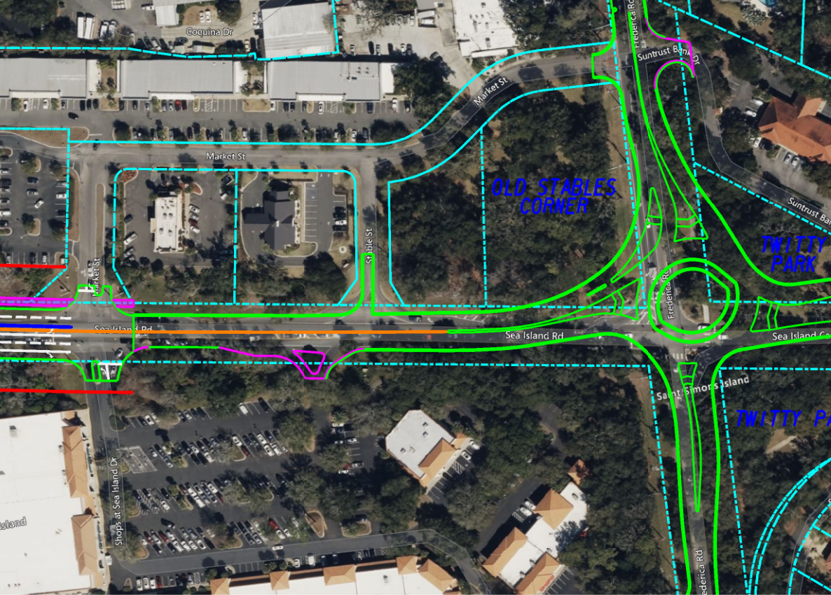
Demere Road and Frederica Road
Corridor study takes into account future work potential from the St. Simon’s Gateway Study
Corridor study ties into the Frederica Road roundabout

Slide 9
Public Input Concerning Corridor
Public Workshop – March 8, 2023
Brunswick Area Transportation Study (BATS) Policy Committee meeting – April 10, 2023
Brunswick Area Transportation Study (BATS) Technical Coordinating Committee –May 8, 2023
Brunswick Area Transportation Study (BATS) Citizens Advisory Committee – May 8, 2023
Brunswick Area Transportation Study (BATS) Policy Committee meeting – June 12, 2023
Public Comment Period – From June 12, 2023, to July 12, 2023, the Draft Sea Island Corridor Study was available to the public for review and comment.

Slide 10
Public Comments
Summary – Public Workshop & 30 Day Comment Period
Sea Island Corridor Study Public Workshop 3/8/23
Attendees | Comments | For | Against | Conditional | Uncommitted | Multi-use path | Twitty Park | No alternatives presented | Live Oak Trees
42 w/o staff | 55 | 14 | 25 | 7 | 5 | 24 | 4 | 7 | 9
Sea Island Corridor Study - 30-Day Public Comment Period Comments 6/12/23 - 7/12/23
# People Commented | Comments submitted | Explicit support for option 6 , multi-use path, or bike lanes | Oppose road widening because it would not resolve traffic issues | Oppose road widening because of ecological resources impacts (live oaks, tree canopy, salt marsh, wildlife habitat) | Oppose road widening because of safety concerns for speeding, increased colisions, entrances, children, cyclists, pets, families | Oppose road widening because of increased noise and/or loss of buffers | Oppose road widening because of loss of asthetics, natural beauty, charm, scenery, character, ambience | Oppose road widening due to concerns about eminent domain | Oppose road widening due to concerned about loss of property value
147 | 362 | 26 | 94 | 91 | 50 | 24 | 42 | 16 | 8
The 147 people who provided comments make up less than 1% of the island’s overall population.
  This does NOT take into consideration commuters to and from mainland Brunswick for work.
The 147 people who provided comments make up approximately 10-15% of the population of Epworth and Hamilton Landing residences.

Slide 11
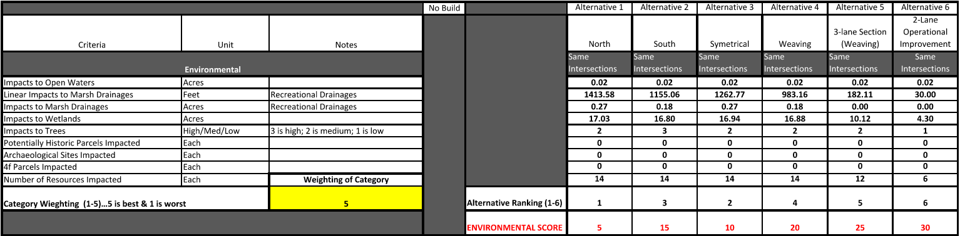
Evaluation Criteria - Environmental
Environmental weighting was originally a 1 and was increased to a 3 prior to the June Policy Committee meeting due to public concerns and comments received.
The weighting was further increased to a 5 after the Key Stakeholder Group meeting due to public concerns and comments received.

Slide 12
Evaluation Criteria – Operations
Scoring methodology was revised based on public comment & previous comments from Policy Committee member – Best alternative tied for top (1-4) positions, next best received next position, etc.
Rankings were changed to 1-6 rather than 1-5 to be consistent per request at TCC meeting on 8/11/2023
MBI recommended an intersection analyses be performed during future design phase, particularly the intersection of Hamilton Landing.

Slide 13
Evaluation Criteria - Safety
Rankings were changed to 1-6 rather than 1-5 to be consistent per request at TCC meeting on 8/11/2023
MBI’s recommendation for speed reduction is to reduce the speed limit from 45mph to 35mph.
  Provides a safer roadway.
  Provides opportunities to reduce the overall footprint to minimum, thereby reducing impacts to Environmental Resources and Right of Way impacts to adjacent properties.

Slide 14
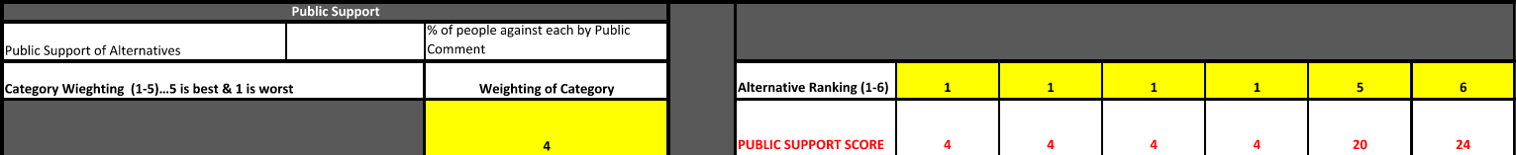
Evaluation Criteria – Public Support
Public Support weighting was increased from a 3 to a 4 due to the public concerns and comments received.
Rankings were changed to 1-6 rather than 1-5 to be consistent per request at TCC meeting on 8/11/2023

Slide 15
Evaluation Criteria – Evacuation
Evacuation weighting was decreased from a 5 to a 3 due to the public concerns and comments received.
Rankings were changed to 1-6 rather than 1-5 to be consistent per request at TCC meeting on 8/11/2023
The previous reference to “faster” was not intended to refer to speed (note MBI’s recommendation to reduce speed limit from 45mph to 35mph), it was in reference to how quickly evacuation procedures would be comparing a 2-lane, 3-lane and 4-lane roadways
The comment was also made regarding there being plenty of time to evacuate (typically 3-4 days in advance).
While this is true, re-entry is a different matter altogether and should be considered in a situation such as this.

Slide 16
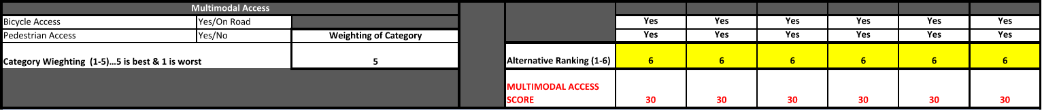
Evaluation Criteria – Multi-Model Access
Rankings were changed to 1-6 rather than 1-5 to be consistent per request at TCC meeting on 8/11/2023
All alternatives ranked the same due as all include a multi-use path.

Slide 17
Evaluation Criteria – Right of Way
Right of Way weighting was originally a 1 but was increased to a 3 prior to the June Policy Committee meeting due to the public concerns and comments received.

Slide 18
Evaluation Criteria – Results
Note: Overall scores throughout the alternatives changed slightly due to revisions in weighting and scoring methodology from previous MPO committee comments and public concerns; however, the Preferred Alternative remains the 4-lane Weaving Alternative.

Slide 19
Project File Links
Final Corridor Study Report – https://eFTP.mbakerintl.com/link/U5RG18SNeQuPRZlSdoT0rZ
Supplemental Appendices – https://eftp.mbakerintl.com/link/BM5mprHmJgQkgCnMMh29AO
Preferred Alternative (4-Lane Weaving Alternative) – https://eftp.mbakerintl.com/link/tY5UXCCFpaZ7BtkGzBTz88
REVISED Evaluation Criteria – https://eFTP.mbakerintl.com/link/ridkUhrFj1iXuvmuEvX05t

Slide 20
Questions

