Slide 1
NORMOG
AGM – 11th November 2025

Slide 2
Agenda
Minutes of 2024 AGM & matters arising
Officers’ reports:
Centre Secretary
Treasurer
Election of Officers
Annual subscriptions
Website
Programme for 2025/6
AOB

Slide 3
Centre Secretary’s report

Slide 4
Centre Secretary’s Report
2024/25 events, etc:
Noggins
Coffee & Chats:
Jan: Garage Bar & Grill, Roger & Pat
Feb: Botanics, Roger & Pat
Mar: Three Horsehoes, Malcolm & Julie
Apr: Brancepeth Golf Club, Dennis
May: Little Haven Hotel, David
Jun: Teesdale Cheesemakers, Vaughan & Eunice
Jul: Thornton Hall, Malcolm & Janice
Aug: Travellers Rest, Steven
Sep: Causey Arch, Roger & Pat
Oct: Brocksbushes, Peter & Pam
Nov: Crook Golf Club, Dennis

Slide 5
Centre Secretary’s Report
2024/25 events, etc:
14 December: Christmas Lunch, Beamish Hall, Roger & Pat
4-6 April: MSCC AGM & Dinner Dance, Burn Hall, York
27 April: Drive it day, 63 mile route from Beamish with lunch at the Derwent Manor, David & Dawn
25 May: Thornton-le-Dale Show, Vaughan & Eunice
27-29 June: Mogfest, Beaulieu

Slide 6
Centre Secretary’s Report
2024/25 events, etc:
5-6 July: Normog 60th Anniversary Weekend
Eshott Airfield, John & Alison
60th Anniversary Dinner, Eshott Hall
Mauritania Day Amble, Peter & Pam
Northern British Sports Car Show @ Beamish Museum, Roger & Pat
10 August: Normog Concours & lunch, Crown, Mickleton, Derek & Sue
17 August: Dalmain Cumbrian Classic Car Show, Elaine & Nick
2-6 September: Scottish Borders tour, Roger & Pat

Slide 7
Centre Secretary’s Report
2024/25 events, etc:
Scottish Borders Tour – 2-9 September
Based on Traquair Arms Hotel in Innerleithen
20 members and 9 Morgans
Traquair House
Thirlestane Castle
Kalzie Gardens

Slide 8
Treasurer’s Report FOR FY 2024 - 2025

Slide 9
Treasurer’s Report
ACCOUNT BALANCES:
OPENING BALANCE 1st NOVEMBER 2024
£4,771.96
CLOSING BALANCE 31ST OCTOBER 2025
£4,850.40

Slide 10
Treasurer’s Report
As Treasurer, John Curry reported that a copy of the Accounts for FY 2024-25 had been circulated to Members in advance of this meeting. These show a healthy balance with no outstanding payments and all monies due to the account have been received.
A projector has been added to the Club’s assets. Membership of forty-nine is similar to last year with new members joining and others leaving during the year.
During this Financial Year HSBC have announced that the NORMOG account will no longer incur a monthly charge for servicing the account. The only bank charges which will be incurred in the future will be for cash and cheque transactions

Slide 11
Treasurer’s Report End
QUESTIONS:
OF GENERAL INTEREST TO OTHER MEMBERS NOW
PERSONAL INTEREST SEE ME AFTER AGM

Slide 12
Election of Officers

Slide 13
2025/26 Subscriptions

Slide 14
Normog Website

Slide 15
Normog Website
normog.co.uk launched in July
Webmaster Peter Hyde
Based on Go Daddy development platform & hosting
Includes:
Normog history
News
Events programme & regular meetings
Contact information
Membership forms etc
External expenditure funded by MSCC
Still need to delete old normog.com site!!!

Slide 16
MSCC Website Regional Centres Page

Slide 17
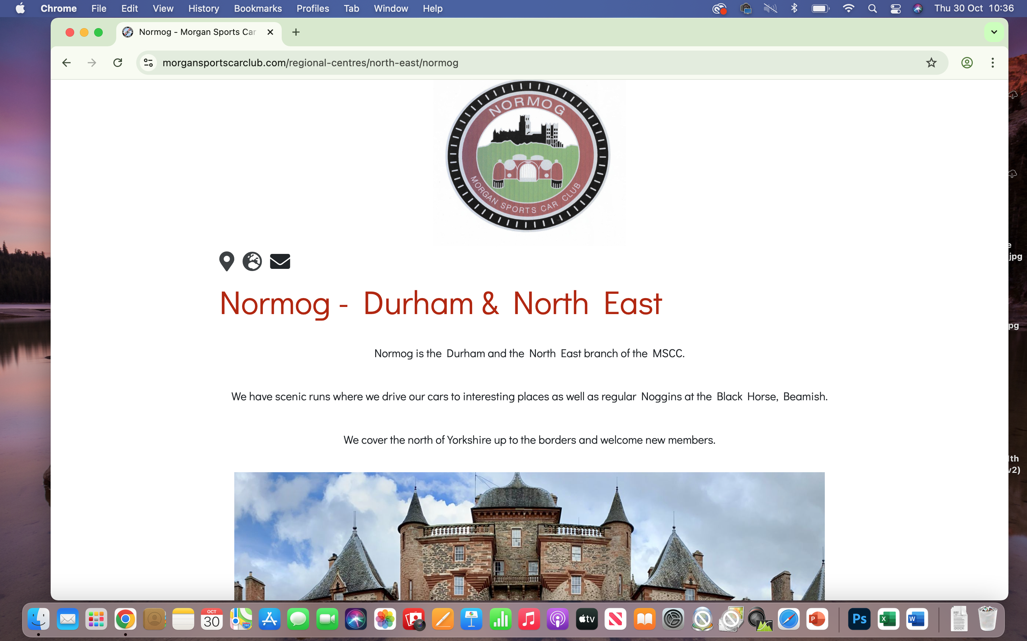

Slide 18
2025/6 Programme

Slide 19
2025/6 Programme
Normog Christmas Lunch – Saturday 13th December at 12.30 pm
Manor House, Cartaway Heads
Coffee & Chats
Normog Annual Dinner
Drive it Day
Normog BBQ at Peter Aitkens’ farm in aid of St Cuthbert’s Hospice
Date in June to be confirmed
MSCC75 Anniversary Weekend – 3rd-5th July
Normog Concours weekend
Annual Trip?

Slide 20
AOB

Slide 21
