Slide 1

Single Stream Recycling Education
Lara Rezzarday
Total Recycling Program Manager

Slide 2
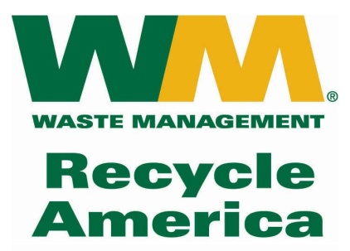
About Waste Management
  Operates over 100 recycling facilities in the United States, of those, over 50 are Single Stream Facilities
  North America’s largest recycler, handling more than 14 million tons annually
  2 facilities are located in Denver: A commercial facility at 48th Ave. and a residential facility at Franklin Street and 54th Ave.

Slide 3
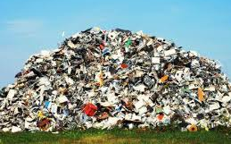
Why Should We Recycle?
On average, each American creates about 4.7 pounds of waste every single day. About 50% of what is thrown in the garbage can be recycled/composted.

Slide 4
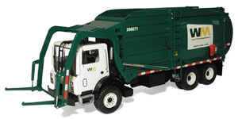
Why reducing waste is important
Did you know?
There are less landfills today:
1988: 8,000 landfills
2006: 1,700 landfills
Less material going to the landfill will lengthen the lifespan.
Colorado has one of the lowest recycle rates in the U.S. at less than 12% compared to 35% for the rest of the country.
Recycling creates more than 10 jobs for every 1 job created by landfilling your waste (per ton).

Slide 5
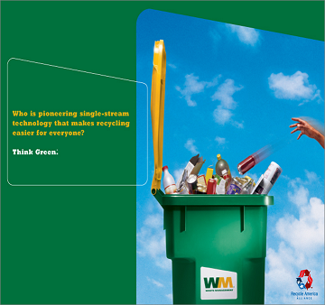
What is Single Stream Recycling?
  All recyclables are placed in a single container for collection (business & residential).
  The recyclables are sorted at our Materials Recovery Facility (MRF), baled and shipped to manufacturers.
  Offering single stream recycling increases participation rates.

Slide 6
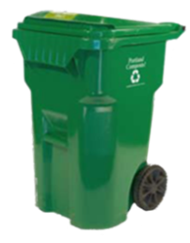
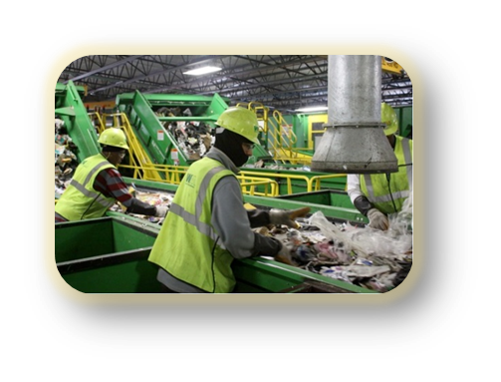
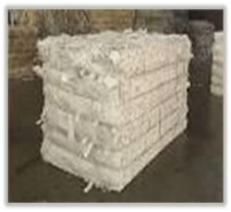
What Makes Something Recyclable?
Can we collect it?
Can we process it?
Will someone buy it?
Notes:
So – lets shift gears. What makes makes something recyclable?
Over the past 2-3 years, recycling markets have constricted while many producers have pushed us to recycle their products.
Here is what we consider before adding a material.
First - can it be collected at the curb?
Frankly, with cart based recycling collection, we can collect just about anything.
Next - can materials be separated for recycling at our recycling facilities?
There are physical limitations to what can be sorted for recycling. Equipment and labor may not be able to identify or separate certain types of materials.
If recyclables are too small they fall through the screens and end up in the trash, or if they look or act like other materials, they may end up in the wrong bale. For example, film plastics and pouches would fall into this category as they act like paper at our recycling facilities and end up in paper bales – becoming a contaminant when they get to the paper mills.
Finally – are there end-Markets?
Robust end-markets are critical for sustainable recycling. Markets require a mix of sufficient and volume and value to generate buyers for the material. Once materials are added to curbside recycling programs, we need reliable multiple markets to make recycling sustainable at our scale.
Collection – convenience, size, will people put it in their bins?
Processing – identification, sorting, size
End market – demand, volume, value

Slide 7
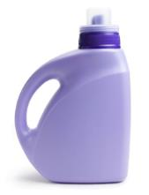

Changes in Recycling: The Evolving Ton
Less paper, more plastic (small one-use pieces and no end markets)
Change outpaces MRF technology
Global markets have dried up for #3-#7 plastics and scrap paper
Notes:
The material that we use in our daily lives has evolved tremendously. We call this the evolving ton. We use less paper, more plastic and there is no growth in metal. Today there is an evolution of plastic packaging.
Future:
Custom packaging
Small packaging
Non-recyclable (limited sorting technology)
No end markets
Machines meant to handle more paper, less plastic (trend 10 years ago). Updating machines is expensive. Redesigning plants is expensive
Consumers are confused about what is recyclable. While only 20% of participants admitted they weren’t always sure of what to recycle, up to 65% of participants improperly placed non-recyclable items in the recycling in practice.
Consumers can recycle more. Traditional curbside recyclables ~52% of the waste stream. We recycle about half of what we could be recycling in our curbside programs
Messages need to be simple and targeted for behavior change to occur
Only 9% of the total plastic waste generated in 2012 was recovered for recycling. 55% of aluminum beer and soft drink containers generated were recycled

Slide 8
Changes in Recycling: How did We Get Here?
Recycle, but no reduce or reuse
Collection prioritized over markets
Cost & convenience > quality control
Focus on landfill avoidance “zero waste”
Measuring in tons = rewarding bad behavior
Wish-cycling
Notes:
How did we get to this?
Reduce and reuse were ignored. In most places we don’t even measure it!
Collection was prioritized over markets
Cost and consumer convenience took precedence over quality control
Landfill avoidance played a key role for effective messaging. Pretty soon it was the only message.
Because we measured in tons collected, we rewarded bad behavior
Wishful recycling

Slide 9
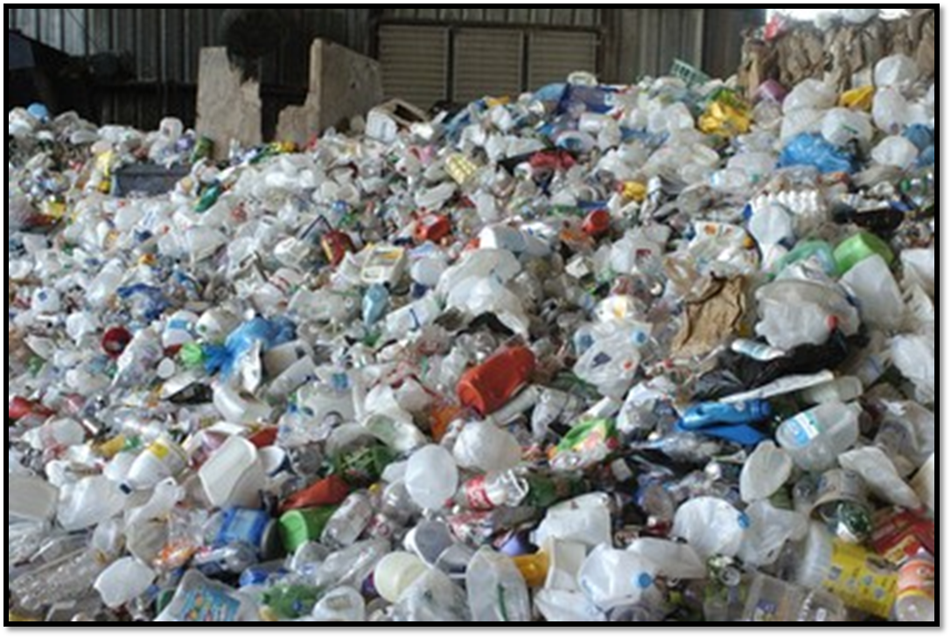
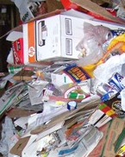
The Process: Tipping Floor at the Material Recovery Facility

Slide 10
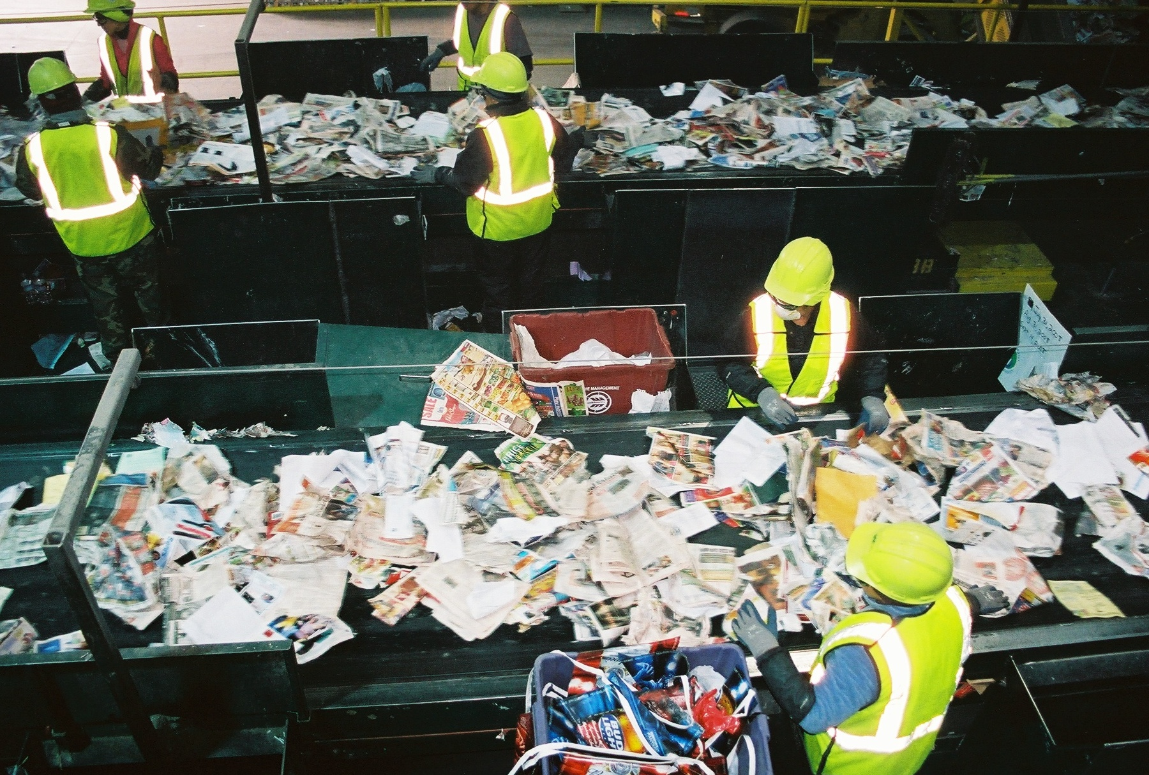
The Process: Sorting of Products Occurs Using Gravity, Manual Labor and Technology.

Slide 11
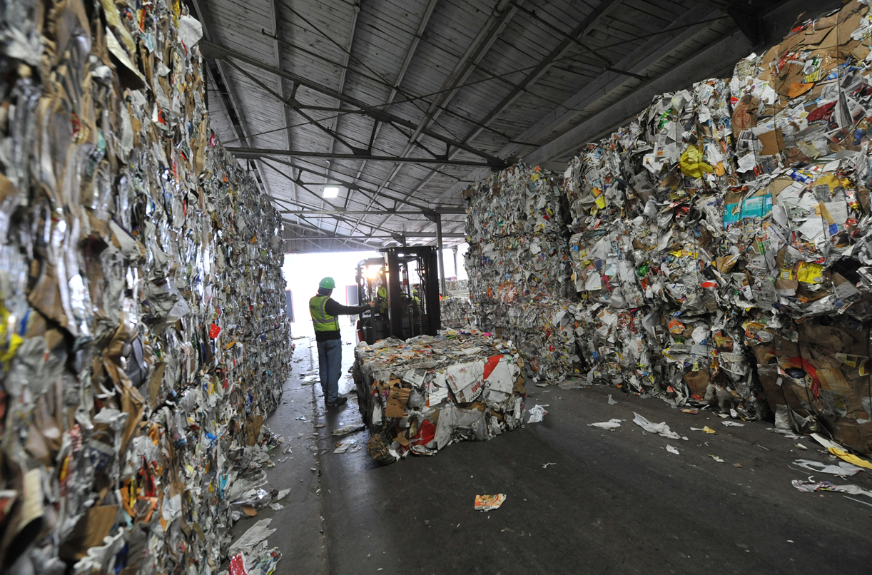
The Process: End Product is Baled Material Shipped to Recycling Manufacturers

Slide 12

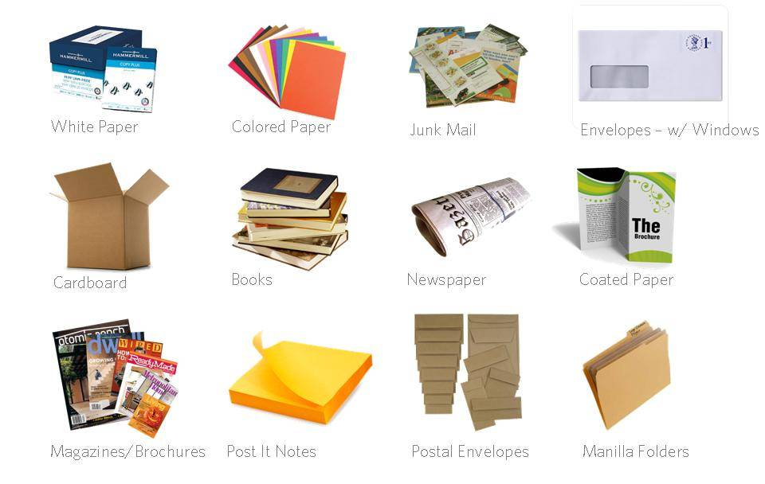
Acceptable Paper Items

Slide 13
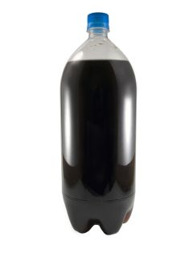
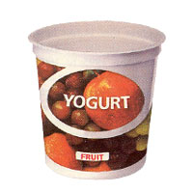
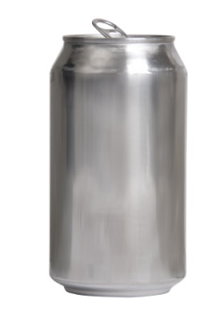
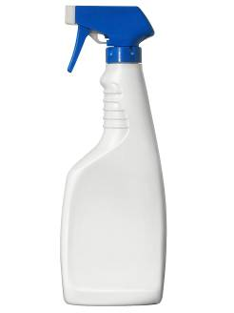
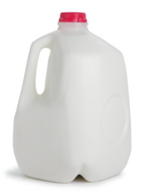
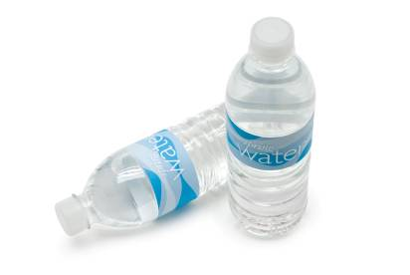
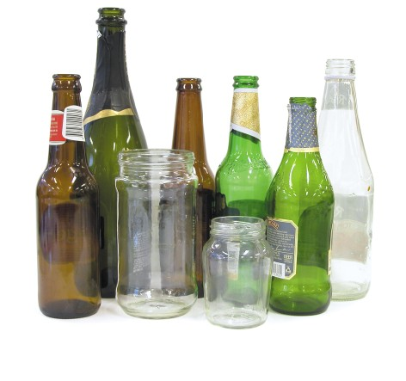
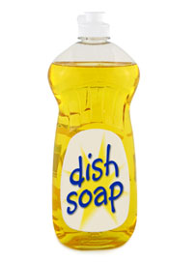
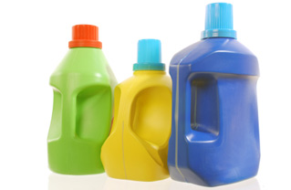
Acceptable Containers
All plastic bottles, jugs and tubs with lids
ALL caps are acceptable
All metal beverage or food cans
All glass bottles and jars

Slide 14
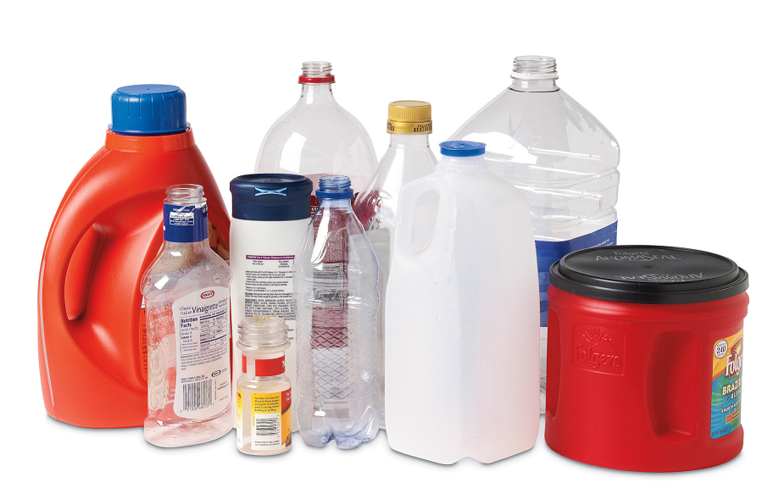
Tip: Look for the Shape!
The # on plastic does not indicate recyclability, only the resin used to create it
All caps and lids can stay on
Plastic Bottles, Tubs, Jugs
Notes:
Lots of confusion around plastics. Best to judge by the shape rather than the presence of a mobius

Slide 15

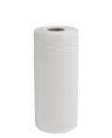
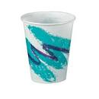


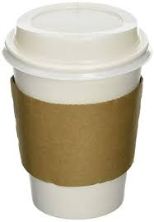
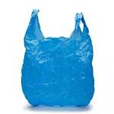





Unacceptable Items
Food Waste
Napkins
Paper Towels
Wax Cups
Coffee Cups
Plastic Bags
Vinyl Binders
Foam Cups, Containers
Electronics
CDs, DVDs
Wood

Slide 17
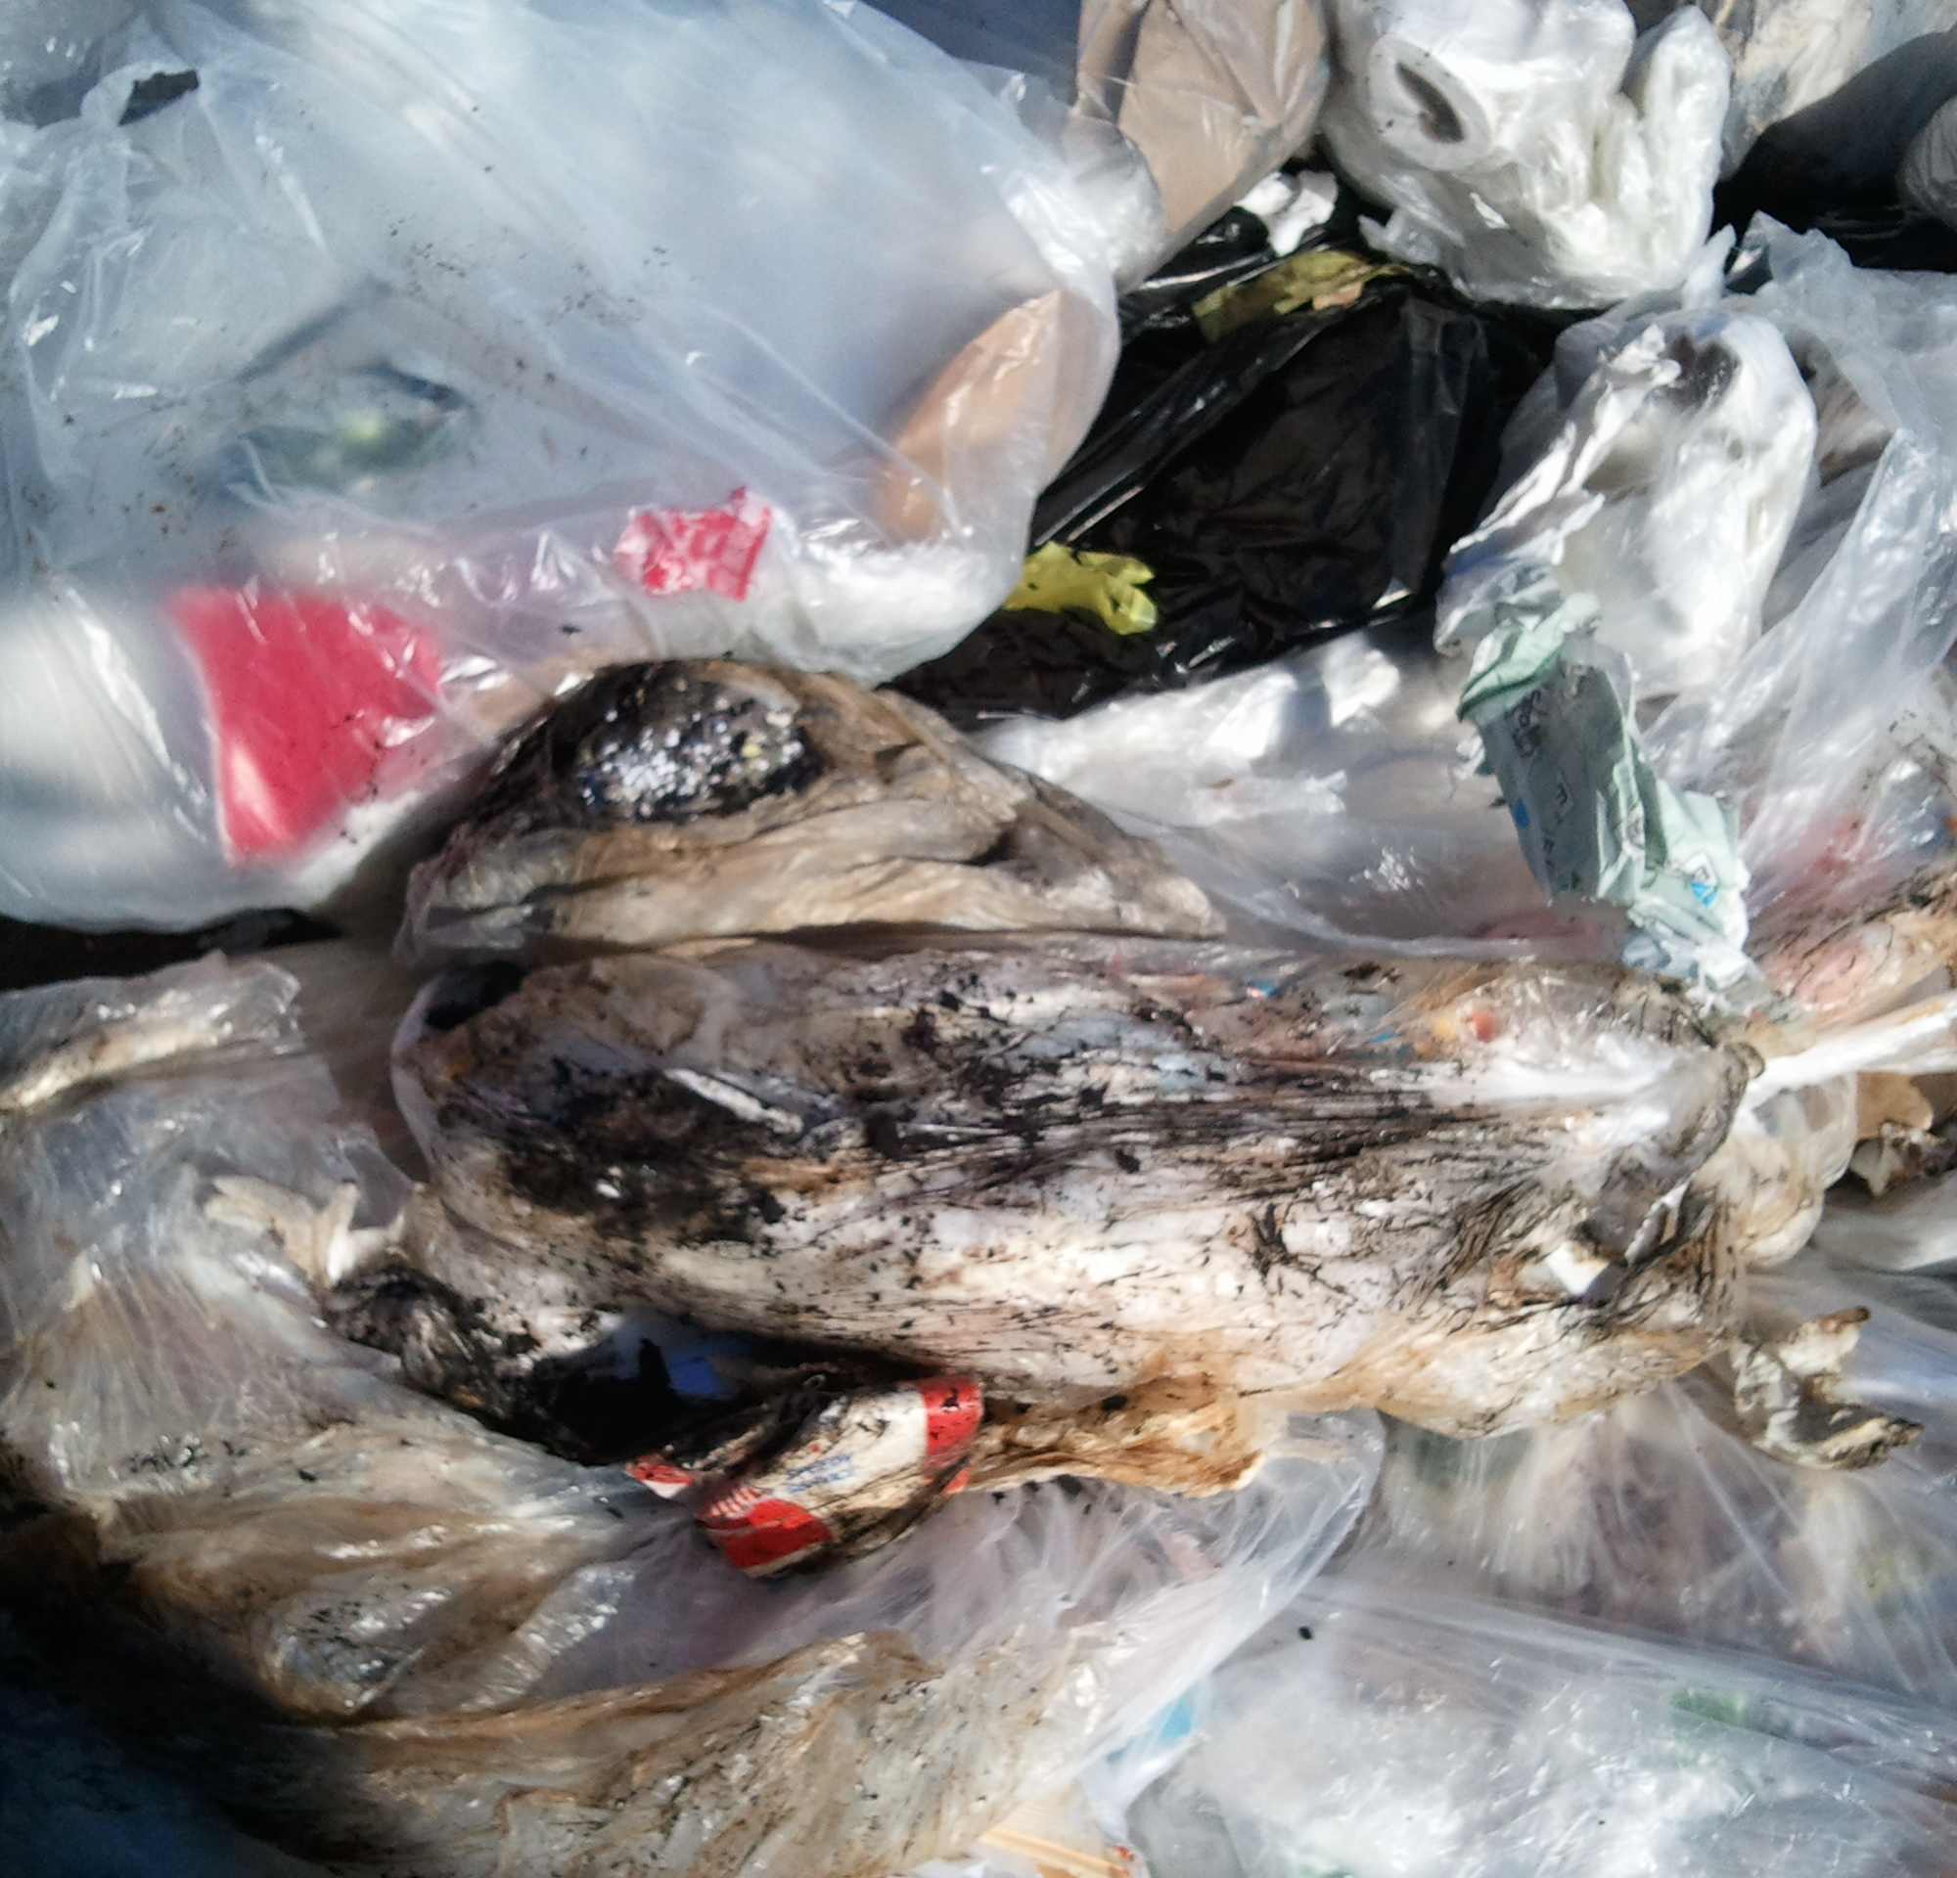
Let’s Talk About Contamination…
How does contamination happen?
    Improper signage
    Lack of training
    Trash/recycle container is full
Recycling that is contaminated may be taken to landfill – which will remain for years to come
Dangerous to our employees
Results in higher processing costs, which may be passed on to customers

Slide 18
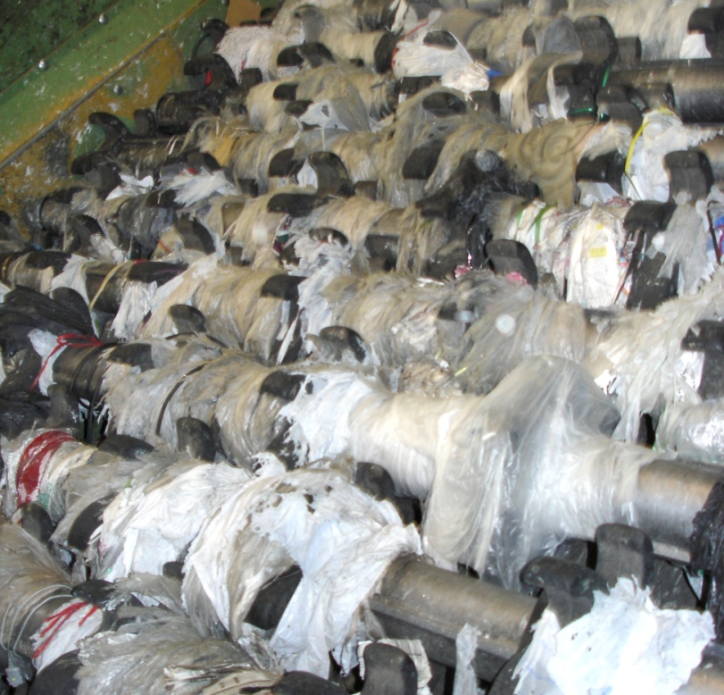
The Cost of Contamination
Plastic bags do this to recycling equipment.

Slide 19
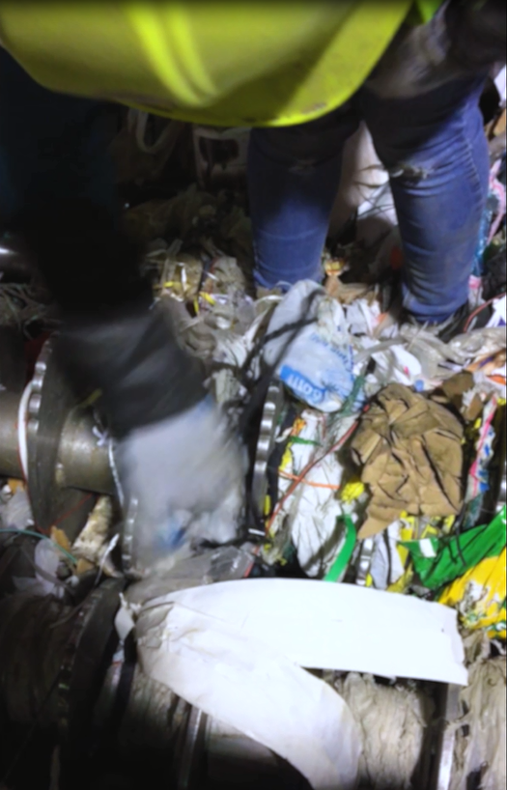
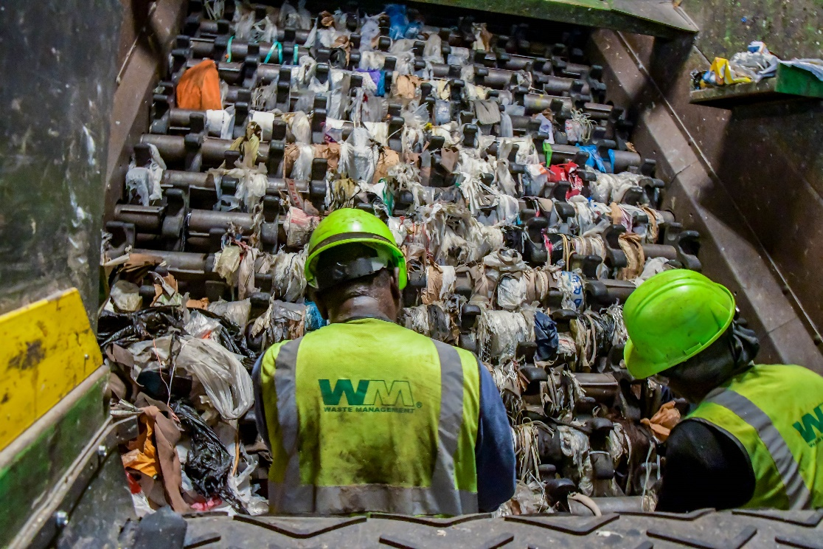
Power of a Plastic Bag
Workers cut bags off several times daily

Slide 20
3 Simple Rules
Recycle all empty bottles, cans, paper and cardboard
No food or liquid in recycling
Keep plastic bags out of recycling cart
Notes:
Recycling should be rewarding and easy for everyone, so our call to action is simple – recycle more of the good stuff, keep out the bad, and share what you’ve learned. That’s the grassroots part.

Slide 21
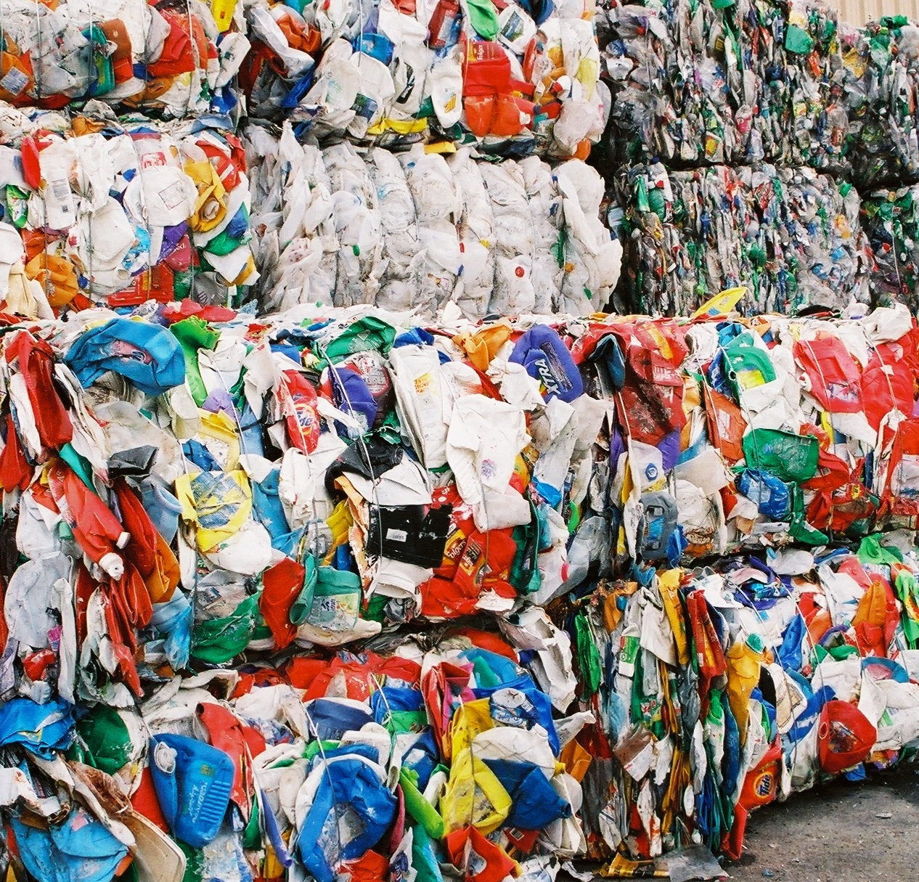
What Ultimately Happens To My Recyclables?
Aluminum cans be recycled an infinite amount of times
Plastic bottles are flaked, pelletized and spun into fiber
Cardboard boxes can become new cardboard boxes
Soda can cases or cereal boxes can become newspaper
Glass is recycled bottle-to-bottle through a local company (Momentum)

Slide 22
How Can I Learn More?
VISIT:
www.wm.com
www.thinkgreenfromhome.com
www.recycleoftenrecycleright.com
Tour our MRF or landfill!
Lara Rezzarday
lrezzard@wm.com
303-594-8389
+21
MILLION
CUSTOMERS
390
COLLECTION
OPERATIONS
$12.M TOTAL
DONATED
IN CHARITABLE
GIVING
18
SECONDARY
PROCESSING
FACILITIES
310
TRANSFER
FACILITIES
4
INDEPENDENT
POWER
PRODUCTION
PLANTS,
2 PRODUCE
RENEWABLE ENERGY
136
LANDFILL-
GAS-TO-
ENERGY
PROJECTS
244
ACTIVE
SOLID WASTE
LANDFILLS
104
TRADITIONAL
RECYCLING
FACILITIES
53 ARE
SINGLE STREAM
12 ARE C&D
RECYCLING
FACILITIES
WM Sustainability Facts
5
ACTIVE
HAZARDOUS
WASTE
LANDFILLS
43
ORGANIC
PROCESSING
FACILITIES
Creates enough energy to power more than 470k homes every year
84
Natural Gas
Fueling Stations
25 Also Serve
The Public
Manages nearly 14 million tons of recyclable commodities
17 WASTE-
TO-ENERGY
PLANTS
OVER
42,600
EMPLOYEES
Dedicates 25,000 protected acres to wildlife habitats

