Slide 1
Notes:
https://us02web.zoom.us/j/86225853384 | 862 2585 3384 | ksj:+%3A:+LNTs3

Slide 2
Sexual & Gender Minority Statuses
As of 2021, 7.1% of the 329.5 M (2020 Census) adults in the U.S. identified within the LGBTQ+/”Queer” community according to a Gallup News poll
Disclosing sexuality
Acknowledging sexual thoughts, feelings, and proposed bxs; less often prompted internally over externally
Requires medicine specific to sexual health and more
Disclosing gender identity
Often challenges the understood Binary
May not require “disclosure” in the same sense or may be visible from earlier ages than sexual orientation; may be prompted externally rather than internally
Requires medicine specific to gender-affirming needs and more
© 2022 | E-Psych Services PC
2

Slide 3
What is “Coming Out?”
Considered to be a significant disclosure, a major life event, the acknowledgement of an identity that Hafstad et al. (2010) compare to the “negative and positive sequelae of trauma” when understood and processed effectively.
Important folks clients typically mention they wish to Come Out to are: psychotherapists, physicians, employers/co-workers, siblings, old romantic partners, parents & family, neighbors, etc., typically taking months-to-years in talk therapy.
Start by exploring the person’s intent to disclose all at once, partially, or gradually
Parents’ response tend to be most important based on clinical observations.
© 2022 | E-Psych Services PC
3

Slide 4
Anti-LGBTQ Laws & Regulations
Human Rights Campaign cited over 266 anti-LGBTQ bills under consideration beginning in 2021. Examples:
No Promo Homo laws in: UT, AZ, TX, OK, LA, MI, AL, SC
These “gag rules” limit what schools can speak on LGBTQ matters in class, starting with Health classes and progressing into other school subjects over the past six years
Governors signed measures re: Athlete bans in: AR, MI, TN, AL, SD re: MTF trans athletes playing on the gendered teams they ID with
AR banned gender medicine for minors (being considered AL & TX)
“Don’t Say Gay” in FL
© 2022 | E-Psych Services PC
4

Slide 5
The Costs of Staying in the Closet
• Living in-authentically & typically developing false personas
• Lowered self-esteem or poor self-image
• Fear or hypervigilance of being “outed”
• Anxiety symptoms of excessive worry, negative self-talk
Self-aggression, self-hatred
Posttraumatic stress (PTS) [Zavala & Waters, 2020]
• Clinical Observations
Difficulty finding “tribe,” friends, partners
Homonegativity (Frost & Meyer, 2009), internalized heterosexism, lack of Queer education
© 2022 | E-Psych Services PC
5

Slide 6
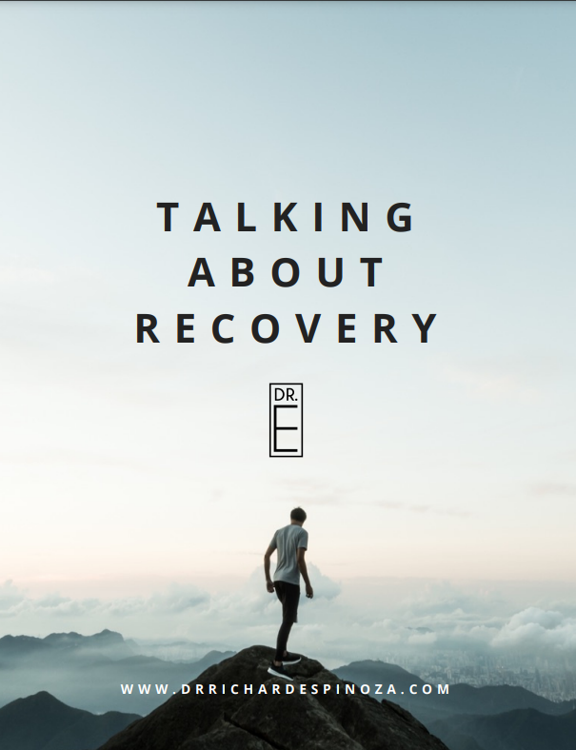
Assessing Readiness for Coming Out
• Screen for depression & SI (PHQ-9), anxiety (GAD-7), PTS (PC-PTSD-5)
Assess alcohol & other drug use (AUDIT-C & DAST-10)
Ode to Vices | Reality Check | Talking About Recovery
© 2022 | E-Psych Services PC
6
Notes:
Process Question examples…

Slide 7
More on Assessing Readiness for Coming Out
• Assess the individual’s health psych & insight
• Thoroughly explore the timing of the disclosure
Strategize who or what circles to come out to first and why
• Assess physical safety, threats of violence, trauma hx
• Develop contingency plans for if unhoused or relocated
• Provide resources, resources, resources
• Assess the person’s hopes, fears & realistic outcomes
• Build confidence, decondition negative self-talk
© 2022 | E-Psych Services PC
7

Slide 8
Compounding Factors to Coming Out
Intersections with:
• Ethnic identity/race
• Culture
• Religion/faith
• Gender
• SES
• Straight-acting
Homonegativity
© 2022 | E-Psych Services PC
8

Slide 9
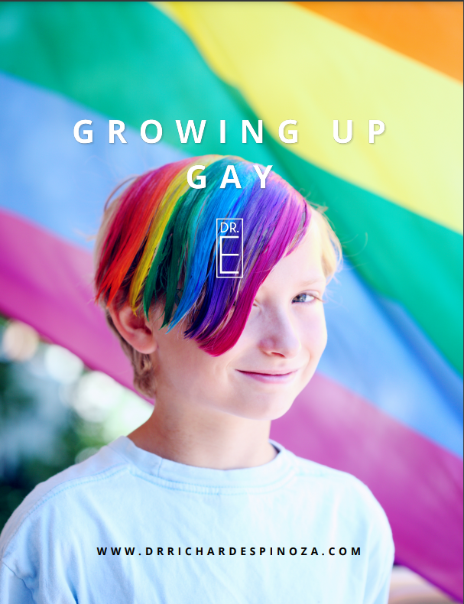
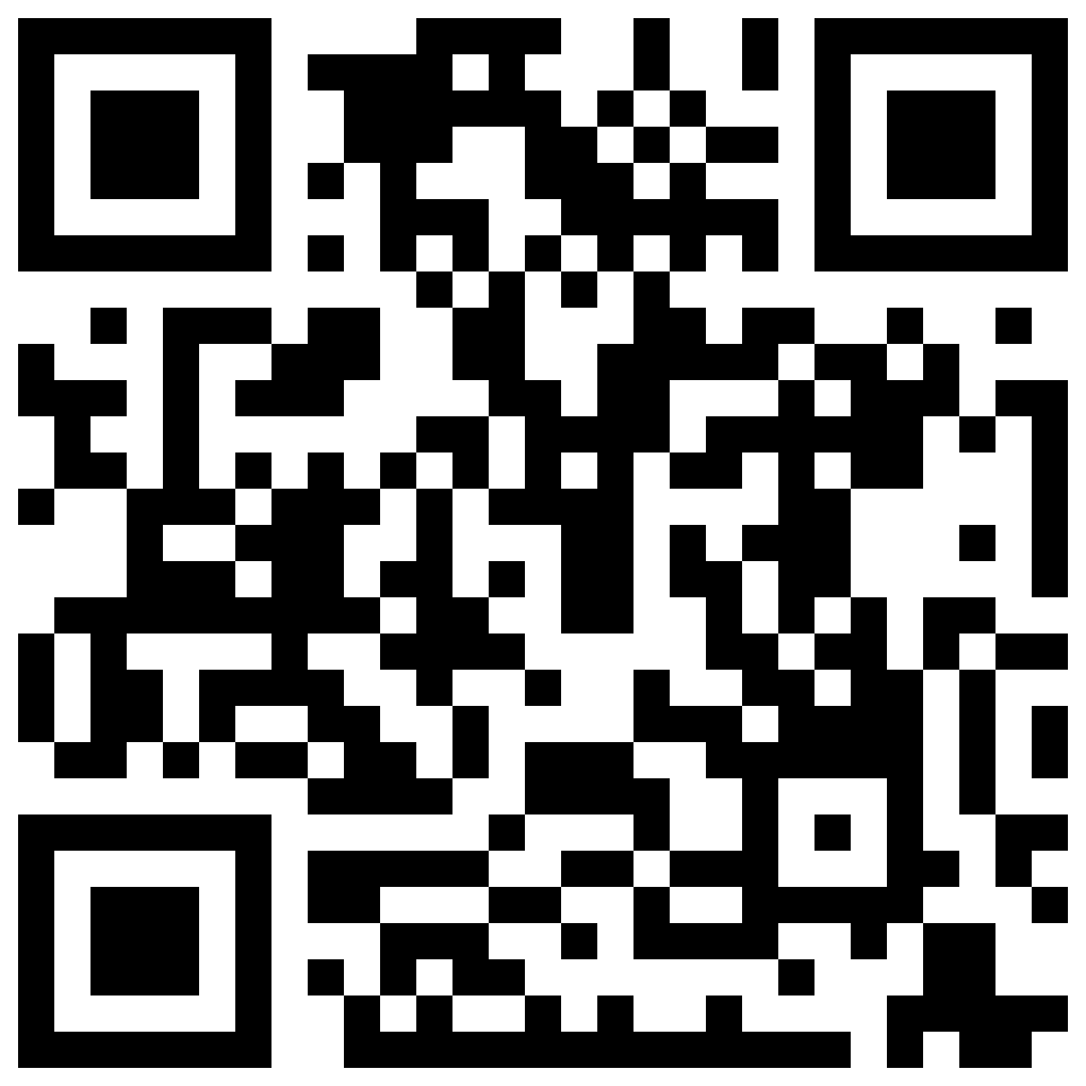
Tx Planning for LGBTQ+ Persons
Acknowledge, explore, and process the experience of growing up LGBTQ+
Growing Up Gay | Worksheet
Explore views on masculinity/femininity and passing for straight
U Straight Acting? | Worksheet
Worksheet QR
© 2022 | E-Psych Services PC
9

Slide 10
More on Tx Planning for LGBTQ+ Persons
Acknowledge & process any traumas while extrapolating and highlighting resiliency
Humor can be helpful in developing and maintaining resilience, just not self-deprecating humor
If one isn’t met with Strengths-Based Parenting (Zavala & Waters, 2020), develop a Chosen Family, but “don’t let your sexual preferences be the filter by which you let people into your life (Downs, 2012).”
Hyperarousal may be a concern, as social intelligence is a necessary skill so developing Distress Tolerance, coping skills, and meditative practices are advised. Again, acknowledging the distress while highlighting the adaptive coping applied (i.e. “gaydar”) [Boulden, 2001; Schelp, 2003; Bhattasali & Maiti, 2015; Grätz, 2018; Miller, 2018; Ais et. al., 2020; Barton, 2015; Smith, 2021; Kannabiran, 2022; Rehaag & Cameron, 2020]
Psychoeducation re: fluid nature of human sexuality, gender, intimate relationships, homophobia, heterosexism, homonegativity, and Queer history are advised for Queer folks & Allies alike.
Develop a Tx Team privy to medication management, sexual health, gender medicine, social work, and community engagement
© 2022 | E-Psych Services PC
10

Slide 11
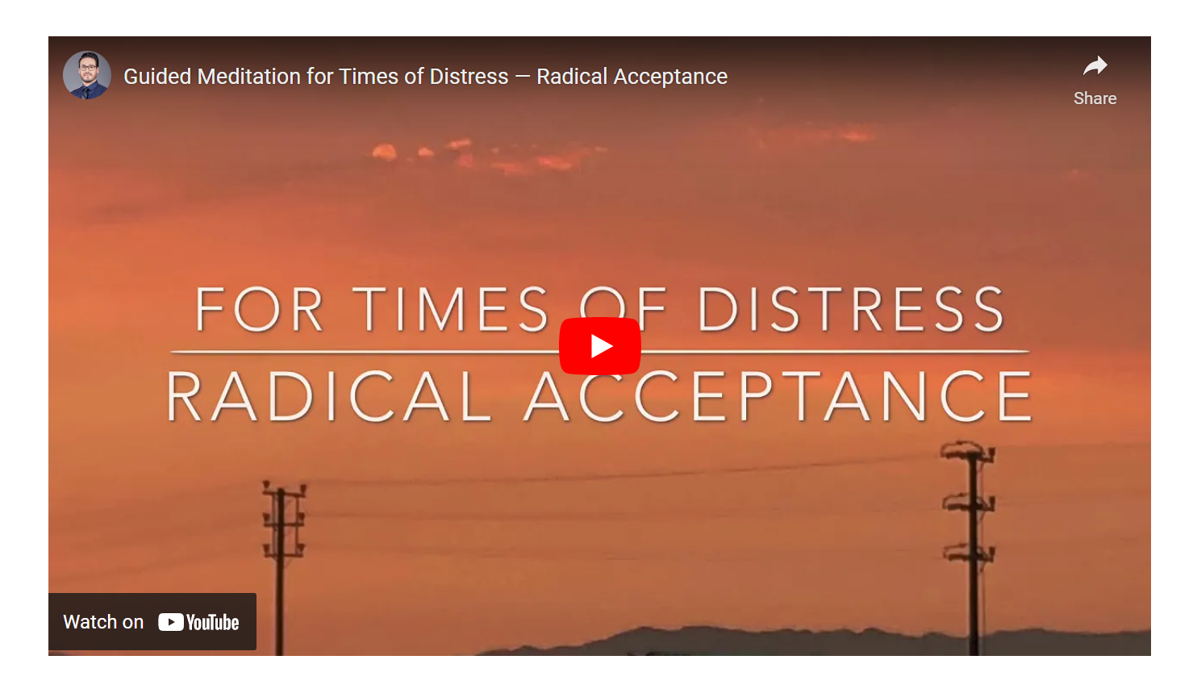
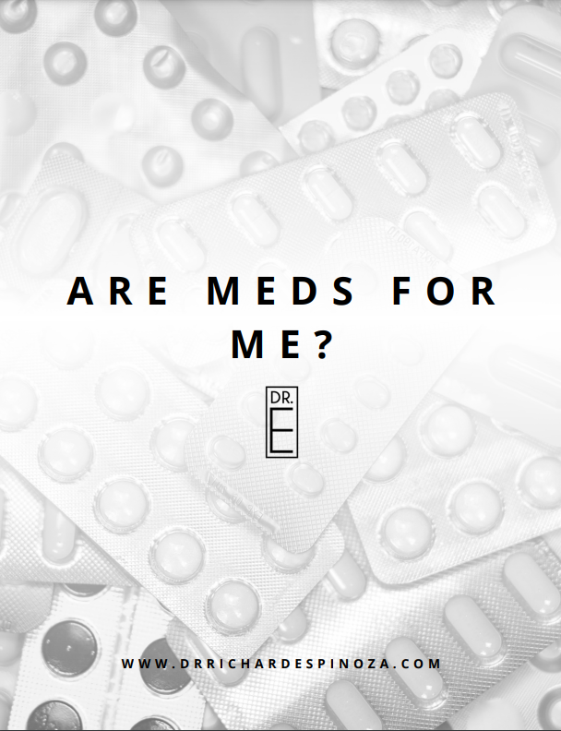
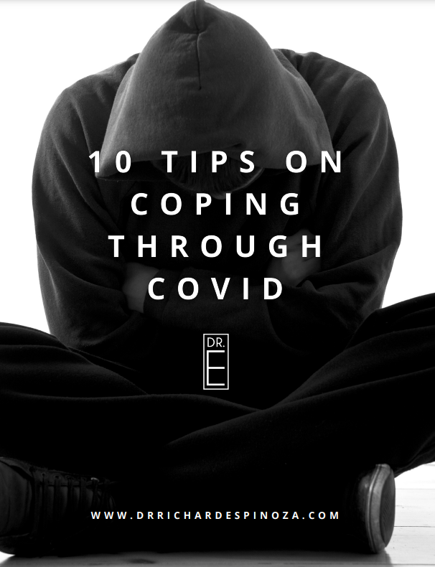
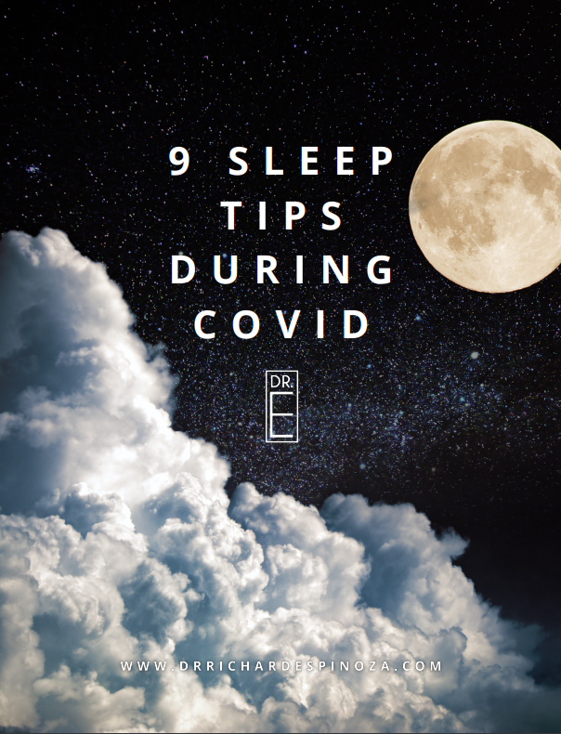
Interventions for LGBTQ+ Persons
© 2022 | E-Psych Services PC
11
Notes:
Process Question examples…

Slide 12
The Importance of Family
• Strength-Based Parenting (SBP)
• Family Systems formulations, Tx Plan & interventions
• Culturally-responsive Rogerian UCR
Prosocial bxs for clients, LGBTQ+ networking resources
• Spiritual counseling congruent with culture
Chosen Family (Kim & Fayissa, 2021)
© 2022 | E-Psych Services PC
12

Slide 13
Parallel Process for Queer Clinicians
• Self-disclosure falls under Multicultural and Humanistic lenses, just remember psychotherapy is an intimate relationship that remains professional; appreciating the one-sided nature of talk therapy differs it from friendship.
Consult with one’s own treatment, clinical supervisors, or clinician support groups
Avoid interventions that may receive feedback such as: “When you opened up about that, Dr. Smith, I wasn’t sure who the client was that session…”
Clarify Roles and the Therapeutic Frame as needed
Thp & Clt should discuss what happens if you run into each other in public (i.e. Pride Festivals, ALC, AIDS Walk, Dyke March, and other Queer spaces)
© 2022 | E-Psych Services PC
13

Slide 14
How to Ally
Experiential Time! Allies, hold hands with someone who presents as the same gender as you and take a lap around the block.
Normalize the topic…
Ask LGBTQ+ loved ones if they plan to date or are actively dating. Get comfortable using the pronouns of the gender(s) your Queer loved ones are attracted to. Decrease to use of words like “friend” when knowingly referring to a potential partner.
Ask to attend Queer spaces, and acknowledge you are a guest but not a special guest star in Queer spaces
Yes, connect your queer loved ones to possible partners like you do with your fellow heterosexual Allies, but play matchmaker based off common interests and personality match, not based on the mere fact they are LGBTQ+.
Sentiments such as: “I always knew (or suspected)” has mixed reception; use caution
Coming Out isn’t always linear, and LGBTQ+ persons may need support in situations where they are forced to try and “pass” to remain safe.
© 2022 | E-Psych Services PC
14

Slide 15
More on How to Ally
Asking about an LGBTQ+ status (i.e “How do you identify?”) gives the person a chance to confirm their identity. Waiting for them to disclose their LGBTQ+ status lends a chance to affirm their identity; choose accordingly.
Pro Tip: Asking Yes/No questions asserts privilege
Allied Clinicians, try starting therapy with stating your pronouns and sexual orientation—strange at first, huh? This is experiential, humanistic, and facilitates the therapeutic frame from a place of collaboration—a pillar in culturally responsive psychotherapy.
Try direct affirmations such as: “If you’re [Queer], know that I love and support you.” instead of “I still love you,” which can subtly reinforcing heteronormativity. Try to avoid sentiments like, “ I don’t care either way if you’re [Queer].”
Remember, the better way to affirm something is to directly say it, not imply it. If any of these notions cannot comfortably come out of your mouth as an Ally yet, take more time to reflect and become comfortable much like your Queer loved one is.
© 2022 | E-Psych Services PC
15

Slide 16
Parallel Process for Queer Clinicians
Remember that clients’ narratives have always held the potential to be triggering for therapists
Remember that focusing on doctor-patient similarities can sometimes create cultural blind spots
Consult with one’s own therapist, supervisor or consult group re: boundaries & parallel process
Clarify roles as needed, and apply Humanistic self-disclosure skillfully if deemed appropriate
Remember that therapy, indeed, is an intimate exchange, yet always a professional service
© 2022 | E-Psych Services PC
16

Slide 17
Local Resources
Dr. E’s Therapy Worksheets: www.DrRichardEspinoza.com/worksheets
AIDS/LifeCycle | www.aidslifecycle.org | (415) 581-7077
APLA Health & Wellness | www.aplahealth.org | (323) 215-1725
Cheer Los Angeles | www.cheerla.org
Los Angeles LGBT Youth Center | www.lalgbtcenter.org | (323) 993-7400
Los Angeles LGBT Center | www.lalgbtcenter.org | (323) 993-7400
PFLAG Los Angeles | www.pflag.org | @pflag | (888) 735-2488)
Trans Wellness Center | www.mytranswellness.org
Youth Center on Highland |www.lalgbtcenter.org | (323) 860-2280
© 2022 | E-Psych Services PC
17

Slide 18
National Resources
CA Youth Crisis Line | www.calyouth.org | (800) 843-5200
Child Welfare Information Gateway | www.childwelfare.gov | (800) 422-4453 Childhelp®
GLMA: Health Professionals Advancing LGBTQ Equality | www.glma.org
GMHC | www.gmhc.org | (800) 243-7692
National Adult Protective Services Association | www.napsa-now.org
National Domestic Violence Hotline | www.thehotline.org | (800) 799-SAFE (7233)
National Alliance on Mental Illness | www.nami.org
National Suicide Prevention Lifeline| (800) 273-TALK (8255)
SAMHSA’s National Helpline | www.samhsa.gov
The Trevor Project| www.thetrevorproject.org| (866) 488-7386
© 2022 | E-Psych Services PC
18

Slide 19
Closing Thoughts
Coming Out is a major life disclosure event unique to LGBTQ folks. It’s an event that can promote a sense of community at it’s best and symptoms of PTSD near its worst. Coming Out can be cathartic and painful at first, but liberating in the long run. Acknowledging and disclosing one’s identity within the LGBTQ+ community is necessary for healthy psychological development, yet little research and protocol exists to help inform LGBTQ-affirming psychotherapy and treatment planning.
To-date, the best practices have come from Positive Psychology, which has been Eurocentric and less inclusive to ethnic and religious minorities to-date. As such, Coming Out can be more challenging for POC and those belonging to a faith; this can be compounded by anti-LGBTQ laws supporting homophobia and maintaining heterosexism and homonegativity.
Coming Out can become a more positive experience with help from LGBTQ-affirming psychotherapy and treatment planning with clinicians skilled in identifying and treating the key elements and stressors of this experience.
© 2022 | E-Psych Services PC
19

Slide 20
References
Ais Jr, M., Collao, K., Deuna, L. J. S., Lopez, E. J. C., Mejia, A., Perez, K. K., ... & Valdez, J. P. (2020). A STUDY FOCUSED ON GAYDAR AND THE DIFFERENT BASES USED BY GAY STUDENTS OF POLYTECHNIC UNIVERSITY OF THE PHILIPPINES IN IDENTIFYING INDIVIDUALS THAT HAVE THE SAME SEXUAL ORIENTATION AS THEIRS.
Barton, B. (2015). How like perceives like: Gay people on “gaydar”. Journal of Homosexuality, 62(12), 1615-1637.
Bhattasali, N., & Maiti, E. (2015). Machine “gaydar”: using Facebook profiles to predict sexual orientation. Mach Learn.
Budge, S. L. (2014). Navigating the balance between positivity and minority stress for LGBTQ clients who are coming out. Psychology of Sexual Orientation and Gender Diversity, 1(4), 350.
Blair, K. L., & Pukall, C. F. (2015). Family matters, but sometimes chosen family matters more: perceived social network influence in the dating decisions of same- and mixed-sex couples. The Canadian Journal of Human Sexuality, 24(3), 257+. https://link.gale.com/apps/doc/A441585157/HWRC?u=dall6191&sid=bookmark-HWRC&xid=aa666687
Boulden, W. T. (2001). Gay men living in a rural environment. Journal of Gay & Lesbian Social Services, 12(3-4), 63-75.
Brandon-Friedman, & Kim, H.-W. (2016). Using social support levels to predict sexual identity development among college students who identify as a sexual minority. Journal of Gay & Lesbian Social Services, 28(4), 292– 316. https://doi.org/10.1080/10538720.2016.1221784
© 2022 | E-Psych Services PC
20

Slide 21
References
Carastathis, G., Cohen, L., Kaczmarek, E., & Chang, P. (2017). Rejected by family for being gay or lesbian: Portrayals, perceptions, and resilience. Journal of Homosexuality, 64(3), 289–320. https://doi. org/10.1080/00918 369.2016.11790 35.
Charbonnier, E., & Graziani, P. (2016). The stress associated with the coming out process in the young adult population. Journal of Gay & Lesbian Mental Health. https ://doi.org/10.1080/19359705.2016.11829 57.
Downs, A. (2012). The velvet rage: Overcoming the pain of growing up gay in a straight man’s world. Da Capo Lifelong Books.
Fish, McInroy, L. B., Paceley, M. S., Williams, N. D., Henderson, S., Levine, D. S., & Edsall, R. N. (2020). “I’m Kinda Stuck at Home With Unsupportive Parents Right Now”: LGBTQ Youths’ Experiences With COVID-19 and the Importance of Online Support. Journal of Adolescent Health, 67(3), 450–452. https://doi.org/10.1016/j.jadohealth.2020.06.002
Grätz, M. (2018). Gaydar and the fallacy of decontextualized measurement. Sociological Science, 5, 270-280.
Hammack, Frost, D. M., Meyer, I. H., & Pletta, D. R. (2017). Gay Men’s Health and Identity: Social Change and the Life Course. Archives of Sexual Behavior, 47(1), 59–74. https://doi.org/10.1007/s10508-017-0990-9.
Hafstad, G. S., Gil-Rivas, V., Kilmer, R. P., & Raeder, S. (2010). Parental adjustment, family functioning, and posttraumatic growth among Norwegian children and adolescents following a natural disaster. American Journal of Orthopsychiatry, 80(2), 248.
© 2022 | E-Psych Services PC
21

Slide 22
References
Human Right Watch. (2016, December 7). US: Repeal Anti-Gay No Promo Homo Laws [Video]. https://www.youtube.com/watch?v=RG0pGl8CRjY.
Jones, J. M. (2021). What Percentage of Americans Are LGBT?. Gallup.com. https://news.gallup.com/poll/332522/percentage-americans-lgbt.aspx.
Kannabiran, G. (2022). Flying under the gaydar. Interactions, 29(3), 24-26.
Kim, S., & Feyissa, I. F. F. (2021, April). Conceptualizing “family” and the role of “chosen family” within the LGBTQ+ refugee community: A text network graph analysis. In Healthcare (Vol. 9, No. 4, p. 369). Multidisciplinary Digital Publishing Institute.
Lytle, M., Vaughan, M., Rodriguez, E., & Shmerler, D. (2014). Working with LGBT individuals: Incorporating positive psychology into training and practice. Psychology of Sexual Orientation and Gender Diversity, 1(4), 335– 347. https://doi.org/10.1037/sgd0000064.
Miller, A. E. (2018). Searching for gaydar: Blind spots in the study of sexual orientation perception. Psychology & Sexuality, 9(3), 188-203.
Mills-Koonce, W., Rehder, P., & McCurdy, A. (2018). The significance of parenting and parent–child relationships for sexual and gender minority adolescents. Journal of Research on Adolescence, 28(3), 637–649. https ://doi.org/10.1111/jora.12404.
Milton, D. C., & Knutson, D. (2021). Family of origin, not chosen family, predicts psychological health in a LGBTQ+ sample. Psychology of Sexual Orientation and Gender Diversity. Advance online publication. https://doi.org/10.1037/sgd0000531
© 2022 | E-Psych Services PC
22

Slide 23
References
NBC News. (2021, April 27). Advocates Fear Wave of Anti-LGBTQ Bills Could Become Law | NBC News NOW. [Video].https://www.youtube.com/watch?v=LvqkR76bGEg
Phillips. (2001). The Overstimulation of Everyday Life: I. New Aspects of Male Homosexuality. Journal of the American Psychoanalytic Association, 49(4), 1235–1267. https://doi.org/10.1177/00030651010490042001
Price, E., & Prosek, E. (2019). The lived experiences of GLB college students who feel supported by their parents. Journal of GLBT Family Studies.
Rehaag, S., & Cameron, H. E. (2020). Experimenting with Credibility in Refugee Adjudication: Gaydar. Can. J. Hum. Rts., 9, 1.
Ronan, W. (2021). 2021 Slated to Become Worst Year for LGBTQ State Legislative Attacks as Unprecedented Number of States Poised to Enact Record-Shattering Number of Anti-LGBTQ Measures Into Law. [website] www.hrc.org. https://www.hrc.org/press- releases/2021-slated-to-become-worst-year-for-lgbtq-state-legislative-attacks.
Shelp, S. G. (2003). Gaydar: Gaydar. Journal of Homosexuality, 44(1), 1-14.
Smith, S. (2021). Who is Most Likely to Stereotype the LGBTQ+ Community?. Honors Theses. 19.
https://digitalcommons.newhaven.edu/honorstheses/19
© 2022 | E-Psych Services PC
23

Slide 24
References
Solomon, D., McAbee, J., Åsberg, K., & McGee, A. (2015). Coming out and the potential for growth in sexual minorities: The role of social reactions and internalized homonegativity. Journal of Homosexuality, 62(11), 1512-1538.
Waters, L. (2015a). The relationship between strength-based parenting with children’s stress levels and strength-based coping approaches. Psychology, 6, 689–699. https ://doi.org/10.4236/psych.2015.66067.
Waters, L. (2015b). Strength-based parenting and life satisfaction in teenagers. Advances in Social Sciences, 2, 158–173.
Waters, L. (2017). The strength switch. New York: Avery.
Zavala, & Waters, L. (2020). Coming Out as LGBTQ +: The Role Strength-Based Parenting on Posttraumatic Stress and Posttraumatic Growth. Journal of Happiness Studies, 22(3), 1359–1383. https://doi.org/10.1007/s10902- 020-00276-y.
© 2022 | E-Psych Services PC
24

Slide 25
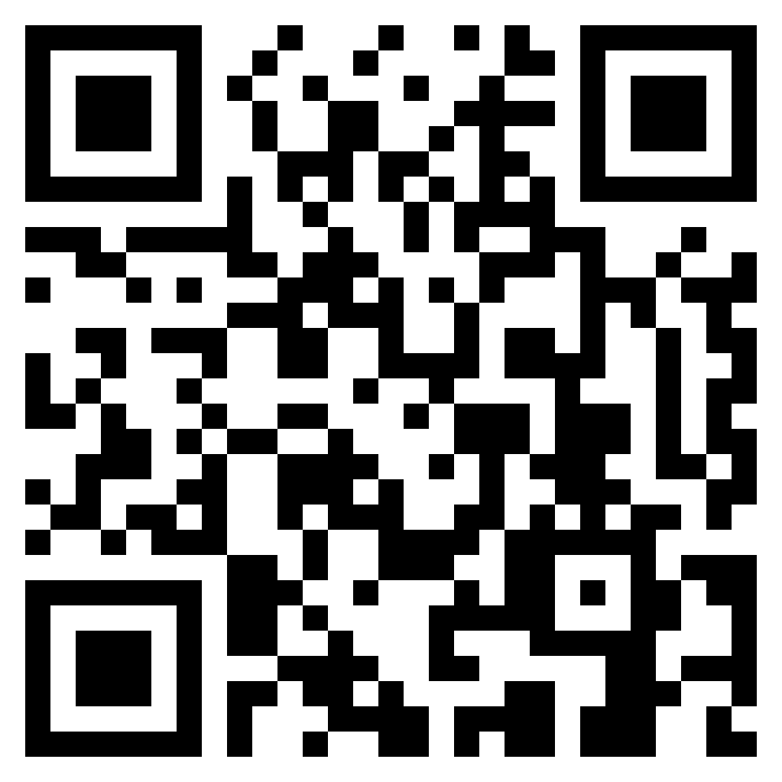
My next talks…
Playing It Straight | Thursday June 2nd, 2022 from 12pm to 1:30pm PST online
Let’s Talk About Coming Out | Thursday June 16th, 2022 from 12pm to 1:30pm PST online
Save your seats here.
© 2022 | E-Psych Services PC
25

Slide 26
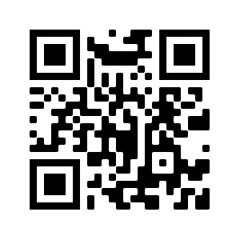
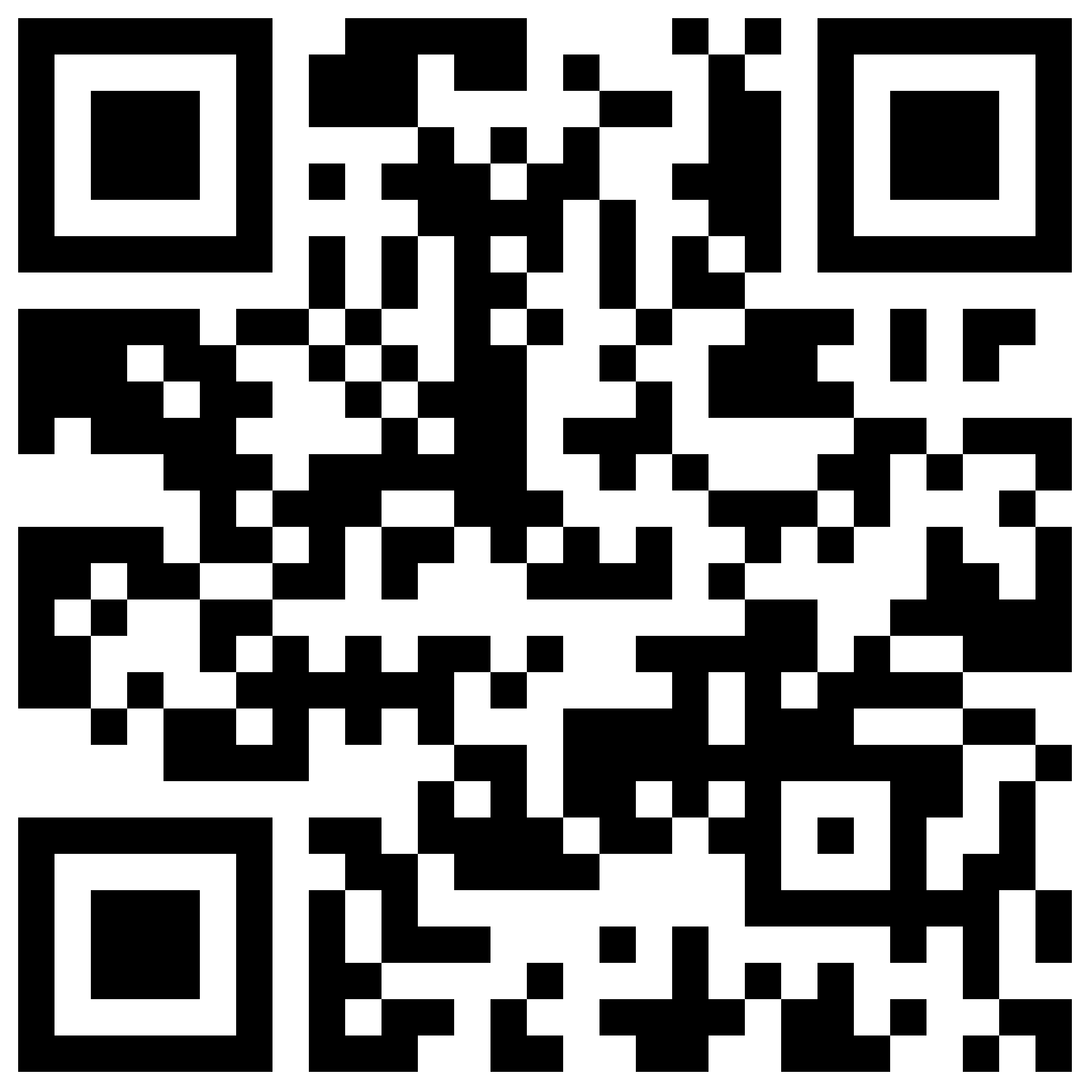
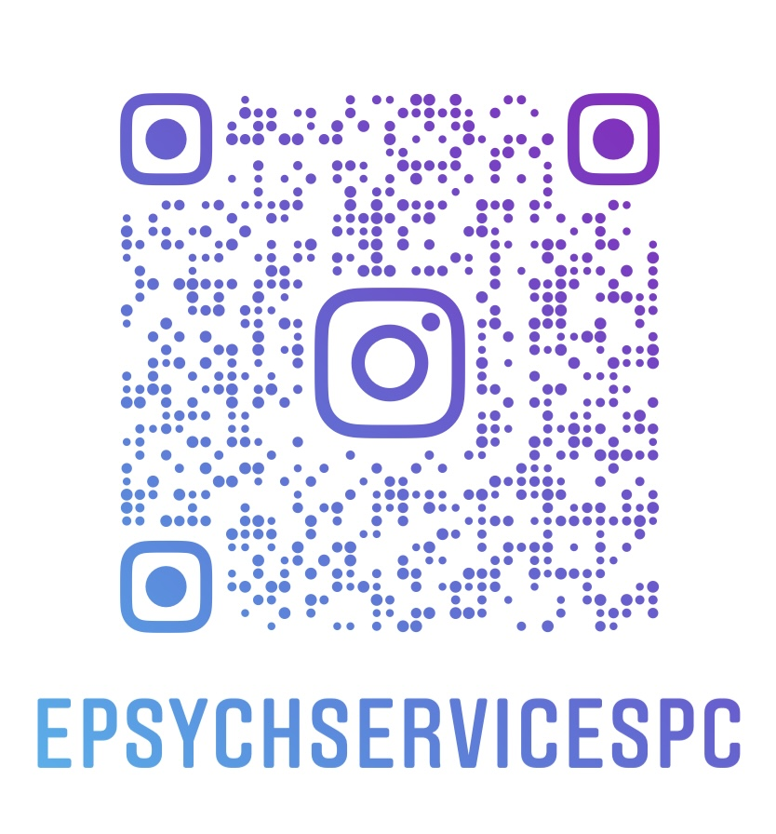
www.DrRichardEspinoza.com |
www.HealthInequalityStudies.org |
@ePsychServicesPC |

