Slide 1
Participant Directed Services in Pennsylvania: Pursuing Life, Liberty and Happiness, Your Way
Participant Directed Advocates of Geogia
Annual Conference, August 2026
Marian Frattarola-Saulino, MSW
Notes:
I'll now talk about the organizational practices that enable co-production to support people’s right to life, liberty and the pursuit of happiness;
examples and insight into the organization I co-founded with Paul, my husband and now lead in partnership with people using services such as Robert, family members such as Pam and the professionals

Slide 2


Slide 3
Values Into Action Est 2005
Offering
Individualized support to people with disabilities and their families, exclusively in their own homes and communities.
Presuming
Competence- every one of us is the expert of our own lives
Believing
That a person’s strengths and aspirations defines who they are and that every human being has the right to self determination
Demonstrating
That the more complex and significant one’s support needs, the more compelling the reason to direct one’s own services, and hence their life course
Shifting
The professional role from decision maker to facilitator
Notes:
Into of the Values Into Action Network: who we are and why we do what we do
Values Into Action Network: who we are and why we do what we do
PA –supporting over 300 people with varying support needs across PA, urban, suburban and rural communities to use HCBS;
NJ-team of 20 SCs (non medical professionals) supporting over 600 people in urban, suburban and rural communities
Co-founded and volunteer executive leadership to two disability led organizations: Collaborative NJ and Alliance for Citizen Directed Supports
DD council grantee in both NJ and PA
Sought for publications and consultation on self direction and organizational design and delivery of HCBS services
And beyond!

Slide 4
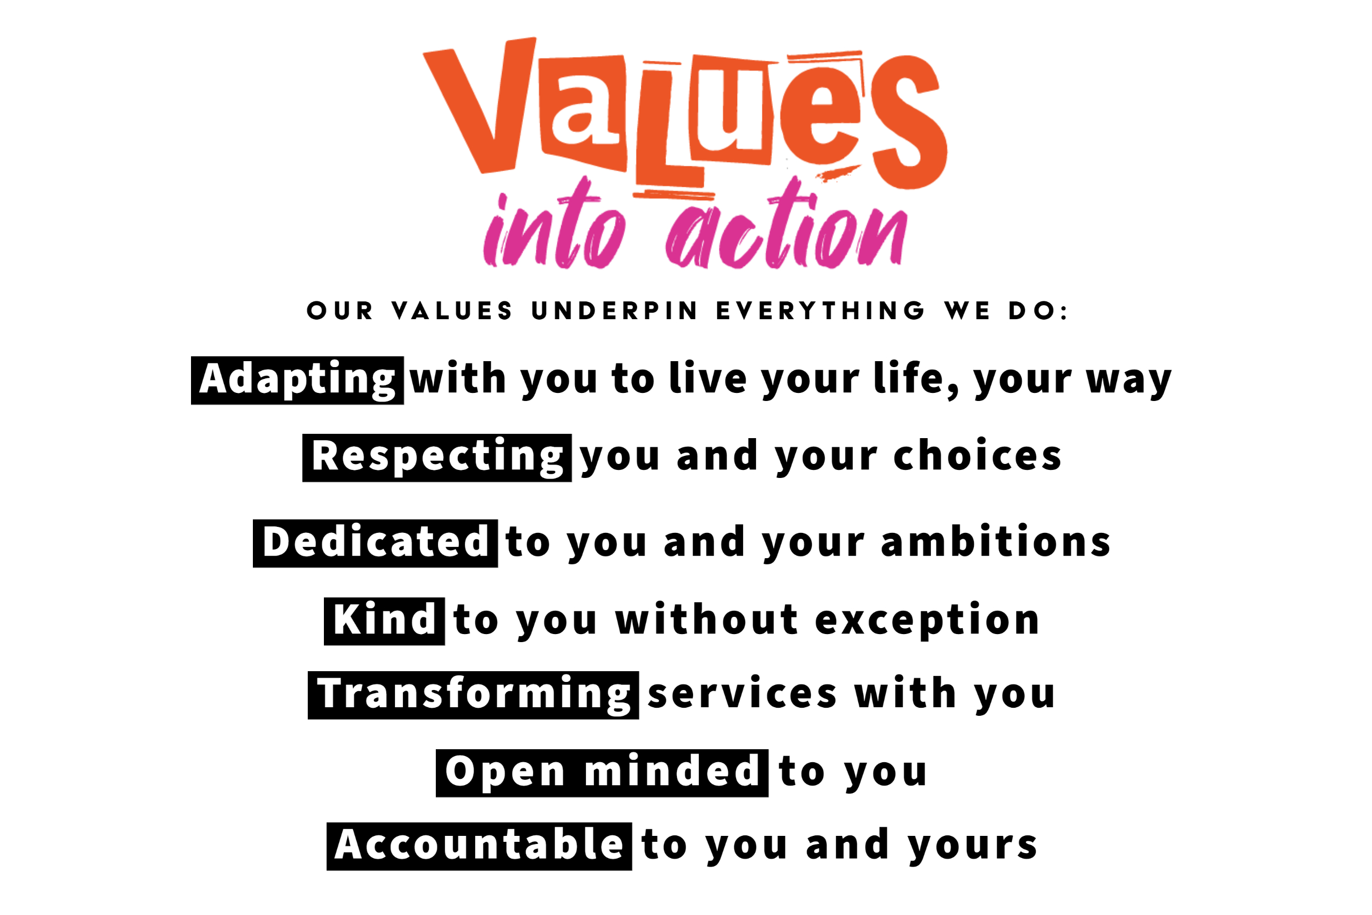
Our Values
Notes:
Our core values underpin everything we do.

Slide 5
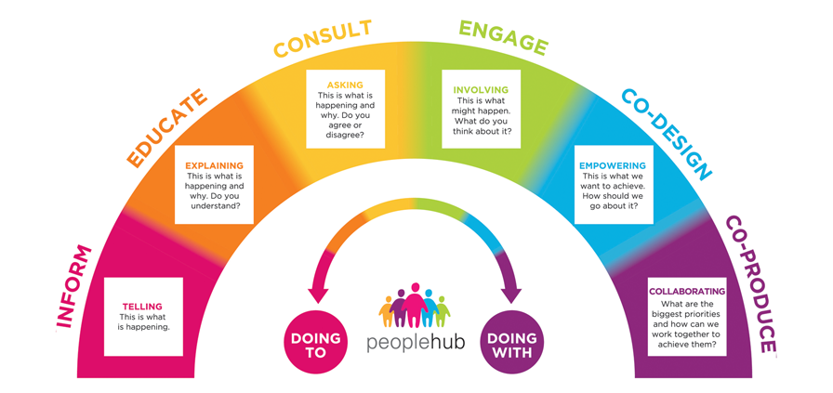
Spectrum of Participation
Notes:
1 min
Foundation of our approach

Slide 6

We value what is important to people with disabilities and their families, who are striving for an everyday life.
People with disabilities have a right to an everyday life; a life that is no different than all other citizens.
PA Office of Developmental Programs (2016)
www.dhs.pa.gov/publications/EverydayLives
Notes:
Pennsylvania has a long history of promoting values that focus on understanding what people with disabilities want and the supports they need to life like all citizens. The concept of Everyday Lives in Pennsylvania began in 1989 when a group of people with disabilities, families, advocates, government officials and service providers came together to discuss what the future should look like for all people with disabilities. The result was a list principles set to guide the Office of Developmental Programs (ODP) and the service system. In 2016, Everyday Lives was revised to reflect recommendations of current stakeholders. Today, Everyday Lives continues to guide the policies and practices of the ODP and the service system.
The foundation of "Everyday Lives: Values In Action" focuses on two statements:
1. We value what is important to people with disabilities and their families, who are striving for an everyday life. An everyday life is about opportunities, relationships, rights, and responsibilities. It is about being a member of the community, having a valued role, making a contribution to society, and having one’s rights as a citizen fully respected. It is a vision that we should all be working toward together.
2. People with disabilities have a right to an everyday life; a life that is no different than that of all other citizens. This continues to be the truest statement on which we can build our work.
"Everyday Lives" will be a guide to the Office of Developmental Programs as it develops policy and designs programs. Providers of services will use these recommendations to support individuals and their families to achieve an everyday life.

Slide 7

Everyday Lives:
Values in Action
Recommendations to make Everyday Lives a Reality
Promote Self-Direction, Choice, & Control
This happens when people:
Have support to have choice and control over all aspects of their life
Trust and be respected by the people who provide assistance
Have clear and understandable information
Have their preferences and rights to make mistakes respected by others
Are supported to make their decisions become a reality
Notes:
Supports Brokers play a role in all elements of Everyday Lives as they assist and guide those who choose to self direct or direct services for their family member.
You are especially instrumental to the recommendation to Promote Self-Direction, Choice, and Control come to life. Everyday Lives describes that “Personal choice and control over all aspects of life must be supported for every person. Choice about where to live, whom to live with, what to do for a living, and how to have fun are all key choices in life, as are seemingly small choices, such as what to eat, what to wear, when to wake up in the morning, and when to go to bed. It’s important that people with disabilities be able to trust people who provide assistance, to feel confident that they respect the person and her right to manage her own life, and to enjoy the company of others. Self-direction (or person-directed supports and services) work best when people have clear and understandable information, opportunities to exercise choice, and assistance with making decisions when needed. Self-direction is only possible when family, friends, and people who provide supports respect the person’s preferences and their right to make mistakes and facilitate the implementation of the person’s decisions.

Slide 8
SUPPORTS BROKER
Facilitating Community Connections and Natural Supports
Helping the participant cultivate unpaid, natural support systems (e.g., family, friends, and community groups) to supplement their Medicaid services
Assisting in identifying, mapping, and connecting with generic community resources

Slide 9
SUPPORTS BROKER
Regulatory Compliance
Ensures the participant’s self-directed services and Individualized Service Plan (ISP)
comply with Medicaid waiver rules and regulations
Helps monitor spending limits and assists with developing
emergency back-up staffing plans

Slide 10
SUPPORTS BROKER
Budget and Employer Authority Management
Assisting participants with navigating Financial Management Services (FMS) and required payroll paperwork
Helping with recruiting, interviewing, hiring, and supervising direct support staff
Coaching and guiding the employer with determining staff pay rates and developing work schedules

Slide 11
Supports Brokering
In Action
Assisting with starting up with the FMS
Helping with recruiting, interviewing, orienting and scheduling Service and Support Professionals (SSPs) and maintaining approved hours and service types
Supporting the person and/or the employer with service documentation policies and regulations
Facilitating a Circle of Support
Identifying and organizing natural supports

Slide 12
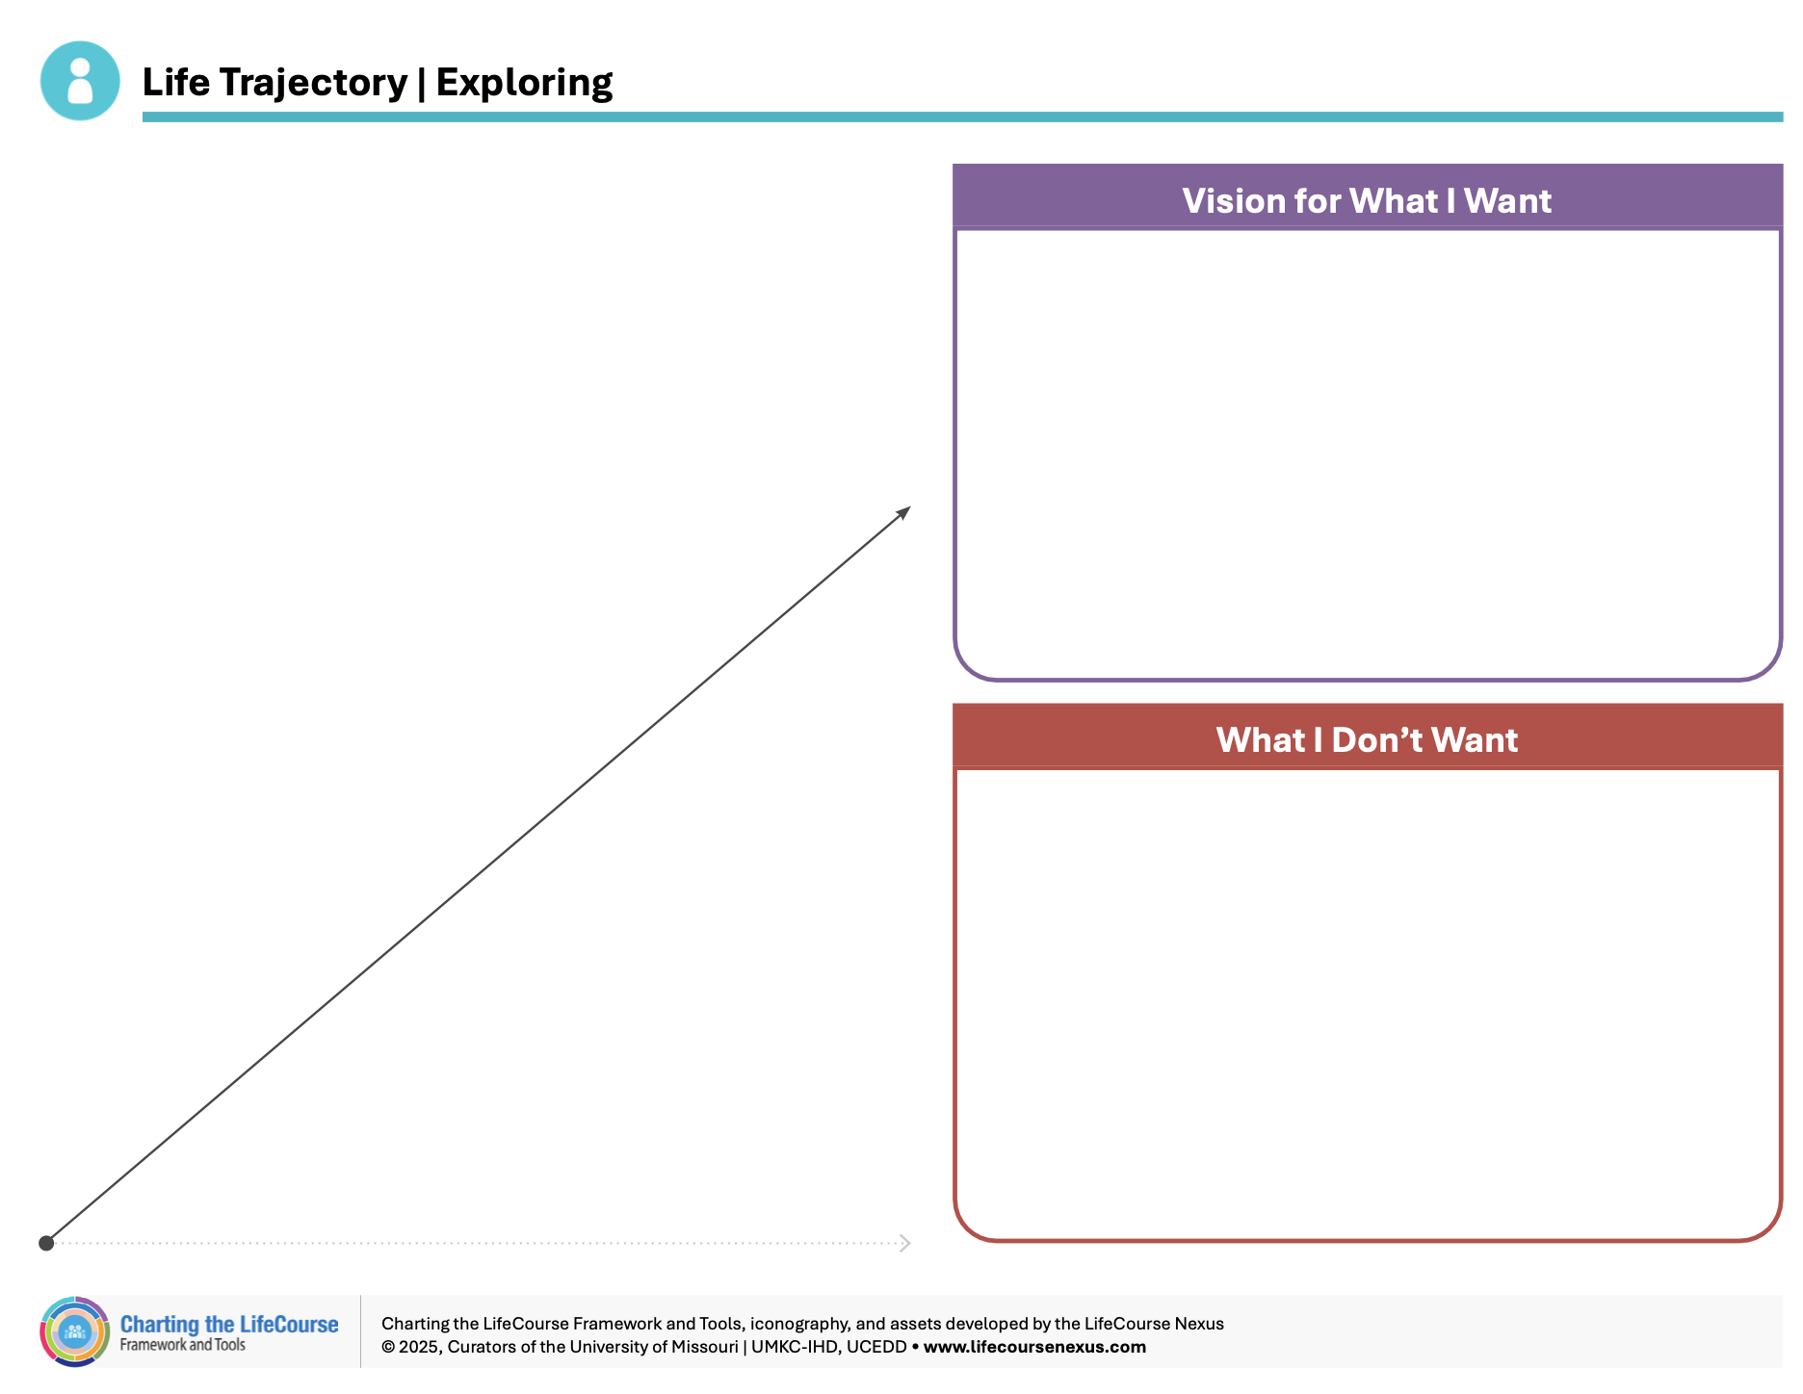

Slide 13
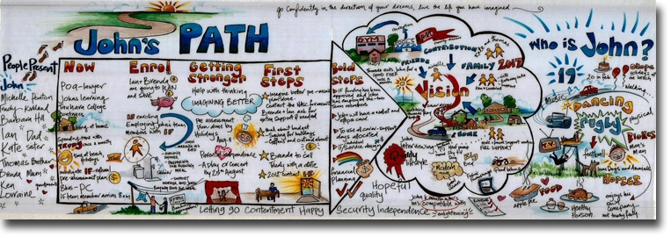
Notes:
Instructor
PATH – Planning Alternative Tomorrow’s with Home (although rarely referred to by it’s full name) is an extremely effective strategy for visioning and identifying strategies to help the person achieve his or her vision.
We’re going to spend time today going over developing a PATH and will give you an opportunity to practice. This screen shows a sample of John’s Path. You’ll see it’s both informative and visually appealing. Don’t let that scare you though. You do not have to be an artist to facilitate a PATH.
Note: As an alternate demonstration, instructors may use images or actual PATHs they’ve conducted with permission of focus person

Slide 14
Using the Path and/or Charting the Lifecourse Framework… to guide planning and service delivery
Communicate Next Steps/Action Items
Follow-up with completion and troubleshoot as needed
Communicate if service changes are needed
Maintain visioning info to use with ISP revisions
Modify the tools as needed

Slide 15
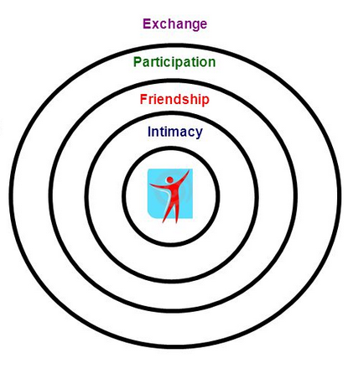
Circles of Support
Selected by the person
Problem-solve and
plans with the
person
Provide support,
encouragement,
and assistance to
help achieve vision
Ongoing resource
Notes:
Instructor
Introduce topic by sharing that we’re going to spend some time looking at relationships. To effectively support people, we have to look at the people and systems that surround the person. A Circle of Support is a way to support individuals in finding/building/maintaining natural supports, focus on the neighborhood/surrounding areas, develop “allies,” help community members know how/when they can help.
Using newsprint draw a circle of support in steps, begin with the person at the center of a circle. Make the participants aware that the members of the circle, who may include family, friends and other community members, are usually not paid to be there. They are involved because they care enough about the focus person to give their time and energy to helping that person to overcome obstacles and increase the options which are open to them.
The person is always at the center. The first circle nearest to the person is for the most important relationships to that person. The second circle is for other people that play a major role in someone’s life, for example, close friends and relatives. The third circle is for organizations the person belongs to. This could include work, churches, clubs. The fourth circle is where we are going to place any support you pay for like the hairdressers, doctors, exercise classes.
Activity:
Break participants into pairs.
Using a blank sheet of paper ask that they develop a relationship circle by having a conversation with his/her partner. Make sure enough time is given to give each partner an opportunity to practice.
Have them underline the names of those people they would want to invite to a circle meeting if they were in need of support.
Conduct a large group debrief where volunteers share their experience. Use the notes that follow to continue instruction about circles of support.
Instructor
The circle acts as a community around that person (the “focus person”) who, for one reason or another, is unable to achieve what they want in life on their own and decides to ask others for help.
The focus person is in charge, both in deciding who to invite to be in the circle, and also in the direction that the circle’s energy is employed, although a facilitator is normally chosen from within the circle to take care of the work required to keep it running. This is often the role of the supports broker. You may be called upon to facilitate meetings of the person’s circle. These meetings may happen every couple months or a few times a year, a lot will depend on the needs of the person at any given time. It is important to keep the circle engaged on a regular basis. The circle is a great group to pull together to conduct a path.
Although the focus person’s goals are the primary drive in everything the circle does, the relationship is not just one way. The members will all have diverse gifts and interests, and there can appear many new opportunities and possibilities which had not even been considered before the forming of the circle. Because of this, an important function of the circle is to regularly re-visit the plans which they are working with, to keep the direction current in terms of what the person really wishes to achieve.
Circles of support are often the person’s first connection to his/her community. It’s members not only can help him/her realize his/her vision, but also help him/her make the connections in the community necessary to do so.

Slide 16
The Circle Can Help with Problem Solving
Working Not/Working
Grounded in Negotiation Principles
Focus on the here and now
Gain multiple perspectives
Encourages respectful listening and perspective taking
Requires next steps
http://helensandersonassociates.co.uk/person-centred-practice/person-centred-thinking-tools/whats-workingnot-working/
What’s working
What’s not working
  For the person
  For the family
  For the staff
What needs to happen
to build on what’s
working and change what’s not working?
Notes:
Instructor
This is easy for the Supports Broker to use and can be done fairly quickly during a team meeting, or during a discussion with an employer or during supervision with a SSP
The Supports Broker facilitates the discussion that focuses on what is working for the person, and what’s not, as well as what is and is not working for the family and the SSP. It encourages honest and open communication among all parties. It is action oriented and provides clarity to all stakeholders.
Activity:
Use the case study that includes conversations from various team members. Determine what is working and working from each perspective and arrive at suggested next steps using this information
Material
2.11 Working Not Working

Slide 17
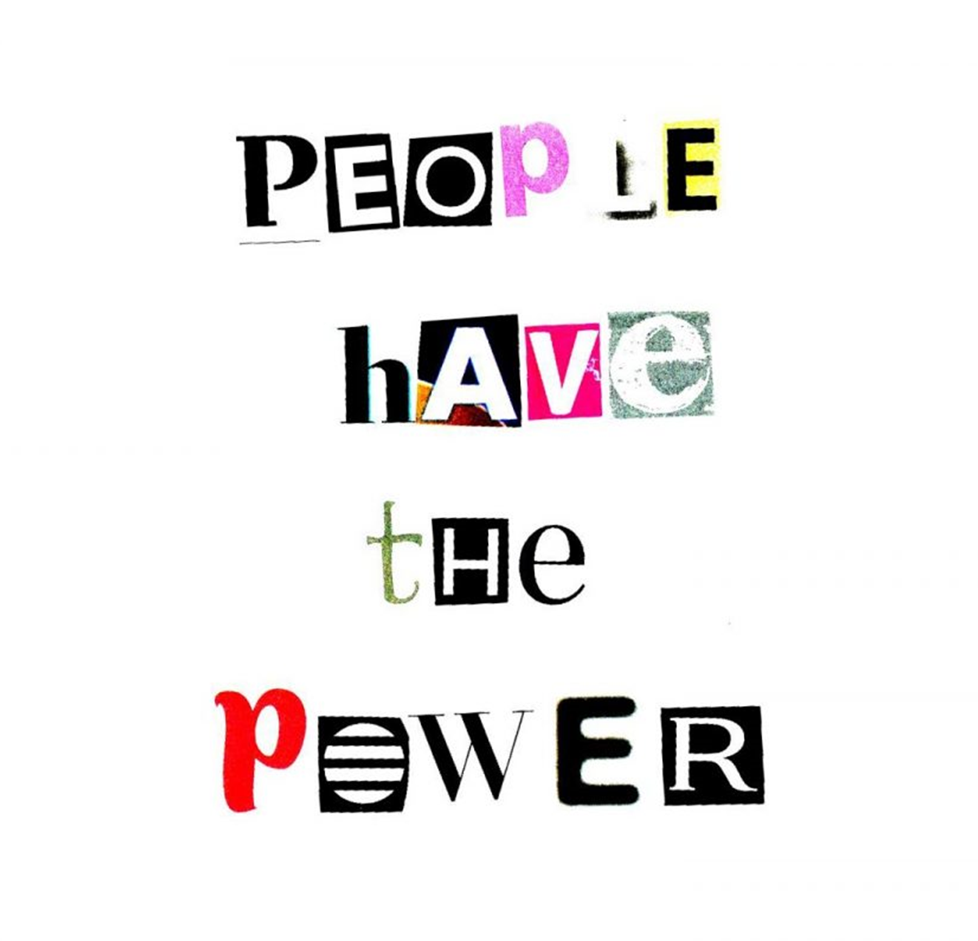

Slide 18

Questions?
Discussion and Sharing of Experiences

