Slide 1

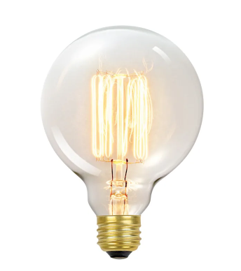
Notes:
Welcome back to school

Slide 2
Lesson 3-8a

Slide 3
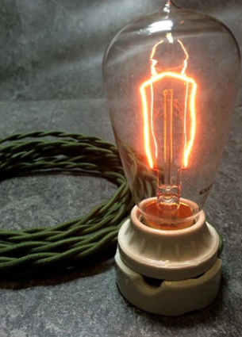
Bell Work
Write five sentences about how you think a light bulb works?
Escribe cinco oraciones sobre cómo crees que funciona una bombilla.

Slide 4
Welcome Scientists
ברוכים הבאים למדענים
Hola, científica y científicos.
Kɔc nyic käŋ acï keek loor
Добро пожаловать, ученые!
Willkommen, Wissenschaftler!
مرحبا بالعلماء
科学者の皆様へようこそ
እንኳን ደህና መጡ ሳይንቲስቶች.
Karibu Wanasayansi
Bienvenue aux scientifiques
Croeso i Wyddonwyr
Velkomnir vísindamenn
과학자 여러분 환영합니다
Notes:
Welcome back to school

Slide 5

Our Path to Success
M-Materials First
A-All Other Items Away
P –Place Your Backpack
Notes:
Thank you for following our map.

Slide 6

Dr. Lewis' Classroom Rules
Who are we?
We are a community of respect, courtesy, excellence, and responsibility.
Notes:
Who are we?
We are a community of respect, courtesy, excellence., and responiblity

Slide 7

Lesson Purpose
I can investigate and explain how energy flows through an electrical system and how electric current makes electrical systems work.

Slide 8
Driving Question
?
How does energy travel through an electrical system to make the system work?

Slide 9
Success Is When…
I can identify the parts of an electrical system.
I can explain how energy moves through an electrical system.
Notes:
I can identify the parts of an electrical system.
I can explain how energy moves through an electrical system.
I can explain how electricity creates a magnetic field.
I can use evidence from investigations and readings.
I can model how electrical systems convert energy.

Slide 10
Success Is When…
I can explain how electricity creates a magnetic field.
I can use evidence from investigations and readings.
I can model how electrical systems convert energy.
Notes:
I can identify the parts of an electrical system.
I can explain how energy moves through an electrical system.
I can explain how electricity creates a magnetic field.
I can use evidence from investigations and readings.
I can model how electrical systems convert energy.

Slide 11
Spiral Connection
What I Learned Before: Changing the distance between magnets changes the amount of energy transferred.

Slide 12
Spiral Connection
What I Am Learning Now: Electric current transfers energy through a system and can create changing magnetic fields.

Slide 13
Spiral Connection
What I Will Learn Next: Magnets and electromagnets work together inside a speaker to produce sound.

Slide 14
Our Path To Success
0–5 min
Bell Work/Centennial Light Bulb
5– 25 min
Investigations
25– 35 min
What Our Results Mean
35- 40 min
Claim, Evidence, Reason
40 - 45 min
Cleanup/ Wrap Up

Slide 15
Bell Work
Write five sentences about how you think a light bulb works?
Escribe cinco oraciones sobre cómo crees que funciona una bombilla.
Notes:
Discuss the bell work with the class.

Slide 16
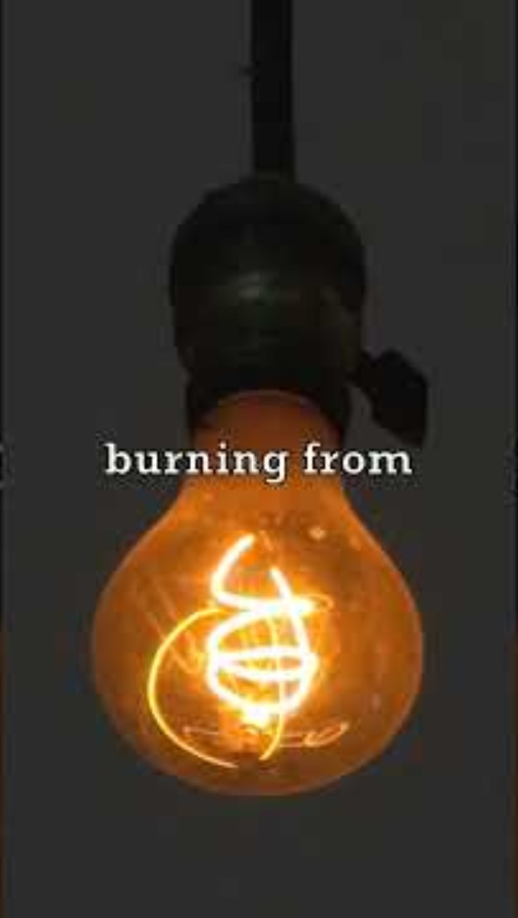
Centennial Light Bulb
How has the Centennial Light Bulb been burning since 1901?
Notes:
How has the Centennial Light Bulb been burning since 1901?

Slide 17
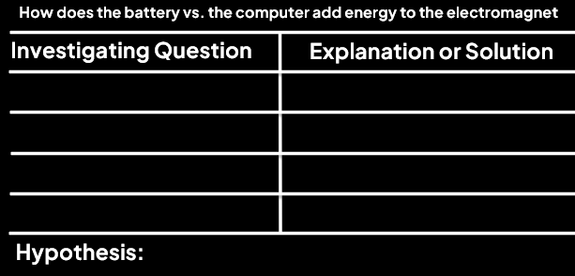
In Your Notebook
Notes:
Have students copy this investigation chart into their science notebook
How does the battery vs. the computer provide energy to the electromagnet?
Make a T-chart with 2 columns and 4 rows to keep track of each investigation question and the related explanation or solution.
Below this leave space to record hypotheses for a future investigation.
Say, Let’s explore one example of that first. How can you connect a battery to a lightbulb in order to get it to provide energy to the bulb? Write that question in the first row of your table to investigate with a small group. Show slide C to reference this question and show students where to add it in the data table:
How can we connect a battery to a lightbulb in order to provide it energy?

Slide 18
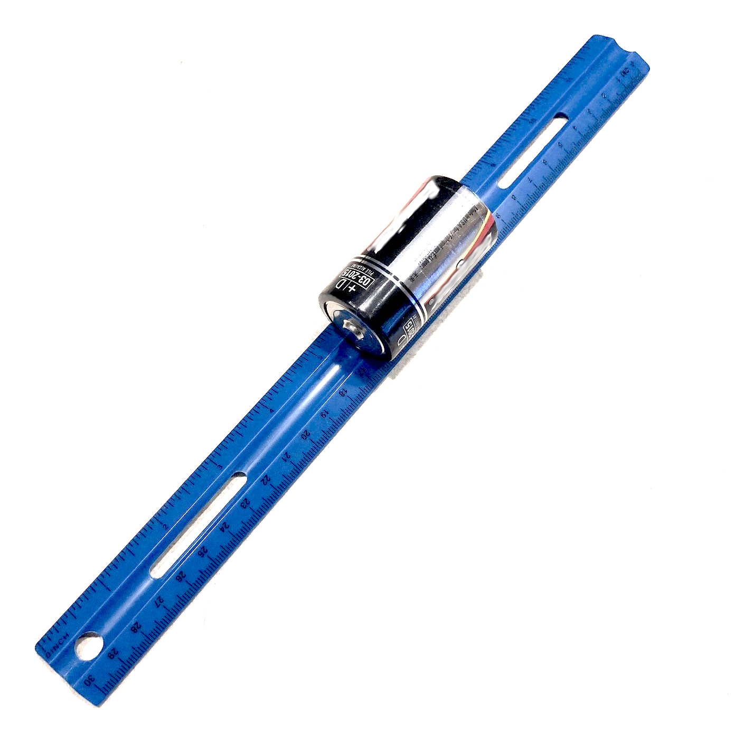
Battery and Incandescent Bulb Investigations
Notes:
Introduce the equipment students will use. Show slide D. Point out that the photo shows one way to use a ruler as a battery holder, which can keep the battery from rolling and also free up your hands to work with other parts of the system. Point out where the equipment bins and stations are for the investigations. Assign students to lab groups. Encourage students to try different ways of hooking up the battery if the first thing they try doesn’t work. And remind students as they work with it that the lightbulb is quite fragile.
Do the investigation. Set the timer for 4 minutes. When it goes off tell students they have one minute left and have them push the materials to the side and complete their data table row now if they haven’t yet. Reset the timer for 1 minute and signal students when it goes off.

Slide 19
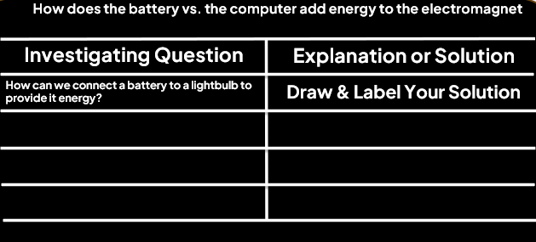
In Your Notebook
How can we connect a battery to a lightbulb to provide it energy?
Notes:
Use a lightbulb, a battery, stickers or tape, and a ruler (as a battery holder) to figure out how to do this.
Draw and label a diagram of your solution or explain what you did to make this happen in your science notebook.
Introduce the ideas of a complete circuit and electric current. Connect the word circuit to the word circle. Ask, How is a circuit similar to a circle? Students should respond that both are continuous--no beginning or end. Consider adding circuit and current to your class Word Wall.
Say, Making this sort of connection to both ends of the battery so that energy can get to the lightbulb is called making a complete circuit. It is called a complete circuit because it provides a continuous path for electric current to flow. The electric current transfers energy from the battery to the lightbulb when it is hooked up to the battery.
Instruct students to add labels to their own diagram they made from the previous investigation to indicate the path for electric current to flow through the battery to the lightbulb.

Slide 20
Think About It
If electric current flows through a wire, what happens around the wire?
How might that connect to what we learned about magnets in Lesson 7?
Notes:
How does this speaker transfer energy?
How does this relate to the transfer of energy in your throat when you speak?

Slide 21
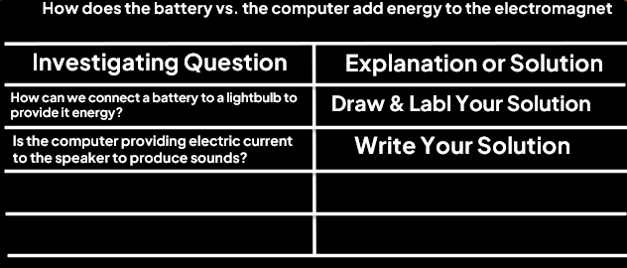
In Your Notebook
Is the computer providing electric current to the speaker to produce sounds?
Notes:
Use a lightbulb, a battery, stickers or tape, and a ruler (as a battery holder) to figure out how to do this.
Draw and label a diagram of your solution or explain what you did to make this happen in your science notebook.
Introduce the ideas of a complete circuit and electric current. Connect the word circuit to the word circle. Ask, How is a circuit similar to a circle? Students should respond that both are continuous--no beginning or end. Consider adding circuit and current to your class Word Wall.
Say, Making this sort of connection to both ends of the battery so that energy can get to the lightbulb is called making a complete circuit. It is called a complete circuit because it provides a continuous path for electric current to flow. The electric current transfers energy from the battery to the lightbulb when it is hooked up to the battery.
Instruct students to add labels to their own diagram they made from the previous investigation to indicate the path for electric current to flow through the battery to the lightbulb.

Slide 22
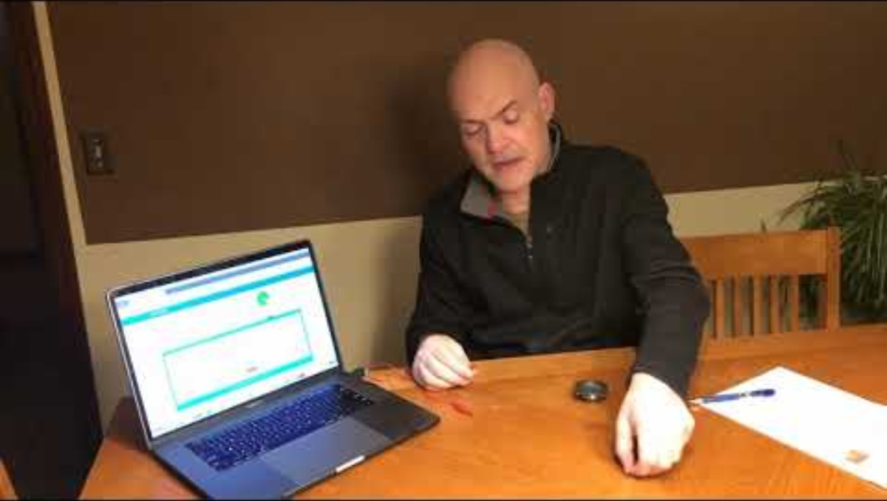
How Volume Affects Light Produced by an Incandescent Light Bulb
Notes:
Have students watch the embedded video and record their observations in their notebook

Slide 23
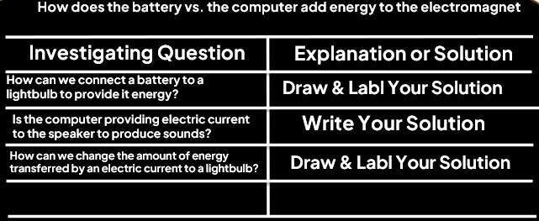
Battery and Incandescent Bulb Investigations
How can we change the amount of energy transferred by an electric current to a lightbulb?
Notes:
Use a lightbulb, 2 batteries, stickers or tape, and a ruler (as a battery holder) to figure out how to do this. Draw and label diagram of your solution or explanation.
Do the investigation. Set the timer for 4 minutes. When it goes off tell students they have a minute left and should push the equipment to the side and complete their data table row now if they haven’t yet. Reset the time for 1 minute and signal students when it goes off.

Slide 24
In Your Notebook
Write questions, ideas for investigations, and predictions did you generated during today’s lesson.
Notes:
How does this speaker transfer energy?
How does this relate to the transfer of energy in your throat when you speak?

Slide 25
What Our Results Mean
What is electric current? How is circuit completed?
How does a circuit relate to circle?
Notes:
Make sense of the results. Have all students bring their notebooks up to the circle again to sit around the whole-class demonstration table. Ask students to share what they did to get the battery to provide energy to the lightbulb.
Students will say that they had to connect each of the two wires from the bulb to the two different sides of the battery.
Introduce the ideas of a complete circuit and electric current. Connect the word circuit to the word circle. Ask, How is a circuit similar to a circle? Students should respond that both are continuous--no beginning or end.
Say, Making this sort of connection to both ends of the battery so that energy can get to the lightbulb is called making a complete circuit. It is called a complete circuit because it provides a continuous path for electric current to flow. The electric current transfers energy from the battery to the lightbulb when it is hooked up to the battery.
Instruct students to add labels to their own diagram they made from the previous investigation to indicate the path for electric current to flow through the battery to the lightbulb.

Slide 26
What Our Results Mean
How are a circuit
and circle similar?
Notes:
Make sense of the results. Have all students bring their notebooks up to the circle again to sit around the whole-class demonstration table. Ask students to share what they did to get the battery to provide energy to the lightbulb.
Students will say that they had to connect each of the two wires from the bulb to the two different sides of the battery.
Introduce the ideas of a complete circuit and electric current. Connect the word circuit to the word circle. Ask, How is a circuit similar to a circle? Students should respond that both are continuous--no beginning or end.
Say, Making this sort of connection to both ends of the battery so that energy can get to the lightbulb is called making a complete circuit. It is called a complete circuit because it provides a continuous path for electric current to flow. The electric current transfers energy from the battery to the lightbulb when it is hooked up to the battery.
Instruct students to add labels to their own diagram they made from the previous investigation to indicate the path for electric current to flow through the battery to the lightbulb.

Slide 27
What Our Results Mean
Are both are continuous?
How does making this sort of connection make a complete circuit?
Notes:
Make sense of the results. Have all students bring their notebooks up to the circle again to sit around the whole-class demonstration table. Ask students to share what they did to get the battery to provide energy to the lightbulb.
Students will say that they had to connect each of the two wires from the bulb to the two different sides of the battery.
Introduce the ideas of a complete circuit and electric current. Connect the word circuit to the word circle. Ask, How is a circuit similar to a circle? Students should respond that both are continuous--no beginning or end.
Say, Making this sort of connection to both ends of the battery so that energy can get to the lightbulb is called making a complete circuit. It is called a complete circuit because it provides a continuous path for electric current to flow. The electric current transfers energy from the battery to the lightbulb when it is hooked up to the battery.
Instruct students to add labels to their own diagram they made from the previous investigation to indicate the path for electric current to flow through the battery to the lightbulb.

Slide 28
What Our Results Mean
How does a complete circuit provide a continuous path for electric current to flow?
Notes:
Make sense of the results. Have all students bring their notebooks up to the circle again to sit around the whole-class demonstration table. Ask students to share what they did to get the battery to provide energy to the lightbulb.
Students will say that they had to connect each of the two wires from the bulb to the two different sides of the battery.
Introduce the ideas of a complete circuit and electric current. Connect the word circuit to the word circle. Ask, How is a circuit similar to a circle? Students should respond that both are continuous--no beginning or end.
Say, Making this sort of connection to both ends of the battery so that energy can get to the lightbulb is called making a complete circuit. It is called a complete circuit because it provides a continuous path for electric current to flow. The electric current transfers energy from the battery to the lightbulb when it is hooked up to the battery.
Instruct students to add labels to their own diagram they made from the previous investigation to indicate the path for electric current to flow through the battery to the lightbulb.

Slide 29
What Our Results Mean
How does the electric current transfers energy from the battery to the lightbulb when it is hooked up to the battery?
Notes:
Make sense of the results. Have all students bring their notebooks up to the circle again to sit around the whole-class demonstration table. Ask students to share what they did to get the battery to provide energy to the lightbulb.
Students will say that they had to connect each of the two wires from the bulb to the two different sides of the battery.
Introduce the ideas of a complete circuit and electric current. Connect the word circuit to the word circle. Ask, How is a circuit similar to a circle? Students should respond that both are continuous--no beginning or end.
Say, Making this sort of connection to both ends of the battery so that energy can get to the lightbulb is called making a complete circuit. It is called a complete circuit because it provides a continuous path for electric current to flow. The electric current transfers energy from the battery to the lightbulb when it is hooked up to the battery.
Instruct students to add labels to their own diagram they made from the previous investigation to indicate the path for electric current to flow through the battery to the lightbulb.

Slide 30
What Our Results Mean
Add labels to their own diagram to indicate the path for electric current to flow through the battery to the lightbulb.
Notes:
Make sense of the results. Have all students bring their notebooks up to the circle again to sit around the whole-class demonstration table. Ask students to share what they did to get the battery to provide energy to the lightbulb.
Students will say that they had to connect each of the two wires from the bulb to the two different sides of the battery.
Introduce the ideas of a complete circuit and electric current. Connect the word circuit to the word circle. Ask, How is a circuit similar to a circle? Students should respond that both are continuous--no beginning or end.
Say, Making this sort of connection to both ends of the battery so that energy can get to the lightbulb is called making a complete circuit. It is called a complete circuit because it provides a continuous path for electric current to flow. The electric current transfers energy from the battery to the lightbulb when it is hooked up to the battery.
Instruct students to add labels to their own diagram they made from the previous investigation to indicate the path for electric current to flow through the battery to the lightbulb.

Slide 31

Energy Transformation
Battery → Electrical Energy → Light Bulb → Light Energy + Thermal Energy

Slide 32
Energy Transformation
Computer → Electrical Energy → Speaker → Sound Energy

Slide 33
What Our Results Mean
Add labels to their own diagram to indicate the path for electric current to flow through the battery to the lightbulb.

Slide 34
Claim, Evidence, Reason
Using CER (Claim, Evidence, Reason) Answer: How does a complete circuit allow energy to transfer from a battery to a light bulb?

Slide 35
What Our Results Mean
What did you do to get the battery to provide energy to the lightbulb?
Notes:
Make sense of the results. Have all students bring their notebooks up to the circle again to sit around the whole-class demonstration table. Ask students to share what they did to get the battery to provide energy to the lightbulb.
Students will say that they had to connect each of the two wires from the bulb to the two different sides of the battery.
Introduce the ideas of a complete circuit and electric current. Connect the word circuit to the word circle. Ask, How is a circuit similar to a circle? Students should respond that both are continuous--no beginning or end.
Say, Making this sort of connection to both ends of the battery so that energy can get to the lightbulb is called making a complete circuit. It is called a complete circuit because it provides a continuous path for electric current to flow. The electric current transfers energy from the battery to the lightbulb when it is hooked up to the battery.
Instruct students to add labels to their own diagram they made from the previous investigation to indicate the path for electric current to flow through the battery to the lightbulb.

Slide 36
Exit Ticket
Draw and label a complete circuit.

Slide 37
Lesson Purpose
I can investigate and explain how energy flows through an electrical system and how electric current makes electrical systems work.

Slide 38
Driving Question
?
How does energy travel through an electrical system to make the system work?

Slide 39

Cleanup
Wrap it up, clean your space,
Leave it tidy, leave no trace.
Tools away, trash in the bin,
A fresh start helps us win!

Slide 40
Lesson 3-8b

Slide 41
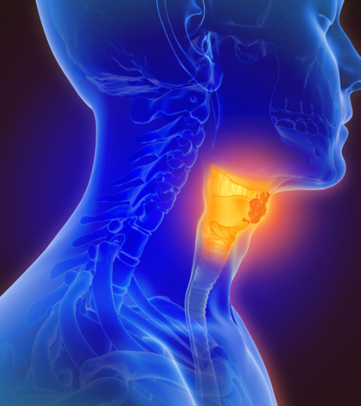
Bell Work
Gently place your hand around your throat and talk. Write five sentences about how you think energy produces sound.
Coloca suavemente la mano alrededor de la garganta y habla. Escribe cinco oraciones sobre cómo crees que la energía produce sonido.

Slide 42
Welcome Scientists
ברוכים הבאים למדענים
Hola, científica y científicos.
Kɔc nyic käŋ acï keek loor
Добро пожаловать, ученые!
Willkommen, Wissenschaftler!
مرحبا بالعلماء
科学者の皆様へようこそ
እንኳን ደህና መጡ ሳይንቲስቶች.
Karibu Wanasayansi
Bienvenue aux scientifiques
Croeso i Wyddonwyr
Velkomnir vísindamenn
과학자 여러분 환영합니다
Notes:
Welcome back to school

Slide 43
Our Path to Success
M-Materials First
A-All Other Items Away
P –Place Your Backpack
Notes:
Thank you for following our map.

Slide 44
Dr. Lewis' Classroom Rules
Who are we?
We are a community of respect, courtesy, excellence, and responsibility.
Notes:
Who are we?
We are a community of respect, courtesy, excellence., and responiblity

Slide 45
Lesson Purpose
I can investigate and explain how energy flows through an electrical system and how electric current makes electrical systems work.

Slide 46
Driving Question
?
How does energy travel through an electrical system to make the system work?

Slide 47
Success Is When…
I can identify the parts of an electrical system.
I can explain how energy moves through an electrical system.
Notes:
I can identify the parts of an electrical system.
I can explain how energy moves through an electrical system.
I can explain how electricity creates a magnetic field.
I can use evidence from investigations and readings.
I can model how electrical systems convert energy.

Slide 48
Success Is When…
I can explain how electricity creates a magnetic field.
I can use evidence from investigations and readings.
I can model how electrical systems convert energy.
Notes:
I can identify the parts of an electrical system.
I can explain how energy moves through an electrical system.
I can explain how electricity creates a magnetic field.
I can use evidence from investigations and readings.
I can model how electrical systems convert energy.

Slide 49
Spiral Connection
What I Learned Before: Changing the distance between magnets changes the amount of energy transferred.

Slide 50
Spiral Connection
What I Am Learning Now: Electric current transfers energy through a system and can create changing magnetic fields.

Slide 51
Spiral Connection
What I Will Learn Next: Magnets and electromagnets work together inside a speaker to produce sound.

Slide 52
Our Path To Success
0–5 min
Bell Work
5– 10 min
Sound and Energy
10–30 min
Investigations
30- 40 min
Your Hypothesis
40 - 45 min
Cleanup/ Wrap Up

Slide 53
Bell Work
Gently place your hand around your throat and talk. Write five sentences about how you think energy produces sound.
Coloca suavemente la mano alrededor de la garganta y habla. Escribe cinco oraciones sobre cómo crees que la energía produce sonido.
Notes:
Discuss the bell work with the class.

Slide 54
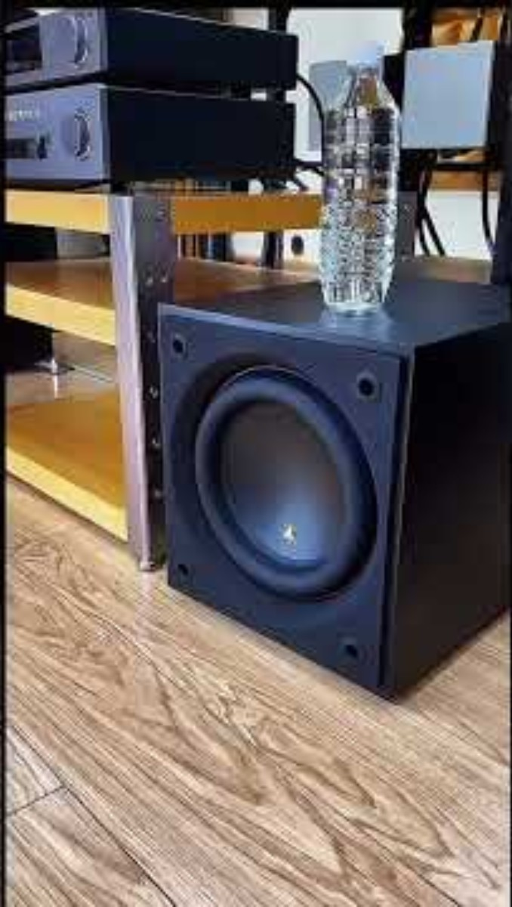
Sound and Energy
How does this speaker transfer energy?
Notes:
How does this speaker transfer energy?
How does this relate to the transfer of energy in your throat when you speak?

Slide 55
Your Ideas
What questions, ideas for investigations,
and predictions did you generate last time?
Notes:
How does this speaker transfer energy?
How does this relate to the transfer of energy in your throat when you speak?

Slide 56
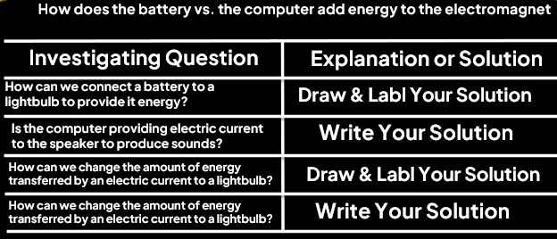
Frequency and LED Bulb Investigations
How can we change the amount of energy transferred by an electric current to a lightbulb?
Notes:
Have students add this investigation to their notebooks

Slide 57
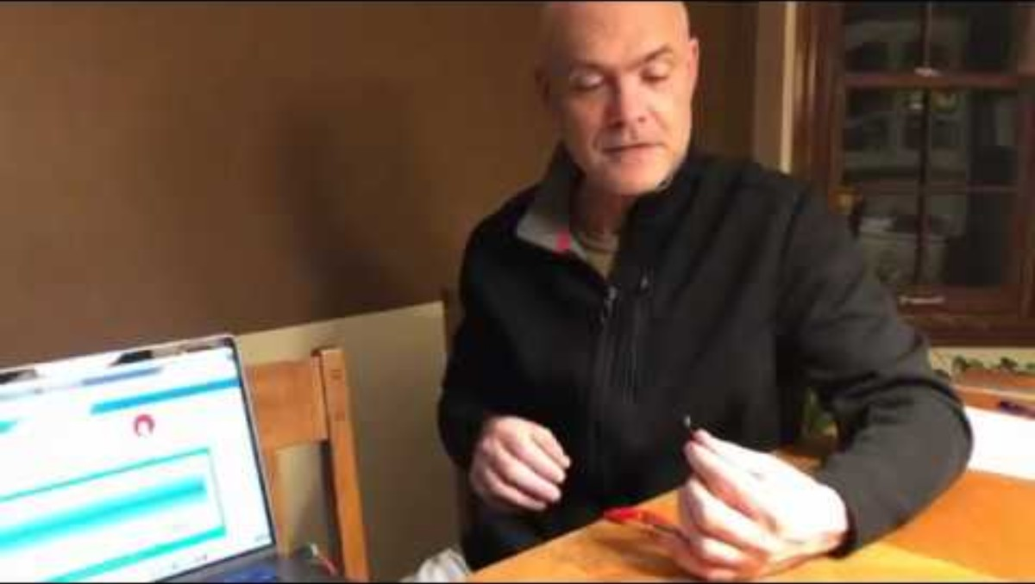
How Frequency Affects Light Produced by an Incandescent Light Bulb
Notes:
Have students watch the embedded video and record their observations in their notebook

Slide 58
What Our Results Mean
What changed when the frequency increased?
What stayed the same?
What does this suggest about the electrical energy entering the speaker system?
Notes:
Discuss with the whole class

Slide 59
Work in A Group
Explore how to produce light (of different colors) from a single LED using batteries and wires.
Notes:
Students will work in small groups to explore how to produce light (of different colors) from a single LED using batteries and wires.

Slide 60
Your Hypothesis
What hypothesis could you investigate with an LED bulb?
How would you do that?
What variables would you test?
Notes:
Students develop a hypothesis to Trest.

Slide 61
Claim, Evidence, Reason
Using CER (Claim, Evidence, Reason) Answer: How does electric energy travel through a speaker to make sound?

Slide 62
Exit Ticket
Predict what would happen if current increased in an electrical system.

Slide 63
Lesson Purpose
I can investigate and explain how energy flows through an electrical system and how electric current makes electrical systems work.

Slide 64
Driving Question
?
How does energy travel through an electrical system to make the system work?

Slide 65
Cleanup
Wrap it up, clean your space,
Leave it tidy, leave no trace.
Tools away, trash in the bin,
A fresh start helps us win!

Slide 66
Lesson 3-8c

Slide 67
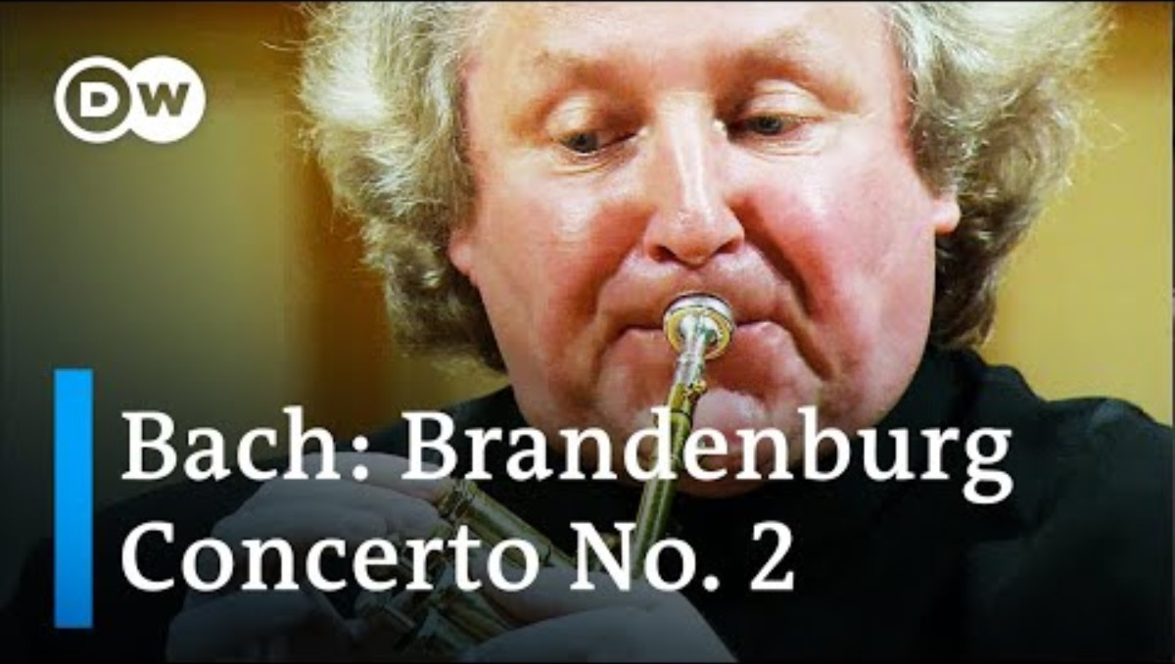
Bell Work
Based on what you learned this the last two days, write five sentences about how the instruments in this video produce low and high notes.
Basándote en lo que aprendiste durante los últimos dos días, escribe cinco oraciones sobre cómo los instrumentos de este video producen notas graves y agudas.

Slide 68
Welcome Scientists
ברוכים הבאים למדענים
Hola, científica y científicos.
Kɔc nyic käŋ acï keek loor
Добро пожаловать, ученые!
Willkommen, Wissenschaftler!
مرحبا بالعلماء
科学者の皆様へようこそ
እንኳን ደህና መጡ ሳይንቲስቶች.
Karibu Wanasayansi
Bienvenue aux scientifiques
Croeso i Wyddonwyr
Velkomnir vísindamenn
과학자 여러분 환영합니다
Notes:
Welcome back to school

Slide 69
Our Path to Success
M-Materials First
A-All Other Items Away
P –Place Your Backpack
Notes:
Thank you for following our map.

Slide 70
Dr. Lewis' Classroom Rules
Who are we?
We are a community of respect, courtesy, excellence, and responsibility.
Notes:
Who are we?
We are a community of respect, courtesy, excellence., and responiblity

Slide 71
Lesson Purpose
I can investigate and explain how energy flows through an electrical system and how electric current makes electrical systems work.

Slide 72
Driving Question
?
How does energy travel through an electrical system to make the system work?

Slide 73
Success Is When…
I can identify the parts of an electrical system.
I can explain how energy moves through an electrical system.
Notes:
I can identify the parts of an electrical system.
I can explain how energy moves through an electrical system.
I can explain how electricity creates a magnetic field.
I can use evidence from investigations and readings.
I can model how electrical systems convert energy.

Slide 74
Success Is When…
I can explain how electricity creates a magnetic field.
I can use evidence from investigations and readings.
I can model how electrical systems convert energy.
Notes:
I can identify the parts of an electrical system.
I can explain how energy moves through an electrical system.
I can explain how electricity creates a magnetic field.
I can use evidence from investigations and readings.
I can model how electrical systems convert energy.

Slide 75
Spiral Connection
What I Learned Before: Changing the distance between magnets changes the amount of energy transferred.

Slide 76
Spiral Connection
What I Am Learning Now: Electric current transfers energy through a system and can create changing magnetic fields.

Slide 77
Spiral Connection
What I Will Learn Next: Magnets and electromagnets work together inside a speaker to produce sound.

Slide 78
Our Path To Success
0–5 min
Bell Work
5– 10 min
Sound and Energy
10–30 min
Investigations
30- 40 min
Your Hypothesis
40 - 45 min
Cleanup/ Wrap Up

Slide 79
Bell Work
Based on what you learned this the last two days, write five sentences about how the instruments in this video produce low and high notes.
Basándote en lo que aprendiste durante los últimos dos días, escribe cinco oraciones sobre cómo los instrumentos de este video producen notas graves y agudas.
Notes:
Discuss the bell work with the class.

Slide 80

Sound and Energy
How does the pattern change as the frequency (pitch changes)?
Notes:
How does this speaker transfer energy?
How does this relate to the transfer of energy in your throat when you speak?

Slide 81
In Your Notebook
Things We
Figured Out
Questions We Have
Notes:
Have students list things they figured out and questions they have

Slide 82
Reading Instructions
Read silently until you get to a question in bold.
  Pause and wait for your partner.
  Quietly discuss your ideas to answer the question.
  Continue reading until the next bold question.
Notes:
Read silently until you get to a question in bold.
Pause and wait for your partner.
Quietly discuss your ideas to answer the question.
Continue reading until the next bold question.
As you read about them, place a check mark by things we figured out from our two-column chart.
As you read about new ideas to answer our questions, place a star by them in the reading.
When you complete the reading, discuss the questions from your two-column chart with your partner.
How would you answer the questions now?

Slide 83
Reading Instructions
As you read about them, place a check mark by things we figured out from our two-column chart.
As you read about new ideas to answer our questions, place a star by them in the reading.
Notes:
Read silently until you get to a question in bold.
Pause and wait for your partner.
Quietly discuss your ideas to answer the question.
Continue reading until the next bold question.
As you read about them, place a check mark by things we figured out from our two-column chart.
As you read about new ideas to answer our questions, place a star by them in the reading.
When you complete the reading, discuss the questions from your two-column chart with your partner.
How would you answer the questions now?

Slide 84
Reading Instructions
Read silently until you get to a question in bold.
  Pause and wait for your partner.
  Quietly discuss your ideas to answer the question.
  Continue reading until the next bold question.
As you read about them, place a check mark by things we figured out from our two-column chart.
As you read about new ideas to answer our questions, place a star by them in the reading.
Notes:
Read silently until you get to a question in bold.
Pause and wait for your partner.
Quietly discuss your ideas to answer the question.
Continue reading until the next bold question.
As you read about them, place a check mark by things we figured out from our two-column chart.
As you read about new ideas to answer our questions, place a star by them in the reading.
When you complete the reading, discuss the questions from your two-column chart with your partner.
How would you answer the questions now?

Slide 85
Reading Instructions
When you complete the reading, discuss the questions from your two-column chart with your partner.
How would you answer the questions now?
Notes:
Read silently until you get to a question in bold.
Pause and wait for your partner.
Quietly discuss your ideas to answer the question.
Continue reading until the next bold question.
As you read about them, place a check mark by things we figured out from our two-column chart.
As you read about new ideas to answer our questions, place a star by them in the reading.
When you complete the reading, discuss the questions from your two-column chart with your partner.
How would you answer the questions now?

Slide 86
With Your Class
What are the key ideas from this lesson?
Notes:
Students will summarize and discuss with the whole class key ideas from this lesson

Slide 87
In Your Notebook
Things We
Figured Out
Questions We Have
Notes:
Have students list things they figured out and questions they have

Slide 88
Claim, Evidence, Reason
Using CER (Claim, Evidence, Reason) Answer: How does energy travel through an electrical system to make the system work?

Slide 89
Exit Ticket
Explain how electrical energy becomes sound energy.

Slide 90
Lesson Purpose
I can investigate and explain how energy flows through an electrical system and how electric current makes electrical systems work.

Slide 91
Driving Question
?
How does energy travel through an electrical system to make the system work?

Slide 92
Cleanup
Wrap it up, clean your space,
Leave it tidy, leave no trace.
Tools away, trash in the bin,
A fresh start helps us win!

