Slide 1

Maximizing Profitability in Unconventional Reservoirs
Schubarth software systems llc
Schubarth inc.

Slide 2
Where are we now?
Are operators focused on economic return or early-time production?
  WSJ – “Frackers, Chasing Fast Oil Output, Are on a Treadmill” – April 8, 2019
    High initial production and rapid decline rates lead to the need for more capital to maintain production
Is return on investment as promised?
  WSJ – “Frackers Face Harsh Reality as Wall Street Backs Away” – February 24, 2019
    Economic returns have been less than promised and Wall Street is wary on new projects
Are well’s producing as projected?
  WSJ – “Fracking’s Secret Problem – Oil Wells Aren’t Producing as Much as Forecast” – January 2, 2019
    Many operators are not meeting projected reserve estimates
Drilling wells too close together
  WSJ – “A Fracking Experiment Fails to Pump as Expected” – July 4, 2019
    Ecana’s Cube Experiments meets IP targets, but declines rapidly and will recovery only 50% of expected EUR
The processes we have developed explain and predicts ALL of the above cases.

Slide 3
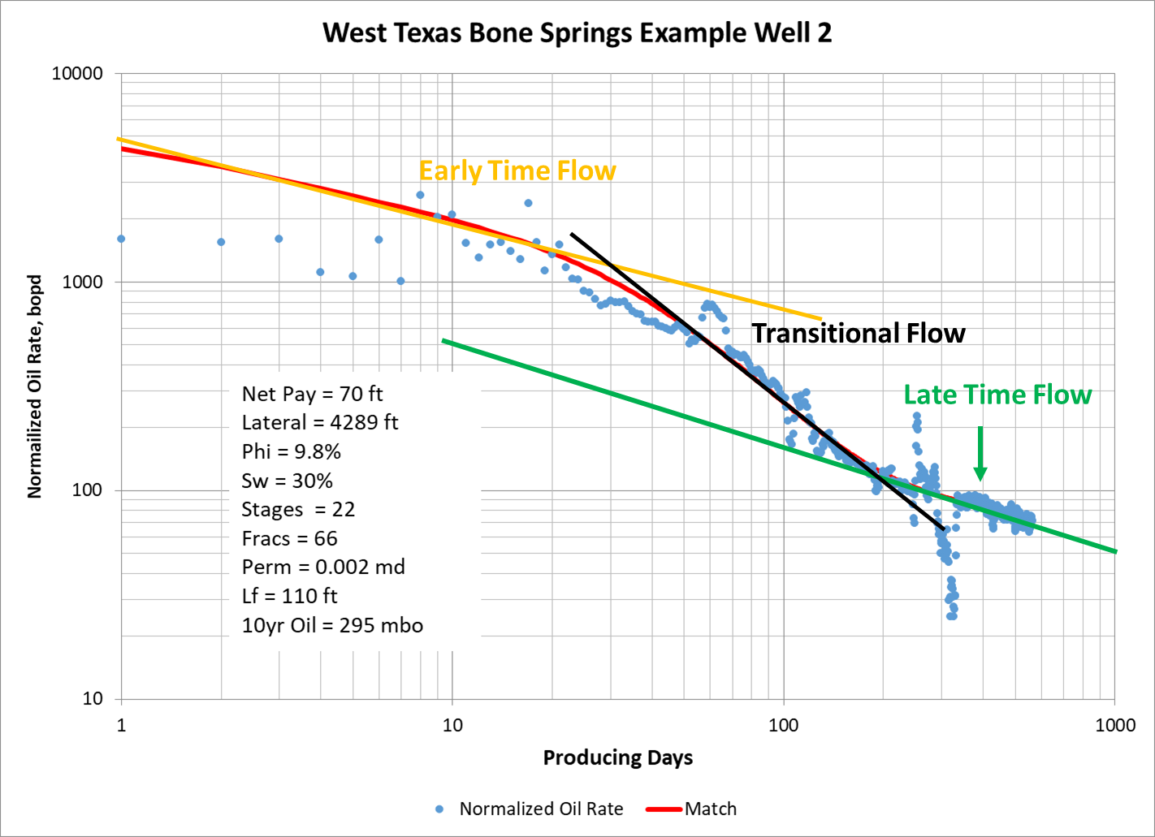
How does production decline in Hz wells?
All Hz Multi-Stage well’s production decline in the same manner
  Early Time Flow
    Dependent on the number and length of fracs created and the formation permeability
  Transitional Flow
    Increased decline rate, timing of the beginning is dependent on distance between fracs & formation permeability
  Late Time Flow
    Level and timing is dependent on formation permeability

Slide 4
Characterizing Reservoir & Completion Success
Knowledge of reservoir permeability and the effectiveness of frac treatments allows for predicting results from future wells
Schubarth Software Systems LLC has developed a software program “Terranaut” to both analyze past wells to determine formation permeability & frac effectiveness and then project what completion design returns the best economic results
Performing these analyses has shown that completion costs can be reduced by 100’s of thousands of dollars and increase well profit by millions of dollars on a per well basis
The cost of performing these analyses are insignificant compared to the benefits
Knowledge of effective fracture lengths also leads to better well spacing decisions and optimal recovery of oi & gas for the investment made

Slide 5
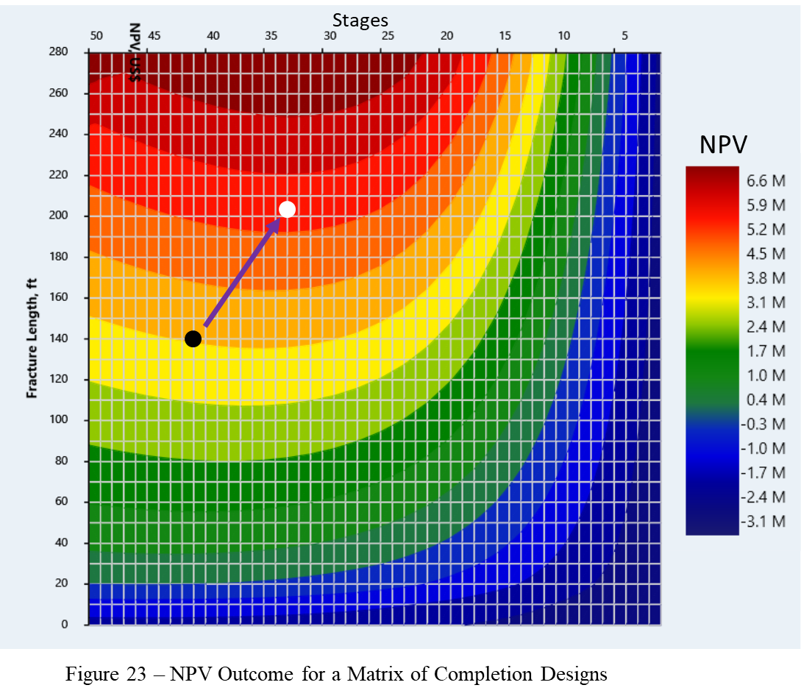
Optimizing Completions
This example is from an URTeC paper presented in July 2019 by our company
The black dot indicates current practices, the white dot indicates a point of improved economics
Results Indicate:
  Reduce Stage count from 41 to 33
  Increase Stage size from 360klbs to 525klbs
  Reducing well cost by $151,000 (-3%)
  Increasing well profit by $1,640,000 (+52%)
  Increased effective frac length increases well drainage area which reduces the number of wells needed to develop land, further reducing cost and increasing return on investment

Slide 6
Past Evaluations
Here are some of the evaluations we have completed
The table shows the percentage decrease in total well cost and improvement in NPV we have identified in each study
The industry has been chasing early time rate and not focusing on well life economics
This has led to spending too much capital for too little incremental oil & gas, thus poor returns

Slide 7
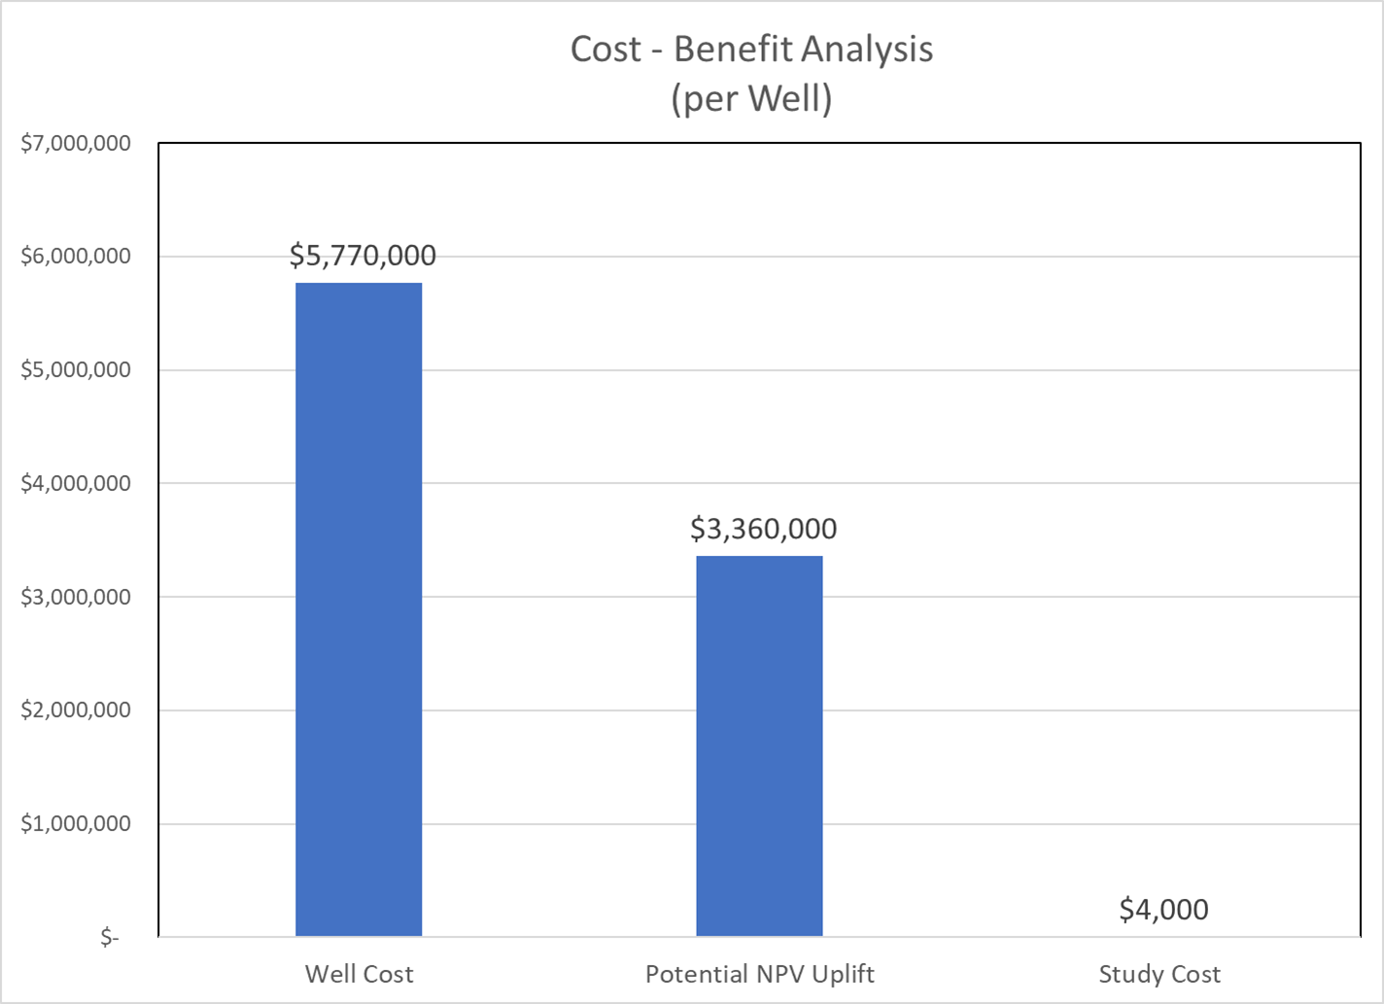
Cost/Benefit
Terranaut cost of analyses are:
  Individual well production history matching
    $4000/well (updates $1000/well)
  Completion optimization for unlimited number of wells
    $10,000/horizon (updates $5,000/horizon)
  Well Spacing and Development Optimization
    $15,000/horizon (updates $7,500/horizon)

Slide 8
Where do we go from here?
We are looking to establish relationships with Capital Providers, Operators and Consulting Advisors to work together to identify opportunities for improved return on investment and document the success of these opportunities.
We would like the opportunity to meet and detail the process we have developed to improve economic returns in horizontal multi-stage wells. We have used our software to analyze wells in numerous shale plays.
Our presentation should take about an hour of your time and detail the process, the cost of the process and benefits you should see and be able to document.

