Slide 1

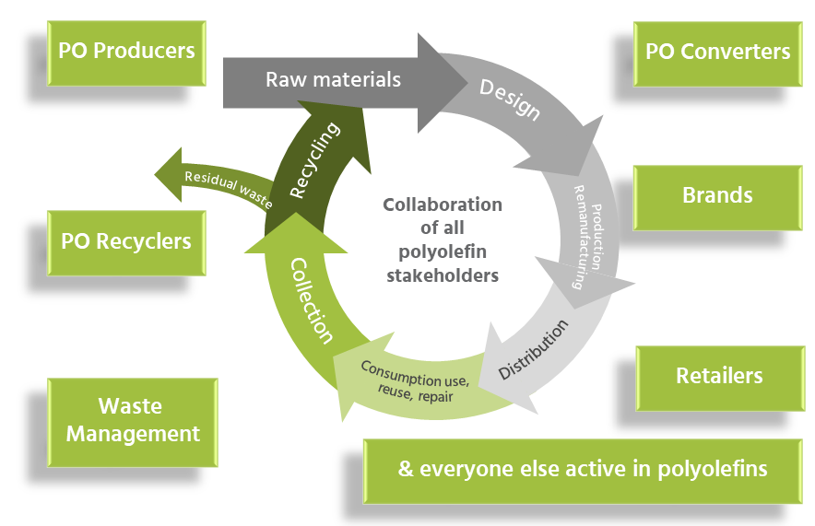
Driving circular polyolefin system
Collaborating towards three strategic goals: designing out waste; keeping maximum products and material in use for as long as possible; then recycling into high-quality new raw material.
Three major areas of work:
Membership:
Innovating for circular economy
Enhancing collection and sorting
Developing markets for recycled polyolefins
www.pcep.eu @pcepeu info@pcep.eu

