Slide 1
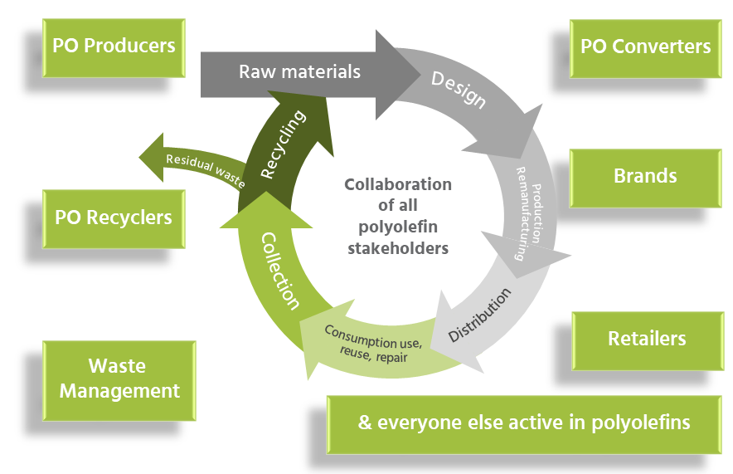
Driving circular polyolefin system
Collaborating towards three strategic goals: designing out waste; keeping maximum products and material in use for as long as possible; then recycling into high-quality new raw material.
Six work streams:
Membership:
Innovate for a circular economy
Enhance collection & sorting
Develop end markets for recycled polyolefin
Understand our material flow and progress
Advocate for a supportive framework
Communicate a circular polyolefin economy
www.pcep.eu @pcepeu info@pcep.eu

Slide 2
PCEP Members

