Slide 1
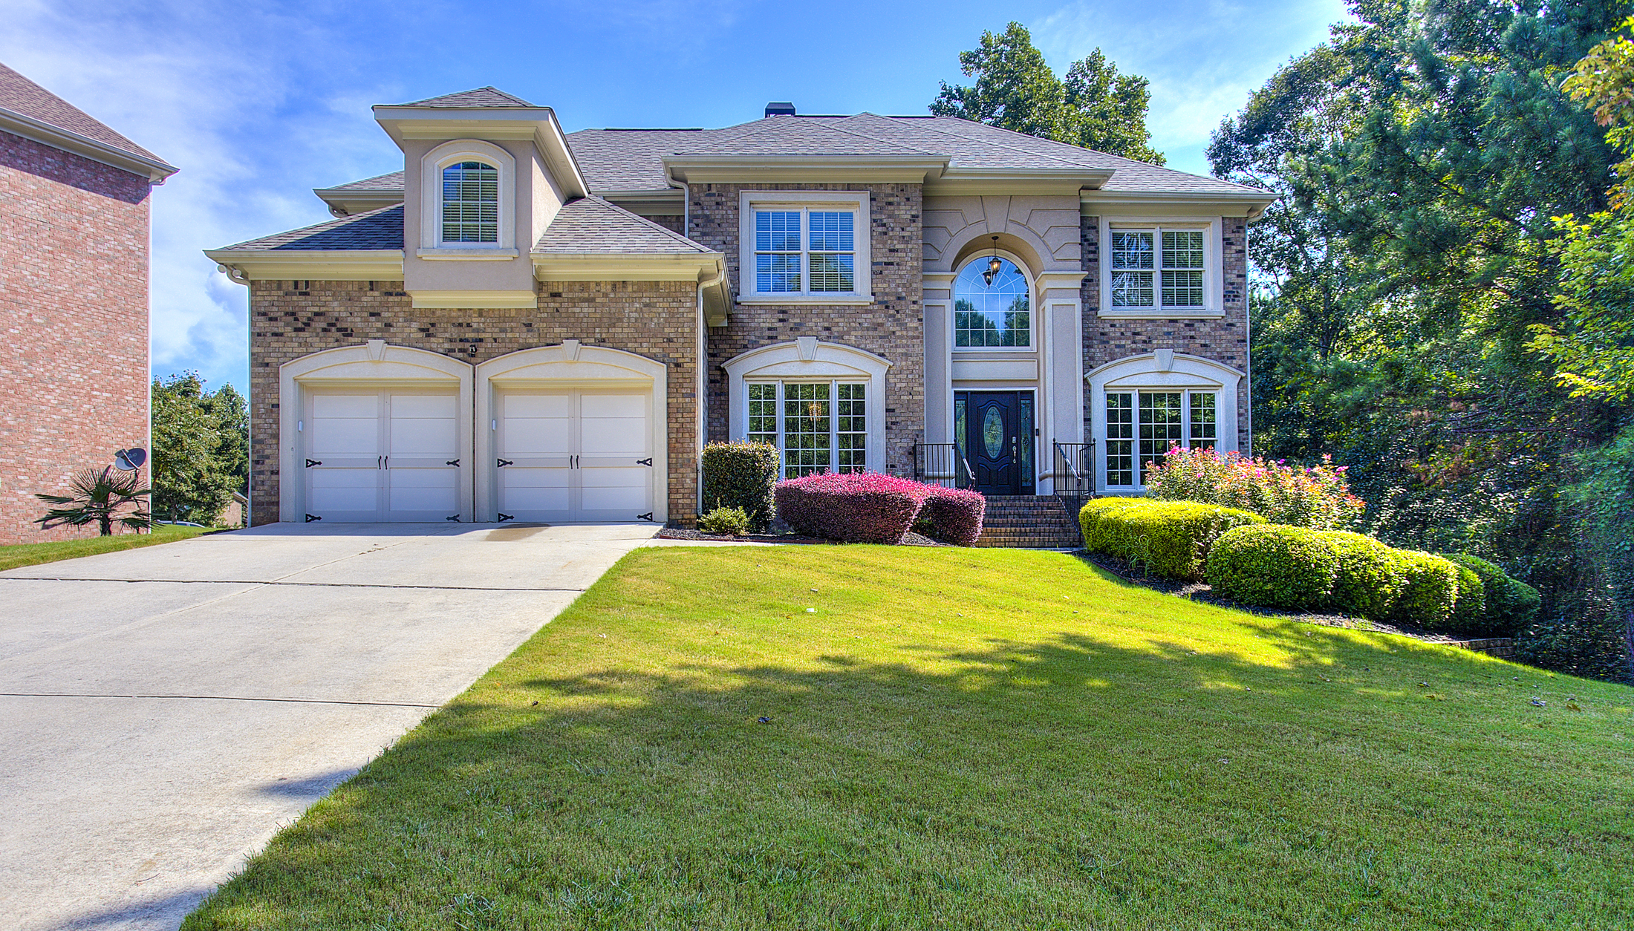
HOME BUYING GUIDE
SHAWNTELL CARTER- MCFADDEN | GEORGIA Realtor®
T.A.M.G Realty Inc.
Real Estate Associate Broker
(678)571-2082 | SHAWNTELL@SELLINGHOUSESINGA.COM
WWW.SELLINGHOUSESINGA.COM

Slide 2
Your Home Buying Adventure
STARTS NOW
Dear Home Buyer,
“
Welcome to one of the most exciting moments in your life.
Your home isn’t just the roof over your head; it’s where you eat, sleep, raise your family, and build your life.
I’ve created this guide to walk you through all the important steps you need to take in order to get the most out of your home buying experience.
If you have any questions, please do not hesitate to contact me.
Sincerely,
”
Shawntell Carter McFadden
Georgia Realtor®
Real Estate Associate Broker
Email: Shawntell@sellinghousesinga.com
Direct: (678)571-2082

Slide 3
STEP 1:
CHOOSE YOUR REALTOR
START BY HIRING A PRO REALTOR WHO WORKS EXCLUSIVELY FOR YOU
When it comes to buying your home, I’ve got you covered:
I know the market, and about neighborhoods you didn’t know existed. I obsess over prices, property values and the latest, hottest listings. I access historical sales data and keep up to date with builders and new developments. I problem-solve. I negotiate. I go into scary basements. I make sure my clients don’t buy the wrong home.
My goal is to always make your experience as quick and seamless as possible. This means:
BEING REAL AND TRANSPARENT THROUGH THE PROCESS
&
BEING RESPONSIVE AND AVAILABLE TO YOU.
Buying a home is one of the biggest transactions you’ll make in your life. Get the time and attention of a competent agent.

Slide 4
UNDERSTAND YOUR OPTIONS
STEP 2:
GET FINANCING
When determining which mortgage best suits your situation, there are some basic decisions you’ll need to make:
TYPE OF MORTGAGE
CONVENTIONAL MORTGAGE
This is the most common type of mortgage. Your lender will loan you up to 80% of the purchase price of the property or its appraised value (whichever is lower), and you have yourself the other 20% as a down payment.
HIGH RATIO MORTGAGE
If you don’t have at least a 20% down payment needed to get a conventional mortgage, a high ratio mortgage can advance you up to 95% of the home’s purchase price or appraised value. However, you’d be required to purchase mortgage insurance (not to be confused with home insurance), the amount of which would be added to your mortgage principal.
INTEREST RATE
Your mortgage is made up of 2 components: principal and interest. Essentially, interest is the cost of borrowing money.
FIXED-RATE
You agree on an interest rate with your lender and this rate gets locked in for the term of the mortgage. A fixed-rate mortgage is great in an economy where the Bank of [Canada]’s prime rate is increasing, but undesirable if the going rate is decreasing.
VARIABLE-RATE
Your interest rates fluctuate with the Bank’s prime interest rate. Your monthly mortgage payment amount stays the same. However, if the prime rate falls, more of your payment goes towards the principal and less goes towards the interest. If the interest rate rises, less of your payment goes towards the principal and more goes towards the interest.
TERM AND AMORTIZATION
A mortgage term is the amount of time a lender will loan you money for – typically from 6 months to 5 years. When the term is up, the remaining amount is payable in full unless you arrange new financing for another term.
Because few of us can pay off an entire mortgage in even a 5-year term, lenders calculate – or amortize - the mortgage payments over a much longer time, often as long as 30 years. They aren’t loaning you the money for a 30-year period; they’re simply calculating the payment schedule as if it would take you that long to pay back your mortgage. You will likely renew the mortgage at the end of your term within your amortization period.

Slide 5
SHOP FOR A LENDER
Most people believe that the best lender for them is the bank they already have an account with. They’re persuaded by ads on branch walls about consolidating their services with the same provider.
Personally, I’ve always shopped for my home loan using a Mortgage Broker.
Here's why:
MORTGAGE BROKERS
VERSUS BANKS
The big banks have only a LIMITED access to their OWN mortgage rates and terms. They’ll post posters of discounts on their rates, but YOU are responsible for negotiating these rates.
On the other hand, Mortgage Brokers have access to MULTIPLE lenders and mortgage products. They shop around for the best mortgage terms tailored to your individual circumstances, THEY NEGOTIATE FOR YOU, and they present you with the lowest rate on the market.
Broker fees are also paid by the financial institution who services your mortgage, so it’s a good way to comparison shop without actually doing the work yourself. And yes, you read that right. Their commissions are paid by the lender. So their services to you are FREE.
Here’s the Mortgage Broker that I recommend:
Linnell Edwards – Barrett Financial Mortgage Broker
Phone: (334) 354-8917 Email: ledwards@barrettfinancial.com
GET PRE-APPROVED FOR A MORTGAGE
Your broker will help get you pre-approved for a mortgage to give you the confidence of knowing how much home you can afford. This in turn will help you know the price range of homes you should be focusing on in your search.
A mortgage pre-approval will be in writing (generally valid for 90 or 120 days), and will require you to prove your income and credit history. If you don’t have something in writing and you haven’t provided financial documentation, then you likely don’t have a mortgage pre-approval.
Ensure you have a pre-approval before embarking on your home hunting journey. Knowing how much your lender is willing to loan you will eliminate the risk and uncertainty of being able to obtain financing once you find your perfect home.

Slide 6
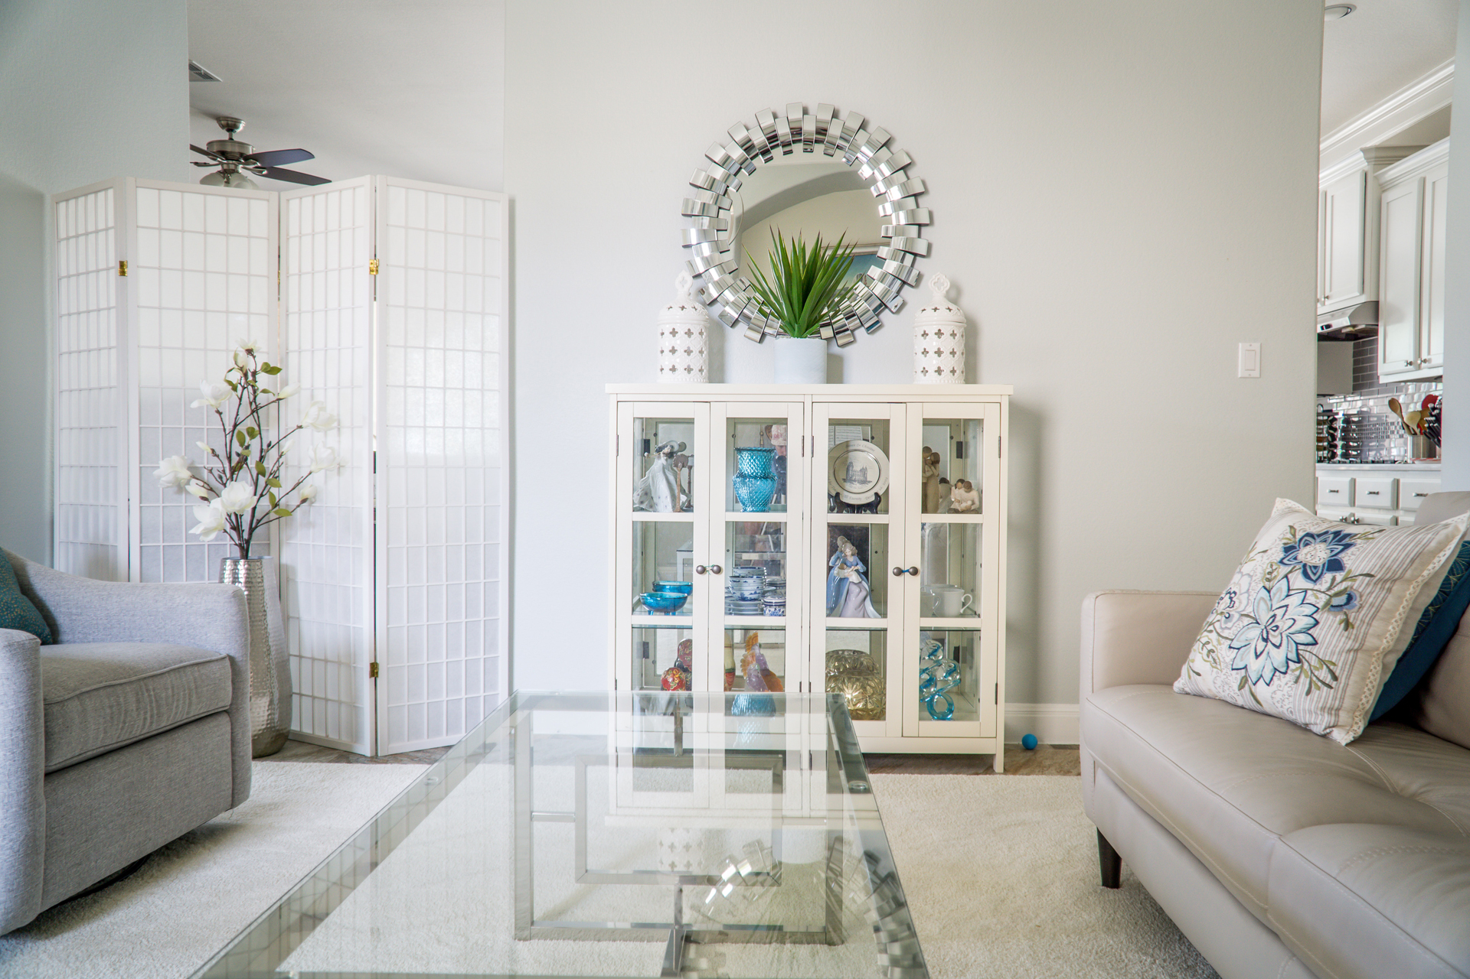
STEP 3:
GO SHOPPING
LET THE FUN BEGIN
You’ve picked a Pro Realtor, Shawntell to work with and have been pre-qualified for a mortgage. Now it’s time to start looking for your new home. Let the fun begin!
CREATE YOUR WISH LIST
SCREEN LISTINGS ONLINE
What are your needs versus your wants? How many bedrooms must you have? What kind of finishes are you looking for? Do you need a large yard for your dog? A great school for your kids?
Of course, in a hot market like Toronto’s, compromise is a part of the process. Would you rather live in a bigger property or closer to downtown? Are you okay spending more money for something turnkey or could you buy a fixer-upper and do the renos yourself?
Talk to your agent about what’s most important to you.
Our home search tool allows you to setup a custom home search that instantly notifies you as soon as a property hits the market that matches your exact criteria.
Awesome right? Contact me to get you setup today. In my system that will automatically send you listings that fits your criteria.

Slide 7
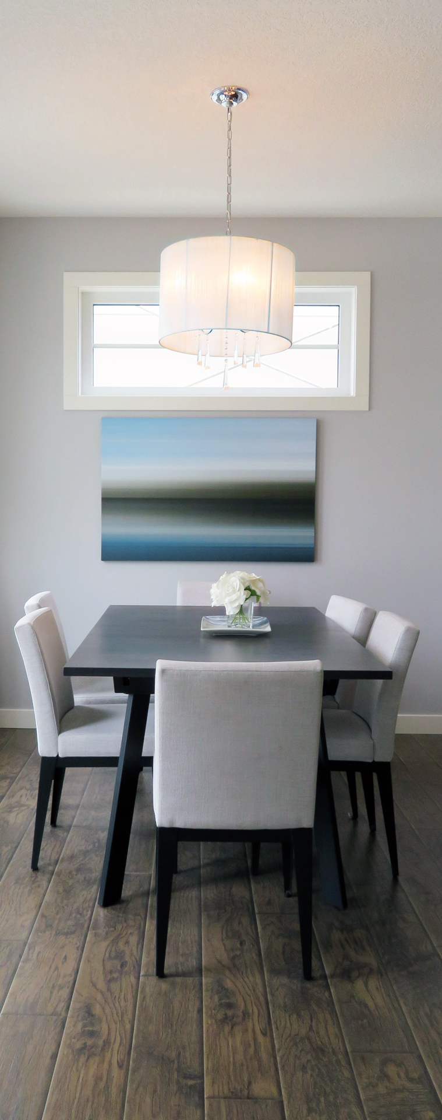
Big Decisions
SHOULD I BUY A HOME?
The most important factor to consider is your personal financial health. How much can you comfortably afford without giving up your life? Although buying a home can be a smart investment because your equity grows tax-free, don’t forget about utilities, property taxes, and ongoing maintenance costs. Evaluate your financial situation and be honest with yourself. If you’re considering renting or have subpar credit, contact me to help evaluate your options.
SHOULD I BUY OR SELL FIRST?
If you already own a home and are contemplating whether to sell it or buy a new home first, the answer depends on what kind of property you currently live in and where it’s located. If you’re in a high-demand neighbourhood, downtown house, or unique condo, you’ll likely be able to sell quickly. If you’re in a less desirable area or building, selling may take 60 or 90 days. You’d be better to sell before buying.
The other big factor to consider is your financial resources. Can you afford to carry two mortgages if your current home doesn’t sell? While there’s no right or wrong answer, the goal is to make sure you have realistic expectations and a plan that works for you and your family. Let's chat to discuss various scenarios based on current market conditions and your unique current circumstances.

Slide 8
STEP 4:
PUT IN THE OFFER
YOU’VE FOUND ‘THE ONE’
NOW LOCK IT DOWN
Your house hunting efforts have paid off. You’ve found a home that satisfies your wants and needs, is in the price range, and just feels right.
HAVE YOUR DEPOSIT READY
A deposit is paid by the Buyer to the Seller, and forms part of the final purchase price.
WHY DO I NEED A DEPOSIT?
Because it provides security to the Seller. A deposit ensures that the Buyer has a stake in the agreement and something to lose if they don’t close on the deal.
Depending on local practices, one may be requested along with your offer, or within 3 days upon acceptance. A typical deposit is around 2 to 5% of the purchase price, which is held in trust until closing.
SUBMIT YOUR OFFER
We begin by drafting an offer on a Purchase and Sale Agreement This is the official legal document which outlines everything from the price you are prepared to pay, to the inclusions you want (appliances, light fixtures), to your preferred closing date (the date you take possession), to conditions that need to be met for the deal to go through

Slide 9
PRO
TIP
One of the most included conditions is the financing condition. It’s used to protect you, the Buyer, by telling the Seller that your offer to buy their property is conditional on you obtaining financing.
MEET CONDITIONS
In your offer, you may have included ie. a financing condition, a home inspection, ( Due Diligence Period ) or a solicitor review.
What happens to your deposit if you don't fulfill a condition by the due date?
If your offer was conditional on ie. getting financing but your bank doesn’t approve you for a mortgage, then you get your deposit back.
There is an expectation and obligation to act in good faith. You can’t just wake up the next day, change your mind, and use the financing clause to get out of the purchase.
A deposit is returned only with the agreement of both the Buyer and the Seller. If the Seller doesn’t believe you acted in good faith in fulfilling a condition, they can refuse to release the deposit.
If your purchase was not conditional on financing (or you previously waived the condition) and you are now unable to obtain financing, that spells serious trouble. You forfeit your deposit and risk being sued for additional damages.
While the legal wording may vary from contract to contract, a well-worded clause states that the financing obtained must be “satisfactory to the Buyer in their sole and absolute discretion.” This means that the terms and conditions of the financing obtained (interest rate, payments, etc.) must be satisfactory to you – not just that you were able to obtain financing in general.
POWERFULLY NEGOTIAGE
Once you’ve submitted your offer, the Seller can either accept it, reject it or counter it. During these back-and-forth negotiations, you may need to compromise on small things, but a savvy Realtor will work hard to get you what you want.

Slide 10
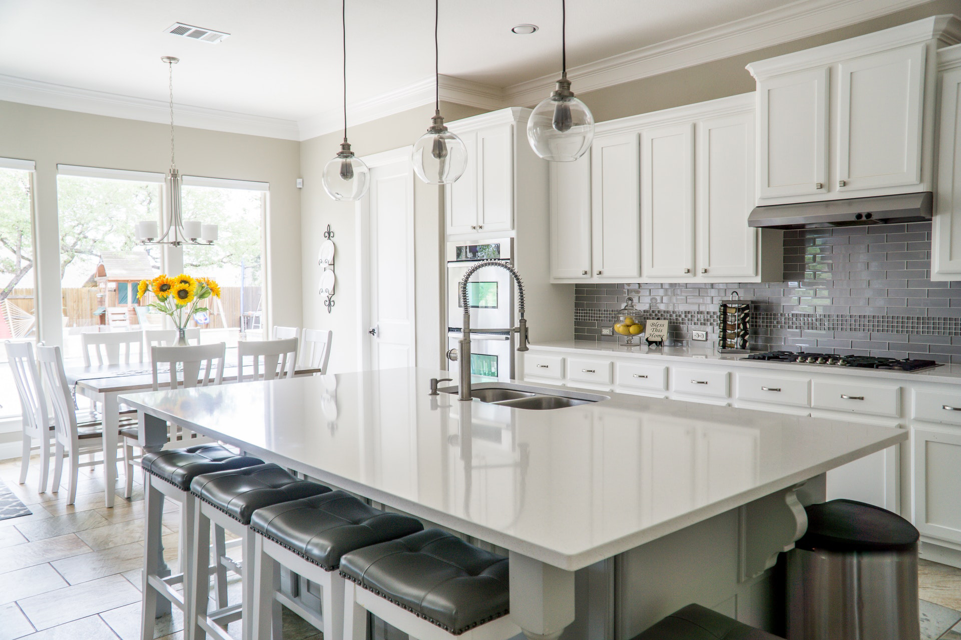
STEP 5:
THE CLOSE
As soon as your offer is accepted, your deposit is submitted, and there are no more conditions to be fulfilled, you have a firm agreement, and the closing process begins.
Closing is the point at which the ownership and possession of the property are transferred from the Seller to you.
At this point you will be in close contact with your lender and lawyer. You’ll need to sign a ton of paperwork and of course, provide payment for your new home.
Once all legal and financial obligations have been met, then pick up your keys and a bottle of wine, because –
CONGRATULATIONS!
You‘ve just got yourself a new home!
Ready to get started?
Email Shawntell@sellinghousesinga.com or call (678) 571-2082

