Slide 1


Upper Loudoun Little League
2026 Spring Season – Parents Meeting

Slide 2

Agenda
Welcome
Board of Directors
2025 Season & All-Star Highlights
Spring 2026 Player Divisions
Division Structure & Rules
Important Dates & Schedule
Safety
Equipment
Umpires
Fields & Facilities
Fees
Parent Resources
Parent Code of Conduct
Parent Volunteers
Take Note

Slide 3
Board of Directors (Volunteers)
President – Will Smith
Vice President – Bryan Fulkerson
Player Agent – Ryan Martin
Secretary – Mike Puckli
Treasurer – Paul Szczenski
Information Officer – Casey Becker
Safety Officer – Sean Ryan
Umpire-In-Chief – Shane Conrad
Coaching Coordinator – Buddy Teschner
Big Field Coordinator – Neil Kraus
American League Commissioner – Chris Malvagna
National League Commissioner – Mike Geaneas
Scheduler – Chris Lose
Additional Volunteers
Sarah Smith – Social Media
Becky Reilly – Sponsorships/Fundraising
Concessions – Kelly Conrad
IT Support – Jenny Bilstad

Slide 4
2025 Season & All-Star Highlights
8 Divisions / 64 Teams / 729 Players
All-Star Teams
7 All-Star Teams
8, 9, 10 (2 teams)
9, 10, 11 (2 teams)
Little League (2 teams)
Juniors (1 team)
Seniors (1 team)
2 Invitational Teams
7, 8, 9 (2 teams)
Juniors team made it to Southeast Region championship game (Win away from Jrs World Series)

Slide 5
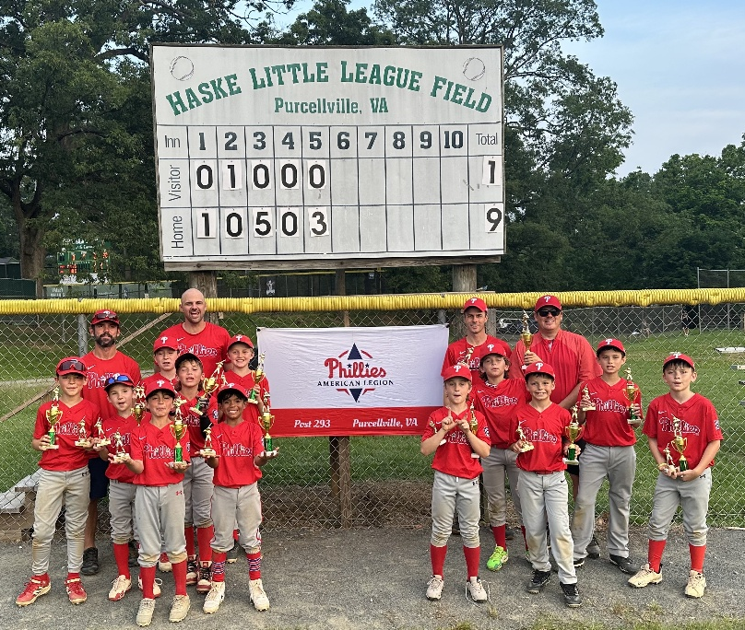
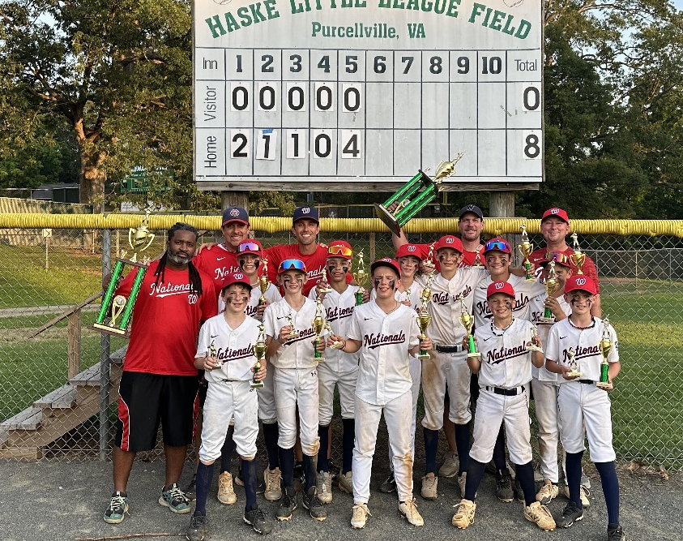
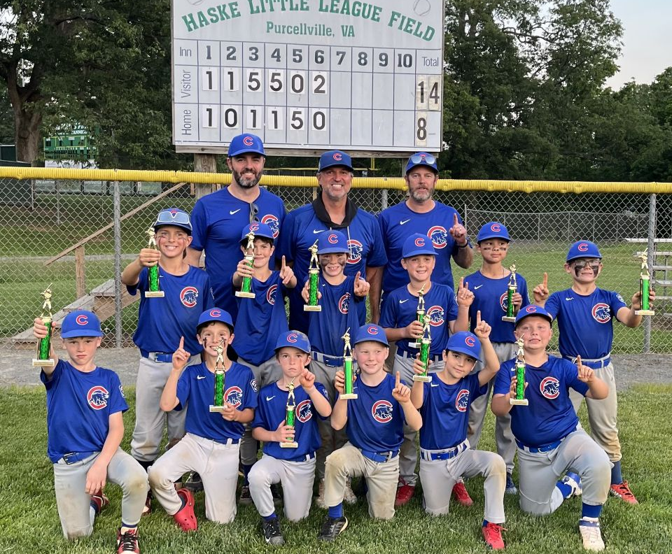
2024 Spring AAA Champions
2024 Spring Majors Champions
2025 Spring AA Champions

Slide 6
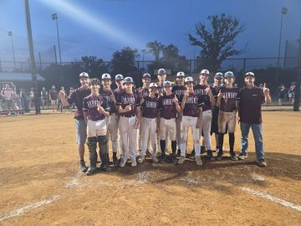
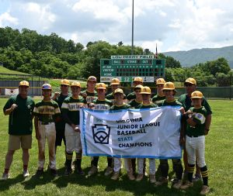
2025 Spring Middle School Champions – Harmony MS
2025 Spring Juniors State Champions
2025 Big Field Program

Slide 7
Spring 2026 Player Divisions
8 Divisions / 64 Teams / 711 Players
Tee Ball (Baseball ages 5-6) – 8 Teams (down from 12)
Coach Pitch (Baseball ages 6-8) – 14 Teams (down from 18)
A (Baseball ages 8-9) – 8 Teams (up from 4)
AA (Baseball ages 8-10) – 8 Teams (steady)
AAA (Baseball ages 9-12) – 6 Teams (down from 8)
Majors (Baseball ages 10-12) – 8 Teams (steady)
Juniors (Baseball ages 13-14) – 5 Teams (up from 4)
Middle School (Baseball ages 13-16) – 2 Teams (Rosters up from 12 to 15)

Slide 8
Division Structure
Players are drafted/assigned to an appropriate division based on:
Residency (per ULLL established boundaries)
Geographically (Tee Ball and Coach Pitch only)
Playing Age (per 2026 Little League® Age Chart)
Little League® experience (number of seasons played and previous divisions)
Manager/Coach evaluations
Number of players/teams at each level that can be accommodated by available fields/managers
Evaluation/assessment results (if available)

Slide 9
Division Structure
The ULLL divisions are as follows:
National League
American League
Tee Ball – assigned geographically
Coach Pitch – assigned geographically
Single “A” (A) – common pool draft
Double “A” (AA) – common pool draft
Triple “A” (AAA) – common pool draft
Majors – common pool draft
Juniors – common pool draft
Tee Ball – assigned geographically
Coach Pitch – assigned geographically
Single “A” (A) – common pool draft
Double “A” (AA) – common pool draft
Triple “A” (AAA) – common pool draft
Majors – common pool draft
Juniors – common pool draft
Middle School is drafted based on enrollment and/or “intended” middle school

Slide 10
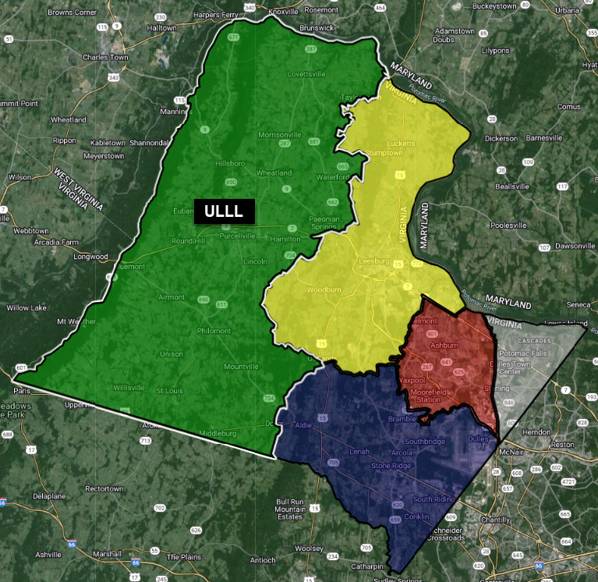
CLLL
DLL
LLLL
LSLL

Slide 11
Division Structure - Teams
TEE BALL
Introduction to baseball
COACH PITCH
Basic skills development – hitting, fielding, base-running
SINGLE “A” (A)
Introduction to full player pitching
DOUBLE “A” (AA)
Softer tee-ball and batting tee used
Shorter practices/games
No scores kept
ALL players league age 5
Players league age 6 WITHOUT prior season of Spring t-ball experience
Mandatory infield/outfield play
No scores kept
ALL players league age 6 WITH prior season of Spring t-ball experience
Players league age 7 WITHOUT prior season of t-ball experience, at parent request and league approval
Players league age 7 with a sibling in this division, at parent request and league approval
Beginning emphasis on position player development
No stealing
Scores kept; no standings
Field size is 46/60
Players league age 7 at parent request to try out, league approval, AND are drafted
Players league age 8 who try out AND are drafted
Players league age 9 who are not drafted to AA team
Full player pitching
Refinement of position player skills
Refinement of base-running skills
Scores kept; no standings
Field size is 46/60
End of season tournament
Players league age 8 who try out, assess appropriately AND are drafted
Players league age 10 who are not drafted to AAA team

Slide 12
Division Structure - Teams
TRIPLE “A”
(AAA)
MAJORS
JUNIORS
MIDDLE SCHOOL
Preparation for Majors play
Regulation Little League games and rules
Competitive; scores and standings kept
Field size is 46/60.
End of season tournament
Potential All-Star play
Players league age 9 who try out, assess appropriately AND are drafted
Players league age 10-11 who request NOT to play Majors
Players league age 11 who are not drafted to Majors team
Players league age 12 who waiver their right to play Majors
Regulation Little League games and rules
Highest level of play on small diamond (46/60)
Mandatory player evaluation and draft
Highly competitive; scores and standings kept
Field size is 46/60
End of season tournament
Potential All-Star play
Players league age 10-11 who try out AND are drafted
ALL players league ages 11-12 who have previously played in division
ALL players league age 12 who have not requested to play in AAA
Introduction to regulation baseball dimensions/rules
Leads, pick-offs, balks
Metal cleats
Mandatory player evaluation and draft
Interleague play
Highly competitive; scores and standings kept
Field size is 60/90
End of season tournament
Potential All-Star play
ALL players league age 13-14
High School preparation
Leads, pick-offs, balks
Metal cleats
BBCOR bats
Mandatory player try outs
Interleague play
Highly competitive; scores and standings kept
Field size is 60/90
End of season tournament
Potential All-Star play
Players league age 13-16 who are also in 6th, 7th, or 8th grade

Slide 13
Spring 2026 Division Specific Rules
Division | No New Inning After: | Drop Dead Time | Mercy Rule | Max Runs in an Inning
Tee Ball | 3 Innings Max | 1 Hour | N/A | N/A
Coach Pitch | 1 Hour 30 Minutes | 1 Hour 30 Minutes, or 6 Innings | N/A | N/A
A | 1 Hour 45 Minutes | 2 Hours, or 6 Innings | 15 runs after 3 innings, 10 after 4 innings, or 8 runs after 5 innings | 5 (Unlimited after 4 innings)
AA | 1 Hour 45 Minutes | 2 Hours, or 6 Innings | 15 runs after 3 innings, 10 after 4 innings, or 8 runs after 5 innings | 5 (Unlimited after 4 innings)
AAA | 1 Hour 45 Minutes | 2 Hours, or 6 Innings | 15 runs after 3 innings, 10 after 4 innings, or 8 runs after 5 innings | 5 (Unlimited after 4 innings)
Majors | N/A | N/A | 15 runs after 3 innings, 10 after 4 innings, or 8 runs after 5 innings | N/A
Juniors | 2 Hours 15 Minutes | 2 Hours 45 Minutes | 15 runs after 4 innings, 10 after 5 innings, or 8 runs after 6 innings | N/A
Middle School | 2 Hours 15 Minutes | 2 Hours 45 Minutes | 15 runs after 4 innings, 10 after 5 innings, or 8 runs after 6 innings | N/A

Slide 14
Important Dates – Spring 2026
March 14, 2026
Spring Practices Started (not really)
March 22, 2026
Spring Practices Start (A, Coach Pitch, Tee Ball)
Week of March 30 – April 3, 2026
Spring Break for LCPS, Practices will be optional
Week of YOUR FIRST GAME
April 6-10 (MS, Jrs, Majors, AAA, AA)
Uniforms distributed to coaches (MUST have 5 cleared volunteers)
April 11, 2026
ULLL Opening Day Ceremony – Homerun Derby @ Franklin Park
ULLL Picture Day @ Harmony Middle School

Slide 15
Important Dates – Spring 2026
April 14 – 18, 2026
Spring Games Begin (A, CP, TB)
Week of June 1, 2026
Start of Playoff Games
Championship Games (Dates subject to change)
June 9, 2026 – AA Championship Game
June 10, 2026 – AAA Championship Game
June 11, 2026 – Majors Championship Game
*Dates are subject to change*
June 15, 2026
LCPS Last Day of School

Slide 16
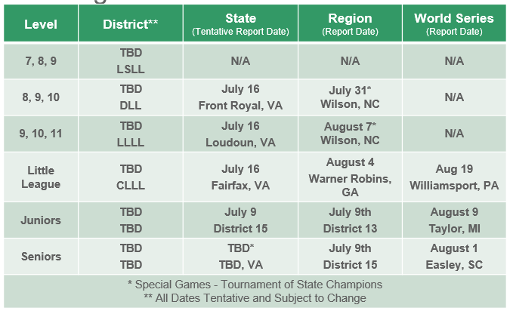
Important Dates – Spring 2026
2026 Virginia District & State Tournaments

Slide 17
Important Dates – Spring 2026
2026 Virginia District & State Tournaments
Level | District** | State (Tentative Report Date) | Region (Report Date) | World Series (Report Date)
7, 8, 9 | Week of June 9 TBD | N/A | N/A | N/A
8, 9, 10 | June 14 – 23 TBD | July 3 Centreville, VA | July 18* TBD | N/A
9, 10, 11 | June 18 – 27 TBD | July 10 Coeburn, VA | July 25* TBD | N/A
Little League | June 28 – July 6 TBD | July 17 Bowling Green, VA | July 29 Warner Robins, GA | Aug 13 Williamsport, PA
Juniors | June 20 – 23 TBD | July 3 Tazewell, VA | July 18 Bridgewater, VA | Aug 3 Taylor, MI
Seniors | June 21 – 23 TBD | TBD* TBD, VA | July 17 Safety Harbor, FL | July 26 Easley, SC
* Special Games - Tournament of State Champions ** All Dates Tentative and Subject to Change

Slide 18
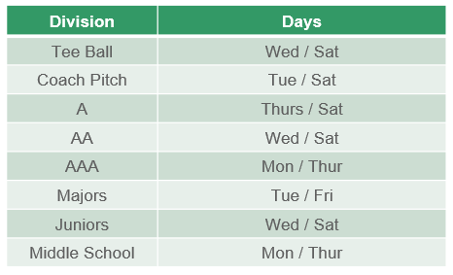
Schedule
Game Days for Each Division

Slide 19
Safety
Background checks are performed for ALL managers, coaches, volunteers, and board members.
All managers, coaches, volunteers, and the UIC receive mental, social, and emotional well-being training (Diamond Leader Training).
All managers, coaches, volunteers, and the UIC receive abuse awareness training (Abuse Awareness Training).
All managers, coaches, and the UIC receive concussion protocol training.
All teams are issued a first-aid kit
All league provided equipment is thoroughly inspected
NO DOGS ALLOWED!

Slide 20
Safety
How YOU Keep Player Safety a # 1 Priority:
Give your player’s gear a once over
Make sure your player has plenty of water
Encourage your player to take warm-ups seriously
Encourage your player to have open communication with the coaches.
Athletic cups are recommended for all male players, required for Coach Pitch and above.
Athletic cups are required for ALL male catchers
Consider using a batting helmet with a C-Flap (jaw guard)
Make sure your coach knows of ANY medical conditions

Slide 21
Safety - Pitch Counts
By Days of Rest (14 & Under)
1-20 pitches | Zero (0)
21-35 pitches | One (1)
36-50 pitches | Two (2)
51-65 pitches | Three (3)
66+ pitches | Four (4)
By League Age
6-8 | 50 pitches
9-10 | 75 pitches
11-12 | 85 pitches
13-16 | 95 pitches
By Days of Rest (15 & 16)
1-30 pitches | Zero (0)
31-45 pitches | One (1)
46-60 pitches | Two (2)
61-75 pitches | Three (3)
76+ pitches | Four (4)
* Under no circumstance shall a player pitch in three (3) consecutive days.

Slide 22
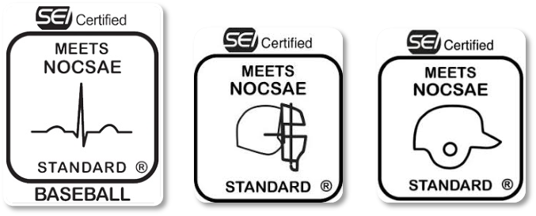
Equipment
League Provided
Jersey & Hat
Batting Tees (Tee Ball only)
Balls (Practice & Game)
First-Aid Kit (Provided to Manager)
Catcher’s Gear – mitt, mask, chest protector, leg guards (A and Coach Pitch only)

Slide 23
Equipment
Player/Parent Provided
Baseball Pants (Full Length or Knickers, per Manager)
Belt & Socks (Manager will let you know what color)
Cleats (NO metal cleats in Little League® – Majors and below)
Helmet (NOCSAE)
Athletic supporter/cup
Catcher’s Gear – mitt, mask, chest protector, leg guards (if needed)
Bat

Slide 24


Equipment - Bats
TEE BALL
Certified bats (26” and shorter) will feature the USA Baseball mark and text, ONLY FOR USE WITH APPROVED TEE BALLS.
A, AA, AAA, MAJORS
USA Baseball standard (USABat)
JUNIORS
USA Baseball or BBCOR
MIDDLE SCHOOL
BBCOR only
Certified bats shall not be more than 34” in length nor more than 2 5/8” in diameter. If wood, not less than 15/16” in diameter (7/8” for bats less than 30”) at its smallest part. Wood bats taped or fitted with a sleeve may not exceed 16” from the small end. Solid one-piece wood barrel bats do not require a USA Baseball logo. BBCOR bats also permitted and must be labeled with a silkscreen or other permanent certification mark.
Certified bats shall not be more than 36” in length nor more than 2 5/8” in diameter. If wood, not less than 15/16” in diameter (7/8” for bats less than 30”) at its smallest part. Wood bats taped or fitted with a sleeve may not exceed 18” from the small end. Bats shall not weigh more than 3 ounces less than the length of the bat (e.g., a 33-inch-long bat cannot weigh less than 30 ounces). Non wood BBCOR bats must be labeled with a silkscreen or other permanent certification mark.
Certified bats shall not be more than 33” in length nor more than 2 5/8” in diameter. If wood, not less than 15/16” in diameter (7/8” for bats less than 30”) at its smallest part. Wood bats taped or fitted with a sleeve may not exceed 16” from the small end. Solid one-piece wood barrel bats do not require a USA Baseball logo.
* The use of pine tar or any other similar adhesive substance is prohibited at all levels of Little League® Baseball.

Slide 25
Umpires
Umpires NEEDED
Must be age 13 or older
Youth umpires are eligible to be paid $40-65 per game; Adult umpires are volunteers (unpaid).
Umpire Training & Clinics (3/21 Clinic)
Please contact Shane Conrad at (571) 639-1958 or umpire@ulll.org
Adult Game Coordinators REQUIRED when there is an all-youth umpire crew (not applicable to TeeBall or Coach Pitch)
Must be present on field for pre-game meeting
Must be present for entire game

Slide 26
Fields & Facilities
2025 ULLL Improvements
Haske Mound, outfield fence, padding behind plate
Rebuilt pitcher's mounds at various fields
Ongoing maintenance to fields, sheds, and dugouts
Ongoing maintenance and repairs to league lawnmowers
Future ULLL Improvements
Continued renovation project at Haske field
Repair/replace batting cage netting at various fields
Bullpen rebuilds at various fields
Ongoing maintenance to fields, sheds, and dugouts
Ongoing maintenance and repairs to league lawnmowers

Slide 27
Fees
Each season, ULLL collects a registration fee from each player based on the expected costs to run the league. Here is a breakdown of where your Spring 2026 registration dollars will go to support ULLL:
Administrative costs such as IT related operational resources, office supplies, copies, shipping, etc.
Player and umpire equipment, including balls, catcher's gear, tees, etc.
Fees, including PRCS county fee, Little League® Baseball charter/insurance, bank fees, umpires, portapotties, etc.
Field maintenance, equipment, and improvements
Services such as youth umpires, background checks, facility rentals, Opening Day ceremony, etc.
Trophies and awards
Uniforms, including jerseys, caps, and patches
Utilities and miscellaneous items such as power, water, trash, etc.

Slide 28
Parent Resources
Little League® International website – www.littleleague.org
Little League® 2026 Rulebooks app
ULLL website – www.ulll.org

Slide 29
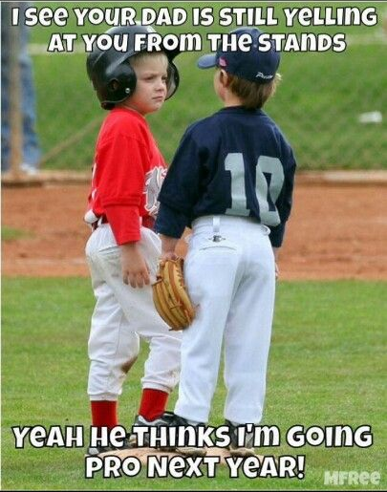
Parent Code of Conduct
The behavior of parents, families, and fans at youth sports games and practices has a significant impact on the player experience. Parents can set an example for all players by displaying the high-level of sportsmanship that Little League® expects of all its participants and respecting all players, coaches, umpires, and volunteers.
Please support ULLL in promoting positive behavior by reading the Parent/Guardian Code of Conduct provided to you during registration (also available on ULLL website). Questions or concerns should be directed to Will Smith, ULLL President.

Slide 30

Parent Volunteers
ULLL is a 100% volunteer non-profit community organization supported by parents who, like you, are committed to providing a fun and safe experience for our children on and off the field. Please consider volunteering as:
GameChanger Scorekeeper
Manager / Coach / Assistant Coach
Umpire (training available)
Adult Game Coordinator
Concession Stand (select fields only)
Sponsorship
Donations
IMPORTANT!!! - ALL volunteers must complete a Volunteer Registration Form and Abuse Awareness Training
High School students can earn volunteer hours for graduation.

Slide 31
Take Note
PLEASE REMEMBER…
THESE ARE KIDS
IT’S JUST A GAME
COACHES ARE VOLUNTEERS
UMPIRES ARE HUMAN VOLUNTEERS
NO COLLEGE SCHOLARSHIPS WILL BE HANDED OUT TODAY
Any parent, player, coach, or spectator guilty of improper conduct at any game or practice will be asked to leave the sports facility and suspended from the following game. Repeat violations may cause a multiple game suspension, or the season forfeiture of the privilege of attending all games.

Slide 32

Will Smith
president@ulll.org
703.822.1388

