Slide 1


Upper Loudoun Little League
2026 Spring Season – Coaches Meeting

Slide 2

Agenda
Welcome
Board of Directors
Spring Season Dates & Schedule
Safety – Priority # 1
Equipment
Coaches Corner
Field Maintenance / Supplies
Umpires
Little League Rules & Regulations, Local Rules
Equipment Handout
Play Ball!

Slide 3
Board of Directors (Volunteers)
President – Will Smith
Vice President – Bryan Fulkerson
Player Agent – Ryan Martin
Secretary – Mike Puckli
Treasurer – Paul Szczenski
Information Officer – Casey Becker
Safety Officer – Sean Ryan
Umpire-In-Chief – Shane Conrad
Coaching Coordinator – Buddy Teschner
Big Field Coordinator – Neil Kraus
American League Commissioner – Chris Malvagna
National League Commissioner – Mike Geaneas
Scheduler – Chris Lose
Additional Volunteers
Sarah Smith – Social Media
Becky Reilly – Sponsorships/Fundraising
Concessions – Kelly Conrad
IT Support – Jenny Bilstad

Slide 4
Important Dates – Spring 2026
March 13 - 16, 2026
  ULLL Dick’s Sporting Goods Discount Weekend (20% off, Leesburg only)
March 14, 2026
  Spring Practices Start (ALL)
March 19, 2026
  Mandatory Parents Meeting-HMS Auditorium
March 30- April 3, 2026
  LCPS Spring Break; Practices optional

Slide 5
Important Dates – Spring 2026
Week of YOUR FIRST GAME
  Uniforms distributed to coaches (MUST have 5 cleared volunteers)
April 6-10, 2026
  Spring Games Begin (MS, JRS, Majors, AAA, AA)
April 11, 2026
  ULLL Opening Day Ceremony – Homerun Derby @ Franklin Park
  ULLL Picture Day @ Harmony Middle School
April 14-18, 2026
  Spring Games Begin (A, CP, TB)

Slide 6
Important Dates – Spring 2026
Week of June 1, 2026
  Start of Playoff Games
Championship Games
  June 9, 2026 – AA Championship Game
  June 10, 2026 – AAA Championship Game
  June 11, 2026 – Majors Championship Game
  Dates are subject to change
June 15, 2026
  LCPS Last Day of School

Slide 7
Important Dates – Spring 2026
2026 Virginia District & State Tournaments
Level | District** | State (Tentative Report Date) | Region (Report Date) | World Series (Report Date)
7, 8, 9 | TBD LSLL | N/A | N/A | N/A
8, 9, 10 | TBD DLL | July 16 Front Royal, VA | July 31* Wilson, NC | N/A
9, 10, 11 | TBD LLLL | July 16 Loudoun, VA | August 7* Wilson, NC | N/A
Little League | TBD CLLL | July 16 Fairfax, VA | August 4 Warner Robins, GA | Aug 19 Williamsport, PA
Juniors | TBD TBD | July 9 District 15 | July 9th District 13 | August 9 Taylor, MI
Seniors | TBD TBD | TBD* TBD, VA | July 9th District 15 | August 1 Easley, SC
* Special Games - Tournament of State Champions ** All Dates Tentative and Subject to Change

Slide 8
Schedule
Master Schedule
  Shared Google Sheets document, PLEASE USE IT! (All managers have received via email) Strongly encourage to check weekly.
Game Days for Each Division
Division | Days
Tee Ball | Wed / Sat
Coach Pitch | Tue / Sat
A | Thurs / Sat
AA | Wed / Sat
AAA | Mon / Thur
Majors | Tue / Fri
Juniors | Wed / Sat
Middle School | Mon / Thur

Slide 9
Schedule
CONTACT INFO:
scheduler@ulll.org
Scheduling
  For Tee-ball and Coach pitch Divisions, if a game needs to be rescheduled, please email scheduler@ulll.org to request approval.
  For Single “A”, AA, AAA, and Majors divisions, if a game needs to be rescheduled, please email scheduler@ulll.org AND umpire@ulll.org to request approval.
  For Juniors and Middle School divisions, if a game needs to be rescheduled, please email bigfield@ulll.org.
  *In Spring, there are no ties, please contact scheduler@ulll.org if a game ends in a tie and we will schedule a continuation.*

Slide 10
Schedule
Requests
  Please check the master schedule on the shared google sheet to make sure the field is available
  Send an email to the appropriate contact with your team's name, requested day/time and field location
Rainouts
  League wide rainouts will be handled by ULLL and managers notified.
    Loudoun County PRCS Rainoutline (app available)
    IF A FIELD IS CLOSED, IT IS CLOSED!!!

Slide 11
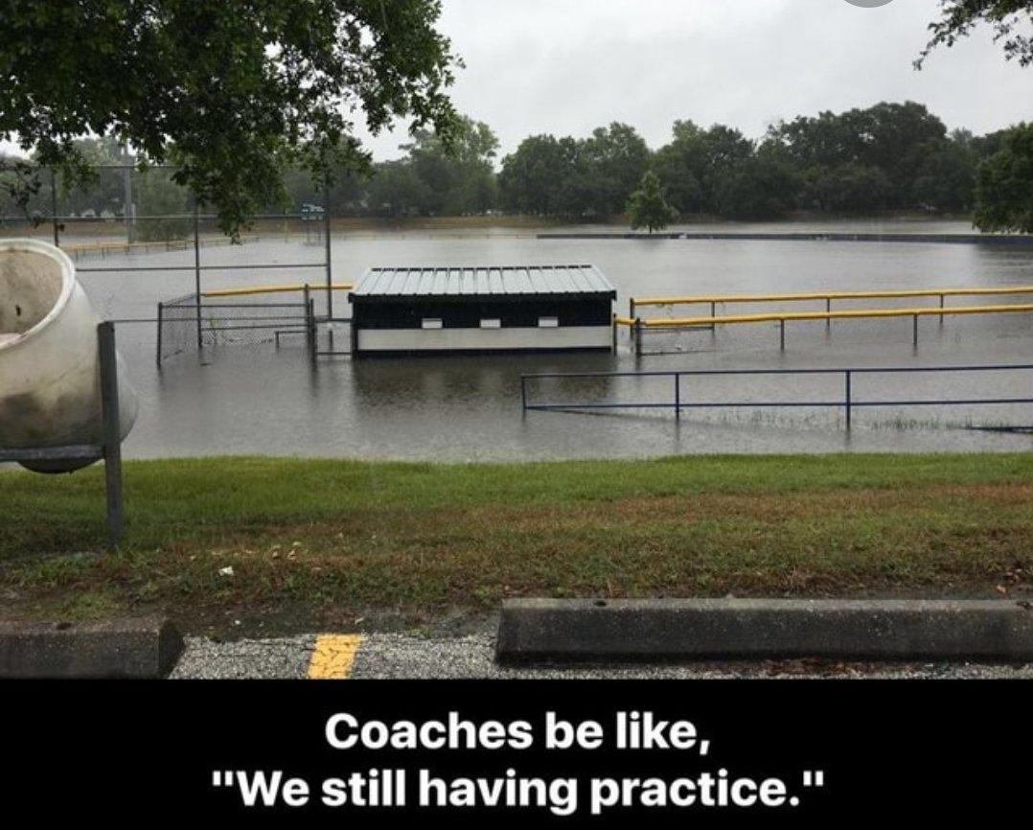

Slide 12
Safety
Background checks required for ALL volunteers
ULLL Safety Plan
Medical & Concussion Release Forms
Be aware of your players medical requirements
Maintain First Aid Kit
Adult coach MUST be in the dugout at all times
Injuries
Dominate the Diamond
Weather & Lightning
  Use common sense
  30-minute rule

Slide 13
Safety - Pitch Counts
By Days of Rest (14 & Under)
1-20 pitches | Zero (0)
21-35 pitches | One (1)
36-50 pitches | Two (2)
51-65 pitches | Three (3)
66+ pitches | Four (4)
By League Age
6-8 | 50 pitches
9-10 | 75 pitches
11-12 | 85 pitches
13-16 | 95 pitches
By Days of Rest (15 & 16)
1-30 pitches | Zero (0)
31-45 pitches | One (1)
46-60 pitches | Two (2)
61-75 pitches | Three (3)
76+ pitches | Four (4)
* Under no circumstance shall a player pitch in three (3) consecutive days.

Slide 14
Safety - Pitch Counts
    Baseball Pitcher/Catcher Game Rules
      Pitch in only 1 game per day
      Limit reached during batter/rollback rule
      41 or more pitches = no catch
      Catch 4 innings = no pitch
      GameChanger MUST be used to track pitch counts and catcher innings for Player Pitch Divisions

Slide 15

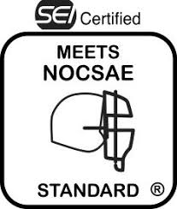

Equipment
Safety rules are mandatory and apply to ALL practices and games
Enforce use of proper equipment:
  Uniform/hat
  Cleats (NO metal cleats in Little League – Majors and below)
  Helmets (NOCSAE)
  Athletic supporter/cup
  Catcher’s gear (including throat protector & catcher’s mitt)
  Game/practice balls
  Bats
    USA Baseball only for Little League or wood bats acceptable
    USA Baseball or BBCOR for Juniors or wood bats acceptable
    BBCOR only for Middle School or wood bats acceptable

Slide 16
Equipment
CONTACT INFO:
american@ulll.org
national@ulll.org
League Provided:
  Jersey & Hat
  Batting Tees (Tee Ball only)
  Balls (Practice & Game)
  Bucket
  First-Aid Kit
  Catcher’s Gear – mitt, mask, chest protector, leg guards (AA, A and Coach Pitch only)
    HELP US HELP YOU!
      If supplies are running low or are completely out, please contact us ASAP.
Notes:
Supplies like turface, chalk. The earlier we know the better chance to get it replenished before it affects a game.

Slide 17
Coaches Corner
CONTACT INFO:
coaching@ulll.org
Games on Haske and Elementary School fields:
  HOME TEAM is responsible for dragging and lining the field before games.
  HOME TEAM is responsible for dragging field after the game. Rake/repair pitcher’s mound and batter’s box (as needed).
  HOME TEAM is responsible for putting bases away (not including home plate). If there are no base plugs, the bases should be left in place. Please contact a ULLL board member if base plugs are missing.
    Visit the ULLL YouTube channel for informational videos (http://www.youtube.com/@UpperLoudounLittleLeague)

Slide 18
Coaches Corner – League Divisions
TEE BALL
  Introduction to baseball
  Softer tee-ball and batting tee used
  Shorter practices/games; no scores kept
  ALL players league age 5
  Players league age 6 WITHOUT prior season of Spring t-ball experience
COACH PITCH
  Basic skills development – hitting, fielding, base-running
  Mandatory infield/outfield play
  No scores kept
  ALL players league age 6 WITH prior season of Spring t-ball experience
  Players league age 7 WITHOUT prior season of t-ball experience, at parent request and league approval
  Players league age 7 with a sibling in this division, at parent request and league approval

Slide 19
Coaches Corner – League Divisions
SINGLE “A” (A)
  Introduction to full player pitching
  Beginning emphasis on position player development
  No stealing
  Players league age 7 at parent request to try out, league approval, AND are drafted
  Players league age 8 who try out AND are drafted
  Players league age 9 who are not drafted to AA team
DOUBLE “A” (AA)
  Full player pitching
  Refinement of position player skills
  Refinement of base-running skills
  End of season tournament
  Players league age 8 who try out, assess appropriately AND are drafted
  Players league age 10 who are not drafted to AAA team
TRIPLE “A” (AAA)
  Preparation for Majors play
  Regulation Little League games and rules
  Competitive; scores and standings kept
  End of season tournament
  Potential All-Star play
  Players league age 9 who try out, assess appropriately AND are drafted
  Players league age 10-11 who request NOT to play Majors
  Players league age 11 who are not drafted to Majors team
  Players league age 12 who waiver their right to play Majors

Slide 20
Coaches Corner – League Divisions
MAJORS
  Regulation Little League games and rules
  Highest level of play on small diamond
  Mandatory player evaluation and draft
  Highly competitive; scores and standings kept
  End of season tournament
  Potential All-Star play
  Players league age 10-11 who try out AND are drafted
  ALL players league ages 11-12 who have previously played in division
  ALL players league age 12 who have not requested to play in AAA
JUNIORS
  Introduction to regulation baseball dimensions/rules
  Leads, pick-offs, balks
  Metal cleats
  Mandatory player evaluation and draft
  Interleague play
  Highly competitive; scores and standings kept
  End of season tournament
  Potential All-Star play
  ALL players league age 13-14
MIDDLE SCHOOL
  High School preparation
  Leads, pick-offs, balks
  Metal cleats
  BBCOR bats
  Mandatory player try outs
  Interleague play
  Highly competitive; scores and standings kept
  End of season tournament
  Potential All-Star play
  Players league age 13-16 who are also in 6th, 7th, or 8th grade

Slide 21
Field Maintenance
Lawnmowers (Treat Kindly!)
Sheds
  Lock combos included on practice and game schedule
County Responsibilities:
  Prep and postgame field maintenance for Franklin Park (All Fields), Scott Jenkins (All Fields), Woodgrove Park and Lovettsville Park (All Fields) only.
    Please DO NOT touch these fields
    Visit the ULLL YouTube channel for videos on proper infield dragging and chalking base lines (http://www.youtube.com/@UpperLoudounLittleLeague)
Notes:
Do NOT lay anything across the top of the tractor. If it’s out of gas or low on gas let the League Commissioner know. Some ground work allowed, light rake, etc.

Slide 22
Umpires
2026 Umpire-In-Chief
  Shane Conrad: (571) 639-1958 or Umpire@ulll.org
  ULLL uses Arbiter Sports to schedule and communicate with our umpires. (www.arbitersports.com)
  2026 Spring Assignments:
    Many Youth & New Umpires (Be Kind!)
    Zero Tolerance for Mistreatment
    Generally, 2-man crews for Majors (if available)
    Generally, 1 umpire for AAA, AA, A (please always have a parent ready to ump in the absence of an umpire)
Notes:
Any umpire intimidation will be met sternly, and consequences will be high.

Slide 23
Umpires
    Umpires NEEDED
      Must be age 13 or older
      Youth umpires are eligible to be paid $40-65 per game, Adult umpires are volunteers (unpaid).
    Umpire Training & Clinics
      Please contact Shane Conrad at (571) 639-1958 or Umpire@ulll.org
    Game Coordinators REQUIRED when there is an all-youth umpire crew
      Must be present on field for pre-game meeting
      Must be present for entire game

Slide 24
Umpires
    Upcoming 2026 Spring Umpire Clinics
      Umpire Field Training
        March 14th – 9 AM to 3 PM, Loudoun Valley Community Center (lunch provided)
        All new umpires are required to attend one Q&A session and one field training session.
        See https://www.ulll.org/about-us/umpire-info/ for more info.

Slide 25
Little League International Rules & Regulations, Local Rules
2026 Rulebook (Online App)
Local Rules – posted on ULLL website
How to approach an umpire
Protesting a game
Mound Visits
Volunteer Code of Conduct

Slide 26
Rule Clarifications
    No electronic devices (except for rules and scoring)
    Night game curfews
    Warm-up pitches
    Equipment in the dugout - Speaking of this…equipment missing from assessments. Check your kids at your first practice.
      1. Grey and yellow Easton Havoc bat that has the owners name on it.
      2. Grey and green Marucci F5 bat in size 28”.
      3. Adidas batting helmet with green initials, EK on it.
      4. Black Rawlings batting helmet with "Chambers" written on blue duct tape on the inside.
    Speed-up the game

Slide 27
Volunteers
Requirements
  Volunteer Registration Form
  Background check through JD Palantine
    Wait for an email from JDP and complete
    SSN is required and is secure. JDP is used by all of Little League International.
  Diamond Leader Training
  Abuse Awareness Training

Slide 28
Volunteers
Games:
Tee-Ball & Coach Pitch: Manager plus 3-4 Coaches
  Minimum of five (5) Cleared volunteers are required
Single “A” & Up: Manager plus 2 coaches (In the dugout)
  Other volunteers include Scorekeeper, Adult Game Coordinator, etc. (Outside of the dugout)
  Minimum of five (5) cleared volunteers are required
All others must remain outside of the playing field
Other assistants may help during practices (must be cleared volunteers)

Slide 29
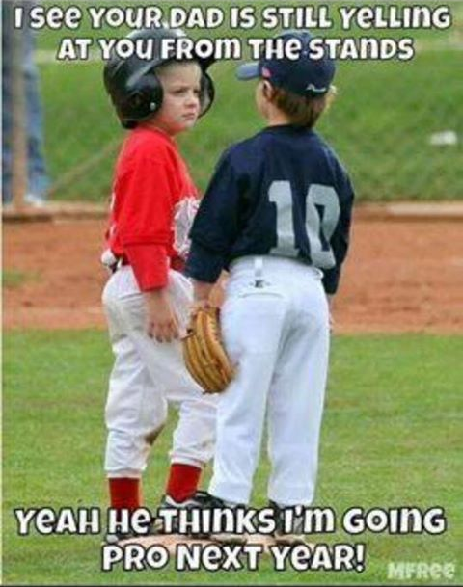
Play Ball!
Will Smith
president@ulll.org
703.822.1388

