Slide 1
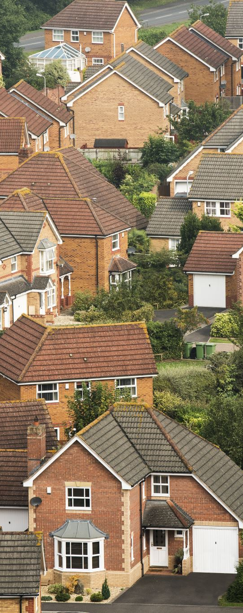

  Historical Perspective….
  A Wise Investment
Gates County Commissioner Report 3.19.2025
Reba Green-Holley, Chairman

Slide 2
Who and How?
Who:
  Volunteers that have a desire to give back to the community.
  Agency representatives that work with the target population
How:
  Operates on donations (private, faith-based), grantsmanship, Commissioner funding and volunteers.
  Agency Collaboration
  Procedure:
    Application, Review (App, Site Visit, Income Verification), Decision, List, ID Contractor & Funding, Repair

Slide 3
Why Gates County Housing Committee?
Originally established by Gates County Department of Social Services in 2008
501© 3 status established 2012
  Assisted DSS Agency Homeowner Clients
    Substandard housing needing urgent repairs
    Housing issues causing health and safety.
    Gates County DSS Medicaid expenditures
    Live in a safe, healthy environment

Slide 4
Mission and Target Audience
MISSION
  Elimination of unsafe and unhealthy substandard housing and homelessness in Gates County utilizing community collaboration strategies.
TARGET AUDIENCE
  Gates County DSS Homeowners - Elderly, Disabled, Handicapped, Veterans
  Grant Required Target Audience
  200% Poverty Level

Slide 5
Gates County Demographics
10,478
1.48K below poverty line
  14.3% poverty status
  12.5% National average
Largest demographic living in poverty:
  1) Females 65 – 74
  2) Males 18 - 24
  3) Females 25 - 34
Notes:
Median Household Income - $61,612
W/o heath care coverage - 6.6%
BA degree - 10.8%
Employment rate - 51%

Slide 6
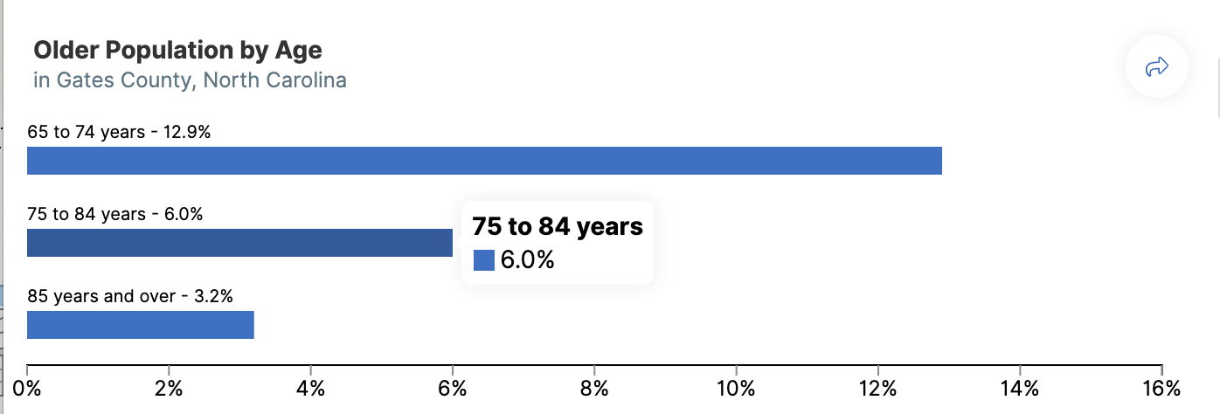
Total Older Population
22% (2,305)

Slide 7
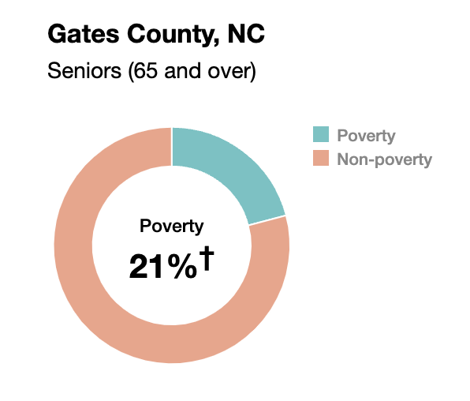

Slide 8
Gates County Housing
SUBSTANDARD HOUSING - Any condition that endangers the life, limb, property, safety, or welfare of the occupants or general public.
Severe Housing Problems - Occupied household units that have at least one of the following issues: *
  Lack of adequate kitchen (>1 occupant per room),
  Lack of plumbing facilities
  Overcrowded - > 1.5 persons per room
  Cost-burden - > 30% monthly income (rent, mortgage, utilities)
  *The U.S. Department of Housing and Urban Development defines

Slide 9
2021 Gates County Housing Data
4809 housing units in GC
14% population - 1 of 4 HUD-designated housing problems
Highest percentage of people with severe housing problems
19% Gates Tract 9702
Lowest percentage of people with severe housing problems
7.12% Gates Tract 9701

Slide 10
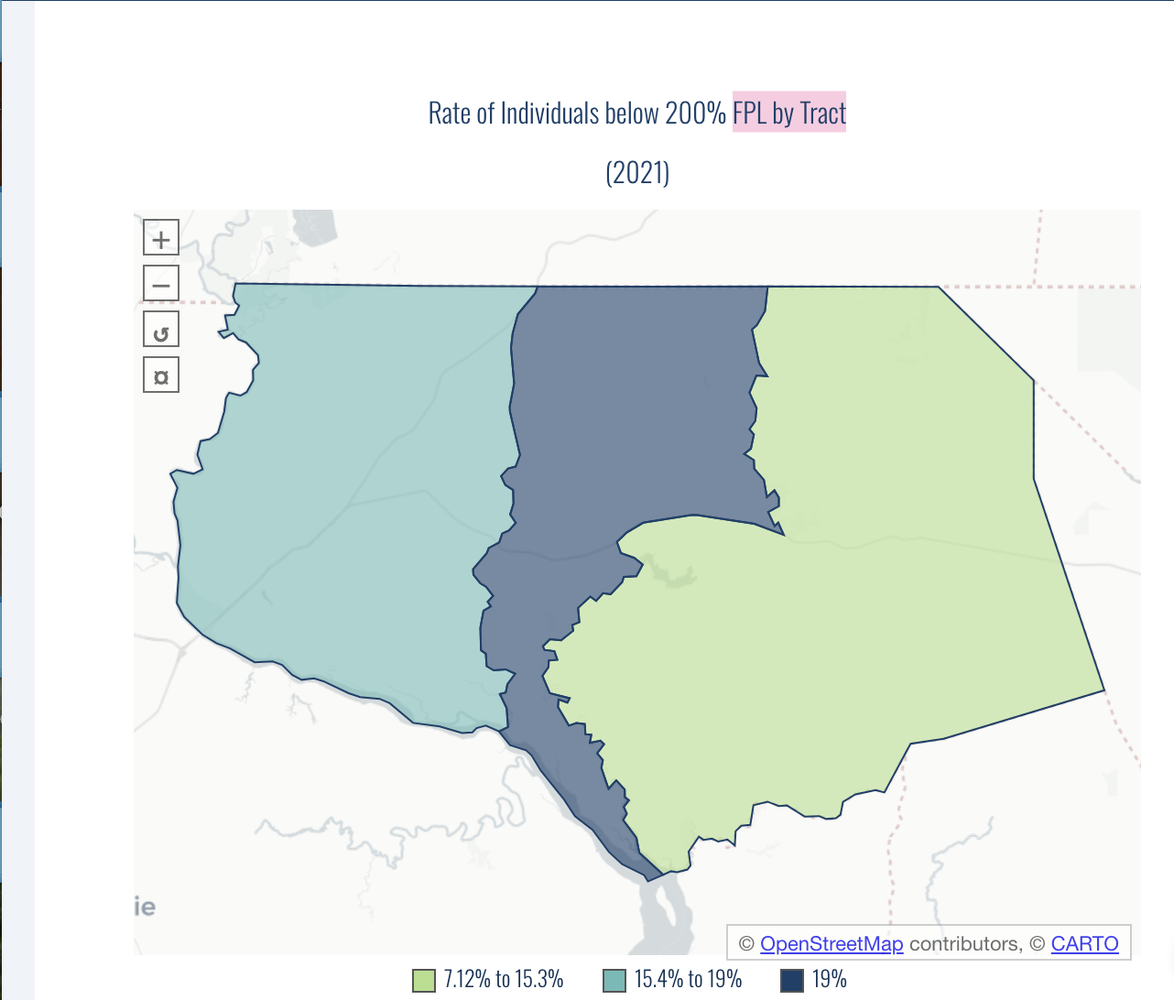
Where do they live?
Federal Poverty Level
Data provided by Cape Fear Collective, North Carolina Severe Housing Problems Model Data
1
2
3

Slide 11
Historical Perspective
Unique Collaboration w/County – Other counties desire same
2008 – 2014: GCHC wrote - secured - implemented successfully urgent repair housing grants by deadline date in collaboration with the County.
McDavid & Associates (MA) established partnerships with numerous counties in NE Region. County Manager during this time decided to contract with MA to implement Urgent Repair (URP) Grants and any other housing repair grants.
GCHC agreed to share list of urgent repair housing needs, secure and forward apps to MA to ensure efficiency and timely identification of eligible applicants which would assist with grant compliance by required grant end date.

Slide 12
Historical Perspective #2
2017 - COMMUNITY DEVELOPMENT BLOCK GRANT “NEIGBORHOOD REVITALIZATION GRANT “
CDBG-17-C-2987 NR - $750,000
GCHC requested that County Commissioners apply
  Grant allowed for house replacement and Senior Center
  GCHC requested a senior center be included in the funding request.
  Commissioner voted unanimous to approve including Senior Center.
Funds Awarded
  Requested Senior Center was removed in submitted grant by County Manager and Board Chair.
  Commissioners never revoted to revise initial approval of addition of Senior Center
  County contracted with McDavid & Associates to implement grant.

Slide 13
Historical Perspective #3
2017 – CDBG-17-C-2987 NR - $750,000
Replacement Home Requirements:
  Current home unrepairable based on the max repair funds available under the state grant program guidelines.
  Guidelines - All issues health and safety have to be addressed with allotted funding. Can’t repair if not able.
GCHC collaboration agreement with MCDAVID
  Secure & Forward Applications
  Marketing grant availability
MCDAVID collaboration agreement with GCHC
  Provide GCHC quarterly housing repair reports
    indicating status of applications, repairs and home replacements
    Who Selected Replacement Homes?
McDavid and Associates

Slide 14
Historical Perspective #4
2017 – CDBG-17-C-2987 NR - $750,000
Essential Single-Family Rehabilitation Loan Program (ESFRLP) 2019 - $71,769
Two Urgent Repair Grants
Issues
  No reports
  Disgruntled Applicants
  No timely communication by MA
  Requested assistance from County Admin – Routed back to MA
  Paperwork not in order
  Gates County Commissioners – Out of Compliance
    Funding deadlines continuously not met after numerous extensions
    Homes not replaced as required by grant
  NC Department of Commerce (funders) prepared to pull funding and ask for a refund of $750,000

Slide 15
Historical Perspective – Timeline
2017 CDBG-17-C-2987 NR – 2019 ESFLRP – Two URP Grants
Year
2017 | MOU Signed – 4 Homes Replaced | 2017 County Manager
11.13.2021 | Original Grant Period & Close Out (16 month) | Final paperwork submitted
11.13.21 – 11.12.22 | Extension Requested | Approved
11.18.22 | 71% funds expanded
11.13.22 –5.17.23 | Extension Requested | Approved
5.17.23 6.10.23 6.30.23 | Requirement - All Funds Obligated Requirement - All Funds Expended Requirement - Project Closed | NC Department of Commerce
7.2024 | -CDBG Grant Closed 2yrs 18 mo (41 months) | 2024 County Admin Team

Slide 16
Historical Perspective – “Clean Up”
2017 CDBG-17-C-2987 NR
Essential Single-Family Rehabilitation Loan Program (ESFRLP) 2019
Two Urgent Repair Funds Prior 2020
Administrative Team
  Pitt Godwin, County Attorney
  Michael Irvin, Albemarle Commission Director
  Tim Wilson, County Manager
  Scott Sauer, Interim County Manager
  Dr. Althea Riddick, Chair, Gates County Board of Commissioners

Slide 17
Historical Perspective Homeowners
County Impact: Out of compliance; At risk of repaying funds
Homeowner Impacts:
Elderly homeowners had to relocate during process
Expectation - 16 months homeless
16-month grant extended to 41 months of homelessness
Homeowner Results:
  2 homeowners living healthy & safe in new home
  1 homeowner only enjoyed home for several weeks & then died
  1 homeowner died before getting to move in

Slide 18
OTHER FUNDING
Albemarle Commission
  URP 22 - $30,000 - 2 homes
  Legislative Funds 23 - $30,000 – 4 homes
  URP 24 - $20,000 – 2 homes
Gates County Housing 2023 - 2024 – 15 homes
  RC Foundation Grant - $100,000
  Gates County Commissioners - $7,000
Impacts:
Grants successfully completed and closed out on time
Homeowner can remain in home

Slide 19
KEY TAKE AWAYS

Slide 20
Gates County Assisted Living Cost
 | Daily | Monthly | Year
National Average | $7,900 | $9,000 | $94,800 - $108,000
Gates Health & Rehab (Semi) | $300 | $9,125 | $109,500
Gates House Assisted living (Semi) | $118 | $3,600 | $43,200 $600 - $1700 1x level of care fee

Slide 21
$$ GCHC A WISE INVESTMENT $$
 | Annually | Cost per Home Avg | Total
GCHC Homes Repaired - 2024 | 15 homes | $5,000 | $75,000
Commissioner Appropriation | $7,000 | $467
Medicaid Cost ($2,000 resources) | $43,200 - $109,500 per person
Annual County Medicaid Savings
$36,200 - $102,500 per person

Slide 22
The ability for a person to stay in their home cuts down on Medicaid cost for health issues and nursing home placement.
A savings to the county!

Slide 23
References
US Census Bureau (2023)
American Community 5-year Estimates
Census Reporter Profile – Gates County, NC
http://censusreporter.org/profiles/05000US37073-gates-county-nc/
Healthy Communities, NC
National Council on Aging
Gates County Dept of Social Services
HTTPS://GCHOUSINGCOMM.ORG

