Slide 1
Jointing and Planing
Bryan Jones

Slide 2
Agenda
Introduction
Wood structure
Jointing
Planing

Slide 3

Introduction
Retired Engineer.
Took woodshop in high school.
Built a shop just prior to retiring.
Made lots of mistakes.
Rebuilt a planer and learned a lot.
Thought this would be a good talk for folks new to woodworking.
Wood does not come in the size we need to do woodworking.
So, need to learn the basic fundamental steps to be successful. Wood is expensive and mistakes cost.

Slide 4
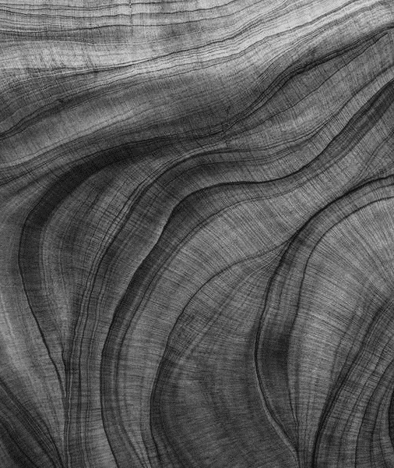
Wood structure
The make up of wood.

Slide 5
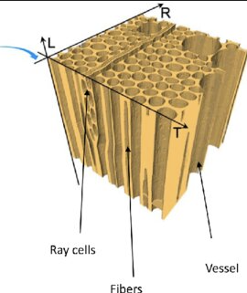
Wood structure
It’s like a bundle of straws. As the wood dry's, the straws get smaller on the diameter.

Slide 6
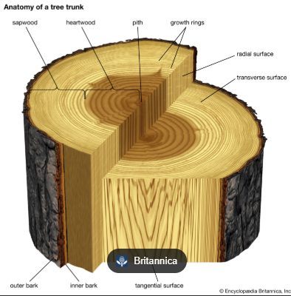
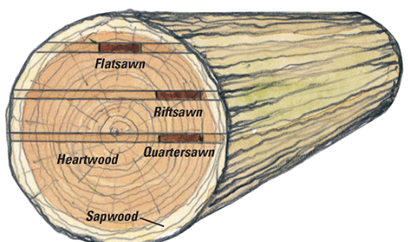
Definitions

Slide 7

Seasons
Seasons create growth rings
Tropics little to no growth rings
However, it has been said that trees with tighter and smaller growth rings moves less. This is not true.

Slide 8
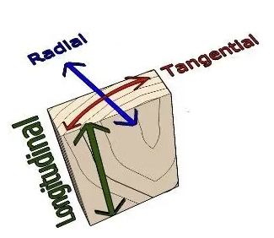
Shrinkage
Volumetric Shrinkage is total cumulative shrinkage in all directions.
Tangential shrinkage is the amount the wood moves along the growth rings. Imagine this as the side-to-side swelling of those straws. This is the greatest amount of movement lumber experiences.
Radial shrinkage is the amount the wood moves perpendicular to the growth rings or along the radial or medullary rays that transport nutrients into the interior of the tree. This is a small amount of movement but still should be accounted for.
If you take the ratio of tangential versus radial movement or T/R ratio you can get a good feel for how stable a species is. The closer these numbers are the less the board will have a tendency to warp and cup.
High T/R you will get more shrinkage in one direction
Tangential shrinks normally at twice the rate than radial.
This will lead to less shrinkage on quartersawn than on Flatsawn wood.

Slide 9
Examples
Name | Location | Radial Shrinkage | Tangential Shrinkage | Volumetric Shrinkage | T/R Ratio
Rosewood (Dalbergia) | Asia | 2.70% | 5.90% | 8.50% | 2.20
Ipe | South America | 5.9% | 7.20% | 12.40% | 1.2
Rosewood could cup easily depending on how it is cut.
Ipe Is very stable.

Slide 10
Jointing

Slide 11
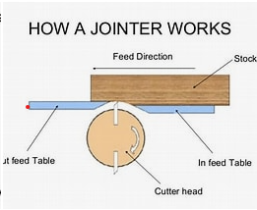
How it works
Jointing will make it flat. Since the cut size is the same distance from the outfeed to infeed table there is no problem of rocking.
However, if you start with a bent board there are techniques to straighten.

Slide 12
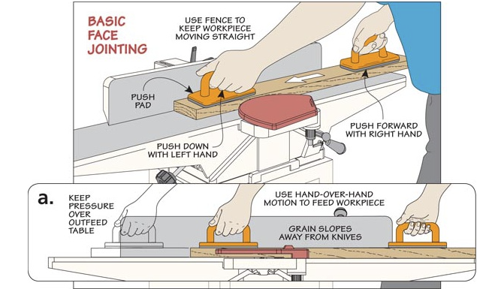
Jointing

Slide 13
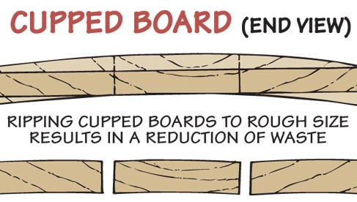

Slide 14
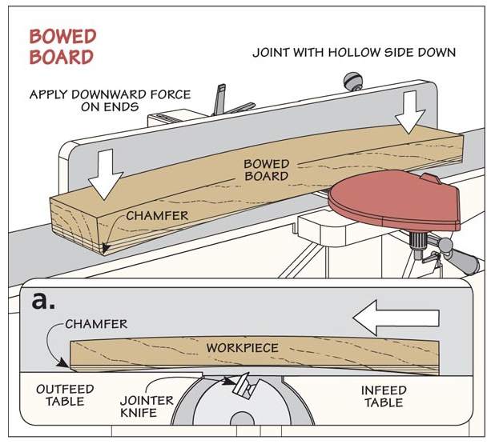

Slide 15
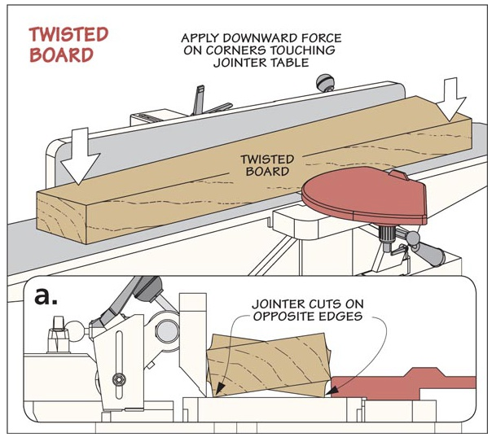

Slide 16
Planing
Methods to execute

Slide 17
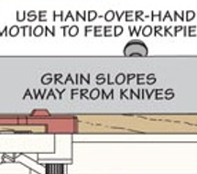
Planing
Makes the board the same thickness.
  Plane the board with the grain.
    If you cut against the grain it may tear.
If you are doing narrow boards that will fit on the Jointer, use that first to get one side flat.
  Then use the planner for the other side.
What about Bow, Twist of Cupping.

Slide 18
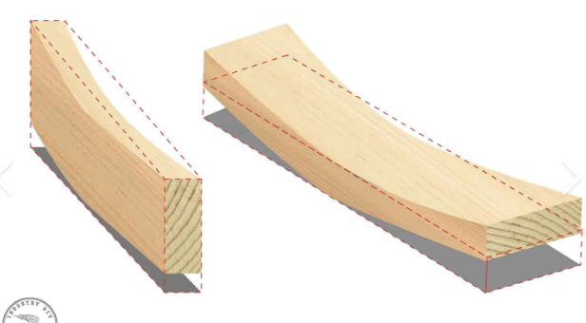
Cupping Bow
Paper shims
A good strategy is as follows:
  First place shims in the middle to keep from compressing when running through the planer.
    Use paper strips and tape down.
  Run the other side until flat.
  Then remove the shims and cut that side.
If the board is too thin the planer may compress it flat. You will get the proper thickness but will not remove the bow.
  If it is can be done on the Jointer cut the bow side down until flat, then finish on the planer.
  If it can’t then use the shim method. Plane till the opposite side is flat. Then do the other side.

Slide 19
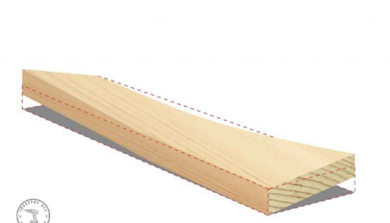
Twist
Shims
Steps to fix this:
  First place shims at the above locations and may need some toward the middle. Use paper strips and tape down. Run until flat.
    On a planer the force will twist the board, the shims keep it from flattening.
  Then remove the shims and cut that side.

Slide 20
Mounting support sides for planning wood with odd twists, bows, etc.
Mount here
Mount two boards, same size and attach the board. Then run through the planer. Use shims ect., for proper alignment.

Slide 21
Planning thin stock
Material to plane.
Carrier
Cutting thin stock, use a carrier to hold the piece you want to plane. Mount with hot glue, double stick tape, etc. DO NOT JUST LAY IT ON THERE it can damage your planer if it gets loose.

Slide 22
General Planing Tips
Remove waste off each side equally. Sometimes it can warp if too much taken off one side verses the other. Wood is always drying.
A good practice is to take it down close but not all the way. Allow to air dry for a day for two then complete to the finished thickness.

Slide 23

Final tips
Figured wood will not joint or plane well.
  Maybe best to get close and sand to thickness. Ray cells coming to the surface. Grain is twisted and interlocked.
When planing or jointing mark the surfaces with a pencil.
  You can then make sure the material is surfaced right when you don’t see the pencil mark.
Make sure when you start prepping your material. Always have one edge jointed, and then the surface planed. I mark the jointed end. So, when you start cutting everything will be straight.
Don’t use branches in building furniture. They were under stress and will twist, bend when material is removed. They are best used for firewood.
This is reason we need to know these techniques. This is the Home depot tree farm.

Slide 24
Thank you
Bryan Jones
AZWoodworkers.Org

