Slide 1

2026 Used Homes and Available Lots
185 JennLake Drive
Starkville, MS 39759
Office: 662-324-1001
Mobile: 404-796-4152
jennlake662@gmail.com
Jennlakemeadows.com
EMPTY Lots Available for New Home Installations:
  There are currently 2 single wide lots that will be available Fall 2026, and 1 double wide lot available now!
USED Homes for Sale:
  128 Dixie Way
  176 Bernice Way
  166 Dixie Way
Homes SOLD in 2026:
  51 Bernice Way
  169 Clara Way
  487 JennLake Dr
  41 Bernice Way
  181 Bernice Way
  92 Bernice Way
  14 Bernice
  570 Jennlake Dr
  35 Clara Way
  49 Clara Way
  191 Bernice Way
  512 Jennlake Dr
  120 Bernice Way
13 Bernice Way
224 Bernice Way
100 Jennings Loop
52 Bernice Way
142 Dixie Way
150 Bernice Way

Slide 2
185 JennLake Drive
Starkville, MS 39759
Office: 662-324-1001
Mobile: 404-796-4152
jennlake662@gmail.com
Date Listed: 07/22/2026
Used Home for Sale
JennLake Meadows must approve applications BEFORE you purchase a home. If you are interested in making an offer on a home, make sure you are approved to live at JLM. If you plan to remove the home from the property, notify the office for coordination.
Pre-sale inspection results are provided to sellers and published to the Interested Buyers list. Any items not completed prior to home closing will be transferred to the buyer at time of signing Lease Agreement.
All home closings must be done in the JennLake office. JennLake Meadows does not allow any rental properties and we do not allow Homeowner Financing. We allow up to two residents and two vehicles regardless of number of bedrooms. The primary resident must be an immediate family member of the owner. Residents may have one approved roommate.
The office has a JD Power MH Connect subscription and will provide the estimated value report for any home upon request at no charge (new or used). Please read the Age of Home policy which is available in the website Documents section.
Address | Home Info |  | Price
128 Dixie Way | Year: | 2021 | $89,000
 | Size: | 16 x76 3BD/2BA
Seller Info | Mfr/Model: | Hamilton/Hodges
Pete Stanovich 251-753-2501 saltforester@gmail.com Jackson Stanovich 251-753-9893 | Features: | Metal Roof Thermal Pane Windows Composite Siding ( Non- Vinyl ) Non-Smoking Home No Carpet
 | Maintenance / Upgrades: | Fiber Optic Internet
 | Other Info: | Appliances included ( Except washer and Dryer)

Slide 3
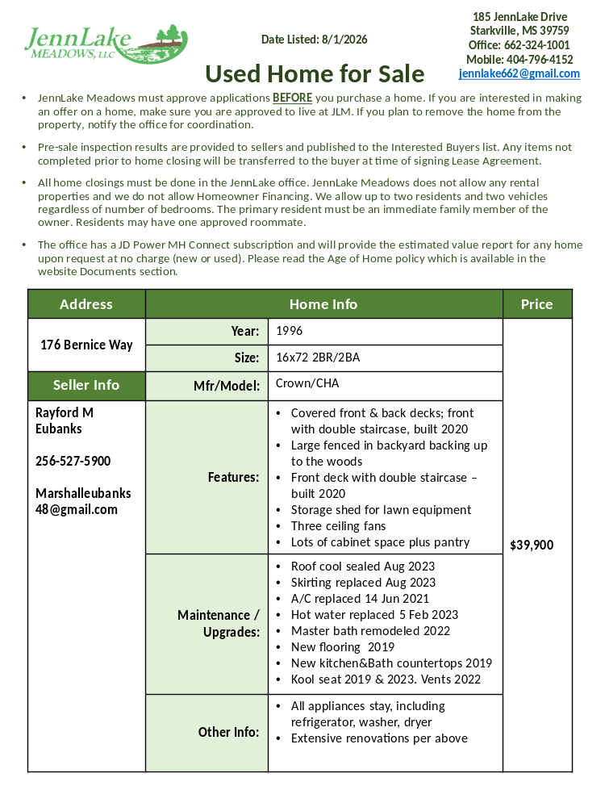

Slide 4
