Slide 1
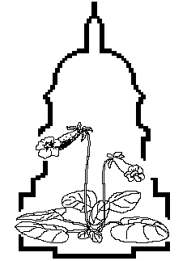

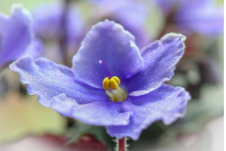
Petal Tones
Newsletter of the National Capital Area Chapter of the Gesneriad Society
Volume 57 Number 4 April 2026
National Capital Area Chapter
of the Gesneriad Society (NCAC)
Emmanuel United Methodist Church
10755 Scaggsville Road, Laurel, MD 20723
Meets second Saturday of each month at 10:30am
https://us02web.zoom.us/j/82968033274?pwd=KVc68b7bbbhKSLIN87rBKAzczmUGYW.1
Meeting ID: 829 6803 3274
Passcode: 957283
April 11th – No Meeting RAVS show
May 9th – Streptocarpus, Part 1 Andy Meier
May 16th – Green Spring sale
June 13th – Primulinas Gary Smith
July 11th – No meeting; picnic?
August 8th – September Show prep’
Sept 12th – Mini show at Church
Oct 10th – Streps, Part 2 Andy Meier
Nov 14th – Waiting on MAAVS dates
Dec 12th – Holiday Get Together
The Richmond African Violet Society
Flower Show & Sale
Lewis Ginter Botanical Garden
1800 Lakeside Avenue
Richmond, Virginia 23228
Saturday, April 18, 2026
Sale Hours 9am – 5pm (African violets & other gesneriads will be sold)
Show Hours 1pm – 5pm
Sunday, April 19, 2026
Sale Hours 9am – 4pm (African violets & other gesneriads will be sold)
Show Hours 9am – 3pm
Saturday, April 18, 2026
Sale Hours 9am – 5pm (African violets & other gesneriads will be sold)
Show Hours 1pm – 5pm
Sunday, April 19, 2026
Sale Hours 9am – 4pm (African violets & other gesneriads will be sold)
Show Hours 9am – 3pm
(Please note: We will NOT be open on Friday.) RAVS Show is free of charge. The Garden has an admission fee* page 3
www.richmondavs.org
’
President's message:
Since we have no meeting this month, we just have a brief issue of Petal Tones to keep you up to date.
I am busy potting up gesneriad seedlings and plants for Richmond's first joint violet and gesneriad show on the 18th (see left). There will be lots of gesneriads for sale on Saturday and Sunday.
With spring finally here, I am also getting other yard and houseplants ready for the sale at Green Spring Gardens next month.
By the way, if you picked up seedlings from me at the propagation workshop, remember to post pictures when they bloom. Some are hybrids or rare plants from Brazil that don't have any pictures on line. Happy growing!
Barbara
’.
!
1

