Slide 1
Burn Pits: Post-9/11 Veterans’ Agent Orange
Creative Commons
Ronald “Rocky” Roodhouse, maj, usaf (ret)
J.D., LL.M.

Slide 2
Military Burn pits: agent orange of our generation
Introduction
What Was Burned & What Toxins Were Released
Compensation (Courts & VA)
Congress – Legislation Proposed & Passed
How You Can Help

Slide 3
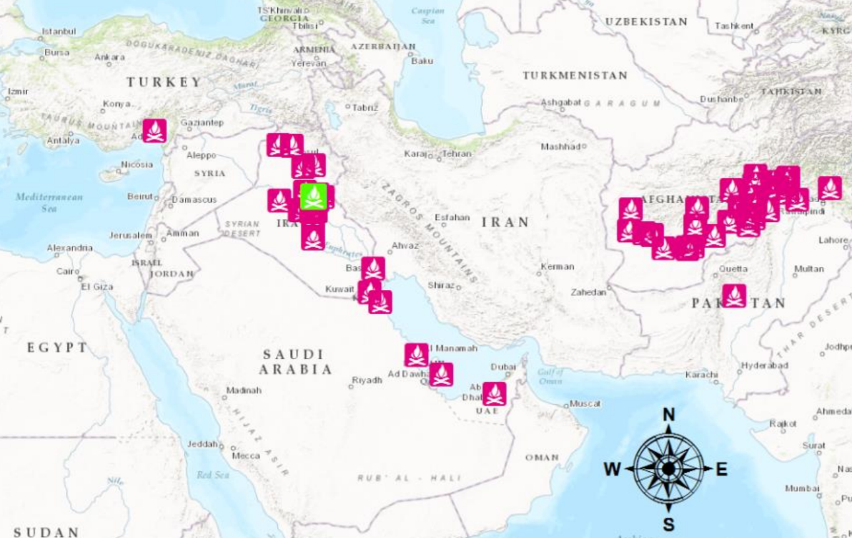
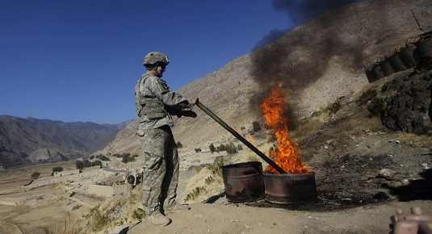
Burn Pit Locations (1991 – Present)
Over 300 known burn pits
Many clustered on the map
Ex: 14 burn pits in Kuwait
Map does not include:
Host country burning
Burn barrels
VetsHQ
AP/Rafiq Maqbool
Notes:
Transitory: Squads & platoons used these as they went place to place
Like packing out while camping – no trace behind
Kept 55-gallon barrels, stirring rods, accelerant in their vehicles
Host country: Sometimes, they used small pits at host country installations
Let’s take a look at the one I worked next to . . .

Slide 4
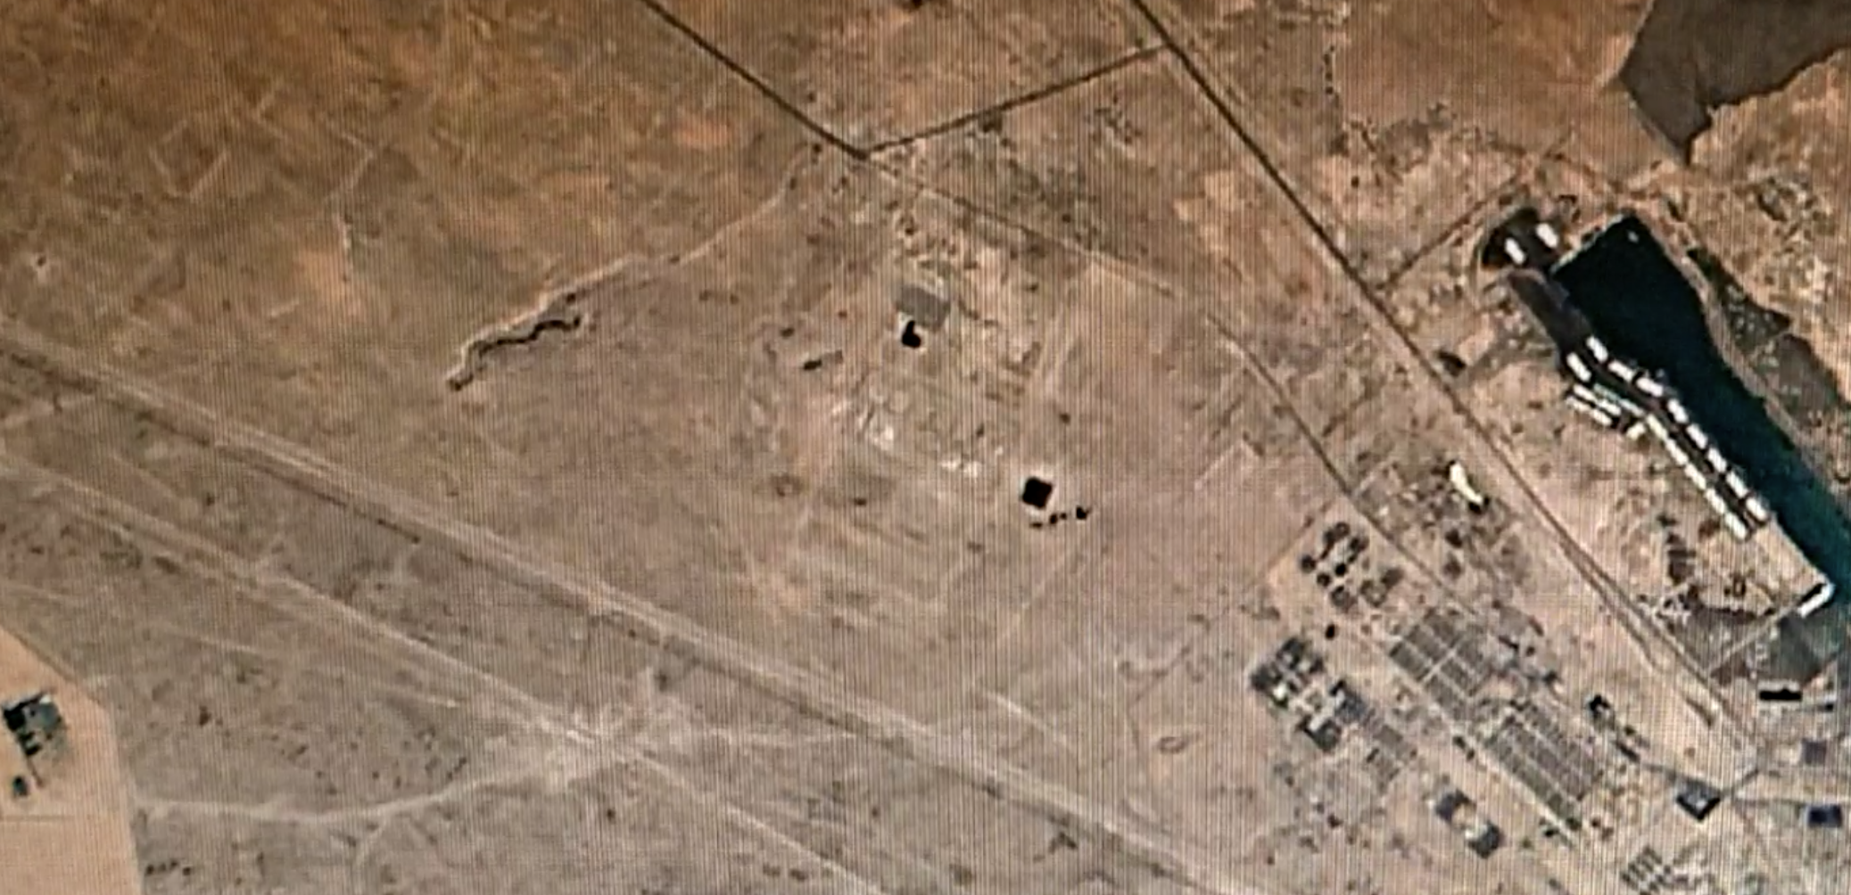
Camp Bucca, Iraq (2005)
IRAQ
KUWAIT
Google Earth Engine
Notes:
Base Layout
Started in upper-left as a small camp w/ ~1000 personnel
On the border w/ Kuwait, near port city of Umm Qasr
Burn pit smoke & human waste ponds south of the camp
Camp kept growing and expanding southward
Footprint expanded significantly when detainees arrived 2005-6
Base population: up to 20K detainees, 7K support personnel (US mil/contractors, allies, TCNs)
1 km x 1 km TIF in the line of smoke
My office was between TIF & human waste ponds
Click 1: The look on my face when I smelled it for 1st time while landing in open helo
Notice my nose turned up
Click 2: The view from my office complex – TIF on left, ponds on right, smoke wafting R-to-L
Smoke wasn’t easy to capture during day (dust/haze, lighting only from sun)
Here, light from several angles in TIF & portable stanchions in office complex
Like standing in fog

Slide 5
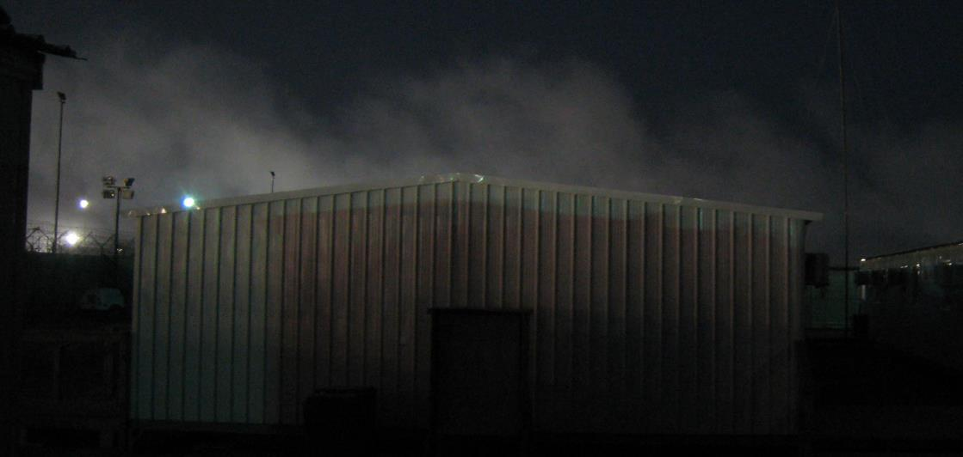
Camp Bucca, Iraq (2008)
IRAQ
KUWAIT
Google Earth Engine
Notes:
Base Layout
Started in upper-left as a small camp w/ ~1000 personnel
On the border w/ Kuwait, near port city of Umm Qasr
Burn pit smoke & human waste ponds south of the camp
Camp kept growing and expanding southward
Footprint expanded significantly when detainees arrived 2005-6
Base population: up to 20K detainees, 7K support personnel (US mil/contractors, allies, TCNs)
1 km x 1 km TIF in the line of smoke
My office was between TIF & human waste ponds
Click 1: The look on my face when I smelled it for 1st time while landing in open helo
Notice my nose turned up
Click 2: The view from my office complex – TIF on left, ponds on right, smoke wafting R-to-L
Smoke wasn’t easy to capture during day (dust/haze, lighting only from sun)
Here, light from several angles in TIF & portable stanchions in office complex
Like standing in fog

Slide 6
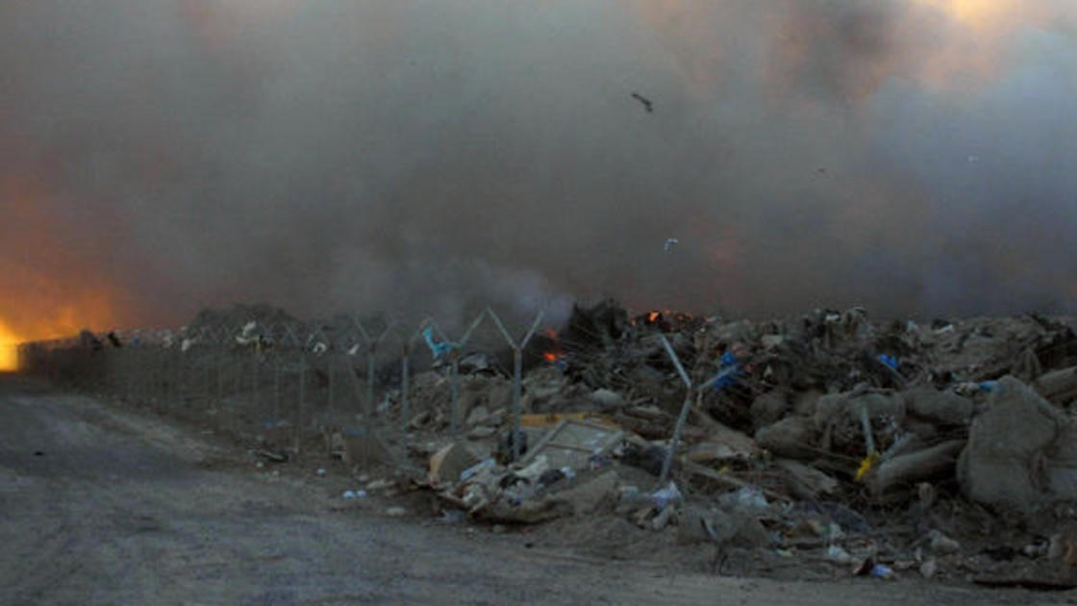
What We Burned
What We Burned:
Everyday Items:
Styrofoam cups, plastic bottles
Office (documents, furniture, etc.)
Electronics (computers, iPods, etc.)
Human waste
Military & Industrial Hardware:
Spent/excess equipment
Unexploded ordnance & munitions
Medical waste, Rx drugs
Building supplies & paint
EVERYTHING!
Everyday Items:
Styrofoam cups, plastic bottles
Documents, chairs, computers
Medical supplies, Rx drugs
Military Items:
Spent/excess equipment
Specialized gear
Jet fuel as accelerant
EVERYTHING!
Daniel Brewer
Notes:
This is what a burn pit looked like
Click 1: This is what we burned
Imagine the trash produced by an entire city in a given day, week, month
Now imagine the extra trash that comes up in a remote environment
No local water source, so add Styrofoam plates & plastic-ware
No safe drinking water, so add plastic bottles
Military units don’t want to ship home its equipment, so add all that equipment
Click 2: So we burned pretty much everything you can imagine
And by “we” I mean contractors (primarily KBR) working on the direction of DoD
So when we look at who to blame, DoD points finger at contractor, vice versa

Slide 7
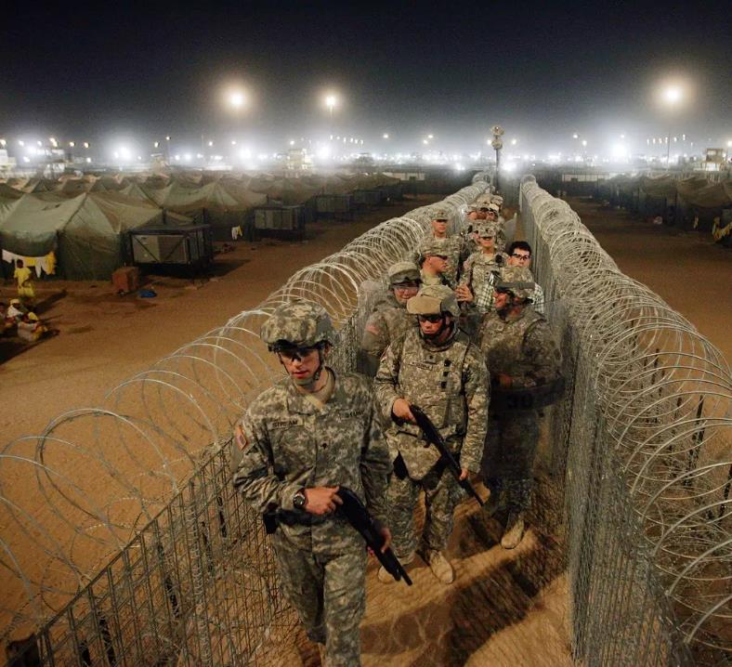
What We Burned (continued)
Jet Fuel
For burn pits
Diesel & gasoline
For power grid
© The Independent / Getty Images
Notes:
On top of all the ash from the garbage we burned, we breathed exhaust from petrochemicals
Ordinary gasoline was ineffective all, so they used jet fuel to get the garbage to the point of combustion
Primary accelerant of WTC: jet fuel
Everything in WTC burned too, so symptoms are similar for NY 1st responders
Most bases were outposts not connected to electricity, so they relied on something cheap over there: fossil fuels
Electricity produced by industrial-strength power generators
This picture is Camp Bucca
Lighting comparable to football field – all angles, fewer dark places for detainees to hide
Glow under the lights isn’t just fog – it’s also dust, soot, smoke

Slide 8
Toxins the burning produced
Polycyclic Aromatic Hydrocarbons
Acenaphthene Acenaphthylene
Anthracene Benzo(a)anthracene
Benzo(a)pyrene Benzo(b)fluoroanthene
Benzo(b)fluoroanthene Benzo(g,h,i)perylene
Benzo(k)fluoroanthene Chrysene
Dibenz(a,h)anthracene Fluoranthene
Fluorene Indeno(1,2,3-cd)pyrene
Naphthalene Phenanthrene
Pyrene
Volatile Organic Compounds
Acetone Acrolein
Benzene Carbon Disulfide
Chlorodifluoromethane Chloromethane
Ethylbenzene Hexane
Hexachlorobutadiene m/p-Xylene
Methylene Chloride Pentane
Propylene Styrene
Toluene
This was only
Balad Air Base, Iraq
(Jan-Apr 2007)
2,3,7,8 TCDD
2,3,7,8-Tetrachlorodibenzodioxin
* Highly toxic *
Also a byproduct of Agent Orange production
Dioxins and Furans
1,2,3,4,6,7,8 HPCDD 1,2,3,4,6,7,8 HPCDF 1,2,3,4,7,8,9 HPCDF 1,2,3,4,7,8 HXCDD
1,2,3,4,7,8 HXCDF 1,2,3,6,7,8 HXCDD 1,2,3,6,7,8 HXCDF 1,2,3,7,8,9 HXCDD
1,2,3,7,8,9 HXCDF 1,2,3,7,8 PECDD 1,2,3,7,8 PECDF 2,3,4,6,7,8 HXCDF
2,3,4,7,8 PECDF 2,3,7,8 TCDD 2,3,7,8 TCDD
Octachlorodibenzodioxin Octachlorodibenzofuran
VA Training Letter 10-03
Notes:
PAH: chemicals formed during incomplete burning of coal, oil and gas, garbage, or other organic substances
VOC: emitted as gases from certain solids or liquids
Can be benign [that new car smell]
Can be toxic [paint, paint thinners]
Dioxins & Furans:
D&F are terms for the shape of the molecule
Very complex in structure; very toxic to ingest
Byproduct of synthetics like plastic & Styrofoam
Many of these were ingredients of AO
Click: Scary part is this is just from one base across 4 months

Slide 9
metals found in soil Samples
Actinium-228 Bismuth-214 Copper
Cesium-134 Cesium-137 Cobalt-60
Europium-152 Manganese Protactinium-234M
Thorium-234 Uranium-235
This was only
Camp Bucca, Iraq
(2003-2011)
Periodic Occupational and Environmental Monitoring Summary (POEMS): Camp Bucca and Umm Qasr, Iraq
Notes:
When jet fuel is used as an accelerant, even metals can combust or otherwise go into the air.
What goes up must come down – bullets, balloons, etc.
Metals that got burned went into the air, fell down, and mixed in with the soil
Many are glowing green – radioactive
The military uses radioactive materials – armor/ammo, scopes, NVGs
Everyday items also have small amounts – fire alarms, exit signs
These airborne toxins & metals from burning everyday items are similar to WTC first responders
Health issues of burn pit veterans & WTC first responders are similar

Slide 10
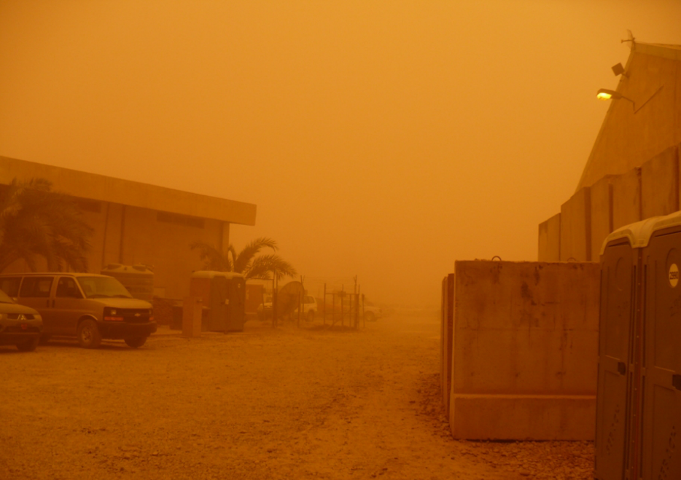
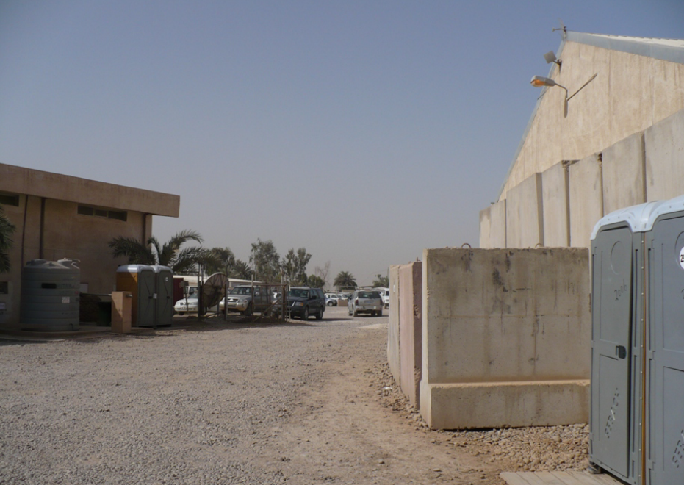
The dust itself
“Iraq Dust is Respirable, Sharp, Metal-Laden, and Induces Lung Inflammation”
-- Anthony M. Szema, M.D. (2014)
Notes:
Another airborne pollutant downrange was the dust itself
Very fine – much smaller than our dust here
Dust was everywhere – on the ground, kicked up by vehicles & even just walking across it
Click – if that wasn’t enough, dust storms would kick up top layer
- Best way to describe it is being on Mars – everything was glowing orange/red
Dust fit into everywhere, even cabinets & lockers
Put personal electronics in plastic bags to prevent being destroyed

Slide 11
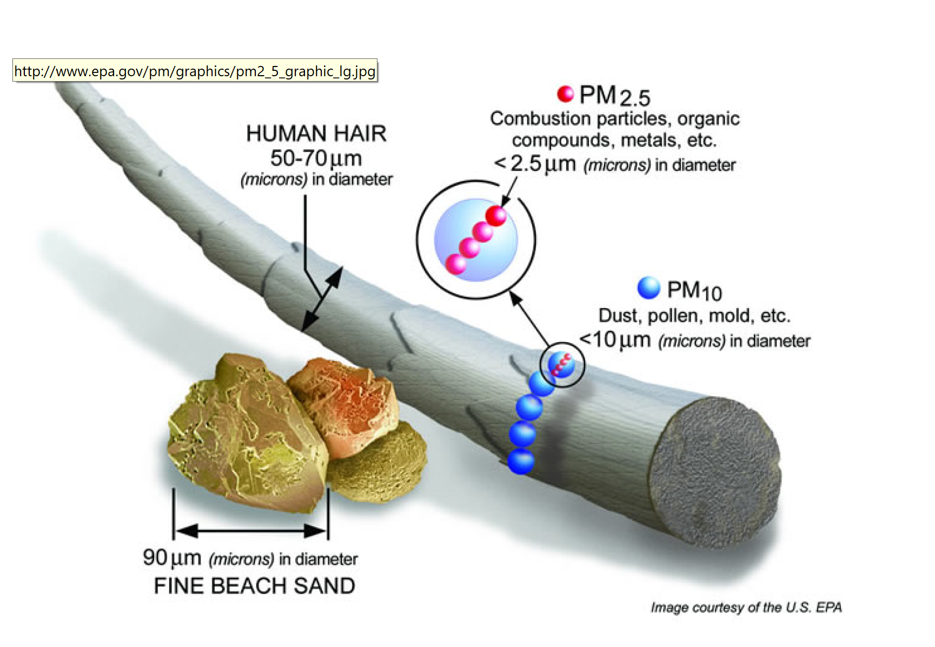
Fine particulate matter
Seventy PM_{2.5} particles fit here
Notes:
This slide illustrates how small these dust and other fine particles were
Tak an ordinary human hair
In the center is a grain of fine beach sand like you would see somewhere like PCB, Destin
Beside that is a human hair with blow-ups to show how small the fine PM is
About 30 PM_{2.5} particles would fit into the human hair strand
The respiratory system is good at removing PM over 10 microns
Cough, sneeze, mucus, etc.
Not so good at PM under 10 microns – leads to infections, getting lodged in resp tract
Next slides will show the short- and long-term effects of these fine particulate matters on the servicemembers’ health

Slide 12
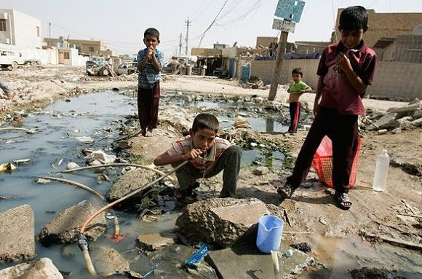
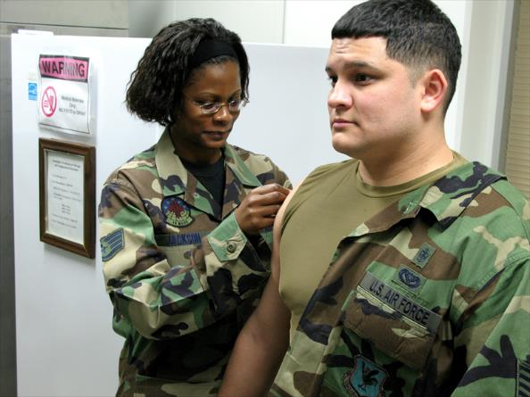
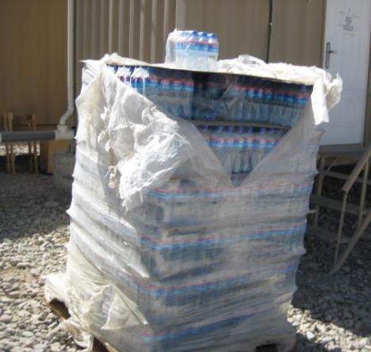
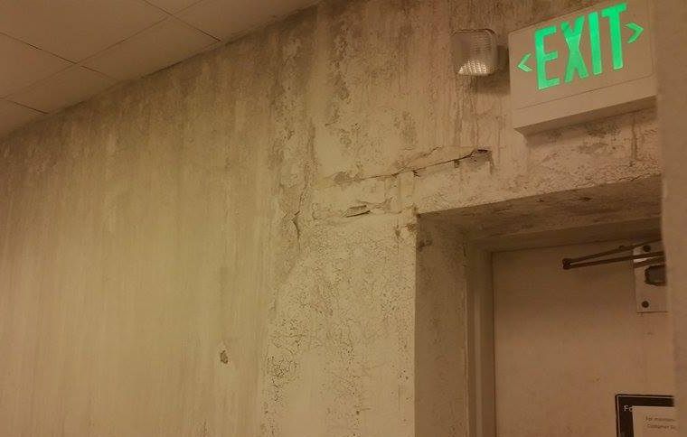
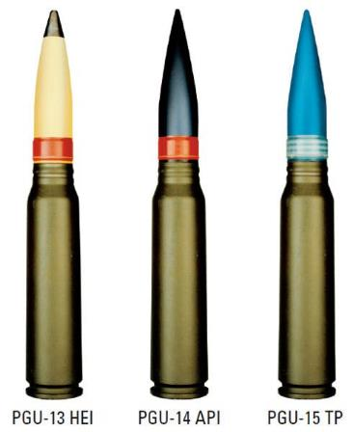
Other toxic exposures
Local Diseases
Immunizations
Toxic Bottles
Moldy Facilities
Depleted Uranium

Slide 13
HOW DOES THIS AFFECT VETERANS’ HEALTH?
Notes:
The answer: Sometimes

Slide 14
acute Health Effects
Worst crud I’ve ever seen, doctor.
Upper respiratory illnesses
Least severe: “The Crud”
Flulike symptoms
Sore/itchy throat
Congestion (sinus and/or nasal)
Discolored mucus
Diarrhea
Most severe: pneumonia, sinusitis, asthma, bronchitis
Indeed. This calls for Motrin AND Robitussin.
Notes:
While in theater, some people contracted major upper respiratory illnesses
They would seek treatment and get out of theater if it didn’t clear up soon
Everyone else got what we called the Iraqi Crud
Flulike symptoms
Mucus would be all different colors, sometimes partly black or in some cases mostly black
Let’s see how this was usually treated in theater
Click 1 & 2
Doctors prescribed heavy-duty Motrin for just about everything
They would recommend OTC medication for the Crud
That’s why not many people bothered to go

Slide 15
Chronic Adverse Health effects
RESPIRATORY/
PULMONARY
Asthma
Chronic bronchitis
Constrictive bronchiolitis
COPD
Difficulty breathing
Throat infections
Persistent Cough
Heart conditions
CANCERS
Leukemia
Lung cancer
Skin cancer
Stomach cancer
Pancreatic cancer
OTHER
Headaches and migraines
Gastrointestinal disorders
Reduced liver or kidney function
Chronic fatigue syndrome
Fibromyalgia
Skin lesions
Sleep disorders
Notes:
Long-term health problems have been tougher to pin down due to the time between exposure & becoming ill
Studies have shown a clear correlation between exposure to fine PM and long-term health effects
Correlation ≠ Causation
Three categories – Respiratory, Cancer, Other (primarily skin, GI, head)
As you can see, many of these take years or decades to develop after exposure
Sometimes makes it difficult for doctors to detect & treat

Slide 16
Chronic Adverse Health effects
Medically Unexplained Chronic Multisymptom Illness (MUCMI)
Diagnosed condition without a conclusive pathophysiology or etiology
Characterized by clusters of chronic symptoms:
Fatigue Headaches Joint pain
Indigestion Insomnia Dizziness
Respiratory disorders Memory problems
Notes:
Toughest to deal with is MUCMI because unknown
Pathophysiology – nothing wrong shows up on blood work, X-ray, CT scan, MRI, etc.
Etiology – nothing is a clear cause of the illness
Very few doctors understand the effects of PM from burn pits b/c it’s so rare & from long time ago
These symptoms are very real but don’t rise to the level of diagnosis
Can’t diagnose with unknown P&E
Difficult to substantiate other than veteran’s word & input from significant others

Slide 17
WHO CAN WE SUE?
Notes:
The answer: Sometimes

Slide 18
DEPARTMENT OF DEFENSE
Burn pits are "field-expedient alternative to reduce waste volume and protect troops from disease"
Shortcomings in execution:
Did not ensure compliance with EPA standards
Collected inadequate contaminant data
Did not disclose all findings of toxicity

Slide 19
Military contractors
68 lawsuits filed against KBR in 2008-13
Plaintiffs’ claim: KBR’s negligence in running burn pits caused harm
KBR’s defense: We ran burn pits as directed by Department of Defense
Court consolidated into one case
Notes:
IN RE KBR, INC., BURN PIT LITIGATION
268 Fed.Supp.3d 778 (2017)

Slide 20
Military contractors
Result: 4th Circuit dismissed the case
Lack of jurisdiction due to “political question doctrine”
Seek redress from Congress or POTUS
US Supreme Court declined to review
IN RE KBR, INC., BURN PIT LITIGATION
268 Fed.Supp.3d 778 (2017)

Slide 21
CAN VETERANS MAKE A CLAIM WITH THE VA?
Notes:
The answer: Sometimes

Slide 22
VA Disability Compensation
Process similar to insurance
Veteran files claim
VA examiner reviews file & veteran
VA issues decision
Veteran may appeal
Favorable Disability Advocates
Notes:
This is my field of practice; remember this isn’t advice & definitely not position/view of VA
With no clear diagnosis, VA is reluctant to provide disability benefits
Very good at rating visible disabilities [missing limbs, scars]
Very tough on invisible disabilities [PTSD, fatigue, other burn pit symptoms]
So you get a very low approval rate for burn pit disabilities
Many of the 20-25% approved were w/in 1st year of discharge
VA has no choice but to approve
Many symptoms take many years to show, so VA is reluctant to approve
-- Esp. because its position is there is no clear association
Again, it comes down to money
Remember, this is just my point of view
VA gets a pot of money from Congress every year, with so much going toward disability
Like an insurance company, can only award that much
Often deny or undervalue claims to stay under that budgeted amount
Spend 10 minutes in FL, see ad for attorneys who fight insurance companies
VA appeals go through several levels of review w/in VA before court
Wait times are measured in years, not months
For those with terminal illnesses, the mantra is . . .
Congress passed a new law to streamline process; we’ll see how that goes
Note on CAVC
Takes ~3 years for the court to review VA decision
Unlike Soc Sec, where can go to any federal court: only one court, in DC
Routinely strikes down VA claims denials
So bad, 76% EAJA rate (no leg for gov’t to stand on)
Unfortunately, usually remand because VA did such bad job, requires 2-3 more years

Slide 23
VA Disability Compensation
Veteran must prove service connection
Current disability
In-service event
Nexus between disability and in-service event
Burden of proof: As likely as not (50%)
“Tie goes to the veteran”
Notes:
This is my field of practice; remember this isn’t advice & definitely not position/view of VA
With no clear diagnosis, VA is reluctant to provide disability benefits
Very good at rating visible disabilities [missing limbs, scars]
Very tough on invisible disabilities [PTSD, fatigue, other burn pit symptoms]
So you get a very low approval rate for burn pit disabilities
Many of the 20-25% approved were w/in 1st year of discharge
VA has no choice but to approve
Many symptoms take many years to show, so VA is reluctant to approve
-- Esp. because its position is there is no clear association
Again, it comes down to money
Remember, this is just my point of view
VA gets a pot of money from Congress every year, with so much going toward disability
Like an insurance company, can only award that much
Often deny or undervalue claims to stay under that budgeted amount
Spend 10 minutes in FL, see ad for attorneys who fight insurance companies
VA appeals go through several levels of review w/in VA before court
Wait times are measured in years, not months
For those with terminal illnesses, the mantra is . . .
Congress passed a new law to streamline process; we’ll see how that goes
Note on CAVC
Takes ~3 years for the court to review VA decision
Unlike Soc Sec, where can go to any federal court: only one court, in DC
Routinely strikes down VA claims denials
So bad, 76% EAJA rate (no leg for gov’t to stand on)
Unfortunately, usually remand because VA did such bad job, requires 2-3 more years

Slide 24
VA Disability Compensation
80% burn pit claims denied
“Lack of formal diagnosis”
“Insufficiently connected to service”
Notes:
This is my field of practice; remember this isn’t advice & definitely not position/view of VA
With no clear diagnosis, VA is reluctant to provide disability benefits
Very good at rating visible disabilities [missing limbs, scars]
Very tough on invisible disabilities [PTSD, fatigue, other burn pit symptoms]
So you get a very low approval rate for burn pit disabilities
Many of the 20-25% approved were w/in 1st year of discharge
VA has no choice but to approve
Many symptoms take many years to show, so VA is reluctant to approve
-- Esp. because its position is there is no clear association
Again, it comes down to money
Remember, this is just my point of view
VA gets a pot of money from Congress every year, with so much going toward disability
Like an insurance company, can only award that much
Often deny or undervalue claims to stay under that budgeted amount
Spend 10 minutes in FL, see ad for attorneys who fight insurance companies
VA appeals go through several levels of review w/in VA before court
Wait times are measured in years, not months
For those with terminal illnesses, the mantra is . . .
Congress passed a new law to streamline process; we’ll see how that goes
Note on CAVC
Takes ~3 years for the court to review VA decision
Unlike Soc Sec, where can go to any federal court: only one court, in DC
Routinely strikes down VA claims denials
So bad, 76% EAJA rate (no leg for gov’t to stand on)
Unfortunately, usually remand because VA did such bad job, requires 2-3 more years

Slide 25
VA Disability Compensation
Common mistakes in VA rating decisions (to name a few):
Not Following Rules
Fail to follow federal law, regulations
Fail to follow VA procedures
Fail to consider all legal theories
Improperly Consider Evidence
Fail to obtain DoD/VA records
Undervalue/omit positive evidence
Overvalue negative evidence
Inadequate Medical Exam
Unqualified examiner
Cursory/unfair examination
Inadequate Decisions
Inadequate explanation of denial
Inaccurate rating percentage
Fail to consider unemployability
Incorrect effective dates

Slide 26
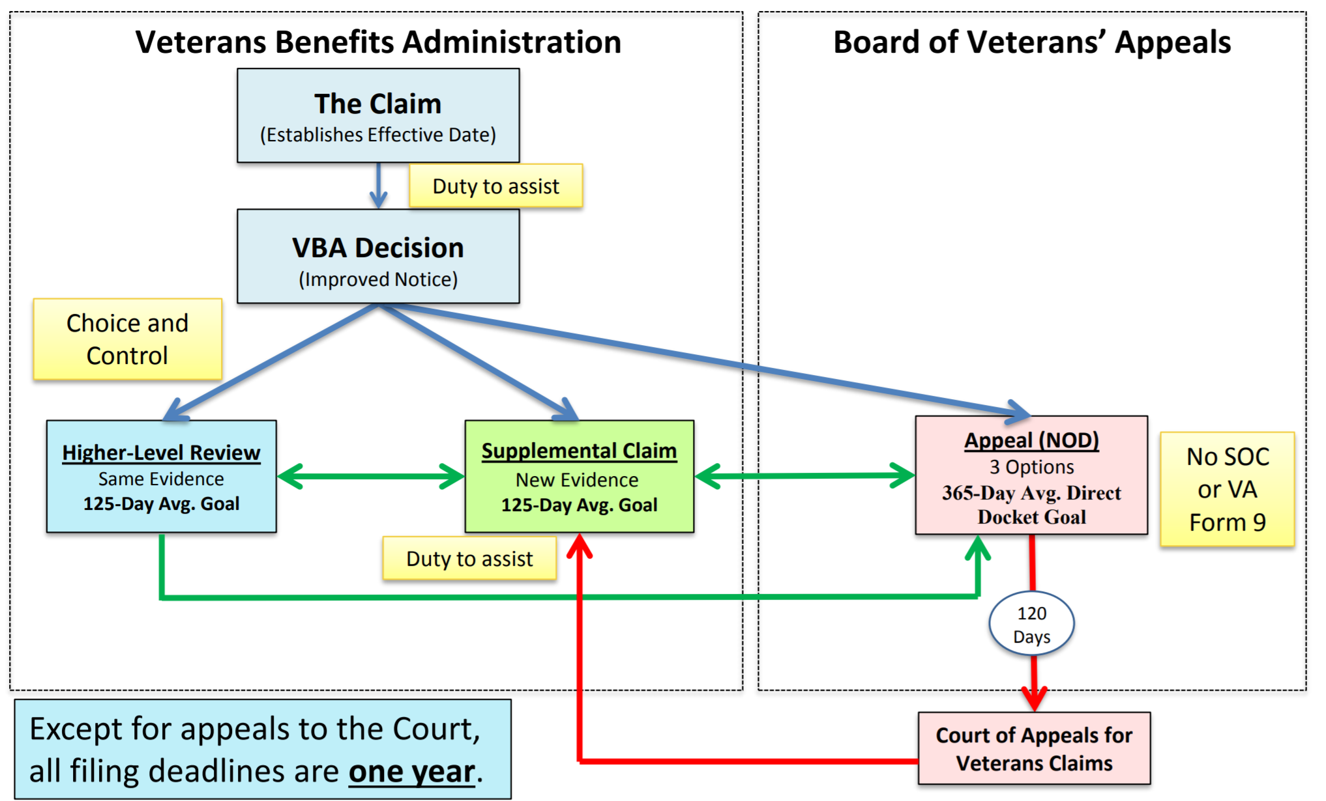
Veterans’ Mantra
Delay, Deny,
Hope They Die
BVA Logjam
1-3 years
CAVC Logjam
3-5 years

Slide 27
Legal Presumptions
VA must grant service connection if veteran meets first two criteria
Current Disability
In-Service Event
Examples:
Agent Orange
Camp Lejeune Water
Atomic Testing
VA

Slide 28
Legal Presumptions
VA Fights Presumptions at Every Stage
Congressional Deliberation “We need more research” “We don’t have DoD data”
After Enactment “We need more time to implement”
After Implementation “This doesn’t apply to all affected veterans” “The statute doesn’t require that.”
VA

Slide 29
Legal Presumption for some burn pit veterans
Qualifying chronic disability (MUCMI) that:
Manifested during active service in SW Asia or before 12/31/2021
Not attributable to any known clinical diagnosis
Limitations
Excludes all diagnosed disabilities (e.g., cancer, respiratory, pulmonary)
Enacted in 1994 – intended for Desert Storm/Shield veterans
Does not address burn pit toxins

Slide 30
WHAT IS CONGRESS DOING ABOUT THIS?
Notes:
The answer: Sometimes

Slide 31
VA AIRBORNE HAZARDS & BURN PIT rEGISTRY
Congress enacted in 2013
VA implemented in 2014
PURPOSE OF DATA COLLECTION:
Understand the health outcomes of those exposed
Track and investigate illness, recovery, deaths
Notes:
The most visible aspect of VA care with burn pit veterans is its registry
Lots of news reports & VA news releases extol the benefits of it
These are the VA’s stated purpose of the registry, as mandated by Congress
VA pretty much took the AO registry and updated it
Much like the AO registry, characterized as “not worth the paper it’s written on”
Self-reported – most veterans don’t know how bad off they are OR try to tough it out
Nothing to say empirically what’s wrong with these respondents
Static – As symptoms and diseases develop, it never gets updated
Defeats the purpose of better understanding the health hazards of burn pits
Few responses – unknown whether veterans don’t know, are healthy, don’t trust the VA, or other reason

Slide 32
VA AIRBORNE HAZARDS & BURN PIT rEGISTRY
LIMITATIONS:
GIGO: unhelpful questions elicit unhelpful responses
Self-reported: no exam to determine extent of harm
Static: VA doesn't update w/ new diagnosis
Apathy: Few veterans filled it out
NIH report (2017):
“not…useful”
Notes:
The most visible aspect of VA care with burn pit veterans is its registry
Lots of news reports & VA news releases extol the benefits of it
These are the VA’s stated purpose of the registry, as mandated by Congress
VA pretty much took the AO registry and updated it
Much like the AO registry, characterized as “not worth the paper it’s written on”
Self-reported – most veterans don’t know how bad off they are OR try to tough it out
Nothing to say empirically what’s wrong with these respondents
Static – As symptoms and diseases develop, it never gets updated
Defeats the purpose of better understanding the health hazards of burn pits
Few responses – unknown whether veterans don’t know, are healthy, don’t trust the VA, or other reason

Slide 33
Recent legislation: What was introduced
House: 12 bills Senate: 2 bills
More burn pit-related presumptions
Enhanced burn pit registry
More DoD & VA reporting of current exposure
More DoD & VA accounting of past exposure
VA establish a burn pit center of excellence
VA health care eligibility for all burn pit veterans

Slide 34
Recent legislation: What Became Law
Pub. L. 115-252
Study into phasing out burn pits
Burn Pit registry education campaign
Pub. L. 115-244 - VA coordinate efforts to understand nature of burn pits, health effects from burn pits, treatment of symptoms

Slide 35
Recent legislation: What Became Law
National Defense Authorization Act, FY2019
DoD/VA coordinate efforts to understand burn pit effects
Burn Pit registry education campaign

Slide 36
Upcoming legislation (2019-20): What’s been introduced
House: 9 bills Senate: 4 bills
More burn pit-related presumptions
Enhanced burn pit registry
More DoD & VA reporting of current exposure
More DoD & VA accounting of past exposure
VA health care eligibility for all burn pit veterans
VA establish a burn pit center of excellence
Diagnostic code for constrictive bronchiolitis

Slide 37
Upcoming legislation (2019-20): What’s been introduced
National Defense Authorization Act, FY2020
DoD plan to phase out burn pits
DoD tell VA where burn pits are/were
DoD/VA report status of studies
VA integrate BP registry into health records

Slide 38
HOW YOU CAN HELP
Notes:
The answer: Sometimes

Slide 39
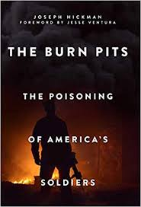
Learn more
The Burn Pits: The Poisoning of America’s Soldiers
2016 Book by Joseph Hickman (137 pages)
Delay, Deny, Hope You Die: How America Poisoned Its Soldiers
2017 Documentary (53 minutes)

Slide 40
Get involved (or donate)
Veterans Service Organizations
American Legion, Disabled American Veterans, VFW, etc.

Slide 41
Get involved (or donate)
Burn Pits 360
burnpits360.org
Veteran Warriors
www.veteran-warrriors.org
Veterans Service Organizations
American Legion, Disabled American Veterans, VFW, etc.

Slide 42
Burn Pits: Post 9/11 veterans’ agent orange
Creative Commons
from my personal & Professional Experience
Notes:
Customize call to action to audience
Veterans
Go to VA as soon as you sense something wrong with respiratory/sleep health
Chest pain, snoring, waking, restless legs
Persist thru VA hospital red tape
Keep calling & consulting w/ pt adv
Get private help if you can afford it
File your claim with VSO help
Not attorney b/c can't charge to fil
Need evidence to prove SC
Get evidence you're different from standard exposure (pics, buddy stmt)
Seek attorney for appeals help
Fiduciary duty to present your case
Many can get IMOs
Paying 25% backpay better than getting 100% of nothing
VSOs
Similarities/differences btw AO & burn pits
Establish network of doctors familiar with these health issues
PTSD, TBI too b/c may interact
Realize your limitations on claims
These are complex conditions; if doctors struggle, you will too
Call regional/national agents, refer to trusted attorneys
Local leaders - Push for:
More $ to veterans disability
More research
Pay for presumptives
Even when authorizing use of force
Transparency in what's going on downrange
Contractors careless w/ money, toxins
DU/toxins in munitions, scopes, NVGs, etc.
More research into these illnesses
More VA & private doctors specializing in these illnesses

