Slide 1
How to play
Tell students a zombie is coming and they must choose one of the places to hide.
Once students have all picked a location play through the PowerPoint and talk about where the zombie goes each time
Eliminate students that are caught by the zombie until you have your final survivors

Slide 2
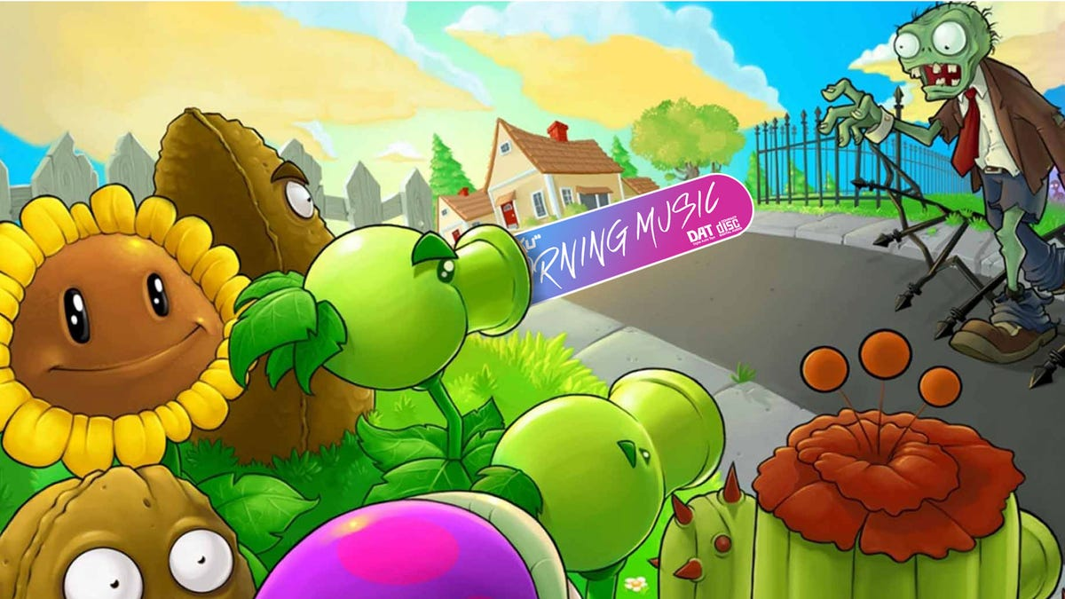

Slide 3


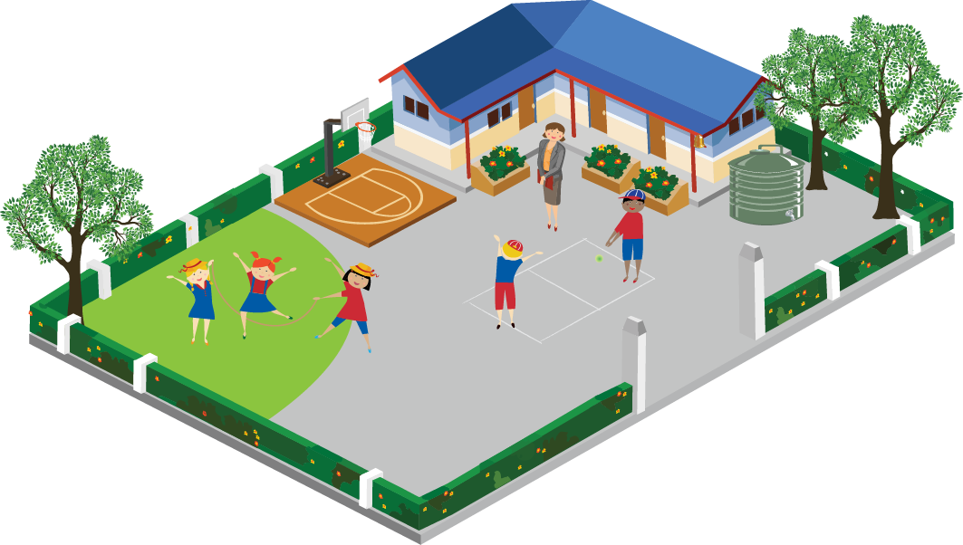






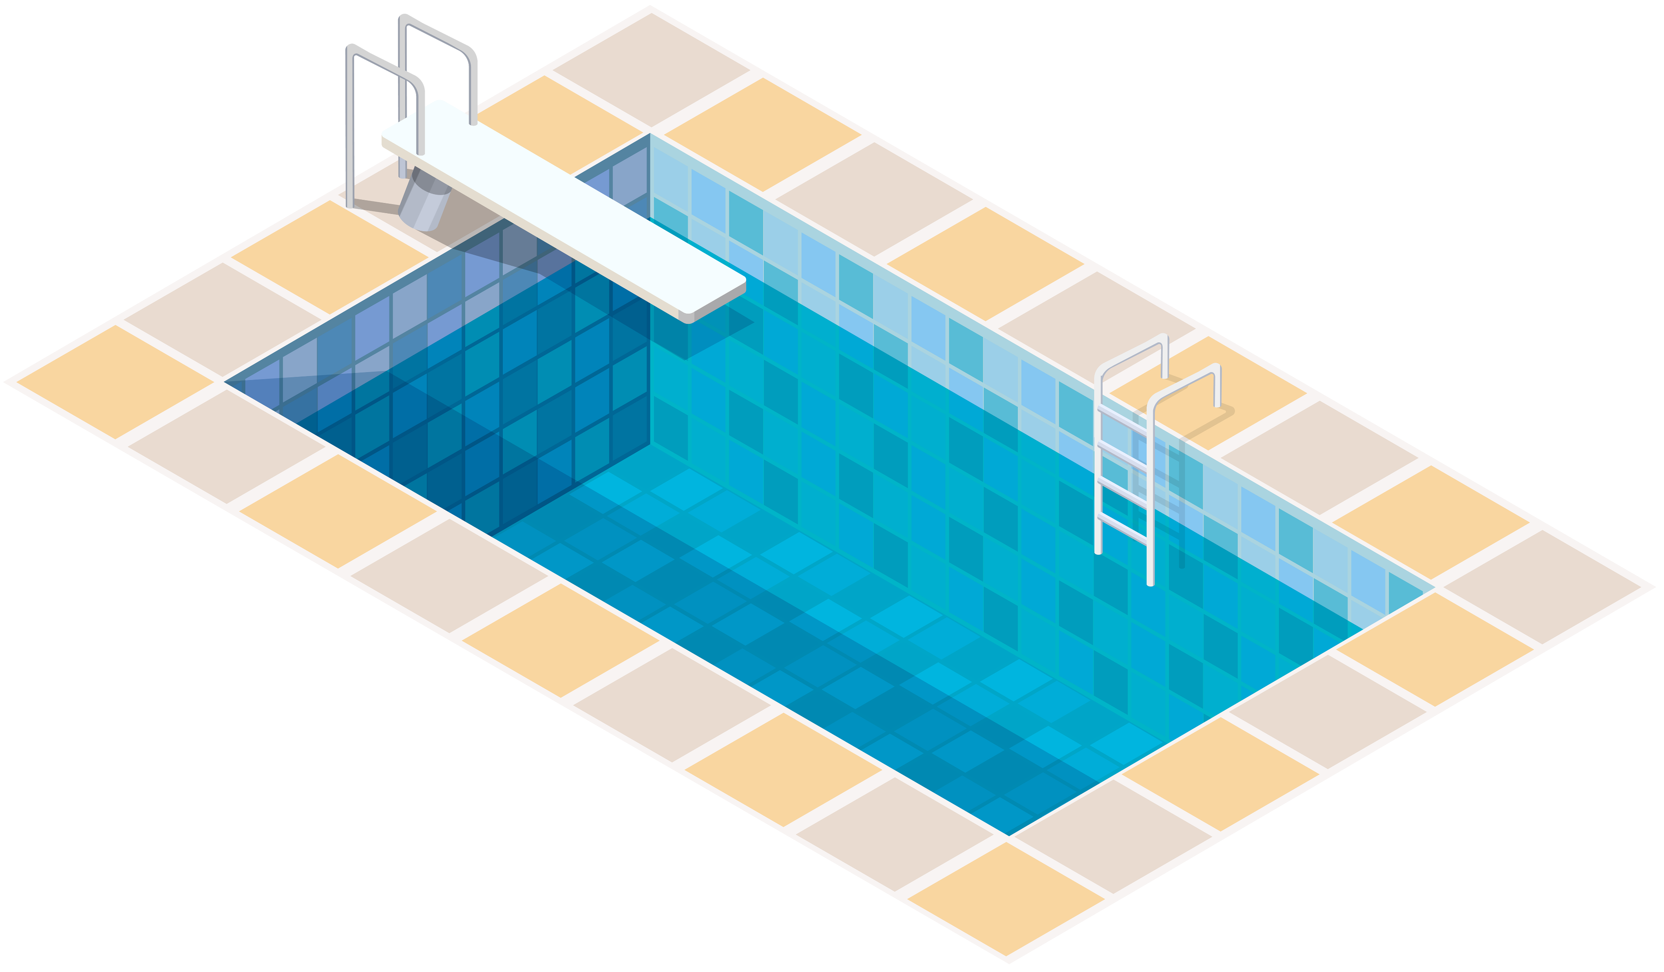
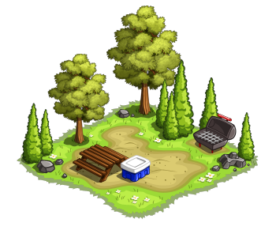

Slide 4


Slide 20


Slide 21
