Slide 1
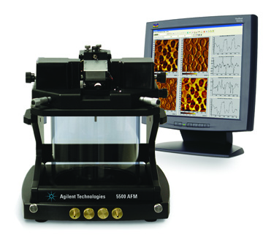
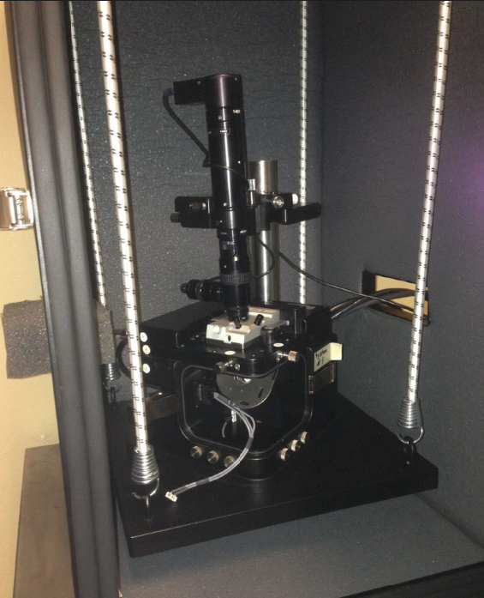
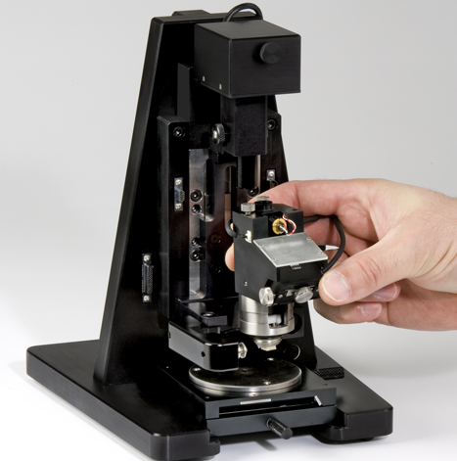
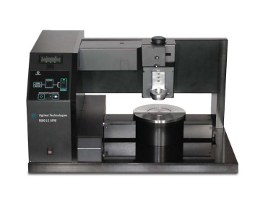
Who is www.ZoomAFM.com ?
Song Xu Application scientist of Agilent Technology Inc
Steve Raba Service engineer of Agilent Technology Inc
XQ Tong Technical Manager of Agilent Technology
Gerald Kada Application Scientist Germany
Louis Pacheco Former Application Engineer France, Founder of CSInstrument
… … … (there will be more to join us, from around the world)
Why we are here ?
Keep your instrument running for 10 more years.
Support Molecular Imaging, Agilent and Keysight AFM users.
Provide lectures and training
Repair and maintenance
Our purpose: we want to provide a consistent support with easy to find communication. Welcome to ask questions or just have a chat, and please be prepared to introduce yourself and what you do with your instrument.

Slide 2

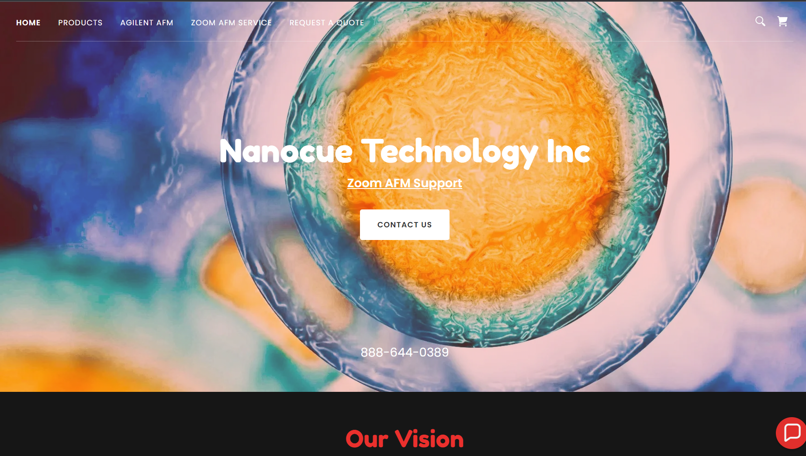


Slide 3
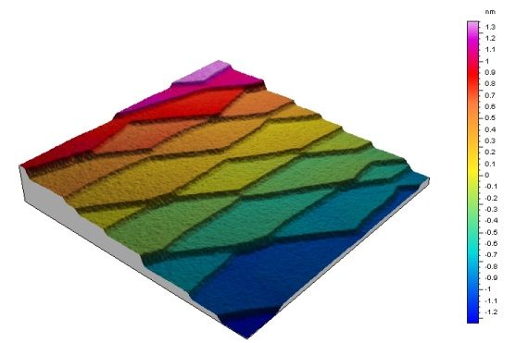
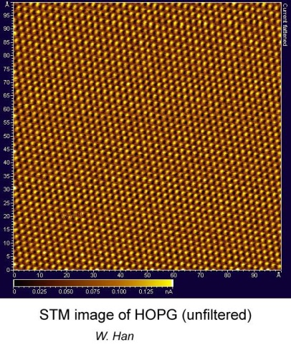
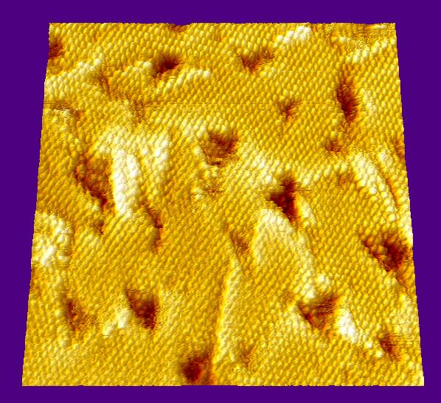

Basic Physics of Atomic Force Microscope III

Slide 4
Content:
Basics of AC / tapping mode
  Basic force interaction involved in tapping mode imaging
  Tappping mode, true non-contact mode, dipping mode
  Understand how to estimate and measure tapping amptlitude
  How to estimate tapping force changing with setpoint and driving power
  Basic steps to achieve high resolution with AC mode.

Slide 5
Force Interaction of AC / Tapping Mode

Slide 6
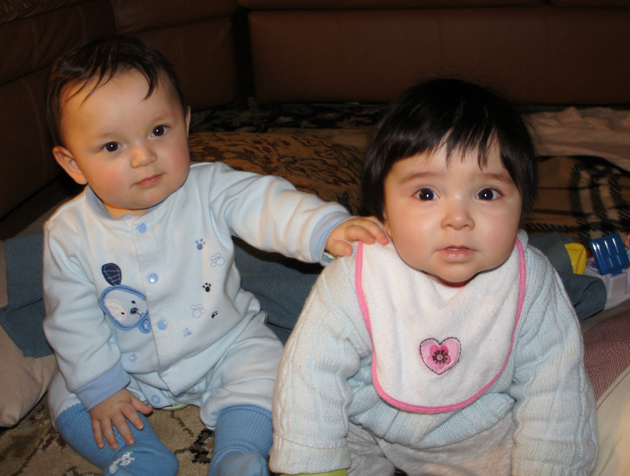
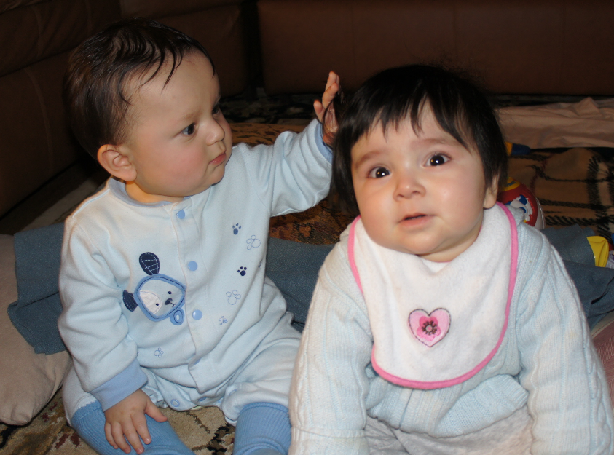
Tapping / AC / non-contact?
Tapping: higher amplitude to ensure short range repulsive interaction
Non-contact: small amplitude interaction at attractive range distance

Slide 7
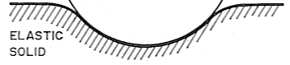
Analysis of basic tip sample interaction and energy dissipation
Motion
Sliding friction or cycling shear
Adhesive debonding
Cycling compression/tension/debonding
Each of these modes can be used to contrast materials and analyze viscoelastic properties.
Force on tip

Slide 8
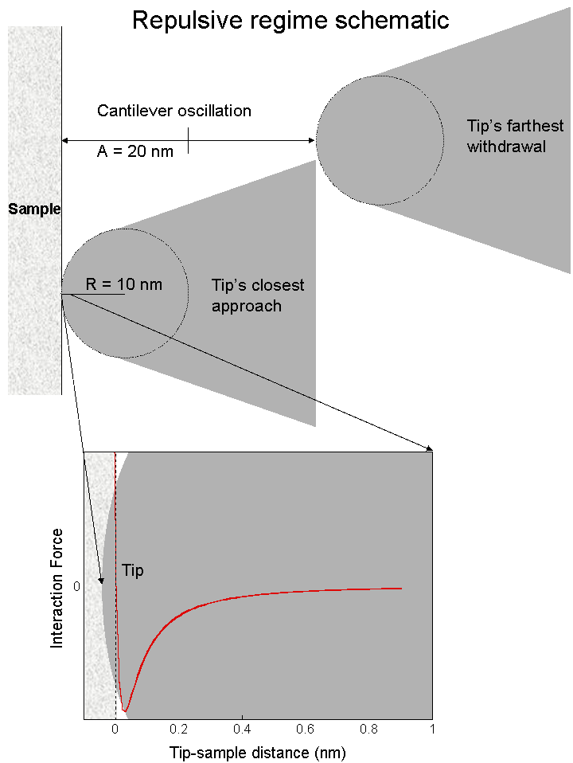
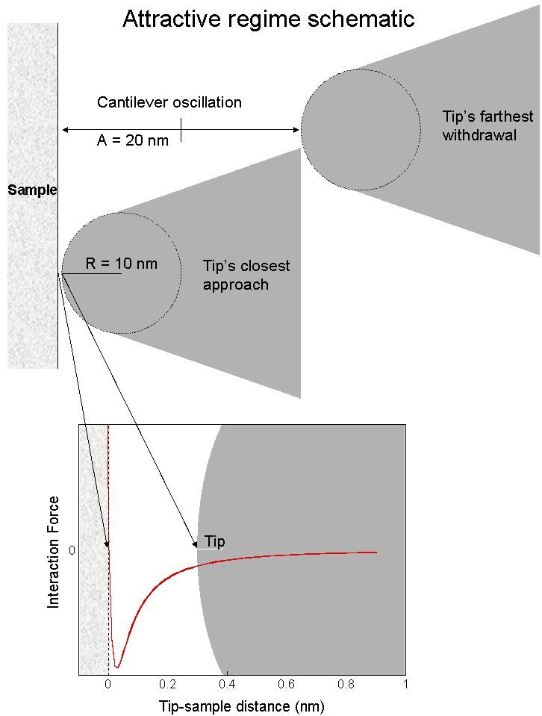
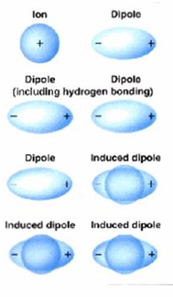
AC / Tapping Mode Imaging on Close Range Force Interaction
< 10 nm
<0 nm

Slide 9
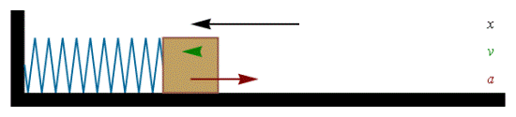


Cantilever tip: a simple harmonic oscillator
    $ω0=( \frac{k0}{m} )$ ^{½},

Slide 10
When the tip interacts with sample

Slide 11
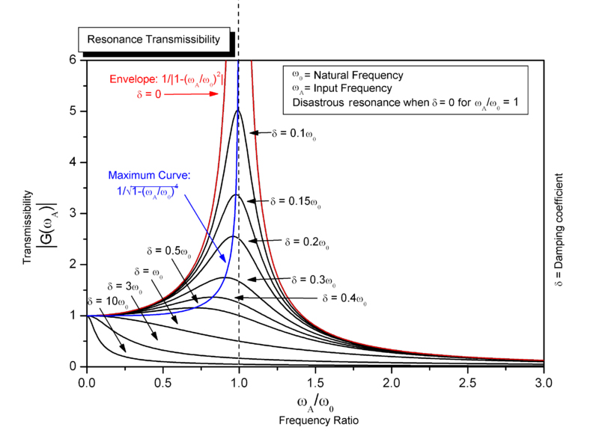



AFM cantilever tip as driven harmonic oscillator
K₀ b
m
Driving
X scan
    $ω0=( \frac{k0}{m} )$ ^{½},
$ω$ = $\sqrt{{ω0}^{2}−\frac{1}{2}\left(\frac{b}{m}\right)2}$

Slide 12
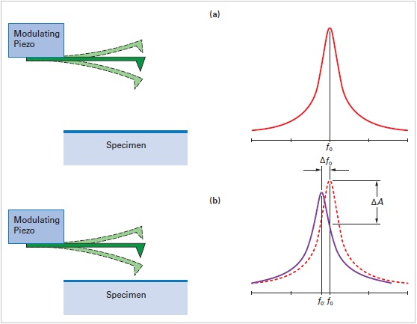
What happen when tip interacts with sample

Slide 13
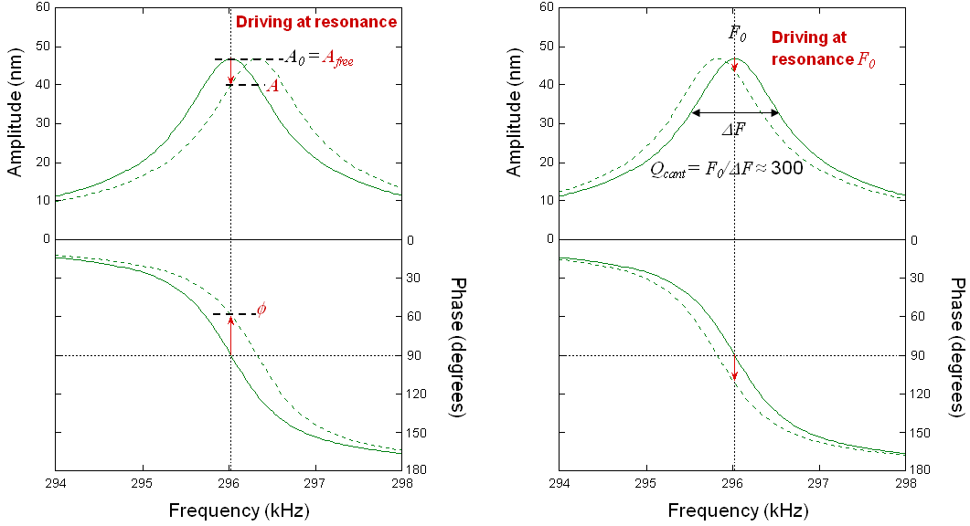

Resonance frequency affected by force gradient: a simple harmonic oscillator
Repulsive region (contact / tapping)
Positive force gradient
Separation distance
No interaction
Cantilever force constance
Net force constance
Attractive force region (non-contact)
Negative force gradient
Force const ( K = df / ds )
Separation distance
    $ω0=( \frac{k}{m} )$ ^{½},
Attractive region: resonance f shift lower
Repulsive region: resonance f shift higher

Slide 14
Resonance frequency affected by force gradient: a simple harmonic oscillator
Net force
Tip-sample interaction
Cantilever deflection force
Repulsive region (intermittened contact / tapping)
Force (positive = force vector from sample surface toward tip)
Separation distance
Tip
sample
Separation distance
No interaction
AFM tip experience two different forces:
Force interaction from the sample
Deflection force from cantilever
Attractive force region (non-contact)
Negative force gradient
Separation distance
Force const ( K = df / ds )
Cantilever force constance
Net force constance

Slide 15
How force gradient changes resonance frequency and phase
Net Attractive
Net Repulsive
F₀
Driving at resonance
Driving at resonance F₀
A₀ = A_{free}
A
Amplitude (nm)
Amplitude (nm)
ΔF
Q_{cant} = F₀/ΔF ≈ 300
φ
Phase (degrees)
Phase (degrees)
Frequency (kHz)
Frequency (kHz)

Slide 16
How AFM cantilever tip detects sample—AC mode
d
approach
z
widthdraw
approach

Slide 17
Basic AFM imaging mode—contact mode & AC mode
Repulsive region (intermittened contact / tapping)
Actual topo
Amplitude
error
Feedback output
Repulsive region (intermittened contact / tapping)
Attractive force region (non-contact)

Slide 18
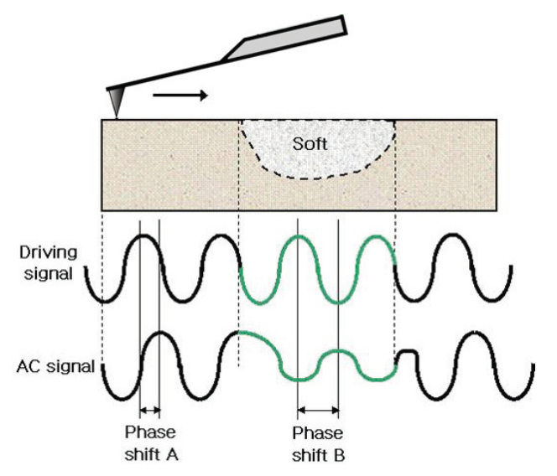
Phase

Slide 19

Thank you for your attention
To be continued
Next week:
Basic to the basic, look at a life instrument
Life Demo!
Every Tuesday morning 11:00 am EST
Consider add: Monday afternoon 3:00 pm EST ??
Every Tuesday morning
support@ZoomAFM.com

Slide 20
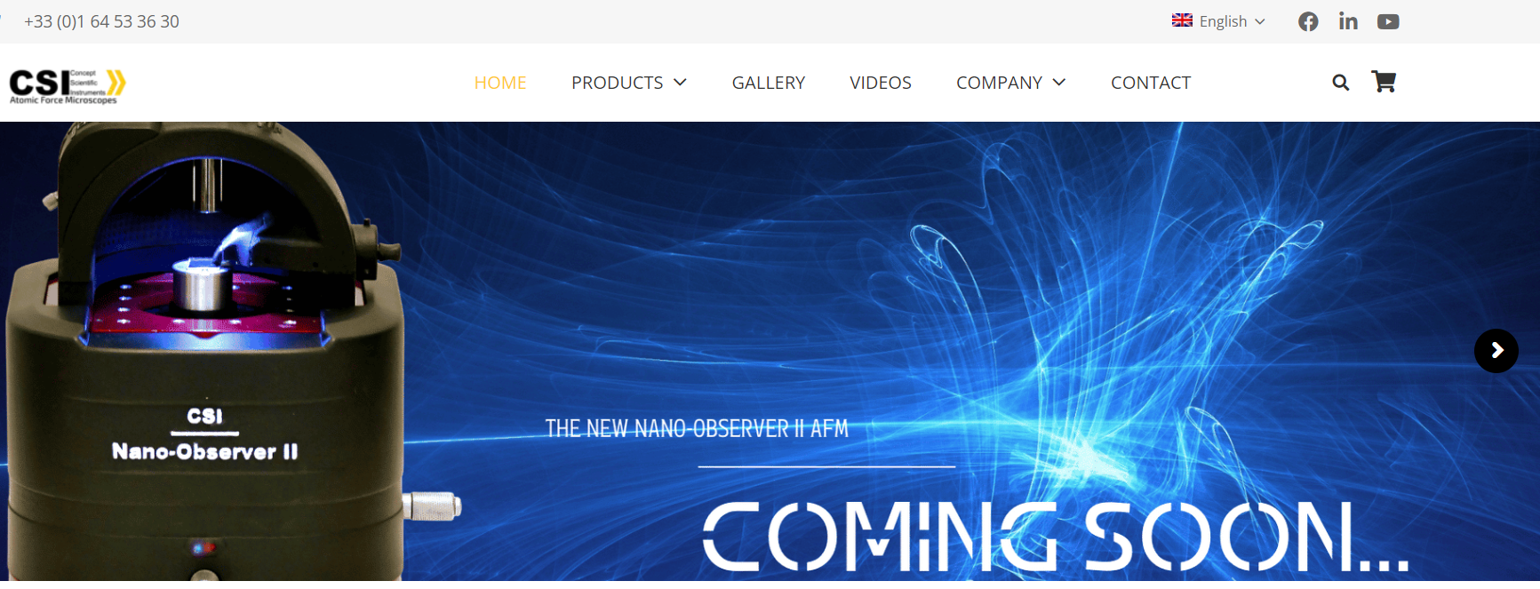

Slide 21

