Slide 1
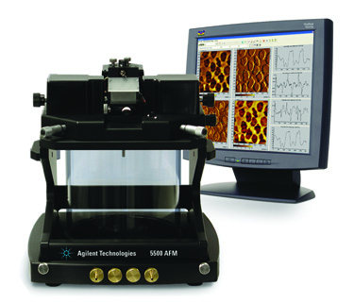
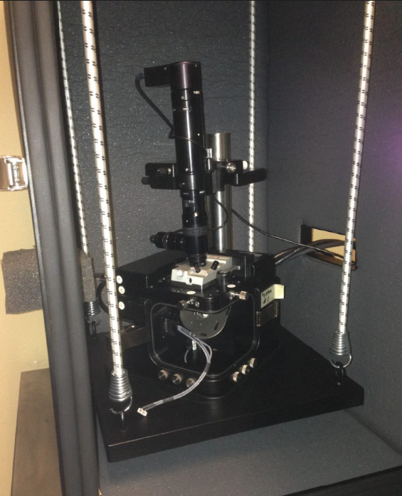
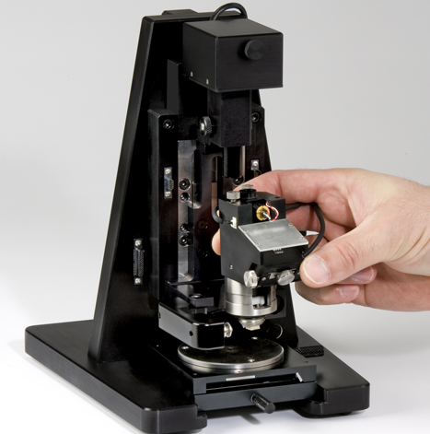
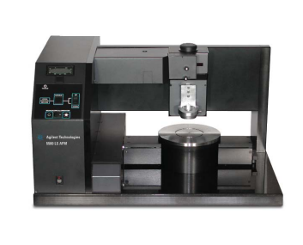
Who is www.ZoomAFM.com ?
Song Xu Application scientist of Agilent Technology Inc
Steve Raba Service engineer of Agilent Technology Inc
XQ Tong Technical Manager of Agilent Technology
Gerald Kada Application Scientist Germany
Louis Pacheco Former Application Engineer France, Founder of CSInstrument
… … … (there will be more to join us, from around the world)
Why we are here ?
Keep your instrument running for 10 more years.
Support Molecular Imaging, Agilent and Keysight AFM users.
Provide lectures and training
Repair and maintenance
Our purpose: we want to provide a consistent support with easy to find communication. Welcome to ask questions or just have a chat, and please be prepared to introduce yourself and what you do with your instrument.

Slide 2
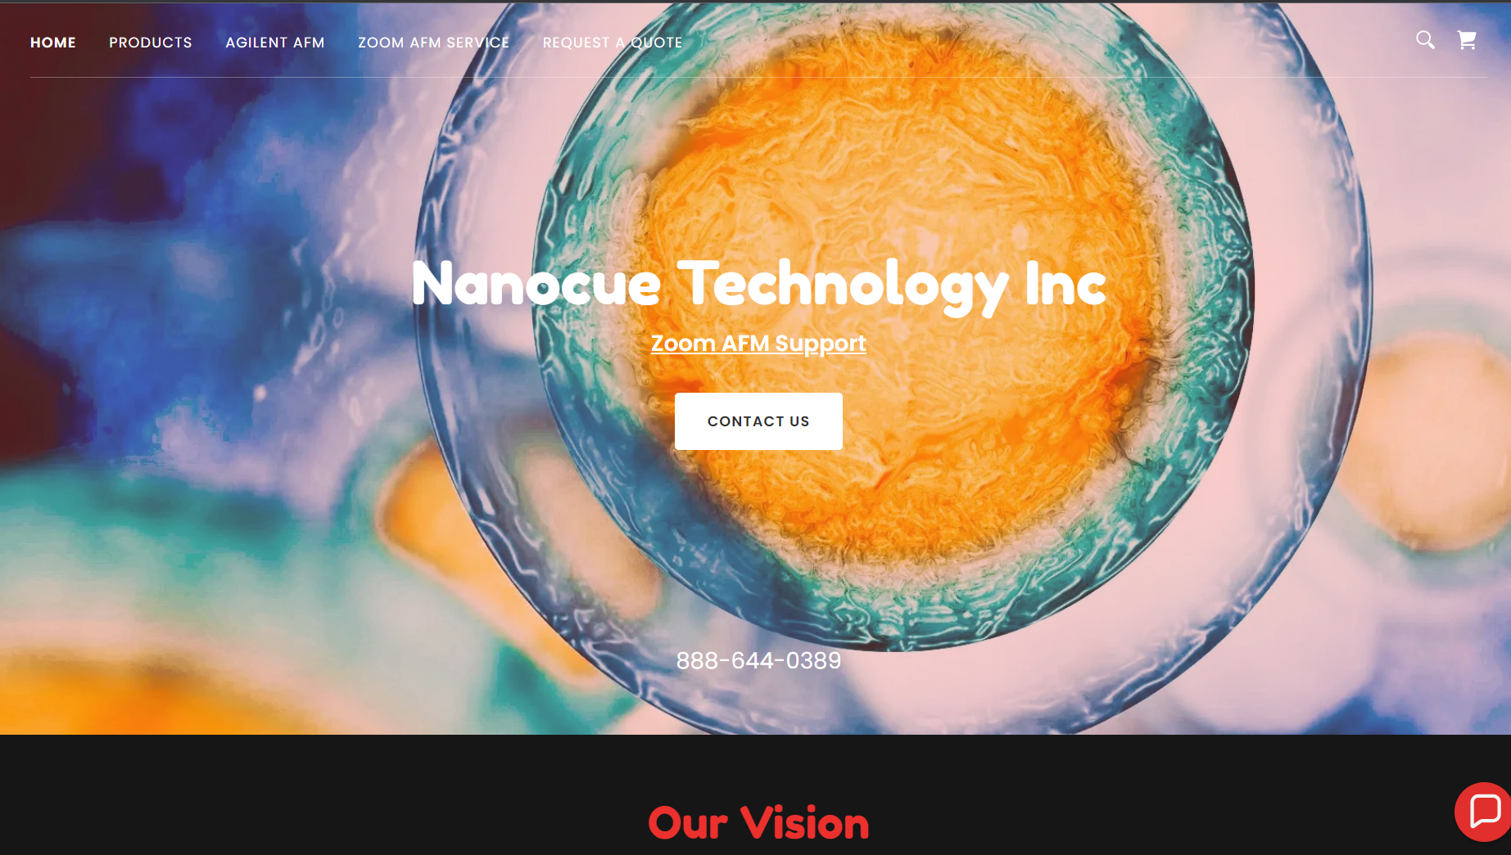

Slide 3
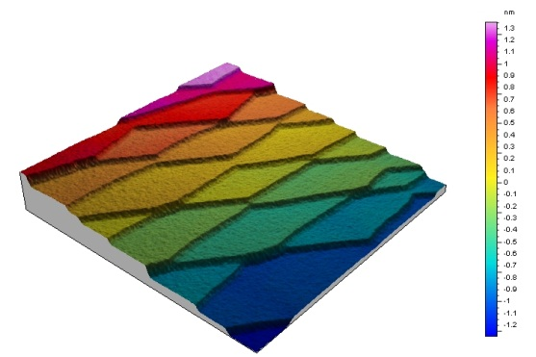
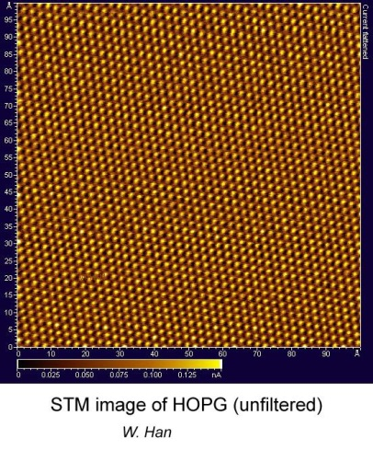
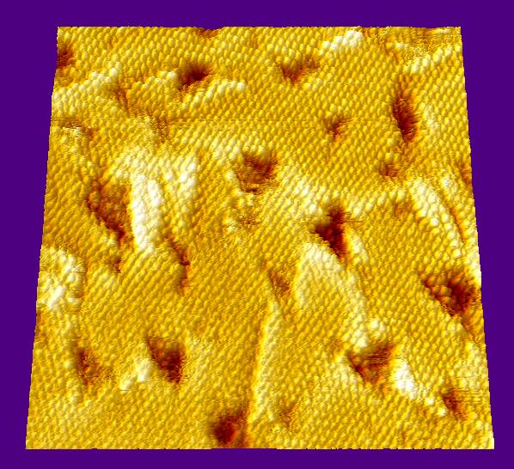
Basic Physics of Atomic Force Microscope IV
Why contact mode is great?
Demo if we have time

Slide 4
Pros and Cons of 1st Gen Tip Scanning AFM
Sensitivity inconsistancy
Y scan
Laser reflective spot
Notes:
Traditional design of tip scanning scanner. The laser is fixed, and tip is scanning. The tracking lens does not track the laser 100% to the tip. Therefore when scanning, the laser spot on the cantilever is moving, which cause the force to vary when scanning at different offset. This will cause different force problem when doing force curve. Because the shape of the cantilever is not uniform, the reflected laser spot will changing the scattering pattern, which is not predictable, therefore further worsen the problem. That is why when scanning larger area, the base line of image of a flat sample will have different curvature every time laser is adjusted.

Slide 5
Balanced pendulum: how does it work
Y scan
Laser tracking spot remain fixed relative to AFM cantilever
Notes:
A pendulum scanner, the laser is part of the scanning unit, and it is pointed to the exact sample spot at the cantilever regardless the scanning offset at any moment, therefore the force, and amplitude sensitivity is very precisely controlled. The XY scanning is driven by plates, instead of tube, therefore deformation stress is zeroed, the pendulum is balanced around its pivot point, this makes the scanning much faster and lower noise at faster scanning rate.

Slide 6
Basic Force Interaction Curve
Which imaging mode –contact mode
--Easier, faster and high resolution
f
f
0
0
z
z
Ambient in fluid
Imaging in fluid increases resolution by decreasing imaging force

Slide 7
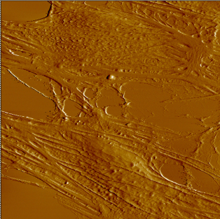
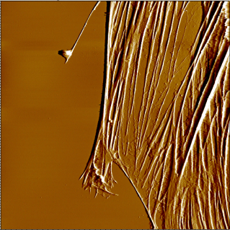
AFM Can Be Used To Probe The Cytoskeletal Structure of Living Cells
200 nm
100 um
25 um
Equipment
Bioscan ®
PicoPlus® AFM system
Multi-purpose large scanner
Low coherence laser
Flow through liquid cell
Collagen coated cover slip
Conditions
Contact mode
Room temperature
In solution (filtered growth media)
Image live cells
Force can be tuned to observe cytoskeletal elements or outer membranes
Top down scanning permits simultaneous AFM and high resolution optical imaging
Combine AFM with phase contrast, DIC, and fluorescence microscopy
AB 002 09-04
Notes:
Bioscan AFM images of live Bovine Capillary Endothelial (BCE) cells grown on collagen coated cover slips. Image on left shows the soft membrane and other features which cover the cell. The image on right shows cytoskeletal structures inside the cell which were resolved after increasing the force applied to the AFM tip. 100 mm x 100 mm
Technical Description
AFM provides a means to study the structural elements of very delicate structures, including living cells, and offers a unique opportunity to image, identify and study elements at the surface and inside of living cells. Non-destructive AFM images of cellular structures below the limits of optical resolution can be quickly and easily obtained with PicoPlus either as a stand alone system or with Bioscan (AFM combined with inverted optical microscope). By imaging living cells, important information on the architecture of membranes, organelles, and cytoskeletal structures can be directly gathered without the use of interfering fluorescent labels or probes. The cytosceleton is the main characteristic feature observed in AFM images and responsible for many mechanical properties of the cell, including shape, activity and mobility of the cell. Real-time monitoring of living cell dynamics, intercellular communication and response to stimulus, drugs, or toxic substances is another powerful application of cellular studies with AFM.

Slide 8
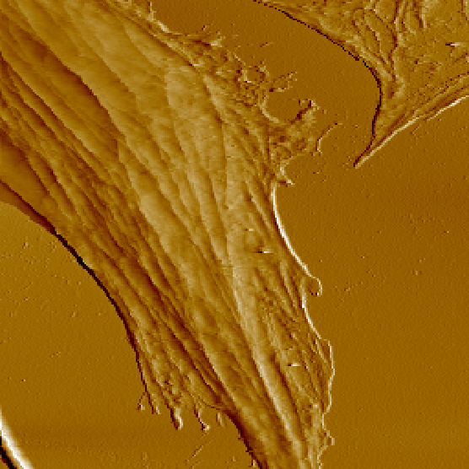
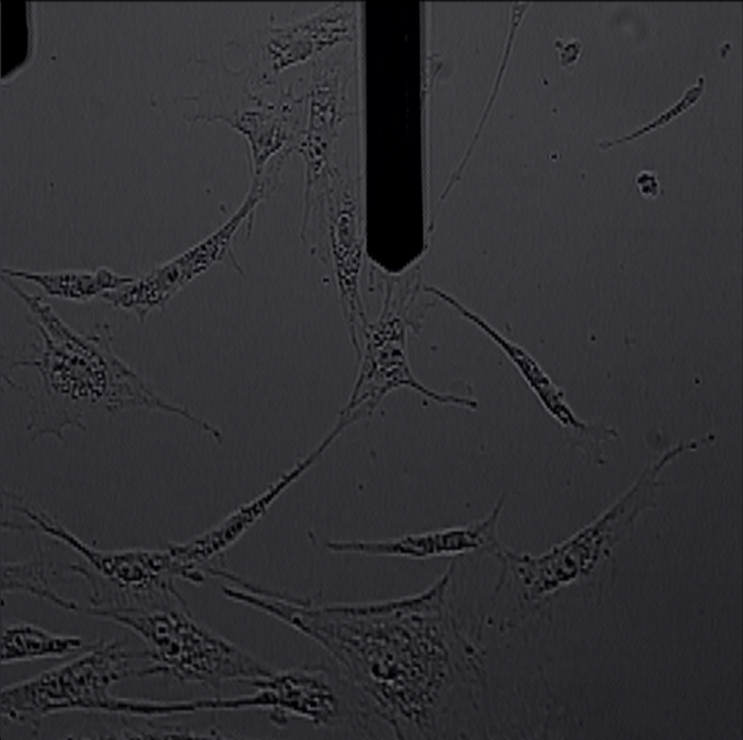
Deflection Image of BCE Cells: using low force shows soft outer membrane
Contact Mode Image
Optical Image on BioScan with 10x objective

Slide 9
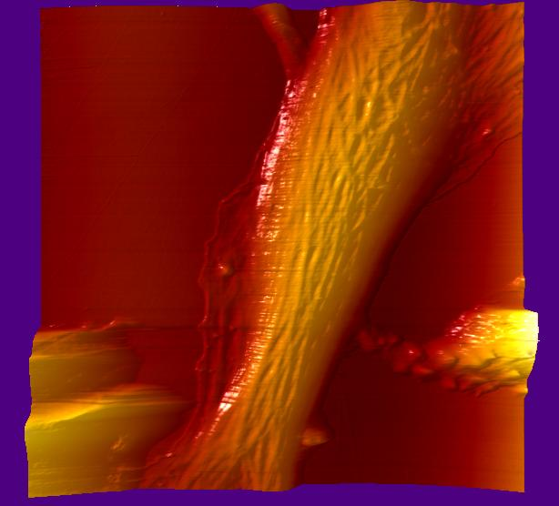
Living Endothelial Cell

Slide 10
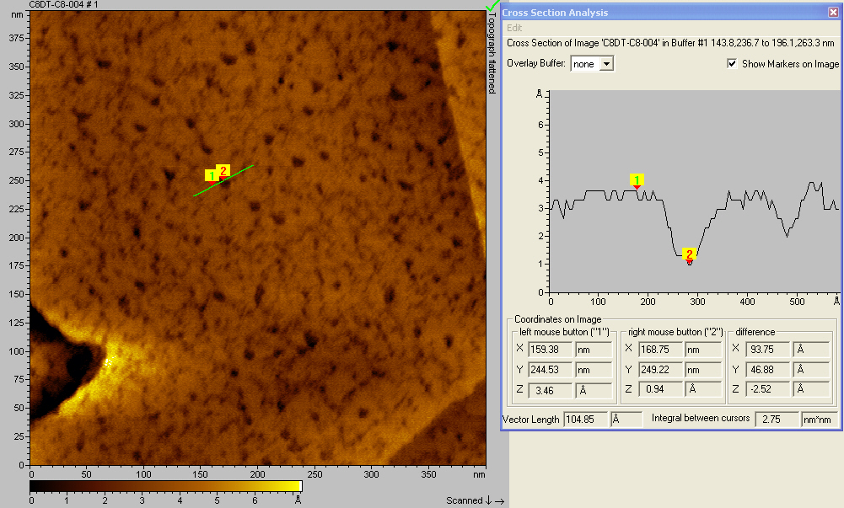
Which imaging mode –contact mode
Contact mode in solvent can achieve very high resolution
A 17.5 x 17.5 nm “white frame” is selected for further zoom. A clean and flat area with no Au(111) steps is essential to get a clear atomic scale lattice image

Slide 11
Which imaging mode –contact mode
High resolution image of a CH₃(CH₂)₁₇S/Au pattern in
CH₃(CH₂)₁₇S/Au matrix
40 nm scan

Slide 12
Nanoshaving of n-alkanethiol SAMs
AFM Image of C18S/Au(111) SAM in 2-butanol
A 160 X 160 nm² topograph of C₁₈S/Au(111) before and after nanoshaving.

Slide 13
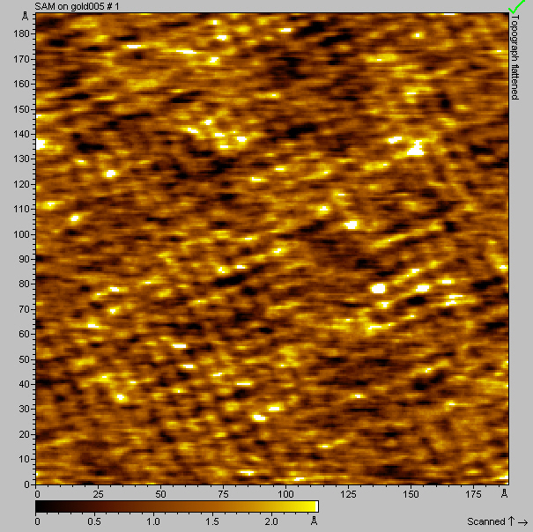
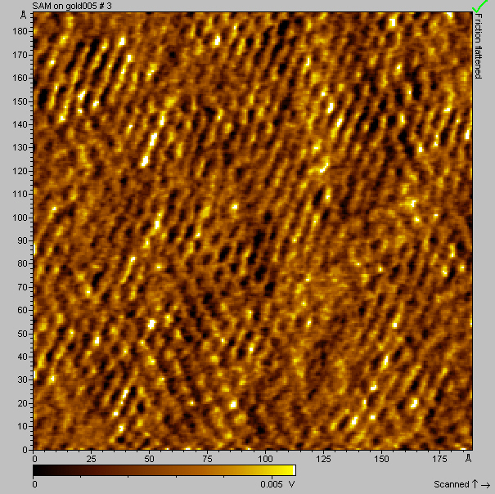
Which imaging mode –contact mode
Contact mode in solvent can achieve very high resolution
Topographic frictional force
17.5 x 17.5 nm scan atomic resolution lattice image

Slide 14
Constant force mode vs. constant height mode
constant force mode Constant height mode
higher scanning speed than AC mode Highest scanning speed
accurate in Z No accuracy in Z
How to:
lower scanning rate Higher scanning rate
high feed back I P gain Low feed back I P gain

Slide 15
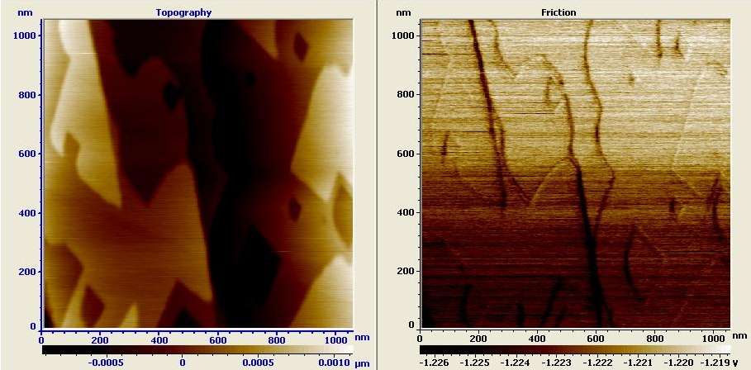
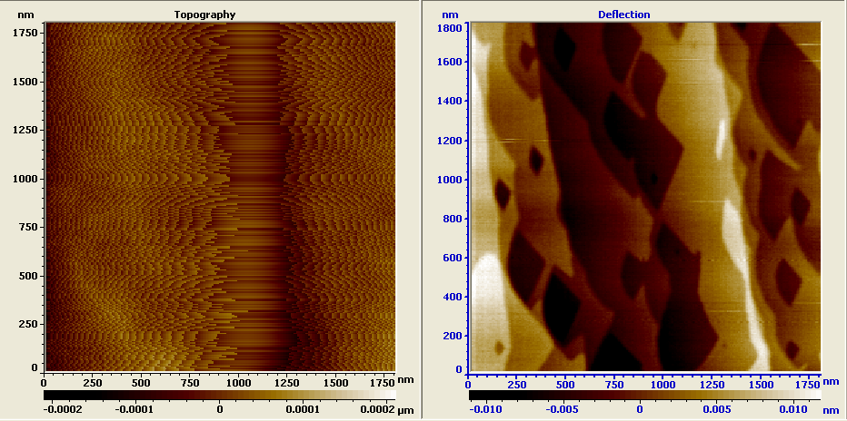
Constant height mode vs. constant force mode
Calcite in water
Constant force mode
Scanning rate: 5 Hz
I gain %: 30
P gain %: 40
Constant height mode
Scanning rate: 15 Hz
I gain %: 0.1%
P gain %: 1%

Slide 16
In-situ example I:
Contact constant force mode observation of thiol self assembly Au(111) in 2-butanol

Slide 17
time = 0
In-situ topographic images of Au(111) at various times after injection of a 0.2 mM solution of CH₃(CH₂)₁₇SH in 2-butanol.

Slide 18
time = 3.5 min
5 A
At t = 3.5 min. Spikes ~5 Å in height begin to appear.

Slide 19
time = 6 min
5 A
At t = 6 min. Continued adsorption of thiols results in a monolayer

Slide 20
time = 8 min
18 A
At t = 8 min. Elevated islands ranging from 20 to 100 Å in lateral diameter start to appear..

Slide 21
time = 80 min
Figure 1-e. At t = 80 min. The size and number of the standing-up islands increase to form a monolayer.

Slide 22
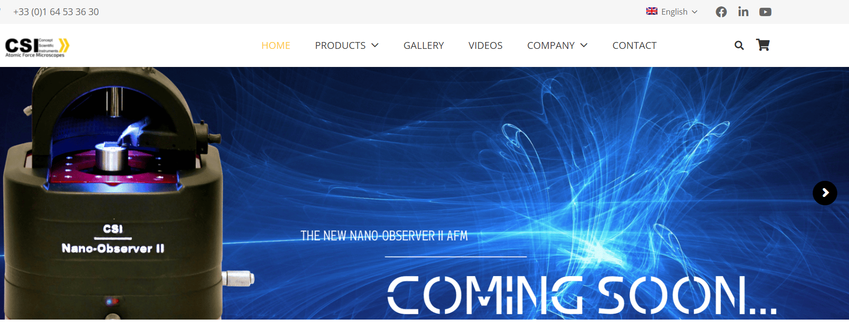

Slide 23
