Slide 1
DDEC Report Familiarization
Rev 8-16-17

Slide 2
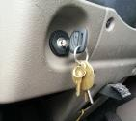
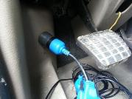
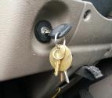
Launching DDEC Reports
Make sure that the ignition is in the <off> position
Connect datalink link connector
Turn Ignition to the <On> position
Launch DDEC Reports program by double clicking on DDEC Reports icon
Source:

Slide 3
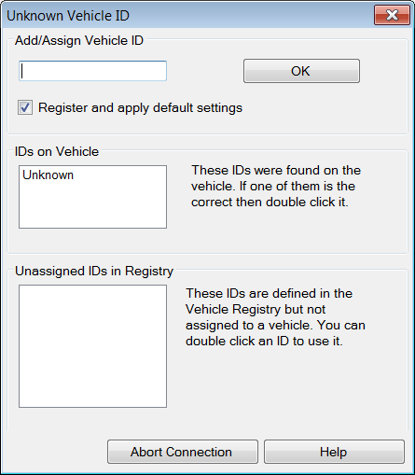
Possible Pop-Up
Enter unit # in Vehicle ID field and click OK

Slide 4
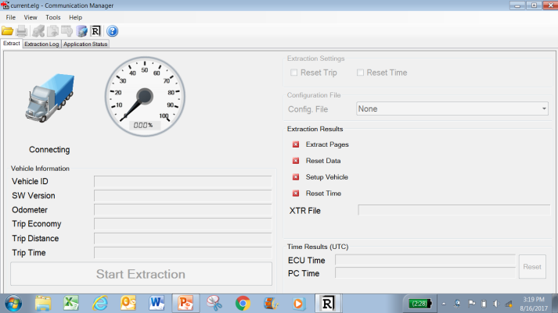
Connection is automatic
With the ignition key on, as soon as you launch the DDEC Reports program it will start trying to connect
The default settings have auto extraction disabled, so while connection is automatic, data extraction is manual
While DDEC Reports is trying to connect, “Connecting” will be displayed

Slide 5
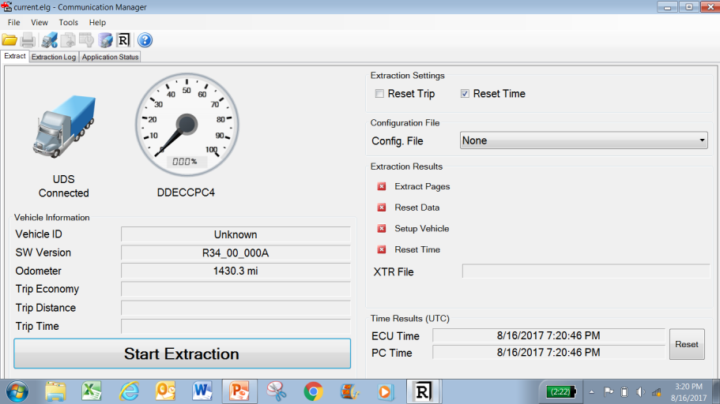
Connected Screen
After connection has been established:
Available vehicle information fields will populate
“Start Extraction” bar will turn from gray to black

Slide 6
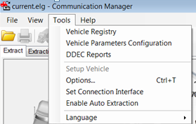
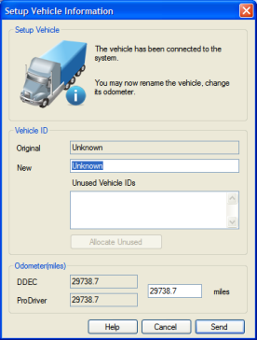
Vehicle ID
If Vehicle ID does not reflect unit # of tractor”, click on “Tools”, then “Setup Vehicle”
Enter unit # in “New” field, then click “Send”

Slide 7
Extraction Settings
Check on Reset Trip if you want to reset trip data on the vehicle.
Check on Reset Time if you want to synchronize the vehicle's time with your PC time.

Slide 8
Extraction
Click on “Start Extraction”

Slide 9
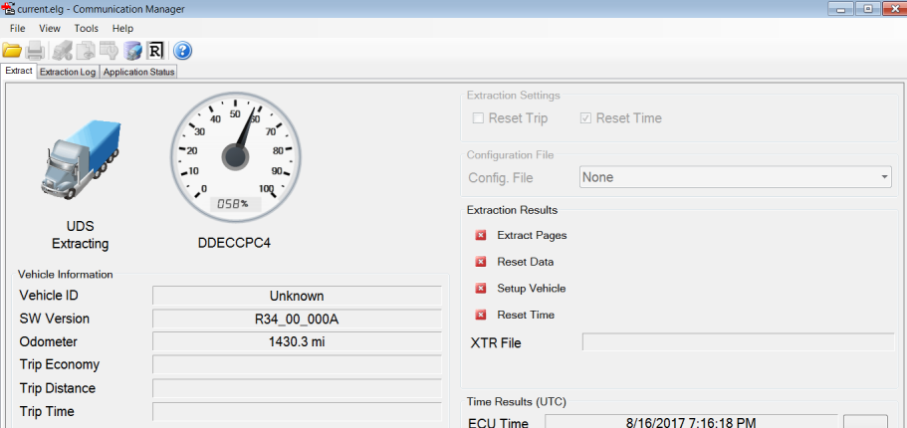
Extraction
Dash gage will show progress of extraction until 100% complete

Slide 10
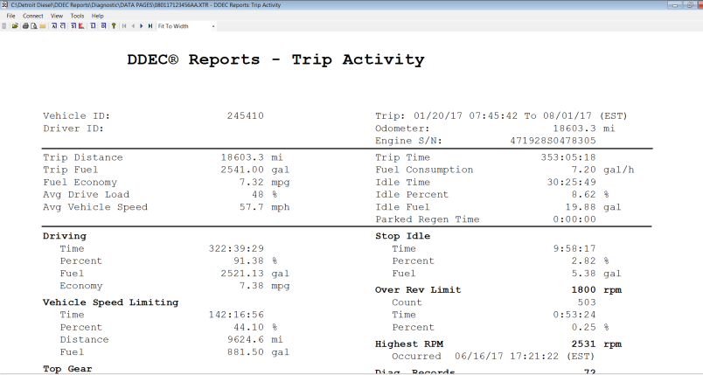
Extraction
New window will open entitled “DDEC Reports – Trip Activity”
File automatically saved in: C:\Detroit Diesel\DDEC Reports\Diagnostic\DATA PAGES
File name format is date (month,day,year) and computer name. Sample:

Slide 11
DDEC Reports – Engine Trip
The engine trip report is the report displayed in the window that opens after the extraction is complete
Information available in the Engine Trip report is as follows:
Driving
Vehicle Speed Limiting
Top Gear
Top Gear – 1
Cruise
Top Gear Cruise
Speeding A
Speeding B
Highest Speed
Coasting Time
Coasting %
Stop Idle
Over Rev Limit
Highest RPM
Diag Records
Hard Brake Count
Firm Brake Count
Brake Count
Fan On Time
Engine Utilization
Vehicle Utilization
DPF Regeneration
DEF

Slide 12
DDEC Reports – Transmission Trip
To view transmission trip report, click on “View”, then “Activity”, then “Transmission Trip”
Information available in the Engine Trip report is as follows:
Economy Mode
Performance Mode
Manual Mode
Launching
eCoast
Clutch Overload/Clutch Overtemp
Creep Mode

Slide 13
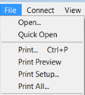
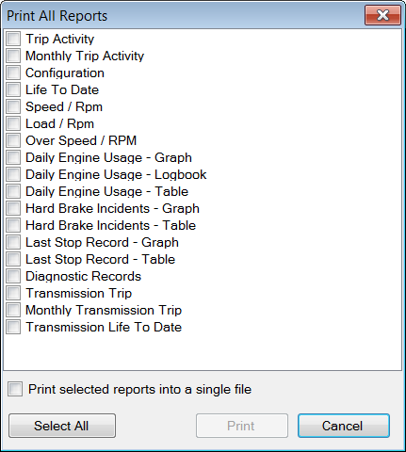
Printing / Sharing
“Print” will print current screen report displayed
“Print All” will generate pop-up where you can select which reports you want
The best way to share DDEC Report data is to have a “print to PDF” printer set-up and print desired reports to PDF printer
Be sure to select “Print selected reports into a single file”
NOTE: Selecting all reports will result in a 50 page report
If the recipient has DDEC Report software, you can send them the XTR file from C:\Detroit Diesel\DDEC Reports\Diagnostic\DATA PAGES
There is an Export function but it is not recommended

Slide 14
Accessing Saved Reports
Click on “File”
Click on “Quick Open”
Select desired file to open

