Slide 1
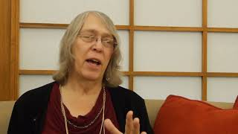
STATION 1: EMILY NEWBERRY

Slide 2
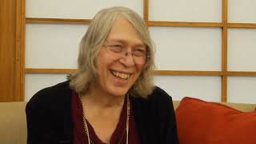
STATION 1: EMILY NEWBERRY

Slide 3
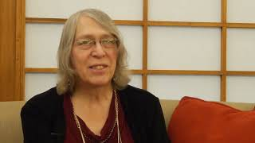
STATION 1: EMILY NEWBERRY

Slide 4
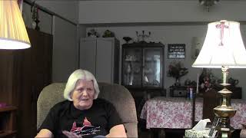
STATION 2: JOANNE CARROL

Slide 5
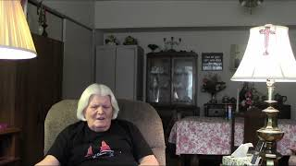
STATION 2: JOANNE CARROL

Slide 6
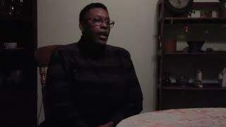
STATION 3: MARIA WARREN

Slide 7
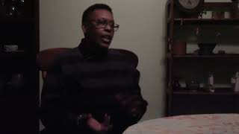
STATION 3: MARIA WARREN

Slide 8
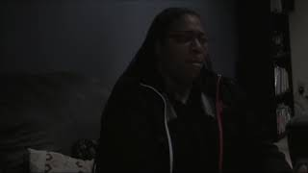
STATION 4: LINDSAY SNOWDEN

Slide 9
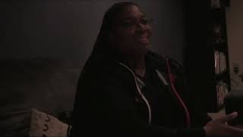
STATION 4: LINDSAY SNOWDEN

Slide 10
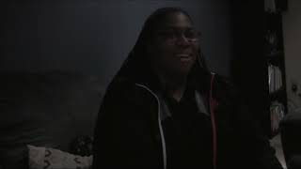
STATION 4: LINDSAY SNOWDEN

