Slide 1
Alpha Kappa Alpha Sorority, Incorporated®
Theta Rho Omega Chapter
Officers’ and Committee Chairmen’s Workshop 2025
Meetings

Slide 2
Agenda
What is a Committee?
Role of a Committee Chairman
Committee Meeting Basics
Principals & Rules to Conduct a Meeting
MINIMUM

Slide 3
What is a Committee?
A committee is a body of one or more people, elected or appointed by the Basileus and/or the chapter, to consider, investigate, or take action on certain matters or subjects, or to do all of these things.

Slide 4
Types of Committees
Standing Committees
  Finance*Program*Nominating*Standards*Membership*Archives*Technology*Protocol
  Risk Management*Sisterly Relations*Bylaws*Leadership Development*Connections & Social Action
Program and Regular Committees
Executive*Courtesy*Founders’ Day*Tellers*Logistics*Scholarship*AKApe’
Public Relations*Fund Raising*Audit*Strategic Planning*Pan-Hellenic Activities
Communications*Rituals*International Programs (Supreme Basileus Programs)
Ad Hoc Committees
As the need arises to carry out a specific task.
Subcommittee
Appointed by a committee. Reports back to the committee. Members of the committee.

Slide 5
Role of a Committee Chairman
Committee chairman are responsible for the productive functioning of their committee and acceptance of the position is considered a commitment to serve. An effective Chairman should be:
  Good in motivating others
  Prepared ahead of time
  Open and honest with the group
  Tactful and responsive
  Committed
Committee Chairman Tasks:
  Call the committee together Preside over committee meetings
  Get committee member contact info Know the task of the committee
  Know the budget Know any special instructions
  Develop the agenda for the meeting Appoint a secretary to take minutes
  Establish good rapport with your committee members
  Submit a written report on the committee activities
  Tracks committee member attendance at meetings and events

Slide 6
Meeting Basics
Face-to-Face Virtual Email Conference Calls
Executive Committee Meetings
Includes ALL Officers and Committee Chairman. Basileus approves other attendees.
Meets monthly and as needed for special situations.
Officers and Chairmen must provide a report to this committee prior to reporting out to the chapter. No exceptions without Basileus approval.
The executive Committee screens all reports that will be made to the chapter and makes recommendations where appropriate.
The Executive Committee screens all correspondence. This aids the Epistoleus in deciding how to dispose of incoming mail.
The executive Committee recommends solutions for chapter problems.
The Executive Committee assists in the preparation of the chapter meeting agenda.
Use first meeting to set goals and timetables. Collaborate with other committees.
The co-chairman takes minutes. Send minutes in a timely fashion.
Chairman is responsible for the written report. Submit 4 copies of report of committee activity (Basileus, Anti-Basileus, Grammateus, Committee copy). Report must have original “wet” signature of committee chairman.

Slide 7
Meeting Basics
Face-to-Face Virtual Email Conference Calls
Chapter Meetings
Conducts the business of Alpha Kappa Alpha Sorority, Incorporated® in a fair, orderly and expeditious manner.
Vehicle for building commitment in our sisterhood while determining strategies for achieving our sorority goals and objectives.
Officers and Chairmen must provide a report to this committee prior to reporting out to the chapter. No exceptions without Basileus approval.
Meetings are held each month except July and August.
Business attire is mandatory.
Always helpful to start with a meditation to set a positive mood.
The Basileus presides using parliamentary procedure . All remarks are addressed to her.
Executive Committee members support the Basileus during the chapter meeting.

Slide 8
Meeting Basics
Face-to-Face Virtual Email Conference Calls
Other Meetings
Meets as needed to fulfill purpose but at least quarterly.
Agenda is similar to chapter meeting agenda. Send ahead of meeting.
Start your meeting ON TIME.
Use first meeting to set goals and timetables. Collaborate with other committees.
The co-chairman takes minutes. Send minutes in a timely fashion.
Chairman is responsible for the written report. Submit 4 copies of report of committee activity (Basileus, Anti-Basileus, Grammateus, Committee copy). Report must have original “wet” signature of committee chairman.

Slide 9
Principles and Rules to Conduct Meetings
Items of business must be handled one at a time. Do not allow business to stray from the topic.
All members have equal rights, responsibilities, privileges and obligations.
The will of the majority prevails.
The rights of the minority must be protected.
Every member has the right to know what motion is before the body and what effect that motion would have if adopted.
Meetings must be conducted with fairness and in good faith.

Slide 10
Thank You!
Soror June Cole Boulware
jcole21935@sbcglobal.net

Slide 11


Alpha Kappa Alpha Sorority, Incorporated®
Theta Rho Omega Chapter
Officer and Committee Chairmen Financial Responsibilities
Theta Rho Omega Chapter Finance Team:
Tamiouchos
Pecunious Grammateus
Former Tamiouchos
3 elected chapter members
Anti-Basileus

Slide 12
Alpha Kappa Alpha Sorority, Incorporated®
Theta Rho Omega Chapter
Officer and Committee Chairmen Financial Responsibilities
Theta Rho Omega Chapter Finance Team Responsibilities:
Supervise TRO annual budget
Manage TRO Operations budget and Program budget
Draft the budgets for the upcoming year for TRO to approve

Slide 13
Alpha Kappa Alpha Sorority, Incorporated®
Theta Rho Omega Chapter
Officer and Committee Chairmen Financial Responsibilities
Pecunious Grammateus Responsibilities:
Collect all funds submitted to TRO
Maintain a cash receipts journal of all funds received by fund source
Maintain an alphabetical list of active TRO sorors
Keep a record of all payments made by sorors

Slide 14
Alpha Kappa Alpha Sorority, Incorporated®
Theta Rho Omega Chapter
Officer and Committee Chairmen Financial Responsibilities
Tamiouchos Responsibilities:
Follow Alpha Kappa Alpha Sorority, Incorporated financial procedures
Receive all funds from the Pecunious Grammateus
Keep a record of income and expenses
Deposits funds in TRO bank accounts
Issue checks upon receipt of properly executed vouchers
Sign checks along with the Basileus or Anti-Basileus
Reconcile monthly bank statements
Prepare AKA Corporate annual reports
Pay with the Basileus, TRO chapter tax, and soror per capita and EAF
Maintain a cash disbursement journal
Maintain TRO checkbooks
Chairman of the Finance Committee

Slide 15
Alpha Kappa Alpha Sorority, Incorporated®
Theta Rho Omega Chapter
Officer and Committee Chairmen Financial Responsibilities
Requesting Reimbursement
Begins with a completed TRO chapter voucher and original receipts
Voucher contains purpose of expenditure, committee name or officer requesting the reimbursement, amount of expenditure and receipts
Vouchers properly completed and signed by the officer or committee chairman are submitted to Tamiouchos for reimbursement of funds – no exceptions
Checks are signed by Basileus and Tamiouchos, may be signed by Anti-Basileus when Basileus is not present
Basileus reimbursement, checks are signed by the Anti-Basileus and Tamiouchos
Tamiouchos reimbursement, checks are signed by the Basileus and Anti-Basileus
Reimbursement is issued once the expense has occurred
The reimbursement of chapter expenses is done using chapter checks only.
Receipts and vouchers submitted after 60 days will be considered void.

Slide 16
Alpha Kappa Alpha Sorority, Incorporated®
Theta Rho Omega Chapter
Officer and Committee Chairmen Financial Responsibilities
Committee Chairmen:
Standing committee chairmen and International Programs committee chairmen are required to maintain their committee budget and review and approve authorized vouchers for payment
Standing committee chairmen and International Programs chairmen provide input on their committee budget line item

Slide 17
Alpha Kappa Alpha Sorority, Incorporated®
Theta Rho Omega Chapter
Officer and Committee Chairmen Financial Responsibilities
PROGRAM BUDGET
Anti Basileus (International Program Chairman) and Program Committee Chairmen determine their budget based on current year activity spending and anticipated activity spending for upcoming year
Anti-Basileus (International Program Chairman) and Program Committee Chairmen submit their recommendations for their committee budget to the Finance Committee
Funds for the Program budget are generated by the chapter’s fundraising projects
These funds are to be used exclusively for community service activities and scholarships
These funds are to be maintained in a checking account used exclusively for community service activities and scholarships

Slide 18
Alpha Kappa Alpha Sorority, Incorporated®
Theta Rho Omega Chapter
Officer and Committee Chairmen Financial Responsibilities
BUDGET CONTROL
Expenses may be reimbursed for budgeted items, only if the funds have been collected by chapter dues or fundraising
Approval of Operations Budget or Program Budget does not guarantee funds will be available
Funds are only available if the funds have been collected
If there are unplanned/un-budgeted anticipated expenses, these should be presented to the executive committee before expense
Executive committee should make a recommendation on unplanned expenses and then present to the chapter for their approval or non-approval of unplanned expenses

Slide 19
Alpha Kappa Alpha Sorority, Incorporated®
Theta Rho Omega Chapter
Officer and Committee Chairmen Financial Responsibilities
PROGRAM BUDGET - FINANCIAL RESPONSIBILITIES OF PROGRAM COMMITTEES
Program committee chairmen must approve (by signature on vouchers) all requests for expenditures from their respective committees
Budget revisions (including the transfer of funds from one program committee to another program committee) must be presented to the Executive committee first for recommendation
and then present to the chapter for their approval or non-approval
The Tamiouchos cannot disburse funds until approval has been granted by chapter members majority vote

Slide 20
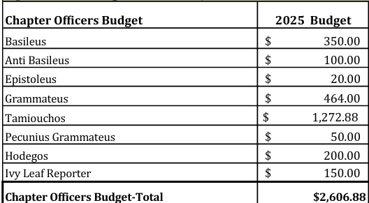
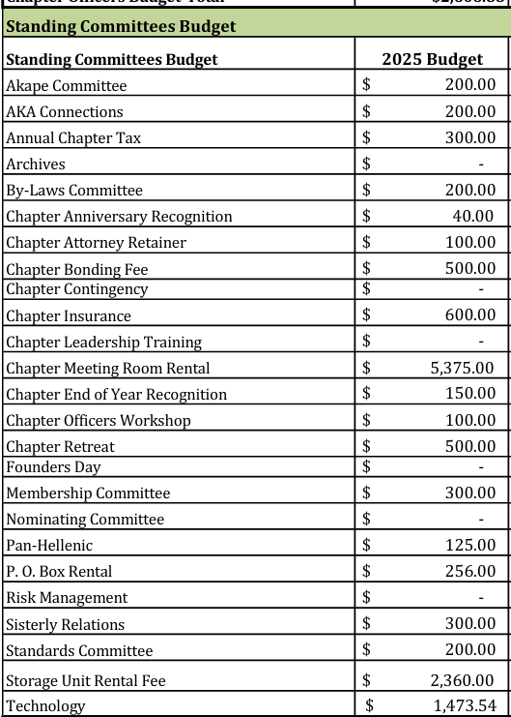
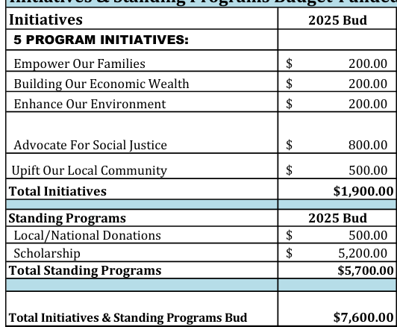
Alpha Kappa Alpha Sorority, Incorporated®
Theta Rho Omega Chapter
Officer and Committee Chairmen Financial Responsibilities

Slide 21
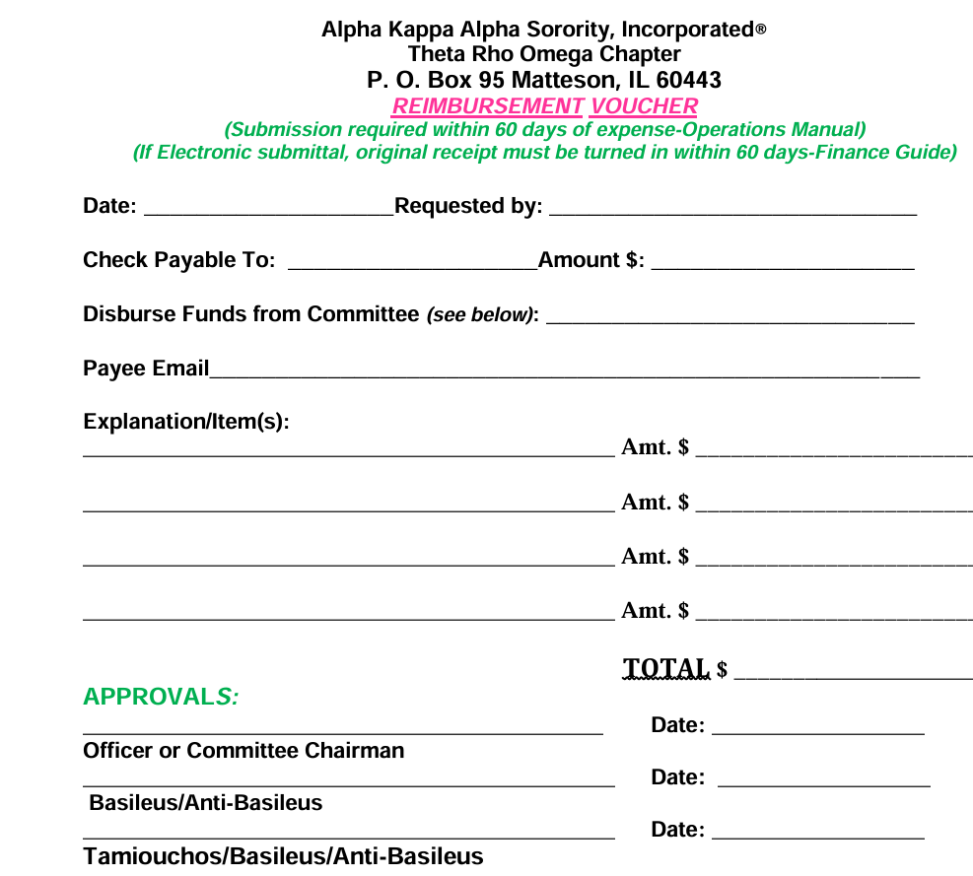
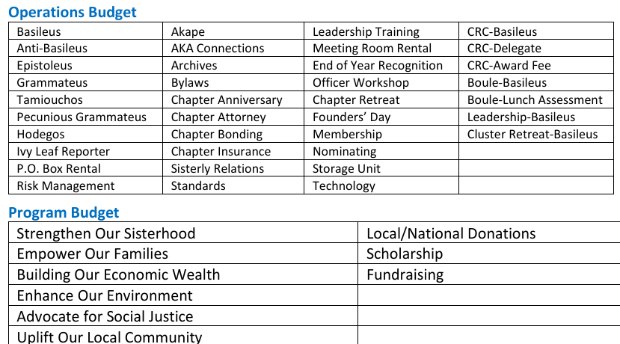
Alpha Kappa Alpha Sorority, Incorporated®
Theta Rho Omega Chapter
Officer and Committee Chairmen Financial Responsibilities

Slide 22
Alpha Kappa Alpha Sorority, Incorporated®
Theta Rho Omega Chapter
Officer and Committee Chairmen Financial Responsibilities
Presentation Sources:
TRO Bylaws
TRO Operations Manual
Alpha Kappa Alpha Sorority, Incorporated financial procedures

Slide 23


TECHNOLOGY
Soror Brittany and Soror Imani

Slide 24
HOW TO REQUEST A FLYER
TRO Flyer Request Form

Slide 25
TAKEAWAYS
  Allow at least one month advanced notice for flyer requests*
    1-2 weeks for flyer design, edits, and approval process
    2-3 weeks for event to be publicized on social media
  Don’t forget to include your desired caption (including any links, tags, etc.)
Flyer requests made outside of the allotted time window will not be accepted.
Notes:
*Please note, you may not use the Sorority shield (excludes Fundraising). Use the SOAR administration logo and program logo (for Program Committees). Chapter and anniversary logos are not permitted.

Slide 26
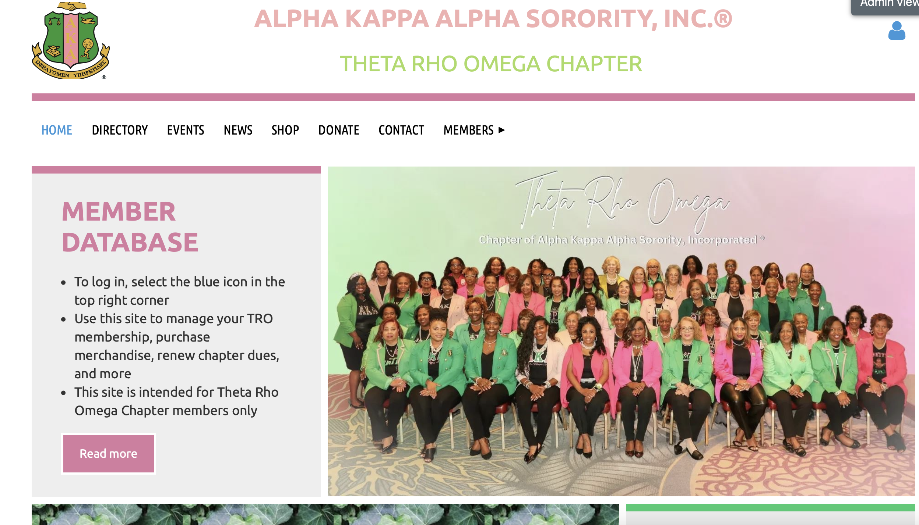
REGISTRATION FOR YOUR EVENTS
TRO Wild Apricot

Slide 27

  To streamline the registration process for TRO Member Events, we will use Wild Apricot (WA). Please submit an Event Registration Request via email:
    You may email anyone on Technology directly
    Include event date, time, location, details, flyer, etc.
    Event will automatically populate on the Chapter Calendar
    Technology will send the event link for you to utilize; we recommend using bit.ly for short links and QR Code Monkey to create a QR Code for flyers
  For non-TRO member events, you may use other registration methods, as well as WA.
    If using WA, please follow the same steps above
    Please email requests at least 2-4 weeks prior to the event.
Notes:
Timing: if creating your own flyer, two weeks is fine

Slide 28
HELPFUL EVENT REMIDERS
FROM TECHNOLOGY
  Committee Chairmen:
  Email event registrants 1-2 days prior to event as a reminder and to share additional details (i.e. Zoom meeting link)
  Email event registrants a ‘Thank You’ email post event and include the evaluation link
Notes:
We can do this via Wild Apricot if you provide the info

Slide 29
EVALUATIONS
  Template to be shared via GoogleDrive
    Make a copy and customize for your events
    Share/Add troaka@gmail.com as a Collaborator on the form

Slide 30
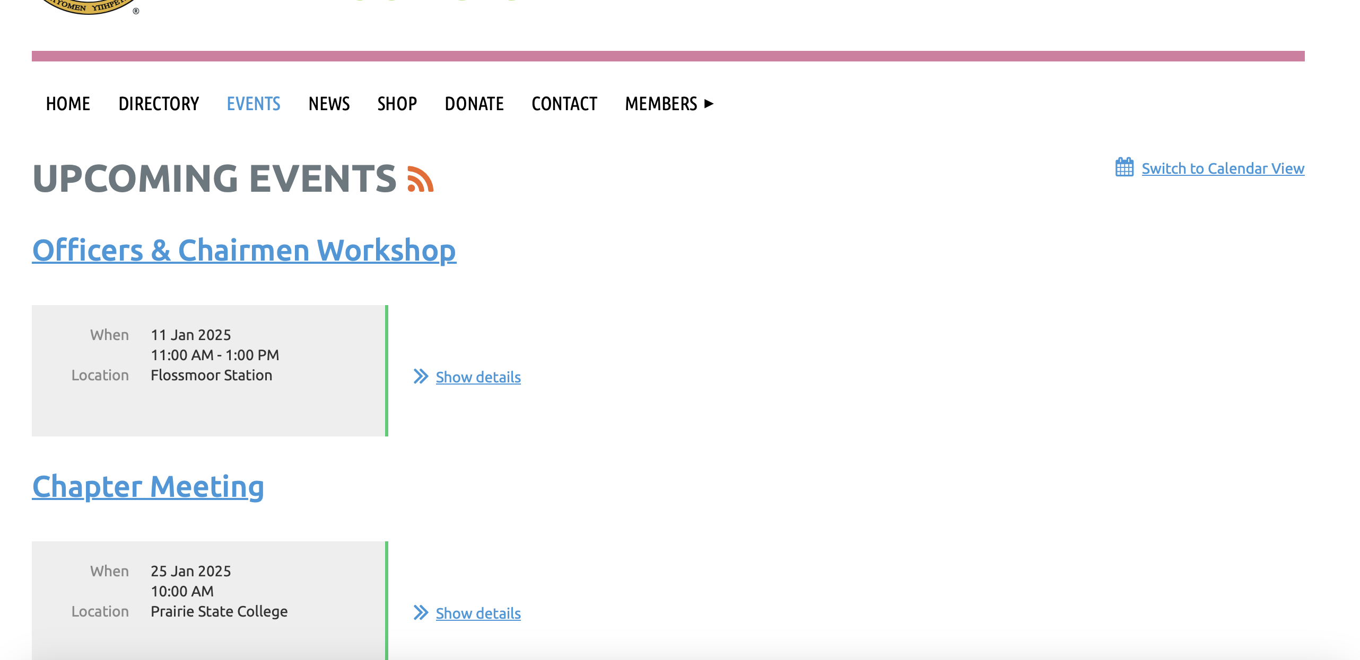
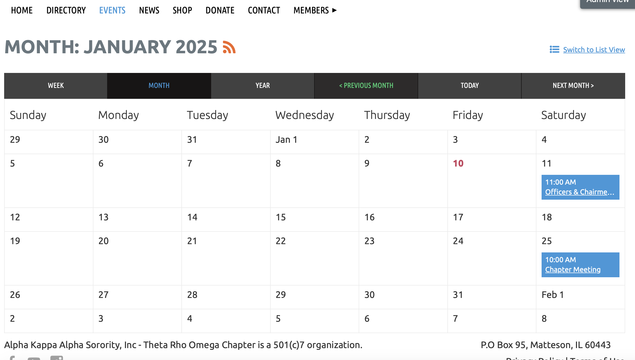
CHAPTER CALENDAR
  The Chapter calendar may be accessed via Wild Apricot. We need YOUR help to keep it updated. Please provide your events & dates as soon as possible.
  Check back periodically for updates. Please share with your committee members.
Notes:
Let’s all get out our phones and visit Wild Apricot together; in your next meeting, please share your meetings as an announcement. Madam Basileus, happy to include Committee meeting dates as well.

Slide 31
REQUESTING A ZOOM MEETING
WEBINAR
MEETING
Expecting more than 50 attendees, we recommend using a Webinar
It is critical to plan a ‘tech check’ and run-through the day prior
You may request a Webinar by emailing a request to the Technology Committee
Soror only or small group settings, we recommend using a Meeting
You may request a meeting invitation by emailing a request to the Technology Committee
Technology can provide meeting links for your committee meetings, if needed.
  To ensure participation, use Zoom unless otherwise decided by the committee

Slide 32
QUIZ TIME

Slide 33
How much advanced notice is needed for flyer requests?
QUESTION 1

Slide 34
4 Weeks
(Bonus): 1-2 weeks (design, edit, approval)
2-3 weeks (publicized)
ANSWER

Slide 35
Where can you find the Flyer Request Form?
QUESTION 2

Slide 36
Chapter Website (troaka.org)
*Members Only Section
ANSWER

Slide 37
When using the Evaluation Template in GoogleDrive, what is the first thing you must make sure you do?
QUESTION 3

Slide 38
Make a copy!
(Bonus: share the new form with TRO gmail)
ANSWER

Slide 39
How do you access the chapter calendar?
QUESTION 4

Slide 40
Visiting Wild Apricot and clicking the Events tab
ANSWER

Slide 41
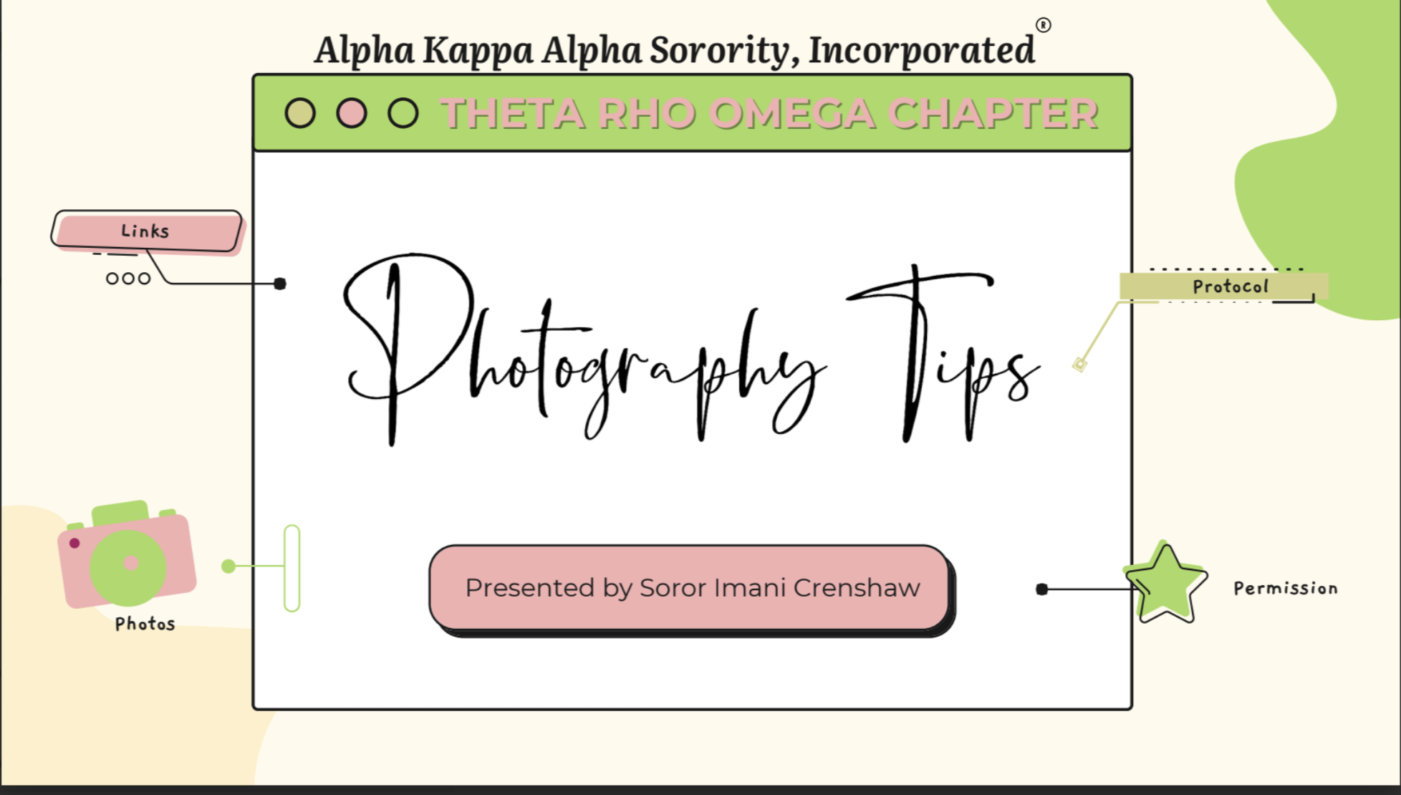

ADDITIONAL RESOURCES
Available on Members Only
troaka.org

Slide 42
QUESTIONS?

Slide 43
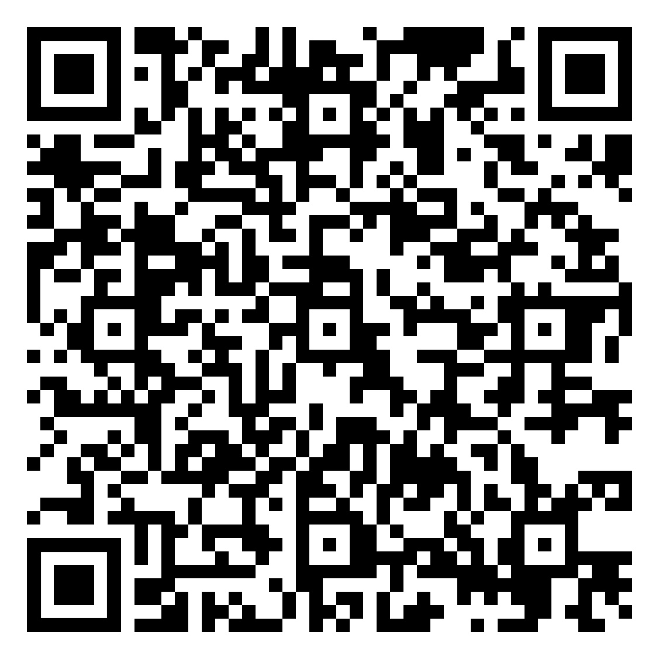
EVENT EVALUATION

