Slide 1
Understanding, Destigmatizing and Addressing Hoarding
Kay T Jewels, B.A., Director of Next Step to Reorganization, Inc.
Clinical Research Assistant, Mclean Hospital
Donald A. Davidoff Ph.d, Chief, Department of Neuropsychology, Mclean Hospital,
Assistant Professor Harvard Medical School
Notes:
Hello, thank you for coming as well as for having us. I am Kay Jewels, this is Dr. Davidoff and we work together at McLean Hospital studying and guiding treatment efforts on hoarding behavior from the neuropsychological perspective. To ensure you get the most from this “get together”, before we start, I'd like to take a second to have you all introduce yourself and

Slide 2
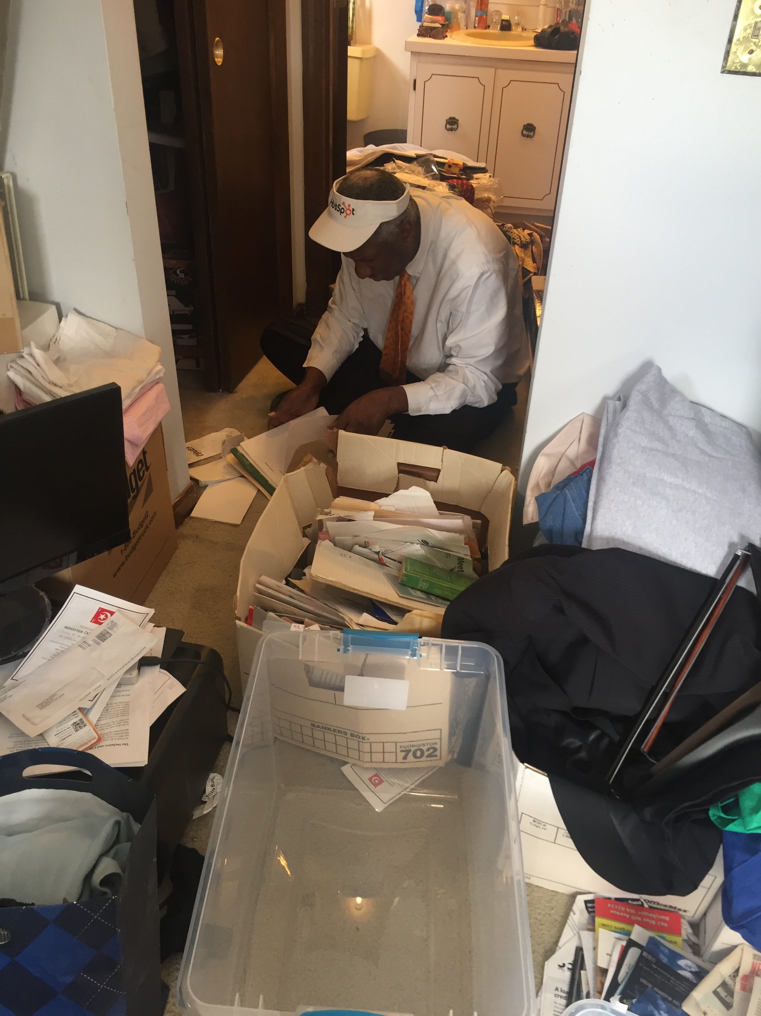
Learning Objectives
What is hoarding?
Why is it a problem?
How can we focus on solutions?
Notes:
Before I heard your questions, it was my understanding that you wanted to know more about what hoarding is, why it's a problem, and how we can focus on solutions - which happens to be my favorite topic! I hope we can answer all those questions with the slides we prepared for today. If not, don't be afraid to ask us again during Q and A.

Slide 3
Hoarding Disorder begins in early childhood
Hoarding behaviors in healthy children under ten is very typical
Usually between 10 yrs. of age and 17 normal “early age” hoarding behaviors phase out
Hoarding behavior in children is obscured by parents controlling their living environment and purchasing power
Hoarding becomes recognizably impairing as the child reaches adulthood when they have more control over these domains but lack the executive functions to make appropriate decision regarding saving and discarding
Hoarding Disorder symptoms onset in childhood
Notes:
Let's start with some basic facts about hoarding.
The prevalence of hoarding behavior varies considerably at different points across the lifespan. For example, moderate to severe hoarding behavior is displayed in up to 60% of prepubescent children, ages 2 to 6 years of age. However, in neurotypical development, by years 6 to 8 this unusually high rate of incidence declines. This declines places prevalence of clinically significant hoarding behavior in children and adolescents, ages 6-17 at about 3.7 % of children. While most persons with hoarding disorder report an early onset, they also go undiagnosed until older adulthood. One reason children who continue hoarding go undetected is that parents have some control over their children's environments and purchasing power until they are living on their own.

Slide 4
DSM-5 300.3 Hoarding Disorder
Persistent difficulty discarding or parting with possessions, regardless of actual value
Difficulty due to perceived need to save items and to distress associated with discarding them
Results in accumulation of possessions that congest and clutter active living areas and compromises their intended use
Causes clinically significant distress or impairment in social, occupational, or other important areas of functioning
Not attributable to another medical condition
Not better explained by the symptoms of another mental disorder
Specify if:
With excessive acquisition
With good, fair or poor insight
With absent insight/delusional beliefs
Notes:
As many as 6.2% older adults will meet the criterion for hoarding disorder by in the 5th or 6th decades of life. Most individuals presenting for treatment are discovered through third party reports when their impaired ability to make organizational and discarding decisions have already had a profound impact on their living areas, their functioning, and socioemotional development. Late-life diagnosis of HD is in part because HD is technically only diagnoseable with DSM-5 criteria when difficulties discarding results in accumulation of possessions that congest and clutter active living areas and compromises their intended use-to the point of causing clinically significant distress or impairment in social, occupational, or other important areas of functioning to self or others. Saving this much clutter requires control over your own money and living space, which typically only acquired in adulthood. Specifiers (e.g., excessive acquisition and lack of insight) are listed because they can complicate treatments but are not present in all individuals with hoarding disorders.
If would like to screen yourself for hoarding behavior, we included the 5-question hoarding self-report that correlates with DSM-5 symptoms in the packet. It's quick and easy to do.

Slide 5
Neurodegenerative Conditions
Neurodevelopmental Disorders
Obsessive Compulsive Disorder
Schizophrenia/Psychosis
Hoarding Behavior
Mood Disorders
Clinically significant levels of clutter that result from hoarding is not always caused by a Hoarding Disorder.
Evaluation is needed to rule out other disorders that cause hoarding.
Notes:
Not all hoarding behavior is a hoarding disorder. Some hoarding behavior may be attributable to another medical or mental health condition. Hoarding behavior occurs at a significantly higher rate in those without other neuropsychiatric complications. For example, studies indicate the prevalence of clinically severe hoarding behavior in children with atypical neurodevelopment, such as those with obsessive-compulsive disorder (OCD), Prader-Willi syndrome, autism, intellectual or developmental disabilities, and learning disabilities, can be as high as 50%. A 2016 study investigating hoarding behavior in those other adult mental health disorders indicated the prevalence of hoarding in those with eating disorders as 22.5%, major depression as 7.7%, anxiety disorders as 7.4 %, and psychotic disorders (5.9 %). Multiple studies investigating hoarding behavior in dementia note, hoarding behavior can occurs in up to 22% of dementia patients. Which is why, evaluation is needed to rule out other causes before assuming hoarding behavior is attributable to hoarding disorder.

Slide 6
Why is hoarding problematic?
Notes:
Hoarding is problematic because it puts people at an increased risk for falls, fire hazards, poor hygiene, poor nutrition / food contamination, social isolation, medication mismanagement, dust / mold / rodent infestation, substantial problems using home environment-often includes access to plumbing and makes one more vulnerable to eviction and homelessness.

Slide 7
Externally, hoarding is a behavior comprised of saving unnecessary objects in quantities that are disruptive to living areas and cause impairment in one or more essential areas of functioning.
Hoarding Symptoms
Observable Symptoms
Cognitive Symptoms
Internally, hoarding behavior is the direct result of saving cognitions that precipitate decisional distress, urges to save items, and emotional pain when trying to discard things.
Notes:
Hoarding disorder symptoms have two significant manifestations; some symptoms are observable, whereas others are internal cognitive symptoms. Many might notice the outside symptoms over time (e.g., clutter or social isolation). However, the internal symptoms, such as saving cognitions, that precipitate the development of decisional distress, urges to save items, and emotional pain when trying to discard things go unnoticed by observer.
Feel free to reference the Saving cognition inventory in the packet we handed out if you want to learn more about saving cognitions- the self-report is easy and came with scoring instructions.

Slide 8
What is Clutter?
Clutter is not defined by the object, the objects value or its potential utility; it is defined by it’s order, its placement or its location impairing the intended function of the other object you need to use.
Notes:
Clutter, the most apparent noticeable symptom of hoarding, is the tangible result of two opposing societal imperatives: acquire more and do not waste anything. At the intersection, lies a massive accumulation of objects no longer needed but seemingly too valued to be trash. Clutter is not definable by the object's intended purpose, the object's value, or its potential utility; it is definable by its order, its placement, or its location, impairing the intended function of the other object you need to use. By this definition, a million dollars on the toilet is also considered clutter. To help clarify what is normal clutter we have added a page in the packet about clutter on the spectrum of collective behaviors from collecting, hoarding, to squalor and normative levels of clutter.

Slide 9
What is Clinically Impairing Clutter?
Clinically Impairing Clutter
Urges to Save and Acquire
Difficulty Discarding Personal Possessions
Cognitive and Behavioral Avoidance Pattern that Result in Clinically Impairing Clutter
Clinically Impairing Clutter
When objects that are not necessary for everyday functioning impair the practical use of rooms and areas of living, so much so, that they no longer can be used for the intended purpose
The impaired functionality of the house and living areas can have dramatic impacts on the individual’s ability to function including impaired relationships and social withdrawal
Due to sanitary, structural, and safety issues the state of living areas may impact those living outside the home: e.g., family, neighbors, landlords, community members
Notes:
If you care to reference the Clutter Image Rating (CIR) scale in the packet we gave out, you can get an idea of when clutter becomes clinically impairing. Typically, we encourage people with approaching level of four or above to get help right away because when clutter reaches levels that invade the living areas of the home (e.g., bathroom, kitchen and bedroom), in this context and volume, clutter can compromise one's own ability to complete everyday activities of daily living (e.g., cooking, showering, cleaning), resulting in an increased risk of health and safety violations (obstructed egresses, mold, bug infestations, poor hygiene, and health).

Slide 10
Focusing on Solutions
Understanding the Problem
Acknowledging the Impact
Breaking the Silence
Notes:
Creating solutions requires an understanding of the problem, how it impacts the individual, and breaking barriers to treatment. The "problem" we are trying to understand is not just the potential consequences of hoarding behavior (e.g., clutter, the impact on individuals, society, or world). Instead, how each person came to have Clinically Impairing Clutter and how we can help them overcome problems that manifest in Clinically Impairing Cutter in their lives. The impact we are trying to understand is the impact on their person's everyday functioning and safety- as to help them improve their well-being. Breaking the silence is about reducing stigma- creating awareness.

Slide 11
Why is Hoarding Behavior and Clutter Problematic?
Increased fall risk
Fire hazard
Poor hygiene
Poor nutrition / food contamination
Social isolation
Medication mismanagement
Dust / mold / rodent infestation
Substantial problems using home environment
Often includes access to plumbing
More vulnerable to eviction and homelessness
Perceived Need to Save
Discarding Distress
Difficulty Discarding
Clinically
Impairing
Clutter
Functional Impairment of Living Areas
Notes:
Without intervention, difficulty discarding possessions, perception of need, urges to save, and acquiring new items leads to significant disorganization and clutter that disrupts the ability to use living spaces, causing danger, distress, and functional problems.

Slide 12
Clinically Impairing Clutter: Impact on Individual
Excessive Accumulation of Objects
Increased Risk to Health and Safety
Compromises the Function and Safety of Home
Inhibits the Functionality of Living Area’s
Clutter
Reduces Function
Health or Legal Consequences
Impairs Safety of Self and Others
Eviction
Obstructs Access
Reduces ADL’s
Conflict and Social Isolation
Injury or Death
Notes:
Clutter is specifically listed as a symptom because of its association with functional impairment when it reaches levels that invade the living areas of the home (e.g., bathroom and kitchen). In this context and volume, clutter can compromise one's ability to complete everyday activities of daily living (cooking, showering, cleaning), resulting in an increased risk of health and safety violations (obstructed egresses, mold, and bug infestations). Clinically impairing levels of clutter put those with hoarding behavior at risk for homelessness, legal, or health consequences.

Slide 13
Clinically Impairing Clutter: Economic Impact
$384,511.37
$55,591.21
Town legal fees for one single family dwelling (2012-2016)
Condo clean-out services for nuisance conditions (2015)
Fire started by paper in one hoarded apartment spread to cause damage in 16 other units (2013-2014)
$40,423.00
$4500.00
One apartment eviction, plus moving costs (2014)
(Statewide Steering Committee on Hoarding, 2017)
Notes:
These economic costs are each for unique instances in which reporting was done. They are separate from the increased use of social services resources– that has been impossible to total as of yet.

Slide 14
Focus of Traditional Treatment Models
Behaviors
Feelings
Beliefs
Notes:
Traditional Treatment Models have historically focused on altering beliefs, behaviors, and feelings with CBT. Traditional Treatment Models have historically focused on altering beliefs, behaviors, and feelings with CBT. These CBT treatments are helpful as assisting one to learn to recognize maladaptive patterns thinking, distorted feeling, and patterns of avoidance that lead to hoarding behavior.

Slide 15
Unconscious Motivations
Fear
Anxiety
Anger
Sadness
Trauma
Loneliness
What are unconscious motivations and cognitions we seek to avoid with our avoidant behavior?
Notes:
Our thoughts and feelings can serve as motivations to avoid discarding. I’ve included a page in the packet that is called “Why We Do What We Do? If you want to write yours down as we go.
Many of you may be familiar with unconscious motivators for saving behavior, and I bet you can think of some I have not listed on the slide. But, any negative feeling of uncertainty can become an unconscious motivation for avoidant behavior that results in clutter. Some examples might be to manage our fears about tomorrow; to relieve our anxiousness today; to feel control after trauma or loss; to suppress our sadness; to comfort us during moments of loneliness.

Slide 16
What are Common Conscious Rationales Used To Explain Saving and Acquiring Behavior?
Waste Related Beliefs
Objects as Memory Aids
Potential Utility of Objects
Aesthetic Value of Objects
Conscious Reasoning used to explain our behavior
Notes:
Beliefs- that lead to saving.
The four most common conscious rationales person with clinically impairing clutter give to explain their saving behavior, include Waste Related Beliefs, Objects as Memory Aids, Potential Utility of Objects, and the Aesthetic Value of Object. A study which examined these beliefs in those with hoarding behavior and those without, found it was not these ideas that separated the two groups. Those without a hoarding disorder will often give similar reasons for not discarding a similar item, yet those with HD still saved more items. What that really separated the two groups was the number of items that were valued as worthy of saving using these beliefs. And the intensity in which the object-related beliefs were felt to be true and acted upon without regard to other circumstances that should otherwise influence decision making (for example, I already have three; I need more space for walking) that really separated the two groups).

Slide 17
Decisional Duress
Emotional Distress
Cognitive Arrest
What is Avoidant Behavior?
An avoidance ritual is any behavior that allows you to avoid making decisions about organizing and discarding objects
Notes:
Avoidance behavior leads to the accumulation of objects over time. You may be asking, "What defines Avoidant Behavior?" In the most simplistic terms, any behavior that allows you to avoid making decisions about organizing and discarding objects could be considered an avoidance behavior. Avoidance mechanisms can be cognitive or behavioral (e.g., avoiding thinking or making choices regarding object organization or discarding) or conscious or unconscious. Consider the work acholic, who works too much to avoid interpersonal distress at home.

Slide 18
Clutter Gap in Clinical Approaches for Hoarding
Perceived Need to Save
Discarding Distress
Clutter
Cognitive
Behavioral Therapy
Discarding Avoidance
Exposure and Response Prevention Therapy
Exposure and Response Prevention Therapy
Notes:
A study, by Randy Frost, note that changes in saving cognitions through CBT can mediate lasting changes and reductions in hoarding behavior (Frost et al., 2009). However, other studies indicate that in the older adult population that changing long-standing beliefs and behaviors with CBT and ERP therapy is much more difficult to do. Moreover, the over-focus on these aspects of hoarding in clinical practice can create a gap in service and funding for delivering affordable access to hoarding informed clutter interventions. Adding adjacent therapies that target cognitive difficulties can improve treatment and is highly recommended.

Slide 19
The Next Step Model for Hoarding Behavior
Neurocognitive Construct
Difficulties with Attention, Memory, Executive Function, Emotional Regulation and Categorization.
Unconscious Motivations
The feelings we try to avoid with our behavior.
Conscious Reasoning
The thoughts we use to explain our behavior.
Notes:
The model I use in Next Step Interventions focuses on the cognitive substrates that lead to clinically impairing clutter. This model includes difficulties with Attention, Memory, Executive Function, Emotional Regulation, and Categorization that lead to most commonly clutter in hoarding behavior.

Slide 20
Memory Difficulties
Functional Difficulties
Executive Attention
Sustained Attention
Visuospatial Attention
Conceptualization
Inhibition
Decision Making
Self-Regulation
Working Memory
Visual Memory Deficits
Verbal Memory Deficits
Task Initiation
Task Completion
Goal Directed Motor Responses
Executive Difficulties
Attention Difficulties
What is the Neurocognitive Construct ?
Notes:
The Neurocognitive Construct is a fancy way of referring to the Attention, memory, executive control, and functional difficulties that are shared by those with organizational difficulties and clinically impairing clutter. Though, as you can see with this illustration, hoarded clutter is a multifactorial problem involving a unique confluence of behavioral and emotional symptoms arising from cognitive deficits- this is, in part, why hoarding is seen in so many other disorders a comorbid feature. As depicted, higher-level unconscious cognitive processes such as memory and attention trickle down into problems with conceptualization, self-regulation, decision-making, and inhibition. This results in functional impairments with goal-directed behavior, task initiation, and task completion. Essentially, this means, even when the person can imagine all the steps to declutter a room, underlying problems with decision making, organization, prioritization, maintaining motivation, sustaining the effort, and staying on task will still remain as barriers that inhibit successful completion of all the steps necessary to declutter an entire room.
To give you a few examples of how cognitive difficulties impair the decluttering process let’s review some examples from other peers who have participated in next step interventions.

Slide 21
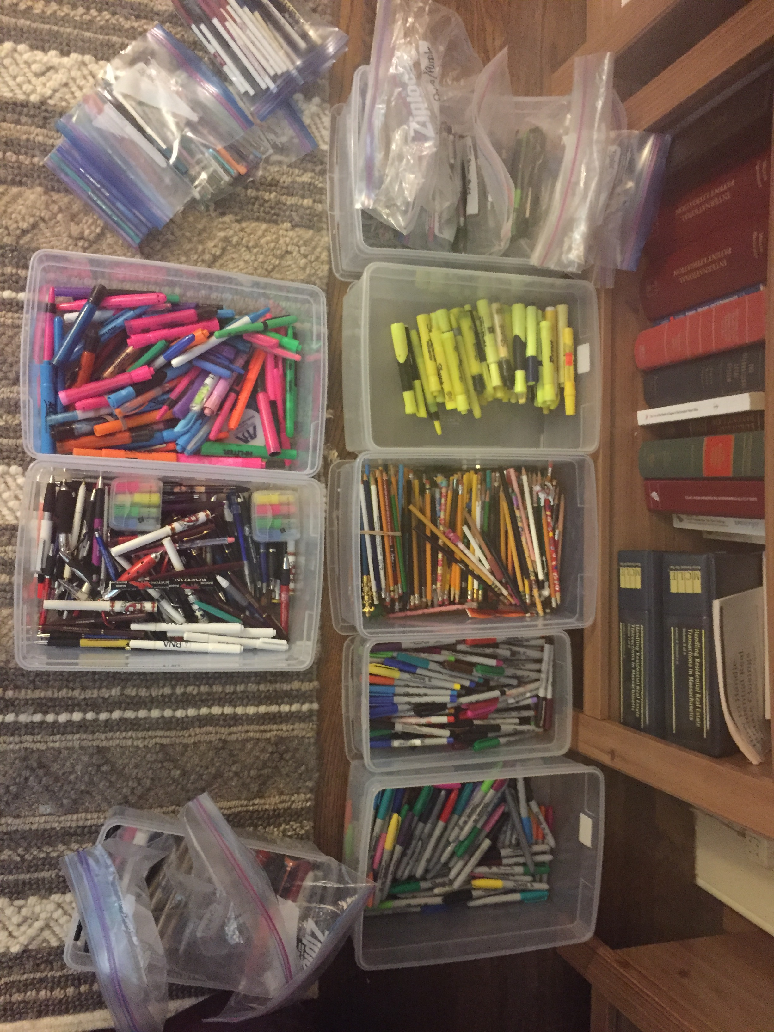
Cognitive Difficulties Can Impair Object Sorting
People think and act differently when sorting objects and storing information
Understanding how each persons sorts their stuff is integral to helping them organize their stuff in a way that is meaningful and helpful to them.
Notes:
Problems with regulating the flow of information in working memory may also influence hoarding behavior and heighten fear of discarding objects associated, especially those with valued memories or objects with perceived potential utility. It's possible that an increased number of object dimensions in working memory during decision making may account for under-inclusive categorization and proliferation of unique groupings

Slide 22
Cognitive Difficulties Can Impair Object Processing Resulting in Value Misappraisals
Inflates Perception of Need and Distress Associated with Discarding
Value Misappraisal
Interferes with the categorization conceptualization process
Notes:
Some research has implicated that cognitive disturbances that occur during object processing result from these subsequent misappraisals in object value. The object misappraisal contributes to the individual's perception of distress when considering the prospect of discarding or parting with possessions because it inflates the individual's perception of need. Other research indicates how HD appraises the 'value' of an object may play a significant role in categorizing objects. As such, objects associated with memories or those with perceived potential utility may be given an inflated value, which then interferes with the categorization conceptualization process.

Slide 23
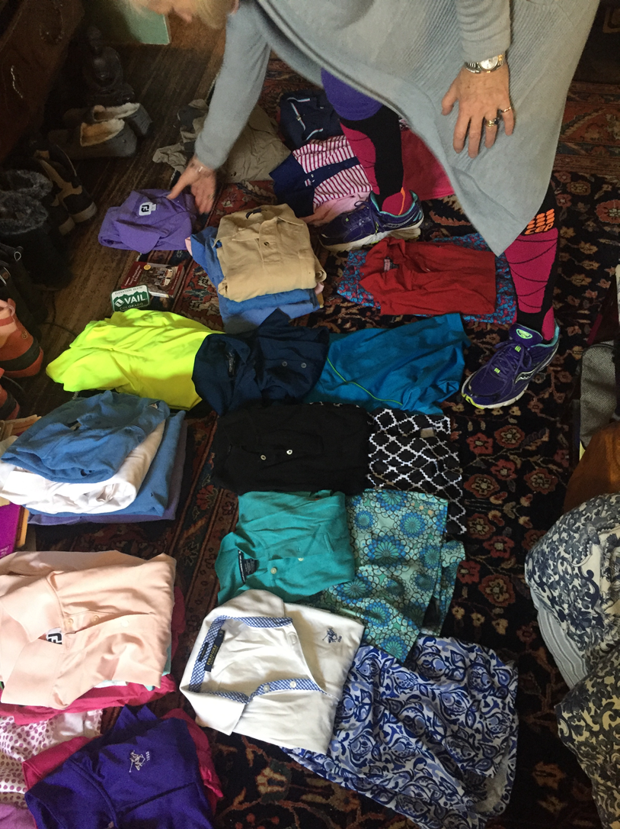
Cognitive Deficits Can Impair Conceptualization and Categorization Processes
Difficulties with sorting and categorization
Too many narrowly and idiosyncratically defined categories
Concrete, unrealistic or illogical groupings
(Ayers 2016; Woody 2014;Timpano 2014;Wincze 2007;Santostefano 1978)
Notes:
Studies show that categorization functions differently in HD. For example, numerous studies indicated that those with HD tend to utilize too many narrowly and idiosyncratically defined categories in sorting information. A pattern is reminiscent of how children and adults with some learning disabilities sort information.
The above picture exemplifies the too many narrowly, and idiosyncratically defined categories in sorting information talked about the literature. The woman is grouping all golf shirts with a matching golf skirt, which doesn't seem too illogical until you realize that she also intends to store them in one drawer like this. In case you haven't figured out why this is a problem, just imagine that either the shirt or the skirt has to go on top in the drawer and there are seven skirts and thirty-five shirts. Using this grouping will obstruct the visibility of either the top or bottom half of the outfit. This will also overstuff the drawer, making it difficult to use and keep organized.

Slide 24
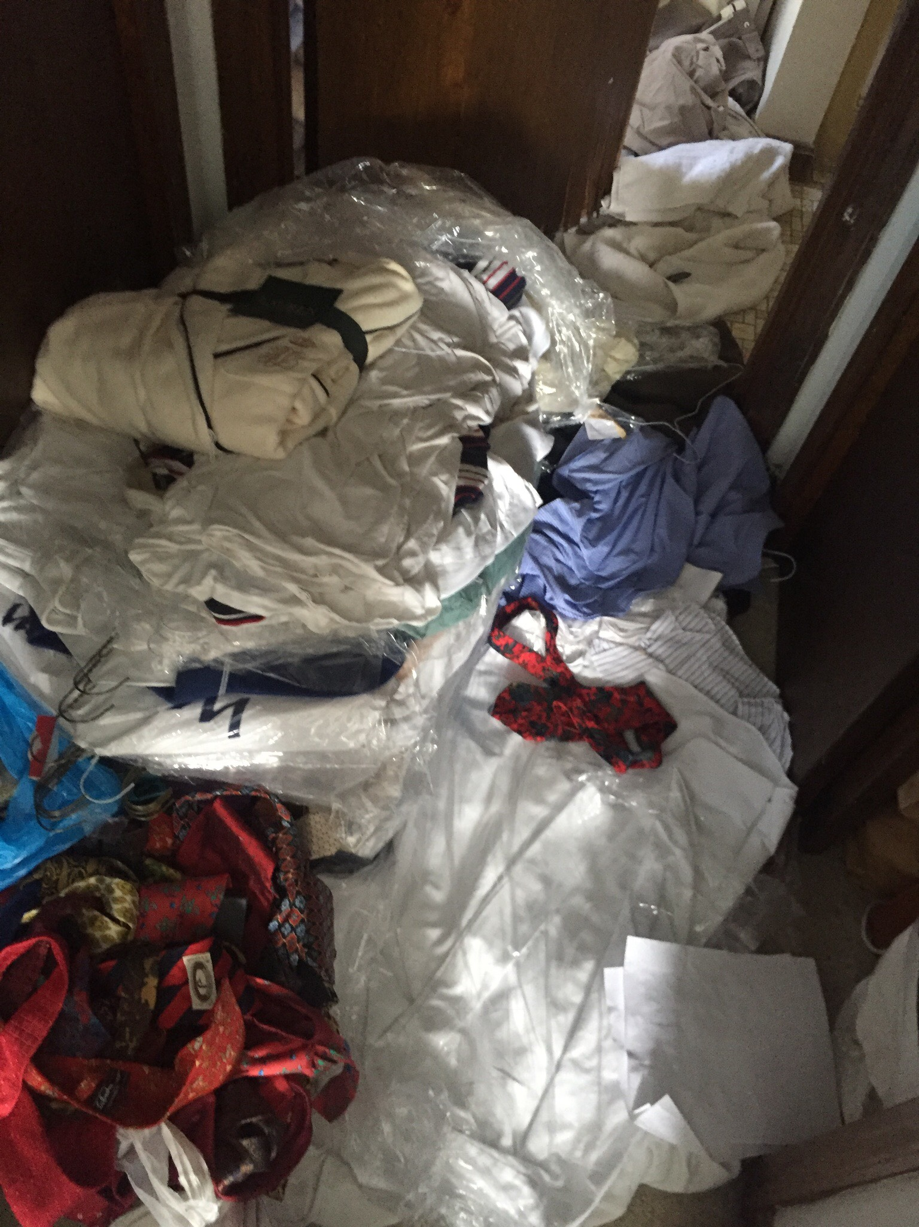
Cognitive Deficits Can Influence Decision-Making
Problems with executive functions can impair decision making including processes such as categorization and object groupings, which are necessary for the organization of tasks involved in decluttering.
Problems with memory can heighten fear of making bad choice, i.e. discarding needed objects.
Problems with memory may discourage people from using storage systems and places that put object out of sight, like a filing cabinet or closet.
(Woody 2014)
Notes:
Visuospatial deficits in object location memory may discourage people who hoard from using organizational strategies that involve putting objects out of visibility, such as in a closet or a file drawer, because this deficit heightens the fear that they will forget where the object is located (woody). These behaviors result in clutter because it results in them not put things away, using out of sight storage, and of course, making an organized choice they lead to more organized living.

Slide 25
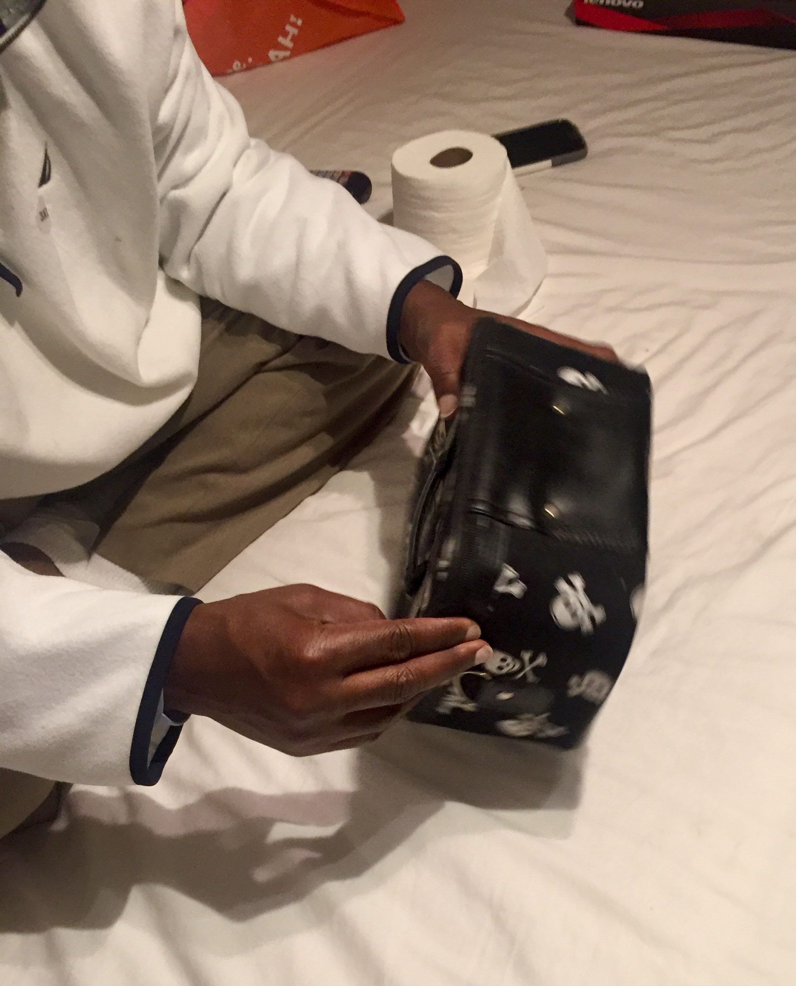
Cognitive Deficits Can Impact Emotional Regulation
Reluctance to accept emotional responses
Difficulty regulating behavior when distressed
Lack of access to strategies for feeling better when distressed
(Tolin 2018)
Notes:
Studies that examined emotional regulation difficulties in those with HD found that deficits in emotional regulation were significantly correlated with the severity of hoarding-related behaviors. In detail, difficulty regulating behavior when distressed and lack of access to strategies for feeling better when distressed was correlated significantly with acquiring behaviors while an unwillingness to accept emotional responses was significant with acquiring and saving symptoms in hoarding.
Here is one example of how hoarding helps clients regulate emotional responses. This item the client retrieved from the trash at his home specifically because it was associated with positive memories of his daughter's birthday many years ago. Though the client admits feeling sad that these happy times have passed, he says, that this is not the main reason he retrieved the item from the trash. He states he took the item because he fears the future will not be as bright, and the item helps him counters those warm thoughts feelings from the past.

Slide 26
Taking the Next Step….
What are potential solutions once you understand the problem?
Notes:
As we previously discussed; Knowing the steps to clean the room is not "the entirety of the problem." Instead, underlying difficulties with attention memory and executive function result in decluttering difficulties. So, the very first step starts with you; that is getting you to understanding you. Indeed, just as you won't change if you don't want to…You also can't change if you don't know which changes will compliment your life better, why you would even want to make that change, to begin with, or how to execute those changes successfully.

Slide 27
Understanding why items are being saved and how it impacts your life 2. Maintaining focus on discarding decisions that are goal relevant to your life 3. Addressing issues that manifest Clinically Impairing Clutter in your life
Long Term Solutions to Clinically Impairing Clutter Require:
Notes:
Develop insight into your own motivations for saving and acquiring through working with a therapist or peer support inside the home while decluttering. Define goals and priorities in relation to the objects Define the difference between objects that have accumulated, those which are being saved, and those which we are being collected. Learn new organizational strategies to store objects and information that can reduce clutter

Slide 28
Enhancing Accountability & Decluttering
Decisional Duress
Emotional Distress
Cognitive Arrest
Develop insight into what causes clutter in your life
Explore what disincentivizes you to declutter
Seek social and emotional support from peers
Learn to Recognize Avoidance Patterns
Notes:
That said, some specific ways research has found to enhance the efficacy of CBT and produce better results when decluttering is: have at least one "peer support" you can call "for support" during efforts to declutter. And, just in case we are unclear about what I mean, a peer is someone who typically has the same or similar issues as you. Peer supports can empathize as you explore and discovers what disincentivizes you to declutter and how "the struggle to declutter" is real and overwhelming to you. Peers should provide validation for your emotions, but also motivate you to sustain through your decisional duress, emotional distress, and help you find ways to overcome cognitive arrest and behavioral avoidance.
In addition to peer support; attend group meetings for HB, NOT ONLY to find the social and emotional support you will likely need to maintain progress; but, specifically, seek out psychoeducational support groups for HB (like this one) that actually teach skills about decluttering, or utilize techniques, such as motivational interviewing and thought mapping to enhance your understanding of what causes clutter in your too life (as that is different for everyone) as well as help you develop insight into what incentivizes you to declutter; and just as important, helps you learn what skills others, like yourself, have used to overcome clutter that you can try to adopt in your own life.

Slide 29
Motivational Interviewing & Thought Mapping
Support Groups
Peer Support
Develop insight into what causes clutter in your life
Explore what incentivizes you to declutter
Seek social and emotional support from peers
What Techniques Facilitate Change?
Notes:
Research indicates there are many techniques one can use in the field to help you learn to facilitate change more successfully in your everyday life, especially while they are working with individuals decluttering in the actual home. For those of us who do not know the difference between these types of therapies: Motivational interviewing is a technique known to enhance the efficacy of treatment for hoarding behavior, as it helps the 'therapist/coach" uncover information that can be used later to re-incentives them when they lose motivation or are discouraged during decluttering. Thought mapping is particularly helpful at developing insight because it can help us pictorially depict the process of how our cognitions; drives our emotions, which then can drive our avoidant behaviors, which in turn produces clutter and how others came to different results.
Seek social and emotional support from other peers. Yes, it's true, peer support can really be helpful. Not only can a peer help you" re-find a reason to declutter" as well as develop and enhance your decluttering skills; A study in San Francisco recently found that peer-led CBT groups are just as effective as though led by doctors. Ask yourself, do you have a peer? If so, are you also their peer? Is the relationship reciprocal? Remember, just because you have decluttering issues doesn't mean you can't reach out and help someone who also has decluttering issues. In fact, research has demonstrated with fMRI imaging that even on a neurological level, those with HD have less difficulty and distress making decisions about other personal stuff than they do their own. So, helping a peer can essentially starting point, especially regarding learning new decision-making skills.

Slide 30
What Causes Clutter in Your Life?
Do you prioritize and manage time for decluttering appropriately?
Overly committed to much to many intentions?
Do you have good coping skills?
Do you have social and emotional support?
By what words do you define clutter?
How do you sort and contain your objects?
Do you use your storage spaces appropriately?
What is trash to you?
Notes:
Develop insight into what causes clutter in your life and what is clutter in your life, and tackle that first. Any intervention aimed to help you should focus on helping you figure out where that process you are caught. Ask yourself; do you prioritize and manage time for decluttering appropriately? Or wait until it is absolutely overwhelming and then avoid it because the activity is so distressful to you. If that is you: might you benefit from just scheduling it with a peer? Do you have good coping skills to face the emotional roller-coaster of opening those thirty-year-old boxes and seeing all those moments gone by? Do you have the social and emotional support to prevent relapse after CBT treatment? Or does it run deeper than that? Is your difficulty in deciding what, of all, your treasured objects are truly treasures worthy of saving? Have you thought of what objects you really will need in the future? Are there multiple objects that have just accumulated? Finally, what hierarchy of grouping do you use to sort and contain your objects? Are you overly restrictive or under-inclusive; do you come to many groups or too little? What is trash to you? What is clutter for you?

