Slide 1
Harassment, Intimidation & Bullying (HIB)
LRSD Anti-Bullying Procedures for Reporting

Slide 2
HARASSMENT/INTIMIDATION/BULLYING (HIB) INVESTIGATION PROCEDURES
The Little Rock School District strives to provide students with optimal conditions for learning by maintaining a school environment where everyone is treated with respect and no one is physically or emotionally harmed.
In order to ensure respect and prevent harm, it is a violation of district policy for a student to be harassed, intimidated, or bullied by others in the school community, at school sponsored events or when such actions create a substantial disruption of the educational process. Student(s) will not be harassed because of their race, color, religion, ancestry, national origin, gender, sexual orientation, including gender expression or identity, mental or physical disability or other distinguishing characteristics.

Slide 3
Continued
Any school staff who observes, overhears, or otherwise witnesses harassment, intimidation or bullying or to whom such actions have been reported must take prompt and appropriate action to stop the harassment and to prevent its reoccurrence.

Slide 4
HARASSMENT/INTIMIDATION/
BULLYING (HIB) INVESTIGATION PROCEDURES
Individuals who feel they have been harassed,
intimidated, or bullied should:
Communicate to the harasser the individual expects the
behavior to stop, if the individual is comfortable doing
so. If the individual wants assistance in communicating
with the harasser, the individual should ask a teacher,
counselor or principal to help.
If the harassment does not stop, or the individual does not feel
comfortable confronting the harasser, the individual should tell
a teacher, counselor, principal or an adult in the building.

Slide 5
HARASSMENT/INTIMIDATION/BULLYING (HIB) INVESTIGATION PROCEDURES
Complaint Procedure
An individual who believes they have been harassed, intimidated or bullied will notify a teacher, counselor, principal or an adult in the
building.
The individual will complete the HIB Complaint Form which will be turned over to the investigator.
The investigator will:
  Keep the information confidential
  Give a copy of the Complaint Form to the individual completing the form
  Ask for evidence of the incident(s)
  Begin the investigation of the reported incident(s)

Slide 6
HARASSMENT/INTIMIDATION/BULLYING (HIB) INVESTIGATION PROCEDURES
Investigation Procedure
The investigator will reasonably and promptly commence the investigation upon receipt of the complaint. The investigator will interview the complainant and the alleged harasser..
The investigator will maintain consistent communication with the complainant during the investigative process.
If the allegations are substantiated, the investigator will impose the appropriate disciplinary sanctions.
The School Based Intervention Team will be notified and both parties will have interventions to prevent similar actions.
Follow-up with both parties to ensure the incident(s) do not reoccur and/or there is no retaliation.
The School Wide Bullying Committee will review the results of the investigation and forward the information to the District Wide Bullying Committee for review and documentation.

Slide 7
LRSD Anti-Bullying Reporting Procedures Flow Chart
Report to Adult & Administration
Upon Receipt of Report, Contact Parent Immediately & Document Date on (HIB)
Complete Harassment/Intimidation/Bullying (HIP) Form Electronically
Provide Copy to Complainant

Slide 8
LRSD Anti-Bullying Reporting Procedures Flow Chart
Provide Preliminary Interventions, If Needed
Document interventions, make parent contact and share documented interventions (HIB)
Begin Investigation
Maintain documented communication with victim during this process (HIB)
Determination of Investigation

Slide 9
LRSD Anti-Bullying Reporting Procedures Flow Chart
Impose Sanction, If Applicable
Post-Interventions & Mediation
Notify Complainant of Outcome

Slide 10
LRSD Anti-Bullying Reporting Procedures Flow Chart
Follow-up to Ensure No Reoccurrence or Retaliation
School-Wide Bully Review Committee
District-Level Review Committee
*** Parents are Contacted and Interventions are Documented in ALL Steps

Slide 11
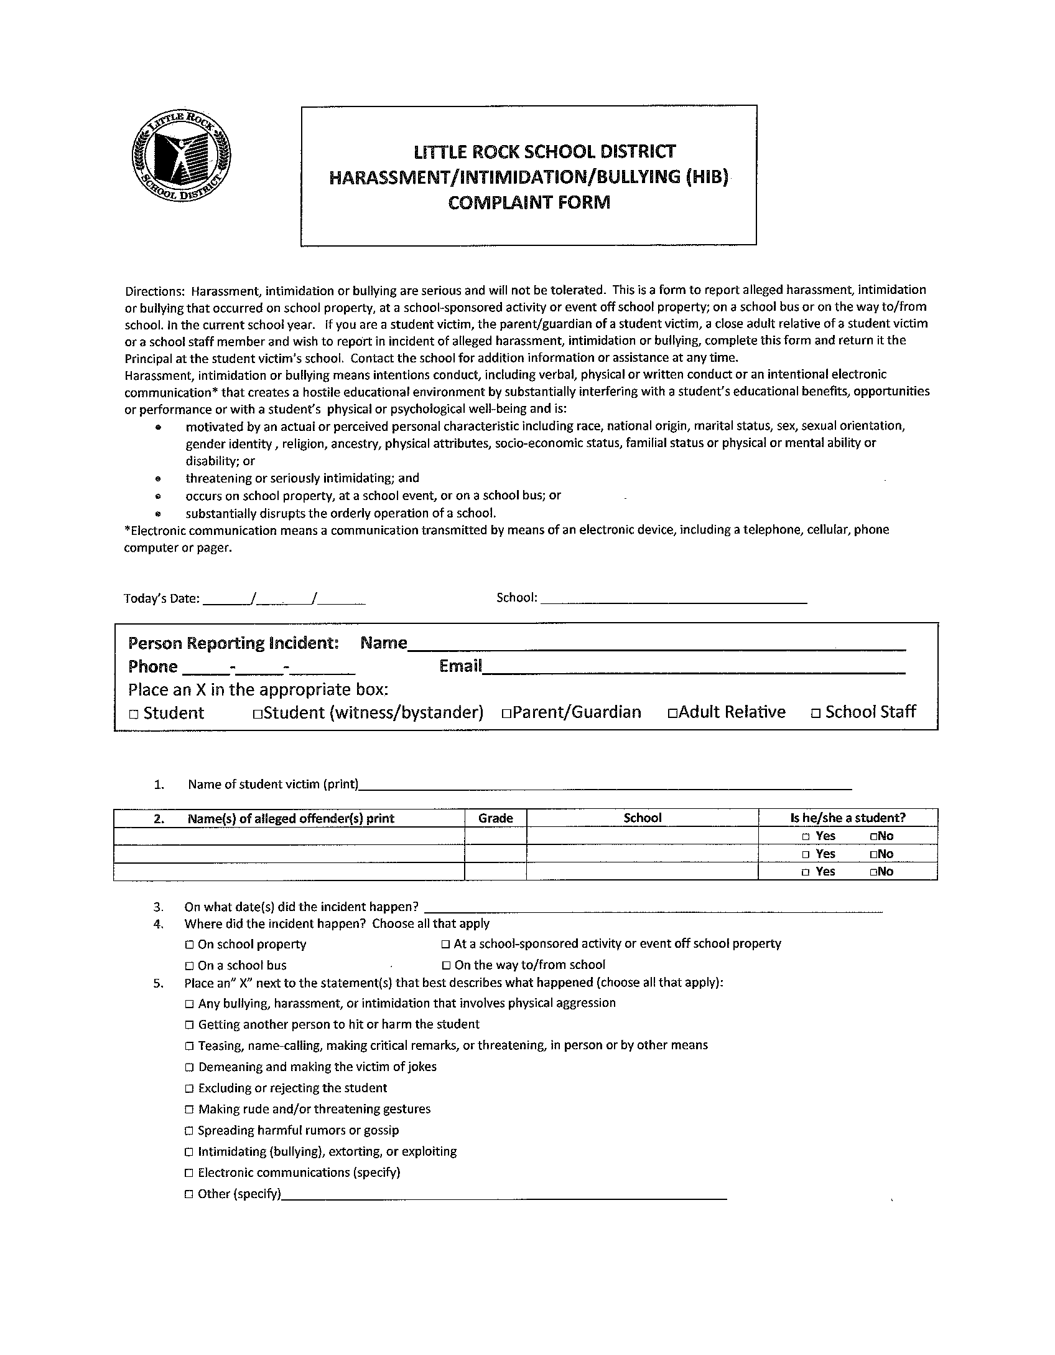
LRSD HIB Complaint Form

Slide 12
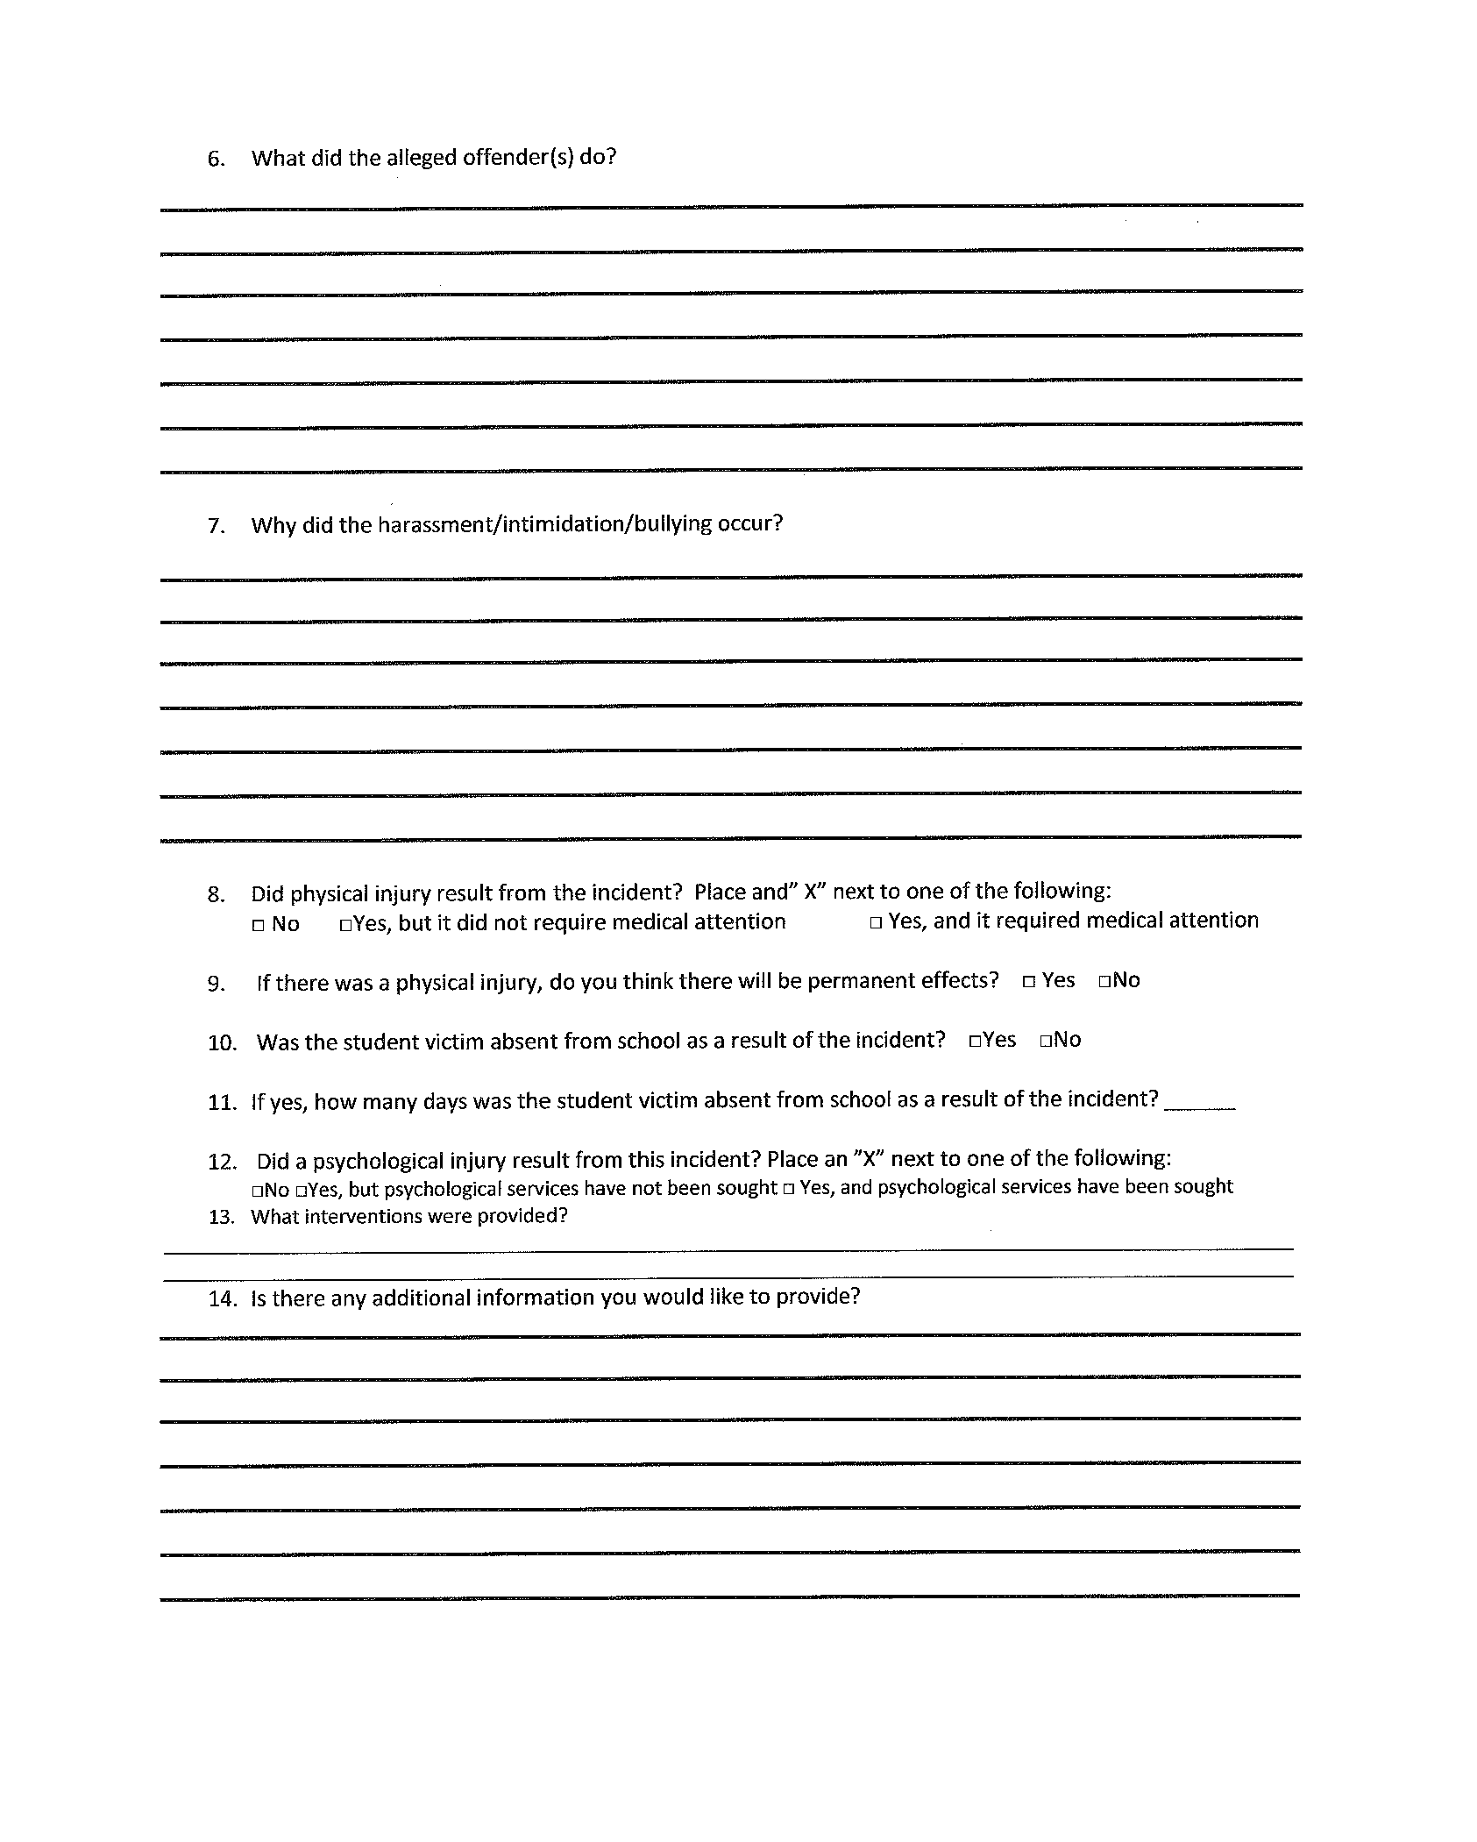
LRSD HIB Complaint Form

Slide 13
Acknowledgement
As a Little Rock School District Employee, I understand that it is my obligation to adhere to every step of the Harassment , Intimidation and Bullying reporting procedures.

Slide 14
The Results
Your compliance with honoring this directive will ensure student access to a safe and orderly climate that is conducive to learning and
improved student achievement.

