Slide 1


THE INFIELD
FLY RULE
(For Dummies)
Notes:
Going to discuss IFF
Want to make it simple and meaningful

Slide 2
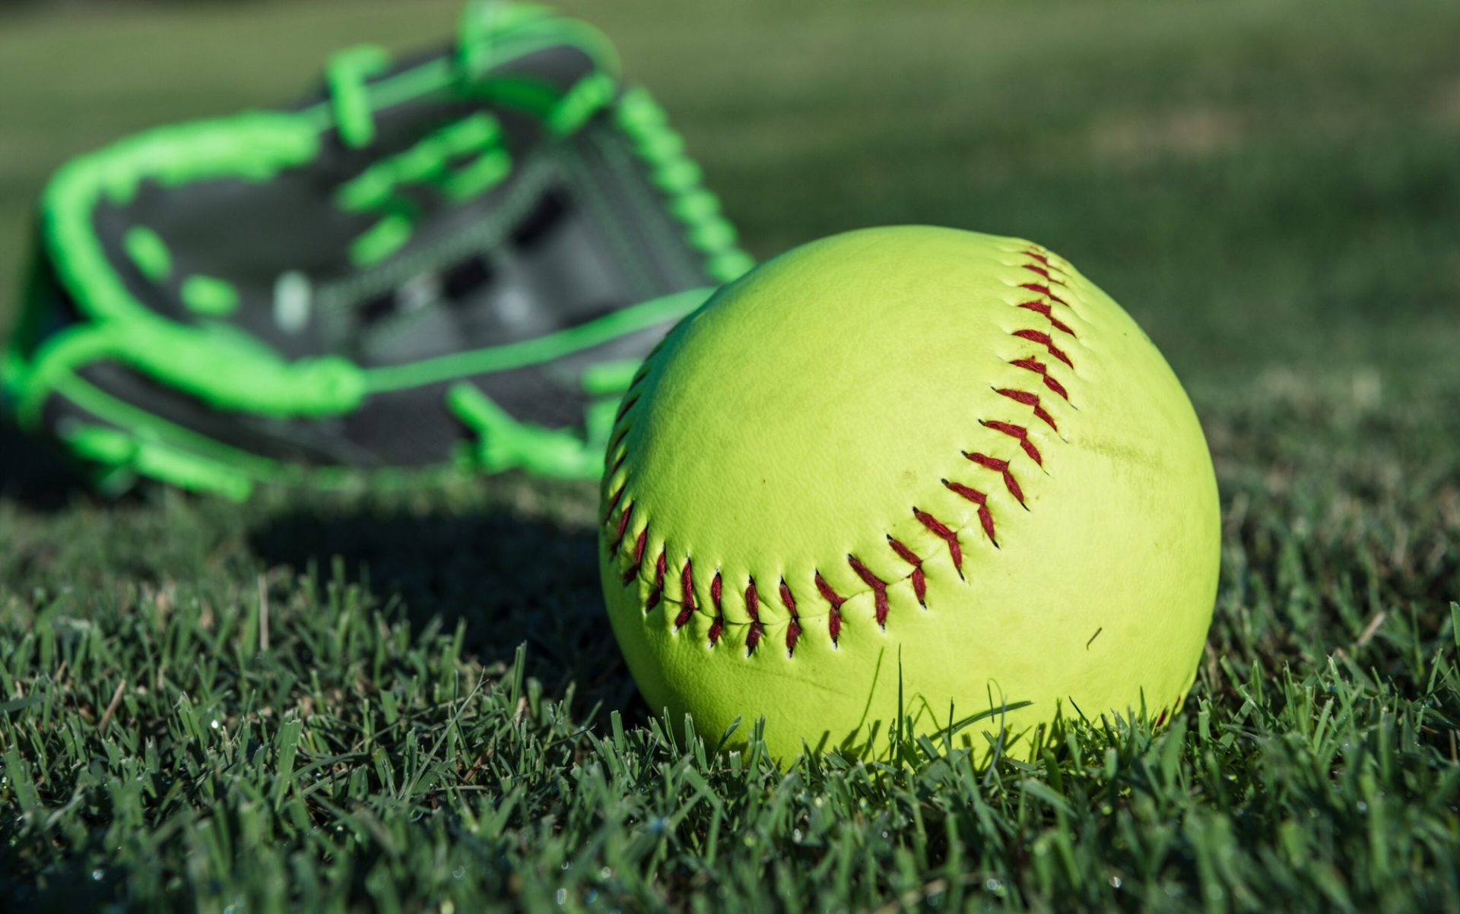
Rule 2-29 INFIELD FLY RULE
An infield fly, when declared by the umpire, is a FAIR FLY (not including a line drive or attempted bunt) that can be caught by an INFIELDER with ORDINARY EFFORT when runners are on first and second or all 3 bases, and before there are 2 outs.
Any defensive player positioned in the INFIELD at the time of the pitch shall be considered an infielder for purposes of this rule. The rule does not preclude outfielders from being permitted to make the catch.
Notes:
This Rule requires a thorough understanding of numerous definitions from Rule 2
Must be a fair fly
Can be caught with ordinary effort BUT DOESN’T REQUIRE AN ACTUAL CATCH
1 and 2 or bases loaded, less than 2 outs

Slide 3

Rule 2-29 INFIELD FLY RULE (Continued)
The Ball is LIVE, the batter is OUT, which removes the force, but runners may advance at their own risk.
The runners may tag up and advance as soon as the batted ball is touched by a fielder.
If a declared infield fly becomes foul, it is treated as a foul ball, not an infield fly.
Notes:
Ball remains Live, runners can advance at own risk

Slide 4

Rule 2-28 INFIELD (Defined)
The INFIELD is that portion of the field in fair territory that is normally skinned and covered by the pitcher and infielders.

Slide 5

Rule 2-2-art 6 FLY BALL and
Rule 2-2-art 2 BATTED BALL
A FLY BALL is a BATTED BALL that rises an APPRECIABLE HEIGHT above the ground.
A BATTED BALL is any pitch that comes in contact with the bat. Contact may result in a fair or foul ball and NEED NOT be intentional.
Notes:
A BATTED BALL that reaches an APPRECIABLE HEIGHT
Contact with bat, no intent to contact is required

Slide 6
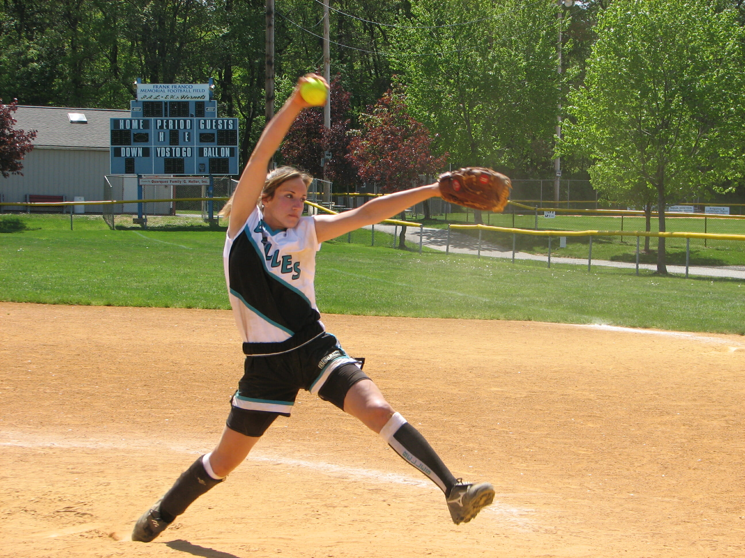
Rule 2-19-art 1 FAIR BALL
A FAIR BALL is a batted ball that:
  (a) Settles or is touched on or over fair territory between home and first base or home and third base
  (b) touches or bounds over a base
  (c) touches first, second or third bases
  (d) while on or over fair territory, touches the person of any umpire or player or clothing or equipment
  (e) while over fair territory, passes out of the field of play
  (f) first falls or is first touched on or over fair territory beyond first, second or third base
  (g) while over fair territory, an offensive player interferes with a defensive player attempting to field a batted ball.

Slide 7
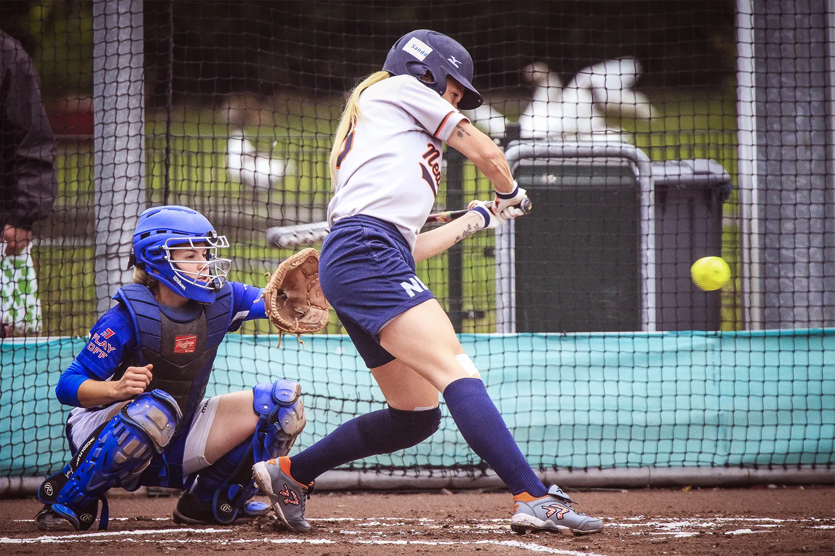
Rule 2-19 art 2 FAIR FLY
A FAIR FLY shall be judged according to the relative position of the Ball and Foul Line … and not as to whether the fielder is in fair or foul territory at the time the fielder touches the ball. It does not matter whether the ball first touches fair or foul territory as long as it does not touch anything foreign to the natural ground in foul territory and complies with all other aspects of a fair ball.
Notes:
Judge by position of ball relative to foul line
Position of fielder is not relevant

Slide 8

SOME QUESTIONS???
What is the Purpose or Intent of the Rule?
  Answer: Protects the Offense from an unwarranted DOUBLE (or triple) PLAY. First adopted in 1895.
Can an OUTFIELDER catch an INFIELD FLY? If so, what are the requirements that must be established?
  Answer: Yes, must be positioned in infield at TOP.
Can an INFIELD FLY be called for a ball that lands beyond the cut out of the infield?
  Yes, includes infield, but also includes areas of shallow outfield that an infielder can cover.
Can the CATCHER catch an INFIELD FLY? REMEMBER that the Catcher is NOT in fair territory at the time of the pitch.
  Answer: Yes, the Catcher is the only position that is allowed to legally be in foul territory at TOP.
We know that an attempted bunt can never cause an infield fly, but how about a:
  CHECKED SWING?
  UNINTENTIONAL CONTACT WITH THE BAT?
  Answer: Both could produce an infield fly as intent for contact is not required. All other aspects of IFF rule must still be met.

Slide 9
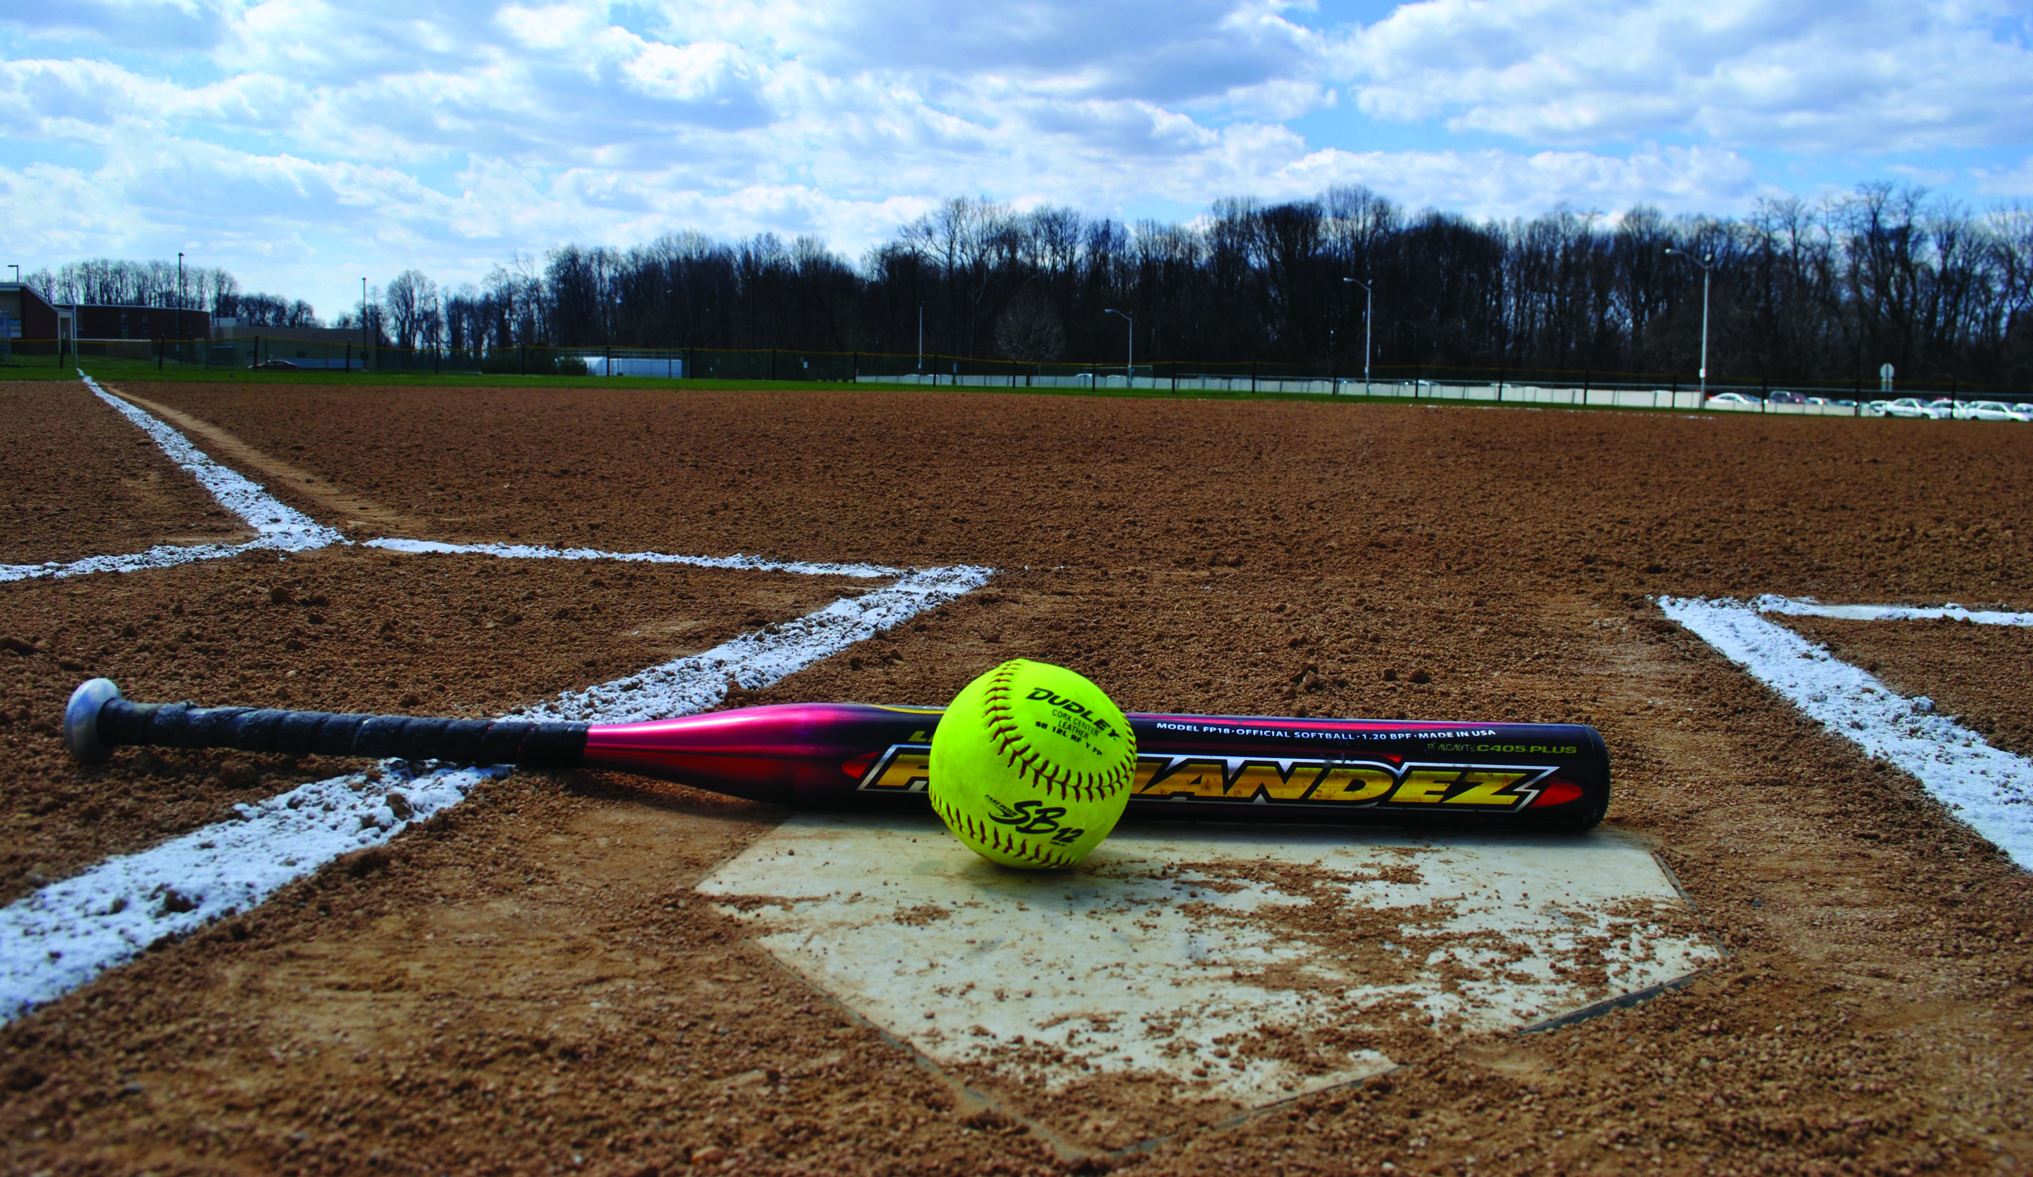
MORE QUESTIONS???
Must the ball be caught for the infield fly rule to apply?
  Answer: No, the rule creates the out, not the catch. Avoids intentional drops.
What are the consequences if the ball IS dropped (intentionally or not) by the infielder?
  Answer: Runners can advance without tagging up.
What is ORDINARY EFFORT? Which Infielder do you judge “Ordinary Effort“ by?
  Answer: Usually “caught with ease”, usually closest infielder
Can environmental conditions (wind ,dust, mist, sunlight, etc.) ever negate “ordinary effort”? If so, would you discuss in pregame with Coaches?
  Answer: Yes, these factors can definitely make any catch “unordinary”
How high is APPRECIABLE HEIGHT? Higher than:
  10 feet?
  Height of backstop, telephone pole?
  Answer: Judgment Call. No specific height distance requirement.
Always judge “appreciable height” in conjunction with “ordinary effort”. Can’t have one without the other for an INFIELD FLY.

Slide 10
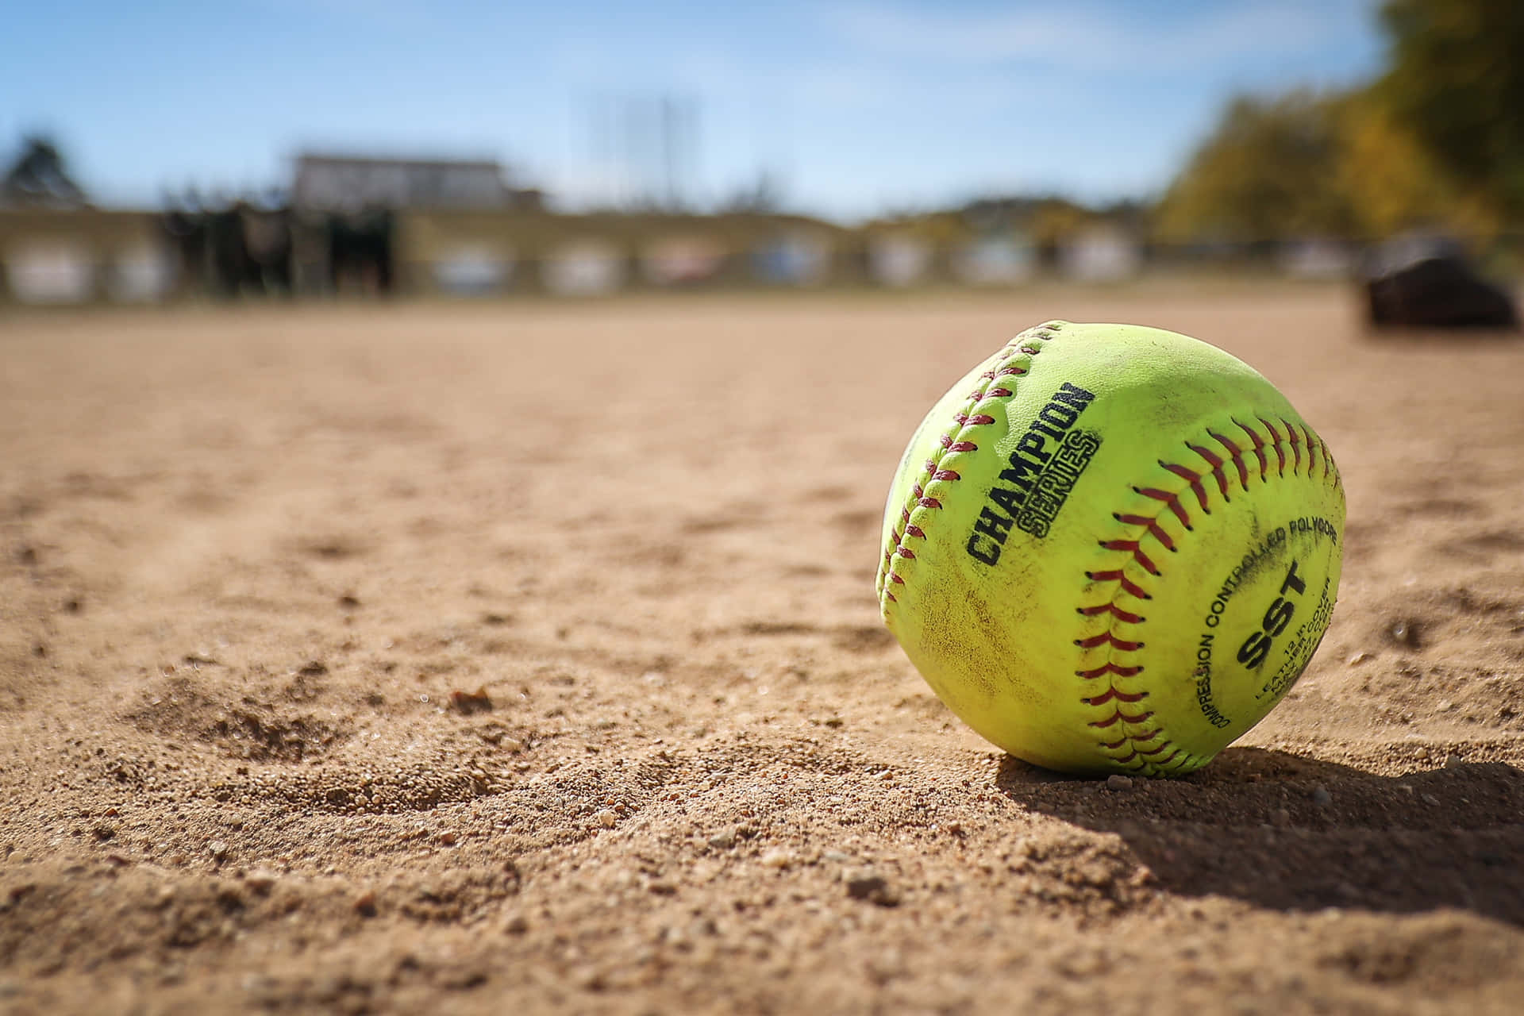
INFIELD FLY MECHANICS
Discuss in Pregame Meeting
Call “Infield fly, the batter is out, if fair!” Call while ball is still in flight. Call loud enough so all runners on base can hear.
Raise right arm straight above your head with your hand in a fist (Signal F)
Which Umpire makes the Call? Can either Umpire make the call?
What happens if neither Umpire makes an INFIELD FLY call, but it should be an INFIELD FLY?

Slide 11
Game Scenarios
R1 on 2B and R2 on 1B, No Outs, B3 hits a high pop fly that is likely to fall in the infield behind the pitcher, and the Short Stop yells “Help! I lost the ball in the sun!” The Pitcher, SS, 2B and CF (who was playing in) are all maneuvering to catch the ball. Ruling?
Bases loaded, 1 Out, B4 hits a high pop fly that lands just foul between home and 1B, but the ball rolls and settles on the foul line, Pitcher then picks up he ball and throws to F3 who tags R3 while she is still standing on 1B, then F3 throws to F4 who tags R2 while she is standing 1 foot away from 2B. Ruling?

Slide 12
Game Scenarios Continued
It’s clear that the Assigning Committee doesn’t like you because they assigned you a game with me as your partner. We have a great pregame where we discussed everything including the IFF Rule. You are the Plate Umpire and I am on the Bases. Nonetheless in a closely contested game with 2 animated coaches, in the 5th Inning with bases loaded and no outs, the trailing team is at bat and B6 hits a pop fly that questionably reaches an “appreciable height”, you believe the ball could never be caught with “ordinary effort”, and further the ball in flight is affected by swirling winds. Yet despite all this I proudly, loudly and excitably call “Infield Fly. The Batter is Out!”
What is the proper mechanic to negate my Call??

Slide 13

Game Scenario Consequences

Slide 14

QUESTIONS?

