Slide 1
Improvisation Lesson
BACK TO SCHOOL NIGHT with TOM TERRELL
Modeled Lesson Plan to improve the quality
and effectiveness of improvised solos
for upper secondary-school jazz performers

Slide 2
Class
Discussion
WHAT ARE A FEW CHARACTERISTICS
OF A “GOOD” JAZZ SOLO?
(good = effective, moving, pleasant)
Appropriate style
Easy to follow melodic ideas
Ideas/motives related to thematic material of the piece
Effective use of embellishment and variation
Control of rhythmic variations/motives
Appropriate arc (flow, texture, volume, diminution)

Slide 3
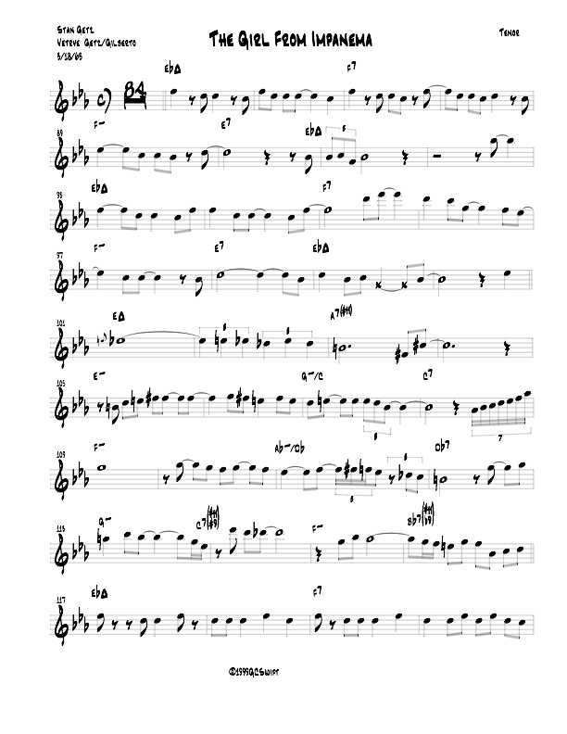
Class: Listen to Stan Getz on The Girl From Ipanema
SHARE: What did you hear?
Student: Transcribe the first 16 measures of Getz’s solo onto provided notation
NOTICE!
very close to original melody
Note where he starts to vary melodic phrasing
Can you see the notes and delivery he adds?

Slide 4
Class: practice soloing over the first 16 measures
Repeat the 16-bar A section FOUR times for EACH student
First time play the original melody
Second time play Stan Getz’ solo
Third and fourth time slowly add your own variation/embellishment/ornamentation
Stay rhythmically concise at first! Limit ideas to 8th notes and triplets
Thank you RHYTHM SECTION! :)

Slide 5
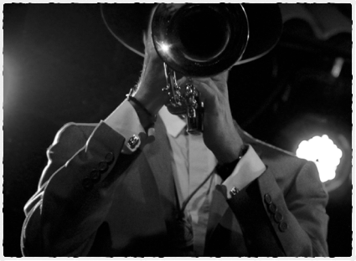
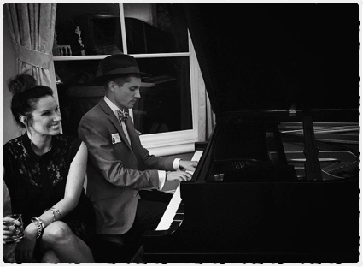
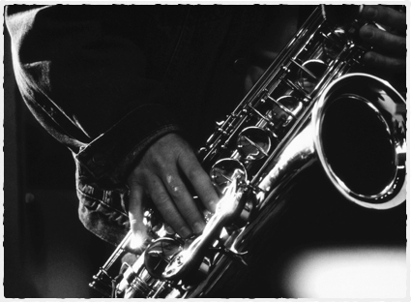
Congrats! Nice playing!
REFLECT:
How has this approach changed your view on building an effective solo?

Slide 6
ASSESSMENT
Jazz Soloing is FUN!
However, try to avoid doing too much at first.
Below are the number of times a student plays:
a note outside of the key, a confusing rhythm,
or loses the feel (style) of the tune

Slide 7
Homework challenge
Further challenge!
Transcribe the rest of his solo at home and bring in to class to play next time!
Try listening to one of these classic examples and transcribe parts of the solo to visualize the same lesson
Soloist | Instrument | Tune | Difficulty (1-5)
Miles Davis | Trumpet | Freddie Freeloader | 2
Cannonball Adderly | Alto Saxophone | All Blues | 3
Chet Baker | Trumpet | Autumn Leaves | 2
Clifford Brown | Trumpet | Joy Spring | 4
Herbie Hancock | Piano | Watermelon Man | 2
Nat King Cole | Piano | The Christmas Song | 1
John Coltrane | Tenor Saxophone | Giant Steps | 5

